Slide 1
Developing
Security Policies
CSH5 Chapter 66
“Developing Security Policies”
M. E. Kabay & Sean Kelley
Notes:
M. E. Kabay, PhD, CISSP

Slide 2

Topics
Introduction
Collaborating in Building Security Policies
Phase I: Preliminary Evaluation
Phase 2: Management Sensitization
Phase 3: Needs Analysis
Phase 4: Policies and Procedures
Phase 5: Implementation
Phase 6: Maintenance
Some Resources for Policy Development

Slide 3
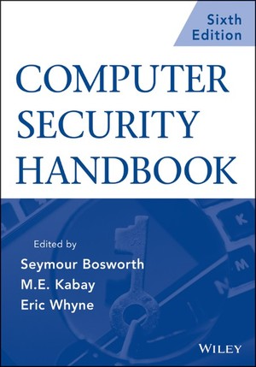
Introduction
Many chapters in CSH5 deal explicitly with policy; e.g.,
22/23 – Physical Security
25 – LANS
44 – Guidelines
47 – OPSEC
45 – Employment
48 – E-mail / ‘Net Usage
49 – Awareness
50 – Social Psychology
52 – Application Controls
54 – Audits
56 – CSIRTs
57-59 – BU, BCP, DRP
66 – Developing Security Policies
67 – Developing Classification Policies

Slide 4
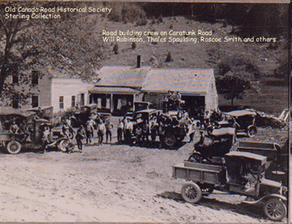
Collaborating in Building Security Policies
Organizational & individual resistance to policy development
  Threats to self-perception, norms, habits, comfort, confidence
  Fear of blame,
  interference,
  bureaucracy, delay
Process of development
influences acceptance
  Must demonstrate
  personal benefits to all
  Involve all parts of
  organization
Permission of © owners gratefully acknowledged.
http://tinyurl.com/2all5p

Slide 5

Phase I: Preliminary Evaluation
Few organizations have policies that are
  Complete
  Maintained up-to-
  date
  Understood
  Monitored
  Applied / enforced
Must have formal authorization
  Upper management support required
  Even preliminary study needs explicit permission
    Taking employee time and organizational resources

Slide 6
Planning Evaluation
Work Closely with HR Department
  Must convince department managers to cooperate
  HR staff likely to know key managers in each department
Must design or use survey instruments
  Questionnaires / surveys
  Focus groups
  One-on-one interviews
Some HR staff may be experts in interview techniques
May decide to use outside experts

Slide 7
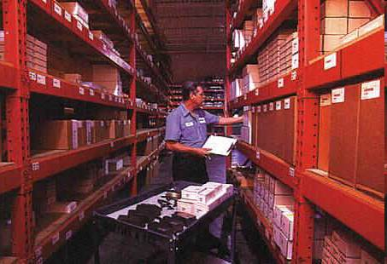
Preliminary Evaluation:
Inventory
Inventory precedes
approval for full project
  Only a few days of
  work
  Ask everyone what
  they perceive as their most important security needs
NEVER argue or disagree with subjects!
  Job is to learn about issues from user perspective

Slide 8

Introduce Study –
Non-Threatening
Employees may perceive many questions as threatening
Preamble or introduction should make clear
  Not an audit
  Not attempt to punish people
Information should be anonymized
  No person targeted for reprisal
Reassure employees:
  Study to learn about facts of security
  Improvement
  Not a search for culprits who will be punished

Slide 9
Preliminary Evaluation Checklist
Introduce study – non-threatening
State of current policy?
Data classification?
Sensitive systems?
Critical systems?
Authenticity issues?
Exposure (consequences)?
Responsibility and awareness?
Physical security?
Software development security?
Computer operations security?
Data Access Controls
Network and communications security?
Anti-malware measures?
Backups, archives, data destruction?
BCP / DRP?
Use audit checklists on the following pages for details

Slide 10
State of Current Policy?
Does enterprise have any security policies at all?
Who developed them? Individual? Group?
Where and how are security policies available (paper, electronic)?
When were policies last updated? Last disseminated?
Who, if anyone, has explicit responsibility for maintaining security policies?
Who implements security policy at enterprise level?
To whom does chief information security officer report within enterprise?
Who monitors compliance with security policies, standards, and compliance?

Slide 11
Data Classification?
Levels of security classification that apply to your work? If so, what are they called?
Are there rules for determining whether information you handle should be classified at a particular level of confidentiality?
Are documents or files labeled to show their security classification?
What is your opinion about value of such classification?
Do people in your group pay attention to security classifications?
Do you have any suggestions for improvement of how data are classified?

Slide 12
Sensitive Systems?
In your work, are there any kinds of information, documents, or systems that you feel should be protected against unauthorized disclosure? If so, name them.
How do you personally protect sensitive information that you handle?
How do others in your department deal with sensitive information? No names, please.
To your knowledge, have there been any problems with release of sensitive information in your department?
Do you have any suggestions for improving handling of sensitive data in your area?

Slide 13
Critical Systems?
In your work, are there any kinds of information, documents, or systems that you feel are so critical that they must be protected against unauthorized modification or destruction? If so, name them.
Are there any special precautions you use or know of to safeguard critical data in your area?

Slide 14
Authenticity Issues?
Do you know of any cases in which anyone has used someone else’s identity in sending out messages such as letters, faxes, or email? If so, were there any consequences?
Does anyone in your group use digital signatures on electronic documents?
Does anyone in your group make or use unauthorized copies of proprietary software? If so, do you think there is any problem with that?

Slide 15
Exposure (Consequences)?
Worst consequences from publication of most
sensitive information you control in newspapers?
What if key competitors obtained specific confidential information that you use or control in your area?
Monetary costs associated with scenarios you have described above?
Worst consequences if critical information altered without authorization or through accidental modification?
What if you could not access critical information quickly enough for your work?
Estimate costs of such breaches of data integrity and data availability?
What if someone forged documents in your name or in enterprise’s name? Scenarios and associated costs resulting from such breaches of authenticity?

Slide 16
Responsibility And Awareness?
As far as you know, who is responsible for developing security policies?
Do you know where to find the security policies that apply to your work?
When, if ever, did you last sign any documents dealing with your agreement to security policies?
Who is responsible for monitoring compliance with security policy in your work group? In the enterprise as a whole?
Have you ever received any training in security policies? If so, when was the last time?
Have you ever seen any written materials circulating in your work group that discuss information security?
Do you think of protecting corporate information as one of your official responsibilities?

Slide 17
Physical Security?
Does anyone check your identity when you
enter the building where you work?
Are there any electronic access-control systems limiting access to your work area? What are they?
Do people hold a secured door open to let each other into your work area? Do you let people in after you open a secured door?
Have you ever seen a secured door into your area that has been blocked open (e.g., for deliveries)?
Do people leave your work area unlocked when everyone leaves?

Slide 18
Physical Security (cont’d)
Do staff members wear identity badges at work? Are they supposed to? Do you wear your badge at work?
Do visitors wear badges?
Have you ever seen strangers in your area who are not wearing visitor badges?
What would you do if you saw a stranger in your area who was not wearing a visitor’s badge?
Do you lock any parts of your desk when you leave your workspace?
What would you do if you heard the fire alarm ring?
Where is the nearest fire extinguisher?
Who is the fire marshal for your floor?

Slide 19
Physical Security (cont’d)
What would you do if someone needed emergency medical attention?
Is there an emergency medical station in your area or on your floor?
Do you know who is qualified in cardiopulmonary resuscitation (CPR) in your group or on your floor? Do such people wear identifying pins?
Have you had recent training in what to do in the event of an emergency? Have you been trained in how to evacuate the building?
Is there anything that comes to mind that you would like to see to improve physical security and safety in your work area?

Slide 20
Software Development Security?
Are there any security policies that apply to
your work? What are they?
Have you ever discussed security policies in your group?
Is security viewed positively, neutrally, or negatively in your group? And by yourself?
Do you and your colleagues discuss security during the requirements analysis and specification phases when developing software?
How do you see quality assurance as part of the development process?
Do you use automated software testing tools?
Tell us about version control in your group. Do you use automated version control software?

Slide 21
SW Dev’t Security (cont’d)
How do you document your systems?
Do you think that your source code is adequately protected against unauthorized disclosure and modification?
What is your opinion about Easter eggs (unauthorized code for an amusing picture or game)?
Could anyone plant an Easter egg or a logic bomb (unauthorized, harmful functions) in code being developed in your group?
Have you ever seen an Easter egg or a logic bomb in code from your group? Did it get through to production?
Can you think of ways you would like to see better security in your work?

Slide 22
Computer Operations Security?
How long do you wait after initial release before installing new operating system versions on your production machines?
How do you put new software into production?
Can development personnel access production software? Production data?
How do you handle problem reports? Do you have an automated trouble-ticket system?
Can people from outside the operations group enter the operations center?
Are contractors, including repair technicians, allowed to circulate in operations without being accompanied?
Do cleaning staff ever circulate within the secured areas of operations without operations staff present?

Slide 23
OPSEC (cont’d)
Are system components labeled?
Is there an emergency cutoff switch for main power to the entire data center? Does it include air conditioning?
Are there uninterruptible power supplies for critical components of your systems?
Do you keep records of system downtime? What is your downtime over the last three months? The last year?
What accounts for most of the downtime?
Who monitors system resource utilization? Are there automated reports showing trends in disk space usage? CPU utilization? Network bandwidth usage?
What improvements in security would you like to see in operations?

Slide 24
Data Access Controls
Do you have to identify yourself to the computers and networks you work with?
Do you have a user name (ID) that no one else shares?
Are you required to use a password, passphrase, or personal identification number (PIN) as part of your routine when starting to use your computer?
Have you ever shared your unique user ID and password or PIN with someone else? Or have you borrowed someone else’s user ID and password to get some work done? If so, how often does this happen?
Do you use a token, such as a physical key or a smart card, to prove who you are to the computer system? If so, have you ever lent or borrowed such tokens? What for? How often?

Slide 25
Data Access Controls (cont’d)
In your work, are there any limitations on the data you are allowed to work with?
Are there data you can see but not change?
Do you use encryption on any of the data you work with?
Do you or members of your group use laptop computers? If so, do you encrypt sensitive data on the disks of those portable systems?
Do you or anyone in your group take work home? If so, do you put corporate data on your own, personal (noncompany) computers? Does anyone else have access to those computers? Are there any controls on accessing corporate data on the home computers?

Slide 26
Network And Communications Security?
As a user, do you know what the rules are about using
your employer’s email system and Internet access?
Do you know anyone who regularly violates system usage restrictions? No names, please.
Have you ever seen pornography on corporate systems? Child pornography? Racist and other objectionable materials? If so, did you know what to do? And what did you do?
Has anyone ever discussed rules for secure email with you? Do you know how to encrypt sensitive messages? Do you ever encrypt messages?
As a network manager, do you have up-to-date network diagrams, or can you produce them on demand?
Do you know which services are running on your Internet-connected systems? Are all of the running services needed?

Slide 27
COMSEC (cont’d)
How do you determine which patches are appropriate for installation on your systems? How often do you check? Who is responsible for managing patches? How long
does it take between notification of a vulnerability and installation of an appropriate patch?
Does your security architecture include firewalls? If so, what determines the security policies you instantiate in the filtering rules?
Do you have egress filtering enabled on your firewalls?
Do you have intrusion detection systems? If so, who responds to apprehended intrusions? How are the responsible people notified of an intrusion?
What are the procedures for responding to an intrusion?
If your organization uses passwords, how do you handle requests for new passwords?
Do you have centralized remote-access controls?
Do remote users use virtual private networks (VPNs) to access corporate systems from outside the firewalls?

Slide 28
COMSEC (cont’d)
Are your users supposed to use encryption for sensitive
email that traverses the Internet? Do they? How do you know?
Do your users apply digital signatures to all communications?
Are your Web servers protected against intrusion and vandalism?
Have you kept sensitive information off your Web servers?
Do you encrypt all sensitive information stored on your Web servers?
How long would it take you to recover a valid version of the Web site if it were destroyed or vandalized?
Do your telephone voicemail boxes have unique, nonstandard passwords? How do you know?
How do you find out if an employee is being fired or has resigned? How long does it take between termination of employment of such an employee and deactivation of all system and network access?

Slide 29
Anti-malware Measures?
Do you and all of your users have antimalware products installed on every workstation?
How often are antimalware products updated? How are they updated?
How long does it take for all vulnerable systems to be brought up to date?
Do you or your users open unexpected, unsolicited email attachments?

Slide 30
Backups, Archives, Data Destruction?
How often do you do backups of your electronic data?
Where do you store backup media? Are current copies retained off site as well as on? How do you know which media to use to restore a specific file?
How long do you keep different types of backups? Why?
How do you prevent unauthorized access to backup media?
If you keep data backups for several years, how do you ensure that the old media will be readable and that the data developed for old applications will be usable?

Slide 31
Backups (cont’d)
How do you dispose of magnetic and optical storage media after their useful life is over? Are the discarded media readable?
Do you make backup copies of paper documents? Where are these copies kept? How would you locate a specific document you needed?
How long do you keep various types of papers? Why?
When you dispose of paper documents, does their content influence how they are destroyed? How do you dispose of sensitive paper documents?

Slide 32
BCP / DRP?
Do you have business resumption planning (BRP) or disaster recovery plans (DRP)? If so, where are they kept?
Who is responsible for keeping BRP and DRP up to date?
Have you ever participated in a BRP or DRP testing? If so, how long ago was the last one? When is the next scheduled test?
During BRP and DRP tests, does anyone use movie cameras or tape recorders to keep track of critical steps in the recovery?
After a test, have you participated in analyzing the results of the tests to improve the plans?

Slide 33

Phase 2: Management Sensitization
Goal: approval for organization-wide audit & policy-formulation project
Reason: upper management support sine qua non
Tools
  Short meeting
  Sensitization
  videos
  Present results of
  preliminary survey
  Name working
  group
  Estimate time and costs
  Extra readings for managers

Slide 34

Phase 3: Needs Analysis
Information Protection Working Group (avoid “Security Group” – bad associations to name)
  Reps from every sector of enterprise
  Will provide important insights
  Serve as ambassadors /
  cheerleaders / advocates
  within their own groups
May need subcommittees
if enterprise is large
(>10,000 employees)

Slide 35

Phase 4: Policies and Procedures
Use existing templates as previously discussed (see next slide)
  Avoid reinventing wheel
  Usually see alternate versions of policies
  Save months of work
Ask for feedback from employees affected by policies
Respond to legitimate needs

Slide 36
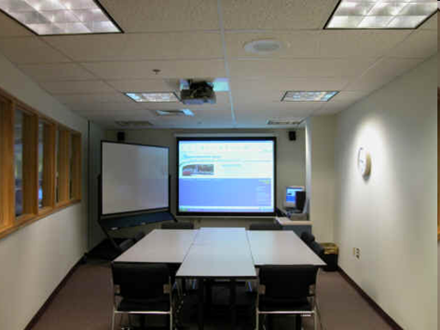
Phase 5: Implementation
Use insights from social psychology (see Ch 50) to aid implementation
Usually segment ATE (awareness, training and education) by sector and management level
  Tailor presentations to audience
  Provide most
  relevant policies and
  discussions

Slide 37

Phase 6: Maintenance
Continuing security-awareness programs
UPDATE POLICIES to meet changing needs
Annual rereading and signing of security agreement
Monitoring and enforcement of policies

Slide 38

Some Resources for Policy Development
NOT an exhaustive list!
ISPME
NIST CSRC SP 800
CERT-CC
BSI
SANS

Slide 39
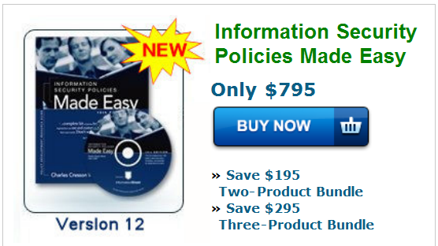
ISPME
Prof Kabay has no financial involvement with ISPME
Information Security Policies Made Easy, Version 12
Charles Cresson Wood
http://www.informationshield.com/ispmemain.htm

Slide 40
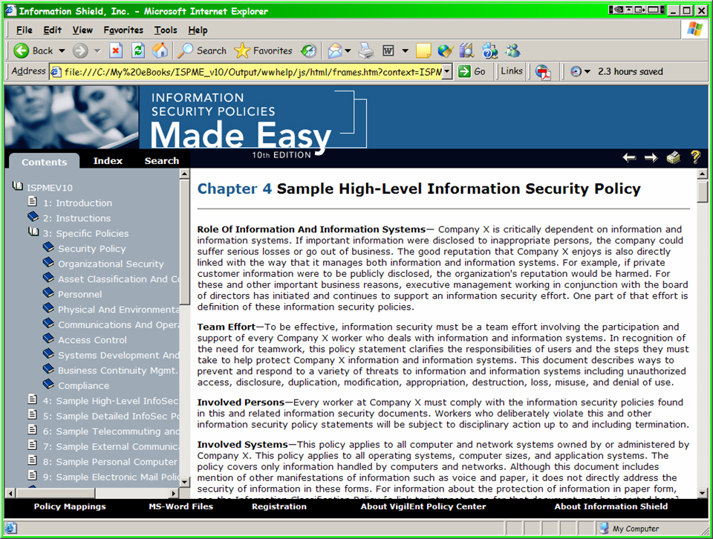
Phase 4 – illustration from ISMPE

Slide 41
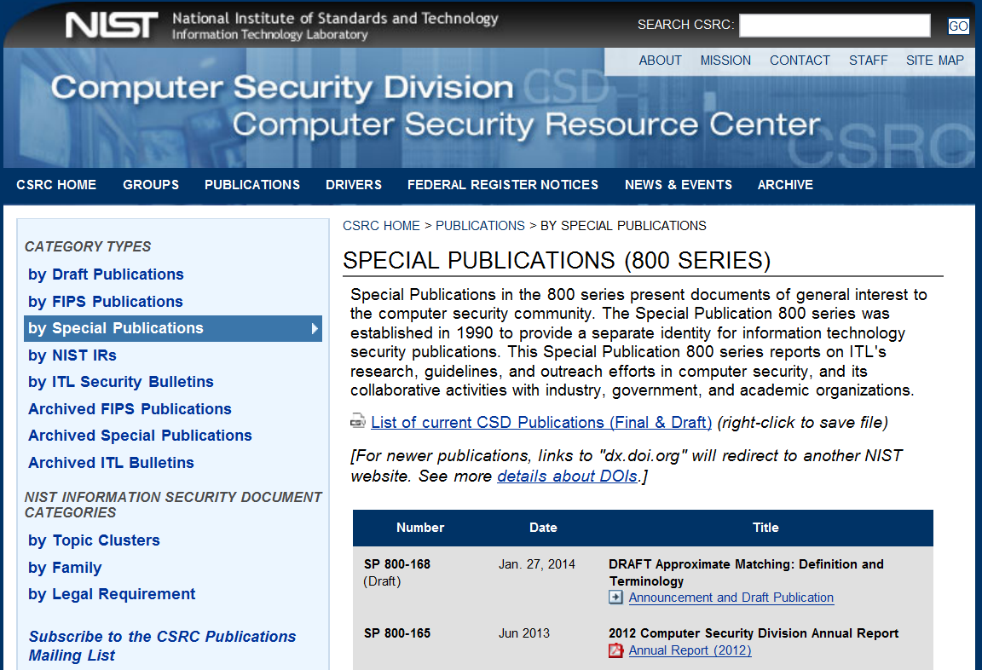
NIST Computer Security Resource Center

Slide 42
NIST Special Publications
Array of valuable documents – free! E.g.,
SP 800-18 Rev. 1: Guide for Developing Security Plans for Federal Information Systems (Feb 2007)
SP 800-40 Version 2: Creating a Patch and Vulnerability Management Program (Nov 2005)
SP 800-164 (Draft): Guidelines on Hardware-Rooted Security in Mobile Devices (Oct 2012)
SP 800-161 (Draft): Supply Chain Risk Management Practices for Federal Information Systems and Organizations (Aug 2013)
SP 800-153: Guidelines for Securing Wireless Local Area Networks (WLANs) (Feb 2012)
SP 800-144: Guidelines on Security and Privacy in Public Cloud Computing (Dec 2011)
http://csrc.nist.gov/publications/nistpubs/index.html

Slide 43
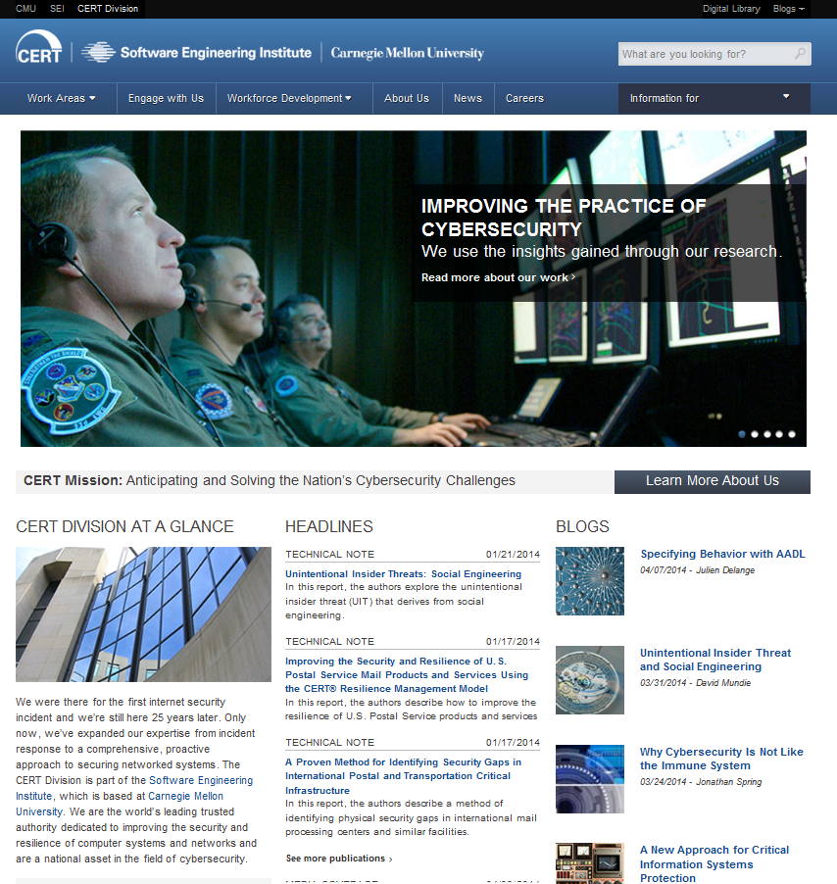
CERT-CC

Slide 44
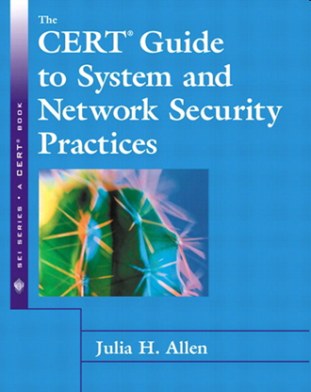
CERT-CC
http://www.cert.org/index.html
Computer Emergency Response Team Coordination Center of SEI at CMU
Valuable documentation (free) especially on CIRT-related matters
CERT Security Improvement Modules
http://www.cert.org/security-improvement/
  Outsourcing Managed Security
  Services
  Securing Desktop Workstations
  Responding to Intrusions
  Securing Network Servers
  Deploying Firewalls
  Securing Public Web Servers
  Detecting Signs of Intrusion

Slide 45
CERT-CC (cont’d)
See also complete list of articles, reports and papers at http://www.cert.org/nav/allpubs.html
Examples (of many)
  Advanced Information Assurance Handbook
  CERT® System and Network Security Practices
  Creating a Computer Security Incident Response Team: A Process for Getting Started
  First Responders Guide to Computer Forensics

Slide 46

BSI: German Federal Office for Information Security
Vast amount
of valuable
information
in ENGLISH
as well as in
German
Particularly
good resources for educating managers
See following slides

Slide 47
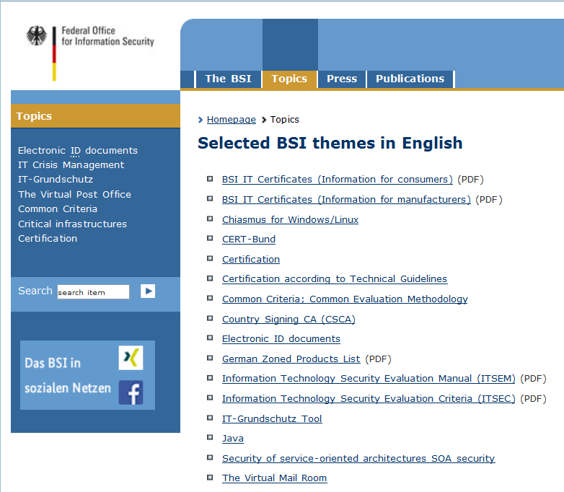
BSI Index
http://www.bsi.bund.de/EN/Topics/topics_node.html

Slide 48
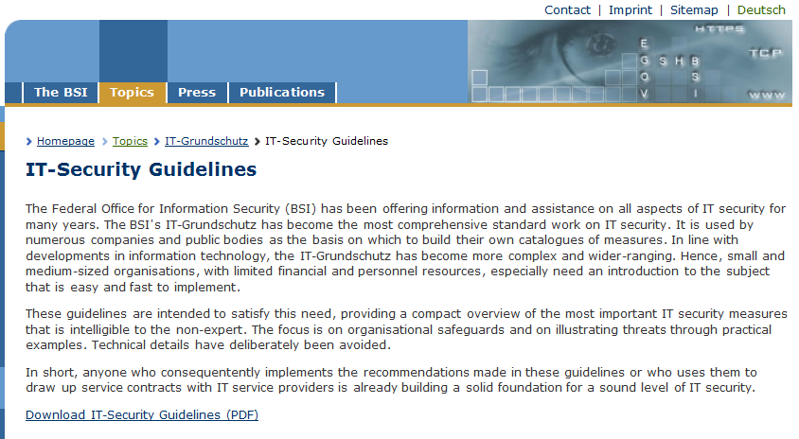
BSI IT-Security Guidelines
http://www.bsi.bund.de/EN/Topics/ITGrundschutz/ITSecurityGuidelines/itSecurityguidelines_node.html

Slide 49
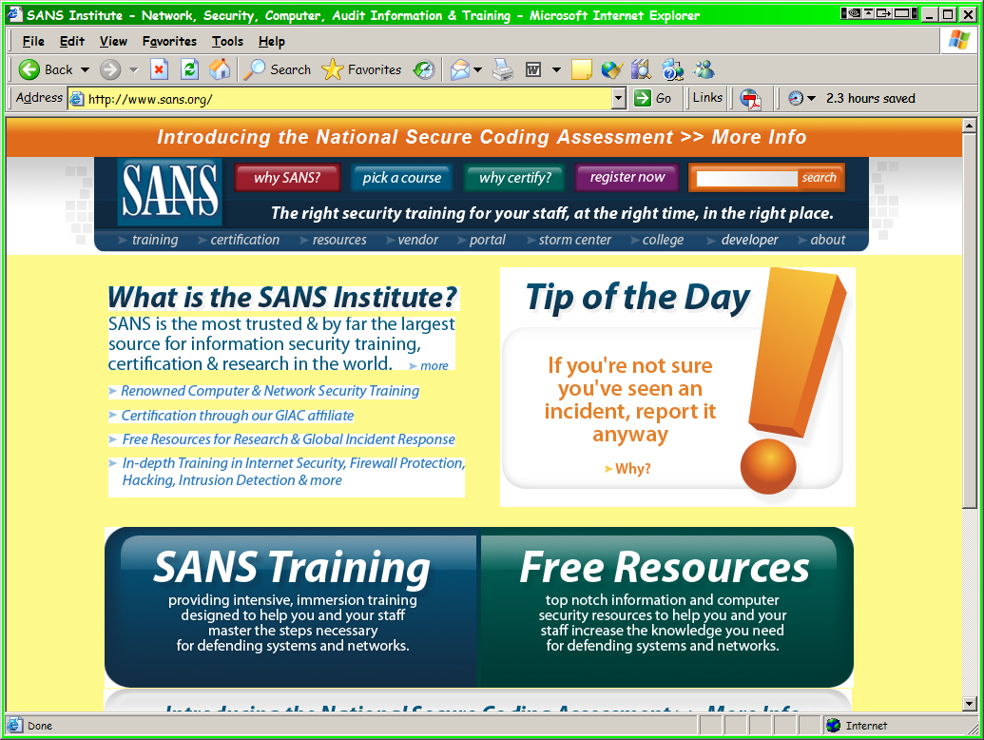
SANS Policy Resources
SANS Security Policy Project
http://www.sans.org/resources/policies/
Community project with contributions from many organizations
FREE materials
List of topics follows on next slide

Slide 50
SANS (cont’d)
Acceptable Encryption Policy
Acceptable Use Policy
Analog/ISDN Line Policy
Anti-Virus Process
Application Service Provider Policy
Application Service Provider Standards
Acquisition Assessment Policy
Audit Vulnerability Scanning Policy
Automatically Forwarded Email Policy
Database Credentials Coding Policy
Dial-in Access Policyx
DMZ Lab Security Policy
E-mail Policy
E-mail Retention
Ethics Policy
Extranet Policy
Information Sensitivity Policy
Internal Lab Security Policy
Internet DMZ Equipment Policy
Lab Anti-Virus Policy
Password Protection Policy
Remote Access Policy
Risk Assessment Policy
Router Security Policy
Server Security Policy
Third Party Network Connection Agreement
VPN Security Policy
Wireless Communication Policy

Slide 51
Review Questions
Why does it matter how we develop and implement policies? Why not just impose them?
If you don’t already have security policies in place, what’s first step in trying to develop them? Why? I.e., why not just go ahead and develop them outright?
What kinds of push-back might you encounter in an organization as you try to create new security policies? Why? How can you overcome resistance?
As you plan your management-sensitization session, what would you look for in a training video?
Why would you segment employee population into different groups rather than just put everyone into a big auditorium and get it all over with in one go?
Why does maintenance involve changing policies? Shouldn’t they be right from start?

Slide 52
DISCUSSION

