Slide 1
Classification Policies
CSH5 Chapter 67
“Developing Classification Policies for Data”
Karthik Raman & Kevin Beets

Slide 2
TOPICS
Introduction
Purpose / Benefits
Role in IA
Legal Requirements
Design & Implementation
DC Solutions

Slide 3
Introduction
Popular literature / media refer to “TOP SECRET”
No clear understanding of issues
Misrepresentation as negative: hiding information from stakeholders
Data classification
Labels info to support compliance with data-protection policies
Historically used by government, military, government contractors
Now increasingly used to comply with legal requirements on commercial organizations
Financial / operational records
Privacy protection

Slide 4
Purpose / Benefits
Information life cycle management (ILM)
Control of data
Throughout life cycle
Creation
Access
Modification
Destruction
Legal requirements increasing pressure in private sector; e.g.,
HIPAA
European Privacy Directive
Benefits
Compliance with data standards, legal requirements
Streamlined/secure data sharing
Efficient data storage / retrieval
Tracking data through ILM

Slide 5
Role in IA
Federal Financial Institutions Examinations Council (FFIEC) guidelines
Ensure consistent protection of data
Focus controls / efforts efficiently
Systems must be classified at highest level of information stored / transmitted
Supports risk analysis
Clarifies basis for access restrictions
Supports business continuity planning & disaster recovery planning
May be mandatory
Necessary for data-loss prevention (DLP)

Slide 6
Legal Requirements in US
Privacy Act of 1974
Including Computer Matching & Privacy Protection Act of 1988
Family Educational Rights & Privacy Act (FERPA)
Health Insurance Portability & Accountability8 Act (HIPAA)
Gramm-Leach-Bliley Act (GLBA)
Sarbanes-Oxley Act (SOX)
Federal rules of Civil Procedure (FRCP)

Slide 7
Compliance Standards (1)
US Federal Government Executive Order 12958
Further Amendment to Executive Order 12958… Classified National Security Information
ISO/IEC 27001:2005
Guidelines & principles for information security management
5 levels
Public documents
Internal use only
Proprietary
Highly confidential
Top secret

Slide 8
Compliance Standards (2)
Defense contracting (DoD)
Finances (Federal Financial Institutions Examination Council – FFIEC)
Life sciences (FDA)
Media, telecom (FCC)

Slide 9
Design
Obtain management approval
Study BCP, IT assets, storage-management
Present benefits DC to business unit (BU) heads
Survey users in BUs re data utilization / management & preferences for organization & labeling
List revenue-generation & mission-critical usage of data for each BU;
Study information sharing

Slide 10
Implementation
Obtain management approval
Map data-labeling to available hardware, networks, systems, storage
Apply automation / DC tools as appropriate
Guide users through adoption & solicit feedback
Develop service-level agreements (SLAs) for data usage
Plan for DLP
Develop cost model
Report results to management

Slide 11
DC Solutions
Primarily related to data storage
Virtualization
Deduplication
Cheaper media
Features of DC software
Policy-based data-type discovery
File metadata classification
Multiple file system management
Compliance & legal consideration
Report style

Slide 12
Product Roundup from SearchStorage
http://searchstorage.techtarget.com/report/Product-Roundup-Data-classification

Slide 13
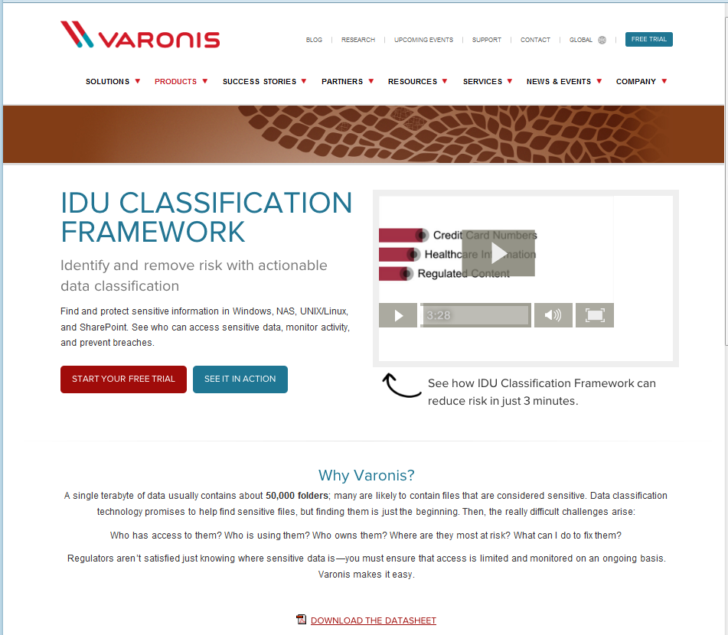
Varonis
http://www.varonis.com/products/data-classification-framework.html
Professor Kabay has no financial interest in any of the products shown as examples.

Slide 14
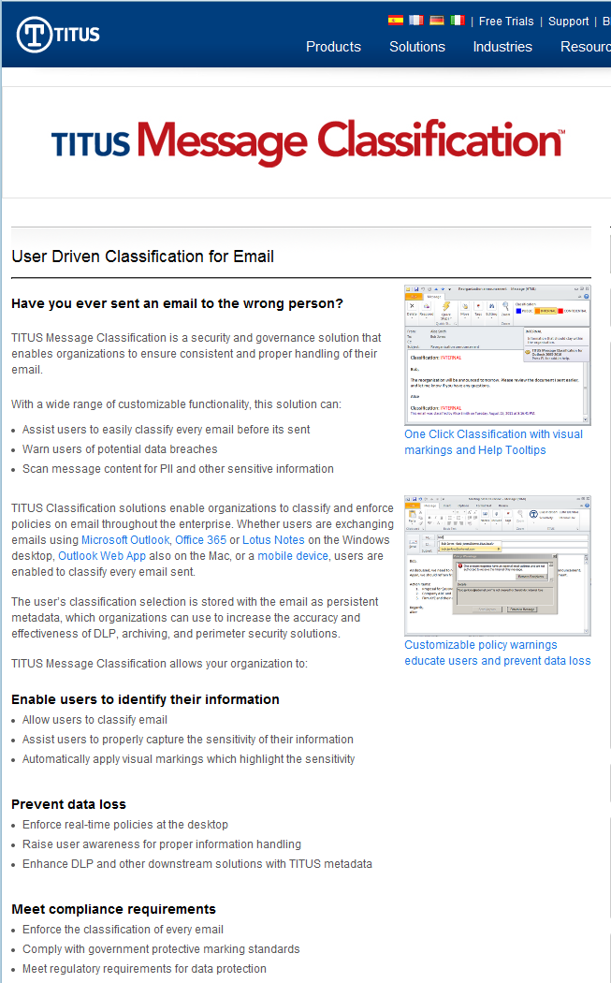
TITUS
http://www.titus.com/software/message-classification/
Specifically for email control
Professor Kabay has no financial interest in any of the products shown as examples.

Slide 15
Some Useful Videos
Data Classification
Part 1 < http://www.youtube.com/watch?v=rfP56qua5pc >
Part 2 < http://www.youtube.com/watch?v=1-Y2EvWMhD0 >
What is Network Data Loss Prevention (McAfee)
< http://www.youtube.com/watch?v=9jLK5jybSnI >
TITUS Classification Solutions Overview
< http://www.youtube.com/watch?v=dsuH_EA_NdY&feature=pyv >
McAfee Data Loss Prevention (DLP)
< http://www.youtube.com/watch?v=TXYNNSaMxsI >

Slide 16
DISCUSSION

