Slide 1
PRIVACY IN CYBERSPACE
CSH6 Chapter 69
“Privacy in Cyberspace:
U.S. and European Perspectives”
Henry L. Judy, Scott L. David,
Benjamin S. Hayes, Jeffrey B. Ritter, Marc Rotenberg, & M. E. Kabay

Slide 2

Topics
Worldwide Trends
European Approaches to Privacy
United States
Compliance Models

Slide 3

Worldwide Trends
Technology brings increased opportunities for data collection & commercial use
Growing concern over privacy protection
Cutting-edge developing technologies
  DNA databases
  RFID
  Electronic health records
Recent cyberprivacy issues

Slide 4

Recent Cyberprivacy Issues
NSA Domestic Spying
NSA PRISM in USA
Phone Hacking in UK

Slide 5

NSA Domestic Spying
October 2001 – President Bush orders
NSA to begin surveillance within USA
No law authorizing capture of
telephone & Internet
communications
No court order satisfying 4th
Amendment requirements
Bush administration concedes that
order violates even FISA (Foreign
Intelligence Surveillance Act)
Obama administration continued illegal surveillance
For cartoons lampooning this surveillance, see http://tinyurl.com/oagvwp4

Slide 6
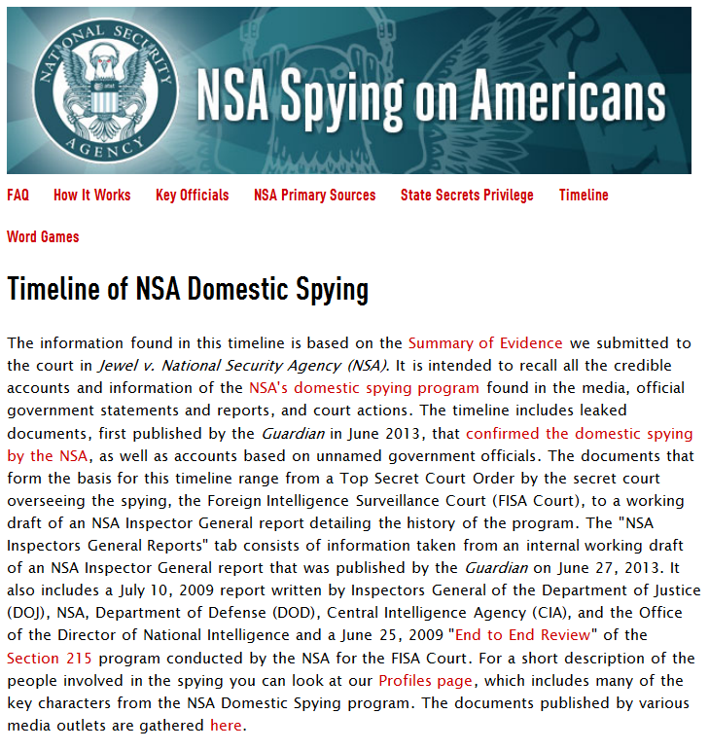
NSA Spying on Americans
https://www.eff.org/nsa-spying/timeline

Slide 7

NSA PRISM in USA
NSA collecting metadata about all phone calls in USA
FISC (Foreign Intelligence Surveillance Court)
ordered Verizon phone
company to turn over all
records
Violated USAPATRIOT
Act compelling disclosure
only of relevant data

Slide 8
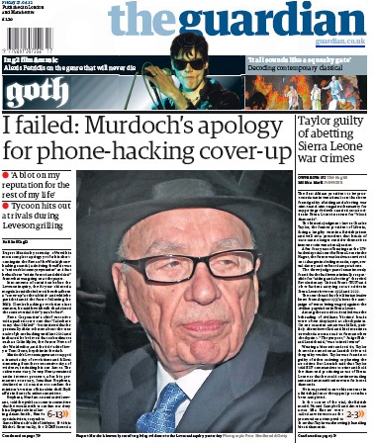
Phone Hacking in UK
News of the World UK newspaper accessed voice mail of investigative targets from 2003 through 2007
Management systematically opposed and undermined investigations by legal authorities
Major failure to comply with journalistic and legal requirements

Slide 9
Laws, Regulations & Agreements
General patterns emerging across countries
Personally identifiable information (PII)
  Anything tied to individual
  Potentially subject to regulation
Principle: data subject should
control PII
Privacy laws: obligations to respect data subject’s expectations
Fair information practices
  Control by data subject
  Prohibition of specific practices/applications concerning PII
Challenge: integrate business, law & technology

Slide 10
Sources of Privacy Law
Governments & public-sector entities
  Restrained from undue intrusion
  Constitutional mechanisms
  Access to government-held PII in democracies
Restraints on private-sector usage by laws
European Charter of Fundamental Rights
  Nation states must consider protection of PII as fundamental human right
  Applies also to future members of EU
Privacy being integrated into national constitutions & supranational law

Slide 11

European Approaches to Privacy
History & OECD
EU Data Protection Directive
Harmonization of Non-EU European Countries
EU Telecommunications Directive
European Data Protection Supervisor

Slide 12

History & OECD*
Privacy increasingly important in 1960s & 1970s
  Surveillance potential of computers and networks
  1st modern data-protection law 1970: Hesse (state) in [West] Germany
1981: Council of Europe – “Convention for the Protection of Individuals with regard to the Automatic Processing of Personal Information”
  Aka COE Convention – adopted by > 40 countries
1981: OECD “Guidelines Governing the Protection of Privacy and Transborder Data Flows of Personal Information”
  Aka OECD Guidelines – used even by non-EU nations
*Organisation for Economic Co-operation & Development

Slide 13

EU Data Protection Directive
Directive 95/46/EC passed in 1995
Became effective 1998
Requires EU member states to pass national laws implementing its terms
National laws not identical
Not enough for businesses with EU interests to use only DPD – must examine local laws
Details:
  EU Directive Requirements
  International Data Transfer Restrictions
  State of implementation

Slide 14

EU Directive Requirements
Notice: who, why, how, where, to whom
Consent: right to block, opt out, require permission
Consistency: follow terms of notice
Access: see own info, make corrections
Security: prevent unauthorized access
Onward Transfer: contractual
obligations to follow same rules
and agreements
Enforcement: private right of action,
Data Protection Authority in every country
  Investigate complaints
  Levy fines
  Initiate criminal actions
  Demand changes

Slide 15

International Data Transfer Restrictions
Regulation of interjurisdictional
information exchanges
Transfer from EU to non-EU
countries
  PROHIBITED unless
  Destination has “adequate”
  legal protections
  USA not considered to have adequate protection
US/EU Safe Harbor arrangements discussed later in chapter

Slide 16
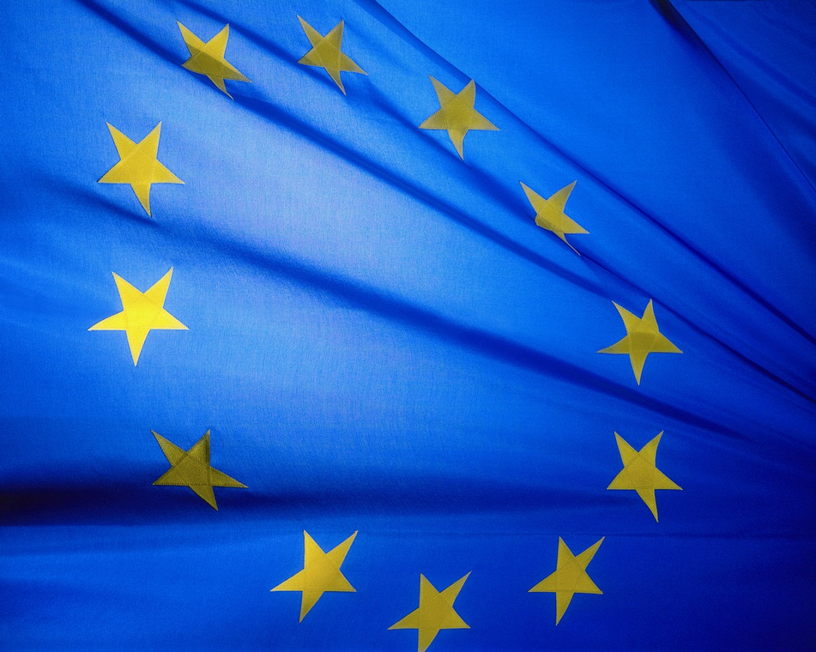
State of Implementation
“All 27 member countries of the European Union, including the new members states, have passed legislation fully implementing the directive.”

Slide 17
Harmonization of Non-EU European Countries
Prohibition on transfer of PII
has moved non-EU countries
to pass consistent laws
  Adverse economic impact
Two categories
  EU trading partners
  Potential future members
  of EU

Slide 18
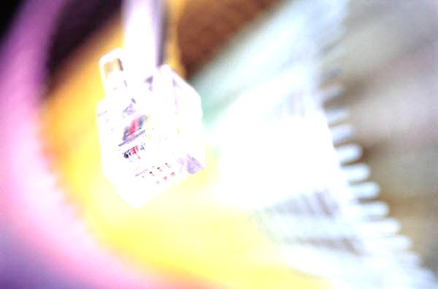
EU Telecommunications Directive
Specific to telecommunications companies & agencies
Ensure technological assurance of privacy for communications
Restricts access to billing information
Limits marketing strategies
Allows per-line blocking of caller ID
Forces deletion of call-specific information at end of communication
New proposal goes further: affect all electronic communications

Slide 19
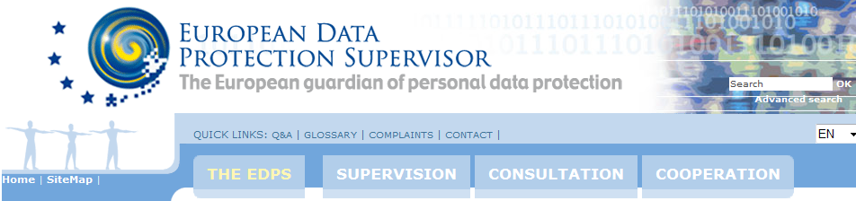
European Data Protection Supervisor
http://www.edps.europa.eu/EDPSWEB/edps/EDPS
Independent supervisory body
Monitor application of regulations affecting data gathering, transmission, and use of PII

Slide 20

United States
History, Common Law Torts
Public Sector
Private Sector
State Legislation

Slide 21

History, Common Law Torts
Privacy as cause for tort:
20th century development
  Constitution did not recognize
  privacy explicitly
  Growing urbanization forced
  growing awareness of need for
  privacy law
  “Right to be left alone” posited in 1890
    Charles Warren & Louis Brandeis
    Harvard Law Review article
  State laws evolved without overarching federal law

Slide 22
Evolution of US Privacy Theory
1960 Restatement of Torts defined 4 subtorts related to privacy:
  Intrusion: unreasonable breach of seclusion if offensive to reasonable person
  Revelation of private facts: unauthorized & unreasonable publicity of facts not of legitimate concern to public – when given to wide audience
  False light: conveying false impression
  Misappropriation: unauthorized
  use of name or likeness for
  benefit or gain (often
  used by celebrities)

Slide 23
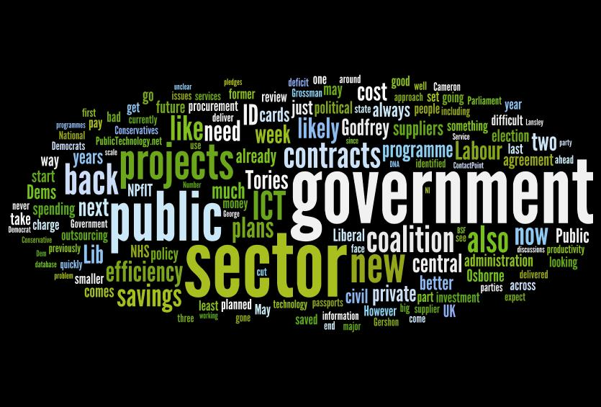
Public Sector in USA
History
Privacy Act of 1974 & FOIA
ECPA of 1986
Right to Financial
Privacy Act of 1978
Driver’s Privacy
Protection Act
Law Enforcement &
National Security Surveillance

Slide 24
History of US Public Sector Privacy Laws
Long-standing restrictions on government intrusions into private lives of citizens
US Constitution
  4th Amendment governs search and seizure
  14th Amendment governs state laws
  But no explicit mention of privacy
Case law and statutes have
defined privacy rights
State constitutions usually also
include restrictions
Governments usually have stricter
privacy protection than private sector

Slide 25
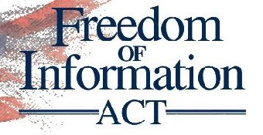
Privacy Act of 1974 & FOIA
Privacy Act of 1974
  Limits on federal government can use & transfer PII
  Individual rights to know PII held by federal government
Freedom of Information Act (FOIA) part of Privacy Act
  Determine
  Forbid
  Access
  Correct
  Current, relevant, not excessive
  Private right of legal action

Slide 26
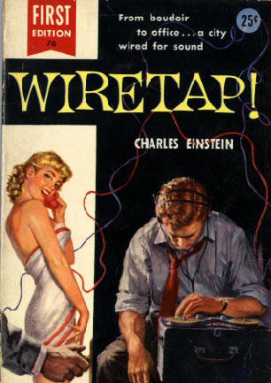
ECPA of 1986
Electronic Communications Privacy Act of 1986
  Amended Wiretap Law of 1968
  Prohibits unauthorized,
  intentional
    Interception of
    Access to
  Wire, oral, electronic
  communications
Require court orders to install
devices
  Pen registers (outbound
  phone numbers)
  Trap and trace (incoming
  phone numbers)
  Not probable cause – only certification from LEO

Slide 27

Right to Financial Privacy Act of 1978
Federal government cannot
  Obtain financial records for individual
  Without informing subject of investigation
Subpoena: 90 day limit for informing subject
Other methods for authorizing disclosure
  Must inform subject
    Before
    Simultaneously with
  Investigation

Slide 28
Driver’s Privacy Protection Act
1st time Congress passed law limiting state government access to PII
Prohibits disclosure of PII associated with motor vehicle ownership / driver’s license
Exceptions
  Legitimate government activities
  Facilitate (safety) recalls

Slide 29
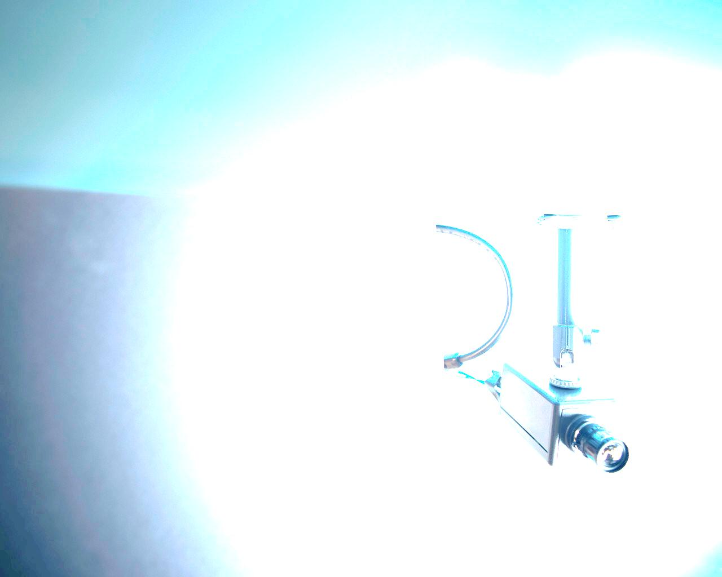
Law Enforcement & National Security Surveillance
Criminal activity aided by technological advances
Law enforcement & national security information gathering also enhanced
Monitoring – search data for signs of crime
  Packet sniffers: capture & scan packets for keywords using signatures or heuristics
  Black boxes: log communications traffic
Surveillance – eavesdrop on communications / behavior of specific subjects of investigation
  ECHELON – USA, UK, NZ, Australia, Canada
  CALEA (Communications Assistance for Law Enforcement Act of 1994) requires technical standards for ISPs
  Council of Europe Convention on Cyber-Crime (2004)
    22 countries ratified
    Criticism from privacy advocates

Slide 30
Private Sector
Overview of US Private Sector Regulations
Gramm-Leach-Bliley Act
Children’s Online Privacy Protection Act
Health Insurance Portability and Accountability Act
Cable and Video Acts
US/EU Safe Harbor
Workplace Privacy
Anonymous Cybersmearing
Online Monitoring Technology
Location Privacy
Genetic Discrimination
Social Network Sites & Privacy

Slide 31
Overview of US Private Sector Regulations
US relatively limited in regulating private sector
  Preference for self-regulation
Most privacy-related laws are sector-specific
  Financial services
  Healthcare services
Evolving issues
  Workplace privacy
  Defamation
  Location
  Genetics
  Social networks

Slide 32
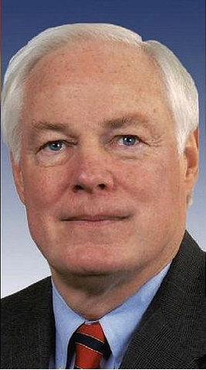
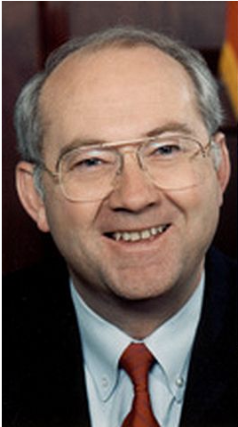

Gramm-Leach-Bliley Act
GLB – 1999 law named for its architects
  Took effect July 1, 2001
Applies to all financial institutions
  Protect data subjects’ PII
  Disclose policies to data subjects
  Provide options for sharing info (or not)
  FTC in particular has extended definition
  of financial institutions
Widespread effects in many industries
  Capture & maintain opt-out requests
  Send notices to affected customers
  Limits on selling customer lists
  Be sure arrangements meet multiple
  regulators’ requirements
Jim Leach
Phil Gramm
Tom Bliley

Slide 33

Children’s Online Privacy Protection Act
COPPA passed 1998
Prohibits
  Collection
  Use
  Disclosure
Children’s PII without verifiable parental consent
FTC rules violations “unfair or deceptive trade practices”

Slide 34
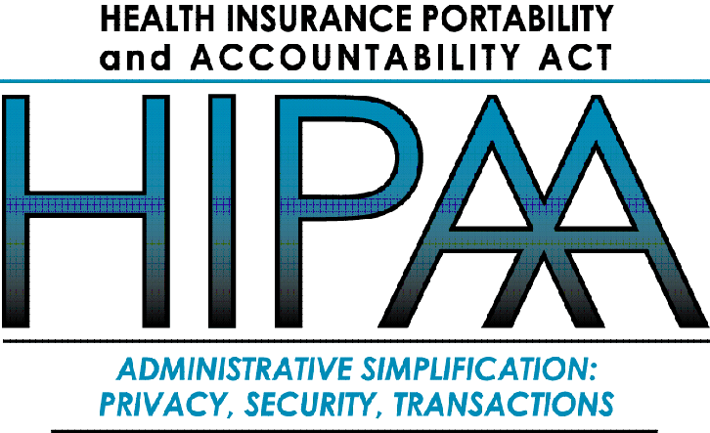
Health Insurance Portability and Accountability Act
HIPAA (not HIPPA) passed 1996
  Last compliance deadline was
  2004
Providers & health plans must
  Give patients clear written
  explanations of how organizations handle PII
  Minimize use of PII to essentials
  Disclosure logs
  Cannot condition services on waiver of rights
Criminal penalties for fraudulent obtention
States not preempted from more restrictive laws
Substantial fines for violations

Slide 35
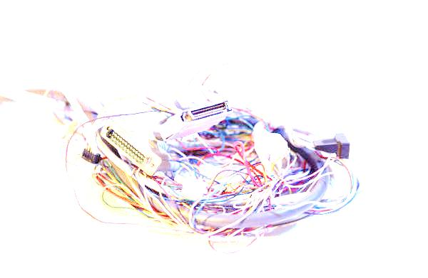
Cable and Video Acts
Cable Communications Policy Act of 1984 §551
  Protection of subscriber privacy
  Annual notice of data collection/use practices
  Mandatory prior consent
  Law enforcement require court order for info
  Private right of action (punitive damages, fees)
Video Privacy Protection Act of 1988
  Prohibits transfer of video rental records
  Exceptions require customer approval
  LEOs require warrant
  Sometimes described as result of borking (now a recognized verb) Robert Bork in 1987 over (inoffensive) video rentals

Slide 36
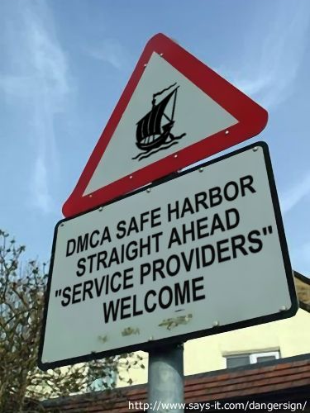
US/EU Safe Harbor
EU Privacy Directive (1998) restricts
transfer of PII to nations with adequate
privacy protection
April 1998 – July 2000: negotiations
on Safe Harbor provisions allow
data transfers to companies
willing to
  Comply with EU Directive
  principles
  Self-certify adherence by public
  report to US Dept of Commerce
  Provide for independent audit or
  membership in suitable organization
    TRUSTe, BBBOnline
  Be subject to FTC regulation
    Violation of SH actionable as fraud by FTC

Slide 37
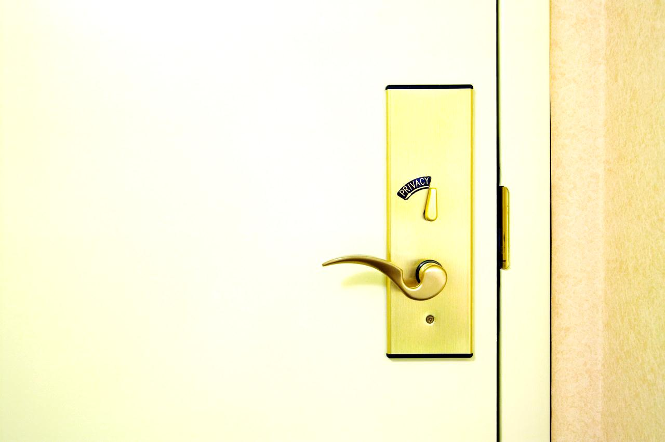
Workplace Privacy
EU: simply restricted by EU Privacy Directive = NONE
Difficult balance in US
  Excessive monitoring = invasion of privacy
  Inadequate monitoring = negligence
Common law: employer owns resources
  Therefore need only provide notice of restrictions and monitoring
ECPA governs wiretapping / capture
  But excepts system providers
  And consent: contract with employees
  Live telephone calls: employer cannot monitor non-work-related phone calls
  FL & MD require consent of both parties to make wiretap legal

Slide 38
Anonymous Cybersmearing
Organizations can be claqued or smeared
by anonymous posters on the ‘Net:
options include
  Do nothing (don’t feed the trolls)
  Identify the poster – contact or sue
  Contact law enforcement
    Threats to individuals or
    property
    Attempts to manipulate stock
    prices
  File suit against “John Doe” and subpoena ISP to discover identity of poster
    May not work

Slide 39
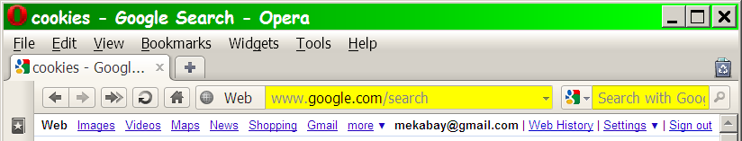
Online Monitoring Technology
Unauthorized monitoring of Web activity
Cookies
  Text files on hard drive
  Recognize user (e.g., GOOGLE)
Web beacons / bugs / single-pixel GIFs
  Used in email messages to tell if recipient has opened the message
  Report user identity and history to Web server

Slide 40

Location Privacy
Wireless devices often
include GPS capabilities
Direct localized advertising
to user
Concerns over use by criminals
(e.g., automatic “not at home now”
beacon)
Regulations limited

Slide 41

Genetic Discrimination
Collection and distribution of genetic
information an issue
Can be used to predict differential
susceptibility to specific diseases
Could be used to discriminate against
victims
  Insurance companies could refuse to
  cover
  Employers could refuse to hire or promote
[MK adds personal opinions:
– Exactly what happens today with XX chromosomes (join NOW to fight this)
– People with genes for high melanin skin pigment production (join the NAACP to fight this)]

Slide 42

Social Network Sites & Privacy
Facebook, MySpace…
Explosion of publication of formerly private PII
  Marketing groups salivating
  Stalkers too
2007 ENISA report (European
Network and Information
Security Agency)
  Clear benefit
  False sense of intimacy
  Encourage social-networking education in schools
  Encourage openness, notification of breaches
  Privacy-friendly defaults

Slide 43
State Legislation
US federal laws/regulations provide minimum terms
States may be more stringent
Many state laws
  Organized by industry or sector
  May affect anyone doing business in the state
Notable examples
  CA SB 1386 (2003) requires notification of breaches
  California Financial Information Privacy Act (2003)
  Most states have genetic-information protection laws
  Several states regulate interception of RFID (radio-frequency identification devices)

Slide 44
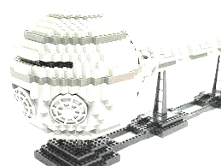
Compliance Models
US Legislation
US FTC §5 Authority
Self-Regulatory Regimes & Codes of Conduct
Contract Infrastructure
Synthesis of Contracts, Technology & Law
Getting Started: A Practical Checklist

Slide 45
US Legislation
Pass specific law
Apply to any organization gathering/using PII
Define rights of data subjects
Various enforcement mechanisms
  Private right of action (lawsuits & class action)
  Actions by state attorneys
  general
  Action by FTC re unfair/deceptive
  trade practices

Slide 46
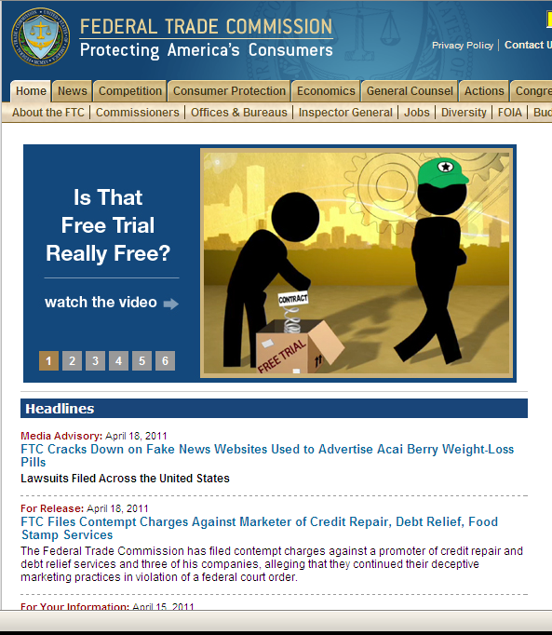
FTC
Investigate unfair / deceptive trade practices
Has applied to many privacy cases
Mostly cases of negligent security

Slide 47
Self-Regulatory Regimes & Codes of Conduct
Benefits
  Minimizes need for
  government resources
  Allows greatest
  flexibility for businesses
Criticisms
  Insufficient standards
  Inadequate enforcement

Slide 48
Contract Infrastructure
Contracts can support or damage privacy
Govern entire life cycle of PII
  Collection
  Storage
  Use
  Transfer
Develop chain
of contracts

Slide 49
Synthesis of Contracts, Technology & Law
Problems
  Policing contracts may beyond means
  or inclination of many businesses
  Businesses unlikely to sue
  trading partners
  Consumers unlikely to launch individual lawsuits
  Class-action lawsuits possible
  Once compromised, PII cannot realistically be re-protected
  Extent of problem may exceed practical resources for enforcement
Therefore may have to rely on technology

Slide 50

Review Questions
Use the checklist of
recommendations from
authors in §69.4.6
Be prepared to explain
every one of the
recommendations

Slide 51
A Practical Checklist (1)
Achieve buy-in, at the highest level of the organization, to the idea that personal information management must be part of an organization’s critical infrastructure.
Perform due diligence to identify all types of personal information collected and the routes by which the data travel in and out of the organization.
Identify all of the uses to which the information is put during its life cycle through collection, processing, use, transfer, storage, and destruction.

Slide 52
A Practical Checklist (2)
Identify each law affecting the collection, use, and transfer of personal information to which the company is subject.
Create an institutional privacy policy that accurately considers both a commitment to abide by various legal requirements and the legitimate business activities of the organization.
Create supporting materials that educate employees and instruct on policy implementation.

Slide 53
A Practical Checklist (3)
Implement consistent data transfer agreements with all data-trading partners, vendors, service providers, and others with whom personal information is acquired or transferred.
Build privacy management into the organization’s strategic planning, providing sufficient resources for personnel, training, technology, and compliance auditing.
Hold employees accountable for implementation and compliance with the privacy policy and contract requirements.

Slide 54
A Practical Checklist (4)
Consider innovative approaches to privacy protection and business development that limit or eliminate the collection of personally identifiable information.
Periodically audit compliance.

Slide 55
Now go and study

