Slide 1
Law & Order: VIRUS
CJ341 – Cyberlaw & Cybercrime
Video & Discussion
M. E. Kabay, PhD, CISSP-ISSMP
mailto:mekabay@gmail.com
V: 802.479.7937
Assoc Prof Information Assurance
School of Business & Management

Slide 2
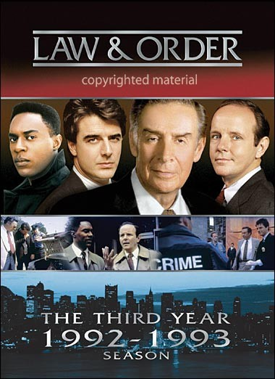
Cover

Slide 3
Law & Order
Season 3, Episode 19 – 21 April 1993
Synopsis:
A computer virus creates a malfunction at a diabetes clinic and leads to the death of two patients….
Lead actors:
Jerry Orbach / Detective Lennie Briscoe
Chris Noth / Detective Mike Logan
Dann Florek / Captain Donald Cragen
Michael Moriarty / Exec ADA Ben Stone
Richard Brooks / ADA Paul Robinette
Steven Hill / DA Adam Schiff\

Slide 4
Discussion
Did you know that a computer virus could cause harm to real people?
Do you know of other examples where viruses have caused significant harm?
Who writes viruses?
Why do people write viruses?
Some people argue that writing viruses is an expression of free speech and therefore should be protected in the US by our First Amendment. Others argue that writing viruses should be illegal. What do you think?
Some university courses teach people to write viruses? Why do you think they do that? What do you think of that?

