Slide 1
Unauthorized Access & Denial of Service
CJ341 – Cyberlaw & Cybercrime
Lecture #3
M. E. Kabay, PhD, CISSP-ISSMP
School of Cybersecurity, Data Science & Computing
Norwich University

Slide 2
Topics
Sources of damage to computer systems
Examples of system penetration
Examples of Web vandalism
Examples of denial of service

Slide 3
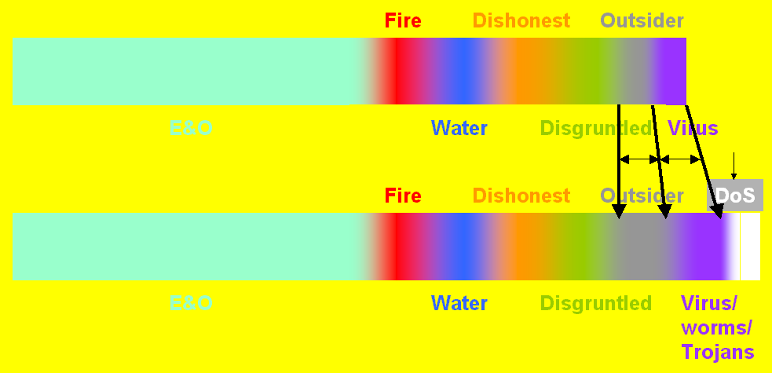
Rough Guesses About Sources of Damage to IT
Before 1993
After 1993
See
CSH5 Ch 10, “Understanding Studies and Surveys of Computer Crime.”
Also http://www.mekabay.com/methodology/crime_stats_methods.htm

Slide 4
Famous Cases of Penetration
Mitnick
DISA Report
Citibank Hack
More examples

Slide 5
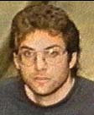
1980-2003: Kevin Mitnick (1)
Famous hacker born 1963
  As young teenager, stole bus rides by using special punch for bus transfers
  Phone phreaking, pranks, breakins using social engineering against DEC
1981: social engineering to enter PacBell
  Juvenile court ordered psychological study
  1 year probation
1987: arrested for penetrating USCA
  Stored stolen VAX VMS code on disks
1988: Arrested by FBI; sentenced 1989 to 1 year jail & 6 months rehabilitation

Slide 6
Kevin Mitnick (2)
1992: FBI tried to arrest him for stealing services from phone company computers
  Went underground
1994: Insults Tsutomu Shimomura
  Physicist & Internet security expert
  Mitnick left rude messages on computer, voice-mail
  Shimomura helped FBI track Mitnick
1995: FBI arrests Mitnick
1999: Convicted of wire fraud, computer fraud & illegal interception of wire communication
  Sentenced to 46 months federal prison

Slide 7
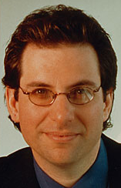
Kevin Mitnick (3)
Became cause célèbre among criminal hackers
  FREE KEVIN defacements worldwide
  Funniest: FREE KEVIN on Mexican Web site after release of KM
2000: released from prison
  3 years parole
  Restricted access to computers
  Profits from writing and speaking
  about criminal career used to
  reimburse victims
  Founded own computer-security firm
  Wrote books about defending against social engineering

Slide 8
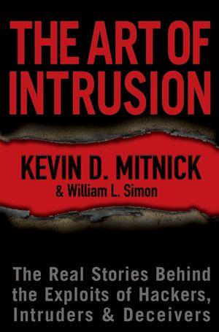
Kevin Mitnick (4)
Readings about the Mitnick case
  Goodell, J. (1996). The Cyberthief and the Samurai: The True Story of Kevin Mitnick—and the Man Who Hunted Him Down. Dell (New York). ISBN 0-440-22205-2. xix + 328.
  Hafner, K. & J. Markoff (1991). Cyberpunk: Outlaws and Hackers on the Computer Frontier. Touchstone Books, Simon & Schuster (New York). ISBN 0-671-77879-X. 368. Index.
  Littman, J. (1996). The Fugitive Game: Online with Kevin Mitnick—The Inside Story of the Great Cyberchase. Little, Brown and Company (Boston). ISBN 0-316-5258-7. x + 383.
  Shimomura, T. & J. Markoff (1996). Takedown: The Pursuit and Capture of Kevin Mitnick, America's Most Wanted Computer Outlaw—by the Man Who Did It. Hyperion (New York). ISBN 0-7868-6210-6. xii + 324. Index.

Slide 9
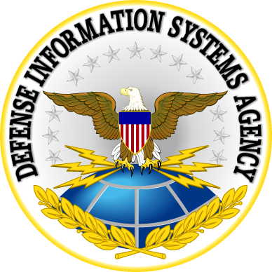
DISA
US DoD agency
Real-time IT & communications
support
Core Mission Areas
  Control & communications
  Defense network management
  Information assurance
Web site home page
http://www.disa.mil/

Slide 10
DISA Penetration Studies (1)
The original DISA study lasted from 1994 through 1996
38,000 DoD unclassified computers
  Tested by Red Teams / Tiger Teams
  Easily-available penetration tools
  66% of the military Internet-visible systems & networks vulnerable to relatively trivial attack methods
  Of 25,000 vulnerable systems, only 4% (~1,000) were run by system managers who noticed the intrusions
  Of the systems where anyone noticed the problem, only about ½% (~5) actually reported the intrusions the way procedures dictated.

Slide 11
DISA Penetration Studies (2)
1997.03 — EDUPAGE
InfoWar Division of Defense Information Systems Agency of US
Retested 15,000 Pentagon computers
  Had warned system managers of vulnerabilities in previous audit
90% of systems were still vulnerable
Recommended emphasizing response (immediate shutdown) instead of focusing solely on preventing penetrations

Slide 12
Penetration: Citibank Hack
1998.02 (events started 1994.07)
Vladimir Levin of St Petersburg hacked Citibank computers
Conspirator Alexei Lachmanov transferred U$2.8M to five Tel Aviv banks
Admitted to attempting to withdraw US$940,000 from those accounts
Three other members of the gang pleaded guilty
Levin extradited 1997.09

Slide 13
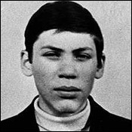
Citibank Hack (2)
1998.02 -- Levin sentenced to 3 years, fined
Vladimir Levin convicted by NYC court
Transferred $12M in assets from Citibank
Crime spotted after first
$400K theft
Citibank cooperated with
FBI
MORAL: report computer
crime & help prosecute
criminals

Slide 14

Robert Matthew Bentley
2008.06 – Pensacola, FL
21 year-old criminal hacker sentenced to 3 years in federal prison
Pled guilty to charges of computer
fraud
Infected hundreds of computers in
Europe
  Adware installed illegally
  Used computers in Florida to
  implant software on victims’
  computers
  Paid by “Dollar Revenue” company in Europe
Investigation and conviction required intensive international cooperation
Notes:
http://www.cybercrime.gov/bentleySent.pdf

Slide 15

Web Vandalism Classics
CIA (1996.09)
USAF (1996.12)
NASA (1997.03)
AirTran (1997.09)
UNICEF (1998.01)
US Dept Commerce
(1998.02)
New York Times
(1998.09)
SETI site (1999)
Fort Monmouth (1999)
Senate of the USA (twice)(1999)
DEFCON 1999 (!)

Slide 16
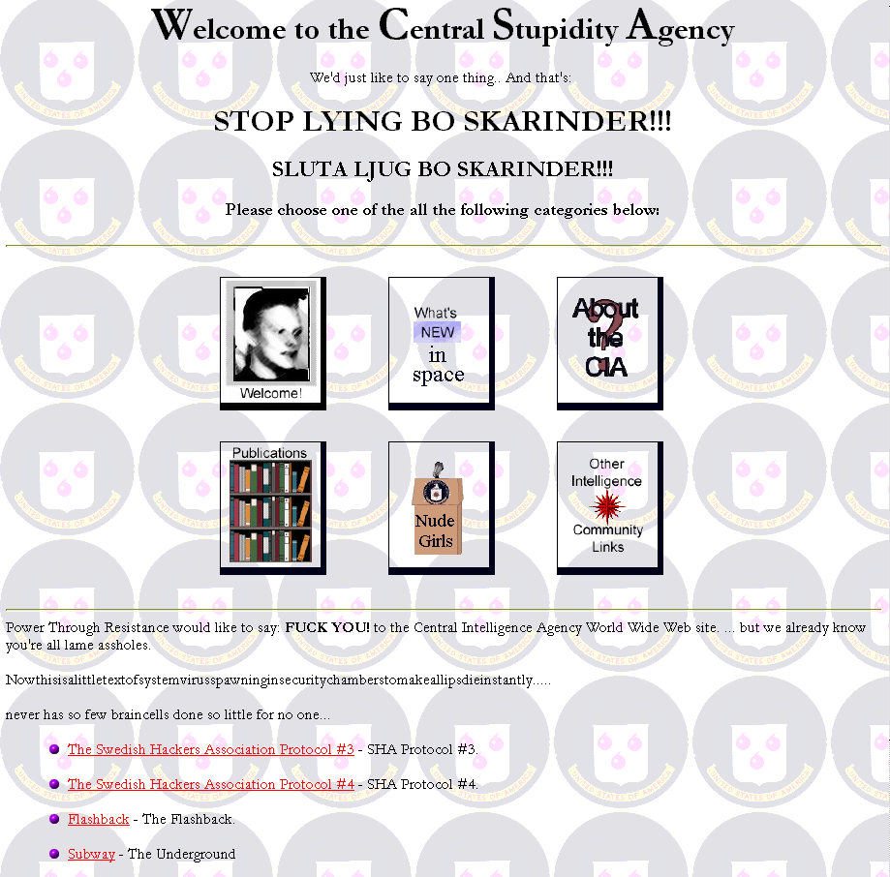
CIA (1996.09)
CIA
Notes:
Examples are from <http://www.2600.com> archives unless otherwise noted.

Slide 17
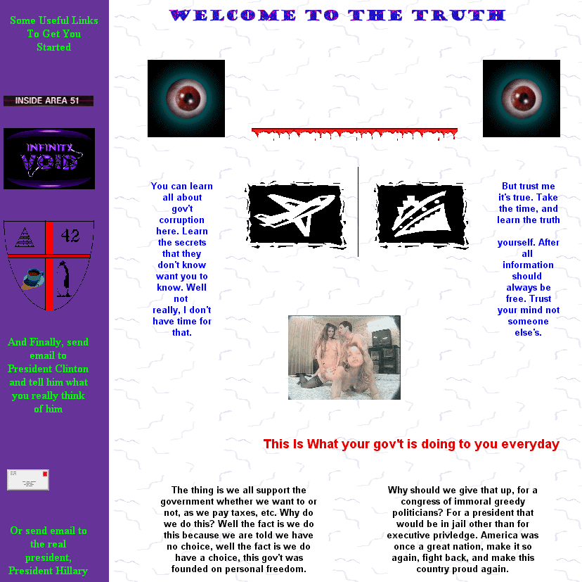
USAF (1996.12)
USAF

Slide 18
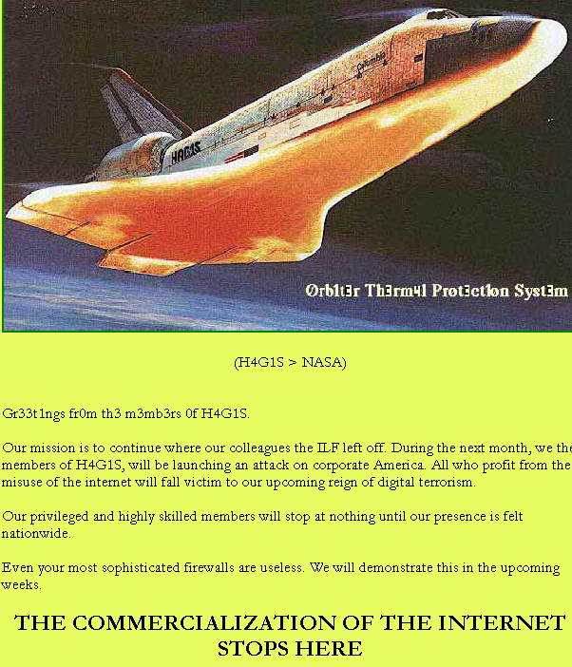
NASA (1997.03)
NASA

Slide 19
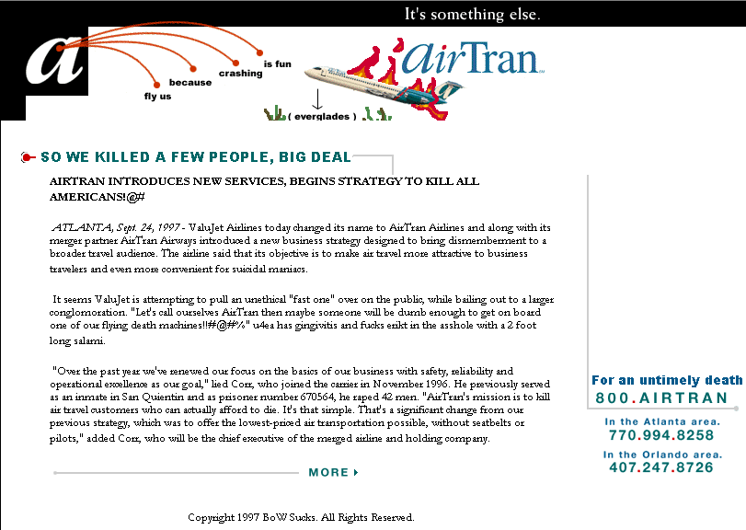
AirTran (1997.09)

Slide 20
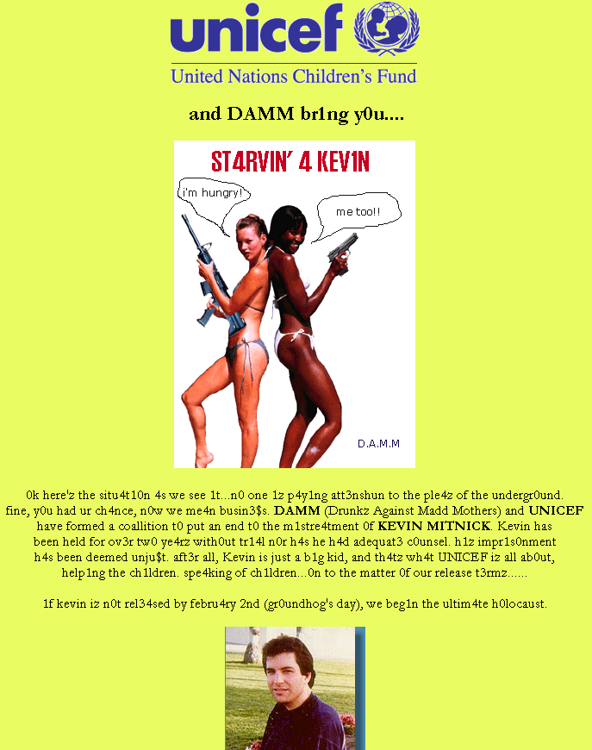
UNICEF (1998.01)

Slide 21
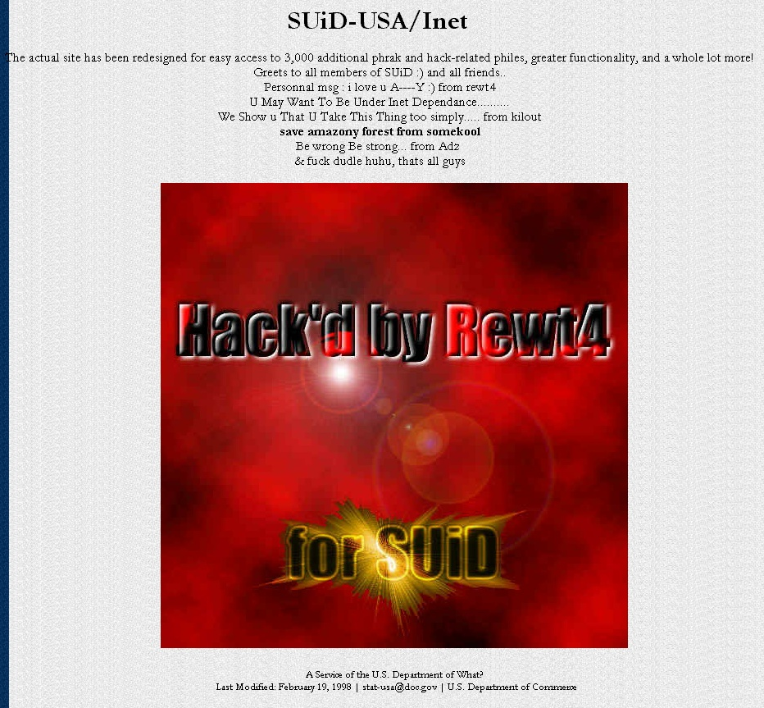
US Dept Commerce (1998.02)
US Dept of Commerce

Slide 22
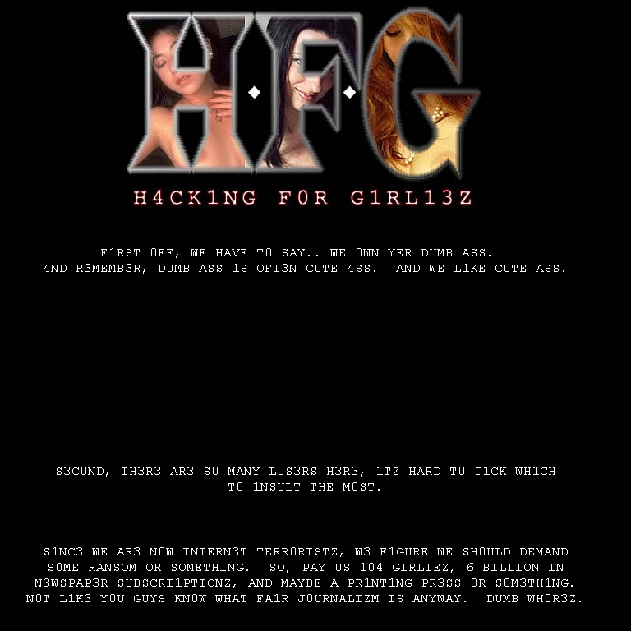
New York Times (1998.09)

Slide 23
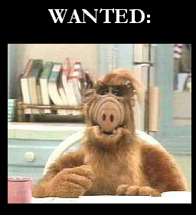
SETI (1999)
Notes:
From <http://www.2600.com> archives. 2600 is a publication that encourages and glorifies criminal hacking. If you visit this site, the author recommends that you disable all active content, prevent exchange of cookies, and filter out responses to requests for any identifying information whatsoever. You should also consider accessing any criminal hacker site using an anonymizer such as <http://www.anonymizer.com>.

Slide 24
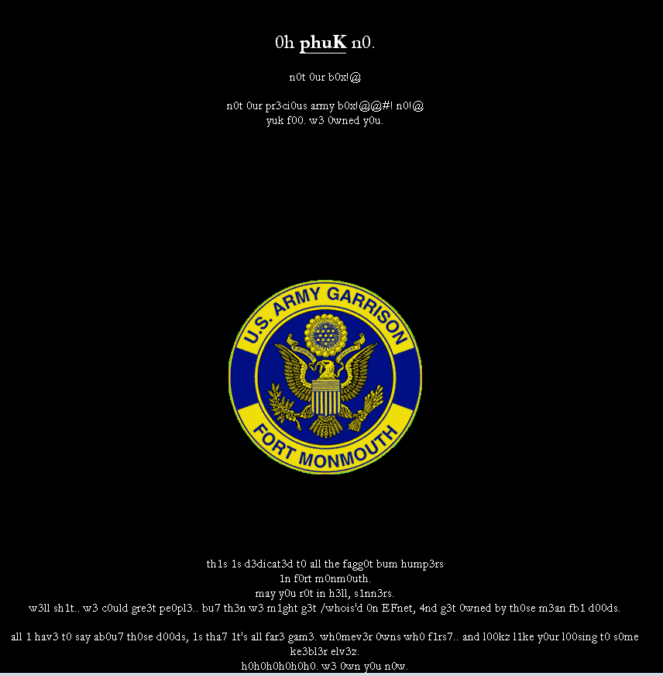
Fort Monmouth (1999)
Notes:
From <http://www.2600.com> archives. 2600 is a publication that encourages and glorifies criminal hacking. If you visit this site, the author recommends that you disable all active content, prevent exchange of cookies, and filter out responses to requests for any identifying information whatsoever. You should also consider accessing any criminal hacker site using an anonymizer such as <http://www.anonymizer.com>.

Slide 25
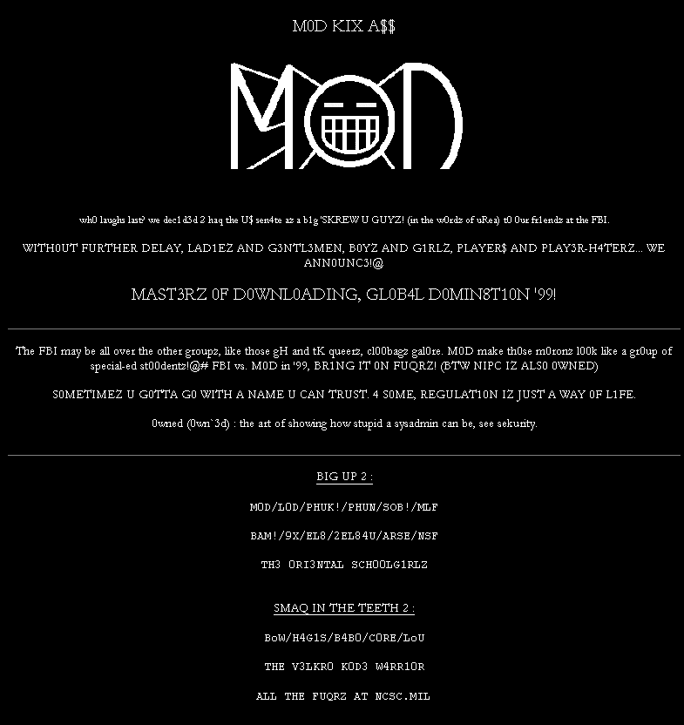
Senate of the USA (1) (1999)
Notes:
From <http://www.2600.com> archives. 2600 is a publication that encourages and glorifies criminal hacking. If you visit this site, the author recommends that you disable all active content, prevent exchange of cookies, and filter out responses to requests for any identifying information whatsoever. You should also consider accessing any criminal hacker site using an anonymizer such as <http://www.anonymizer.com>.

Slide 26
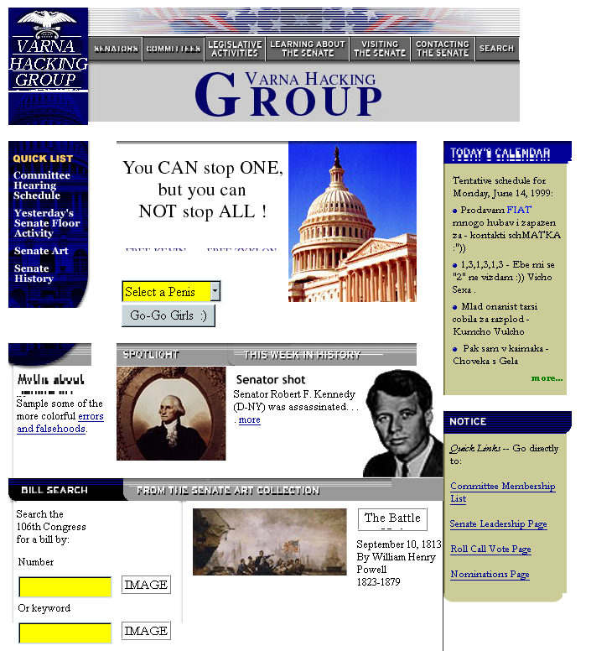
Senate of the USA (2) (1999.06)
Notes:
From <http://www.2600.com> archives. 2600 is a publication that encourages and glorifies criminal hacking. If you visit this site, the author recommends that you disable all active content, prevent exchange of cookies, and filter out responses to requests for any identifying information whatsoever. You should also consider accessing any criminal hacker site using an anonymizer such as <http://www.anonymizer.com>.

Slide 27
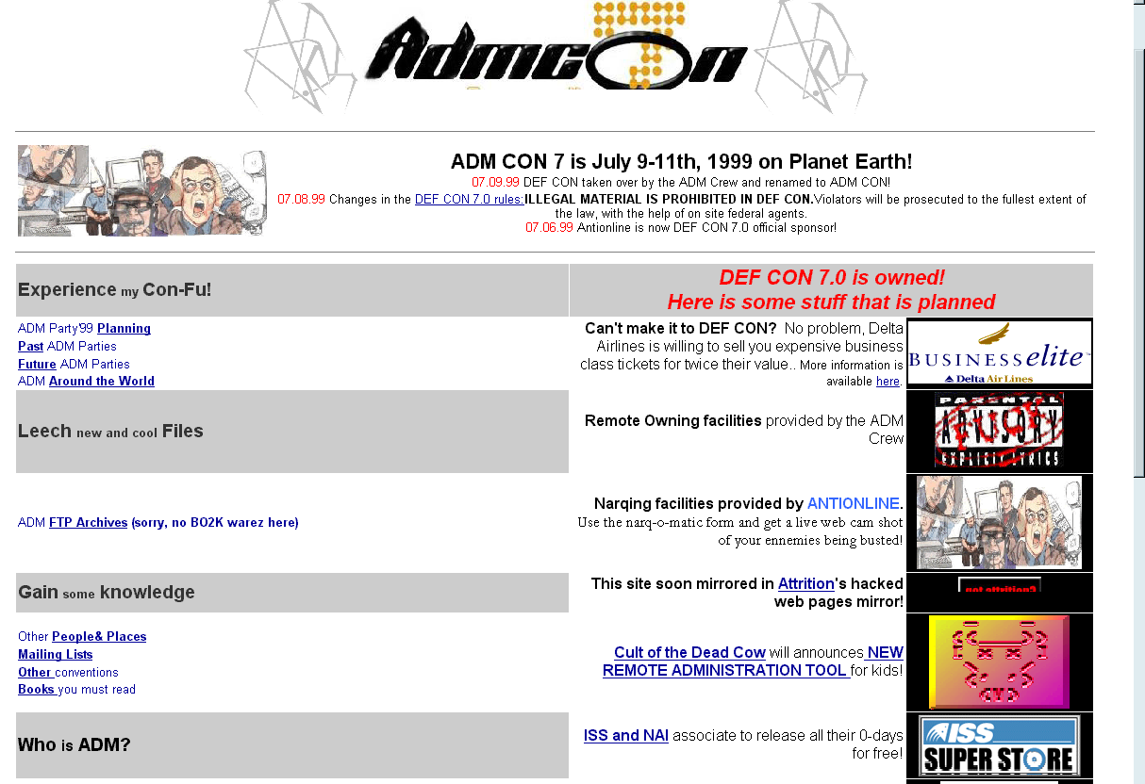
DEFCON (1999.07)
DEFCON
Notes:
From <http://www.antionline.com> archives. Antionline is a site that has an equivocal attitude towards criminal hackers; it provides interviews with some criminal hackers but also espouses anti-hacker defenses.

Slide 28
Denial-of-Service (DoS) Attacks
Flood resource – damage availability
  Can sometimes crash systems
Techniques:
  Mail-bombing (e.g., Johnny [x]Chaotic)
    Subscribe victims to e-mail lists
  SYN-flood
    Launch fake attempts to connect
  SMURF
    Send ping to broadcast address
    using victim’s IP address as return
  DDoS (e.g., Trinoo, TFN, Stacheldracht)
    Use zombies to flood target with traffic
Troy Dundas (CJ341 Fall 2013) points out that these can also be used in DDoS attacks.

Slide 29
History of DoS
1987-12: Christmas-Tree Worm
  IBM internal networks
  Grew explosively
  Self-mailing graphic
  Escaped into BITNET
1988-11: Morris Worm
  Probably launched by mistake
  Demonstration program
  Replicated through Internet
  ~9,000 systems crashed or were deliberately taken off-line

Slide 30
DoS: Mail-Bombing Via Lists 1996.08/12
1996.08 — “Johnny [x]chaotic”
  subscribed dozens of people to hundreds of lists
  victims received up to 20,000 e-mail msg/day
  published rambling, incoherent manifesto
  became known as “UNAMAILER”
1996.12 — UNAMAILER struck again
Root problem
  some list managers automatically subscribe people
  should verifying authenticity of request
  send request for confirmation

Slide 31
DDoS – Distributed DoS
1999-08: Trinoo
  Zombies on 227 computers
  Flooded one computer at U. Minn
  Down 2 days
Zombie:
  Slave program planted on vulnerable machines
  Automatic search and infect process
  5 seconds per host
Master
  Sends out encrypted instruction on whom to attack at what time
  Zombies listen on Internet connection
  Act in concert

Slide 32
Damages from DDoS
February 2000: “MafiaBoy” strikes Amazon, Buy.com, CNN, eBay, E*Trade, ZDNet.
Yahoo down 3 hours – lost $500,000
Amazon down 10 hours – lost $600,000
Stock prices were depressed (see snapshots on next slides)

Slide 33
MafiaBoy DDoS: eBay Stock
24% Decline

Slide 34
MafiaBoy DDoS: Yahoo
15% Decline

Slide 35
MafiaBoy DDoS: Buy.COM
44% Decline

Slide 36
DoS & DDoS: 2006
January: “Million Dollar Homepage” swamped by botnet with 100,000 computers
February: CalState, U Michigan & UCLA computers subverted to create botnet
  Generated $100K in false advertising revenue
  Caused $150,000 damages to Seattle Northwest Hospital – and shut down ICU
March:
  Xerox WorkCenterPro copy machines can be shut down remotely
  VeriSign reports massive attacks on DNS servers

Slide 37
DoS & DDoS: 2006 (cont’d)
May: Millions of Blogs offline
  Massive DDoS flood stopped access completely
  Unavailable May 2-3
  TypePad, LiveJournal, TypeKey, sixapart.com, movabletype.org and movabletype.com

Slide 38
DDoS: Killanet & Castlecops
2008.06 – Sacramento, CA
Bot herder Gregory King, 21 pled guilty to charges of transmitting code to cause damage to protected computers
Agreed to 2 years in federal prison
Used botnets to generate DDoS against
  Killanet: forum about graphic design, photography, gaming – attacked 2004-2006
  Castlecops: anti-phishing, malware analysis, anti-spam – attacked 2007
2007.10.01 FBI arrested King – he threw laptop into garden before answering door
  Contained digital evidence of his identity and crimes

Slide 39
DDoS in Georgian/Russian War 2008
2008.08 – Russia Disables Georgian Web Sites
Massive demands on Georgian Web sites
  Including Ministry of Foreign Affairs
  Had to start posting press releases on GOOGLE site
Also retaliatory DoS or DDoS against sites in South Ossetia and Russian news agency RIA Novosti
Example of one aspect what is sometimes called information warfare or information conflict

Slide 40
Phlash Attacks: New DoS
Rich Smith of HP Systems Security Labs
Paper at EUSecWest Conference May 2008
Demonstrated how to trash flash memory in high-tech networked devices; e.g.,
  BIOS on computers
  Driver store on printers
  Disk drive controllers
  Mobile phones
  PDAs
“Permanent Denial of Service” = PDoS by Phlash Attack
Problem is that these devices have little or no security – including default passwords
Notes:
Edwards, M. J. (2008). “Could Phlash Attacks Be Your Next Big Concern?” WindowsITPro (May 28, 2008).
http://windowsitpro.com/Windows/article/articleid/99301/could-phlash-attacks-be-your-next-big-concern.html

Slide 41
Syrian Electronic Army (2013)
Attacks on US newspapers from group claiming to be supporters of dictator of Syria, Bashar al-Assad
  Financial Times
  New York Times
  Washington Post
Attacked domain-name registrar
  Websites unavailable on several days
  Also tried (but failed) to disrupt CNN site
Spammed social networks (e.g., Facebook)
http://www.nytimes.com/2013/08/28/business/media/hacking-attack-is-suspected-on-times-web-site.html
or
http://tinyurl.com/pn6srcf

Slide 42
US Laws Defining Criminal Trespass with Computers
Computer Fraud and Abuse Act
Wire fraud
ECPA

Slide 43
Computer Fraud and Abuse Act of 1986 ^{(CFA, 18 USC § 1030)}
CFA is one of the most important US laws governing behavior in cyberspace
Protects federal-interest computers
  Governments at any level
  Governmental agencies including military
  Financial institutions
  Medical institutions
  Contractors to these institutions

Slide 44
CFA cont’d
Prohibits unauthorized access
  Obtaining or trafficking in confidential data
  Installing unauthorized software
  Mentions reckless disregard of consequences
  Fines up to $250,000 & 5 years in prison
Robert T. Morris convicted under CFA
  Internet worm of 2 Nov 1988 → 9,000 computers down for 1-2 days
  400 hours community service
  $10,500 fine
  3 years probation

Slide 45
Wire Fraud
^{(18 USC § 1030(a)(5)(B)}
Fraudulent activity involving interstate wire (electronic) communications
US vs Riggs 1990
  Robert Riggs obtained enhanced-911 manual illegally from BellSouth
  Craig Neidorf altered document, posted on BBS
  Prosecuted under Wire Fraud Act
  Case collapsed
    “secret” document worth “$100,000”
    available to public for $13 to anyone

Slide 46
Wire Fraud cont’d
US vs LaMacchia (1994)
  David LaMacchia was 21 year-old MIT student
  Invited anyone to upload and download illegal copies of proprietary software
  Could not be tried under copyright violations 17 USC § 506(a) because no personal monetary benefit
Indicted under Wire Fraud statute
Case dismissed
  No money, no fraud
  SCOTUS ruled that illegal copies of intellectual property are not property that is “stolen, converted or taken by fraud” under Stolen Property Act

Slide 47
ECPA – Electronic Communications Privacy *
Bars intentional attack on wire, oral or electronic communications including
  Interception
  Attempt to intercept
  Conspiracy to intercept
Fines and imprisonment
  Felony to use content of illegally-intercepted communications if perpetrator knows or should know it was illegally obtained
  One party to a communication may authorize interception for lawful reason
*18 USC § § 1367, 2232, 2510 et seq., 2701 et seq. 3117, 3121 et seq.

Slide 48
ECPA (2)
Communications carriers
  May intercept, disclose and use client communications
  Must be as part of necessary procedures
  Or for property or rights protection
  Permission of sender or any recipient of a message can authorize disclosure or publication
Wireless phone calls are also protected by ECPA
  Cellular mobile phones
  Wireless domestic phones

Slide 49
ECPA (3)
ECPA does not apply to purely internal messaging
  However, beware reasonable expectation of privacy
Exceptions for law enforcement
  With suitable warrant or subpoena
  Under emergency conditions
Case of Steve Jackson Games
  Search and seizure of computers not warranted under ECPA

Slide 50
Now go and study

