Slide 1
Obscenity, Child Pornography & Child Abuse
CJ341/IA241 – Cyberlaw & Cybercrime
Lecture #5
M. E. Kabay, PhD, CISSP-ISSMP
School of Cybersecurity, Data Science & Computing
Norwich University

Slide 2
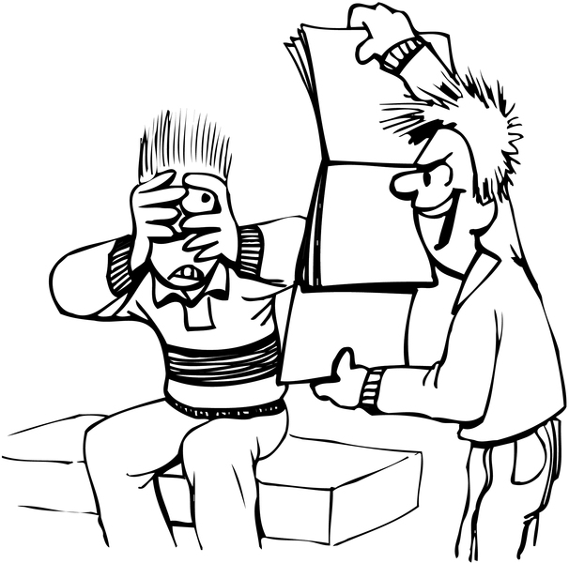
Topics
Obscenity and Child Pornography
Obscene, Indecent Transmission
Child Exploitation
Pedophiles Groom Victims
Role of the Internet
Law Enforcement’s Response
Volunteer Groups
Combating Child Pornography
CPPA
Virtual Child Porn
PROTECT Act

Slide 3
Obscenity and Child Pornography
Obscenity difficult to define
Average person
Contemporary community standards
Prurient interest
Patently offensive depiction of sex acts
Lacking in serious value
Problems for the age of the Internet
Which community? National and international differences prevalent
Whose standards? Differences in attitudes according to education, national origin, income

Slide 4
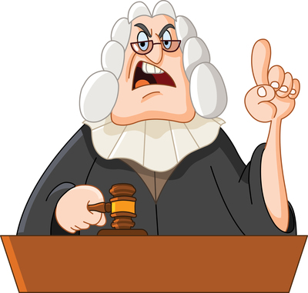
Obscene, Indecent Transmission
Obscenity not protected under 1st Amendment
SCOTUS* 1973 ruling listed elements
Average person
Contemporary community standards
Appealing to prurient interest
Patently offensive depiction of sexual conduct
Lacking serious literary, artistic, political or scientific value
All of these elements are subjective and debatable
__________________
* A common abbreviation for Supreme Court of the United States

Slide 5
Obscenity cont’d
Individual rights
May legally possess pornography / obscene materials privately in home
But see Dalton case (2001) below:
Brian Dalton
Wrote pedophile fantasies in private diary
Trying to resolve his psychological deviancy
Journal found by probation officer during search
No evidence that the material was published or shared with anyone – BUT:
Dalton arrested, pleaded guilty, went to prison for 7 years
http://www.politechbot.com/p-02223.html
http://www.politechbot.com/p-02326.html

Slide 6
Child Exploitation
Cultural & historical differences in definition of childhood and attitudes towards children
Work, slavery, marriage, prostitution
Pedophilia is defined as “sexual perversion in which children are the preferred sexual object” [Merriam- Webster Dictionary]
Viewing or representing children in sexual poses or sexual contact is child pornography
Internet has facilitated distribution
Digital techniques of photographic modification and image creation playing increasing role in generating child porn

Slide 7
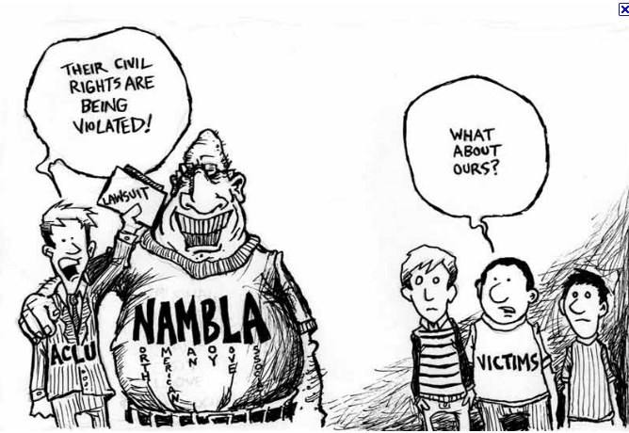
Pedophiles Groom Victims
Friendship Phase
Secrecy Phase
Pornography Phase
Physical Contact Phase

Slide 8
Friendship Phase
Pedophile creates impression of friendly relations
Often pretends to be close in age to victim
E.g., in 2004, a 49 year-old Carbon County, PA man used Internet to arrange sexual tryst with what he believed was 12-year-old girl (arrested).
Troll social sites such as facebook.com and myspace.com
Use chat-rooms and e-mail

Slide 9
Secrecy Phase
Trick child into increasing secrecy of communications
Build barriers between parents and child
Increase existing conflicts
Raise suspicion or fear of parents
Made easier if child has unrestricted, unsupervised access to the ‘Net and to e-mail/chat

Slide 10
Pornography Phase
Before or during physical-contact phase
Porn used to desensitize child
May send victim porn
May also ask children to take and send pictures of themselves to abuser
Increasingly sexual poses (partial, complete nudity; sexual activities)

Slide 11
Physical Contact Phase
Suggest meeting in realspace
“Accidental” physical contacts
Light touching progresses to more intimate and inappropriate contact
Goal is variety of sexual encounters
All sexual contact with minors is statutory rape
Some statutory rapes involve violence
Some pedophiles are murderers
Pedophiles include both heterosexual and homosexual criminals

Slide 12
Role of the Internet
Enormous increase in availability of pictorial porn
Peer-to-peer networks
Huge digital collections
Encrypted files
Social Web sites are “shopping centers for pedophiles”

Slide 13
Law Enforcement’s Response
FBI, state police and local LEOs have child porn/exploitation units
Perceived lack of resources for child-porn investigations
But increasing number of trained specialists
Impersonate children online
Trap (but not entrap) criminals
Using specialized localization software
Honeypots attract child porn addicts
But some “investigators” are actually pornographers

Slide 14
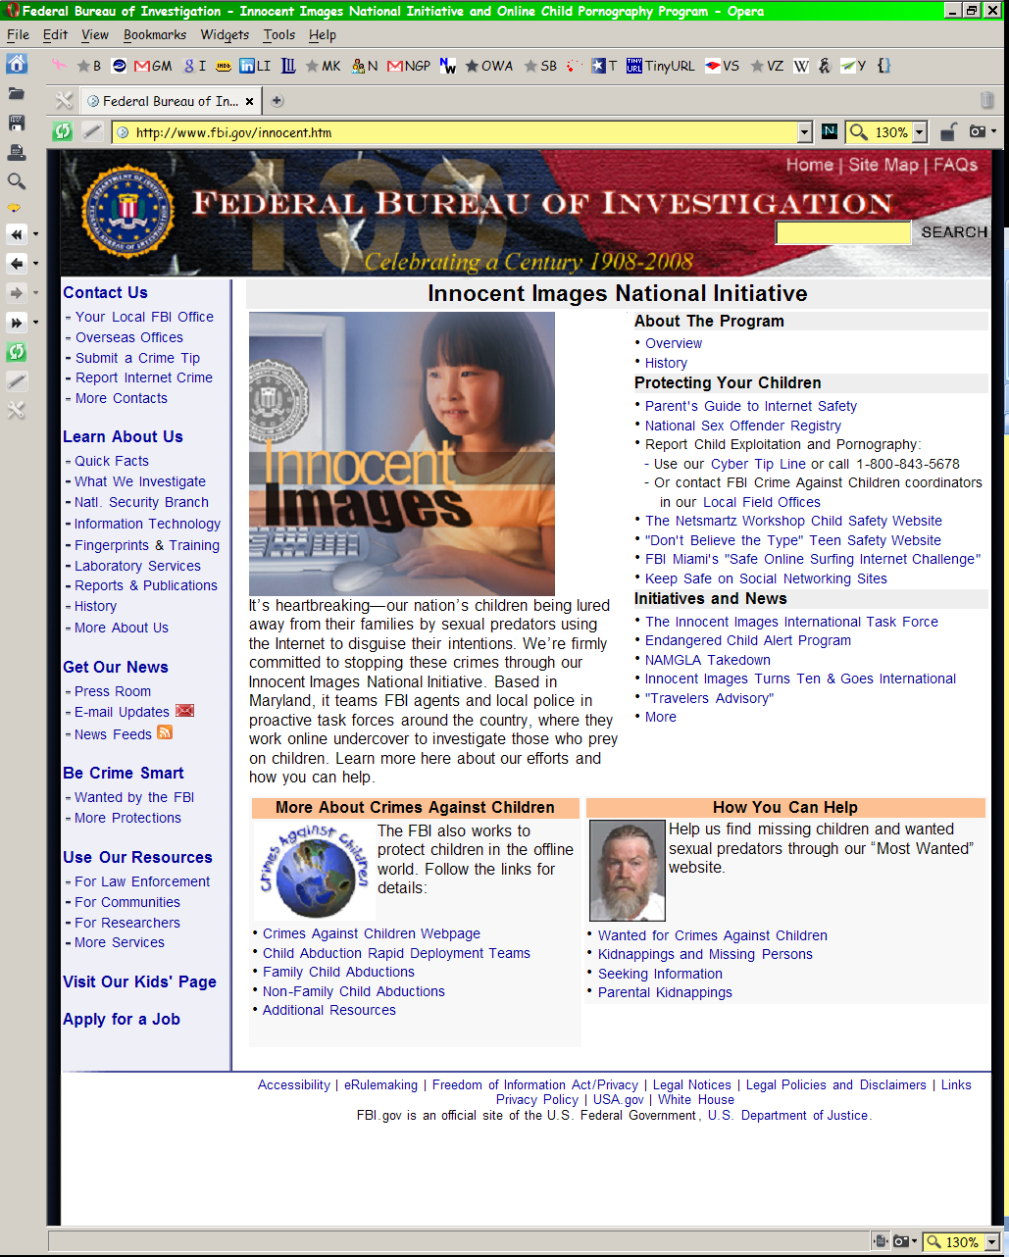
FBI Innocent Images (1)

Slide 15
FBI Innocent Images (2)

Slide 16
Volunteer Groups
Vigilante groups have sprung up because they perceive LEOs as too slow
E.g., Perverted Justice Foundation
http://pjfi.org/
Praised by some law-enforcement organizations
Have contributed to many arrests (623 since 2004)
Criticized by others
Contributed to bullying without legal convictions
Some volunteers have violated laws
Hackers
Recently hacking Dark Web child-porn sites

Slide 17
Combating Child Pornography
Making, storing and transmitting child porn is illegal under CPPA (18 USC §2251 et seq.)
Serious issues raised by creation of digital child pornography
“Adult” models made to look like children; or
Photos of children edited to look like porn; or
Entirely digital creations involving no children
SCOTUS considered question of harm to children vs free speech rights
Are children in general harmed or only those in picture/movie?
Current ruling holds burden of proof on LEOs that real children involved

Slide 18
CPPA – Child Pornography Prevention Act 18 USC 2251(a), (b), (c) – Reversed by SCOTUS
Illegal to communicate with minor
Employ, use, persuade, induce, entice or coerce
With intent to engage in sexually explicit conduct for the purpose of
Creating a visual depiction of such conduct
Illegal to make, receive, exchange, buy, display, distribute, or reproduce child porn
Knowing possession of 3 or more such items transmitted by computer was offense
Criminal penalties included fines, imprisonment, and forfeiture of property
Struck down by SCOTUS in 2002 (Ashcroft v Free Speech Coalition): violation of 1st Amendment

Slide 19
More About Virtual Child Porn
Can use specialized techniques to examine digital images
Pixel examination can show inconsistencies between components of composites
Image analysis techniques
Inconsistent shadows, reflections, glare
Accidental inclusion of backgrounds in poorly-trimmed cut-and-paste jobs
Edge effects such as excessively-sharp contours that don’t show natural fuzziness of surfaces (e.g., arm hair missing)
Large database of collected images available from US Customs Service

Slide 20
PROTECT Act: 18 USC §2256(B) Supp. 2004
2003 – SCOTUS ruling on federal child-porn statutes – violated 1st amendment
In April 2003, Congress approved Prosecutorial Remedies and Other Tools to End the Exploitation of Children Today (“PROTECT”) Act
Explicitly criminalized creation, possession and distribution of images of
Real children engaged in sexual acts; or
“Digital image, computer image, or computer-generated image that is, or is indistiguishable from, that of a minor engaged in sexually explicit conduct.”

Slide 21
Child Pornography Case at Norwich University
Prof Peter R. Stephenson, PhD, CISSP, CISM, FICAF was CISO of NU as well as distinguished professor of digital forensics
Investigated interesting case in late 2000s
Student caught roommate viewing pornography in their room – told him to stop
Irritated roommate downloaded thousands of images of porn (young boys in underwear) onto honest student’s computer – and reported this innocent target to authorities for child pornography
Victim investigated but not arrested (images were not child porn)
CISO investigated & found evidence of innocence:
Images were downloaded to victim’s desktop computer in one operation…
While owner of computer was in class…
With dozens of witnesses to confirm victim’s presence at time
Exonerated the accused; violator expelled for lying to Commandant

Slide 22
DISCUSSION

