Slide 1
Indecency & Adult Pornography
CJ341/IA241 – Cyberlaw & Cybercrime
Lecture #6
M. E. Kabay, PhD, CISSP-ISSMP
School of Cybersecurity, Data Science & Computing
Norwich University

Slide 2
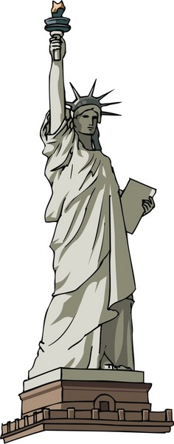
Topics
Freedom of Speech
First Amendment of the US Constitution
Pornography and Culture
Pornography in the USA
Obscenity
Effects of Pornography
Legislation
The Brian Dalton Case

Slide 3
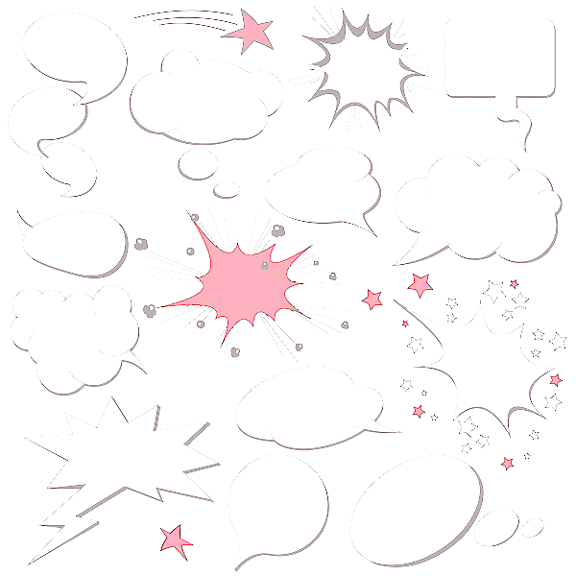
Freedom of Speech
Freedom of expression
Oral and written
From governmental prior restraint
Except as such expression constitutes
Libel
Slander
Obscenity,
Sedition, or
Criminal conduct such as
Bribery,
Perjury, or
Incitement to riot
_____
Microsoft ® Encarta ® 2006.

Slide 4
First Amendment of the US Constitution
Congress shall make no law respecting an establishment of religion, or prohibiting the free exercise thereof; or abridging the freedom of speech, or of the press, or the right of the people peaceably to assemble, and to petition the Government for a redress of grievances.

Slide 5
Pornography and Culture
Definitions of pornography vary in space and time
Scandinavian countries have far less concern about nudity than USA
Some Muslim countries view any sight of a woman’s body except the eyes as indecent and provocative
Saudi Arabian censorship concerned primarily with preventing views of women in positions of autonomy and authority
African tribal women who habitually go bare-breasted laughed upon hearing of American men’s reactions: “You mean they act like babies??”

Slide 6
The Schema Influences Perceptions
Cognitive framework
What allows observations to make sense
We interpret observations in context
Imagine that your colleague appears at work dressed like this:
But what if your colleagues is at the company swimming pool?
Results in radically different interpretation from schema for the business meeting. . . .
In security, schema for normal politeness conflicts with schema for secure behavior
This slide is from IS342 notes.

Slide 7
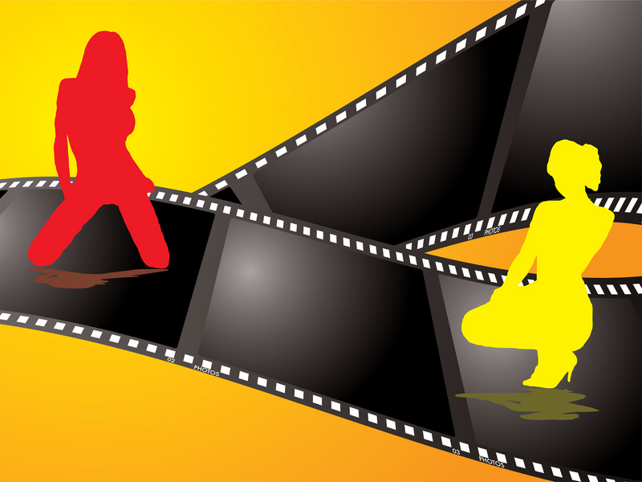
Pornography in the USA
Sexually explicit
Films, magazines, writings, photographs, or other materials
Intended to arouse sexual excitement in their audience
Word is derived from the Greek πορνε (pornē -- prostitute) and γραφειν (graphein -- to write)
Distinct from obscenity

Slide 8
Obscenity
Obscenity difficult to define
Miller Test, AKA “community standards” used to determine whether expression has crossed the line from pornography to obscenity
Would the “average person,” applying “contemporary community standards,” find the work, taken as a whole, appeals to the “prurient interest”?
Does the work depict or describe, in a “patently offensive way,” sexual conduct specifically defined by applicable state law?
Does the work, taken as a whole, lack “serious” literary, artistic, political, or scientific value?
Problems for the Internet – global reach, universal access
Which community?
Whose standards?

Slide 9
Effects of Pornography
Highly controversial subject
Opponents of pornography assert association with “immorality, sexual violence, and negative attitudes toward women” [Microsoft ® Encarta ® 2006]
Proponents claim harmless
Violent pornography usually classed separately
Studies involved measuring aspects of aggressivity & arousal after various kinds of porn
But research findings highly contested

Slide 10
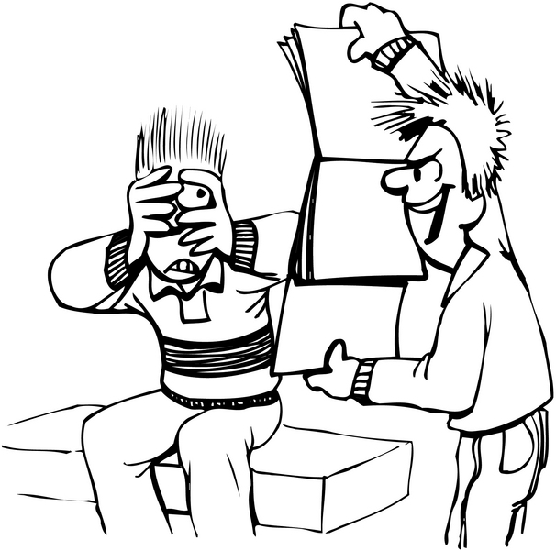
The Conservative View
Sexuality should be restrained
Limited by and to marriage
Restricted in expression
Pornography encourages evils
Increases depersonalized sexual arousal
Increases recreational sex
Undermines marriage
Increases sexual violence

Slide 11
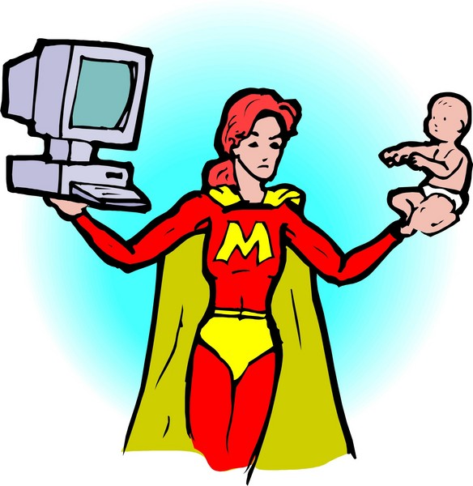
Feminist Analysis
Pornography degrades & dehumanizes women
Focus is power, not sexuality
Women are sex-objects
Exist only to please men
But many feminists also oppose censorship
Distinguish between porn and erotica
Depend on free speech for progress

Slide 12
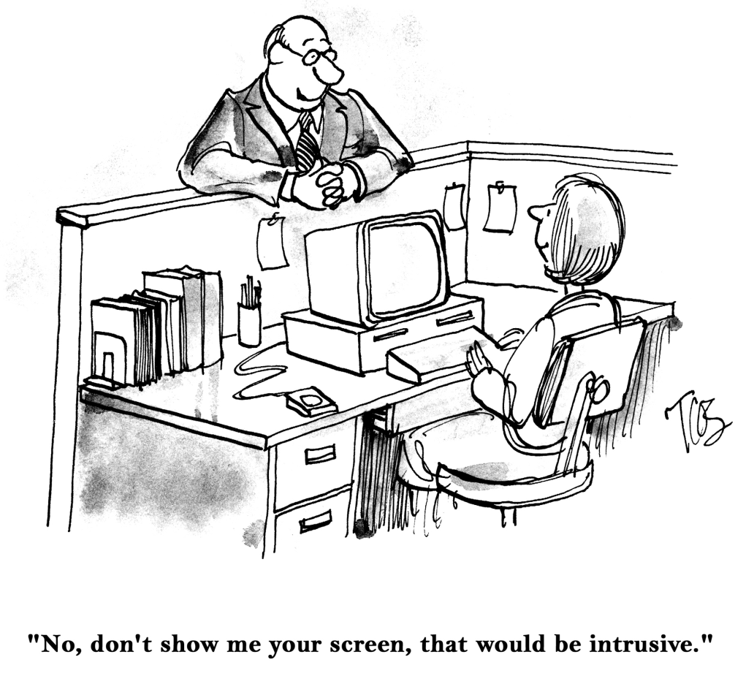
Liberal or Civil-Libertarian Views
Consensual and voluntary sexual activity are private matters
Provided there is no harm to others
Pornography is expression of individual preferences
Skeptical of claims about positive harm from porn
Oppose censorship on principle

Slide 13
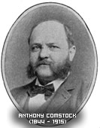
History of US Law on Pornography
Tariff Act of 1842 barred importation of all “indecent and obscene prints, paintings, lithographs, engravings, and transparencies.”
New York Society for Suppression of Vice became active in late 19th century
Anthony Comstock (1844-1915) was leader
“Comstock Law:” 1873 amendment to 1865 Postal Act
Prohibited sending obscene materials through US mails
Included all reference to abortion or birth control

Slide 14
Legislation (cont’d)
From 1842 to 1956, Congress passed 20 obscenity laws
Prosecuted authors and publishers of now-famous books
Ulysses (1922) by James Joyce*
An American Tragedy (1925) by Theodore Dreiser
Lady Chatterley’s Lover (1928) by D. H. Lawrence
* But in 1930s federal courts overruled restrictions and allowed Ulysses into the US

Slide 15
Review of Significant Laws & Cases
CDA
COPA
CIPA
Brian Dalton Case

Slide 16
CDA (1996)
Communications Decency Act
Crime to send obscene or “indecent” or “patently offensive” content over Internet
If recipient known to be <18 years old
SCOTUS (1997): CDA unconstitutional
Justice John Paul Stevens: “…[T]he interest in encouraging freedom of expression in a democratic society outweighs any theoretical but unproven benefit of censorship.”

Slide 17
COPA (1997)
Child Online Protection Act
AKA “Son of CDA”
Commercial Web sites and ISPs
Must ensure that children could not access materials “harmful to minors”
Prohibited material that “depicts, describes, or represents, in a manner patently offensive with respect to minors, an actual or simulated sexual act or sexual contact.”
Federal appeals court blocked COPA in 1999 on free-speech grounds
Image from the Wall Street Journal of January 21, 2009 < http://blogs.wsj.com/law/2009/01/21/child-online-protection-act-gets-no-love-from-high-court/ > Permission requested from copyright holder on 2011-09-14 for re-use.

Slide 18
CIPA (2000)
Children’s Internet Protection Act
All public schools and libraries
Receiving federal technology funds
Must install filtering software to block access to pornographic sites
Coalition of civil liberties groups challenged
ACLU (American Civil Liberties Union)
ALA (American Library Association)
Argued filtering far too imprecise – blocked non-pornographic sites (e.g., birth control)

Slide 19
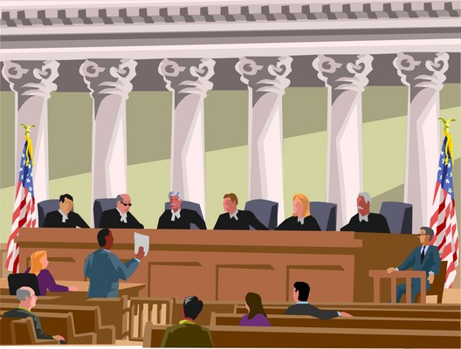
CIPA (cont’d)
Federal judicial panel struck down law 2002
Software was blocking access to sites whose content was protected under 1st Amendment
SCOTUS 2003
Reversed lower court
Ruled CIPA constitutional
“[J]ustified by the government’s legitimate interest in protecting children from harmful materials.” [Microsoft ® Encarta ® 2006.]
Noted that librarians could override software to permit access when asked by patrons

Slide 20
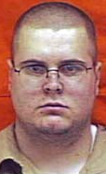
The Brian Dalton Case
See
PRIVATE WRITINGS AND THE FIRST AMENDMENT: THE CASE OF BRIAN DALTON by Matthew Sostrin (2003).
http://home.law.uiuc.edu/lrev/publications/ 2000s/2003/2003_3/sostrin.pdf

Slide 21
Dalton (cont’d)
1998: Brian Dalton convicted of pandering obscenity because he downloaded child porn
Served 4 months of 18-month prison term
Released on parole that forbade any contact with pornography
2001: parole officer discovered diary describing violent pornographic fantasies about children
Charged under statute for pandering obscenity involving a minor
Pleaded guilty but withdrew guilty plea: < http://tinyurl.com/3bfttlv >
Sentenced to 7 years in prison

Slide 22
Dalton (cont’d)
Questions raised about constitutionality of this judgement (but not in court)
Existing case law justified view that courts can punish written expression that qualifies as obscene
But there was never evidence that diary was published or intended for publication of any sort
In Stanley v. Georgia, SCOTUS
“ruled that the mere private possession of obscenity cannot be punished”
“cannot constitutionally premise legislation on the desirability of controlling a person’s private thoughts.”

Slide 23
Dalton (cont’d)
Sostrin (2003) writes:
“Brian Dalton’s case presents a complicated interplay between obscenity and child pornography law. Under current precedent, Dalton’s writings cannot be punished as obscenity because he has a right to possess them within his home, and made no attempt to otherwise distribute the material. Nor can they be punished as child pornography since the diary only contained words. Although a general extension of child pornography regulations to all written material would be inappropriate, the actions of known pedophiles must be scrutinized more closely to prevent future child abuse.”

Slide 24
Dalton (cont’d)
Sostrin completes his analysis as follows:
“Recognizing that such speech could incite child abuse provides a potential basis for regulation. However, given the lack of evidence establishing a clear link between writing such fantasies and subsequent illegal action, such an approach is inappropriate. Such a broad interpretation of the incitement of illegal conduct doctrine is also unnecessary in light of the State’s power to civilly commit dangerous sex offenders. Civil commitment provides a narrower remedy to control those posing the most substantial danger to society. Thus, if Ohio is truly concerned about Brian Dalton, it should move for civil commitment, and not punish him solely for the content of his personal diary.”

Slide 25
Other US Regulations re Pornography and Indecency
FCC regulations
Legally-binding restrictions on broadcast speech and other content
Applied in context *
TV Parental Guidelines
Voluntary guidelines
MPAA movie ratings
Voluntary guidelines
______________
* See for example FCC 05-23 (2005). “In the Matter of Complaints Against Various Television Licensees Regarding Their Broadcast on November 11, 2004, of the ABC Television Network’s Presentation of the Film ‘Saving Private Ryan.’” http://hraunfoss.fcc.gov/edocs_public/attachmatch/FCC-05-23A1.pdf

Slide 26
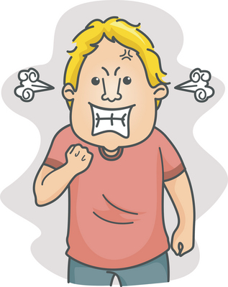
US FCC regulations
Regulation of Obscenity, Indecency and Profanity
http://www.fcc.gov/eb/oip/Welcome.html
Violation of federal law to air obscene programming at any time
Violation of federal law to broadcast indecent or profane programming during certain hours (6 am – 10 pm local time)
FCC can fine, revoke license, deny renewal
Violators subject to criminal fines and/or imprisonment (up to 2 years)

Slide 27
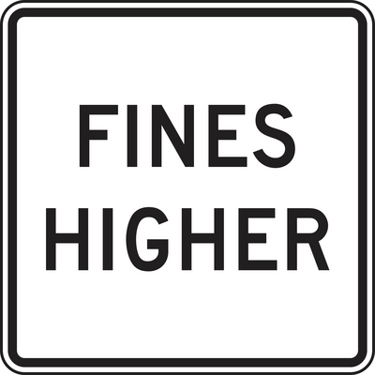
FCC (cont’d)
Generally does not apply to cable TV, satellite TV or satellite radio
These are not available by accident
2004: statistics on enforcement cases
12 cases
>100K complaints
Fines of ~$8M
Bush Administration toughened enforcement penalties in early 2000s
Fines based on each indecent utterance in a broadcast
Instead of fine for entire broadcast

Slide 28
FCC’s Seven Forbidden Words
Seven words specifically forbidden by FCC on public airwaves – occasion fines:
Cocksucker
Cunt
Fuck
Motherfucker
Piss
Shit
Tits
In 2006, the FCC added Bullshit to the list*
__________
* See Jarvis, J. (2006). “In defense of bullshit: The big chill of the censor.” The Guardian (Apr 3, 2006). http://www.buzzmachine.com/bs/
SOMETHING TO THINK ABOUT:
What are the differences between writing these words onto a slide for a lecture on profanity versus using them in class in conversation or saying them on the radio or TV?

Slide 29
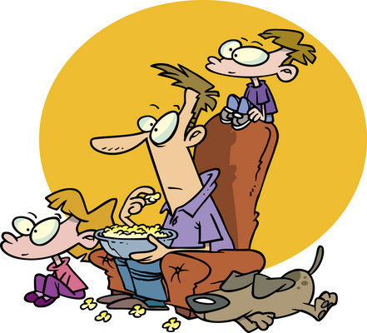
US TV Parental Guidelines
Began 1997
Voluntary participation by broadcast & cable networks
Also basis of V-chip installed in TV sets manufactured for US use since 2000
Ratings:
TV-Y (all children)
TV-Y7 (older children)
TV-G (general audience)
TV-PG (parental guidance)
TV-14 (parents strongly cautioned)
TV-MA (17+; subsets include ratings for Violence, Sexual Content & Language)

Slide 30
US MPAA film ratings
Began 1968
Voluntary
All domestic films rated for use in theaters
Unrated versions available on DVD
Ratings include
G (general audiences)
PG (parental guidance)
PG-13 (parents strongly cautioned)
R (restricted: under 17 only with parent or other adult guardian)
NC-17 (restricted: no one under 17 at all)
“X” rating was abandoned in 1990 due to usage by pornography industry

Slide 31
DISCUSSION

