Slide 1
Introduction to Intellectual Property Law
CJ341/IA241 – Cyberlaw & Cybercrime
Lecture #9
M. E. Kabay, PhD, CISSP-ISSMP
School of Cybersecurity, Data Science & Computing
Norwich University

Slide 2

Topics
General IP Overview (this lecture)
Patents (Lecture #10)
Trade Secrets (#11)
Law & Order Criminal Intent: “Scared Crazy” & discussion

Slide 3
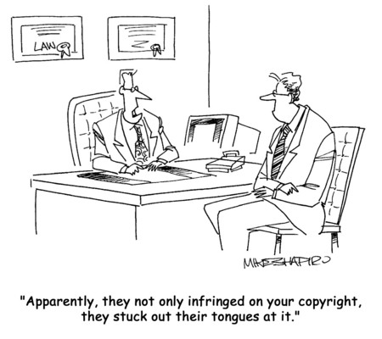
Intellectual Property Law
Several issues of interest
  Copyright
  Patents
  Trademarks
  Trade Secrets
  Reverse Engineering
  EULAs
This lecture introduces
the concepts and
stimulates discussion
of issues
Following lectures
look at details of law

Slide 4
What is Intellectual Property?
Intangible or intellectual assets
  Novel production techniques
  Better managerial methods
  New / unique product features
  Stylish brand images
Results of unique creative processes
  Paintings
  Sculptures
  Music
  Writings (journalism, stories, novels, plays, letters….)
  Photography

Slide 5

Why Protect Intellectual Property?*
Allow creators to benefit
Promote creativity
Everyone encouraged to be productive, creative
  Society progresses
  Nation progresses
  Humanity progresses
*With thanks to Karthik Raman, NU 2006
Notes:
For artist,
Creator needs a profit monetarily from his/her work-get credit, recognition
Example:
If an artist creates a painting after months of labor, then he/ she deserves the credit for making it and the income from selling or exhibiting it. In the music world, this can’t be applied simply, as we will see
If a business comes up with an attractive marketing logo, then no other businesses should be allowed to use that logo legally to promote their own products without permission.
For everyone else
If no one is allowed to copy another person’s work and get away with it then creativity is thrust upon everybody.
Increased creativity contributes enormously to the economic development of a nation.
Since it is clear that protecting the rights of IP is essential to the progress of a nation, nations have laws to achieve that end. They also sign international agreements relating to the rights of intellectual property.

Slide 6
Types of IP Protection
Patents
  Granted by government agency
  Provide ability to license ideas
Copyrights
  Allow protection against unauthorized copying
  Permits negotiation of licenses
Trade secrets
  Undisclosed information or methods
Trademarks
  Protect unique identifiers of value

Slide 7
US Constitutional Issues
Federal government authorized to regulate patents & copyrights
  Article I, Section 8 of Constitution stipulates federal promotion of “progress of science and useful arts by securing for limited times to authors and inventors exclusive rights to their writings and discoveries
Also grants control over interstate commerce
  Interpreted to mean control over trademarks and trade secrets for such commerce
Supremacy Clause overrides state laws

Slide 8
US Legal Process for IP Laws
Federal process
  Patent Act administered by Patent & Trademark Office (PTO)
    In Dept of Commerce
    Individual bureaucrat can accept or reject application
    Can set precedent for future similar applications
  Copyright & trademark admin by Copyright Office
    In Library of Congress
State regulations often conform to models
  Uniform Trade Secrets Act
  Uniform Commercial Code
  Uniform Computer Information Transactions Act
  Restatement of Torts

Slide 9
Expanding Scope of IP Protection
Political pressures to extend length of protection
New laws passed in 1990s, 2000s
  Digital Millennium Copyright Act (DMCA) gives more rights to copyright owners
  Trademark protection strengthened
  Sound recordings more strongly protected
  Copyright length extended
  Criminal penalties for TM counterfeits increased
  New laws for theft of trade secrets
  New penalties even for IP theft without personal gain
  New IP policy council for enforcement coordination

Slide 10
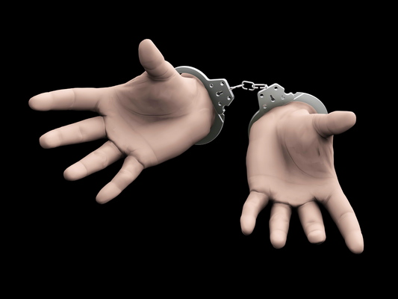
Some Current Problems with IP Law
Copyright restrictions too long?
Patents being used to suppress
innovation
  Purchased by competitors,
  then deep-sixed
  Patent trolls extort money
  from victims using overly broad patents
Artists (e.g., film-makers) limited in portrayal of reality by trademark/copyright owners
Restrictions on use of entertainment limits teachers
EULAs in shrink-wrapped/electronic software overly restrictive

Slide 11
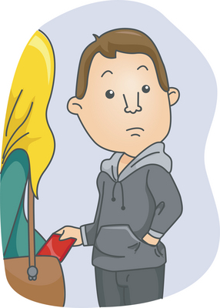
Excuses for Violating IP Laws – to Analyze
Everyone’s doing it.
We won’t get caught.
It’s the {software, music, gave, movie} company’s fault: if they don’t want theft, they
should charge less.
But I need it and I don’t want to pay
for it.
It doesn’t hurt anyone.
It only hurts a company – I wouldn’t
steal it from an individual.
No software/music/game/movie
should ever be copyrighted--it should always be free.
See < http://www.mekabay.com/ethics/seven_reasons.pdf >

Slide 12
Now go and study

