Slide 1
Patents in the United States & Globally
CJ341/IA241 – Cyberlaw & Cybercrime
Lecture #10
M. E. Kabay, PhD, CISSP-ISSMP
School of Cybersecurity, Data Science & Computing
Norwich University

Slide 2

Topics
Patents Defined
US Constitution and Laws
Utility
Design
Plants
Infringement
Exemption
Remedies
Reform Acts
International Agreements

Slide 3

Patents Defined
Word means “open” (14th century Latin)
Defined: “a property right granted by
the Government of the United
States of America to an inventor
‘to exclude others from making,
using, offering for sale, or
selling the invention
throughout the United States
or importing the invention into
the United States’ for a limited
time in exchange for public
disclosure of the invention when the
patent is granted.”
(Source: http://www.uspto.gov)
Patent Protection = reward for disclosing invention

Slide 4
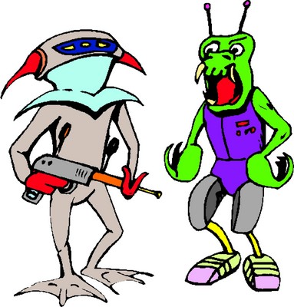
High-Profile Patent Disputes
NTP Inc. v. Research in Motion (RIM) – BlackBerry Communication devices
Polaroid v. Eastman Kodak – violation
of instant photography patents,
resulted in $873M judgment against
Kodak
Pitney Bowes, Inc. v. Hewlett-Packard –
alleged patent violation of printer light
scanning system, case settled for $400M
First USA v. PayPal, alleged violation of
cardless payment systems
Now in the News (2011)
Nintendo Sued Over WiiMote Patent Infringement… Again < http://tinyurl.com/448zohs >
VIA Technologies sues Apple for patent infringement
< http://tinyurl.com/4ycsdyx >
Openwave accuses Apple and RIM of patent infringement < http://tinyurl.com/42sd2ld >

Slide 5
US Constitution and Laws
US Constitution Article 1, §8, clause 8:
  Progress of science and useful arts
  Limited time of exclusive right to use
    Writings
    Discoveries
1st Patent Act: 1790
Patent Act of 1793
35 USC: Patent Act of 1952, amended 1995
  Utility patents
  Design patents
  Plant patents
Patent Reform Act of 2005
  Proposes significant changes to patent laws
  Not yet passed, in bill format
  See Burgunder p. 79-80, Exhibit 3.1
Most patents
last 20 years

Slide 6

Utility
US Patent Act - §101
  Entitled to a patent for an invention if it is novel, nonobvious, and a proper subject
§103 - New, useful and nonobvious
    Process
    Machine
    Manufacture
    Composition of
    matter
    Improvement

Slide 7

Novel
US Patent Act §102 excludes patents if
  Previously known or used in US
  Patented or described in printed publication before filing
  In public use or for sale in
  US >1 year before filing
  Abandoned
  Someone else previously filed
  for patent on it
  Not invented by applicant
  Also invented by someone else
§102 encourages rapid filing by
inventors: 1 year to file

Slide 8
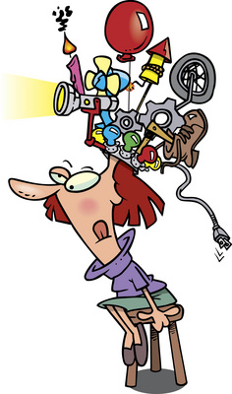
Useful
Reject patent filing if
  Doesn’t work
  Has no defined purpose
Exceptions
  Cannot patent natural process or material
  Abstract mathematical equations or algorithms care not patentable
    However, expressing ideas mathematically or as computer algorithms does NOT preclude patent

Slide 9
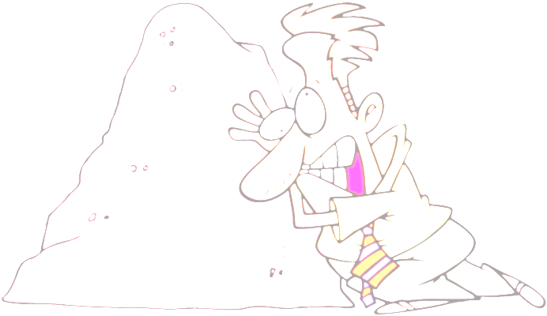
Nonobvious
Exclude patent filing if
  Obvious to person with
    Ordinary skill
    In art (meaning science, technique, technology)
What defines “ordinary skill?”
  Awareness of all pertinent prior art
  Types of problems encountered
  Prior art solutions
  Speed of technology change
  Educational level

Slide 10


Amazon vs Barnesandnoble (2001)
Amazon developed & patented “1-click” ordering
B&N developed “Express Lane” single-click ordering and used on Web site
Amazon sued B&N
B&N protested that 1-click ordering was obvious and therefore patent was invalid
District Court ruled that Amazon was likely to prove patent validity and ordered a preliminary injunction
  No one had put together all ideas in this way

Slide 11
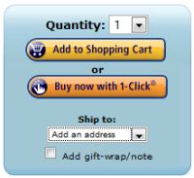
1-Click Case (cont’d)
BN appealed to the Federal Circuit, claiming patent was invalid and no infringement, if valid
Fed Circuit held: Amazon carried its burden with respect to demonstrating likelihood of infringement, but BN raised
substantial questions of patent
validity. Therefore, no
preliminary injunction.
Parties settled the dispute in
March 2002.
See Burgunder p. 197-99
Case demonstrates difficulty of
PTO to review Internet business
methods & make decisions about
novelty
July 2011: Amazon’s 1-Click Patent Rejected By European Patent Office
< http://patentaz.com/blog/?p=785 >

Slide 12


Design
US Patent Act §171 defines patents for design
  New, original and ornamental design
  Any article of manufacture
  14 year protection
Seiko Epson Corp v Nu-Kote Intl (1999)
  Patent infringement on shape of ink cartridges
  Trial court ruled against plaintiff because cartridges not visible to user, thus not patentable as “design”
  US Court of Appeals reversed lower court
    Patent was valid even if design not visible or obvious to user

Slide 13

Patent Duration
Utility Patents: at least 20 years
  Changed in 1995 to comply with
  international agreement obligations
Legal protection starts when the PTO
(Patent Trademark Office) issues the
patent and lasts until expiration
  Note: term begins when filed
    Invention can be used while PTO processes a patent application, even though patent term has not begun
    But once patent granted, patent holder can require royalties for previous use
  Exceptions apply for new pharmaceutical products

Slide 14
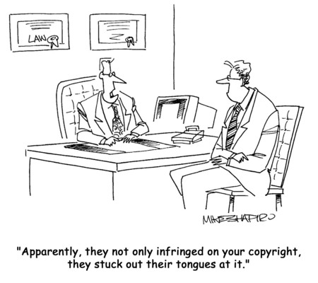
Infringement
}
Without permission of patent holder, to
  Make
  Use
  Offer for sale
  Sell
  Import
the patented invention
Apparently, they not only infringed on your patent, they stuck out their tongues at it.

Slide 15

Exemptions
US Patent Act §273
Good faith
Used subject of patent at least 1 year before filing date of patent
Holder of patent abandoned it for ~6 years or more

Slide 16

Enforcement Issues & Challenges
Patent issued by PTO assumed valid
  Challenger of patent must overcome presumption of validity
  Must show patent invalidly granted by PTO
    Erred in determination that product or process was novel or nonobvious

Slide 17

Remedies
Injunction to stop infringing
  Likely most powerful weapon of
  patent holder
Damages equivalent to royalty +
interest + costs
  Limited to 6 year period before
  filing of complaint
  Examples:
    Profits from lost sales
Treble damages at discretion of court
  Awarded if willful infringement
Attorney fees in exceptional cases
  E.g., where willful infringement found

Slide 18
Reform
Patent Reform Act of 2005 / 2007 / 2009
Currently, US stands alone in first-to-invent approach
  Focuses novelty inquiry on date of invention rather than date of application for patent
  Likely to join international consensus with Reform Act passage
Drawback to current approach
  Increases litigation expenses
    Determining priority by invention is tough;
    Simple to determine who is the first to file
Challenges to change
  Fairness concerns
  Produce a race to the patent office
    Less thoughtful patent applications?

Slide 19
Leahy-Smith America Invents Act of 2011
Signed into law 2011-09-16
“Most comprehensive overhaul to our nation's patent system since 1836.” – USPTO
“More certainty for patent applicants and owners”
Changes to
  Patent examination
  Inter partes disputes
  Fees & budgets
  New programs
USPTO coverage & planning
< http://www.uspto.gov/aia_implementation/index.jsp >

Slide 20
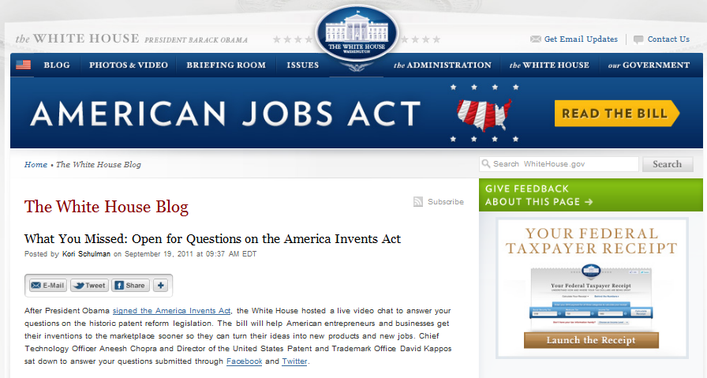
VIDEO: QUESTIONS ABOUT THE AMERICA INVENTS ACT
http://tinyurl.com/44klako

Slide 21

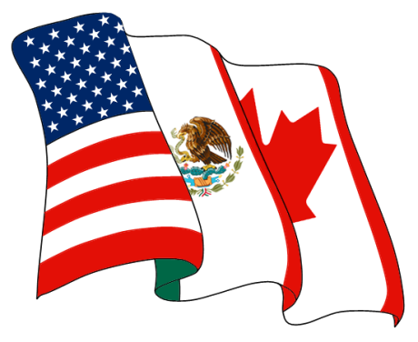
International Agreements on Patents
Paris Convention for Protection of Industrial Property (1883)
TRIPS (1994)
  Agreement on
  Trade-Related
  Aspects of Intellectual Property Rights
  See http://www.wto.org/english/tratop_e/trips_e/tripfq_e.htm
NAFTA (1992)
  North American Free Trade
  Agreement
  See
  http://www.ladas.com/BULLETINS/1994/NAFTAGATT.html
  See also http://www.customs.ustreas.gov/nafta/docs/us/chap-17.html

Slide 22
The Patent Application Process
Initial Considerations
Elements of the Patent Application
PTO Procedures & Appeals
Loss of Patent Rights
Infringement & Remedies
International Patent Protection Issues
Burgunder Chapter 4: Obtaining and Defending Patent Rights
in the United States and Globally. P. 105 ff.

Slide 23
Initial Considerations
Exhibit 4.1 (p. 106) of Burgunder summarizes essentials
Patent Ownership & Right to File Application
Invention Assignment Agreements
Important Steps Before Applying
Expected Fees & Costs

Slide 24
Patent Ownership & the Right to File the Patent Application
Inventor(s) must file with PTO
  Even if rights transferred
  Thus actual inventor(s) must be involved in filing
  Even if no longer employed by former employer who wants to file for patent
Patent Reform Act, if passed, would allow owner of patent rights to file
  No longer need to “chase down inventor”

Slide 25
Invention-Assignment Agreements
By default, inventor (e.g., employee) owns rights to an invention unless
  Job explicitly assigns task of inventing process or solving problem
  Employment contract stipulates ownership by employer
Employment contracts generally demand all rights to employee inventions
  Assume that employer resources relevant
  Even if developed outside work
But some state regulations (e.g., CA) may restrict clauses to work-related inventions
Candidates should read employment contracts carefully
  Especially if working on unrelated inventions
  Involve attorney with experience in employment law to review contract before signing

Slide 26
Important Steps Before Applying
Conduct prior-art search
  Thoroughly research existing patents
  Cheaper to abandon useless application
  May improve patent application
  May license prior art to improve application
  Avoid later surprises that can cancel patent
File in timely fashion
  E.g., within 1 year of 1st publication or sale
  1st to file (if in competition) has advantage
Provisional applications
  Provide disclosure of intent
  1 year to provide details of claims

Slide 27
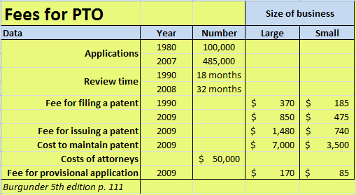
Expected Fees & Costs
Load on PTO & delays in handling applications rising steadily over last decades
  Numbers of applications skyrocketing
    1980:100,000, 1995:200,000, 2007:485,000
  Time to receive decision growing
    1990:18mo, 2000:24 mo, 2008:32mo
    Hi-tech (e.g., computing) patents can take 48 mo for decision
Fees rising

Slide 28
Elements of the Patent Application
Enablement
Best Mode
Information Disclosure
The Claims

Slide 29
Enablement
Enough info in application to allow practice by one skilled in art
  Objectivity: not inventor’s opinion – judged w/ reference to skilled practitioner
  Withholding info
    Not all details of every step required
    May put some into separate patents
  Breadth of claims
    Inventors often try for broadest reach possible
    But then have to show that info provided allows actual execution
    Can harm application
Must not force undue experimentation in evaluation

Slide 30
White Consolidated Industries v. Vega Servo-Control Inc.
Federal Circuit Court of Appeals, 1983
Facts:
  White Consolidated Industries granted patent ‘653 for machine-tool numerical control (NC) system
  Used a translator program such as its secret SPLIT
  White sued Vega for infringing ‘653 patent
  Vega argued that patent was invalid because SPLIT was not included
  White argued that example was good enough for enablement
Courts ruled against White and invalidated patent

Slide 31
Enablement and Computer Programs
Amount of work required to create or modify computer programs to fit needs of a patent varies
Thus some patents omit all details of computer programs on grounds that any programmers can create equivalents without undue effort
  Don’t need internal details of source code
  Sufficient to know required inputs and outputs
  Black-box reverse engineering techniques
Details of program structure may vary without affecting functionality

Slide 32
Best Mode
Particular process inventions may have optimum conditions
Inventor may not want to reveal details
  Can benefit from secret even after patent expires
But Patent Act requires inclusion of best mode for carrying out invention
PTO does not normally probe for best mode before granting patent
But challenges to patent may delve into details
Patent Reform Act may reduce importance of best-mode component

Slide 33
Information Disclosure
Applicants must provide all relevant material information
  Pro or con
Failure to be honest can be judged inequitable conduct
  Must demonstrate intent to deceive
Thus applicants usually provide wealth of information

Slide 34
The Claims
Boundaries of legal monopoly
  Expert assistance strongly recommended
  Includes form and language
Goals usually to maximize breadth of rights
  Can lead to overly broad patents
  Include more specific claims as well
Form can focus on method or purpose
  Lawn mower as parts/machine or method for cutting grass
  Some experts argue that computer programs are best presented in form of machine
  But can also draft as means-for/means-plus-function

Slide 35
PTO Procedures & Appeals
Secrecy Orders
Secrecy of Information Submitted to the PTO
The Patent Examination Process
Appeals

Slide 36
Secrecy Orders
PTO can draft secrecy order if there are national-security ramifications of invention
  E.g., DoD, NRC may evaluate
US inventors may not file for patents overseas unless
  Receive foreign-filing license
  There is no secrecy order within 6 months of US filing
  Violating such an order serious
    Loss of patent rights in US
    Criminal prosecution
International patent conventions protect US inventors
  Patent Cooperation Treaty (PCT)
  Paris Convention

Slide 37
Secrecy of Information Submitted to the PTO
Controversy over US PTO disclosure of patent details
  Released only when patent is issued
  In contrast, European Patent Convention (EPC) & PCT release info 18 mo after filing
Opponents of secrecy (generally large corporations)
  Don’t like submarine patents which “surface” only at issuance
  Prevent others from preparing for patent or avoiding useless R&D
Proponents of secrecy (generally smaller businesses)
  Argue that foreign competitors scan PTO records for unfair competitive advantage
  Patent Reform Act dropped 18mo provision in 2009

Slide 38
The Patent Examination Process (1)
Examiner expert in appropriate field
  Searches existing patents
  Uses online databases & scholarly publications
  Careful analysis of details in application
First Office Action
  Usually lists objections
    Excessive breadth of claims
    Defects of drawings
    Attacks on novelty or nonobviousness
    3 mo to reply
  Or may be Notice of Allowance

Slide 39
The Patent Examination Process (2)
Applicant responds
  Arguments
  More information
  Continued cycle of discussion
Eventually reach Notice of Allowance or Final Rejection
  Patent number if Allowance granted
Patent pending
  Used once application filed
  Has no legal force
  Just a warning to dissuade competitors

Slide 40
Appeals
If Final Rejection issues
6 mo to file appeal
Board of Patent Appeals and Interferences
  Uphold decision (65%) or
  Instruct examiner differently
If Board upholds rejection
  Applicant can appeal to Federal Circuit Board of Appeals
  If they reject, can try to submit to SCOTUS (rarely accepted)
Be aware of enormous legal costs

Slide 41
Loss of Patent Rights
Reexamination
Opposition Procedures
Litigation

Slide 42
Reexamination
PTO can spontaneously re-evaluate granted patents at any time
Usually after public submits information
  Or competitor…
May be initiated when public or industry views a patent as over-broad; e.g.,
  1994: Compton patent for multimedia search & retrieval
  1994: Software Advertising Corp patent for computer screen saver for ads

Slide 43
Opposition Procedures
In countries other than USA, oppositions are formal processes for challenging patents
Generally allow 3rd parties to participate actively
May even begin before patent granted
  E.g., India
  Pre-grant oppositions
  Can delay patent applications for years
Post-grant oppositions
  Patents remain in force during proceedings

Slide 44
Litigation
May choose to ignore patent and use ideas/invention w/out permission or fees
May be sued by patent holder
  Challenge validity of patent as defense
May also sue patent holder first
  Seek ruling overturning PTO grant of patent
  Challenge completeness of information
  Challenge novelty etc

Slide 45
Infringement & Remedies
Literal Infringement
Doctrine of Equivalence
Prosecution History Estoppel
Infringement of Process Patents
Remedies for Patent Infringement

Slide 46
Literal Infringement
Rule of Exactness
  Making, using, selling item conforming exactly to claim in patent; e.g., 4 legged chair violates patent for 4 legged chair
Rule of Addition
  Making, using, selling item conforming to claim in patent plus additional features; e.g., 5 legged chair IS violation of patent
Rule of Omissions
  DO NOT INFRINGE patent if there is ANY omission of an element in the patent claim
  E.g., if patent stipulates 4 legs on chair, 3 legged chair is not violation of patent

Slide 47
Doctrine of Equivalence
Substituting an equivalent for an element of a patent led to abuse
  Graver Tank & Mfr Co v. Linde Air Products
  Patent holder defined electrical welding compound including Mg
  Infringer substituted Mn
  SCOTUS rule in favor of patent holder
Doctrine of equivalence permits litigation against infringement
  Same function
  Same way
  Same results

Slide 48
Prosecution History Estoppel
Suppose inventor patents chair explicitly made of oak wood & not cherry wood
  Cherry chairs ruled obvious
Then competitor makes chair of cherry wood
Patent holder claims infringement
  But patent explicitly excluded cherry wood
  Would be unfair to reverse terms of patent
Doctrine of prosecution history estoppel prevents reversing narrowing of patent when charging infringement

Slide 49
Infringement of Process Patents
Patents on articles apply to manufacture/use/sale in US only
  Outside US do not infringe
  But infringing fabrication outside US precludes sale in US without agreement of patent holder
Process patents more complex
  Any foreign infringement of process patent precludes legal import of results
  Retailers and noncommercial users also precluded from selling or using infringing products

Slide 50
Remedies for Patent Infringement
Ordering payment of damages
  May be huge (e.g., $B) – can bankrupt infringers
  Based on
    Lost profits
    Reasonable royalty
    Penalty for willful infringement
Permanent injunction stopping infringement; patent holder must prove
  Infringer acted despite objectively high likelihood of infringement
  Infringer knew or should have known of risk of infringement

Slide 51
International Patent Protection Issues
Inconsistent patent policies lead to hardship for international companies
  Complex, conflicting rules
  Extra legal costs
  Time
Major categories
  Substantive Patent Policy Issues: what and how?
  Procedural Patent Policy Issues: how much time and money?

Slide 52
Substantive Patent Policy Issues
Patent Terms – generally 20 years now
Patentable Subject Matter
First-to-File Priority
Grace Periods
Secrecy of Patent Applications
Prior-Use Rights
Oppositions & Delays
National Emergencies & Public Health
Other Substantive Issues

Slide 53
Patentable Subject Matter
Many countries still don’t permit patents on
  Medical processes
  Animals (except microorganisms)
    Significant problems for biotechnology industry
  Inventions “contrary to public order or morality”
Computer programs not protected under patent law in many nations

Slide 54
First-to-File Priority
US “first-to-invent” standard for patent priority unique in world
Every other nation uses “first-to-file” standard
Patent reform in US almost certain to move towards conformity to international standards

Slide 55
Grace Periods
US has 1 year grace period for filing
  After 1st sale or 1st publication
Other nations forbid patent if any prior use or publication before application
Different definitions of sale and of public use
  E.g., US includes test marketing
  Other countries don’t

Slide 56
Secrecy of Patent Applications
Many nations maintain secrecy of patent application for only 18 months after filing
US preserves secrecy until patent granted
Thus inventors relying on secrecy of US patent application must be wary about foreign patent applications

Slide 57
Prior-Use Rights
US recognizes prior-use rights for business methods, not for other patents
Many countries allow prior-use to interfere with patent rights
Patent holders may face increased legal hurdles when trying to fight perceived

Slide 58
Oppositions & Delays
Outside US, public may bring formal opposition to patent applications
Delays can last years
Japan in particular has been trying to reduce such delays

Slide 59
National Emergencies & Public Health
HIV/AIDS epidemic example of conflict between profit and need in public health
Expensive drugs impossible to pay for in poorer parts of world
TRIPS (Agreement on Trade Related Aspects of Intellectual Property Rights)
  Includes language allowing exclusion of patent protection for inventions “necessary to protect public order”
  Strong disagreement over export of Indian generic copies of expensive drugs
  Also includes possibility of compulsory licenses

Slide 60
Other Substantive Issues
Breadth of claims
  US quite broad
  Other nations narrower
Limitations on costs of licensing
Best mode
  Must be disclosed in US
  May be secret elsewhere

Slide 61
Procedural Patent Policy Issues
Signatories of Paris Convention include
  Almost all industrialized countries
  Many developing nations
  Agree to respect earlier filing date of application in other signatory country
    Within 1 year of initial signing
European Patent Convention (EPC)
  Established European Patent Office (EPO)
  Allows English-language applications & correspondence
  But judicial enforcement lies within national courts
Patent Cooperation Treaty (PCT)
  World Intellectual Property Organization (WIPO)
  138 member countries in 2009 (148 in 2013)
  Details of application published at 18 months

Slide 62
Now go and study

