Slide 1
Copyright & Fair Use
CJ341/IA241 – Cyberlaw & Cybercrime
Lecture #12
M. E. Kabay, PhD, CISSP-ISSMP
School of Cybersecurity, Data Science & Computing
Norwich University

Slide 2
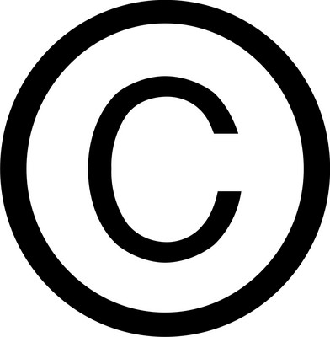
Topics
Copyright purpose & history
Legal formalities
Felony Violations
Misdemeanor Violations
1st Amendment Issues
Defenses to Infringement
Fair Use
COPYRIGHT CLEARANCE CENTER VIDEO
“Copyright on Campus Video” http://tinyurl.com/3ovxxtg

Slide 3
Purpose
Stimulate creativity
Protect creative investments of authors & artists
Mechanisms:
Protect intellectual property
Prevent loss of control or possession
Gainful return on investment

Slide 4
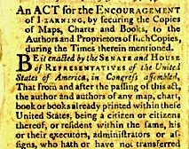
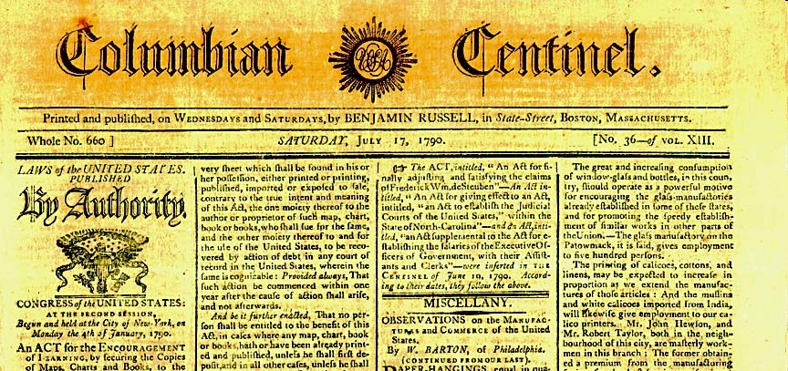
History (1)
Copyright Act of 1790 -- based on Statute of Anne (1710) in England
http://tinyurl.com/kb295
Thanks to Prof Robert Guess of Tidewater Community College!

Slide 5
History (2)
Early 1900s: Federal copyright laws improved
Despite technological advances, fundamental objective remains constant
Multiple amendments of federal copyright statute to accommodate advances
Question: Can the law evolve fast enough to accommodate change?
1995: Digital Performance Right in Sound Recordings Act (DPRA)
Passed before pervasiveness of Webcasting
1998: Digital Millennium Copyright Act (DMCA)
Among other requirements, created new statutory license fee requirement for Webcasting services
Prof Guess also contributed this link: Copyright Office maintains a useful timeline of United States Copyright Laws:
http://www.copyright.gov/circs/circ1a.html

Slide 6
What is Protected by Copyright?
Reproduction
Preparation of derivative works
Distribution
Performance
Display in public

Slide 7
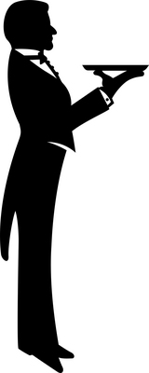
Formalities
Original work is automatically copyrighted in the name of the author / creator
Theoretically not necessary to indicate “Copyright © 2011 name-of-author. All rights reserved.”
But highly advisable to do so to strengthen legal position in case of claimed doubt.
Written assertion of copyright eliminates defense of innocent infringement of copyright
May register US works with US Copyright Office
Offers increased protection
Register within 3 months of publication
$500-$20,000 statutory damages for infringement

Slide 8
Works Made for Hire
Full-time employees generally forfeit claim to work created expressly for purpose of their job
Copyright belongs to the employer
Employers' rights do not apply to creative work outside employment
Not created with employer facilities, tools
Not interfering with regular work
Created outside normal working hours
Problems can occur when creative outside work is directly related to job function

Slide 9
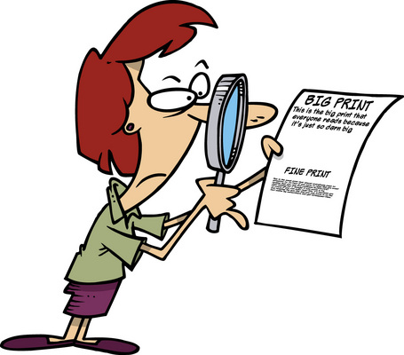
Contractual Sale
Copyright ownership may be traded or sold
Employers often include clause claiming copyright over all creations by employee
Sometimes specify work created for any purpose and at any time
E.g., children's story book
No obligation to agree to such clause
But no obligation to hire employee without such agreement
Publishers almost always try to get all rights
Noteworthy case distinguishes between paper publication and electronic publication (see next slide)

Slide 10
Writers Win a Court Battle for Control 1999-09
New York state court ruled in favor of National Writers Union
Against New York Times
& other major publishers
Affirmed right of writers to control publication if their materials in new media
Publishers wanted to use submissions for CD-ROMs or Web without paying additional royalties
Notes:
For more information about the “Tasini v. The New York Times” ruling visit the National Writers Union Web site at http://www.nwu.org

Slide 11
Infringement
Any use without express permission of copyright holder
Printing
Posting on Web
Using in derivative work
Direct infringement
Monetary profit is not an issue
Distributing someone else's work for free is not a mitigating factor
Contributory infringement: ISPs?
Requires substantial or pervasive involvement

Slide 12
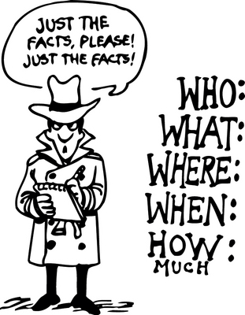
Facts?
Factual information cannot be copyrighted in itself; e.g.,
2+2 = 4
Distance between Norwich and Montpelier
The representation of factual information can be copyrighted; e.g.,
A times-table designed for children with pictures of friendly animals romping around edge of the table
A map of Vermont with particular fonts, colors, and symbols

Slide 13
Hot News Misappropriation
June 2001 – AP claimed copyright protection for facts reported in newswire feeds
Would prevent even summarizing or abstracting articles
Serious doubts about the viability of this claim
Sep 2011 – Second Circuit Court of Appeals
Ruled that aggregating facts from other sources does not violate copyright law
To see how legal scholars analyze issue, see Calman, C. & R. D. Balin (2011). “The Future of the Hot News Misappropriation Tort After Barclays Capital Inc. v. TheFlyontheWall.com.” Medialawmonitor (2011-09-16). < http://tinyurl.com/3s4hmwd >

Slide 14
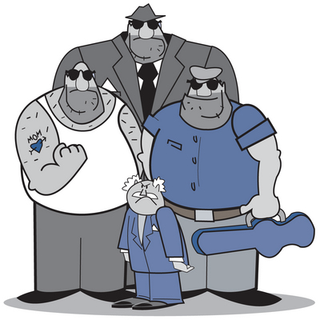
Burden of Proof for Felony
Copyright existed
Defendant infringed the copyright by reproduction or distribution of the work
Defendant acted willfully (intent – mens rea)
Defendant reproduced or distributed
≥10 copies of
≥1 copyrighted works with
a total value of ≥$2,500
within a 180-day period
Punishment: ≤5 years and/or fine;
If no reproduction or distribution, fine & imprisonment ≤1 year;
Harsher penalties for subsequent offenses

Slide 15
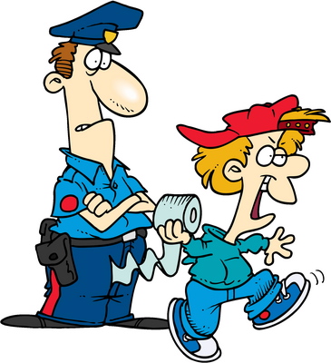
Burden of Proof For Misdemeanor
Copyright existed
Defendant infringed copyright by reproduction and/or distribution
Defendant acted willfully
Defendant either reproduced or distributed the copyrighted material for the purposes of commercial advantage or private financial gain or distributed or copies ≥ 1 copyrighted works with a total retail value of more than $1,000 within a 180-day period
Showing of commercial advantage or private financial gain = penalty enhancer

Slide 16
1st Amendment?
Does the 1st Amendment protect unauthorized copying of copyrighted works?
Some defendants have claimed 1st Amendment protections when publishing work of public officials
But SCOTUS* ruled that even a public official's own copyrighted materials cannot be infringed
No ban on publishing the substance of such documents; only on publishing exact form
________________________
*SCOTUS: Supreme Court of the United States

Slide 17
Defenses to Copyright Infringement: First Sale
Allows someone who buys a copyrighted work to freely distribute copy bought
But only copy actually bought,
NOT copies of the item bought
Typically doesn’t apply when someone is charged with software piracy (Clifford)
Warning: upgrades to software
Upgrades typically purchased with reduced cost when earlier version available
Earlier version cannot legally be sold or given away if upgrade is in use
E.g., if Windows 8 bought as upgrade from Windows 7 must keep Windows 7 disk to justify use of 8 upgrade

Slide 18
Defenses to Copyright Infringement: Lack of Intent
Did not act willfully
“No Electronic Theft Act” – amended 17 USC § 506(a) states that “evidence of reproduction or distribution of a copyright work, by itself, shall not be sufficient to show willful intent
Courts disagree whether willful refers to intent to copy the material or intention to infringe the owner’s copyright
Most interpret willfulness as specific intent to violate copyright laws
Other defenses:
Statute of limitations (government has 5 years to bring charges)
Fair Use (see following slides)

Slide 19
Fair Use Exception
Copyright Act (Sections 107-122) lists a number of exceptions to set of protected rights, including fair use
Fuzzy exceptions, although some specifics
E.g., Section 109: provides that one who owns a copy of a protected work may distribute the copy without getting permission from the copyright owner (First-sale doctrine)
“The notion of fair use acknowledges that copyrights provide substantially broad rights, and that there may be occasions when strict application of those privileges interferes with the public interest.” (Burgunder p. 278)

Slide 20
Fair Use Doctrine: 17 USC § 107
Equitable defense to copyright infringement
Excepts otherwise infringing use of a work for certain purposes
Criticism
Comment
News reporting
Teaching (including copies for classroom use – with some limitations)
Scholarship
Research
Fair Use issues are usually litigated as civil infringement cases

Slide 21
Fair Use
Codified in part in 17 USC §107-118 (Copyright Act)
Fuzzy doctrine: no specific # words, lines
See http://www.copyright.gov/fls/fl102.html
Key issues (quoting from above ref):
the purpose and character of the use, including whether such use is of commercial nature or is for nonprofit educational purposes;
the nature of the copyrighted work;
amount and substantiality of the portion used in relation to the copyrighted work as a whole; and
the effect of the use upon the potential market for or value of the copyrighted work.

Slide 22
Fair Use Guidelines
Guidelines for determining if your use of copyrighted materials qualifies as fair use*:
1. Is your use noncommercial?
2. Is your use for purposes of criticism, comment, parody, news reporting, teaching, scholarship, or research?
3. Is the original work mostly fact (as opposed to mostly fiction or opinion)?
4. Has the original work been published (as opposed to sent out only to one or a few people)?
5. Are you copying only a small part of the original work?
____________
* Larry Lessig, David Post and Eugene Volokh in Cyberspace Law for Non-Lawyers (1996): http://w2.eff.org/legal/CyberLaw_Course/index.html

Slide 23
Fair Use – cont'd
6. Are you copying only a relatively insignificant part of the original work (as opposed to the most important part)?
7. Are you adding a lot new to the work (as opposed to just quoting parts of the original)?
8. Does your conduct leave unaffected any profits that the copyright owner can make (as opposed to displacing some potential sales OR potential licenses of reprint rights)?
The more YES answers there are to the above questions, the more likely it is that your use is legal.
The more NO answers there are, the more likely it is that your use is illegal.
So is this use of the Fair Use text a fair use?

Slide 24
Teachers Try to Extend Fair Use 1999-02
Hearing at US Copyright Office
Educators lobbied for right to use copyrighted works
In distance-education programs
Offered via Internet
Without having to obtain explicit permission
From copyright owners
Position vigorously opposed
Publishers
Speakers for entertainment industry
Notes:
EDUCATORS PUSH FOR EXPANDED COPYRIGHT LAW
Educators testified last week at a hearing organized by the U.S. Copyright Office, advocating an expansion of the current law to give online instructors the same exemptions now available to those who teach via television and radio. Current copyright law explicitly allows distance‑education instructors to use copyrighted works, such as video clips or photos, as part of their presentations without first gaining permission from the copyright holders. However, that provision was written in 1976, when most distance learning took place over audio and video networks. Educators are now fighting to have that provision expanded to include courses taught over digital networks, but publishers and the entertainment industry are vigorously opposing such expansion, saying it could lead to unlawful copying and distribution of digital works. (Chronicle of Higher Education 5 Feb 99)

Slide 25
Teachers Get Support for Fair Use 1999-05
US Copyright Office
Supported requests from public schools, universities
Should be granted exemptions under Fair Use doctrine
Educational
Non-commercial use of copyright materials
Notes:
Wired News 05/28/99 via EDUPAGE

Slide 26
Georgia State University (2008)
Consortium of publishers accused GSU of violating fair use
Putting class readings on “electronic reserve”
Also opposed putting publishers’ © materials on faculty Web sites without permission
See “What's at Stake in the Georgia State Copyright Case.” The Chronicle Review (2011-05-30) in The Chronicle of Higher Education. < http://tinyurl.com/3pj86fb >
Ruling (2012) found only 5 of 99 alleged violations were infringements < http://chronicle.com/article/Long-Awaited-Ruling-in/131859/ >

Slide 27
Helpful Guides to Fair Use
Howard, J. (2011). “What You Don’t Know About Copyright, but Should.” The Chronicle of Higher Education (2011-05-29) < http://tinyurl.com/43nskq6 >
Includes list of URLs for additional readings compiled by Ben Wieder

Slide 28
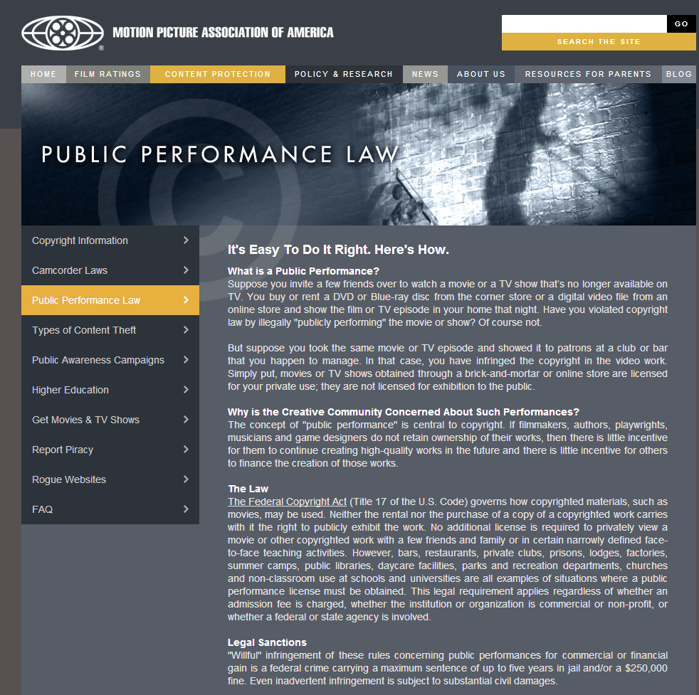
Restrictions on Showing Movies (1)
http://mpaa.org/contentprotection/public-performance-law

Slide 29
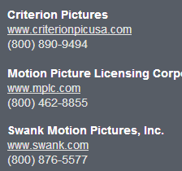
Restrictions on Showing Movies (2)

Slide 30
Now go and study

