Slide 1
Copyright & the Internet
CJ341/IA241 – Cyberlaw & Cybercrime
Lecture #14
M. E. Kabay, PhD, CISSP-ISSMP
School of Cybersecurity, Data Science & Computing
Norwich University

Slide 2
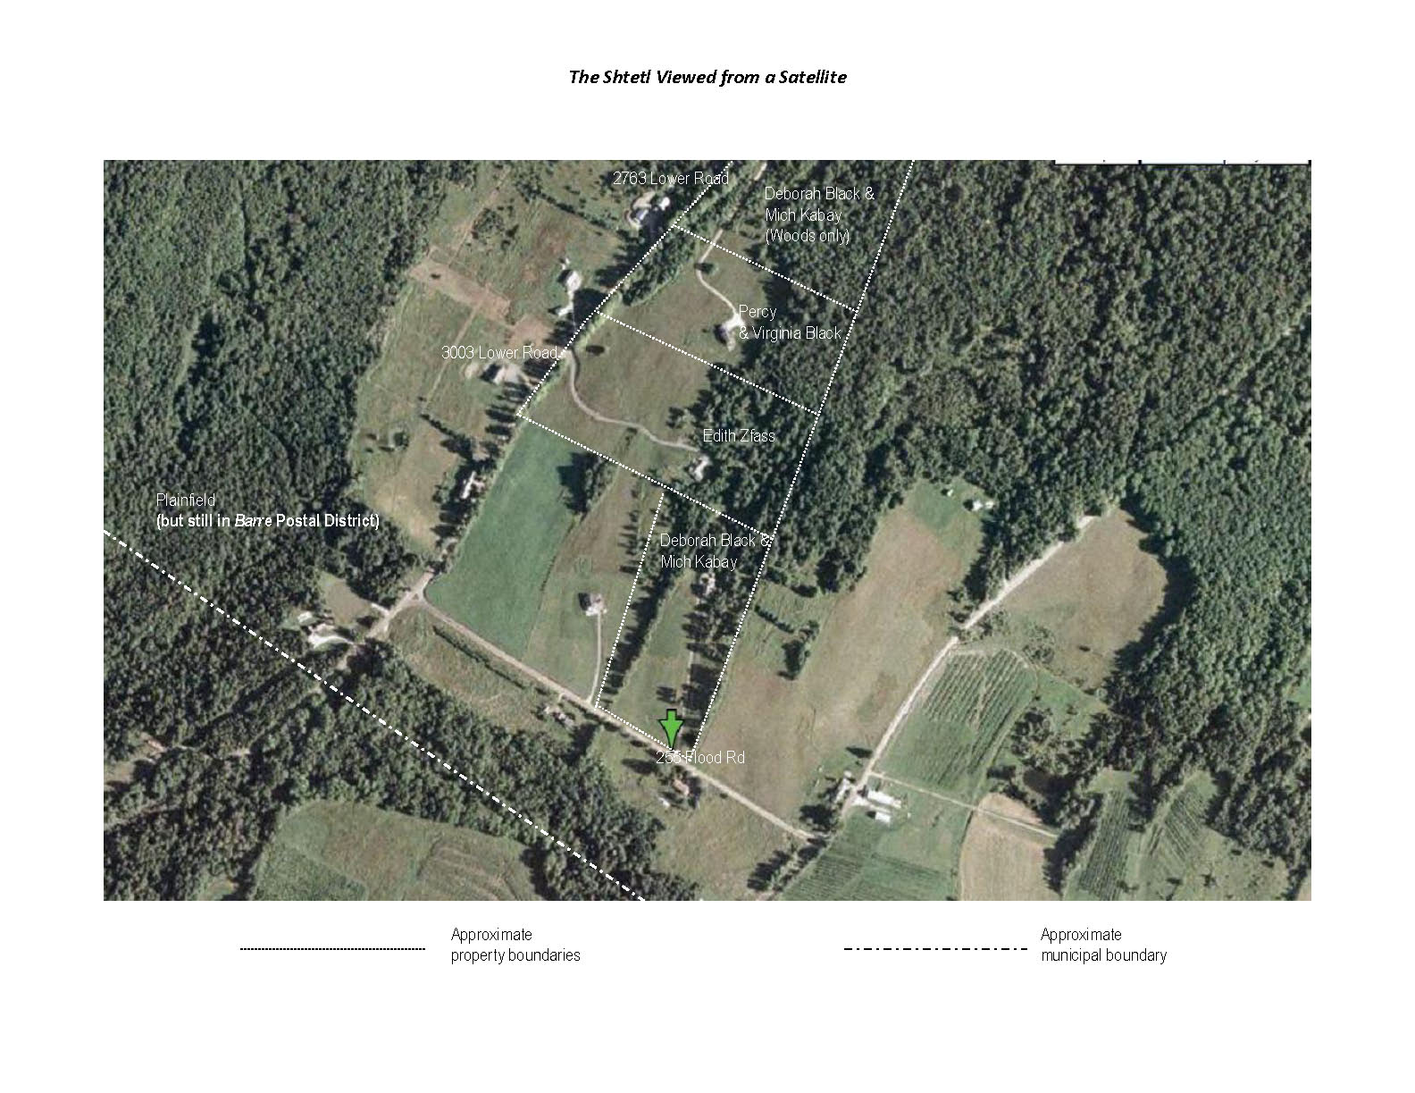
Topics
Piracy
Copyright Issues
Recording Devices
Distribution
Industry Responses
Sampling & Remixing

Slide 3
Piracy
Unauthorized copying of
  Software
  Music
  Video
Economic consequences
  British Phonographic Industry
    ~$2B lost sales in period 2003-2006
  Int’l Federation of Phonographic Industry
    2,000 lawsuits against uploaders in 10 countries

Slide 4
Piracy and the ‘Net
Napster, MP3, Gnutella, Wrapster. . . .
  Trading copies of music
  Most without permission – copyright violations
  Lawsuits against companies & individuals
  Gnutella, Wrapster extending trades to other files
Problems
  Bandwidth saturation – many colleges
  Legal liability if problem ignored
  RIAA (Recording Industry Association America) suing colleges
Notes:
(From IYIR 2000: NewsScan abstracts used with permission of the authors)
U.S. District Judge Jed Rakoff . . . [said] MP3.com is using "indefensible" and "frivolous" arguments in its defense against charges of copyright violations brought by the Recording Industry Association of America. The judge, in ruling against MP3.com, determined that the company "is replaying for the subscribers converted versions of the recordings it copied, without authorization, from plaintiffs' copyrighted CDs. On its face, this makes out a presumptive case of infringement." Rakoff called MP3.com's fair-use defense "indefensible" and its claim that it was protecting record companies from music pirates "frivolous." (Bloomberg/Los Angeles Times 5 May 2000)
[In a related case,] Settling a copyright infringement lawsuit brought against it by Warner Music and BMG Entertainment, the Internet music distribution company MP3.com . . . signed licensing agreements with both those companies. Customers are able to access music in the MP3 database at any time and from any device with Internet access. Warner executive Paul Vidich . . . [said] that the settlement agreement "clearly affirms the right of copyright owners to be compensated for the use of their works on the Internet." (AP/San Jose Mercury News 9 Jun 2000)
[In September,] . . . federal judge [Jed Rakoff ] . . . ruled that MP3.com willfully violated music copyrights and . . . ordered it to pay at least $117 million in damages to Seagram's Universal Music Group -- believed to be the largest copyright infringement penalty in history. "This should send a message that there are consequences when a business recklessly disregards the copyright law," says a senior VP of the Recording Industry Association of America, which represents Universal and the four other major music companies. "We trust this will encourage those who want to build a business using other people's copyrighted works to seek permission to do so in advance." The industry's lawsuit claimed that MP3.com had violated copyright laws by creating a database of 80,000 unauthorized CDs, and the judge's ruling assessed a $25,000 penalty for every Universal CD illegally posted on its My.MP3.com service -- somewhere between 4,700 and 10,000 recordings. MP3.com . . . [said] it will appeal the ruling, which it called "draconian." (Los Angeles Times 7 Sep 2000)

Slide 5
Music Piracy Significant Economic Problem
2005 overall: 147% growth in legal downloads
2006.01 report
  Illegal downloads via P2P (peer-to-peer) networks estimated 250M songs / week
  Legal downloads growing
    Christmas 2005: 9.5M tracks
    Xmas +1: 20M tracks
2006 predictions:
  750M-1B legal downloads
  vs 13B illegal downloads

Slide 6
Video Piracy (1)
Pirate TV downloads worldwide
  UK #1
  Australia #2
  US #3
Viewers use recorders to tape shows digitally, then upload to ‘Net
Monty Python clips available illegally on ‘Net (!!) at http://www.youtube.com
  THE HORROR! THE HORROR!
MPAA (Motion Picture Assoc America)
  Closed down many P2Ps
  Countless lawsuits against individuals

Slide 7
Video Piracy (2)
2005-08: Prosecution of Missouri man (Curtis Salisbury)
  Uploading taped copy of movies
  New law banning such copying
  Tried to profit financially
  Charged with conspiracy, copyright infringement, and two violations of the law banning camcorders in theaters
MPAA estimates 90% of pirated movies on ‘Net taped illegally in theaters
Distributed via P2P networks

Slide 8
The Arguments for Piracy
Everyone’s doing it
We won’t get caught
It’s the company’s fault: they should charge less
But I need it and I don’t want to pay for it
It doesn’t hurt anyone
It only hurts a company – I wouldn’t steal from an individual
No software/music/movie should be copyrighted – it should always be free
See http://www.mekabay.com/ethics/seven_reasons.htm
or http://www.mekabay.com/ethics/seven_reasons.pdf

Slide 9
Legal Issues
Creation of unauthorized copies
Distribution of copies to others
Revenue loss – compensatory damages
Legal responsibility for distribution channels

Slide 10
Legal Responsibility
Considerations for assessing responsibility
  Fairness issues
    Knowledge
      Foreseeability
    Control
    Benefit Derived
      Financial
  Economic
    Costs borne by society
    Benefits to society
    Cost-benefit

Slide 11
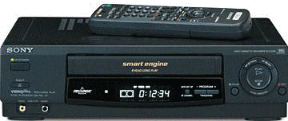
Recording Devices
Sony Corp. v. Universal City Studios 1984
Movie industry sued VCR manufacturer
  Claimed Sony responsible for unauthorized reproductions made by consumers
Supreme Court ruled in favor of defendant
  Time Shifting at home = fair use
  Sony not liable: Copyright Act does not expressly render liability for another’s infringement
  Sale of equipment not contributory infringement
Limitations: does not imply that all use is permissible fair use

Slide 12
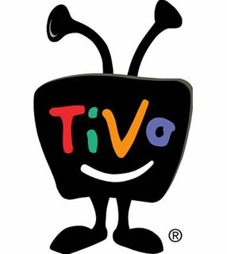
Digital Video Recorders
DVRs (e.g., TiVo) – profitable entertainment opportunities
Fair use questioned (applicability of Sony case?)
  TV without commercials (concern for commercial TV)
  Sharing programs over Internet
    ReplayTV
      Recorded commercials as well as program
      No sending of programs outside home
    TiVo To Go
      Program transfer to other devices
      FCC approval – personal use or registered list
    Slingbox: Transfer of live TV signal to other devices
  Space-Shifting: analogy to time-shifting

Slide 13
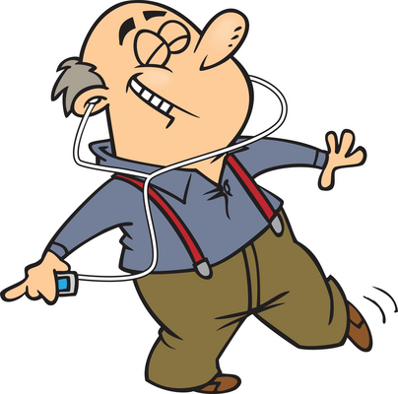
Audio Recording Devices
Audio recording in the old days before digital tools
  Fair-use traditionally assumed
    Inferior quality of original copies
    Fair-use equitable balance may have likely okayed copying for personal use
  Historically no significant worry
  about distribution –
  chain-taping gave terrible quality
Digital audio recording formats
(DARs) changed landscape
  CDs, iPods, phones, Internet…
  Identical copies possible
  Large-scale copying easy
  Distribution a cinch

Slide 14
Audio Home Recording Act (AHRA)
2% royalty by sellers and importers of digital audio recording devices
  Paid to Copyright office
  Distributed to artists, publishers, etc.
Requires integration of Serial Copy Management System (SCMS)
  Creates copy limitations
Closes door on debate about home use audio recording device liability
Applies to devices that have principal purpose of copying sound and music
  Computer manufacturers not required to pay
  Defines digital audio recording media
  Does not include media used to make copies of computer programs
  But CD-ROMs & DVDs used for both. . . .

Slide 15
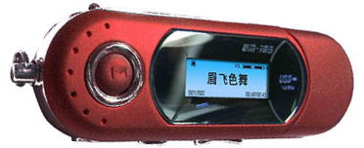
MP3 and Portable Music
MP3 format = MPEG Audio Layer 3
  MPEG: Moving Picture Experts Group
  Common digital audio encoding and compression format
  Capable of reproducing quality of
  original uncompressed sound
  Compresses traditional file to 5-10% of
  original size
Software: iTunes, Windows Media Player
Hardware: iPods
Major concern: Unlawful duplication & distribution via peer-to-peer (P2P) networks

Slide 16
Liability (1)
Traditional offline world
  Suitable targets for bringing lawsuits
  E.g., significant distribution hubs
Online
  Decentralized Internet changes situation
  E.g., 1 individual with Internet access can make copies and distribute millions of copies worldwide
  Effort aided by Online Service Providers (OSPs)
    (aka Internet Service Providers, ISPs)

Slide 17
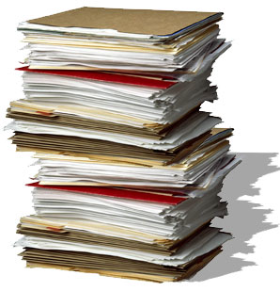
Liability (2)
Contributory Liability
  You are responsible when you
  know others’ use of your
  facilities is for unlawful activities
    Knowledge (reasonable)
    Purpose or control
  Reasonably know something
  unlawful is taking place
Vicarious Liability
  When you are liable for the
  actions of another, even though you might not be directly responsible for the wrongdoing
    E.g., individuals who potentially profit from wrongdoing

Slide 18
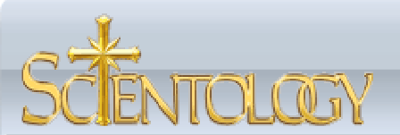
Religious Technology Ctr v. Netcom 1995 (1)
RTC owns copyrights to certain Church of Scientology works by founder L. Ron Hubbard
  Critic posted portions of works on a Usenet group (BBS)
  Managed through Netcom’s servers
Netcom did not monitor content
  Refused to bar critic from the system when asked by RTC
  RTC sued Netcom for copyright infringement

Slide 19
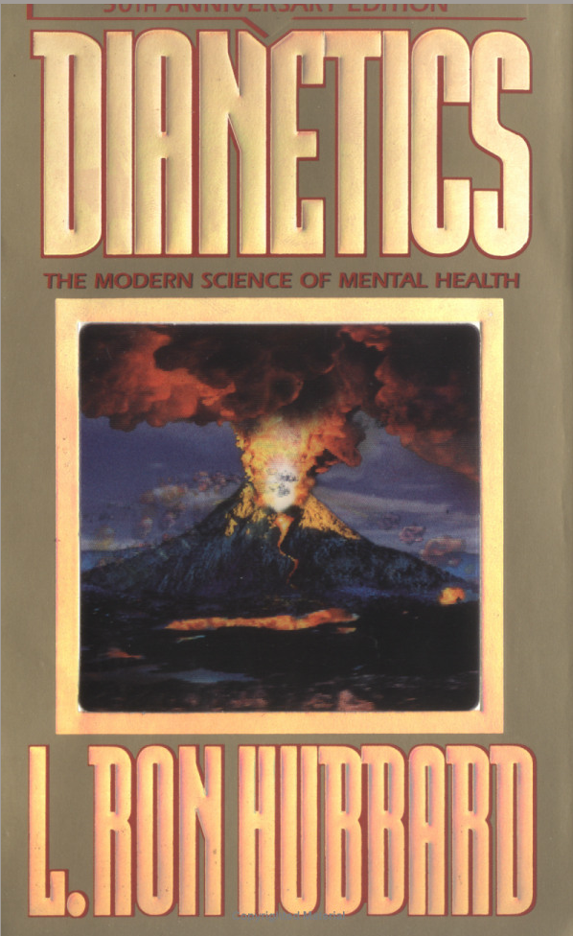
Religious Technology Ctr v. Netcom 1995 (2)
Court concluded
  RTC raised genuine question whether Netcom knew critic was infringing rights and whether Netcom participated in infringement
  Found direct and vicarious infringement claims fail
Bottom line:
  ISPs not directly and absolutely liable for customers’ copyright infringements

Slide 20
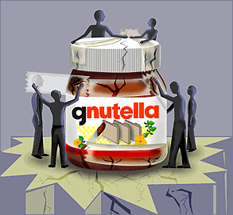


Peer-to-Peer (P2P) Networks
P2P file-sharing
  Materials transmitted directly
  from one user to another
  Ability to search hard drive of
  another, locate file, and
  transmit file
  Wide sharing of digital materials
  (e.g., photos, music, videos)
Napster dispute
  Napster users could download tracks
  Real-time index
  Napster itself did not directly copy or
  transmit copyrighted files

Slide 21


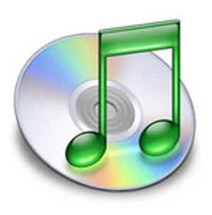
Entertainment Industry Response
Facing new technologies developed by pirates
  BitTorrent, EDonkey
  FreeNet, Tor – The Onion Router
  (anonymized services)
Offering of online subscriber
services
  E.g., Rhapsody, MusicNow,
  iTunes
  E.g., MovieLink
Filtering technologies – block music xfrs
Technical Protection / Security Measures
  Digital watermarking – embedded codes
Lobbying Congress for new legislation
Individual lawsuits

Slide 22

A&M Records v. Napster 2001
Napster allowed users to make, access, transfer MP3 music files stored on individual computer hard drives
  Napster claimed fair use
Court of Appeals found
  A&M would likely succeed in claim of
  contributory infringement claim and
  vicarious liability
  Contributory Liability
    Notice
    Ability to block suppliers of
    infringing material
  Vicarious Liability
    Right to control
    Financial benefit
  Audio Home Recording Act does not cover downloading MP3 files
See http://tinyurl.com/rvkwt

Slide 23
P2P Evolved
2001: Lesson from Napster
  P2P relying on operator servers and control require policing to avoid facilitation of infringement
2002: KaZaA
  Located outside USA
  Jurisdiction and international litigation considerations

Slide 24


Metro-Goldwyn-Mayer Studios Inc v. Grokster Ltd
2003: Grokster & Streamcast sued by MGM
  Entertainment industry losses significant
  Demanded injunction & damages
District court ruled in favor of defendants
  MGM could not prove liability
  Even if all allegations true
MGM appealed decision to Ninth Circuit Court of Appeals
  Affirmed lower court’s ruling
  Found no requisite knowledge of P2P
  infringement (that services would be used to do so)
  Applied precedent from Sony case (1984)
  Services were capable of being used in non-infringing ways

Slide 25
MGM v. Grokster 2005
MGM appealed judgments in favor of
Grokster to Supreme Court
SCOTUS concluded that:
  Record contained evidence of
  purpose to cause copyright violation
  Substantial evidence in MGM’s favor
  Summary judgment in favor of Grokster erroneous
  Reversed lower courts & ruled in favor of MGM

Slide 26
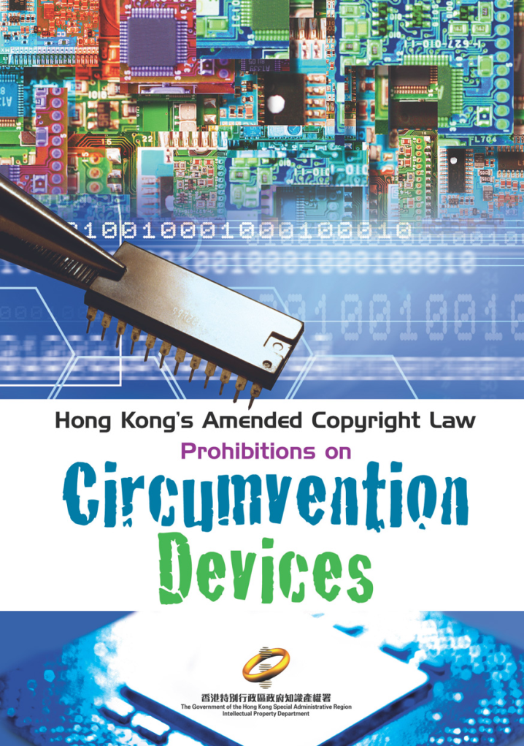
DMCA
DMCA: Digital Millennium Copyright Act
  1998
  17 USC §101 et al.
Outlines
  Anti-circumvention provisions
  Anti-trafficking provisions
Provides exceptions, including
  Fair use
  Freedom of speech
  Interoperability

Slide 27
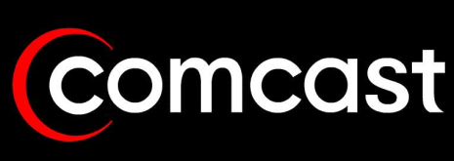

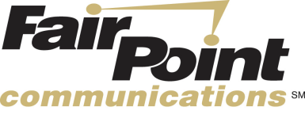
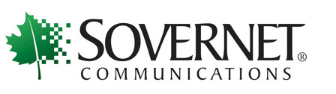
ISPs & DMCA (1)
Illegal to defeat measures for copyright control
Forbids selling/distributing measures to defeat copy-controls
Forbids removal of copyright information
Protects ISPs against claims of infringement under some circumstances (see next slide)

Slide 28
ISPs & DMCA (2)
Incorporates changes into section 512 of Copyright Act that affect ISP liability
Shields ISP if performing merely technical routing functions
Notice and Take-Down
  If ISP knows of infringing material, must work to remove
  If sufficient notice, can remove without liability to subscriber
Safe harbor applies for links
  Similar burden on ISP for liability shield benefit

Slide 29
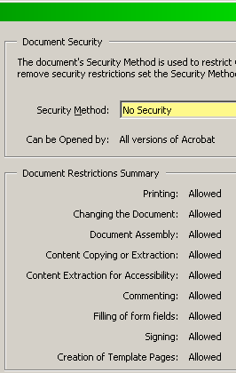
Criticisms of the DMCA
Reduction of fair-use freedoms?
  What if document has copy-controls to prevent data extraction (e.g., PDF with security)?
  Would typing out quotations be violation of DMCA?
Invasions of privacy?
  ISPs must reveal names of users suspected of violating law
  Provides channel for copyright holders to access information without a warrant?

Slide 30
Liability
EXHIBIT 9.5
Flowchart to Address Legal Responsibility When New Technologies Are Used to Infringe Copyright
Can the product be
used to infringe
copyrights?
No
NOT LIABLE
Is there evidence, by your
words or actions, that you
encouraged users to
infringe copyrights?
Yes
LIABLE
Aimster
Grokster
Active assistance
Commercial viability
depends on infringement
Failed to take simple steps
to prevent infringement
No
Did you have knowledge of
specific infringing uses at
a time that you had the
capability to prevent them?
Yes
LIABLE
Napster
Netcom
No
Is the product capable
of substantial
noninfringing uses?
Yes
NOT LIABLE
Sony
Burgunder p 324
How much use is substantial?
Do potential future
uses matter?
How does one appraise
potential future uses?
No
LIABLE

Slide 31

Digital Sampling and Remixing
Sampling Defined
  Re-using snippets or portions of sound recordings
  E.g., Puff Daddy – I’ll be Missing You
    1997 #1 hit single written by Sauce Money (rapper from Brooklyn)
    Based on 1983 Every Breath You Take song from 1983 Song of the Year written by Sting and performed by The Police (Synchronicity album)
  Puff Daddy asked for and received permission to use sample in performance
Examples of Remixing
  Britney Spears – My Prerogative (Bobby Brown)
LISTEN

Slide 32
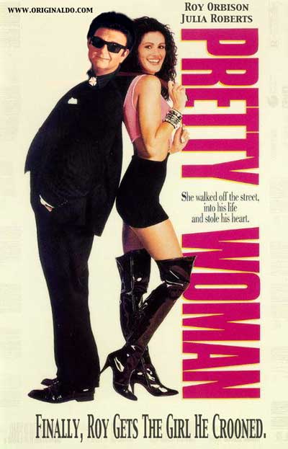
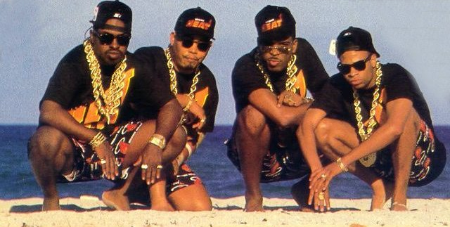
Campbell v.
Acuff-Rose Music
Original (with musicians in ties): http://www.youtube.com/watch?v=E4ufitiABBo&NR=1
Spoof by 2 Live Crew (censored version):
http://www.youtube.com/watch?v=65GQ70Rf_8Y
“Pretty Woman”
  1964: Roy Orbison “Pretty Woman” Song
    Assigned rights to Acuff-Rose, Inc.
  1989: 2 Live Crew “Oh, Pretty Woman” parody
    Copied opening riff & lyrics
    Informed Acuff-Rose of use, explained would credit with ownership & pay fee for use
Acuff-Rose
  Refused to grant permission for use
  Sued 2 Live Crew for copyright infringement
District Court
  Granted summary judgment in favor of 2LC
  Acuff-Rose appealed decision
Appeals Court
  Reversed District Court decision
  Found no fair use
  2 Live Crew appealed decision
  (MORE ON NEXT SLIDE)

Slide 33
Campbell v. Acuff Rose (2)
SCOTUS 1994 concluded Court of Appeals erred
Found 2 Live Crew use fair use through parody
  Purpose and character
    Goal of copyright generally furthered by transformative works
  Fair use extends to parody under Section 107, like comment and criticism
    2 Live Crew’s song reasonably could be perceived as commenting or criticizing original
    Taste does not matter to fair use
  Commercial nature of the use not dispositive
  No more than necessary was taken from original
Significant victory for parodists
Illustrates flexibility of fair-use doctrine

Slide 34
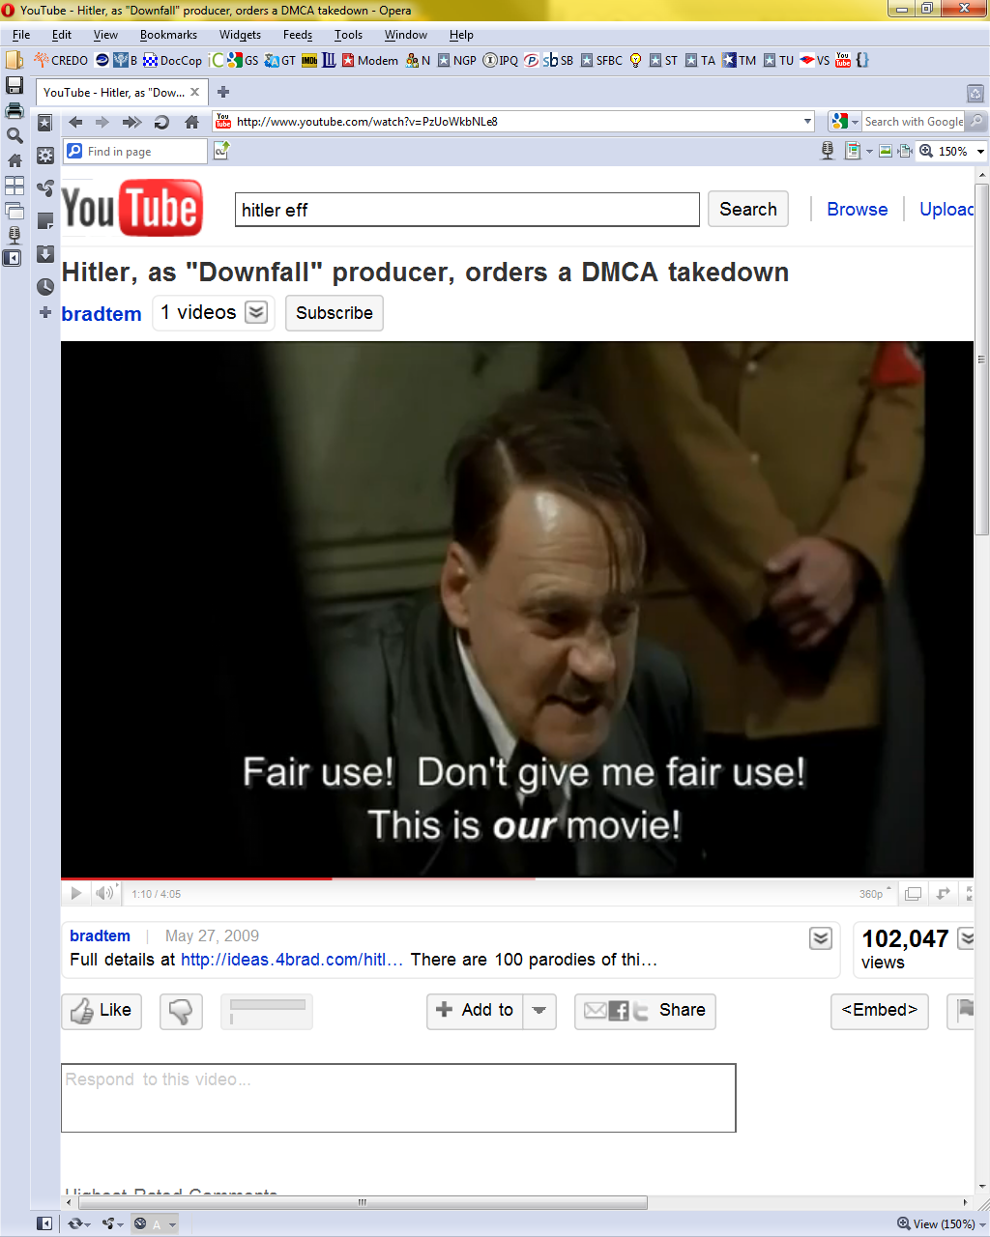
Digital Sampling and Remixing Issues (1)
Audio Sampling and remixing
Probably unlawful copyright infringement without permission
Case-by-case determination
  Facts specific to a case guide
Acuff-Rose suggests
  Parody probably okay depending on
    amount of snippets
    Importance of snippets
Mash-ups
  Not parody, but arguably
    Highly-creative
    Transformative
See takedown of Hitler Parodies parodied by EFF
http://www.youtube.com/watch?v=PzUoWkbNLe8

Slide 35
Digital Sampling and Remixing Issues (2)
Other Intellectual Property Issues
  State statutes protecting personal rights
    Right of Publicity
      Right to profit from own distinctive personal attributes
  To sample or remix, may also need permission of:
    vocalist, artist, in addition to licensing copyrights to underlying composition and sound recording

Slide 36

Digital Sampling and Remixing Issues (3)
“They Say That I Stole This”
Girl Talk master sampler
NPR’s On the Media 2010-12-26:
Twenty years ago a series of lawsuits
criminalized the hip-hop sampling of artists like Hank Shocklee and Public Enemy. And yet, two
decades later, artists like Girl Talk have found
success breaking those same sampling laws.
OTM producer Jamie York talks to Girl Talk,
Shocklee and Duke Law professor James Boyle about two decades of sampling - on both sides of the law.
Stream: http://www.onthemedia.org/transcripts/2010/12/24/04
Download mp3: http://audio.wnyc.org/otm/otm122410d.mp3
Gregg Gillis
aka Girl Talk
Origin of photograph unknown. Found using Google Images at http://clubnotes.pmpblogs.com/files/2010/11/girl-talk.jpg No contact information given for asking permission to use image. Decided to take a chance and use it anyway because it’s a GREAT PICTURE and because it seems unlikely that Gregg Gillis or anyone else will mind very much and sue me for copyright infringement because I amused my students. Let’s hope I’m right and that I am not offending any students or other viewers by this blatant unauthorized use of an image.

Slide 37
Now go and study

