Slide 1
Investigation & Prosecution of Cybercrime: Introduction
CJ341/IA241 – Cyberlaw & Cybercrime
Lecture #16
M. E. Kabay, PhD, CISSP-ISSMP
School of Cybersecurity, Data Science & Computing
Norwich University

Slide 2
Topics
Overview of Cyberspace
Moore
  Tracing a Suspect on the Internet
  Locating Information from E-Mails
  Proactive vs Reactive Strategies
Clifford
  Three Cybercrime Scenarios

Slide 3
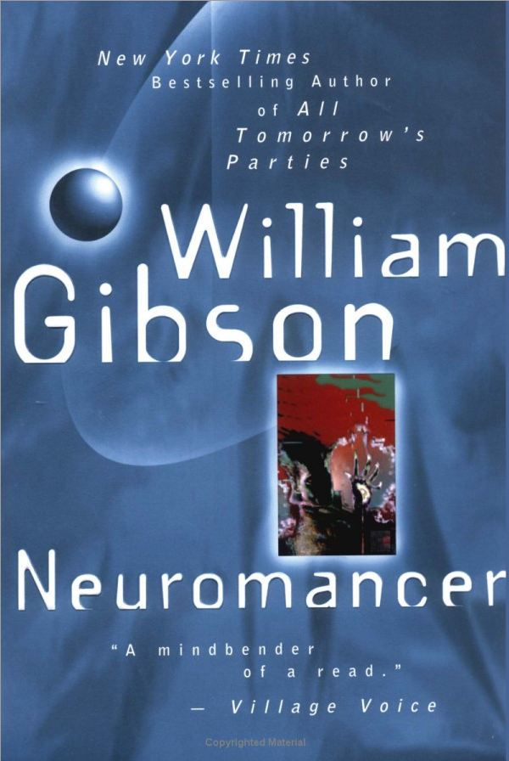
Overview of Cyberspace
The Evolution of Cyberspace
News
The Internet
The World Wide Web

Slide 4
Evolution of Cyberspace
BBSs
VANs
Internet
WWW

Slide 5
Disintermediated News
Newsgroups
Internet
(FTP / Gopher Sites)
Web-based news
Blogs

Slide 6
Discussions
VANs – Value-Added
Networks (e.g., AOL)
(Forums)
Commercial
Services
Social Networking
(e.g., FaceBook)

Slide 7
The Web
Who invented the concept of the WWW?
When?
WWW
Web Pages

Slide 8
Online Forums
These communications channels
may be critically important in
forensic investigations; e.g., CISO at
NU regularly uses these channels when
Investigating alleged security or honor-
code violations.
Types
  Usenet
  IRC
  ICQ
  Mailing lists
  Private or public discussion groups
    Yahoo Groups
    GOOGLE Groups
Chat Clients often include multi-user capabilities
  AIM, Trillian, Digsby….

Slide 9
Online Forums &
Mailing Lists
Mailing-list software
  Users subscribe & unsubscribe
  Sends out e-mail messages to subscribers
  Copies replies to all participants
  e.g., Majordomo
Some mailing lists have Digests
  Single large file per day instead of many messages
  Check the options in mailing lists you join
Online special-interest portals
include discussions
  E.g., commentary in response to
  postings

Slide 10
Online News
Users access news groups through software
  E.g., USENET (NEWS://)
  Other groups, blogs
  RSS feeds from Web sites (podcasts etc.)
Moderated newsgroups
  Editor/moderator
  Controls what appears
  High signal-to-noise ratio
Unmoderated
  Automatic distribution of anything
  Low signal-to-noise ratio
  Subject to spamming
Remember
Stratton-Oakmont
vs Prodigy

Slide 11
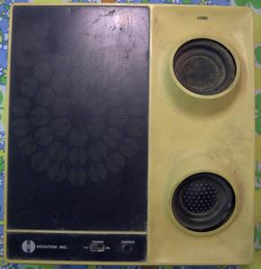
Online Forums: BBSs (OLD)
Historical interest (e.g., War Games, 1983)
Access via phone calls & modems
Professional and amateur
May require long-distance calls
Unregulated: hatred, obscenity
Some moderated, others unmoderated
Unreliable: virus-infected
software
A few run by and for criminals
  Stolen software
  Ads for stolen goods

Slide 12
The Internet
An internet is network of networks
  The Internet grew out of ARPANET
  Based on TCP/IP linkage of networks (see next slide)
Includes > 1B users
  Has 200-300 million nodes
  Growing by 2,000,000 users/month
Users often have free (uncharged) access
  Some cities have “Freenet” service

Slide 13
The Internet
TCP/IP based internetworking
  Transmission Control Protocol = TCP
  Internet Protocol = IP
  Packet-switched protocols
  Dynamic routing of packets for high efficiency
Began as DARPA project in late 1960s
  Defense Advanced Research Projects Agency
  Steady expansion during 1970s & 1980s
  Explosive growth late 1980s and in 1990s
  .com domain opened for general use in 1993

Slide 14
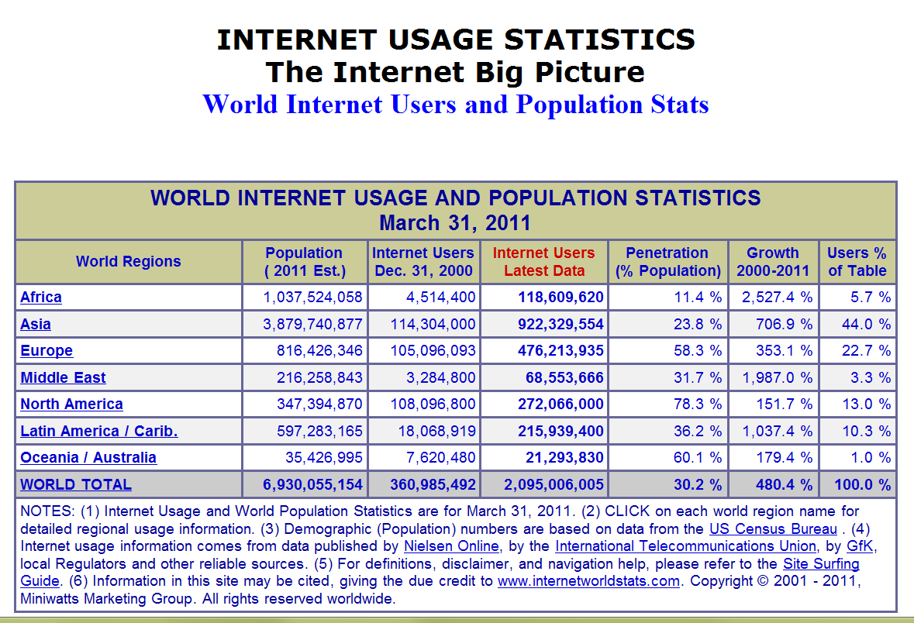
Recent Internet Usage Stats
http://www.internetworldstats.com/stats.htm

Slide 15
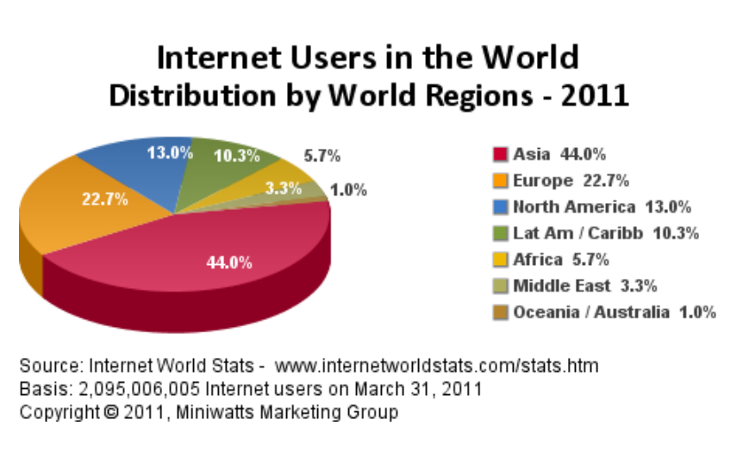
Internet Users by Region (1)

Slide 16
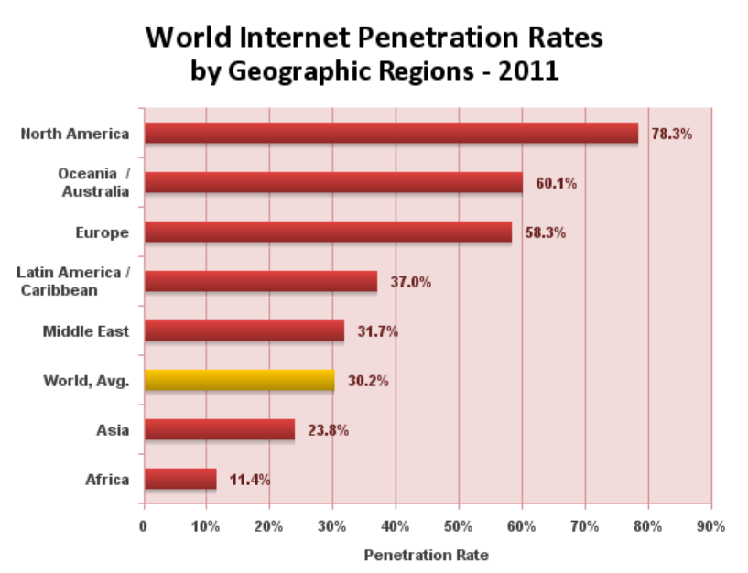
Internet Penetration Rates by Region

Slide 17
Basics: Packet-Switching Networks
DATACOMM
OVERHEAD
Destination
Sequence ID
DATA
DATA I/O
PAD
CRC
Route ID
PACKET
Originally applied to
Telephony in X.25 networks

Slide 18
Basics: Datagram Routing
Buffers
Processor
Circuits
Packets
Vancouver
Node
» »
» »
»
» »
» »
« «
« «
« «
« «
« «
« «
» »
» »
» »
» »
» »
» »
Halifax
Node
Montreal
Node
» »
» »
» »
» »
» »
» »
» »
» »

Slide 19
Basics: Datagram Routing
Buffers
Processor
Circuits
Packets
Vancouver
Node
« «
» »
» »
» »
»
» »
» »
» »
» »
« «
« «
« «
« «
« «
« «
» »
» »
» »
» »
» »
» »
Halifax
Node
Montreal
Node
» »
» »
» »
» »
» »
» »
» »
» »

Slide 20

Basics of TCP/IP -- Video
Warriors of the Net: 12 minutes – used by permission of the authors.
  http://www.mekabay.com/overview/warriors_of_the_internet.mpg

Slide 21

Tracing a Suspect on the Internet
The Dynamic IP Address
Locating the Host
DNS Lookup
betterwhois.com
SamSpade Program
Locating Information
from E-Mails
E-Mail Headers

Slide 22
The Dynamic IP Address
Suspect may have own connection to ‘Net
  Has permanent IP address
  E.g., gmail.com has IP address 64.233.171.83
  Norwich.edu is 192.149.109.197
Or suspect connects to Internet via ISP
  DHCP (Dynamic Host Configuration Protocol)
  User is assigned temporary “dynamic” address
  Re-used and not unique
  Logged by ISP for some time (days to forever)
  Must absolutely get cooperation of ISP and obtain records (if they still exist) under subpoena
  The records will show match of dynamic address to user’s modem’s MAC (media access control) address and from there to the assigned modem location, authorized user, address and so on
What would
an unsecured
WAP do to
this linkage?

Slide 23

Locating the Host
ICANN (Internet Corporation for Assigned Names and Numbers) http://www.icann.org/
  Global coordination of IP address assignments
  Defines rules for domain names
InterNIC < http://www.icann.org/ >
points to registrars around
world
  See lists e.g.,
  http://www.internic.net/origin.html

Slide 24
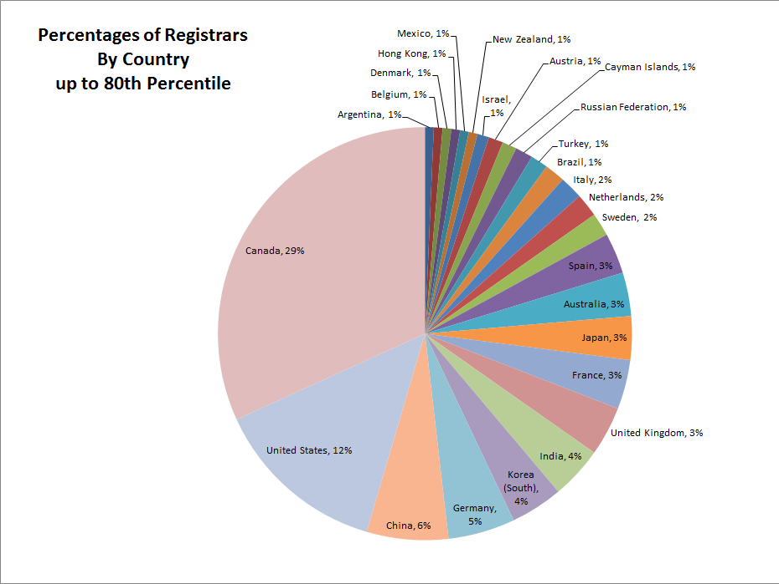
Registrars

Slide 25
DNS Lookup
WHOIS functions available online from each registrar
  But http://www.betterwhois.com/ works with all registrars (see next page)
Many other tools available online for DNS lookup
SamSpade tool and service from http://www.samspade.org can find many records as well as providing additional functions (see page after next)
Info in registry may be false or out of date
  Often see dummy phone numbers in DNS

Slide 26
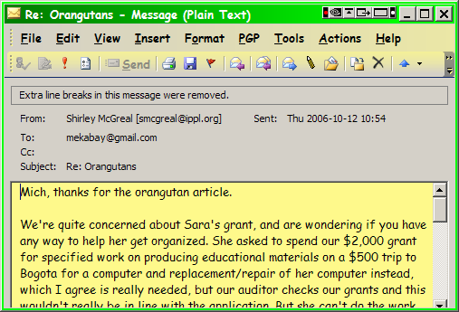
Locating Information from E-Mails
Headers are crucially important
  Often stripped from display

Slide 27
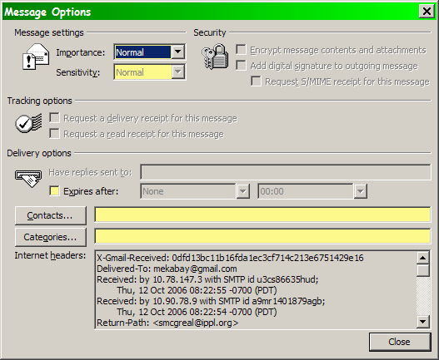
E-Mail Headers
Can be displayed through e-mail options
This example
is from
MS-Outlook

Slide 28
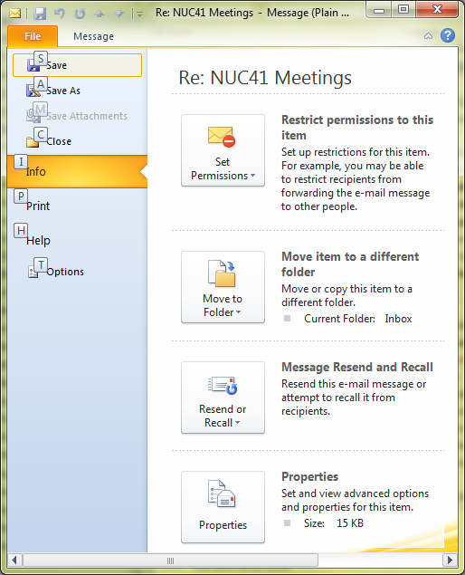
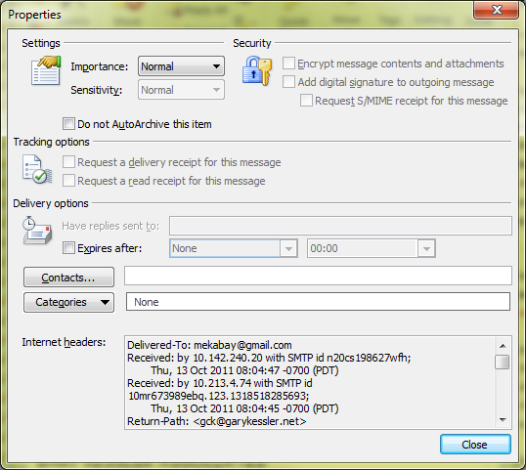
E-Mail Headers
NEVER simply forward an e-mail of interest to an investigator;
always copy and paste the headers into your message to avoid
corrupting the header.

Slide 29
Proactive vs Reactive Strategies
Some crimes are difficult to locate before they happen – need victim complaint to find out
  Identity theft
  Cyberstalking
Others benefit from dragnets
  Child pornography
  Child abuse
Officers need familiarity with argot (slang), culture

Slide 30
Online Stings: Entrapment?
Must not give any basis for claim that officer initiated, suggested, prompted, or encouraged
  Illegal activity or
  Investigative actions that violate privacy or
  Convert a civilian into an agent of law enforcement to violate legal restrictions
ENTRAPMENT can destroy case
  Why? 4th Amendment safeguards
Sorrells v. United States (1932)
  SCOTUS ruled that entrapment defense must show proof that LEO encouraged crime
  Defendant would not have been predisposed to commit crime

Slide 31
United States v. Poehlman (2000)
Poehlman alleged to have met undercover LEO to have sex with minor
But defendant said he started online discussions with LEO to form adult relationship
LEO wrote she was looking for someone “to train her daughters in the ways of the world”
Poehlman explicitly said he wasn’t interested and LEO responded that she would terminate relationship
Poehlman offered to “train” daughters as way of continuing relation but claimed he had no intention of having sex with them – was ploy
SCOTUS ruled in favor of defendant: evidence that pedophilia was not his original intent & LEO was significantly responsible for his actions

Slide 32
Three Cybercrime Scenarios
YOU ARE RESPONSIBLE FOR STUDYING THESE CASES IN DETAIL
Cases presented by Ivan Orton in Ch 3 of Prof Clifford’s text:
  Janet Davis – intrusion and data theft
  Mel Howard – intrusion and data destruction
  Allen Worley – harassment and stalking via e-mail
Study closely – will be discussed throughout remainder of course AND IN EXAMS
  Events
  Investigation
  Prosecution

Slide 33
Now go and study

