Slide 1
Search Warrants & Seizure of Electronic Evidence
CJ341/IA241 – Cyberlaw & Cybercrime
Lecture #17
M. E. Kabay, PhD, CISSP-ISSMP
School of Cybersecurity, Data Science & Computing
Norwich University

Slide 2
Topics
Identifying Physical Location of Electronic Evidence
  ECPA Effects on Data Acquisition
  Collaboration from Third-Party Record-Holders
Which Computers?
Legal Limits on Searches
  Federal Constitutional Limits
  State Constitutional Limits
  Statutes

Slide 3
Identifying Physical Location of Electronic Evidence
General Principles
ECPA Effects on Data Acquisition
  Coverage
  Disclosure to Government Agents
  Contents of Electronic Communications
  Violations of the ECPA
Collaboration from Third-Party Record-Holders
  Finding the Records
  Evaluating Utility of Records
  Authenticating Records
  Obtaining Records
  Contacting ISP & Serving Papers

Slide 4
General Principles
Katz v US (1967): SCOTUS held that publicly disclosed information is not constitutionally protected
  Includes voluntarily transferred
  info in hands of third parties
  Thus third-party repositories
  limited by statute, not 4th
  amendment
Restrictions include laws
protecting
  Bank records
  Cable TV & video rentals
  E-mail & other electronic communications

Slide 5
ECPA Coverage
2000: Updated Wiretap law (18 USC §2510-22)
2004: Added Stored Electronic Communications Privacy Act (SECA, 18 USC §2701-11)
Protects contents of e-communications in storage by service
Prohibits provision of communications to government agencies without strict controls

Slide 6
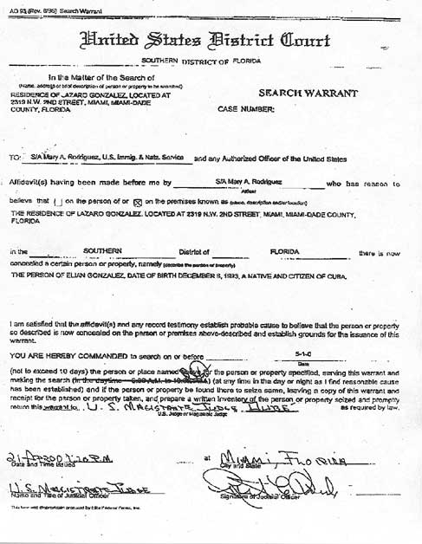
Disclosure to Government Agents
All records may be obtained through warrant
Subscriber/customer records (identity, services) may also be obtained by subpoena
Transaction history available through subpoena since U.S.A.P.A.T.R.I.O.T. Act passed
E-mail may be retrieved by subpoena provided user given notice (up to 90-180 days delay)
May use “§2703(d) court order” to access everything except unopened e-mail stored < 180 days

Slide 7
Contents of Electronic Communications
Agreement of one party in electronic communication suffices for legal disclosure
Take that fact into account when you are writing e-mail
  In general, when writing with
  employee userID, all e-mail
  must be considered equivalent
  to using company letterhead
  All official e-mail may become
  evidence in a court of law
When writing informally using your own address, remember that everything on Internet is POTENTIALLY PERMANENT and may affect your future employment prospects

Slide 8
Violations of the ECPA
Criminal liability
  Up to 2 years in federal prison
Civil liability
  Damages & attorneys’ fees
  Government agent may be
  personally liable
Suppression: NOT a remedy
Good faith defense:
  Government agent may
  Rely on good faith application of warrant or subpoena
  As absolute defense against civil or criminal charges stemming from actions

Slide 9
Evaluating Utility of Records
But look for
video camera
recordings
Records may not be available
  Typically 30-60 day retention of log
  records
  Dynamic IP addresses may make identification difficult for older evidence
Some records may originate in public computers that are effectively anonymous
  Business services (e.g., Kinko’s)
  Libraries, Internet cafés
  Wireless services
  Hijacked services
  Anonymizers

Slide 10
Authenticating Records
Spoofing may disguise origin
  Naïve users alter originating
  address
  But headers show real IP
  addresses
More sophisticated criminals
add faked header lines
  Must always analyze entire header
  SamSpade does this (discussed in lecture 16)
Open spam relay a danger
  Logon to unprotected SMTP server
  Send mail from someone else’s system

Slide 11
Obtaining Records
Typically obtain search warrant
  Better than subpoena
  Can obtain any records at all
  Avoids problem of more restrictive state laws that require warrant
So why not use a warrant?
  Might not have probable
  cause
  Difficulty getting
  warrant across state
  lines

Slide 12
Contacting ISP & Serving Papers
Call ISP to be sure they have records you need
  Discuss IP addresses with
  technical staff
  Identify possible errors of
  analysis
  Find out if there have been
  mergers or acquisitions
  Identify possible IP sub-blocks
  owned/used by other entities
Ask if ISP will accept warrant by fax
Explain exactly what you need

Slide 13
Search Warrants
Which Computers?
Legal Limits on Searches
  Federal Constitutional Limits
  State Constitutional Limits
  Statutes

Slide 14
Which Computers?
Goal of tracing electronic communications:
  Locate computer at origin of evidence of crime
  Link to specific person
Computers that may be involved
  Victims’ computers may be searched without warrant with permission
  Publishers’ computers not restricted if publisher is the victim
  ECPA does not apply to suspects’ computers

Slide 15

Federal Constitutional Limits
Fourth Amendment
  Reasonable expectation of privacy
  Government action
Legal Warrant
  Probable cause
  Neutral/detached magistrate
  Reasonably precise
Rules for Executing Warrant
http://tinyurl.com/4jmcaz

Slide 16
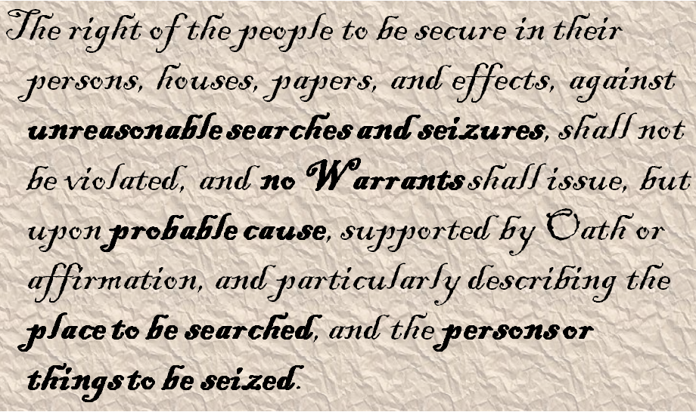
The Fourth Amendment Text
Bold emphasis added

Slide 17
4th Amendment Issues (1)
Reasonable expectation of privacy (EOP)
Subjective expectation
  Computer in home has higher EOP
  Shared computer has lower EOP
  Employer’s computer: depends –
    Policy?
    Awareness?
    Enforcement?
Social acceptance or
expectation of search

Slide 18
4th Amendment Issues (2)
Government action
  Searches by state
  law enforcement
  may transfer results
  to federal agencies
    But federal authorities must not have been involved in a way that would require suppression of evidence
Private citizens
  Constitution does not affect search by private citizen not acting as an agent of law enforcement
  Thus evidence usually admissible in court

Slide 19
Legal Warrant
Probable cause
  Evidence of a crime
  Likelihood that evidence will
  be found in location to be
  searched
    How do you know suspect
    used computer in home?
    Could have been elsewhere
    May need circumstantial evidence such as time stamps, stakeout
Neutral/detached magistrate
  Who has authority for warrant location
  Watch out for cross-state jurisdiction
Reasonably precise
  General description may lead to suppression
  Best to mention computers & media explicitly

Slide 20
Rules for Executing Warrant (1)
Knock and announce: identify as LEOs & explain purpose in entering premises
Take items in
plain view
  But contraband and
  tools for crime may
  also be seized if
  they are visible
  and obviously
  incriminating

Slide 21
Rules for Executing Warrant (2)
Good faith
  Evidence seized under faulty warrant may be suppressed
  But generally LEOs not prosecuted if acting under good faith in legality of (later overturned) warrant
Remove computers for analysis off-site
Prompt execution
  Don’t let evidence evaporate
  Cannot hold warrant in abeyance indefinitely

Slide 22
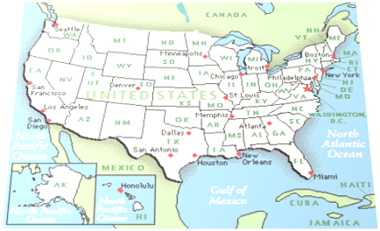
State Constitutional Limits
Some states more restrictive than federal rules
Some do not allow good-faith exception to requirement for valid warrant
Some may protect vehicles (and by implication portable computers) more than federal courts

Slide 23
Statutes
ECPA (as discussed above)
Zurcher v. Stanford Daily
  LEOs had warrant to search student newspaper’s computer for pictures of political demonstration
  SCOTUS ruled that 1st Amendment issues did not further limit warranted searches
This is not a statute.

Slide 24
Statutes: PPA
PPA passed to further restrict warrants
  Privacy Protection Act (42 USC §2000aa)
  Passed in 2000
  Any material intended for publication or broadcasting requires a subpoena
  Exceptions
    Contraband, fruits or tools for crime
    Preventing imminent death or injury
    Material held by target of investigation
    Child pornography
And neither is this.

Slide 25

PPA & Steve Jackson Games
March 1990: Secret Service raided Steve Jackson Games
  Looking for info about BellSouth’s emergency service
  Had been posted on BBS
  Seized entire computer for BBS
  Held for months
  Severely damaged company
SJG sued under PPA & ECPA
  Won trial
  Awarded damages $51K
  Attorneys’ fees $250K
Irony: BellSouth info was actually public & available for sale from company

Slide 26
Now go and study

