Slide 1
Warrantless Seizure of Evidence
CJ341/IA241 – Cyberlaw & Cybercrime
Lecture #18
M. E. Kabay, PhD, CISSP-ISSMP
School of Cybersecurity, Data Science & Computing
Norwich University

Slide 2

Overview of Topics
Exceptions to Requirement for Warrant
Consent
Search Incident to Arrest
Exigent Circumstances
Inventory
Stop and Frisk
Mobility
Plain View
I.C.E.

Slide 3

Exceptions to Requirement for Warrant
Long-standing view in jurisprudence:
  Warrant not necessary IF
  Owner of property agrees to search
Issues
  Does consenter have legitimate right to consent to search?
  Expectation of privacy
  Degree of ownership of property

Slide 4

Consent
Who May Consent?
  Employer
  Parent
  Spouse
  Co-User
  Third-Party Holder
Notification of Right to Withhold Consent
Limitations and Withdrawal of Consent

Slide 5

Who May Consent?
Matlock 1974: Common authority or sufficient relationship to premises or effects
Rith 1999: Mutual use
  Joint access
  Control of property for most purposes
Crucial test: expectation of privacy
  Reduced in shared accommodations
  But evidence of rent & of security strengthens expectation of privacy (see later slides)

Slide 6

Private Employers
Employer not
acting as agent of
LEO is free to
search own
property without
suppression of
evidence
General acceptance of right of search
  For area not exclusively reserved for a particular employee
  Expect same rule for computers
Explicit policy reducing expectation of privacy strengthens admissibility of evidence

Slide 7
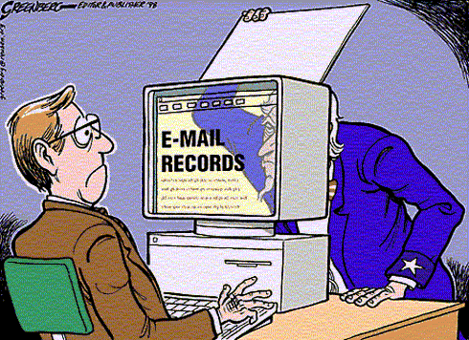
Public Employers
SCOTUS: O’Connor v. Ortega (1987) established expectation of privacy for government employees
  But open office could
  reduce expectation
  Also affected by
  specific policy
Policy effectiveness
depends on
  Clear enunciation of
  limits to privacy
  (e.g., logon banner)
  Evidence that
  employees are aware
  of policy
Problems
  Allowing private use of government computers
  Allowing unauthorized encryption
Used with permission of artist. http://tinyurl.com/6pszy7
Copyright © 1998 Steve Greenberg. All rights reserved.

Slide 8
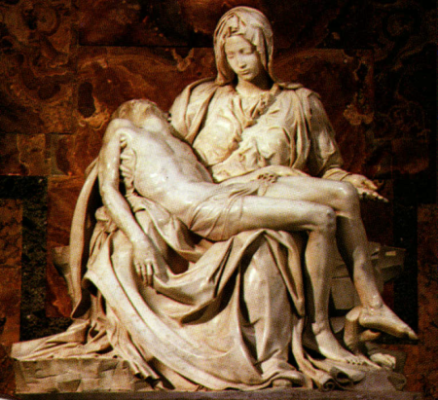
Parent
Closer relationship supports consent
Parents’ consent generally accepted by court
  But child must be “essentially dependent” on parent
  Payment of rent reduces authority to grant consent
US v. Durham (1998): Mother could
not grant consent for search of
son’s computer
  Even though she owned some
  of equipment
  Because son applied security
  to system
  And he paid small amount of
  rent
Pietà, marble sculpture by Michelangelo, 1499; in St. Peter's Basilica, Rome

Slide 9

Spouse
Generally viewed as having “joint control and equal right to occupancy of premises and access to computers on premises” [Orton p 141]
BUT consent is invalid if
  Computer is used exclusively by non-consenting partner
  Kept in separate room (esp. if locked)

Slide 10

Co-User
Shared use reduces expectation of privacy
But still case law to develop on effects of
  Access controls
  Encryption
Co-user cannot
grant consent to
prima facie
private areas
of computer

Slide 11

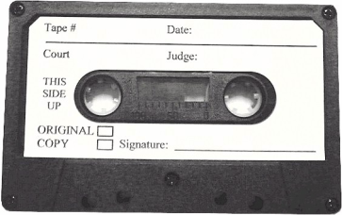
Third-Party Holder
If equipment or media left in possession of someone else, does that person have right to consent to search without warrant?
Problematic case law: contradictions
US v. James (2003):
  Court ruled search of data CDs invalid because
  Owner did not intend to give 3rd party authority to grant consent for search
  But note that CDs were in sealed envelope
US v. Falcon (1985):
  Cassette tape labeled “confidential/do
  not play”
  Court ruled tape admissible without
  warrant
  Argued holder could have played tape any time
CONCLUSION: best to proceed with warrant to avoid risk of suppression

Slide 12

Notification of Right to Withhold Consent
Is consent to search voluntary?
Federal system imposes burden of proof on government using preponderance of evidence
Other jurisdictions may be more exigent
  E.g., requiring “clear and convincing evidence”

Slide 13
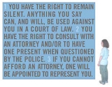
Factors affecting judgement of voluntary consent:
Age/intelligence of suspect
Being advised of
constitutional rights
(Miranda warning)
Custody or detention
(and length)
Physical punishment
or deprivation (sleep,
food)
Generally, advising
person that warrant
will be sought if consent not granted is acceptable

Slide 14
Limitations and Withdrawal of Consent
Consent for search may be withdrawn at any time
Area of search may be limited
Continuing to search after withdrawal or in unauthorized areas leads to suppression of evidence
Does breaking access protection or encryption violate restrictions on unwarranted search?
  In physical world, breaking locks or sealed containers has led to suppression
  But no damage when breaking security so evidence may be accepted by court

Slide 15
Search Incident to Arrest
General principle allows
search and seizure of
evidence at time of arrest
  Purpose: prevent
  destruction of evidence
  Therefore expect same rule for digital evidence
Particularly useful for seizing cell phones and PDAs
  May contain useful data
  E.g., phone lists, calendars, call logs

Slide 16
Exigent Circumstances (1)
Probable cause
Exigent circumstances defined essentially by
  Imminent destruction of evidence
BUT
  Allows for seizure of computer
  But NOT for search
    Need separate warrant for search

Slide 17

Exigent Circumstances (2)
US v. Reed (1991) established requirements for admitting evidence obtained under warrantless search with claim of exigency
  Must demonstrate degree of urgency
  Amount of time required for getting warrant would seriously interfere with process of ensuring justice
  Evidence in danger of
  destruction or removal
  Danger to officers or
  evidence at crime scene
  Suspect’s awareness of
  anticipated seizure of
  evidence
  Ease of destruction of
  evidence by suspect

Slide 18
Exigent Circumstances (3)
US v. David (1991)
  LEO observed suspect deleting data from PDA
  Seized device and scanned names
  Court admitted evidence
  But exigency ended as soon as PDA was
  seized
US v. Ortiz (1996): court ruled that search of pager
was warranted because of risk of data loss as
batteries failed
US v. Romero-Garcia (1997): search of laptop computer was not warranted by fear of battery failure (would not normally destroy data)
Best practice: if device seized under exigent circumstances, obtain a warrant using probable cause to justify search that will ensure evidence is accepted in court unless data are evanescent

Slide 19
Inventory
Normally associated with
searching vehicles to list
all evidence present
Booking search catalogs
possessions of suspect at
time of arrest
Might permit LEO to search computer or electronic device to determine identity of suspect
But should not use as basis for extensive forensic analysis: get a warrant

Slide 20

Stop and Frisk
LEO may search suspect for weapons
May seize computing device during search
BUT should not search computer without warrant

Slide 21
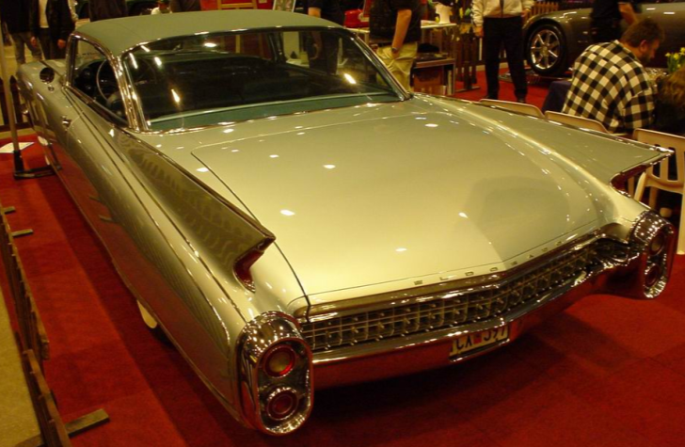
Mobility
Vehicle’s mobility serves as exigent circumstance justifying immediate search without warrant
Could therefore
reasonably seize a
computer found in
such a search
But Orton argues that
this view could not
justify search of
computing devices
And there is no current case law supporting such a procedure

Slide 22
Plain View (1)
Doctrine: If contraband is
  Left in plain view of LEO
  Who is in lawful place
  Then there is no expectation of privacy
Limits
  Incriminating nature must be obvious
  LEO must be legally allowed to be in position where item is in view
  LEO must not alter search process as result of plain-view discovery

Slide 23
Plain View (2)
So cannot exceed limits of warrant when searching computer even if plain-view item such as file-name suggests crime
If protocol in warrant specifies searching all files, may log child porn as long as search continues through all files
If protocol in warrant specifies searching all files but only for business fraud data, may NOT open file suspected to contain child porn
So if new evidence of a different crime is discovered in plain view, get a warrant to change search protocol.

Slide 24
Plain View (3)
US v. Carey (1999)
  Narcotics investigation of computer disk
  Officer’s discovery of 1st child porn image accepted in court
  But subsequent discoveries suppressed – unlawful search beyond terms of warrant
US v. Gray (1999)
  LEO conducting file-by-file search
  Discovered child porn
  Immediately applied for warrant to search of child porn
  Court ruled that not only was officer correct but also that had other child porn been discovered in systematic examination of all files, those images would have been admissible also

Slide 25

Immigration & Customs Enforcement (ICE)
Homeland Security Act of 2002
  http://www.dhs.gov/xabout/laws/law_regulation_rule_0011.shtm
Established Department of Homeland Security (DHS)
  http://www.dhs.gov/index.shtm
Combined many US law enforcement and regulatory agencies
  http://www.dhs.gov/xabout/history/editorial_0133.shtm
US Customs Service and Immigration
and Naturalization Service
contributed to
  Immigration and Customs
  Enforcement (ICE) http://www.ice.gov/
  Customs and Border Protection
  http://www.cbp.gov/

Slide 26
Border Searches (1)
Border guards can search & interrogate anyone entering USA
  http://www.dhs.gov/xlibrary/assets/ice_border_search_electronic_devices.pdf
Not subject to 4th Amendment restrictions
  Need not ask traveler for consent
  May examine any electronic device on demand
  May seize and keep devices “reasonable time”
Very few people have their digital info searched or seized
See Kabay, M. E. (2011). “Search and seizure:
No Fourth-Amendment Rights at Borders.”
< http://www.networkworld.com/newsletters/sec/2011/090511sec1.html >

Slide 27
Border Searches (2)
Cases cited by Customs & Border Patrol
2004: Canadian traveler carrying software stolen from U.S. firm convicted of violating EAR trying to sell restricted software to PRC
2005: traveler showing extreme nervousness carrying child pornography on laptop computer &CDs
2006: currency smuggler – info on laptop about "cyanide and nuclear material"
2006: student carrying information on IEDs, a picture of himself reading his will, and pictures of Al-Qaida terrorists
2007: visitor acting strangely had laptop computer with "violent jihadist materials" – recruiter for terrorist groups
See Kabay, M. E. (2011). “Justifying spontaneous computer seizures.”
http://www.networkworld.com/newsletters/sec/2011/090511sec2.html

Slide 28
Now go and study

