Slide 1
Electronic Crime Scene Investigation
CJ341 – Cyberlaw & Cybercrime
Lecture #19
M. E. Kabay, PhD, CISSP-ISSMP
D. J. Blythe, JD
School of Business & Management

Slide 2

Topics
Introduction
Nature of Electronic Evidence
Handling Electronic Evidence at the Crime Scene
Electronic Devices
Securing and Evaluating the Scene
Documenting the Scene
ECSIGFR = Electronic Crime
Scene Investigation: A Guide for
First Responders (NIJ)
Another useful reference: Volonino, L., R. Anzaldua, J. Godwin (2007).
Computer Forensics: Principles and Practices. Pearson Prentice Hall
(ISBN 0-13-154727-5). xviii + 534. Index.

Slide 3
Introduction
Law Enforcement Response to Electronic Evidence
Latent Nature of Electronic Evidence
RULE 1 OF DIGITAL FORENSICS
Forensic Process

Slide 4
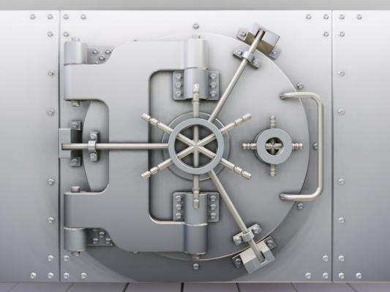
Law Enforcement Response to Electronic Evidence
Computers involved in crime may be
  Tools
  Repositories of
  evidence
  Targets
Personnel of many types may
be involved in responding to
crime involving computers
  LEOs
  Investigators (private, corporate)
  Forensic examiners
  Managers (case, corporate, political)
First responder can be anyone in LE
  Must safeguard EE against loss or tampering

Slide 5
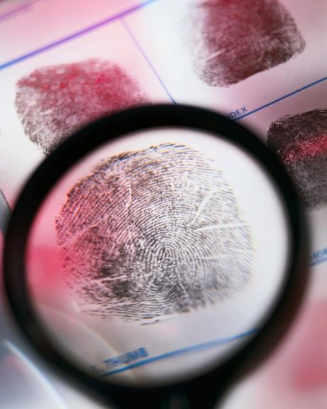
Latent Nature of Electronic Evidence [EE]
“Electronic evidence is information and data of investigative value that is stored on or transmitted by an electronic device.” [ECSIGFR p. 17]
EE thus latent (like fingerprints, DNA evidence) because not immediately visible
  Requires technical equipment
  & expertise
  May need expert testimony in
  court to explain analysis
EE fragile
  Easily destroyed or altered
  Chain of custody & technical
  safeguards essential for
  successful prosecution

Slide 6

RULE 1 OF DIGITAL FORENSICS
HARM NOTHING!
(E.G., DON’T LET AMATEURS
COLLECT DIGITAL
EVIDENCE)

Slide 7
Forensic Process
Key phases:
Collection: search / recognition / collection /
documentation of evidence
Examination (technical perspective)
  Document content / state
  of evidence
  Reveal hidden data
  Identify relevant data
Analysis (legal perspective)
Reporting
  Process notes for expert
  testimony
  Results
  Reliability

Slide 8
Nature of Electronic Evidence
Quoting directly from
ECSIGFR p. 20
Is often latent in the same sense as fingerprints or DNA evidence.
Can transcend borders with ease and speed.
Is fragile and can be easily altered, damaged, or destroyed.
Is sometimes time-sensitive
Therefore only those with expertise should handle digital evidence
  E.g., rebooting alters or destroys data that could be useful in investigation
  Forensic data-capture tools
  often require training

Slide 9

Handling Electronic Evidence at the Crime Scene
Preparations
  Secure and document crime scene (photographs, sketches, notes)
  Use protective equipment to avoid contaminating crime scene (e.g., gloves)
Recognize and identify
evidence
Document electronic
equipment at crime scene
Collect and preserve EE
Package and transport EE
Maintain chain of custody

Slide 10
The Digital Forensics Tool Kit (1)
Volonino et al. p 126 ff
ECSIGFR p 23 ff
Cellular phone
Basic hardware toolkit: screwdrivers, pliers, duct tape etc.
Watertight & static-resistant plastic evidence bags
Labels and indelible markers
Bootable media: DOS startup, bootable CDs, bootable USB drives w/ forensic software
Cables: USB, FireWire, CAT5 crossover & straight-through, power cables
Laptop computer for tools and notes
PDA with integrated camera & link to PC

Slide 11
The Digital Forensics Tool Kit (2)
High-resolution camera(s) w/ date-time stamps
Hardware-write blocker (e.g., FastBloc, DriveLock) to prevent damage to removed drive
Luggage cart
Flashlight
Power strip
Log book
Gloves
External USB hard drive
Forensic examiner platform (e.g., specialized tools) for data acquisition

Slide 12
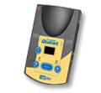
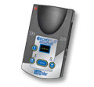
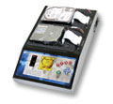
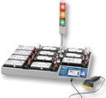

Specialized Forensics Tools
E.g., Logicube® < http://www.logicube.com/ >
Popular hard-drive cloning systems
Used by
  Law enforcement
  Military
  Internal IT departments
Products support various drive interfaces and connectors
  IDE
  SATA
  SAS
  SCSI
  USB

Slide 13
Establish Your Search Parameters
Volonino et al. p 129
What types of evidence are you looking for?
  Photographs? Document? DBs? E-mail?
What is the user’s/suspect’s skill level?
What kind of hardware is involved?
  Computers (Mac? Windows? Linux?)
  PDAs? Cell phones? Watches?
What kind of software is involved?
Do I need to preserve other types of
evidence?
  Fingerprints? DNA?
What is the computer environment?
  Network? (Protocols, topology…) ISP?
  Security? UserIDs? Passwords? Encryption?
  Real bombs inside the cases [thanks to Chris Tanguay]

Slide 14
Managing the Onsite Investigation
Volonino et al. p 130 ff
Maintain integrity of data collection process
Estimate time required for onsite examination
Limit costs to target organization
  Legal liability for interruptions
  of business
  May outweigh importance of
  crime
  May stop investigation
Evaluate necessary equipment for
onsite work
Evaluate personnel costs
  Who should be onsite?
  Would their involvement impede other critical investigations?

Slide 15
Remove Suspect from Computer
Moore Ch 9
Potential for instant data deletion by suspect
  Can prepare programs to delete key evidence
  Activate at touch of keyboard
  (macros, “hot keys”)
  Or through voice-command interface
    E.g., Dragon Dictation, Windows
    voice-recognition
No-knock search warrants still problematic
Therefore instantly move suspect away from computer
  Shake hands with LEO & prevent return
  Physical force only if necessary
  Allow no return to computer
BOOM

Slide 16
Secure the Scene
Photograph scene
  Agencies are currently using digital cameras
  But recall discussion of falsifiability of digital images
  Use video camera to document process
  May see cases hinging on credibility of such evidence
    Defense sometimes challenges timestamps
    But claims of fraud / error must include likelihood (proffer of proof)
Photograph computer screen(s)
  Especially evidence of system time
Photograph everything that may be evidence
  Cost is not a factor w/ digital cameras

Slide 17
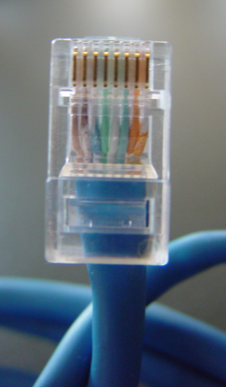
Disconnect Outside Control
Remove network connectivity
  Phone line / DSL
  Cable / satellite modem
  Suspect may be storing
  evidence on remote systems
Wireless connectivity may be
more difficult to handle*
  Wireless I/F may be integrated within computer case – not obvious outside
  Especially true in laptop computers
Look for evidence of home network
  May have data storage in other locations
  *For more details see “The Need for a Technical Approach to Digital Forensic Evidence Collection for Wireless Technologies” by B. Turnbull & J. Slay (2006)
  < http://www.itoc.usma.edu/Workshop/2006/ Program/Presentations/IAW2006-07-1.pdf >

Slide 18

Handling Downloads
What if system shows signs that user was downloading file(s)?
  Could be evidence
Photograph download window
  Reduces chance that suspect can successfully deny involvement in download
  May allow download to complete
Videotape entire process

Slide 19
Powering Down Computer
ECSIGFR p 30 ff
Want to avoid damaging data
Determine Operating System
Save Data from Running Programs?
Save Data in RAM?
Handling Specific OSs
Laptop Computers

Slide 20
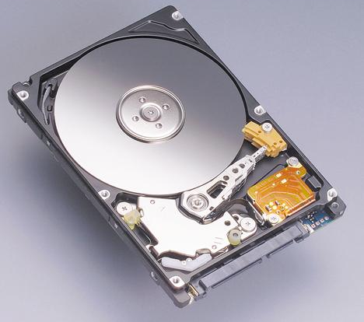

Determine OS for Mobile Devices
GOAL: make bit-images of RAM and of DISK before going any further
OS does not much influence which
tools for bit-image capture on
  Mac versions
  Windows versions
  Unix flavors
OS does influence which tools to use for bit-image capture from mobile devices
  Hardware-specific OSs (cell phones, PDAs)
  Must have right tools and procedures
  Avoid imprecise copy
  Subject of more advanced courses

Slide 21
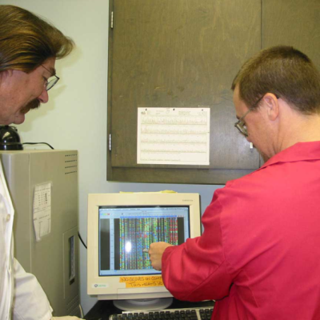
Save Data from Running Programs?
May be able to see that programs
are running (e.g., on program bar)
Disagreement among experts
  Pull the plug: data in temporary
  regions on disk anyway; or
  Save the temporary data explicitly in case they have not yet been written to disk
Technical knowledge essential
  E.g., many OS use extensive write-behind buffering
  Encrypted volumes may be corrupted by instant power-down

Slide 22
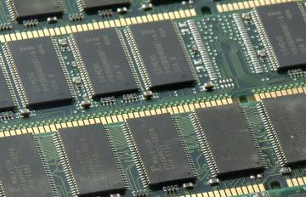
Save Data in RAM?
Most OSs use Virtual Memory (VM)
  Reserve space on hard disk for extension of main memory (RAM)
  Swap data back and forth
  between VM and RAM
  Thus VM swap file a
  treasure-trove of
  potentially valuable data
  about what was in RAM
  However, some users disable VM because of large RAM (e.g., 12 GB)
Specialized utilities for saving data directly from RAM depending on OS & hardware
Particularly important for cell phones and PDAs which may depend on battery power for maintenance of volatile memory

Slide 23




Handling Specific OSs at the Scene
Not suitable topic for this course
For brief overview of
instructions involved, see Moore
p 175 ff
  Microsoft OSs
    Windows 3.11 through XP
  Macintosh
  Unix/Linux
Special tools
for PDAs (e.g.,
Palm, Windows
CE)

Slide 24
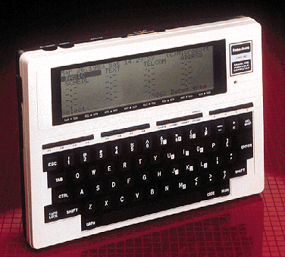
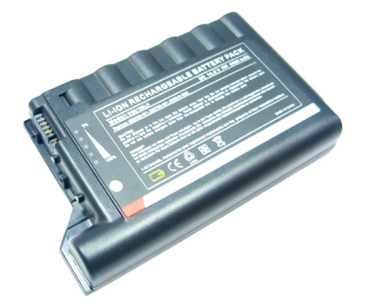
Laptop Computers
Problem: unplugging laptop
instantly switches to battery
power
Need to remove battery from
laptop
  Usually easy
  Simple latch or an easy screw or two
Keep battery with laptop for bagging & shipment
*
* TRS Model 100 from 1983
Computer Desktop Encyclopedia
Used with permission.
Prof Kabay’s very first portable…

Slide 25

Disassembling Computer
Critically important that each computer can be reassembled exactly as it was
Identify each computer with unique identifier
Label absolutely every component with its computer’s identifier
  Particularly the ports (e.g.,
  USB ports, Ethernet ports)
  Mask and mark ports and
  cables in use
  Masking tape or colored
  labels are fine
  Colors can be assigned to
  specific computers
Show directions of connectors (which end to which computer and port or device)

Slide 26

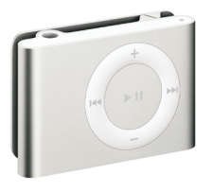
Securing Additional Evidence (1)
How much peripheral equipment should you seize?
  Terms of warrant
  Peculiarities of system (e.g., old)
Peripherals may have evidence
  Cameras, games (XBox, PSPs)
  Scanners (check the scanner bed)
  Sound recorders, iPods (can even carry computer data or operating environments)*
  Calculators (large memory)
Other evidence
  Paper notes and documents
  Digital storage media (magnetic & optical disks – but remember old tape systems)
  Label evidence bags in detail (where, who…)
*Thanks to Ryan Davis
& Stanley François

Slide 27
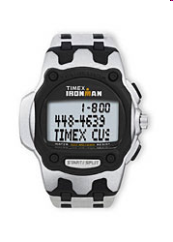
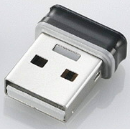


Securing Additional Evidence (2)
USB Port
Already mentioned obvious devices
  PDAs, cell phones, data-watches
USB flash drives may not be obvious
  Small
  May look like pens
  May look like
  … wait for it …
  sushi!

Slide 28
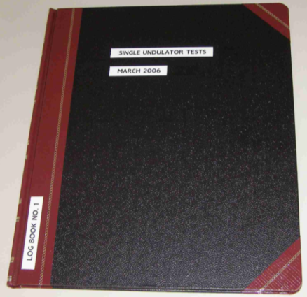

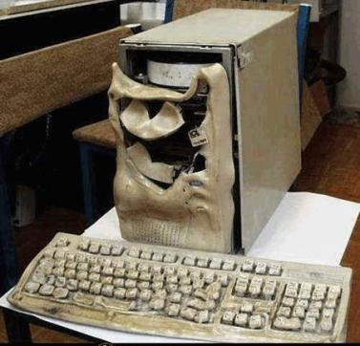
Preparing for Transport
Complete asset-seizure log
  Provide copy to suspect
  Get suspect to sign log sheet
  Note refusal & have OIC
  sign sheet
Bags or boxes depending on
agency
  Do not use Styrofoam – static electricity
  Disk drives that take mobile media (floppies, CDs) should have blanks inserted to
  prevent damage in transit
DO NOT PUT IN TRUNK OF CAR
  Heat & electronic gear can harm
  evidence
  Place on floor or on storage surface

Slide 29
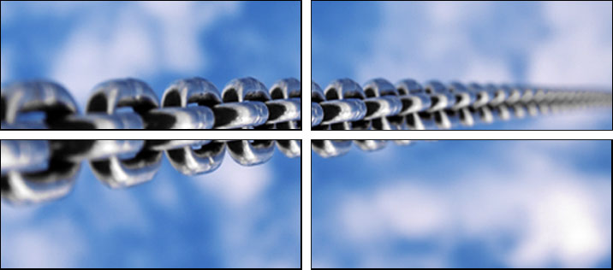
Chain of Custody
Standard concerns about maintaining credible protection of evidence in custody
NEVER allow evidence to be unsecured at any time
Digital evidence can be altered at any time
Unique identification to ensure credibility in court
Detailed records of who accessed the evidence at what time and for how long
Provide detailed records of why individuals needed access to evidence
Ideally, original data must never be released – keep for comparison with digital bitwise copies if anyone challenges authenticity

Slide 30
Now go and study

