Slide 1
Legal Issues in Cybercrime Cases: Unauthorized Access
CJ341/IA241 – Cyberlaw & Cybercrime
Lecture #22
M. E. Kabay, PhD, CISSP-ISSMP
School of Cybersecurity, Data Science & Computing
Norwich University

Slide 2
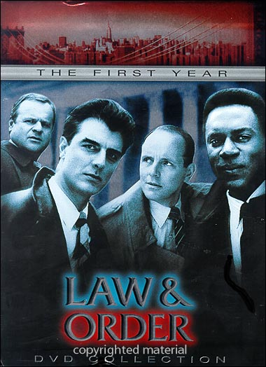
Introduction to §§22-25
Legal Issues in Cybercrime Cases – review of laws affecting acquisition & presentation of electronic
evidence at trial
Serves as significant teaching
tool to solidify knowledge of
statues & procedure
§§:
  22: Unauthorized Access
  23: Cyberfraud & Spam
  24: Intellectual Property
  25: Search & Seizure

Slide 3
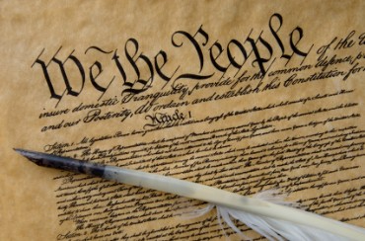
Topics
Defending Cases
  Sixth Amendment to
  the US Constitution
Defenses Defined
Unauthorized Access
  Computer Fraud &
  Abuse Act
Electronic
Communications
Privacy Act
  Wiretap Statute
  Stored Wire & Electronic Communications Act

Slide 4
Defending Criminal Cases
6th Amendment of US Constitution:
In all criminal prosecutions, the accused shall enjoy the right to a speedy & public trial, by an impartial jury of the State & district wherein the crime shall have been committed, which district shall have been previously ascertained by law, & to be informed of the nature & cause of the accusation; to be confronted with the witnesses against him; to have compulsory process for obtaining witnesses in his favor, & to have the Assistance of Counsel for his defence.
Summary of Rights Guaranteed
  Right to Speedy & Public trial
  Right to Impartial jury
  Right to be informed of charge
  Right to confront witnesses
  Right to put forth own witnesses
  Right to Legal Counsel (next slide)
Think about which elements can be used by the defense & how to avoid being vulnerable to legitimate defense tactics.

Slide 5
Right to Legal Counsel
Drafters of Constitution didn’t explain scope of right
Pre-1930s: two enacted statutory provisions suggested limitations on right to representation
Post-1930s: evolution to absolute right to counsel
  Gideon v. Wainwright – unanimous Supreme Court held “that in our adversary system of criminal justice, any person haled into court, who is too poor to hire a lawyer, cannot be assured a fair trial unless
  counsel is provided for him.”
  Right at federal & state levels
  Recently defined as applicable
  to misdemeanors where
  imprisonment can be imposed
  Also applies to felonies

Slide 6
Defense Counsel Responsibilities
“Effective Assistance of Counsel”
  Explain criminal-justice
  process & stages
  Advise defendant of
  his/her legal rights
Check & balance to
government power
  Ensure no violation of
  accused’s constitutional
  rights
  E.g., role to see that
  government meets burden of proof
    Beyond reasonable doubt
    Otherwise risk of arbitrary punishment
    Rule of law depends on equitable application of documented & legal procedures

Slide 7
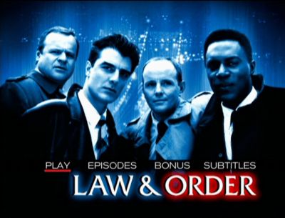
Defense Counsel (cont’d)
Negotiation on behalf of defendant
Handle matters from arraignment to sentencing
  Inquiring/investigating into facts/evidence
  Cross-examining of witnesses
  Raising objections
    Improper evidence
    Improper process
    Improper questions
  Preserving issues for
  appeal
  Presenting legal
  defenses

Slide 8

Defenses
Defenses may be alleged to avoid criminal or civil liability
  Work to limit or excuse liability
Types of criminal defenses
  Innocence (i.e. didn’t
  commit the crime)
  Justification or excuse
  (i.e., did it, but…)
    e.g., self-defense, insanity
  Procedural (e.g., evidence
  suppression / fruit of poisonous tree)
  Innovative or creative (e.g., post-partum depression, involuntarily drugged, ate too many Twinkies™)
Examples of civil defenses
  Lack of jurisdiction
  Failure to state a claim
  Statute of Limitations

Slide 9
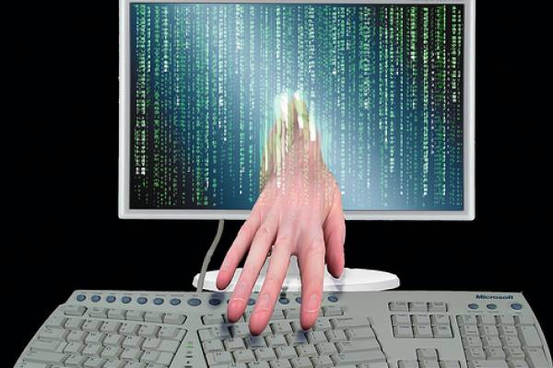
Unauthorized Access
Types of Hackers/Crackers defined
  Motivations
    Personal /
    intellectual
    interest / fun
    Profit
    Sabotage
    Destruction
    Political
    ideology
    Religious fervor
  Criminal Intent – mens rea*
(Latin, “guilty mind”)

Slide 10
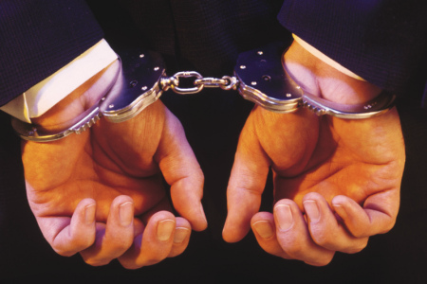
Computer Fraud & Abuse Act (CFAA, 18 USC §1030)
Originally referred
to “federal-interest
computers”
Defined as federal /
state / municipal
government
equipment
Or used by
agencies or
contractors for
such governments

Slide 11
CFAA Revisions
1996: Congress expanded scope
of CFAA
  Replaced ‘federal-interest
  computer” with “protected
  computer”
  Includes every computer
  linked to interstate communications line
    Encompasses Internet
    Covers access to private computer
    Note: If private computer connected to Internet & access occurs in same state, CFAA still implicated
2001: U.S.A.P.A.T.R.I.O.T. expansion of definition
  Includes access to foreign computers that affect US interstate commerce or communications

Slide 12
18 USC §1030(a)(5)
Primary anti-hacking provision of CFAA
Crime to intentionally damage a
protected computer through transmission
of a program, code or command
  Damage: impairment to
  integrity or availability of data,
  program or information
Must act without, or in excess
of, authorization
Must cause, or would have
caused if successful, loss to 1
or more persons during a 1 year
period of at least $5,000
  Loss: any reasonable cost to any
  victim, including loss of revenue

Slide 13
18 USC §1030(a)(5) [cont’d]
May also be liable if causes damage that
  Potentially or actually modified or impaired medical treatment
  Causes physical injury
  Threatens public health or safety
  Damages a computer used by
  or for national security
1996: Amendments tried to limit
available defenses
2001: USA PATRIOT Act tried to
broaden scope of culpable conduct
& eliminate selected intent requirements
  Goal: easier prosecutions

Slide 14
18 USC §1030(a)(5) [cont’d]:
INTENT
If intent to access is found (even if no intent to damage) – can be convicted of misdemeanor
I.e., no defense to CFAA
charge to claim “I didn’t
mean to cause resulting
damage” if intentionally
accessed computer
Before amendments:
whether intent element
went to access or resulting
damage was ambiguous
  U.S. v. Morris: Robert T. Morris* launched destructive program Nov 2, 1988, but didn’t intend to cause damage, only wanted to show vulnerabilities;
  Court convicted Morris of felony, concluding that “intent” element applied to access
* NOT JR!

Slide 15
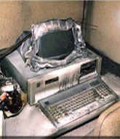
18 USC §1030(a)(5) [cont’d]:
LACK OF DAMAGE
Section 1030(e)(8): damage =
“any impairment to the
integrity or availability of
data, a program, a system,
or information” that
causes a loss of at least
$5000 in a one-year
period.”
2001: loss defined to
include any reasonable
loss; e.g., damage
assessment,
repair, lost profit, among
other losses
Does damage caused rise to requisite level?

Slide 16
18 USC §1030(a)(5) [cont’d]:
Penalties
Federal Sentencing Guidelines: violation of 1030(a)(5) =
4-10 months sentence
Increased penalty for knowingly
or intentionally causing
damage
  12-18 months sentence
  51-63 months sentence
  for disruption to critical
  infrastructure
  (next slide)
  Prior conviction under
  1030(a) or state offense
  involving unauthorized access

Slide 17
Critical Infrastructure
Agriculture, food production & distribution
Electricity generation, transmission &
distribution
Financial services
Gas production, transport &
distribution
Heating
Monty-Python skit suppliers*
Oil & oil products production,
transport & distribution
Public health
Security services
Telecommunication
Transportation systems
Water supply
*OK, not really
See Moteff, J. & P. Parfomak (2004). “Critical Infrastructure and Key Assets: Definition and Identification.” Congressional Research Service, Library of Congress. Order Code RL32631. < http://www.fas.org/sgp/crs/RL32631.pdf >

Slide 18
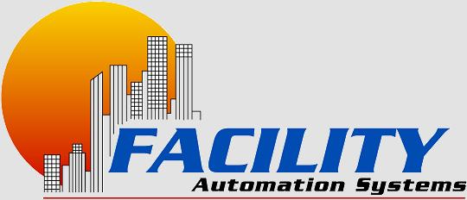
18 USC §1030(a)(5) [cont’d]:
US v. Heim (2006)
Oct. 2006: California defendant, Jay Heim (47 yrs old), sentenced in federal Court for violating §1030(a)(5), for recklessly damaging a protected computer
Heim was founding partner & employee of Facility Automation Systems (FAS)
Left company in March 2005
In Jan 2006, used FAS’ assigned
username & password for its
Internet domain & redirected
all FAS Internet traffic, including
e-mail to a server at his new employer
He knew redirection of traffic would make Web site & e-mail services inaccessible
Cost to FAS: productivity & service restoration >$6K
Heim sentenced to 2 yrs probation + $500 fine & restitution to FAS ($6,050)
http://www.cybercrime.gov/heimSent.htm

Slide 19

18 USC §1030(a)(2)
Prohibits obtaining, without, or in excess of, authorization, information from a financial institution, the federal government, or a protected computer involved in interstate or foreign communication
  “Reading”/viewing info suffices
  Copying or alteration not required
Penalties
  Usually a misdemeanor: 0-6 months under sentencing guidelines (probation)
  Felony if: in furtherance of commercial gain or other crime, or loss >$5,000
  Up to 5 years prison

Slide 20

18 USC §1030(a)(7)
Define extortion
Prohibits online extortion through use of protected computer
  Conduct probably also
  triggers federal extortion-
  specific statute
Felony
  27-33 months in prison
  Increased penalty
    Depending on amount
    of money demanded or
    actual loss
    Damage to critical
    infrastructure or
    involving justice /
    security-related
    computer

Slide 21
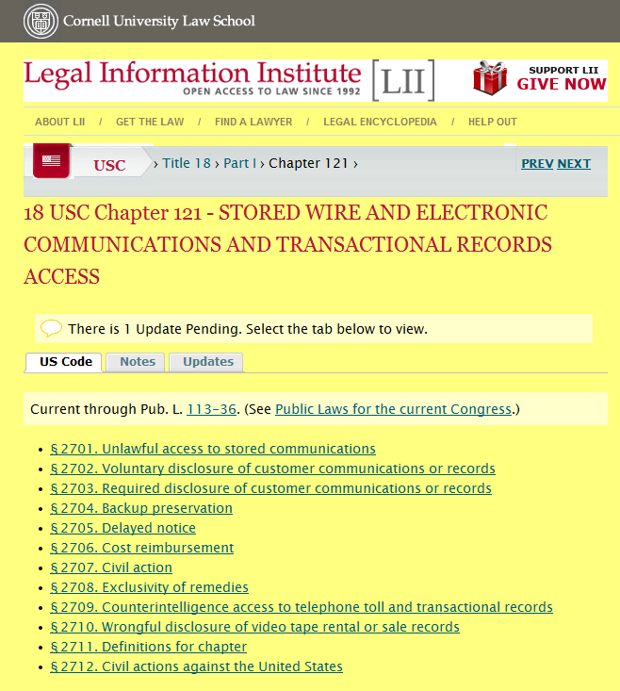

Slide 22
Stored Wire & Electronic Communications Act (cont’d)
Public provider can disclose info about
users under certain conditions:
  Consent of user
  Necessary for provider to
  protect its own rights or
  property
  Inadvertently-obtained
  info related to commission
  of crime
  Reasonable belief of
  danger of death or serious injury
Can also disclose transactional data
Penalties
  Fines, imprisonment < 1 year
  Enhanced penalties for repeat offenders

Slide 23
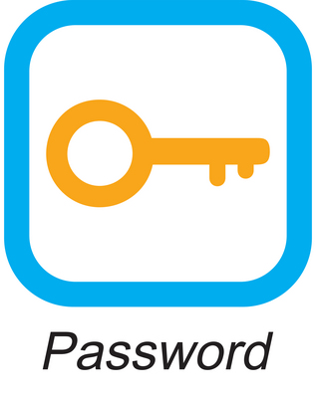
18 USC §1030(a)(6)
Prohibits trafficking in computer passwords used to access protected computer
  Requires intent
    Knowingly
    Intent to defraud
Possibly applicable in ID
theft cases
Penalties
  0-6 months jail
  Increased sentence
  depending on loss

Slide 24
18 USC §1030(a)(4)
Prohibits access with or without authority with intent to defraud or take anything of value (>$5,000)
Defense:
  Defendant can argue no value
US v. Czubinski:
  Defendant charged with 4 counts
  of fraud under 1030(a)(4) for
  unauthorized viewing of
  confidential taxpayer info;
  Court found no violation, as
  viewing information does not
  equal taking something of value
  for statutory purposes
But see US v. Ivanov: Court held
defendant obtained something of value
when obtained root access
Penalties: 0-6 months, depending on loss &
presence of aggravating factors

Slide 25
18 USC §1030(a)(3)
Prohibits intentionally accessing a nonpublic computer of a US department or agency without authorization
Penalties
  0-6 months,
  More possible
  depending on loss
  & type of
  government computer
Possible defenses
  Lacked intent to
  access
  Not US department or
  agency computer

Slide 26
18 USC §1030(a)(1)
Prohibits knowing access of a
computer, without authorization
or in excess of authorization &
subsequent transfer of
classified government info
  Info is protected if it could
  or has potential to injure US
  Doesn’t actually have to be
  used to injure the US
Penalties
  Depends on classification level
  of info involved & existence of any
  aggravating factors
  7-9 years if top secret info; less (4-5) if not

Slide 27
Wiretap Statute (18 USC §2511)
Formulated 1968 & extended by ECPA 1986
Prohibits interception & disclosure of wire, oral, or electronic communication*
  Includes e-mail, voicemail, cell
  phones, satellite signals
  Includes e-mail interception,
  tapping cell phones
    E.g., 2005: Paris Hilton’s cell
    phone hacked**
  Penalties
    Fine, 4-10 months sentence
    Increased penalty for
    commercial gain
*Consent of one party sufficient
** http://abcnews.go.com/Technology/WNT/story?id=545734&page=1

Slide 28
Wiretap Statute (cont’d)
§2511 requires interception during transmission
  Issue: determining “transit”
US v. Councilman:
  Defendant intercepted e-mails sent to amazon.com
  Copied e-mails before they were received by amazon.com
  Court dismissed indictment under Wiretap act,
    E-mails were in form of temporary storage
    As opposed to real-time interception

Slide 29
Electronic Communications Privacy Act (ECPA)
18 USC §2510-2521
Review:
  Enacted in 1986
  Criminalizes unauthorized
  interception of electronic
  communications by private
  entities
  Provides requirements for
  government access of
  electronic communications
  Divided into 2 main chapters
    Wiretap statute
    Stored Wire & Electronic Communications & Transactional Records Act

Slide 30
Stored Wire & Electronic Communications Act
§2701 prohibits access to electronic communications while in storage
Exempts conduct that is authorized by
  Entity providing the service or
  By user (for own communications)
E.g., employer who provides services to be used in employment is not liable for accessing employee communications

Slide 31
Now go and study

