Slide 1
Legal Issues in Cybercrime Cases: Cyberfraud & Spam
CJ341/IA241 – Cyberlaw & Cybercrime
Lecture #23
M. E. Kabay, PhD, CISSP-ISSMP
School of Cybersecurity, Data Science & Computing
Norwich University

Slide 2

Topics
Cyberfraud
  APWG Stats
  ID Theft News
  ITAD (1998)
  ID Theft Penalties
  Defending ID Theft
  Resources for Fraud Victims
Spam
  CAN-SPAM Act
  Notes on Technical Anti-Spam Measures

Slide 3
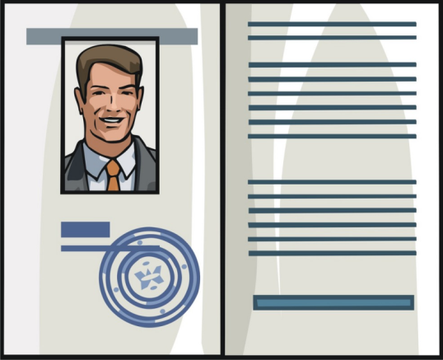

Cyberfraud
Online Fraud among fastest
growing area of crimes
(review notes for lecture 08)
ID Theft
  Argued by some to be
  “inescapable”
  See SpamLaws site:
  http://www.spamlaws.com/id-theft-statistics.html
Phishing
  Growing problem
  Current stats from Anti-Phishing
  Working Group – APWG
  http://www.antiphishing.org/

Slide 4

Company Identity Stolen
2007: FBI broke case in which a company stole another company’s identity!
http://www.fbi.gov/page2/june07/idtheft061807.htm
Private security
companies:
  Executive Outcome,
  Inc. (MI)
  Executive Outcomes,
  Inc. (South Africa)
  (Cont’d on next slide)

Slide 5

FBI: Executive Outcome(s) [1]
2001: British debt collector
  Offered to recover $23M for Executive
  Outcome in MI
  Owed by government of Sierra Leone
  For military training, equipment, security
Actually owed to Executive Outcomes in SA
  But owner of MI firm, John DiPofi, pursued debt fraudulently
  Fabricated documents faking ownership of debt with help of employee Christopher Belan
  Registered “Executive Outcomes” in MI & UK
But Sierra Leone had already agreed to pay real company!
(cont’d on next slide)

Slide 6


FBI: Executive Outcome(s) [2]
MI firm threatened SA owners
  Menacing phone calls – not to be greedy
  or else
  Pictures of interior of SA company’s
  owner’s homes in SA & UK
UK police called FBI
Investigation showed that forged docs
prepared on DiPofi’s office computer
DiPofi & Belan pled guilty
  Conspiracy, wire fraud, income-tax
  evasion
  40 months prison + $51,674 restitution
  See also details of sentencing: http://detroit.fbi.gov/dojpressrel/pressrel07/de032907.htm
More about controversial SA company: http://www.globalsecurity.org/military/world/para/executive_outcomes.htm

Slide 7

ITAD (1998)
Identity Theft and Assumption Deterrence Act of 1998 (ITAD):
18 USC §1001*
Federal crime to: knowingly transfer, possess, or use, without lawful authority, a means of identification of another person with the intent to commit, or to aid or abet, or in connection with, any unlawful activity that constitutes a violation of federal law, or that constitutes a felony under any applicable state or local law
To-date used more to prosecute traditional types of ID theft
_____
* http://www.law.cornell.edu/topn/identity_theft_and_assumption_deterrence_act_of_1998

Slide 8

ID Theft Penalties
Identity Theft Penalty Enhancement Act (ITPEA)
Enhanced ID Theft penalties
  + 2 years prison sentence
  who unlawfully transfers,
  possesses or uses
  another’s ID
  + 5 years ID theft related
  to terrorism

Slide 9
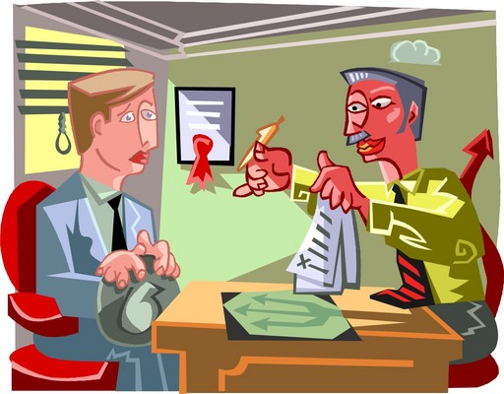
Defending ID Theft
Intent is key
To prove crime, gov’t must prove all elements beyond reasonable doubt:
  Knowing transfer, possession, or use of information
  Without lawful authority
  With intent to commit, or to aid or abet, or in connection with…
  …any unlawful activity that constitutes identity theft

Slide 10
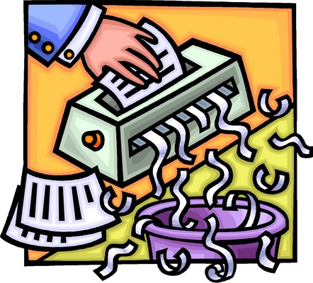
Resources for Fraud Victims
Who should bear responsibility for fraud?
What responsibility, if any, do we have to prevent or minimize risk of fraud?
  Document destruction
    E.g., Shredding sensitive
    information
  Password integrity
    Don’t use same PW on
    multiple sites
  Scams
    E.g., self-education
If it happens to you…
  Visit Privacy Rights Clearinghouse
  http://www.privacyrights.org/fs/fs17g-CrimIdTheft.htm

Slide 11

Privacy Rights Clearinghouse
Fact Sheet 17(g):
Criminal Identity Theft
Copyright © 2001-2008.
Privacy Rights Clearinghouse / UCAN and Identity Theft Resource Center
Posted May 2001.
Revised August 2008.
Identity Theft Resource Center
P.O. Box 26833
San Diego, CA 92126
(858) 693-7935
Web: www.idtheftcenter.org
Email: itrc@idtheftcenter.org

Slide 12

Spam
Controlling the Assault of Non-Solicited Pornography and Marketing Act of 2003 (CAN-SPAM)
  Applies to bulk, unsolicited,
  commercial emails
  Attempts to limit
  email related fraud

Slide 13

CAN-SPAM Act Overview
18 USC §1037
Liability if individual:
  1. accesses a protected
  computer without
  authorization, and
  intentionally initiates
  transmission of multiple
  commercial emails from
  or through such computer;
  2. uses a protected computer to
  relay or retransmit multiple commercial emails, with intent to deceive or mislead recipients, or any Internet access service, as to origin of messages;
  3. materially falsifies header information in such multiple commercial emails
(cont’d on next slide)

Slide 14

CAN-SPAM Act Overview (2)
Liability if individual:
4. registers, using Information that
materially falsifies the identity of the
actual registrant, for five or more
email accounts or online user accounts or two or more
domain names and
intentionally initiates the
transmission of multiple
commercial email
messages from any
combination of such
accounts or domain
names, or

Slide 15

CAN-SPAM Act Overview (3)
5. falsely represents oneself to be the registrant or the legitimate successor in interest to the registrant of 5 or more IP addresses, and intentionally initiates the transmission
of multiple
commercial
email messages
from such
addresses, or
conspires to do
so.

Slide 16

CAN-SPAM
Defenses
Legal Spam
  CAN-SPAM compliant
  unsolicited, commercial
  bulk email
    E.g., Opt-Out
Limited Use
  2004: First criminal
  conviction
    Nicholas Tombros, admitted guilt to wardriving in Los Angeles suburb for wireless access to send spam
    Charged under provision of CAN-SPAM Act that prohibits unauthorized access to send email

Slide 17

Spam Law Loopholes (1)
Circumventing the law
  CAN-SPAM Act argued to yield opposite result – i.e., you can spam
  Spammers have discovered ways around law
    E.g., claiming “Pre-Existing Business Relationship” that authorizes spam

Slide 18

Spam Law Loopholes (2)
Telephones being abused
  Robodiallers call more phones than
  numbers of operators available
  Make victim wait for human attendant
  May also mask return number on
  caller-ID
  Or fake a “disconnected” signal when
  user calls back
Cell phones also being abused
  Unwanted text messaging
  http://abclocal.go.com/kgo/story?section=7on_your_side&id=4711055

Slide 19

Revised CAN-SPAM Rules [1]
May 12, 2008: FTC Approves New Rule Provision Under the CAN-SPAM Act
  http://www.ftc.gov/opa/2008/05/canspam.shtm
Four new terms
  Spam victim requesting removal
  from spammer’s list cannot be
  required to
    Pay for removal
    Provide information other
    than email address &
    opt-out preferences
    Take any other steps other
    than a single email message
    or visit to single Web page
    (cont’d on next slide)

Slide 20

Revised CAN-SPAM Rules [2]
Four new terms (cont’d)
  Definition of “sender” modified
    Easier to determine which
    of multiple parties in
    spam is responsible
  Sender of spam can
  include P.O. box or
  Private Mailbox
    Satisfy CAN-SPAM
    requirement for “valid
    physical postal address”
  Definition of “person” clarified
    Not limited to “natural persons”
    I.e., corporations or other entities have rights to opt out of spam

Slide 21

Notes on Technical Anti-Spam Measures
See http://spam.abuse.net/
Some email systems include excellent antispam: e.g., GMAIL
  mekabay@gmail.com received 447 spam messages caught by GMAIL in 1 week
  Total non-spam emails in that week = 284
Cloudmark collective antispam system
  http://www.cloudmark.com/en/home.html
  Millions of users collaborate to identify new spam – instant addition/distribution of signatures

Slide 22
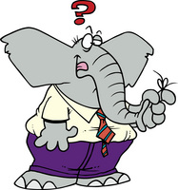
Questions for Class Discussion
Is spam a significant problem
or is it being exaggerated?
Do you think that the
CAN-SPAM Act is working?
Why or why not?
Will technical anti-spam
measures work? Why or
why not?
Can you suggest
improved anti-spam laws? What would they entail?
How would you propose to
solve the spam problem?

Slide 23
Now go and study

