Slide 1
Recent International Legal Developments
CJ341 – Cyberlaw & Cybercrime
Lecture #27
M. E. Kabay, PhD, CISSP-ISSMP
mailto:mekabay@gmail.com
V: 802.479.7937
Assoc Prof Information Assurance
School of Business & Management

Slide 2
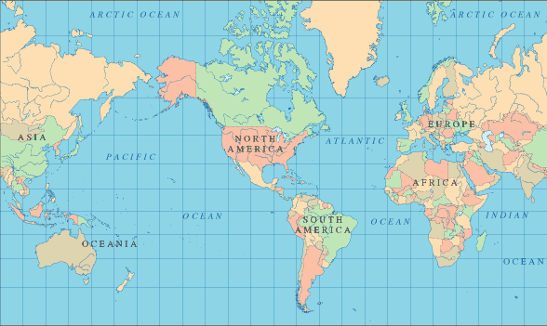
Topics
Overview of International Issues
History
International Investigation & Enforcement Challenges
Dual Criminality Doctrine
US Extraordinary Rendition

Slide 3
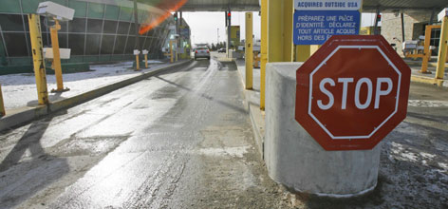
International Issues
Jurisdictional Problems
Commission of offenses across territorial borders
Investigation
Enforcement
What laws apply?
Who enforces them?
Defining computer crime
No international consensus on definition

Slide 4
UN Study: Categories of Cybercrime
Fraud by computer manipulation
Computer-based forgery
Damage to or modifications of computer data or programs
Unauthorized access to computer systems and service
Unauthorized reproduction of legally protected computer programs
Child pornography (creation, trafficking. . .)
Use of computers by organized crime
Terrorist groups committing computer-related crimes or other crimes

Slide 5
Historical Overview
1977: US Senator introduced first cybercrime legislation
Didn’t become law
Credited as the catalyst for international policy
1983: Organisation for Economic Co-operation and Development (OECD)
Study of international legislation
Explored possibility of unified response

Slide 6
History (cont’d)
1986: OECD published Computer-Related Crime Report
Recommended a list of offenses
Envisioned list to be addressed by each UN member country
1986-1989: Council of Europe (CoE) launched its own study
To determine categories of proposed offense conduct
To determine guidelines for enacting criminal legislation
Issued recommendations which expanded OECD list

Slide 7
History (cont’d)
1995: CoE adopted recommendation R(95)13
Identifies substantive offense categories
Considers procedural issues related to investigation & evidence
E.g., search and seizure, co-operation obligations
Concern for civil rights (e.g., individual privacy)
European Privacy Directives require strict protections on privacy
More severe than US laws
http://tinyurl.com/6ggqtm

Slide 8
History (cont’d)
1997: Committee of Experts on Cyberspace appointed by CoE
Charged with identifying new crimes, jurisdictional rights, and criminal liability related to Internet
Canada, Japan, South Africa, and US invited to participate
2001: Committee issued final report
Draft Convention on Cyber-Crime and Memo
Intended as blueprint for first international treaty
http://conventions.coe.int/Treaty/EN/Treaties/Html/185.htm

Slide 9
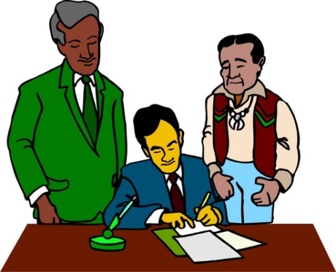
History (cont’d)
2001: Council of Europe, Convention on Cybercrime
International Treaty adopted by Ministers of Foreign Affairs
Signed by 26 member countries, including US
US President signed Convention on Nov. 23, 2001
2004: July 1st treaty took effect
2006: Up to 38 signatories
2006: Sept – US became party
2007: Jan 1: treaty took effect

Slide 10
International Investigation & Enforcement Challenges
Responsiveness (speed) of International Community
“Heel dragging” (Clifford) by governments
Technology-Law lag: laws can’t keep pace
Complexity of international legal landscape
Jurisdiction and venue (where to try) issues
Need for domestic legislation
Lack of global consensus on
Definition of cybercrime
Types of conduct that make up cybercrimes
Definition of criminal conduct (i.e., what conduct should be criminalized)

Slide 11
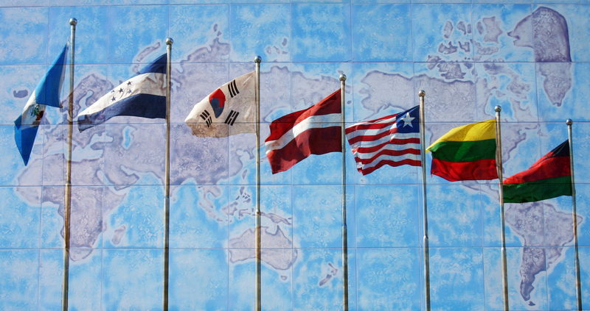
International Investigation & Enforcement Challenges (cont’d)
Transnational scope of many crimes
Lack of procedural law uniformity
Lack of synchronicity of legal mechanisms
E.g., extradition and mutual legal assistance treaties
Inadequate investigatory powers and access to computer systems
Lack of and/or inconsistent training of LE and criminal justice actors
Lack of resources ($)

Slide 12
Resolution of Challenges
Resolution of investigation & enforcement challenges critical
International cooperation is limited to countries with domestic laws and/or to treaty signatories
EC began discussions in 2000 on special international school for LE
Focus on cybercrime
Involve Interpol

Slide 13
Interpol
International Criminal Police Organization
History
Founded Vienna 1923; reconstituted 1946
Nonpolitical
Funded by member contributions
General assembly: annual meeting
Decide policy
Elect officials
HQ in Lyon, France
Functions
Coordinate international police work
Organize regular information exchange
http://www.interpol.int/public/icpo/default.asp

Slide 14
Interpol (cont’d)
Priority crime areas
Public safety and terrorism
Drugs and criminal organizations
Trafficking in human beings
Financial and high-tech crime
Fugitives
Other crime areas
Counterfeit currency and payment cards
Environmental crime
Genocide, war crimes, crimes against humanity
Criminal analysis service
Interpol Annual Report for 2005:
http://www.interpol.int/Public/ICPO/InterpolAtWork/iaw2005.pdf

Slide 15
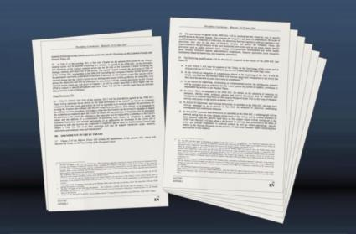
Council of Europe Convention on Cybercrime Treaty
Only multilateral treaty dealing with computer-related crime and evidence
Took effect July 1, 2004
38 Countries have signed
Few have ratified it
US became party in late September 2006
Obligations imposed on participating nations:
Enact legislation criminalizing certain computer-related conduct
Create investigative procedures
Create a regime of broad international cooperation (e.g., co-operation in extradition)

Slide 16
Key Treaty Provisions
Consists of 48 articles, divided into 4 chapters
Chapter II, Section 1
Substantive law issues
Defines 9 offenses grouped into 4 categories
Illegal access
Illegal interception
Data interference
System interference
Misuse of devices
Computer-related forgery
Computer-related fraud
Child pornography related offenses
Copyright related offenses

Slide 17
Key Treaty Provisions Cont.
Chapter II, Section 2.
Addresses procedural law issues
Preservation of stored data
Interception of content data
Disclosure of traffic data
Search & Seizure
Chapter II, Section 3.
Jurisdictional Provisions
Chapter III.
Mutual assistance obligations
E.g., extradition rules

Slide 18
Key Treaty Definitions
Treaty defines 4 principle terms
Computer systems
Computer data
Service provider
Traffic Data
Members not required to incorporate definitions into domestic laws

Slide 19
Treaty Evidence Collection
Provides four methods for securing evidence
Article 18: Production Order
Legal authority must exist to order production of data (e.g., authority to order an ISP to produce subscriber info)
Article 19: Search & Seizure of Stored Data
Applies to stored computer data
Limitation
Doesn’t address trans-border search and seizure (searching without first going through mutual assistance channels)
Article 20: Real time collection of traffic data
Article 21: Interception of Collection Data

Slide 20
Crimes
Section 1, Articles 2-13 establish minimum standards of offenses
Requires all offenses be committed intentionally (mens rea)
Offenses include
Title 1, Articles 2-6: Offenses against confidentiality, integrity, and availability of data and systems
Title 2, Articles 7-8: Offenses related to forgery and fraud
Title 3, Article 9: Offenses related to Child Pornography
Title 4, Article 10: Offenses related to copyright infringements
Title 5, Articles 10-13: Aiding, Abetting, Corporate Liability provisions

Slide 21
Jurisdiction
Article 22: attempts to resolve jurisdiction question
Territoriality principle
Prosecute where committed
Ubiquity doctrine
Crime committed in its entirety within a country’s jurisdiction if one of the elements of the offense or result occurred in that country’s borders
Jurisdiction also applies to co-defendants & accomplices
Principle of nationality
Provides nationals are required to abide by a party’s domestic laws even when they are outside the country

Slide 22
Mutual Legal Assistance Treaties & Other Agreements
Mutual Legal Assistance Treaties (MLATs)
Aimed to improve judicial assistance and facilitate procedures with foreign nations
Usually spell out agreed upon procedures
Only for prosecutors
E.g., Office of International Affairs, Criminal Division of DOJ
Dual Criminality
Meaning conduct is equivalent offense in both countries involved in extradition negotiations
Many MLATs require dual criminality
Investigation can’t proceed if target nation hasn’t criminalized conduct

Slide 23
Dual Criminality Doctrine
Extradition requires
Collaboration of LE agencies across borders
Consistent classification of crimes
Both must define the crime
E.g., Philippines did not define Love Bug distribution as a crime despite massive worldwide damage
If a crime, must match in severity across borders
Thus cannot extradite if extraditing country treats crime as more serious (e.g., felony) than complying country (e.g., misdemeanor)
E.g., US in a minority in North America, South America and Europe in maintaining death penalty
Blocks extradition of some suspects

Slide 24
US Extraordinary Rendition
Controversial process
CIA capturing suspects outside boundaries of United States
Without legal processes for extradition
Sending them for interrogation to countries with looser or no restrictions on torture
Egypt
Jordan
Morocco
Syria
Uzbekistan
http://www.pbs.org/frontlineworld/stories/rendition701/

Slide 25
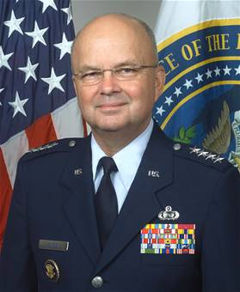
US Extraordinary Rendition [2]
Defenders
E.g., CIA Director GEN Michael V. Hayden
Speaking at Council on Foreign Relations
2007-09-07
Carefully controlled and lawfully conducted
Nothing new
Total numbers in dozens
Used to combat terrorists around world
Intelligence produced irreplaceable and has worked to deter attacks
Constitutional limitations inadequate for current situation
https://www.cia.gov/news-information/speeches-testimony/2007/general-haydens-remarks-at-the-council-on-foreign-relations.html or http://tinyurl.com/5rubaw

Slide 26
US Extraordinary Rendition [3]
http://www.aclu.org/safefree/torture/rendition.html
http://www.fpif.org/fpiftxt/5502
Attackers
E.g., ACLU
Foreign Policy in Focus of Institute for Policy Studies
Process inherently subject to error
Arbitrary arrest, kidnapping
No challenge to allegations
Documented cases of abuse (see following)
Violation of international conventions & US law against torture
Ineffective in extracting usable intelligence
Documented failure of torture to extract truth
Victim will agree to anything to reduce pain
Reduces protection of US personnel against torture around world
Cannot claim US gov’t compliance with UN Convention

Slide 27
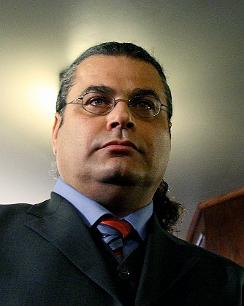
US Extraordinary Rendition [4]
Khaled El-Masri
Innocent German citizen from Ulm on vacation in Skopje in 2003
Detained by Macedonian border guard
Mistaken identity: thought he was Khalid Al-Masri of Al Qaeda in Hamburg
Turned over to CIA
Beaten, stripped, drugged, given enema, dressed in diaper & jumpsuit, flown to Baghdad
Flown to Afghanistan and imprisoned in secret CIO interrogation center
Tortured repeatedly, beaten, raped, force-fed
March 2004: captors admitted he was innocent
Released May 2004 without money on deserted road in Albania
http://www.guardian.co.uk/world/2005/jan/14/usa.germany

Slide 28
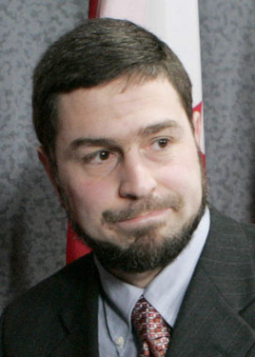
US Extraordinary Rendition [5]
Maher Arar
Canadian/Syrian dual citizen
Sep 2002: Detained at JFK Airport on way home to Canada from holiday in Tunis
Solitary confinement in US under interrogation without lawyer
Deported to Syria & tortured for year
Syrian gov’t found no links to terrorism
Canadian gov’t commission of enquiry cleared Arar of all accusations
Gave him $10.5M compensation
Lawsuit in progress (Arar v. Ashcroft)
US gov’t keeps Arar and family on watchlist
Allowed gov’t to use claim of national security to refuse evidence to court – case dismissed 2009
http://jurist.law.pitt.edu/forumy/2006/09/arar-report-us-should-follow-canadas.php
http://www.maherarar.ca/
http://ccrjustice.org/ourcases/current-cases/arar-v.-ashcroft

Slide 29
Maher Arar case on Democracy Now
Democracy Now October 19, 2006
http://video.google.com/videoplay?docid=-7174998579366061294# (streaming video)
http://www.mekabay.com/courses/academic/norwich/cj341/lectures/27_ghost_plane.mp3 (audio download)
Democracy Now November 3, 2009 – starting 14’56” to 25’25”
http://i2.democracynow.org/shows/2009/11/3 (streaming video)
http://www.mekabay.com/courses/academic/norwich/cj341/lectures/27_maher_2009.mp3 (audio download)

Slide 30
DISCUSSION

