Slide 1
The
U.S.A.P.A.T.R.I.O.T. Act
CJ341/IA241 – Cyberlaw & Cybercrime
Lecture #28
M. E. Kabay, PhD, CISSP-ISSMP
mailto:mkabay@norwich.edu
V: 802.479.7937
Prof Information Assurance & Statistics
School of Cybersecurity, Data Science & Computing
Norwich University

Slide 2
Topics
Purpose
Scope
Provisions
Issues
ACLU Video & Discussion
FOR THOSE WRITING
EXTRA-CREDIT PAPERS
Remember, you are not graded by
whether your instructor agrees with
your political stance: you are graded
on the basis of the clarity of your
exposition.

Slide 3
The Act
Uniting and Strengthening America by Providing Appropriate Tools Required to Intercept and Obstruct Terrorism Act (U.S.A.P.A.T.R.I.O.T. Act)
Act Text: http://www.epic.org/privacy/terrorism/hr3162.html
Federal law (Public Law 107-56)
Wide support for creation and passage of U.S.A.P.A.T.R.I.O.T. Act
  Passed HR 357 – 66
  Passed Senate 98 – 1
Signed by President G. W. Bush, Oct. 26, 2001, after 9/11
Neutral resource:
http://thomas.loc.gov/cgi-bin/bdquery/z?d107:HR03162:@@@L&summ2=m&

Slide 4
Purpose
“To deter and punish terrorist acts in the United States and around the world, to enhance law enforcement investigatory tools, and for other purposes.” (H.R. 3162)
To combat terrorism
  Detect
  Investigate
  Prosecute
Defines & criminalizes domestic terrorism

Slide 5
Scope (1)
Amends a significant number of federal statutes, including:
  Banking Laws
    Bank Secrecy Act
    Right to Financial Privacy Act
    Fair Credit Reporting Act
  Immigrations Laws
    Immigration and Nationality Act
  Computer Fraud & Abuse Act
  Foreign Intelligence Surveillance Act

Slide 6
Scope (2)
Amends…
  Victims of Crime Act
  Electronic Communications and Privacy Act
  Family Education Rights and Privacy Act
Expands
  Domestic Security
  Surveillance Procedures
Affects
  Privacy

Slide 7
List of Laws Amended by U.S.A.P.A.T.R.I.O.T. Act
Wiretap Statute (Title III):
Electronic Communications Privacy Act
Computer Fraud and Abuse Act
Foreign Intelligence Surveillance Act
Family Education Rights and Privacy Act
Pen Register and Trap and Trace Statute
Money Laundering Act
Immigration and Nationality Act
Money Laundering Control Act
Bank Secrecy Act
Right to Financial Privacy Act
Fair Credit Reporting Act
From ACLU summary:
http://epic.org/privacy/terrorism/usapatriot/

Slide 8
History
Swift passage triggered by 9/11
  Many surveillance provisions originally proposed pre-9/11 but were met with resistance (EPIC)
  Recognition of need for new legal tools
  Attempt to beef up security
Sunset Provision
  Several key provisions were scheduled to terminate on Dec 31, 2005, unless extended
  Renewed Mar 2, 2006 until 2011
  Renewed May 26, 2011 until 2015

Slide 9
Provisions – HR 3162 (1)
Title I:
  Enhancing Domestic Security and Terrorism
Title II:
  Enhanced Surveillance Procedures
Title III:
  International Money Laundering Abatement and Anti-Terrorist Financing Act of 2001
Title IV:
  Protecting the Border
Title V:
  Removing Obstacles for Investigating Terrorism

Slide 10
Provisions (2)
Title VI:
  Providing for Victims of Terrorism, Public Safety Officers, and their Families
Title VII:
  Increased Information Sharing for Critical Infrastructure Protection
Title VIII:
  Strengthening the Criminal Laws Against Terrorism
Title IX:
  Improved Intelligence
Title X:
  Miscellaneous

Slide 11
Surveillance & Communications (1)
Major Sources of Authority for surveillance & communications
Title III – requires probable cause for real-time interception of voice/data communications (probable cause required) / contents of information
ECPA – Government access to stored email and communications
  Pen Register Statute – real time interception of dialed numbers or transmitted numbers (probable cause not required, government certifies to court need for information related to criminal investigation)
    U.S.A.P.A.T.R.I.O.T. Act – Expands power to Internet
  Expanded scope of what information service providers must provide to Government when requested

Slide 12
Surveillance & Communications (2)
Major Sources of Authority for surveillance & communications
Foreign Intelligence Surveillance Act – FISA
  U.S.A.P.A.T.R.I.O.T. Act lowers standards for foreign intelligence surveillance
  Government can conduct electronic surveillance upon obtaining court order (probable cause)
Sneak and Peek
  Expansion of Searches
    Good cause
    Permits delayed notification of a search
  Significant departure from 4th Amendment & developed law around search and seizure rights
Expanded Jurisdiction of Search Warrants

Slide 13
Crime Fighting
Records & information
  Expanded scope and access
    Electronic Communications
    Library Records
      E.g., FBI can search library records of suspected terrorists without probable cause, but does need a warrant to do
      Requires librarians to conceal search
RICO (Racketeering statute)
  U.S.A.P.A.T.R.I.O.T. Act permits greater application
    Can now be now used for crimes where no monetary gain

Slide 14
Computer Fraud & Abuse Act
U.S.A.P.A.T.R.I.O.T. Act
  Expands government authority to prosecute computer-related crime
  Increases criminal penalties
    E.g., doubles jail time – first offense max. term now 20 yrs
  Defines/clarifies “loss”

Slide 15
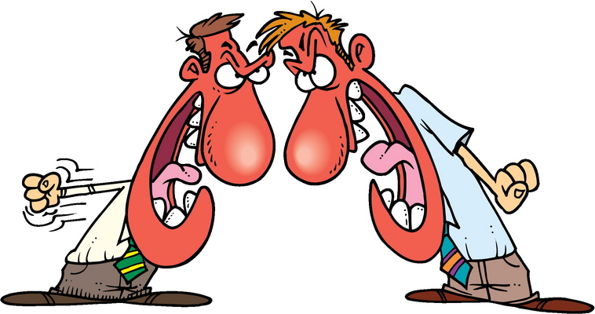
Highly Controversial
Passage by legislators who admitted that did not read
the bill before voting on it
There was no debate about the bill before it was passed.
Privacy
Civil liberties
Constitutionality

Slide 16

Overview (anti-bill)
Electronic Privacy Information Center (EPIC)
http://epic.org/privacy/terrorism/usapatriot/
Civil liberties organization
Detailed analysis with references

Slide 17
Issues (1)
Expansion of surveillance, wiretapping, criminal action
Threat to constitutional rights
Permits “secret searches”
Power to conduct wide surveillance
  Internet
  Phone
  Secret library-records searches
Requires only “intelligence purposes” for criminal investigations
  Elimination of and/or relaxation of probable cause

Slide 18
Issues (2)
Permits jailing/detaining non-citizens on suspicion
  Abrogation of habeas corpus
Allows detaining of suspects without judicial oversight
  Extrajudicial detentions in prison camps (Guantanamo)
  Secret prisons overseas (rendition)

Slide 19
Practical Application
Limited public knowledge about actual application of the Act
Domestic spying concerns
  President Bush’s “secret spying” without authorization
  Executive Order
  Eavesdropping & access to and viewing of communications
  No Secret FISA warrants obtained
  (more in lecture 29)

Slide 20
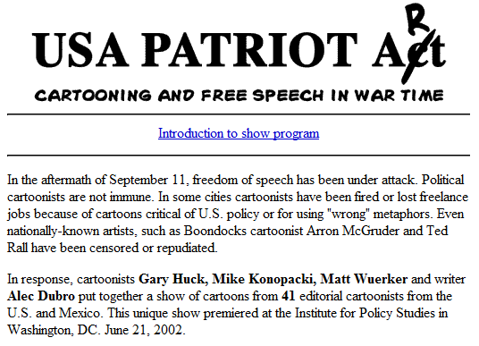
Cartoonists’ Revenge
http://www.solidarity.com/hkcartoons/artshow/artshow.html

Slide 21


ACLU VIDEOS
BEYOND the PATRIOT Act
  http://tinyurl.com/39bvkxj
  10 30-minute episodes
We will now view introductory
video
DISCUSSION to follow in class
RECOMMENDATION: Take notes while you watch – will help in discussion
REMEMBER:
You are NOT expected to agree
with positions in the video.
Articulate, civil disagreement
can stimulate thought. All views
may be expressed without fear.
The ACLU’s logo
Anti-ACLU logo
http://tinyurl.com/8y23qxo

Slide 22
DISCUSSION

