Slide 1
Working with MS-ACCESS
IS 240 – Database Management
Prof. M. E. Kabay, PhD, CISSP-ISSMP
Norwich University
mkabay@norwich.edu
Notes:
M. E. Kabay, PhD, CISSP

Slide 2
Topics
Creating a New Database
Defining Fields in Table
Finish Creating All Tables
Define Relationships
Create Form in Design View
Final Form Design
Final Form Appearance
Creating a Report
Default Report Layout
Preview Report
Further Tuning

Slide 3
Using This Tutorial
Best used online
Available from
http://www.mekabay.com/courses/academic/norwich/cs240/cs240_labs/Working_with_MS-Access.pptx
or
http://tinyurl.com/gtzd7r9
Open or Save the file
Press function key 5 (F5) to start show

Slide 4
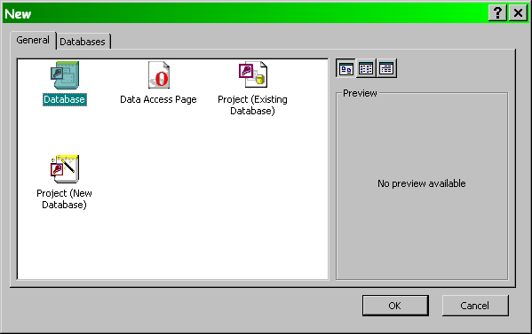
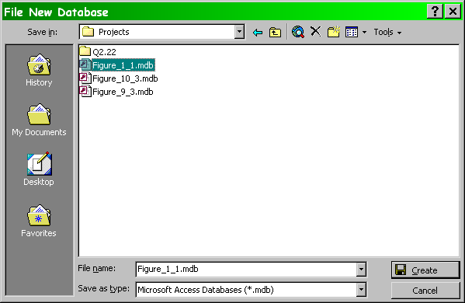
Creating a New Database
New
. . .
Open

Slide 5
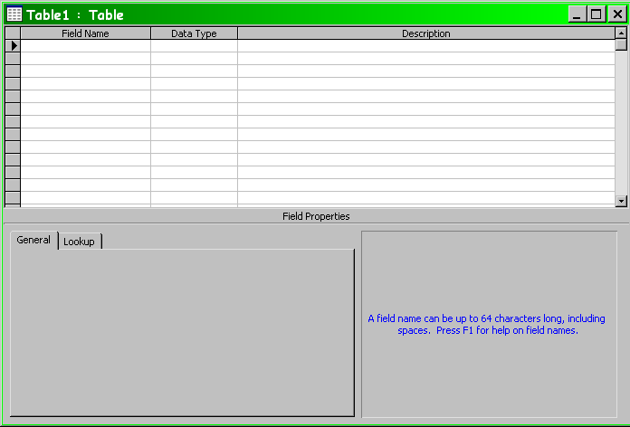
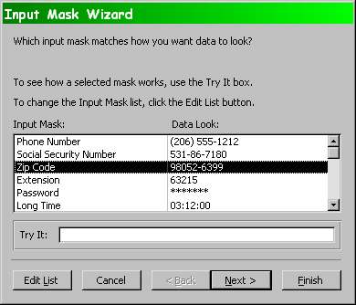
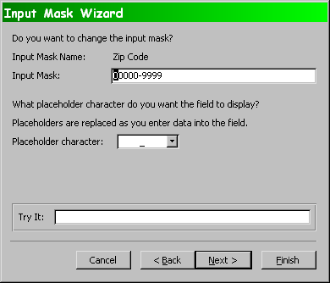
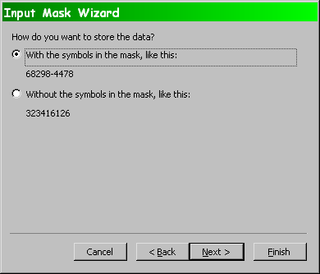
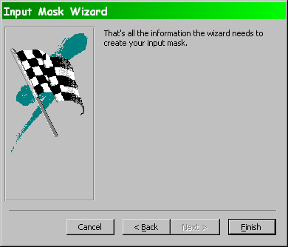
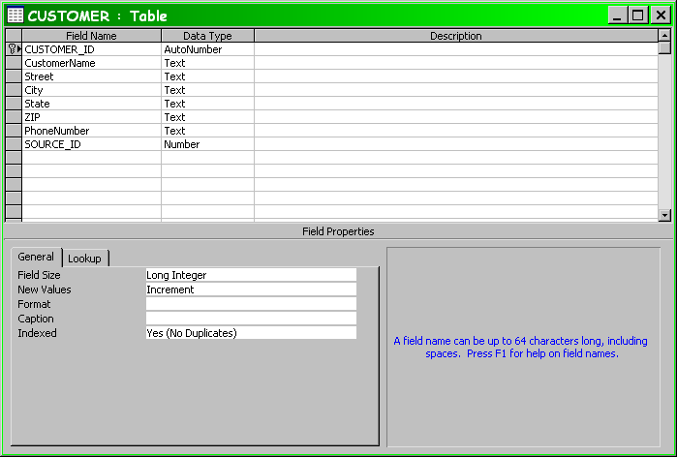
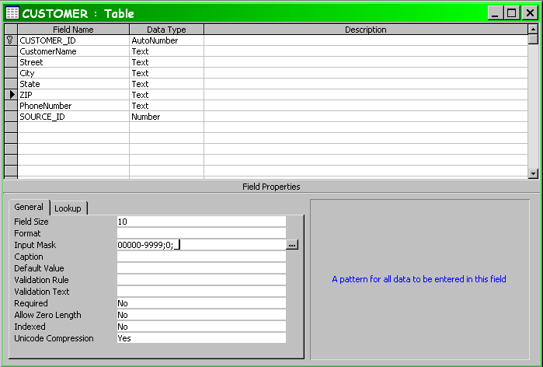
Defining Fields in Table
Primary Key
Chosen via menu

Slide 6
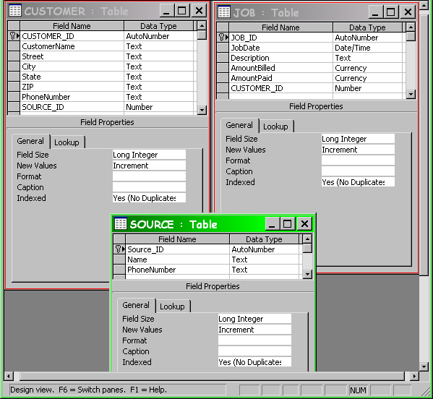
Finish Creating All Tables

Slide 7
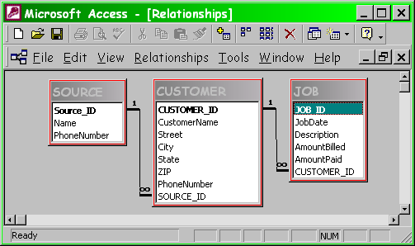
Define Relationships

Slide 8
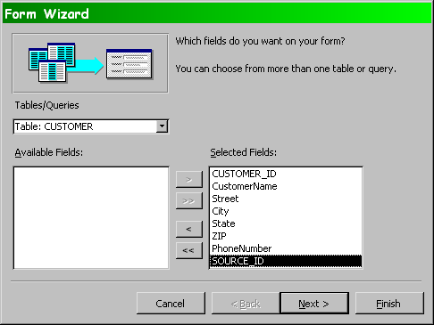
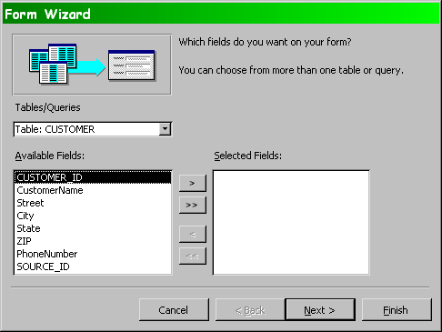
Create Form in Design View (1)

Slide 9
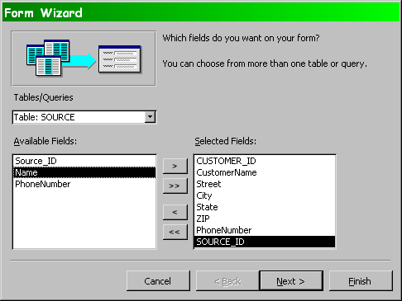
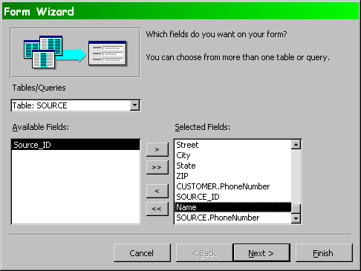
Create Form in Design View (2)

Slide 10
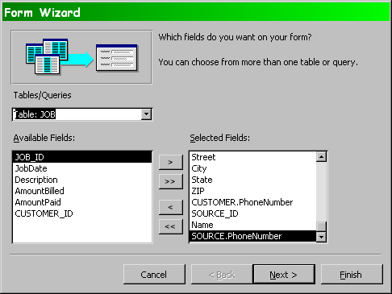
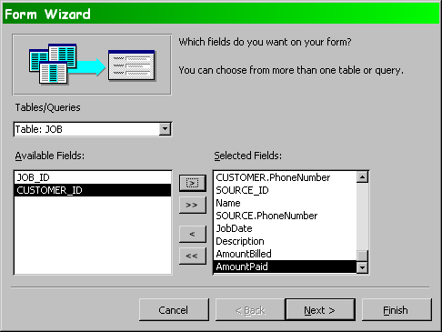
Create Form in Design View (3)

Slide 11
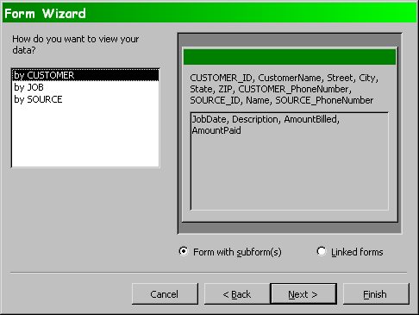
Create Form in Design View (4)

Slide 12
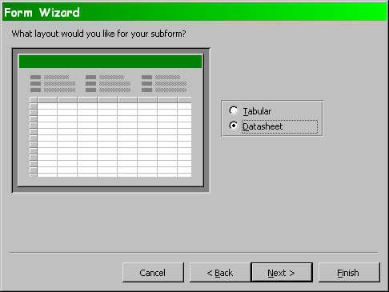
Create Form in Design View (5)

Slide 13
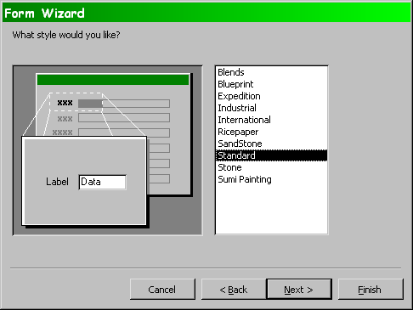
Create Form in Design View (6)

Slide 14
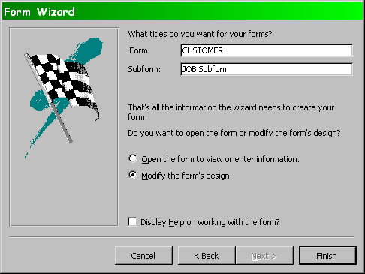
Create Form in Design View (7)

Slide 15
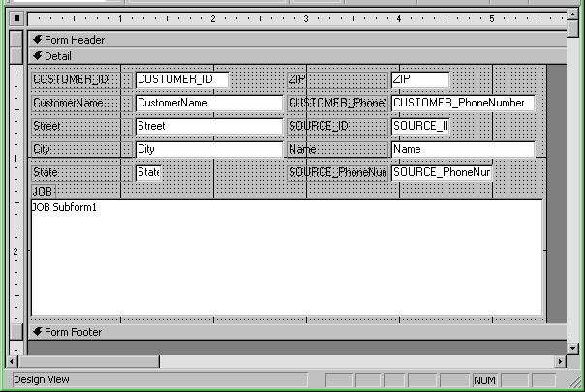
Create Form in Design View (8)

Slide 16
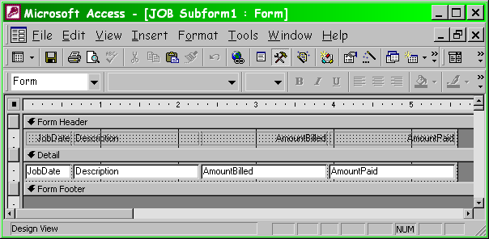
Create Form in Design View (9)

Slide 17
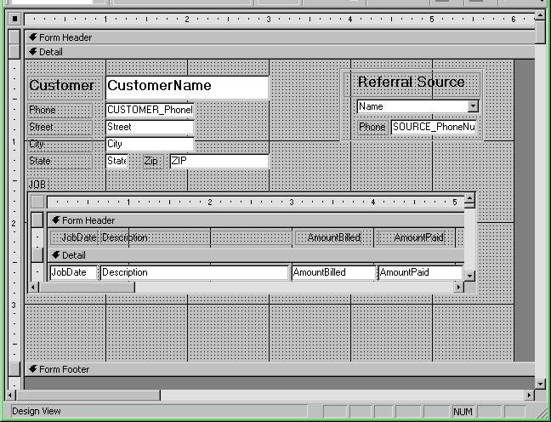
Final Form Design

Slide 18
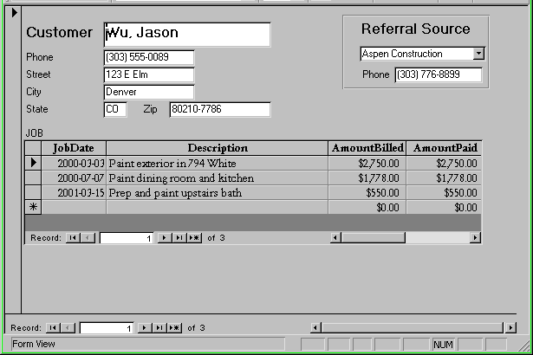
Final Form Appearance

Slide 19
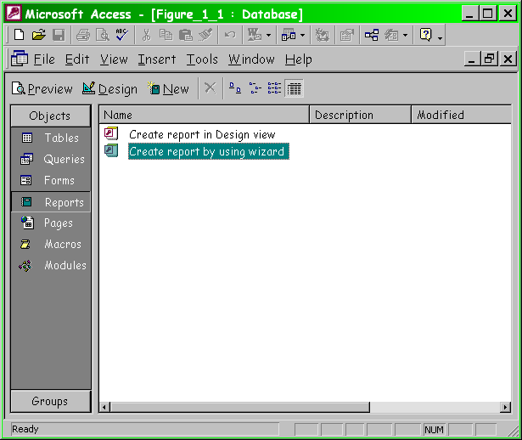
Creating a Report (1)

Slide 20
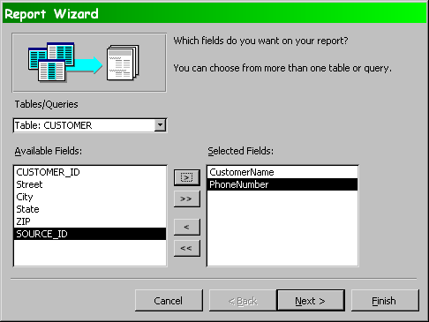
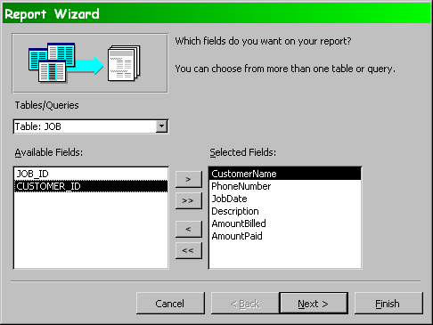
Creating a Report (2)

Slide 21
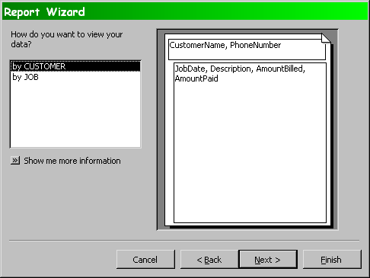
Creating a Report (3)

Slide 22
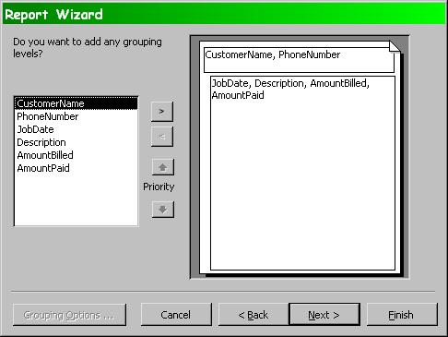
Creating a Report (4)

Slide 23
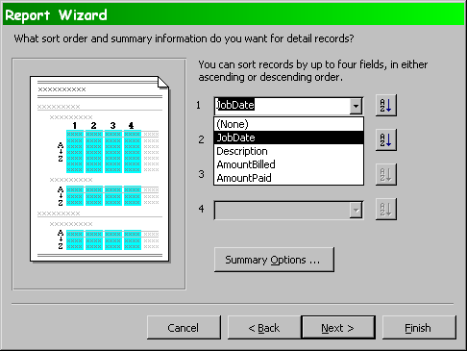
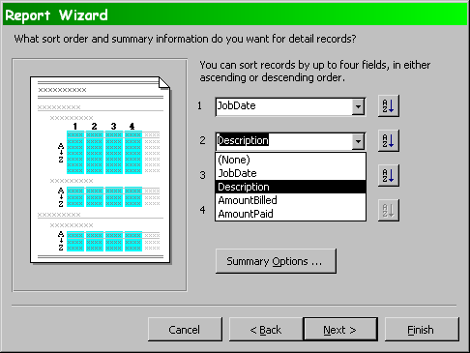
Creating a Report (5)

Slide 24
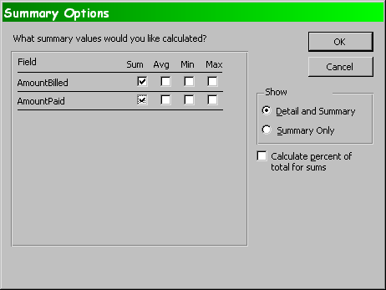
Creating a Report (6)

Slide 25
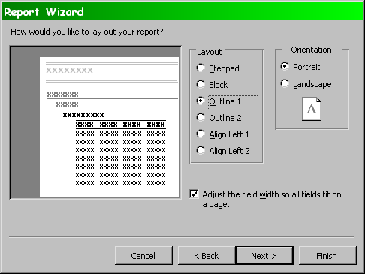
Creating a Report (7)

Slide 26
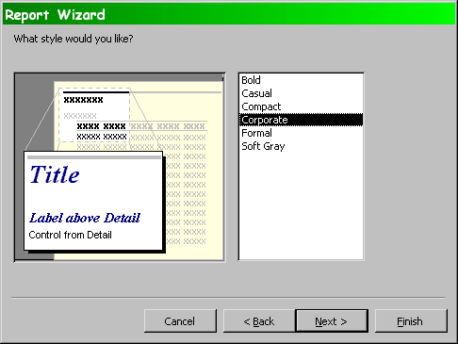
Creating a Report (8)

Slide 27
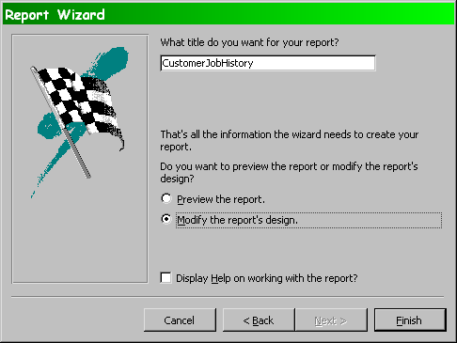
Creating a Report (9)

Slide 28
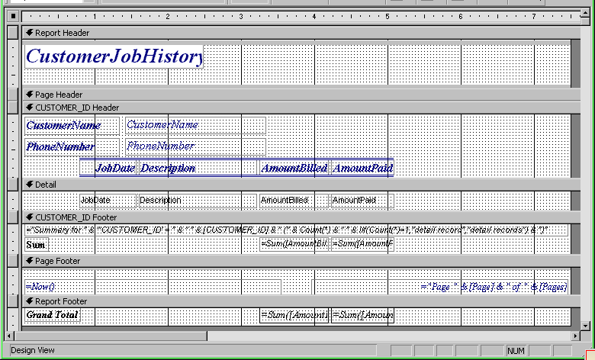
Default Report Layout

Slide 29
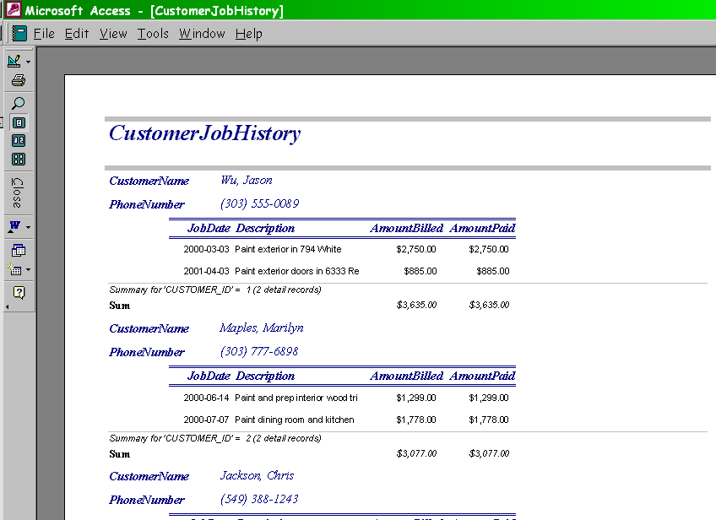
Preview

Slide 30
Further Tuning
Save backup copy of the report
Try making desired changes in design view
Check layout in preview
Experiment!
Use HELP facility

Slide 31
Now go and study

