Slide 1
Supplement: Using the DBDesign System
IS240 – DBMS
27 Jan 2010
Jerry Post, PhD
Reformatted by M. E. Kabay, PhD, CISSP-ISSMP
Assoc Prof Information Assurance
School of Business & Management
Norwich University
Notes:
Class Notes

Slide 2
Topics
DB Design System
Typical Customer Order
DB Design Screen
Adding a Table and a Key
Two Tables
Relationships—Linking Tables
Creating Problems
Detecting Problems (Grading)
Testing a Change
A Solution
Data Types

Slide 3
DB Design System
http://JerryPost.com/DBdesign
Students and instructors need only an Internet connection and a Java-enabled Web browser.
Instructor can sign up free by sending email to: jpost@time-post.com
Instructors set up the class and select assignments.
Students create accounts and work on the assignments.
The system provides immediate feedback in the form of comments and questions for each proposed table.

Slide 4
Typical Customer Order

Slide 5
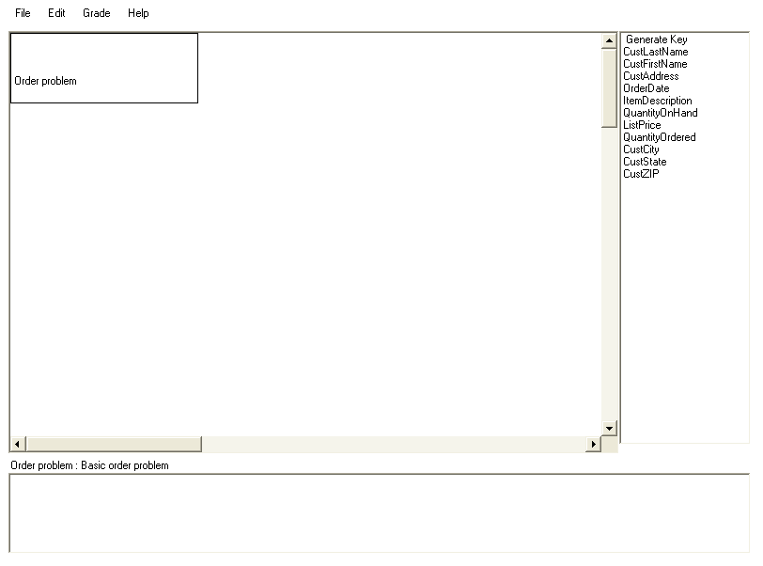
DB Design Screen
Column list
Menu
Title box
(can be moved)
Drawing area
Scroll bars to display more of the drawing area
Status line
Feedback window

Slide 6
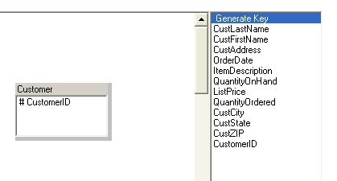
Adding a Table and a Key
Right click in the main drawing window and select the option to Add table.
Right click the gray bar at the top of the table, select the Rename table option and enter “Customer”
Drag the Generate Key item onto the new Customer table.
Right click on the new column name, select the Rename option and enter “CustomerID”
1
2
3
4

Slide 7
Two Tables
The Customer table has a generated key of CustomerID
Each column in the table represents data collected for each customer.
Each column depends completely on the primary key.
Each Order is identified by a unique OrderID generated by the database system.
The CustomerID column is used because the customer number can be used to look up the corresponding data in the Customer table.

Slide 8
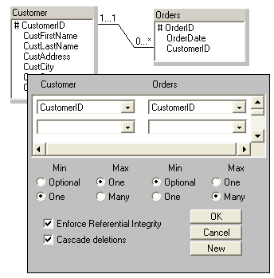
Relationships—Linking Tables
Drag the CustomerID column from the Customer table and drop it on the CustomerID column in the Orders table.
For the Min value in Customer, select One instead of Optional.
Click the OK button to accept the relationship definition.

Slide 9
A Mistake
Note from Prof Kabay:
Putting the OrderID in the Items table is an error
Why? Because it would be impossible to keep a list of items in which we store an Order #; how would we manage with more than one order?
The items in an order should be in a separate table.

Slide 10
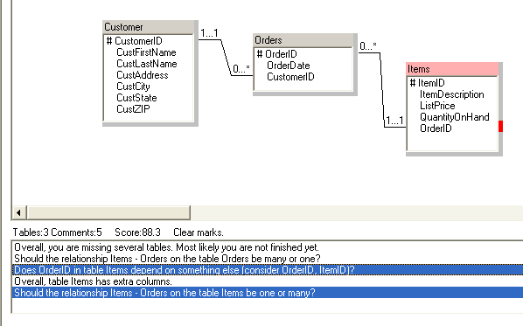
Detecting Problems (Grading)
Double click a line to mark the errors.

Slide 11
Testing a Change
Attempted fix
Make the relationship many-to-many
Make OrderID a key
But, the score went down!!!

Slide 12
A Solution
The intermediate table OrderItem converts the many-to-many relationship into two one-to-many relationships.
Both OrderID and ItemID are keys, indicating that each order can have many items, and each item can be sold on many orders.

Slide 13
Data Types
Right click the column names and set the data type.

Slide 14
Thank you, Dr Post!

