Slide 1
Database System Design
IS240 – DBMS
Lecture #3 – 2010-01-25
M. E. Kabay, PhD, CISSP-ISSMP
Assoc. Prof. Information Assurance
School of Business & Management, Norwich University
mailto:mkabay@norwich.edu V: 802.479.7937
Notes:
Class Notes

Slide 2
Topics
Overview
Design
Entities / Classes
UML
Associations
Inheritance
PetStore
Data Types
Events
Rolling Thunder

Slide 3
Overview
User views
of data.
Conceptual
data model.
Implementation
(relational)
data model.
Physical
data
storage.
Class diagram that shows business entities, relationships, and rules.
List of nicely-behaved tables. Use data normaliza-tion to derive list.
Indexes and storage methods to improve performance.

Slide 4
The Need for Design
Goal: To produce an information system that adds value for user
  Reduce costs
  Increase sales/revenue
  Provide competitive advantage
Objective: To understand system
  To improve it
  To communicate with users and IT staff
Methodology: Build models of system

Slide 5
Designing Systems
Designs model existing & proposed systems
  Provide picture or representation of reality
  Simplification
  Someone should be able to read your design (model) and describe features of actual system.
You build models by talking with users
  Identify processes
  Identify objects
  Determine current problems and future needs
  Collect user documents (views)
Break complex systems into pieces and levels

Slide 6
Design Stages
Initiation
  Scope
  Feasibility
  Cost & Time estimates
Requirements Analysis
  User Views & Needs
    Forms
    Reports
  Processes & Events
  Objects & Attributes
Conceptual Design
  Models
    Data flow diagram
    Entity Relationships
    Objects
  User feedback
Physical Design
  Table definitions
  Application development
    Queries
    Forms
    Reports
    Application integration
  Data storage
  Security
  Procedures
Implementation
  Training
  Purchases
  Data conversion
  Installation
Evaluation & Review

Slide 7
Initial Steps of Design
Identify exact goals of system.
Talk with users to identify basic forms and reports.
Identify data items to be stored.
Design classes (tables) and relationships.
Identify any business constraints.
Verify design matches business rules.

Slide 8
Entities/Classes
Customer
Name
CustomerID
LastName
FirstName
Phone
Address
City
State
ZIP Code
Properties
Add Customer
Delete Customer
Methods
(optional for database)

Slide 9
Definitions
Relational database: A collection of tables.
Table: collection of columns (attributes) describing an entity. Individual objects stored as rows of data in table.
Property (attribute): characteristic or descriptor of class or entity.
Every table has primary key.
  The smallest set of columns that uniquely identifies any row
  Primary keys can span more than one column (concatenated keys)
  We often create primary key to insure uniqueness (e.g., CustomerID, Product#, . . .) called surrogate key.
Primary key
Properties
Class: Employee
Rows/Objects
Employee
EmployeeID TaxpayerID LastName FirstName HomePhone Address
12512 888-22-5552 Cartom Abdul (603) 323-9893 252 South Street
15293 222-55-3737 Venetiaan Roland (804) 888-6667 937 Paramaribo Lane
22343 293-87-4343 Johnson John (703) 222-9384 234 Main Street
29387 837-36-2933 Stenheim Susan (410) 330-9837 8934 W. Maple

Slide 10
Unified Modeling Language (UML)
A relatively new method to design systems.
Contains several types of diagrams:
Contains several types of diagrams:
The class diagram is most important for database design.

Slide 11
Definitions
Entity: Something in real world that we wish to describe or track.
Class: Description of an entity, that includes its attributes (properties) and behavior (methods).
Object: One instance of class with specific data.
Property: A characteristic or descriptor of class or entity.
Method: A function that is performed by class.
Association: A relationship between two or more classes.
Pet Store Examples
Entity: Customer, Merchandise, Sales
Class: Customer, Merchandise, Sale
Object: Joe Jones, Premium Cat Food, Sale #32
Property: LastName, Description, SaleDate
Method: AddCustomer, UpdateInventory, ComputeTotal
Association: Each Sale can have only one Customer.

Slide 12
Associations
General
  One-to-one (1:1)
  One-to-many (1:M)
  Many-to-many (M:N)
Relationships represent business rules
  Sometimes common-sense
  Sometimes unique to an organization
Users often know current relationships, rarely future
Objects related to objects
  An employee can work in only one department
  Many departments can work on many different products
Objects related to properties
  An employee can have only one name
  Many employees can have same last name
Breed
1
*
Animal
Supplier
1
*
Purch.
Order
Cust.
1
*
Sale
Emp
*
*
Tasks
sent to
places 
performs 

Slide 13
Class Diagram
Customer
Class/Entity (box)
Association/Relationship
  Lines
  Minimum
    0: optional
    1: required
  Maximum
    Arrows
    1, M
1 … 1
0 … *
Order
0 … *
1 … *
Item

Slide 14
Sample Association Rules (Multiplicity)
Customer
An order must have exactly 1 customer,
  1 … 1 Minimum of 1
  1 … 1 Maximum of 1
And at least one item.
  1 … * Minimum of 1
  1 … * Maximum many
An item can show up on no orders or many orders.
  0 … * Optional (0)
  0 … * Maximum many
1 … 1
0 … *
Order
0 … *
1 … *
Item

Slide 15
N-ary Associations
Associations can connect more than two classes.
Associations can become classes.
  Events
  Many-to-many
  Need to keep data
Example has two many-to-many relationships.
  We know which components go into each product.
  We know which employees worked on product.
We need to expand relationships to show which employees installed which components into each product.
  Each assembly entry lists one employee, one component, and one product.
  By appearing on many assembly rows, many-to-many relationships can still exist.
Employee
*
*
Component
*
*
Product

Slide 16
N-ary Association Example
Employee
Name
...
1
*
1
Assembly
*
*
1
Component
CompID
Type
Name
Product
ProductID
Type
Name
Assembly
EmployeeID
CompID
ProductID
Multiplicity is defined as number of items that could appear if other N-1 objects
are fixed. Almost always “many.”

Slide 17
Association Details: Aggregation
Sale
Item
contains
SaleDate
Employee
*
*
Description
Cost
Aggregation: Sale consists of set of Items being sold.

Slide 18
Association Details: Composition
Bicycle
Wheels
Bicycle
1
2
Size
Model Type
…
built from
Rims
Spokes
…
Size
Model Type
…
1
1
Wheels
1
Crank
ItemID
Weight
Crank
Two ways to display composition.
1
Stem
Stem
ItemID
Weight
Size
Composition: aggregation where components become new object.

Slide 19
Association Details: Generalization
Animal
DateBorn
Name
Gender
Color
ListPrice
{disjoint}
Mammal
Fish
Spider
LitterSize
TailLength
Claws
FreshWater
ScaleCondition
Venomous
Habitat

Slide 20
Inheritance
Class Definition—
encapsulation
  Class Name
  Properties
  Methods
Inheritance Relationships
  Generic classes
  Focus on differences
  Polymorphism
  Most existing DBMS
  do not handle inheritance
Class name
Accounts
AccountID
CustomerID
DateOpened
CurrentBalance
Properties
Methods
OpenAccount
CloseAccount
Inheritance
Savings Accounts
Checking Accounts
InterestRate
MinimumBalance
Overdrafts
PayInterest
BillOverdraftFees
CloseAccount
Polymorphism

Slide 21
Multiple Parents
Vehicle
Motorized
Human
Powered
On-Road
Off-Road
or
Car
Bicycle

Slide 22
Association Details: Reflexive Relationship
manages
worker
*
Employee
0…1
manager
A reflexive relationship is an association from one class back to itself.
In this example, an employee can also be manager of other employees.

Slide 23
Defining Packages for High-Level Views
Purchase
Animals
Sell
Animals
Supplier
Employee
Customer
Purchase
Merchandise
Sell
Merchandise

Slide 24
PetStore Overview Class Diagram
*
Animal
*
1
*
Animal
Purchase
*
1
1
1
1
*
*
1
Supplier
Employee
Sale
Customer
1
1
*
Merchandise
Purchase
*
*
*
Merchandise
*
*

Slide 25
Pet Store Class Diagram: Access

Slide 26
Data Types (Domain)
Text
  Fixed length 1 to 64 K bytes
  Variable length 1 to 2 G bytes
Memo/Note
Date/Time 8 bytes Jan 1, 100 to Dec 31, 9999
Objects/Raw binary
  Any type of data supported by machine
  Pictures, sound, video . . .

Slide 27
Data Types (cont’d)
Numeric
  Byte 1 byte 0 to 255
  Boolean 2 bytes True or False
  Integer 2 bytes -32,768 to 32,767 (no decimal points)
  Long 4 bytes -2,147,483,648 to 2,147,483,647
  (no decimal points)
  Floating 4 bytes 1.401298E-45 to 3.402823E38
  Double 8 bytes 4.94065645841247E-324 to
  1.79769313486232E308
  Currency 8 bytes -922,377,203,685,477.5808 to
  922,377,203,685,477.5807

Slide 28
Data Type Sizes
 | Access | SQL Server | Oracle
Text fixed variable Unicode memo | Text Memo | char, varchar nchar, nvarchar text | CHAR VARCHAR2 NVARCHAR2 LONG
Number Byte (8 bits) Integer (16 bits) Long (32 bits) (64 bits) Fixed precision Float Double Currency Yes/No | Byte Integer Long NA NA Float Double Currency Yes/No | tinyint smallint int bigint decimal(p,s) real float money bit | INTEGER INTEGER INTEGER NUMBER(38,0) NUMBER(p,s) NUMBER, FLOAT NUMBER NUMBER(38,4) INTEGER
Date/Time Interval | Date/Time NA | datetime smalldatetime interval year … | DATE INTERVAL YEAR …
Image | OLE Object | image | LONG RAW, BLOB
AutoNumber | AutoNumber | Identity rowguidcol | SEQUENCES ROWID

Slide 29
Computed Attributes
Denote computed values with preceding slash (/).
Employee
Name
DateOfBirth
/Age
Phone
…
{Age = Today - DateOfBirth}

Slide 30
Event Examples
Business Event
  Item is sold.
  Decrease Inventory count.
Data Event
  Inventory drops below preset level.
  Order more inventory.
User Event
  User clicks on icon.
  Send purchase order to supplier.
Trigger
ON (QuantityOnHand < 100)
THEN Notify Purchasing Manager

Slide 31
Event Triggers
Business Process: Ship Product
  Trigger: Inventory Change
  Executes function/trigger in Inventory object.
Object: Inventory
  Property: Current Inventory.
  Function: Update Inventory.
  Trigger: On Update, call Analyze function.
Process: Analyze Inventory
  Function: Determine need to reorder.
  Trigger: Generate new order.
Order
…
ShipOrder
…
Inventory
…
Subtract
Analyze
…
Inventory
…
Subtract
Analyze
…
1. Subtract(Prod,
Qty sold)
low
1.1 Analyze
(Product)
1.1.1
Reorder
(Product,
quantity)
Purchase
…
Reorder
…

Slide 32
Design Importance: Large Projects
Design is harder on large projects.
  Communication with multiple users.
  Communication between IT workers.
  Need to divide project into pieces for teams.
  Finding data/components.
  Staff turnover--retraining.
Need to monitor design process.
  Scheduling.
  Evaluation.
Build systems that can be modified later.
  Documentation.
  Communication/underlying assumptions and model.

Slide 33
Large Projects
Project Teams
  Divide work
  Fit pieces together
  Evaluate progress
Standards
  Design
  Templates
  Actions
  Events
  Objects
    Naming convention
    Properties
Project planning software
  Schedules
  Gantt charts
CASE tools
Groupware tools
  Track changes
  Document work
  Track revisions

Slide 34
CASE Tools
Computer-Aided Software Engineering
  Diagrams (linked)
  Data Dictionary
  Teamwork
  Prototyping
    Forms
    Reports
    Sample data
  Code generation
  Reverse Engineering
Examples
  Rational Rose
  Sterling
    COOL: Dat
    COOL: Jex (UML)
  Oracle
  IBM

Slide 35
Rolling Thunder: Top-Level
Sales
Bicycle
Assembly
Employee
Location
Purchasing

Slide 36
Rolling Thunder: Sales
Customer
1…1
Bicycle::Bicycle
CustomerID
Phone
FirstName
LastName
Address
ZipCode
CityID
BalanceDue
1…1
BicycleID
…
CustomerID
StoreID
…
0…*
0…*
Retail Store
Customer
Transaction
StoreID
StoreName
Phone
ContactFirstName
ContactLastName
Address
ZipCode
CityID
0…1
CustomerID
TransactionDate
EmployeeID
Amount
Description
Reference
0…*

Slide 37
Rolling Thunder: Bicycle
ModelType
Bicycle
1…1
BicycleTubeUsed
1…1
ModelType
Description
SerialNumber
CustomerID
ModelType
PaintID
FrameSize
OrderDate
StartDate
ShipDate
ShipEmployee
FrameAssembler
Painter
Construction
WaterBottleBrazeOn
CustomName
LetterStyleID
StoreID
EmployeeID
TopTube
ChainStay
…
1…*
SerialNumber
TubeID
Quantity
0…*
1…1
Paint
0…*
1…1
PaintID
ColorName
ColorStyle
ColorList
DateIntroduced
DateDiscontinued
BikeParts
0…*
SerialNumber
ComponentID
SubstituteID
Location
Quantity
DateInstalled
EmployeeID
0…*
LetterStyle
1…1
LetterStyleID
Description

Slide 38
Rolling Thunder: Assembly
Component
1…1
1…1
Bicycle::BikeParts
ComponentID
ManufacturerID
ProductNumber
Road
Category
Length
Height
Width
Description
ListPrice
EstimatedCost
QuantityOnHand
GroupComponents
SerialNumber
ComponentID
...
0…*
GroupID
ComponentID
0…*
0…*
0…*
Groupo
GroupID
GroupName
BikeType
1…1
ComponentName
Bicycle::
BicycleTubeUsed
TubeMaterial
1…1
1…1
ComponentName
AssemblyOrder
Description
TubeID
Material
Description
Diameter
…
SerialNumber
TubeID
Quantity
0…*

Slide 39
Rolling Thunder: Purchasing
PurchaseOrder
1…1
Manufacturer
1…1
1…1
PurchaseID
EmployeeID
ManufacturerID
TotalList
ShippingCost
Discount
OrderDate
ReceiveDate
AmountDue
ManufacturerID
ManufacturerName
ContactName
Phone
Address
ZipCode
CityID
BalanceDue
1…1
0…*
ManufacturerTrans
ManufacturerID
TransactionDate
Reference
EmployeeID
Amount
Description
0…*
PurchaseItem
Assembly::
Component
PurchaseID
ComponentID
PricePaid
Quantity
QuantityReceived
1…*
1…1
0…*
ComponentID
ManufacturerID
ProductNumber
0…*

Slide 40
Rolling Thunder: Location
Sales::
Customer
Employee::
Employee
City
1…1
CustomerID
…
CityID
1…1
EmployeeID
…
CityID
CityID
ZipCode
City
State
AreaCode
Population1990
Population1980
Country
Latitude
Longitude
0…*
1…1
1…1
1…1
Sales::
RetailStore
Purchasing::
Manufacturer
StoreID
…
CityID
ManufacturerID
…
CityID
0…*
0…*
StateTaxRate
0…1
State
TaxRate

Slide 41
Rolling Thunder: Employee
Employee
Bicycle::
Bicycle
1…1
0…*
worker
EmployeeID
TaxpayerID
LastName
FirstName
HomePhone
Address
ZipCode
CityID
DateHired
DateReleased
CurrentManager
SalaryGrade
Salary
Title
WorkArea
1…1
1…1
Purchasing::
PurchaseOrder
SerialNumber
…
EmployeeID
ShipEmployee
FrameAssembler
Painter
0…*
PurchaseID
…
EmployeeID
0…*
0…*
manages
0…*
0…*
Bicycle::
BikeParts
0…1
manager
SerialNumber
ComponentID
…
EmployeeID
0…*

Slide 42
Rolling Thunder Combined
Customer
Bicycle
BicycleTube
Groupo
BikeTubes
CompGroup
GroupName
BikeType
Year
EndYear
Weight
TubeMaterial
CustomerID
Phone
FirstName
LastName
Address
ZipCode
CityID
BalanceDue
SerialNumber
CustomerID
ModelType
PaintID
FrameSize
OrderDate
StartDate
ShipDate
ShipEmployee
FrameAssembler
Painter
Construction
WaterBottle
CustomName
LetterStyleID
StoreID
EmployeeID
TopTube
ChainStay
HeadTubeAngle
SeatTueAngle
ListPrice
SalePrice
SalesTax
SaleState
ShipPrice
FramePrice
ComponentList
ModelType
SerialNumber
TubeID
Quantity
SerialNumber
TubeName
TubeID
Length
TubeID
Material
Description
Diameter
Thickness
Roundness
Weight
Stiffness
ListPrice
Construction
ModelType
Description
ComponentID
ModelSize
Paint
ModelType
MSize
TopTube
ChainStay
TotalLength
GroundClearance
HeadTubeAngle
SeatTubeAngle
BikeParts
Component
PaintID
ColorName
ColorStyle
ColorList
DateIntroduced
DateDiscontinued
SerialNumber
ComponentID
SubstituteID
Location
Quantity
DateInstalled
EmployeeID
ComponentID
ManufacturerID
ProductNumber
Road
Category
Length
Height
Width
Weight
Year
EndYear
Description
ListPrice
EstimatedCost
QuantityOnHand
CustomerTrans
GroupCompon
CustomerID
TransDate
EmployeeID
Amount
Description
Reference
GroupID
ComponentID
LetterStyle
Employee
LetterStyle
Description
PurchaseItem
ComponentName
EmployeeID
TaxpayerID
LastName
FirstName
HomePhone
Address
ZipCode
CityID
DateHired
DateReleased
CurrentManager
SalaryGrade
Salary
Title
WorkArea
PurchaseID
ComponentID
PricePaid
Quantity
QuantityReceived
ComponentName
AssemblyOrder
Description
PurchaseOrder
RetailStore
PurchaseID
EmployeeID
ManufacturerID
TotalList
ShippingCost
Discount
OrderDate
ReceiveDate
AmountDue
StoreID
StoreName
Phone
ContacFirstName
ContactLastName
Address
Zipcode
CityID
Manufacturer
ManufacturerTrans
Customer
ManufacturerID
ManufacturerName
ContactName
Phone
Address
ZipCode
CityID
BalanceDue
ManufacturerID
TransactionDate
EmployeeID
Amount
Description
Reference
CityID
ZipCode
City
State
AreaCode
Population1990
Population1980
Country
Latitude
Longitude
StateTaxRate
State
TaxRate

Slide 43
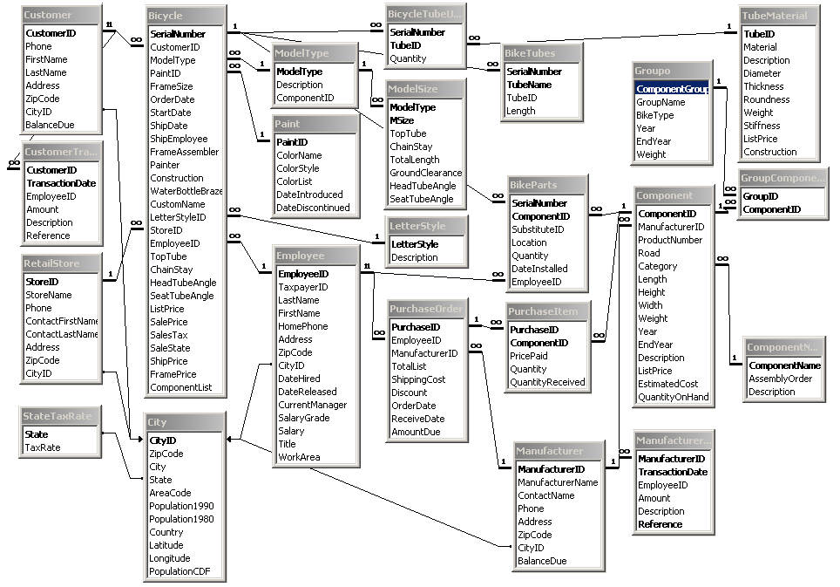
Rolling Thunder: Combined

Slide 44
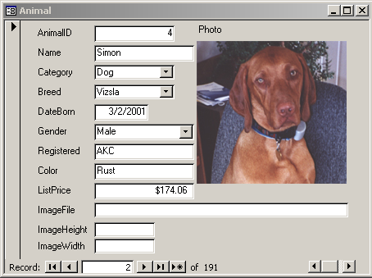
Application Design
Simple form based on one table (Animal).
But also need lookup tables for Category and Breed.

Slide 45
REQUIRED HOMEWORK (1)
By Sunday 7 Feb 2010 at 23:59
Read all of Chapter 2 in the text
Complete Review Questions 1-10 yourself for practice
For exercises using Dr Post’s computer-based training
  http://www.jerrypost.com/DBDesign
  Your AdmitCode is ____________ (write it in; all UC)
Design the database tables required to support the situations described in the following problems in Chapter 2 USING THE DBDesign System online
  Complete problems 1 & 3 online (10 points each)
Answer question 9 (18 pts) in writing and explain your reasoning for every answer by articulating assumptions. Provide minimum and maximum values
Notes:
CODE is EJFY2NA9V (all uppercase)

Slide 46
REQUIRED HOMEWORK (2)
Answer question 10 (15 pts) by indicating A or E for attributes or entities as described in the question.
For 10 points each, COMPLETE one of these sets:
  11-14 (Sally’s Pet Store)
  15-17 (Rolling Thunder Bicycles)
  18-20 (Corner Med)
  (Complete one or two other sets for a up to 20 extra pts)

Slide 47
DISCUSSION

