Slide 1
Data Normalization (2)
IS 240 – Database
Lecture #5 – 2010-02-08
M. E. Kabay, PhD, CISSP-ISSMP
Assoc. Prof. Information Assurance
School of Business & Management, Norwich University
mailto:mkabay@norwich.edu V: 802.479.7937

Slide 2
Don’t Panic!
We are not trying to discuss 66 slides in one session
Much of today’s material will serve as reference and review for your studies
Opportunity to discuss principles and illustrate them with specific cases

Slide 3
Overview of Today’s Work
Continue discussion of normalization
Work on examples together
Important to get involved in class discussion
Can absorb / integrate concepts only by using them
Do not try to memorize without understanding
  Waste of your time
Do the homework exercises seriously
  They will ensure success
  Students from previous IS240 classes have reported good experiences in real jobs – praised for understanding principles that help design good databases

Slide 4
Boyce-Codd Normal Form (BCNF)
Hidden dependency
Example:
  Employee-Specialty(E#, Specialty, Manager)
  Is in 3NF now.
Business rules.
  Employee may have many specialties.
  Each specialty has many managers.
  Each manager has only one specialty.
  Employee has only one manager for each specialty.
Problem is hidden relationship between manager and specialty.
  Need separate table for manager.
  But then we don’t need to repeat specialty.
In real life, probably accept the duplication
(specialty listed in both tables).
Employee-Specialty(E#, Specialty, Manager)
Employee(E#, Manager)
Manager(Manager, Specialty)
Employee(E#, Specialty, Manager)
Manager(Manager, Specialty)
acceptable

Slide 5
Fourth Normal Form (Keys)
EmployeeTasks(EID, Specialty, ToolID)
Technically, if you keyed every column, any table would be in 3NF, which does not solve any problems.
In some cases, there are hidden relationships between key properties.
Example:
  EmployeeTasks(EID, Specialty, ToolID)
  In 3NF (BCNF) now.
Business Rules
  Each employee has many specialties.
  Each employee has many tools.
  Tools and specialties are unrelated
EmployeeSpecialty(EID, Specialty)
EmployeeTools(EID, ToolID)

Slide 6
Domain-Key Normal Form (DKNF)
DKNF is ultimate goal: table will always be in 4NF, etc.
Drawbacks
  No mechanical method to get to DKNF
  No guarantee a table can be converted to DKNF
Rules
  Table => one topic
  All business rules explicitly written as domain constraints and key relationships.
  No hidden relationships.
Employee(EID, Name, speciality)
Business rule: An employee can have many specialties.
So example is not in DKNF, since EID is not unique.

Slide 7
DKNF Examples
Employee(EID, Name, Speciality)
Business rule: An employee can have many specialties.
Example is not in DKNF: EID is not unique.
Employee(EID, Name, Speciality)
Business rule: An employee has one name.
Example is not DKNF: hidden relationship between EID and name.
Employee(EID, Name)
EmployeeSpecialty(EID, Speciality)

Slide 8
DKNF Examples
Student(SID, Name, Major, Advisor)
Advisor(FID, Name, Office, Discipline)
Business rules: A student can have many advisors, but
only one for each major. Faculty can only be advisors
for their discipline.
Not in DKNF: Primary key and hidden rule.
Student(SID, Name)
Advisors(SID, Major, FID)
Faculty(FID, Name, Office, Discipline)
DKNF: Foreign key (Major <--> Discipline) makes advisor
rule explicit.

Slide 9
Data Rules and Integrity
Simple business rules
  Limits on data ranges
    Price > 0
    Salary < 100,000
    DateHired > 1/12/1995
  Choosing from a set
    Gender = M, F, Unknown
    Jurisdiction=City, County, State, Federal
Referential Integrity
  Foreign key values in one table must exist in the master table.
  Order(O#, Odate, C#,…)
  C# must exist in the customer table.
Order
O# Odate C# …
1173 1-4-97 321
1174 1-5-97 938
1185 1-8-97 337
1190 1-9-97 321
1192 1-9-97 776
No data for this
customer yet!
Customer
C# Name Phone …
321 Jones 9983-
337 Sanchez 7738-
938 Carson 8738-

Slide 10
Effect of Business Rules
Key business rules:
A player can play on only one team.
There is one referee per match.

Slide 11
Business Rules 1
There is one referee per match.
A player can play on only one team.
Match(MatchID, DatePlayed, Location, RefID)
Score(MatchID, TeamID, Score)
Referee(RefID, Phone, Address)
Team(TeamID, Name, Sponsor)
Player(PlayerID, Name, Phone, DoB, TeamID)
PlayerStats(MatchID, PlayerID, Points, Penalties)
RefID and TeamID are not keys in the Match
and Team tables, because of the one-to-one rules.

Slide 12
Business Rules 2
There can be several referees per match.
A player can play on several teams (substitute),
but only on one team per match.
Match(MatchID, DatePlayed, Location, RefID)
Score(MatchID, TeamID, Score)
Referee(RefID, Phone, Address)
Team(TeamID, Name, Sponsor)
Player(PlayerID, Name, Phone, DoB, TeamID)
PlayerStats(MatchID, PlayerID, Points, Penalties)
To handle the many-to-many relationship, we need to make
RefID and TeamID keys. But if you leave them in the same
tables, the tables are not in 3NF. DatePlayed does not depend
on RefID. Player Name does not depend on TeamID.

Slide 13
Business Rules 2: Normalized
There can be several referees per match.
A player can play on several teams (substitute),
but only on one team per match.
Match(MatchID, DatePlayed, Location)
RefereeMatch(MatchID, RefID)
Score(MatchID, TeamID, Score)
Referee(RefID, Phone, Address)
Team(TeamID, Name, Sponsor)
Player(PlayerID, Name, Phone, DoB)
PlayerStats(MatchID, PlayerID, TeamID, Points, Penalties)

Slide 14
Converting a Class Diagram to Normalized Tables
Manager
*
1
1
*
Purchase
Order
*
1
Supplier
Employee
*
*
Item
subtypes
Raw
Materials
Assembled
Components
Office
Supplies

Slide 15
One-to-Many Relationships
1
*
*
1
Supplier
Purchase
Order
Employee
Supplier(SID, Name, Address, City, State, Zip, Phone)
Employee(EID, Name, Salary, Address, …)
PurchaseOrder(POID, Date, SID, EID)
The many side becomes a key (underlined).
Each PO has one supplier and employee.
(Do not key SID or EID)
Each supplier can receive many POs. (Key PO)
Each employee can place many POs. (Key PO)

Slide 16
One-to-Many Sample Data
Supplier
Purchase Order
POID | Date | SID | EID
22234 | 9-9-2004 | 5676 | 221
22235 | 9-10-2004 | 5676 | 554
22236 | 9-10-2004 | 7831 | 221
22237 | 9-11-2004 | 8872 | 335
Employee

Slide 17
Many-to-Many Relationships
Purchase
Order
PurchaseOrder(POID, Date, SID, EID)
Purchase
Order
1
*
1
*
*
POItem(POID, ItemID, Quantity, PricePaid)
POItem
*
*
*
1
1
Item
Item(ItemID, Description, ListPrice)
Item
Each POID can have many Items (key/underline ItemID).
Each ItemID can be on many POIDs (key POID).
Need the new intermediate table (POItem) because:
You cannot put ItemID into PurchaseOrder because Date, SID, and EID
do not depend on the ItemID.
You cannot put POID into Item because Description and ListPrice
do not depend on POID.

Slide 18
Many-to-Many Sample Data
Purchase Order
POID | Date | SID | EID
22234 | 9-9-2004 | 5676 | 221
22235 | 9-10-2004 | 5676 | 554
22236 | 9-10-2004 | 7831 | 221
22237 | 9-11-2004 | 8872 | 335
POItem
Item

Slide 19
N-ary Associations
Employee
Name
...
1
*
Assembly
1
*
*
1
Component
CompID
Type
Name
Product
ProductID
Type
Name
Assembly
EmployeeID
CompID
ProductID

Slide 20
Composition
Bicycle
Bicycle
Size
Model Type
…
SerialNumber
ModelType
WheelID
CrankID
StemID
…
Components
Wheels
ComponentID
Category
Description
Weight
Cost
Crank
Stem

Slide 21
Generalization or Subtypes
Item
Raw
Materials
Assembled
Components
Office
Supplies
Item(ItemID, Description, ListPrice)
RawMaterials(ItemID, Weight, StrengthRating)
AssembledComponents(ItemID, Width, Height, Depth)
OfficeSupplies(ItemID, BulkQuantity, Discount)
Add new tables for each subtype.
Use the same key as the generic type (ItemID)--one-to-one relationship.
Add the attributes specific to each subtype.

Slide 22
Subtypes Sample Data
Item
RawMaterials
AssembledComponents
OfficeSupplies

Slide 23
Recursive Relationships
Manager
*
1
Employee
Employee(EID, Name, Salary, Address, Manager)
Employee
Add a manager column that contains Employee IDs.
An employee can have only one manager. (Manager is not a key.)
A manager can supervise many employees. (EID is a key.)

Slide 24
Normalization Examples
Possible topics
  Auto repair
  Auto sales
  Department store
  Hair stylist
  HRM department
  Law firm
  Manufacturing
  National Park Service
  Personal stock portfolio
  Pet shop
  Restaurant
  Social club
  Sports team

Slide 25
Multiple Views & View Integration
Collect multiple views
  Documents
  Reports
  Input forms
Create normalized tables from each view
Combine the views into one complete model.
Keep meta-data in a data dictionary
  Type of data
  Size
  Volume
  Usage
Example
  Federal Emergency Management Agency (FEMA). Disaster planning and relief.
  Make business assumptions as necessary, but try to keep them simple.

Slide 26
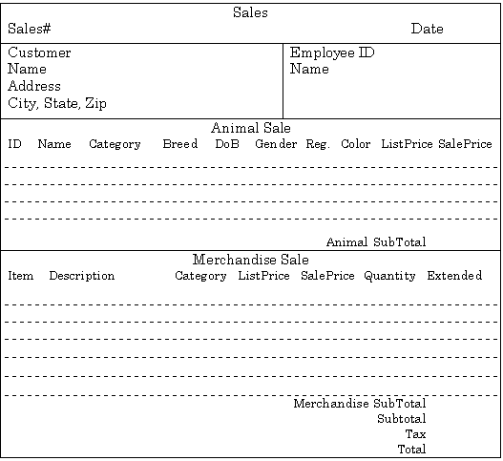
The Pet Store: Sales Form
Sales(SaleID, Date, CustomerID, Name, Address, City, State, Zip, EmployeeID, Name, (AnimalID, Name, Category, Breed, DateOfBirth, Gender, Registration, Color, ListPrice, SalePrice), (ItemID, Description, Category, ListPrice, SalePrice, Quantity))

Slide 27
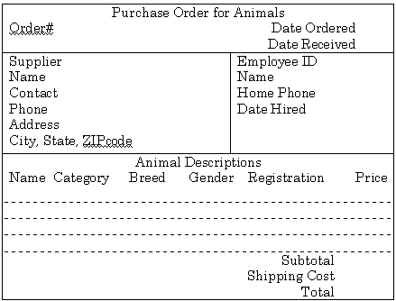
The Pet Store: Purchase Animals
AnimalOrder(OrderID, OrderDate, ReceiveDate, SupplierID, Name, Contact, Phone, Address, City, State, Zip, EmployeeID, Name, Phone, DateHired, (AnimalID, Name, Category, Breed, Gender, Registration, Cost), ShippingCost)

Slide 28
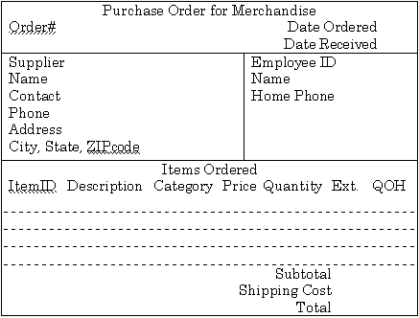
The Pet Store: Purchase Merchandise
MerchandiseOrder(PONumber, OrderDate, ReceiveDate, SupplierID, Name, Contact, Phone, Address, City, State, Zip, EmployeeID, Name, HomePhone, (ItemID, Description, Category, Price, Quantity, QuantityOnHand), ShippingCost)

Slide 29
Pet Store Normalization
Sale(SaleID, Date, CustomerID, EmployeeID)
SaleAnimal(SaleID, AnimalID, SalePrice)
SaleItem(SaleID, ItemID, SalePrice, Quantity)
Customer(CustomerID, Name, Address, City, State, Zip)
Employee(EmployeeID, Name)
Animal(AnimalID, Name, Category, Breed, DateOfBirth,
Gender, Registration, Color, ListPrice)
Merchandise(ItemID, Description, Category, ListPrice)
AnimalOrder(OrderID, OrderDate, ReceiveDate, SupplierID, EmpID, ShipCost)
AnimalOrderItem(OrderID, AnimalID, Cost)
Supplier(SupplierID, Name, Contact, Phone, Address, City, State, Zip)
Employee(EmployeeID, Name, Phone, DateHired)
Animal(AnimalID, Name, Category, Breed, Gender, Registration, Cost)
MerchandiseOrder(PONumber, OrderDate, ReceiveDate, SID, EmpID, ShipCost)
MerchandiseOrderItem(PONumber, ItemID, Quantity, Cost)
Supplier(SupplierID, Name, Contact, Phone, Address, City, State, Zip)
Employee(EmployeeID, Name, Phone)
Merchandise(ItemID, Description, Category, QuantityOnHand)

Slide 30
Pet Store View Integration
Sale(SaleID, Date, CustomerID, EmployeeID)
SaleAnimal(SaleID, AnimalID, SalePrice)
SaleItem(SaleID, ItemID, SalePrice, Quantity)
Customer(CustomerID, Name, Address, City, State, Zip)
Employee(EmployeeID, Name, Phone, DateHired)
Animal(AnimalID, Name, Category, Breed, DateOfBirth,
Gender, Registration, Color, ListPrice, Cost)
Merchandise(ItemID, Description, Category, ListPrice, QuantityOnHand)
AnimalOrder(OrderID, OrderDate, ReceiveDate, SupplierID, EmpID, ShipCost)
AnimalOrderItem(OrderID, AnimalID, Cost)
Supplier(SupplierID, Name, Contact, Phone, Address, City, State, Zip)
Employee(EmployeeID, Name, Phone, DateHired)
Animal(AnimalID, Name, Category, Breed, Gender, Registration, Cost)
MerchandiseOrder(PONumber, OrderDate, ReceiveDate, SID, EmpID, ShipCost)
MerchandiseOrderItem(PONumber, ItemID, Quantity, Cost)
Supplier(SupplierID, Name, Contact, Phone, Address, City, State, Zip)
Employee(EmployeeID, Name, Phone)
Merchandise(ItemID, Description, Category, QuantityOnHand)

Slide 31
Pet Store Class Diagram

Slide 32
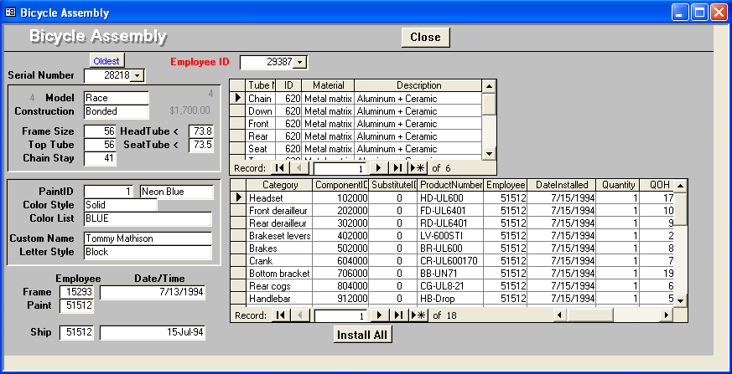
Rolling Thunder Integration Example
Bicycle Assembly form. The main EmployeeID control
is not stored directly, but the value is entered in the
assembly column when the employee clicks the column.

Slide 33
Initial Tables for Bicycle Assembly
BicycleAssembly(
SerialNumber, Model, Construction, FrameSize, TopTube, ChainStay, HeadTube, SeatTube,
PaintID, PaintColor, ColorStyle, ColorList, CustomName, LetterStyle, EmpFrame, EmpPaint,
BuildDate, ShipDate,
(Tube, TubeType, TubeMaterial, TubeDescription),
(CompCategory, ComponentID, SubstID, ProdNumber, EmpInstall, DateInstall, Quantity, QOH) )
Bicycle(SerialNumber, Model, Construction, FrameSize, TopTube, ChainStay, HeadTube, SeatTube,
PaintID, ColorStyle, CustomName, LetterStyle, EmpFrame, EmpPaint, BuildDate, ShipDate)
Paint(PaintID, ColorList)
BikeTubes(SerialNumber, TubeID, Quantity)
TubeMaterial(TubeID, Type, Material, Description)
BikeParts(SerialNumber, ComponentID, SubstID, Quantity, DateInstalled, EmpInstalled)
Component(ComponentID, ProdNumber, Category, QOH)

Slide 34
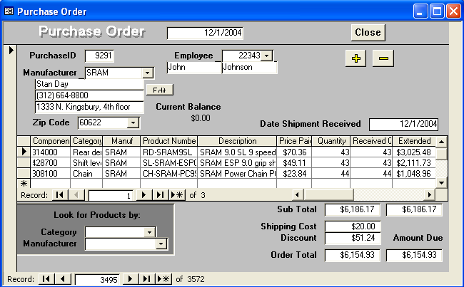
Rolling Thunder: Purchase Order

Slide 35
RT Purchase Order: Initial Tables
PurchaseOrder(PurchaseID, PODate, EmployeeID, FirstName, LastName, ManufacturerID,
MfgName, Address, Phone, CityID, CurrentBalance, ShipReceiveDate,
(ComponentID, Category, ManufacturerID, ProductNumber, Description, PricePaid, Quantity,
ReceiveQuantity, ExtendedValue, QOH, ExtendedReceived), ShippingCost, Discount)
PurchaseOrder(PurchaseID, PODate, EmployeeID, ManufacturerID,
ShipReceiveDate, ShippingCost, Discount)
Employee(EmployeeID, FirstName, LastName)
Manufacturer(ManufacturerID, Name, Address, Phone, Address, CityID, CurrentBalance)
City(CityID, Name, ZipCode)
PurchaseItem(PurchaseID, ComponentID, Quantity, PricePaid, ReceivedQuantity)
Component(ComponentID, Category, ManufacturerID, ProductNumber, Description, QOH)

Slide 36
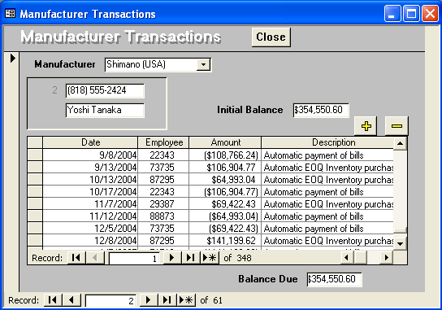
Rolling Thunder: Transactions

Slide 37
RT Transactions: Initial Tables
ManufacturerTransactions(ManufacturerID, Name, Phone, Contact, BalanceDue,
(TransDate, Employee, Amount, Description) )
Manufacturer(ManufacturerID, Name, Phone, Contact, BalanceDue)
ManufacturerTransaction(ManufacturerID, TransactionDate, EmployeeID,
Amount, Description)

Slide 38
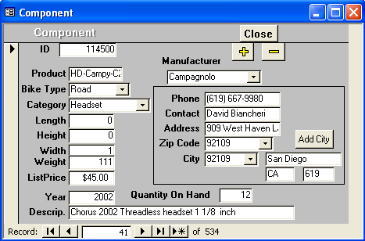
Rolling Thunder: Components

Slide 39
RT Components: Initial Tables
ComponentForm(ComponentID, Product, BikeType, Category, Length, Height,
Width, Weight, ListPrice,Description, QOH, ManufacturerID, Name,
Phone, Contact, Address, ZipCode, CityID, City, State, AreaCode)
Component(ComponentID, ProductNumber, BikeType, Category, Length, Height,
Width,Weight, ListPrice, Description, QOH, ManufacturerID)
Manufacturer(ManufacturerID, Name, Phone, Contact, Address, ZipCode, CityID)
City(CityID, City, State, ZipCode, AreaCode)

Slide 40
RT: Integrating Tables
Duplicate Manufacturer tables:
PO Mfr(ManufacturerID, Name, Address, Phone, CityID, CurrentBalance)
Mfg Mfr(ManufacturerID, Name, Phone, Contact, BalanceDue)
Comp Mfr(ManufacturerID, Name, Phone, Contact, Address, ZipCode, CityID)
Note that each form can lead to duplicate tables.
Look for tables with the same keys, but do not expect
them to be named exactly alike.
Find all of the data and combine it into one table.
Manufacturer(ManufacturerID, Name, Contact, Address, Phone,
Address, CityID, |ZipCode, CurrentBalance)

Slide 41
RT Example: Integrated Tables
Bicycle(SerialNumber, Model, Construction, FrameSize, TopTube, ChainStay, HeadTube,
SeatTube, PaintID, ColorStyle, CustomName, LetterStyle, EmpFrame,
EmpPaint, BuildDate, ShipDate)
Paint(PaintID, ColorList)
BikeTubes(SerialNumber, TubeID, Quantity)
TubeMaterial(TubeID, Type, Material, Description)
BikeParts(SerialNumber, ComponentID, SubstID, Quantity, DateInstalled, EmpInstalled)
Component(ComponentID, ProductNumber, BikeType, Category, Length, Height, Width,
Weight, ListPrice, Description, QOH, ManufacturerID)
PurchaseOrder(PurchaseID, PODate, EmployeeID, ManufacturerID,
ShipReceiveDate, ShippingCost, Discount)
PurchaseItem(PurchaseID, ComponentID, Quantity, PricePaid, ReceivedQuantity)
Employee(EmployeeID, FirstName, LastName)
Manufacturer(ManufacturerID, Name, Contact, Address, Phone,
CityID, ZipCode, CurrentBalance)
ManufacturerTransaction(ManufacturerID, TransactionDate, EmployeeID, Amount,
Description, Reference)
City(CityID, City, State, ZipCode, AreaCode)

Slide 42
Rolling Thunder Tables
Bicycle
Customer
CustomerID
Phone
FirstName
LastName
Address
ZipCode
CityID
BalanceDue
SerialNumber
CustomerID
ModelType
PaintID
FrameSize
OrderDate
StartDate
ShipDate
ShipEmployee
FrameAssembler
Painter
Construction
WaterBottle
CustomName
LetterStyleID
StoreID
EmployeeID
TopTube
ChainStay
HeadTubeAngle
SeatTueAngle
ListPrice
SalePrice
SalesTax
SaleState
ShipPrice
FramePrice
ComponentList
BicycleTube
Groupo
BikeTubes
CompGroup
GroupName
BikeType
Year
EndYear
Weight
TubeMaterial
ModelType
SerialNumber
TubeID
Quantity
SerialNumber
TubeName
TubeID
Length
TubeID
Material
Description
Diameter
Thickness
Roundness
Weight
Stiffness
ListPrice
Construction
ModelType
Description
ComponentID
ModelSize
CustomerTrans
Paint
ModelType
MSize
TopTube
ChainStay
TotalLength
GroundClearance
HeadTubeAngle
SeatTubeAngle
BikeParts
Component
CustomerID
TransDate
EmployeeID
Amount
Description
Reference
PaintID
ColorName
ColorStyle
ColorList
DateIntroduced
DateDiscontinued
SerialNumber
ComponentID
SubstituteID
Location
Quantity
DateInstalled
EmployeeID
ComponentID
ManufacturerID
ProductNumber
Road
Category
Length
Height
Width
Weight
Year
EndYear
Description
ListPrice
EstimatedCost
QuantityOnHand
GroupCompon
GroupID
ComponentID
LetterStyle
Employee
LetterStyle
Description
PurchaseItem
ComponentName
EmployeeID
TaxpayerID
LastName
FirstName
HomePhone
Address
ZipCode
CityID
DateHired
DateReleased
CurrentManager
SalaryGrade
Salary
Title
WorkArea
PurchaseID
ComponentID
PricePaid
Quantity
QuantityReceived
ComponentName
AssemblyOrder
Description
RetailStore
PurchaseOrder
StoreID
StoreName
Phone
ContacFirstName
ContactLastName
Address
Zipcode
CityID
CITY
PurchaseID
EmployeeID
ManufacturerID
TotalList
ShippingCost
Discount
OrderDate
ReceiveDate
AmountDue
Customer
CityID
ZipCode
City
State
AreaCode
Population1990
Population1980
Country
Latitude
Longitude
Manufacturer
ManufacturerTrans
ManufacturerID
ManufacturerName
ContactName
Phone
Address
ZipCode
CityID
BalanceDue
ManufacturerID
TransactionDate
EmployeeID
Amount
Description
Reference
StateTaxRate
State
TaxRate

Slide 43
View Integration (FEMA Example 1)
Team Roster
Team# Date Formed Leader
Home Base Name Fax Phone
Response time (days) Address, C,S,Z Home phone
Total Salary
Team Members/Crew
ID Name Home phone Specialty DoB SSN Salary
This first form is kept for each team that can be called on to help in emergencies.

Slide 44
View Integration (FEMA Example 2)
Disaster Name HQ Location On-Site Problem Report
Local Agency Commander
Political Contact
Date Reported Assigned Problem# Severity
Problem Description
Reported By: Specialty Specialty Rating
Verified By: Specialty Specialty Rating
SubProblem Details
Total Est. Cost
Sub Prob# Category Description Action Est. Cost
Major problems are reported to HQ to be prioritized and scheduled for correction.

Slide 45
View Integration (FEMA Example 3)
Location Damage Analysis Date Evaluated
LocationID, Address Team Leader Title Repair Priority
Latitude, Longitude Cellular Phone Damage Description
Item Loss Total
Estimated Damage Total
Room Damage Descrip. Damage%
Room Damage Descrip. Damage%
Item Value $Loss
Item Value $Loss
On-site teams examine buildings and file a report on damage at that location.

Slide 46
View Integration (FEMA Example 3a)
Location Analysis(LocationID, MapLatitude, MapLongitude, Date, Address, Damage, PriorityRepair, Leader, LeaderPhone, LeaderTitle, (Room, Description, PercentDamage, (Item, Value, Loss)))

Slide 47
View Integration (FEMA Example 4)
Task Completion Report Date
Disaster Name Disaster Rating HQ Phone
Problem# Supervisor Date
Total Expenses
Problem# Supervisor Date
Total Expenses
SubProblem Team# Team Specialty CompletionStatus Comment Expenses
SubProblem Team# Team Specialty CompletionStatus Comment Expenses
Teams file task completion reports. If a task is not completed, the percentage accomplished is reported as the completion status.

Slide 48
View Integration (FEMA Example 4a)
TasksCompleted(Date, DisasterName, DisasterRating, HQPhone, (Problem#, Supervisor, (SubProblem, Team#, CompletionStatus, Comments, Expenses))

Slide 49
DBMS Table Definition
Enter Tables
  Columns
  Keys
  Data Types
    Text
    Memo
    Number
      Byte
      Integer, Long
      Single, Double
    Date/Time
    Currency
    AutoNumber (Long)
    Yes/No
    OLE Object
  Descriptions
Column Properties
  Format
  Input Mask
  Caption
  Default
  Validation Rule
  Validation Text
  Required & Zero Length
  Indexed
Relationships
  One-to-One
  One-to-Many
  Referential Integrity
  Cascade Update/Delete
  Define before entering data

Slide 50
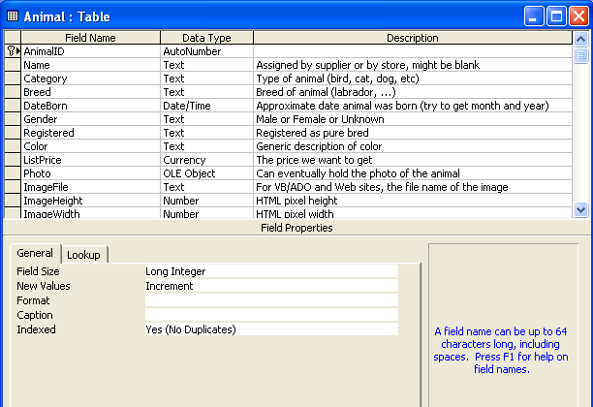
Table Definition in Access
Key
Numeric Subtypes or text length

Slide 51
Data Volume
Estimate the total size of the database.
  Current.
  Future growth.
  Guide for hardware and software purchases.
For each table.
  Use data types to estimate the number of bytes used for each row.
  Multiply by the estimated number of rows.
Add the value for each table to get the total size.
For concatenated keys (and similar tables).
  OrderItems(O#, Item#, Qty)
  Hard to “know” the total number of items ordered.
    Start with the total number of orders.
    Multiply by the average number of items on a typical order.
Need to know time frame or how long to keep data.
  Do we store all customer data forever?
  Do we keep all orders in the active database, or do we migrate older ones?

Slide 52
Data Volume Example
Customer(C#, Name, Address, City, State, Zip)
Row: 4 + 15 + 25 + 20 + 2 + 10 = 76
Order(O#, C#, Odate)
Row: 4 + 4 + 8 = 16
OrderItem(O#, P#, Quantity, SalePrice)
Row: 4 + 4 + 4 + 8 = 20
Business rules
  Three year retention.
  1000 customers.
  Average 10 orders per customer per year.
  Average 5 items per order.
Customer 76 * 1000 76,000
Order 16 * 30,000 480,000
OrderItem 20 * 150,000 3,000,000
Total 3,556,000

Slide 53
Appendices
Review same material as textbook
Excellent review for you
  Explain the slides to each other and to yourself
  Show how examples cause problems
  Explain how you would solve those problems

Slide 54
Appendix: Formal Definitions: Terms
Formal | Definition | Informal
Relation | A set of attributes with data that changes over time. Often denoted R. | Table
Attribute | Characteristic with a real-world domain. Subsets of attributes are multiple columns, often denoted X or Y. | Column
Tuple | The data values returned for specific attribute sets are often denoted as t[X] | Row of data
Schema | Collection of tables and constraints/relationships
Functional dependency | X → Y | Business rule dependency

Slide 55
Appendix: Functional Dependency
Derives from a real-world relationship/constraint.
Denoted X → Y for sets of attributes X and Y
Holds when any rows of data that have identical values for X attributes also have identical values for their Y attributes:
If t1[X] = t2[X], then t1[Y] = t2[Y]
X is also known as a determinant if X is non-trivial (not a subset of Y).

Slide 56
Appendix: Keys
Keys are attributes that are ultimately used to identify rows of data.
A key K (sometimes called candidate key) is a set of attributes
With FD K → U where U is all other attributes in the relation
If K’ is a subset of K, then there is no FD K’ → U
A set of key attributes functionally determines all other attributes in the relation, and it is the smallest set of attributes that will do so (there is no smaller subset of K that determines the columns.)

Slide 57
Appendix: First Normal Form
A relation is in first normal form (1NF) if and only if all attributes are atomic.
Atomic attributes are single valued, and cannot be composite, multi-valued or nested relations.
NOT 1NF
Example:
Customer(CID, Name: First + Last, Phones, Address)
CID | Name: First + Last | Phones | Address
111 | Joe Jones | 111-2223 111-3393 112-4582 | 123 Main

Slide 58
Appendix: Second Normal Form
A relation is in second normal form (2NF) if it is in 1NF and each non-key attribute is fully functionally dependent on the primary key.
K → Ai for each non-key attribute Ai
That is, there is no subset K’ such that K’ → Ai
NOT 2NF
Example:
OrderProduct(OrderID, ProductID, Quantity, Description)
OrderID | ProductID | Quantity | Description
32 | 15 | 1 | Blue Hose
32 | 16 | 2 | Pliers
33 | 15 | 1 | Blue Hose

Slide 59
Appendix: Transitive Dependency
Given functional dependencies: X → Y and Y → Z, the transitive dependency X → Z must also hold.
Example:
There is an FD between OrderID and CustomerID. Given the OrderID key attribute, you always know the CustomerID.
There is an FD between CustomerID and the other customer data, because CustomerID is the primary key. Given the CustomerID, you always know the corresponding attributes for Name, Phone, and so on.
Consequently, given the OrderID (X), you always know the corresponding customer data by transitivity.

Slide 60
Appendix: Third Normal Form
A relation is in third normal form if and only if it is in 2NF and no non-key attributes are transitively dependent on the primary key.
That is, K → Ai for each attribute, (2NF) and
There is no subset of attributes X such that K → X → Ai
NOT 3NF
Example:
Order(OrderID, OrderDate, CustomerID, Name, Phone)
OrderID | OrderDate | CustomerID | Name | Phone
32 | 5/5/2004 | 1 | Jones | 222-3333
33 | 5/5/2004 | 2 | Hong | 444-8888
34 | 5/6/2004 | 1 | Jones | 222-3333

Slide 61
Appendix: Boyce-Codd Normal Form
A relation is in Boyce-Codd Normal Form (BCNF) if and only if it is in 3NF and every determinant is a candidate key (or K is a superkey).
That is, K → Ai for every attribute, and there is no subset X (key or nonkey) such that X → Ai where X is different from K.
Example: Employees can have many specialties, and many employees can be within a specialty. Employees can have many managers, but a manager can have only one specialty: Mgr → Specialty
EmpSpecMgr(EID, Specialty, ManagerID)
EID | Speciality | ManagerID
32 | Drill | 1
33 | Weld | 2
34 | Drill | 1
FD ManagerID → Specialty is not currently a key.
NOT BCNF

Slide 62
Appendix: Multi-Valued Dependency
A multi-valued dependency (MVD) exists when there are at least three attributes in a relation (A, B, and C; and they could be sets), and one attribute (A) determines the other two (B and C) but the other two are independent of each other.
That is, A →B and A → C but B and C have no FDs
Example:
Employees have many specialties and many tools, but tools and specialties are not directly related.

Slide 63
Appendix: Fourth Normal Form
A relation is in fourth normal form 4NF if and only if it is in BCNF and there are no multi-valued dependencies.
That is, all attributes of R are also functionally dependent on A.
If A → → B, then all attributes of R are also functionally dependent on A: A → Ai for each attribute.
NOT 4NF
Example:
EmpSpecTools(EID, Specialty, ToolID)
EmpSpec(EID, Specialty)
EmpTools(EID, ToolID)
OK: 4NF

Slide 64
HOMEWORK
REQUIRED by Sun 20 Feb 2010 at 23:59
  Study Chapter 3 AGAIN using SQ3R
  Check the review questions again to be sure they all make sense to you and you can easily answer them
  For 20 points, submit written answers to Ch 3 problem 7
OPTIONAL by Sun 20 Feb 2010 at 23:59
  For 10 extra points
  Solve and submit solution to Corner Med problem 14 if you haven’t already submitted it for credit.

Slide 65
DISCUSSION

