Slide 1
Queries:
Part 1 of 2
IS240 – DBMS
Lecture # 6 – 2010-02-13
M. E. Kabay, PhD, CISSP-ISSMP
Assoc. Prof. Information Assurance
School of Business & Management, Norwich University
mailto:mkabay@norwich.edu V: 802.479.7937
Notes:
Class Notes

Slide 2
Topics
Why do we Need Queries
Four Questions to Create a Query
Query By Example & SQL
Boolean Algebra
DeMorgan’s Law
SQL Server Views
Simple Computations
SQL Differences
Groups and Subtotals
Where (Detail) v Having (Group)
Student Databases from Website
HOMEWORK

Slide 3
Why do we Need Queries
Natural languages (English) are too vague
  With complex questions, it can be hard to verify that the question was interpreted correctly, and that the answer we received is truly correct.
  Consider the question: Who are our best customers?
We need a query system with more structure
We need a standardized system so users and developers can learn one method that works on any (most) systems.
  Query By Example (QBE)
  SQL

Slide 4
Four Questions to Create a Query
What output do you want to see?
What do you already know (or what constraints are given)?
What tables are involved?
How are the tables joined together?

Slide 5
Tables

Slide 6
Organization
Single table
Constraints
Computations
Groups/Subtotals
Multiple Tables

Slide 7
Sample Questions
List all animals with yellow in their color.
List all dogs with yellow in their color born after 6/1/04.
List all merchandise for cats with a list price greater than $10.
List all dogs who are male and registered or who were born before 6/1/04 and have white in their color.
What is the average sale price of all animals?
What is the total cost we paid for all animals?
List the top 10 customers and total amount they spent.
How many cats are in the animal list?
Count the number of animals in each category.
List the CustomerID of everyone who bought something between 4/1/04 and 5/31/04.
List the first name and phone of every customer who bought something between 4/1/04 and 5/31/04.
List the last name and phone of anyone who bought a registered white cat between 6/1/04 and 12/31/04.
Which employee has sold the most items?

Slide 8
Query By Example & SQL
Query04_01
What tables?
SELECT AnimalID, Category, Breed, Color
FROM Animal
WHERE (Color LIKE ‘%Yellow%’);
Animal
AnimalID
Name
Category
Breed
DateBorn
Gender
What to see?
What conditions?
Field
AnimalID
Category
Breed
Color
Table
Animal
Animal
Animal
Animal
Sort
Criteria
Like ‘%Yellow%’
Or
List all animals with yellow in their color

Slide 9
Basic SQL SELECT
SELECT columns What do you want to see?
FROM tables What tables are involved?
JOIN conditions How are the tables joined?
WHERE criteria What are the constraints?

Slide 10
ORDER BY
SELECT columns
FROM tables
JOIN join columns
WHERE conditions
ORDER BY columns (ASC DESC)
Animal
SELECT Name, Category, Breed
FROM Animal
ORDER BY Category, Breed;
Name Category Breed
Cathy Bird African Grey
Bird Canary
Debbie Bird Cockatiel
Bird Cockatiel
Terry Bird Lovebird
Bird Other
Charles Bird Parakeet
Curtis Bird Parakeet
Ruby Bird Parakeet
Sandy Bird Parrot
Hoyt Bird Parrot
Bird Parrot
AnimalID
Name
Category
Breed
DateBorn
Gender
Field
Name
Category
Breed
Table
Animal
Animal
Animal
Sort
Ascending
Ascending
Criteria
Or

Slide 11
DISTINCT
SELECT Category
FROM Animal;
SELECT DISTINCT Category
FROM Animal;
Category
Fish
Dog
Fish
Cat
Cat
Dog
Fish
Dog
Dog
Dog
Fish
Cat
Dog
. . .
Category
Bird
Cat
Dog
Fish
Mammal
Reptile
Spider

Slide 12
Constraints: And
Query04_02
List all dogs with yellow in their color born after 6/1/04.
Animal
AnimalID
Name
Category
Breed
DateBorn
Gender
Color
SELECT AnimalID, Category, DateBorn
FROM Animal
WHERE ((Category=‘Dog’)
AND (Color Like ‘%Yellow%’)
AND (DateBorn>’01-Jun-2004’));
Field | AnimalID | Category | DateBorn | Color
Table | Animal | Animal | Animal | Animal
Sort
Criteria |  | ‘Dog’ | >’01-Jun-2004’ | Like ‘%Yellow%’
Or
Notes:
REMIND JERRY POST TO ADD COLOR TO HIS ANIMAL TABLE HERE

Slide 13
Boolean Algebra
a = 3
b = -1
c = 2
And: Both must be true.
Or: Either one is true.
Not: Reverse the value.
(a > 4) And (b < 0)
F
T
F
(a > 4) Or (b < 0)
F
T
T
NOT (b < 0)
T
F

Slide 14
Boolean Algebra
The result is affected by the order of the operations.
Parentheses indicate that an operation should be performed first.
With no parentheses, operations are performed left-to-right.
a = 3
b = -1
c = 2
( (a > 4) AND (b < 0) ) OR (c > 1)
Always use parentheses
so other people can read
and understand your query.
It will also help you when you come back to one of your own queries later.
F
T
T
F
T
T
(a > 4) AND ( (b < 0) OR (c > 1) )
F
T
T
F
T
F

Slide 15
DeMorgan’s Law Example
Customer:"I want to look at a cat, but I don’t want any cats that are
registered or that have red in their color."
Animal
SELECT AnimalID, Category, Registered, Color
FROM Animal
WHERE (Category=‘Cat’) AND
NOT ((Registered is NOT NULL)
OR (Color LIKE ‘%Red%’)).
AnimalID
Name
Category
Breed
DateBorn
Gender
Field | AnimalID | Category | Registered | Color
Table | Animal | Animal | Animal | Animal
Sort
Criteria |  | ‘Cat’ | Is Null | Not Like ‘%Red%’
Or

Slide 16
DeMorgan’s Law
Negation of clauses
  Not (A And B) becomes Not A Or Not B
  Not (A Or B) becomes Not A And Not B
Customer:"I want to look at a cat, but I don’t want
any cats that are registered
or
that have red in their color."
CAT: Registered=ASCF
Color=Black
NOT ((Registered is NOT NULL) OR (Color LIKE ‘%Red%’))
T
or
F
not
T
F
(Registered is NULL) AND NOT (Color LIKE ‘%Red%’)
F
not
F
and
T
F

Slide 17
Conditions: AND, OR
Query04_03
SELECT AnimalID, Category, Gender, Registered, DateBorn, Color
FROM Animal
WHERE (( Category=‘Dog’) AND
( ( (Gender=‘Male’) AND (Registered Is Not Null) ) OR
( (DateBorn<’01-Jun-2004’) AND (Color Like ‘%White%’) ) ) );
Animal
List all dogs who are
male and registered
or
who were born before 6/1/2004
and have white in their color.
AnimalID
Name
Category
Breed
DateBorn
Gender
Field | AnimalID | Category | Gender | Registered | DateBorn | Color
Table | Animal | Animal | Animal | Animal | Animal | Animal
Sort
Criteria |  | ‘Dog’ | ‘Male’ | Is Not Null
Or |  | ‘Dog’ |  |  | < ’01-Jun-2004’ | Like ‘%White%’

Slide 18
Useful Where Conditions
Comparisons | Examples
Operators | <, =, >, <>, BETWEEN, LIKE, IN
Numbers | AccountBalance > 200
Text Simple Pattern match one Pattern match any | Name > ‘Jones’ License LIKE ‘A_ _82_’ Name LIKE ‘J%’
Dates | SaleDate BETWEEN ’15-Aug-2004’ AND ’31-Aug-2004’
Missing Data | City IS NULL
Negation | Name IS NOT NULL
Sets | Category IN (‘Cat’, ‘Dog’, ‘Hamster’)

Slide 19
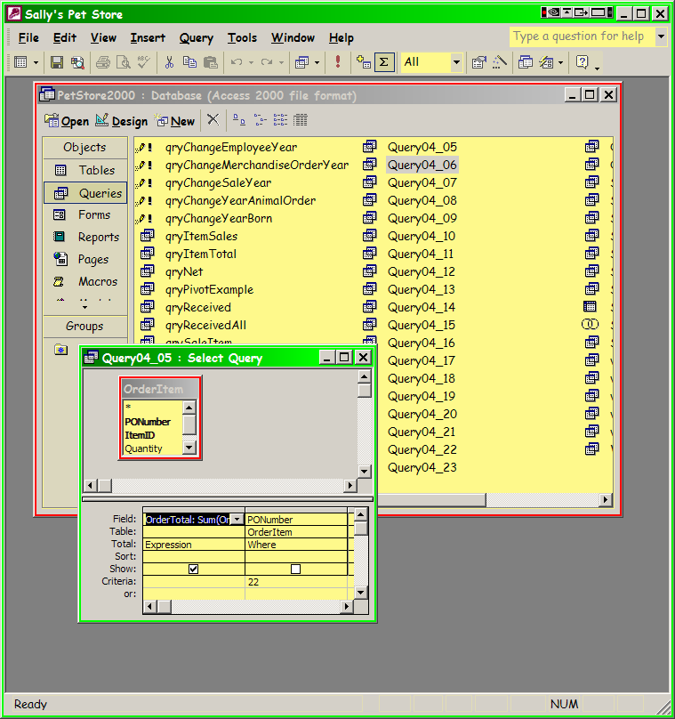
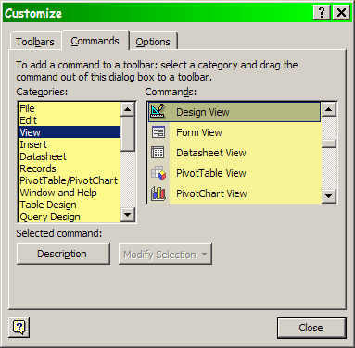
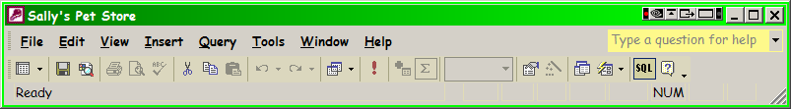
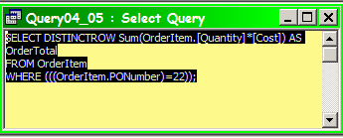
SQL in MS-ACCESS
View | Design View
View | SQL View

Slide 20
Simple Computations
Basic computations (+ - * /) can be performed on numeric data.
The new display column should be given a meaningful name.
SaleItem(OrderID, ItemID, SalePrice, Quantity)
Select OrderID, ItemID, SalePrice, Quantity,
SalePrice*Quantity As Extended
From SaleItem;
OrderID ItemID Price Quantity Extended
151 9764 19.50 2 39.00
151 7653 8.35 3 25.05
151 8673 6.89 2 13.78

Slide 21
Computations: Aggregation--Avg
What is the average sale price of all animals?
SELECT Avg(SalePrice) AS AvgOfSalePrice
FROM SaleAnimal;
SaleAnimal
Sum
Avg
Min
Max
Count
StDev or StdDev
Var
SaleID
AnimalID
SalePrice
Field | SalePrice
Table | SaleAnimal
Total | Avg
Sort
Criteria
Or

Slide 22
Computations (Math Operators)
What is the total value of the order for PONumber 22?
  Use any common math operators on numeric data.
  Operate on data in one row at a time.
OrderItem
PONumber
ItemID
Quantity
Cost
SELECT Sum(Quantity*Cost) AS OrderTotal
FROM OrderItem
WHERE (PONumber=22);
Field | PONumber | OrderTotal: Quantity*Cost
Table | OrderItem | OrderItem
Total
Sort
Criteria | =22
Or
OrderTotal
1798.28

Slide 23
SQL Differences

Slide 24
Subtotals (Where)
How many cats are in the Animal list?
Animal
AnimalID
Name
Category
Breed
DateBorn
Gender
SELECT Count(AnimalID) AS CountOfAnimalID
FROM Animal
WHERE (Category = ‘Cat’);
Field | AnimalID | Category
Table | Animal | Animal
Total | Count | Where
Sort
Criteria |  | ‘Cat’
Or

Slide 25
Groups and Subtotals
Count the number of animals in each category.
  You could type in each WHERE clause, but that is slow.
  And you would have to know all of the Category values.
Animal
AnimalID
Name
Category
Breed
DateBorn
Gender
SELECT Category, Count(AnimalID) AS CountOfAnimalID
FROM Animal
GROUP BY Category
ORDER BY Count(AnimalID) DESC;
Category CountOfAnimalID
Dog 100
Cat 47
Bird 15
Fish 14
Reptile 6
Mammal 6
Spider 3
Field | Category | AnimalID
Table | Animal | Animal
Total | Group By | Count
Sort |  | Descending
Criteria
Or

Slide 26
Conditions on Totals (Having)
Count number of Animals in each Category, but list Category only if more than 10 in that Category.
Animal
SELECT Category, Count(AnimalID) AS CountOfAnimalID
FROM Animal
GROUP BY Category
HAVING Count(AnimalID) > 10
ORDER BY Count(AnimalID) DESC;
AnimalID
Name
Category
Breed
DateBorn
Gender
Field | Category | AnimalID
Table | Animal | Animal
Total | Group By | Count
Sort |  | Descending
Criteria |  | >10
Or
Category CountOfAnimalID
Dog 100
Cat 47
Bird 15
Fish 14

Slide 27
Where (Detail) v Having (Group)
Count Animals born after 6/1/2004 in each Category, but list Category only if more than 10 in that Category.
Animal
SELECT Category, Count(AnimalID) AS CountOfAnimalID
FROM Animal
WHERE DateBorn > ’01-Jun-2004’
GROUP BY Category
HAVING Count(AnimalID) > 10
ORDER BY Count(AnimalID) DESC;
AnimalID
Name
Category
Breed
DateBorn
Gender
Field | Category | AnimalID | DateBorn
Table | Animal | Animal | Animal
Total | Group By | Count | Where
Sort |  | Descending
Criteria |  | >10 | >’01-Jun-2004’
Or
Category CountOfAnimalID
Dog 30
Cat 18

Slide 28
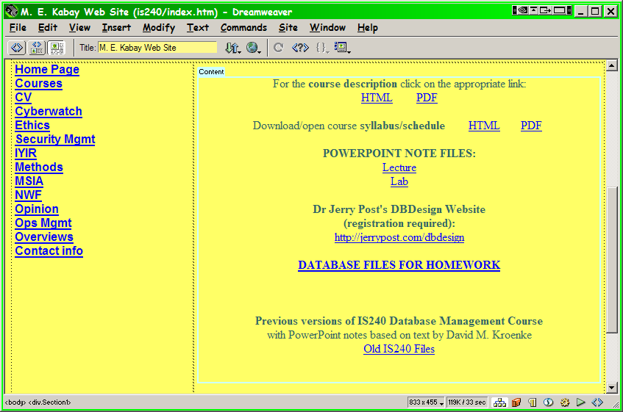
Student Databases from Website
http://www2.norwich.edu/mkabay/courses/academic/norwich/is240/index.htm

Slide 29
HOMEWORK REQUIRED
By Sun 28 Feb 2010 at 23:59
Study Chapter 4 pp 173-201 thoroughly using SQ3R
Answer Review Questions 1-12 for yourself to be sure they all make sense to you and you can easily answer them later in quizzes
Download the PetStore2000.mdb or PetStore2002.mdb file (as appropriate for your system) from Jerry Post’s site
Create SQL code and the records you find to Ch 4 Sally’s Pet Store exercises 1-7 (there’s no way to learn SQL without actually using it).

Slide 30
HOMEWORK OPTIONAL
By Sun 28 Feb 2010 at 23:59
For extra credit, answer any of the questions in
  Rolling Thunder Bicycles #26-35
  Corner Med #51-70

Slide 31
DISCUSSION

