Slide 1

Analyzing and Building Simple Queries in SQL
IS240 – Database Management
Supplement to Chapter 4
M. E. Kabay, PhD, CISSP-ISSMP
Assoc. Prof. Information Assurance
School of Business & Management, Norwich University
mailto:mekabay@gmail.com V: 802.479.7937

Slide 2
Sally’s Pet Store
Someone
From
Ireland
Will
Grow
Horseradish and
Onions
SELECT
FROM
INNER JOIN
WHERE
GROUP BY
HAVING
ORDER BY
Chapter 4
  Exercises 1-25 deal with the Pet Store
  Pp 211-212 (in 4th edition PDF file)
We will examine a way to analyze and solve query problems using SQL on the Pet Store database available from the Jerry Post Web site
Mnemonic

Slide 3
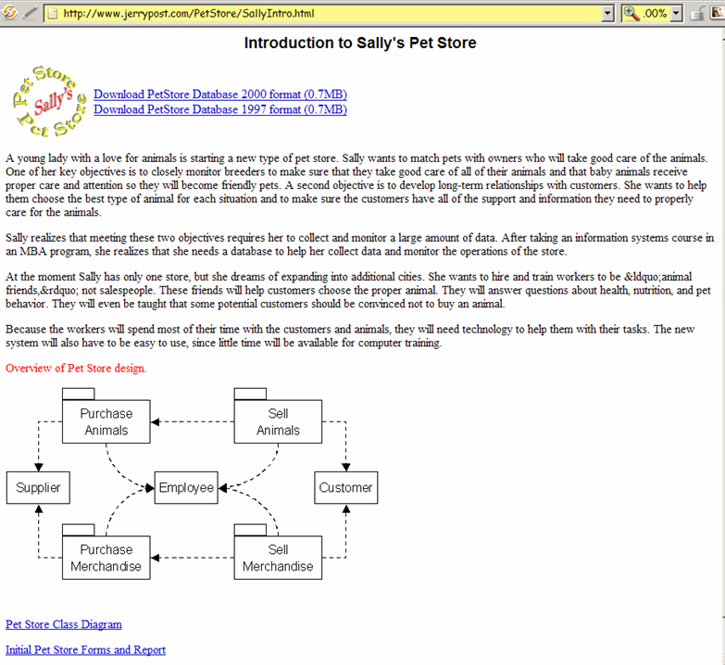
Sally’s Pet Store on the Web

Slide 4
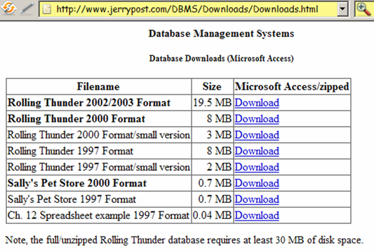
Downloading Other Databases

Slide 5
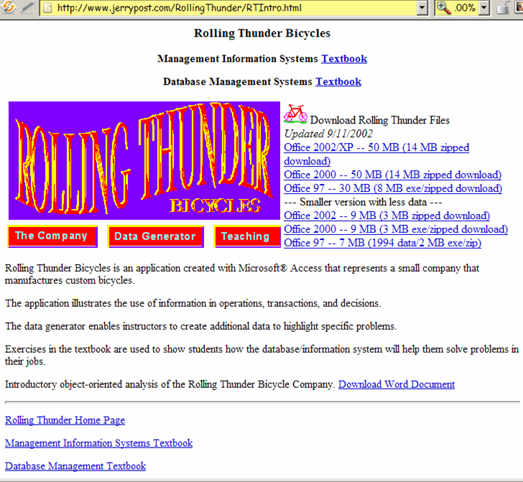
Rolling Thunder Bicycles

Slide 6
How to LEARN about SQL
In the following slides, we will dissect SQL queries into very small slices
  This approach is useful when you are learning SQL
  But it is very tedious
It is not the normal approach to creating queries
  As you become familiar with SQL, you will be able to skip intermediate steps
  It is nonetheless useful to break up complex queries into subqueries
  Can test each step to be sure you are getting the records you expect
  Avoids the confusing debugging problem caused when a complex query is created all at once and gives the wrong answer

Slide 7
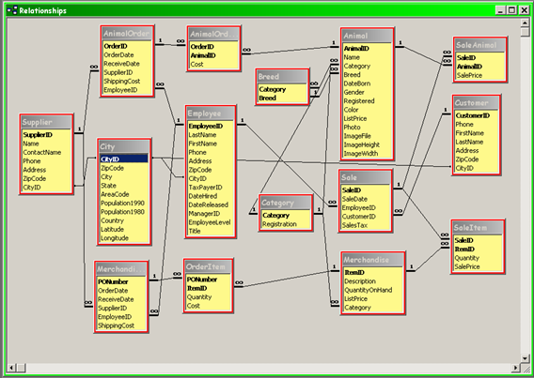
Sample Problem 1: Pet Store
Animals born in May
Notes:
What are the fields needed?
Open the database
Check the Tools | Relationships screen

Slide 8
Sample Problem 1 (cont’d)
Someone
From
Ireland
Will
Grow
Horseradish and
Onions
SELECT
FROM
INNER JOIN
WHERE
GROUP BY
HAVING
ORDER BY
Animals born in May
Which fields do we need?
  AnimalID
  DateBorn
Where are they?
  Animal dataset
Do we need any other datasets to answer
this question?
  No
Which records do we need?
  The ones where the month part of the date is equal to the code for May or where the date is between the start and end of the May.

Slide 9
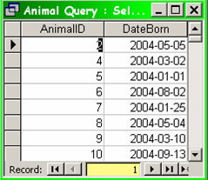
Sample Problem 1 (cont’d)
Animals born in May
Start with the simplest query (no condition):
  SELECT Animal.AnimalID,
  Animal.DateBorn
  FROM Animal;
!

Slide 10
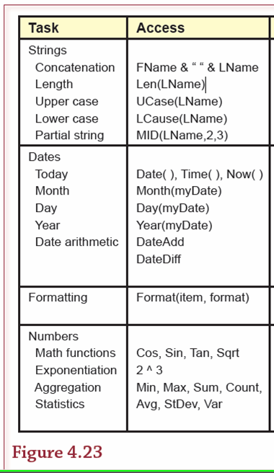
Sample Problem 1 (cont’d)
Animals born in May
How do we determine the month in the date field?
  We can use the Month() function
Functions can save enormous trouble
  Avoid having to define complex conditions
  E.g., setting ranges such as “date between the first and last day of a particular month” which requires hand-coding
P. 196

Slide 11
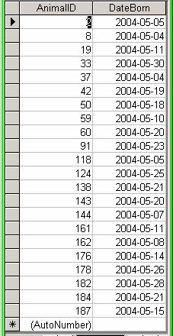

Sample Problem 1 (cont’d)
Animals born in May
Now select the particular month:

Slide 12
Sample Problem 2
Someone
From
Ireland
Will
Grow
Horseradish and
Onions
SELECT
FROM
INNER JOIN
WHERE
GROUP BY
HAVING
ORDER BY
During the 3rd quarter, which item was sold in the largest quantity greater than 5 units?
Which fields are involved?
  ItemID
  Description
  Quantity
  OrderDate
  PONumber
What datasets are involved?
  OrderItem
  Order
  Merchandise

Slide 13
Sample Problem 2 (cont’d)
During the 3rd quarter, which item was sold in the largest quantity greater than 5 units in a single order?
How shall we break down the problem?
  First figure out how to see all the items sold
  Next determine how to find only the items sold more than 5 units at a time (makes code general)
  Next determine how to locate the qualifying item sold in the largest quantity in a single order
  Then figure out how to see all the items sold in the 3rd quarter (don’t use range of days – use months)
  Then combine the conditions to locate the record that fits the problem requirements
  Finally link the chosen record to the Merchandise Description field to get the name of the item
OrderItem
MerchandiseOrder
Merchandise

Slide 14

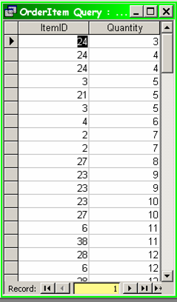
First figure out how to see all the items sold
!
Complete problem:
During the 3rd quarter, which item was sold in the largest quantity greater than 5 units in a single order?

Slide 15

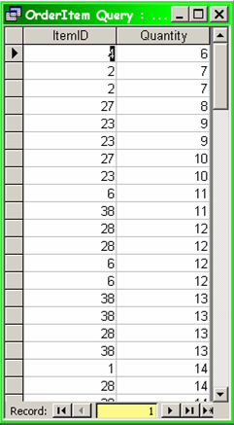
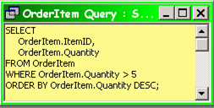
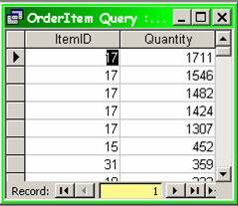
Next determine how to find only the items sold more than 5 units at a time

Slide 16
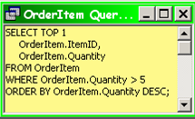

Next determine the qualifying item sold in the largest quantity in a single order
Someone
From
Ireland
Will
Grow
Horseradish and
Onions
SELECT
FROM
INNER JOIN
WHERE
GROUP BY
HAVING
ORDER BY
Complete problem:
During the 3rd quarter, which item was sold in the largest quantity greater than 5 units in a single order?

Slide 17
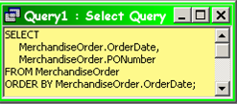
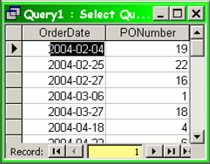
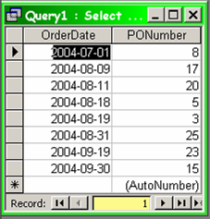
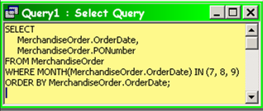
Then figure out how to see all the items sold in the 3rd quarter
First we get all the data we need,
then we reduce them to the
3rd quarter (MONTH 7, 8, or 9)

Slide 18
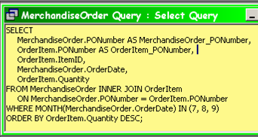
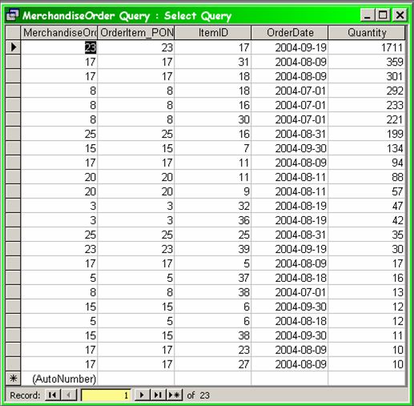
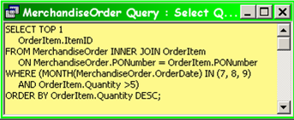
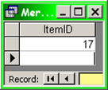
Then combine the conditions to locate the record that fits the problem requirements
Since we don’t actually need all
this info about the item, we use
this simpler query for ItemID:

Slide 19
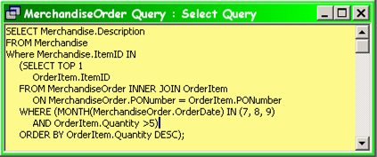
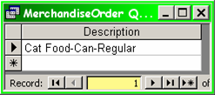
Finally link the chosen record to the Merchandise Description field to see the name of the item

Slide 20
END

