Slide 1
Advanced Query Analysis
IS240 – DBMS
Supplement to Chapter 5
M. E. Kabay, PhD, CISSP-ISSMP
Assoc. Prof. Information Assurance Division of Business & Management, Norwich University
mailto:mkabay@norwich.edu V: 802.479.7937
Notes:
Class Notes

Slide 2
Topics
Sally’s Pet Store: Problem 5-01
Start with Calculation of Order Values
Save the Query
Document the Query
Query is Saved
Then Use the Stored Query in the Complete Query
Use TOP operator to Restrict Output

Slide 3
Sally’s Pet Store: Problem 5-01
Which supplier has the highest average percentage of shipping cost per value of merchandise order?
First, compute the value of each order
Store the query as Query05_01a
Then use the synthetic table of values from Query05_01a to prepare a new synthetic table
Combines the supplier info with the order info
Allows computation of percentage
Sort data

Slide 4
Start with Calculation of Order Values

Slide 5
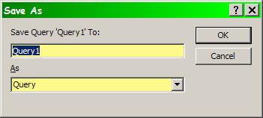
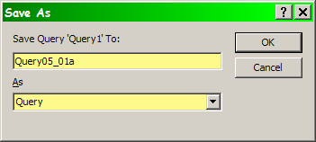
Save the Query

Slide 6
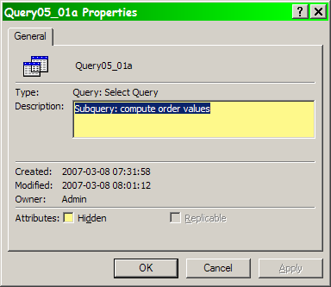
Document the Query

Slide 7
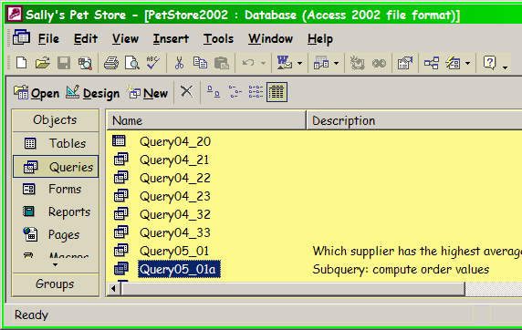
Query is Saved

Slide 8
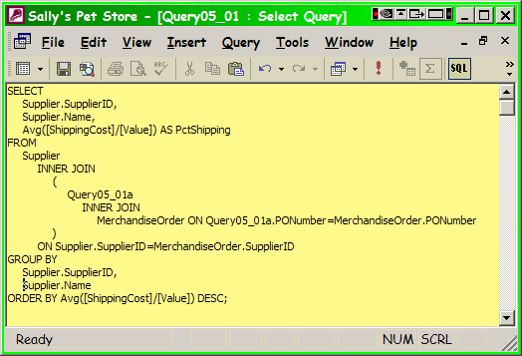
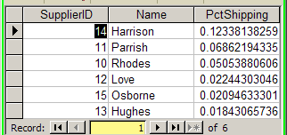
Then Use the Stored Query in the Complete Query

Slide 9
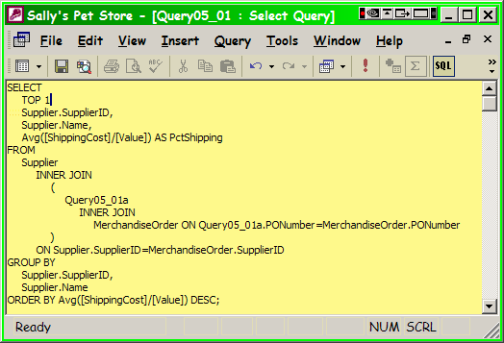
Use TOP operator to Restrict Output

Slide 10
DISCUSSION

