Slide 1
Forms & Reports
Part 1 of 2
IS240 – DBMS
Lecture #9 – 2010-03-22
M. E. Kabay, PhD, CISSP-ISSMP
Assoc. Prof. Information Assurance
School of Business & Management, Norwich University
mailto:mkabay@norwich.edu V: 802.479.7937
Notes:
Class Notes

Slide 2
Topics
Uses of Forms
Human Factors Design
Menus
Queries
Form Properties
Multiple Forms
Integrity
Large Projects
Objects
International Attributes
Direct Manipulation of Objects
Creating a Graphical Approach
TEXTBOOK CHAPTER 6
Pages 270-296

Slide 3
Uses of Forms
Collect Data
Display Query Results
Display Analysis and Computations
Switchboard for other Forms and Reports
Direct Manipulation of Objects
  Graphics
  Drag and Drop

Slide 4
Human Factors Design
User Control
  Match user tasks.
  Application responds to user control & events.
  User customization
Consistency
  Layout, Design & colors
  Actions
Clarity
  Organization
  Purpose
  Terminology
Aesthetics
  Art to enhance, graphics
  Sound
Feedback
  Methods
    Visual
    Text
    Audio
  Uses
    Acceptance of input
    Changes to data
    Completion of tasks
    Events / Activation
Forgiveness
  Anticipation and correction of errors
  Confirmation on delete and updates
  Backup and recovery

Slide 5
Windows Interface Standards
The Windows Interface: An Application Design Guide (Microsoft)
Navigation and Choices
  Mouse, Icons
  Keyboard, Short-cuts
  Menus
Selections from a list
  Single
  Contiguous Multiple
  Disjoint Multiple
Focus
  Outline box
  Cursor
Manipulation
  Activation
  Drag and Drop
Feedback
  Progress indicators and status gauges
  Flashing
  Tool tips
  Status bar
  3-D controls
  Message boxes

Slide 6
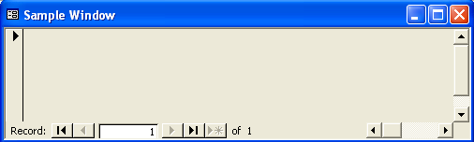
Windows Interface
Frame (sizing)
Minimize
Title bar
Maximize
Close
Scroll up
First record
Scroll box
Scroll down
Previous record
Scroll right
New record
Record number
Next record
Last record
Scroll left
Scroll box

Slide 7
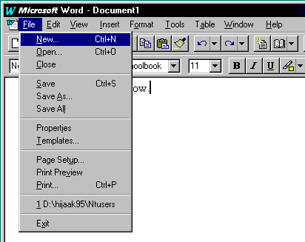
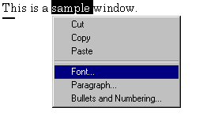
Windows Menus
Mnemonic character for use with ALT key
Drop-down
Menu item
Pop-up (as needed)
Shortcut Keys

Slide 8
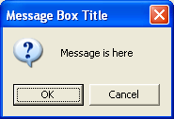
Message Box
(A Simple Form)
Title
Message
Icon
Simple buttons
Modal forms
force user to respond
before returning control
to the application
Active button
First active
button is
the default

Slide 9
Interface / Accessibility
Multiple Input Methods
  Keyboard
  Mouse
  Voice
Multiple Output
  Visual
  Sound
  Color
Some Suggestions:
  Beware of Red/Green.
  Avoid requiring rapid user responses.
  Avoid rapid flashing on the screen.
  Give users customization options.
    Volume
    Color
    Typefaces & Fonts

Slide 10
Form Layout
Control
Control
Types of Forms
  Tabular
  Single Row
  Sub-forms (one-to-many)
  Switchboard
Controls
  Focus is active control
  Often changes appearance
Form Properties
Form Events
  Open, close
Form
Order
Items
11 Dog 5
7 Dog 1
13 Cat 2
Sub-form

Slide 11
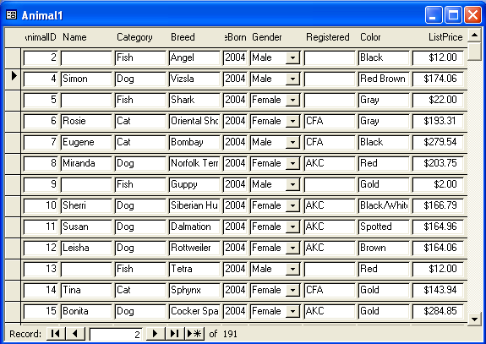
Tabular Form
Works best for single table.
Designer can control data entry sequence.
Often include buttons for sorting
  Usually click column name
  Highlight column name used for sort
  Show triangle pointing up or down for ascending or descending sort

Slide 12
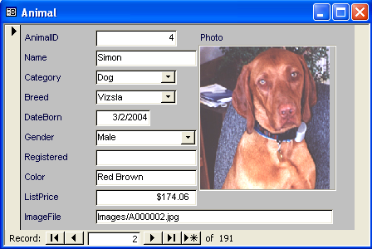
Single Row (Columnar) Form
Data for only one row.
Designer can set optimal layout.
Similar in appearance to paper forms.
Can use color, graphics, and command buttons to make the form easier to use.
Note the importance of the navigation buttons.
Probably want a Find command.
Useful to include subforms.
Navigation buttons

Slide 13
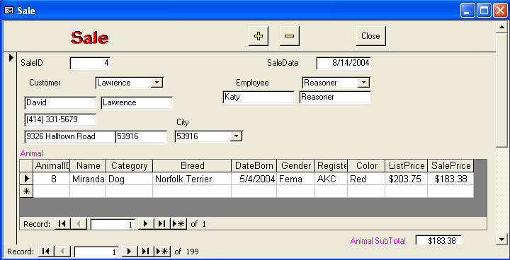
Sub-Forms
Typically a one-to-many relationship.
Subform contents are linked to the main form through a common column (not displayed on the subform.)
Can have multiple subforms (Independent or Nested).

Slide 14
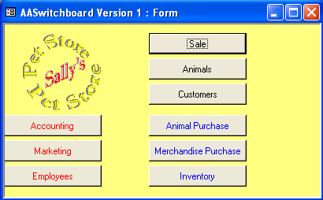
Switchboard (Menu) Form
Start with blank form
Remove scrolling and navigation tools
Graphics/Picture/Background
Identify type of user and provide appropriate functions
User can choose specific task
Arrange functions by
frequency of use
Can branch to a
second menu when
needed for further
options

Slide 15
Menu Design
Main Menu
Customer Information
1. Setup Choices
2. Data Input
3. Print Reports
4. DOS Utilities
5. Backups
Daily Sales Reports
Friday Sales Meeting
Monthly Customer Letters
Exit
Hard to understand
(GeekSpeak)
Organized by user tasks.

Slide 16
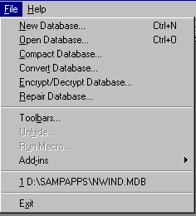
Menus
Consistency
  With operating environment
  Within project
Pull-down
  Name, Action
  Shortcut keys
  Access keys (&File, File)
  Breaks/groups (-)
  Dimmed option
  Check mark
Submenus (>)
  Logical groupings
  Tradeoff: length v depth
Form indicator (…)
Pop-up
  Miniature form
  Tied to location/pointer
  Right-mouse button
  Attribute settings
  Modal (keeps focus) or not

Slide 17
Queries
Queries are used to automatically look up data.
  e.g., Customer name
  e.g., Product description
Be very careful when using queries.
  Each form should store data in only one table.
  For multiple tables, use a subform or separate forms.
  Usually Lock the look up data so it cannot be changed accidentally.

Slide 18
Form Query Example
Clerk enters a CustomerID.
  Stored in the Order table.
Query joins Sale and Customer.
  Automatically matches the CustomerID.
  Matching name is displayed on the form.
  Do not include the join column (CustomerID) from the look up table (Customer).
Customer Order
SaleID
1234
Date
7/25/01
CustomerID
17
Carly
Embry

Slide 19
Form Query: Underlying Tables
Customer Order
SaleID
1234
Date
7/25/01
CustomerID
17
Carly
Embry
Data
entry
Data
display
Sale
Customer
SaleID CustomerID Sdate
1232 23 7/24/01
1233 74 7/24/01
1234 17 7/25/01
CustomerID First Last
15 Connie Fisher
16 Rosie Wade
17 Carly Embry
Query
Join

Slide 20
Form Properties (Some)
Data
  Base Table / Query
  Filters
  Sort
Integrity
  Edits
  Additions, Deletions
  Locks
Other
  Pop-up menus
  Menu Bar
  Help
Format
  Caption
  Scroll Bars
  Record Selectors
  Navigation Buttons
  Size and Centering
  Background/Pictures
  Colors
  Tab Order

Slide 21
Controls on Forms (Basic)
Drop down list or combo box
List box
Label
Text box
Last Name
Clothing
Shoes
Electronics
Country
Payment Method
Options
Credit Card
Check
Cash
x
Gift wrap
Gift card
Monogram
Sales
x
Check box
Command button
Option button

Slide 22

Pictures
Background pictures
  Unbound, unchanging.
  Stored with the form.
  Keep edit screen readable.
  Sizing (zoom, scale, clip).
Pictures stored as data
  Bound to a data column.
  Define column as object.
  Tie to scanner or graphics package through OLE.
  Beware of data size
    Resolution
    Number of colors
  User machine capabilities.
Employee
Name: Che Zhang
ID: 3354
Phone: 222-111-1524
. . .
Photo:

Slide 23
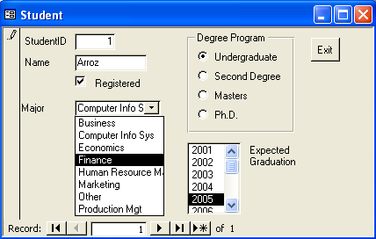
Basic Controls
Option Group
(single response)
Label
Text Box
Command
Button
Combo Box
(click arrow to open)
List Box
(always open)

Slide 24
Combo & List Boxes
User selects from a list
Combo box can enter new data, or restrict to list.
Two basic uses:
  Insert a value into a table
    Choose from a list of preset options, e.g. gender.
    Select from a different table, e.g., choose a customer.
  Find the data record in this form that matches the choice.
Be careful! Many systems do not distinguish between the two uses (enter data and search).
Example when you want to use data entry:
  On a sales form, use a combo box for customer.
  It takes a value from the Customer table and inserts the ID into the Sale table.
Example when you want to use a search:
  On a Customer edit form, you might use a combo to search the Customer table.
  Be sure the combo is not bound to the table!
  Probably need to write code for search.

Slide 25
Combo Box
Properties
ControlSource sets the column to receive the choice (in the Sale table)
RowSource generates the list of data to display.
  Uses standard SQL.
  Note 4 columns displayed.
  First column is the one to store in the data table.
Name CustomerID
ControlSource CustomerID
Format
DecimalPlaces Auto
InputMask
RowSource/Type Table/Query
RowSource SELECT . . .
ColumnCount 4
ColumnHeads No
ColumnWidths . . .
BoundColumn 1
SELECT Customer.CustomerID, Customer.LastName, Customer.FirstName, Customer.Phone FROM Customer ORDER BY Customer.LastName;

Slide 26
Combo Box Sources
Microsoft Access supports three methods:
  Fixed list.
  Query from a table.
  Defined function.
With some systems (e.g., Visual Basic), you write code to generate each list entry.
You might use a fixed list for simple lists like “male”, “female”, “unknown”.
It is better to query from a table, even for simple lists.
  Use a one column table.
  Easier to add to a table than to change a combo box.
Useful feature of list combo box.
  The Row Source property is a text string.
  This string can be generated by code.
  List entries can be changed in response to user actions.
Programmed function.
  For straightforward cases, it is easier to use a fixed list and just change the text.
  More complex cases, you can write a subroutine that generates the list choices following a specific format.

Slide 27
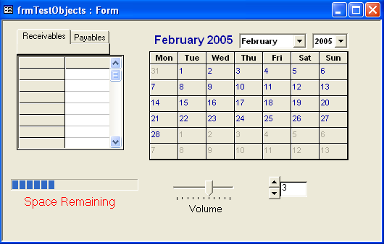
Controls on Forms (Complex)
Common
  Tab
  Grid
  Calendar
  Gauge
  Slider
  Spin Box
Additional
  Purchase
  Create your own (C++)
Calendar
Tab
Grid
Gauge
Slider
Spin box

Slide 28
Charts
Build a query that generates the data to be graphed.
  Numeric data
    Individual series
    Aggregate data
  Labels
  Columns to link to form.
  Summary chart--unlinked.
Insert chart.
  Set chart type.
  Set up data and labels.
  Set chart properties.
  Verify size.
Sale 1
Merchandise
Animal
Sale 2
Merchandise
Animal
Sale 3
Merchandise
Animal
Total Sales
Merchandise
Animals

Slide 29
Multiple Forms
Sale
Customer
FirstName: Mary
LastName: Jones
Address: 123 Oaxaca Ave.
Edit
Customer
FirstName: Mary
LastName: Jones
Address: 123 Oaxaca Ave.
City: Los Angeles
ZipCode: 90086
Gender: Female
Age: 20
AccountBalance: $150
Animals Purchased
Merchandise

Slide 30
Multiple Forms
Animal
Using data on other forms
  The forms object collection
  Forms![FormName]![Control]
Subtotals and subforms
  The form property
  Forms![MainForm]![SubForm].
  Form![Control]
Multi-page v Separate forms
  Same recordset
  Screen size
  Side-by-side
AnimalID
Sale
=AnimalID from Animal form
ItemsSold
- - - - - - -
- - - - - - -
Subtotal=Sum(Price*Quantity)
=Forms!Sale!ItemsSold.Form!Subtotal
Subtotal
Tax
=Subtotal*[TaxRate]
OrderTotal
=Subtotal+Tax

Slide 31
Integrity
Avoid relying on forms
  Set integrity conditions in table definitions
  Be sure to set referential integrity (relationships)
Use forms to make it easy to enter quality data
  Combo/list boxes
  Menus
  Pop-up forms
  Ties to related forms
  Data transfer across forms
  Computations
  Error checking & trapping
Controls
  Security rights
  Data formats
    Data entry
    Round-off
  Selectivity
    Visible
    Enabled & Locked
    Example: no production change after item is sold.
User assistance
  Tool tips
  Status bar
  Menu
  Help--context sensitive

Slide 32
Large Projects
Design Standards
  Templates
    Colors, layout
    Titles
    Actions, common buttons
  Naming convention is crucial
    Forms
    Controls
    Event procedures
    Variables
Team Coordination
  Menu design
    Within a form/standards
    Across an application
  Event / action diagrams
    State diagram
    Scenario diagram/messages
Switchboard
form
Customer Order
Assembly
Order
form
Assembly
form
Backorder
Notice
& Form
Order form
Item#
item not
available
Customer#
large
customer
Customer
Discount

Slide 33
International Attributes
Language
Character sets and punctuation marks
Sorting
Data formats
  Date
  Time
  Metric v English
  Currency symbol and format
  Separators (decimal, . . .)
  Phone numbers
    Separators
    International code prefix
  Postal codes
  National ID Numbers

Slide 34



Direct Manipulation of Objects
Kennel/
Orders
Current Choices
Customer
Bird
Cat
Tabby
Dog
Fish
Mammal
Reptile
Spider
Brown Lab
A graphical approach.
Minimize data entry.
Drag and drop objects (blue arrows).

Slide 35
Creating a Graphical Approach
Get the hardware.
  Images: Scanners
  Sound: Microphone and Sound card
  Video: Camera and capture card
  Lots of disk space.
  High speed processors.
Add an object column to your table definition.
Design the screens.
  Be creative.
  Get user input.
  Make the user’s job easier.
  Avoid using graphics just for show.
  Double-click
  Drag-and-drop
Programming!

Slide 36
HOMEWORK & PLANNING
Study Textbook Chapter 6 pp 270-296 using SQ3R
For Sunday 23:55 4 Apr 2007 (2 weeks)
  Complete LAB CHAPTER 6 Database work
  Keep files for your own review
Wednesday 7 April 2010:
  Lecture on Forms & Reports (2)
Friday 9 April 2010
  Prepare for quiz we missed on 2 Apr 2010 due to Prof Kabay’s horrible wretched equivalent to the bubonic plague:
  Will cover
    Advanced Queries (Lecture 8)
    Forms & Reports (1) (Lecture 9)

Slide 37
DISCUSSION

