Slide 1
Forms & Reports
Part 2 of 2
IS240 – DBMS
Lecture #10 – 2010-03-29
M. E. Kabay, PhD, CISSP-ISSMP
Assoc. Prof. Information Assurance
School of Business & Management, Norwich University
mailto:mkabay@norwich.edu V: 802.479.7937
Notes:
Class Notes

Slide 2
Topics
Report Design
  Terminology
  Types
  Layout
  Computations
  Wizard
Applications
  Design
  Organization
  Structure
  Custom Menus
  Help
In the words of the Hitchhiker’s Guide to the Galaxy, DON’T PANIC.
Although there are 51 slides, many of them are simply illustrations.

Slide 3
Report Design
Report usage/user needs.
Report layout choices.
  Tabular
  Columns/Subgroups
  Charts/graphs
Paper sizes.
Printer constraints.
How often is it generated?
Events that trigger report?
How large is the report?
Number of copies?
Colors?
Security controls
  Distribution list
  Unique numbering
  Concealed/non-printed data
  Secured printers
  Transmission limits
  Print queue controls
Output concerns
  Typefaces
    Readability
    Size
    User disabilities
  OCR needs

Slide 4
Terminology
Page Layout
  Landscape v. portrait
  Margins
  Gutter (binding space)
Typefaces
  Serif (Times New Roman)
  Sans-serif (Arial)
  Ornamental
  Fixed width
Font size
  common: 10 - 12 point
  72 points approx. 1 inch
  pica (1/6 inch) (12 points)
Facing pages (portrait)
gutter
margins
Landscape
Alignment marks for color separations.

Slide 5
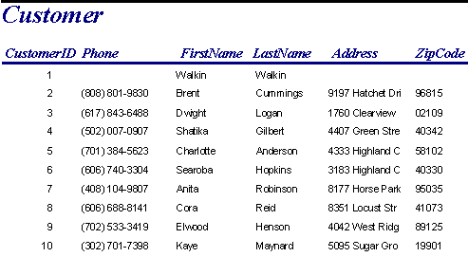
Report Types: Tabular

Slide 6
Report Types: Labels

Slide 7
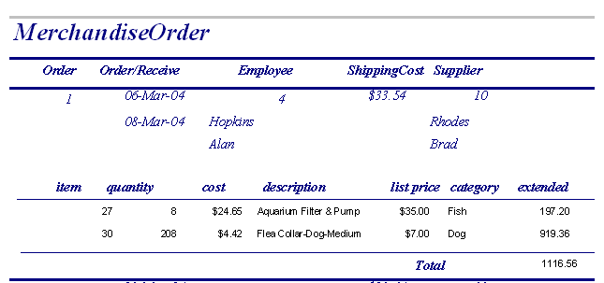
Report Types
Column.
Column with groups.

Slide 8
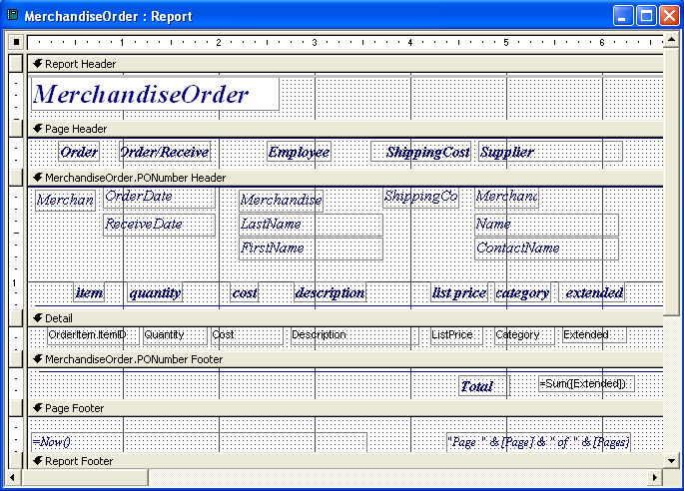
Report Layout
Report Header
Page Header
Group Header1
  Group Header2
    . . .
    Detail
    . . .
  Group Footer2
Group Footer1
Page Footer
Report Footer

Slide 9
Report Layout/Common Use
Report Header
  Title pages that are printed one time for entire report.
Page Header
  Title lines or page notes that are printed at the top of every page.
Group Header
  Data for a group (e.g., Order) and headings for the detail section.
Detail
  Innermost data.
Group Footer
  Subtotals for the group.
Page Footer
  Printed at the bottom of every page--page totals or page numbers and notes.
Report Footer
  Printed one time at the end of the report. Summary notes, overall totals and graphs for entire data set.

Slide 10
Report Layout/Groups
Often use groups/breaks for one-to-many relationships.
Use a query to join all necessary tables.
  Can include all columns.
  Use query to create computed columns (e.g., Extended:Price*Quantity).
  Avoid creating aggregates or subtotals in the query.
Each one-to-many relationship becomes a new subgroup.
Customer(C#, Name, …)
Order(O#, C#, Odate, …)
OrderItem(O#, Item#, Qty, …)
Report of Orders
Rpt footer: graph orders by customer
Group1: Customer
H1: Customer name, address, …
F1: Customer total orders:
Group2: Order
H2: Order#, Odate, Salesperson.
F2: Order total: Sum(Extended)
Detail: Item#, Qty, Extended

Slide 11
Report Computations
Query
  Same row computations.
  Extended=Price*Quantity
Report
  Group subtotals.
  Page and report totals.
  Mixed, e.g., commission = rate * total
  Scope depends on location
    Group footer: subtotal
    Page footer: page total
    Report footer: report total

Slide 12
Report Graphs
Separate query.
Detail
  Locate in detail or group footer section.
  Avoid aggregation and groups in query.
  Include column that links to detail query in report.
Subtotals and totals
  Typically located in report footer or header.
  Compare group totals
  Relies on Group By and aggregation.
  Be sure query groups match report groups.

Slide 13
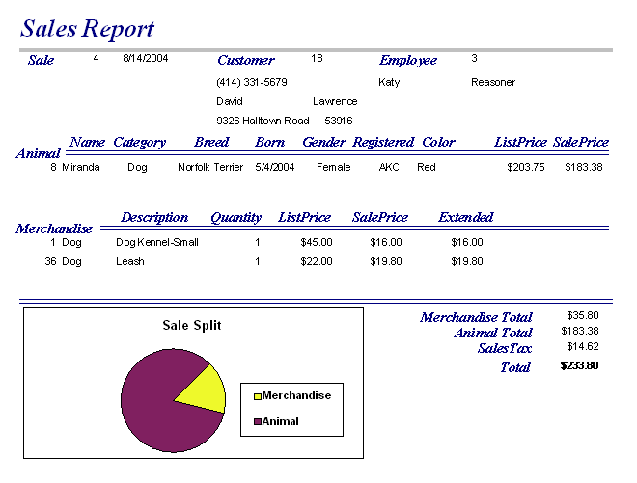
Report Graph for Group

Slide 14
Using the Access Report Wizard
Starting the Wizard
Choosing Fields
Choosing a Basic Format
Defining Groups
Sorting
Group Statistics
Choosing a Print Layout
Embellishing the Appearance
Adding a Report Title
Default Report Layout
Previewing the Print Job

Slide 15
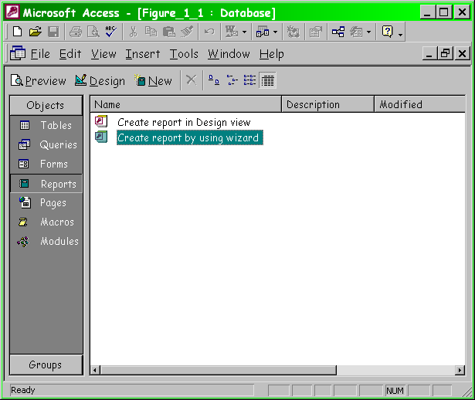
Starting the Wizard

Slide 16
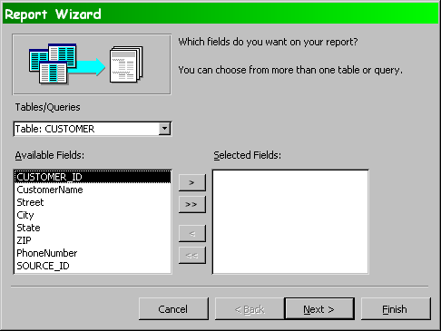
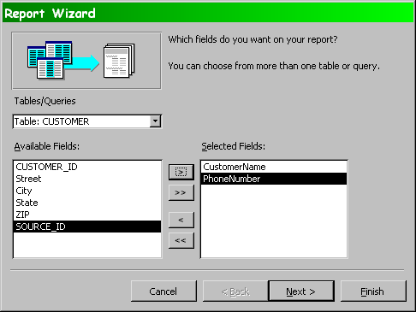
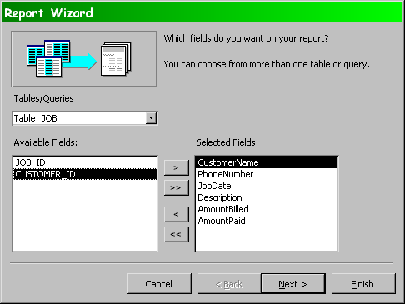
Choosing Fields

Slide 17
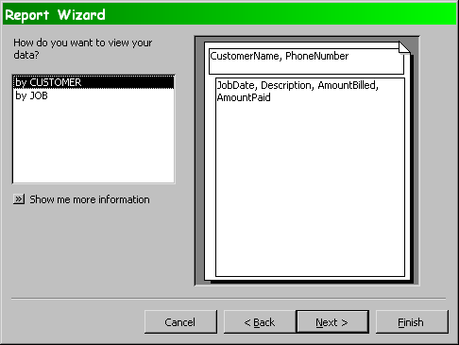
Choosing a Basic Format

Slide 18
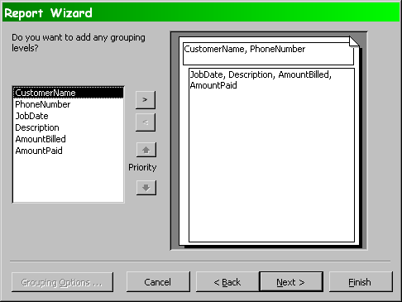
Defining Groups

Slide 19
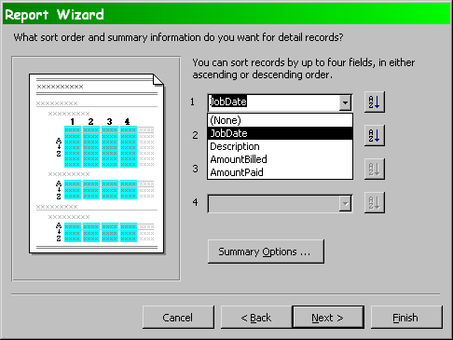
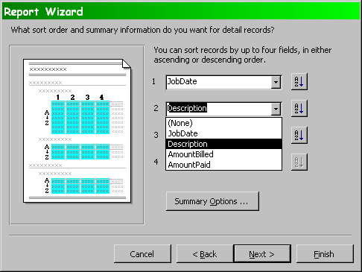
Sorting

Slide 20
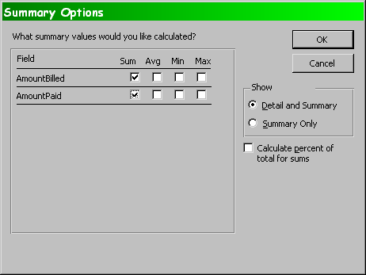
Group Statistics

Slide 21
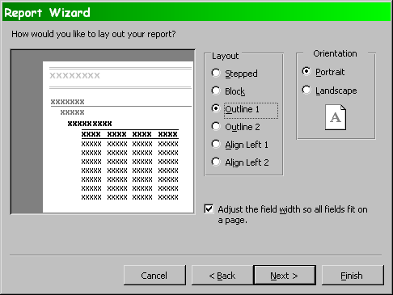
Choosing a Print Layout

Slide 22
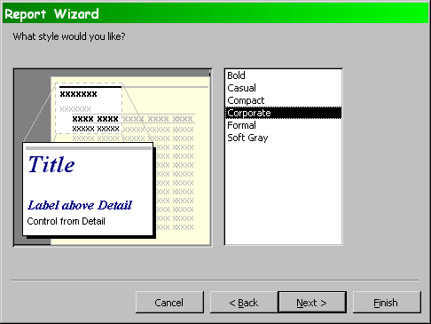
Embellishing the Appearance

Slide 23
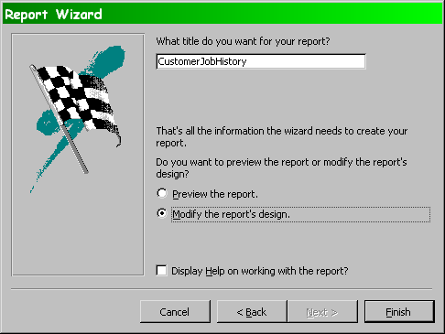
Adding a Report Title

Slide 24
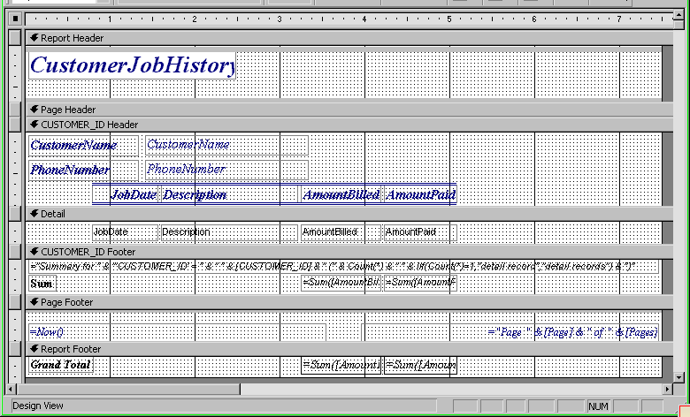
Default Report Layout

Slide 25
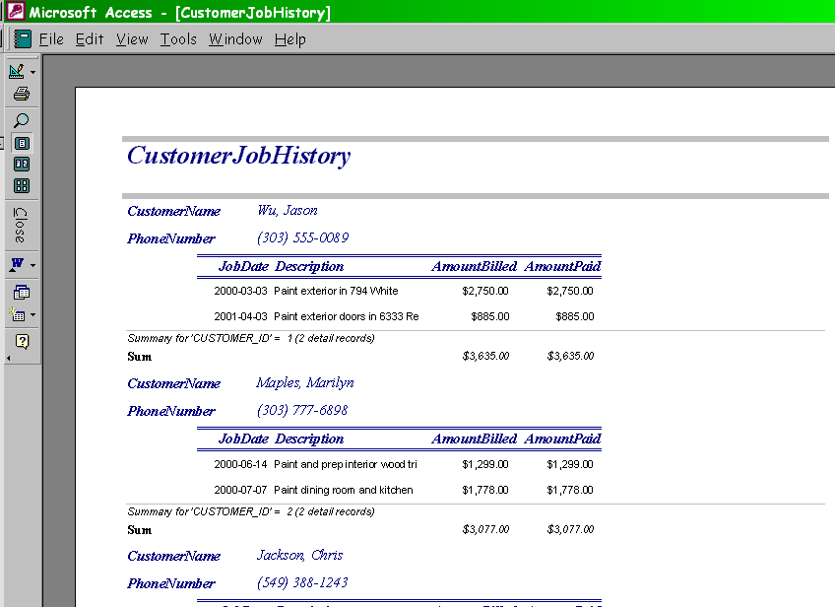
Previewing the Print Job

Slide 26
Application Features
Customer
Report
Application organization
Menu
Toolbar
Help
Transactions
Improving forms
Customized reports
Distributing Applications
File Edit Help
File Edit Help
File Edit Help
File Edit Help
Sales
Report
Switchboard

Slide 27
Application Design
Customer
1592
Jane Doe
333 Elm St.
Order
Customer:
1592 Jane Doe
333 Elm St.
Customer Form
Order Form
Bad design:
  Enter data twice.
Poor design:
  Memorize data (ID) on one form to enter on second.
Better design:
  Automatically transfer data across forms.

Slide 28
Application Importance (1)
User interface
  Make users’ jobs easier.
  Tie input forms and reports.
  Automate basic tasks
  Tie to external data collection devices.
  Help system.
Ensure data integrity
  Validate data.
  Perform computations.
  Verify totals.
  Control user access.
  Maintain related transactions.
  Backup and recovery.

Slide 29
Application Importance (2)
Decision Support
  Monitoring of events.
  Analysis, Graphs, Reports.
  Statistical analysis and optimization.
  Forecasts and simulation.
  Linking to other software.
Expert Systems & Intelligence
  Logic and forward chaining.
  Analysis and decisions in code.
  Databases of cases, situations and solutions.

Slide 30
Application Organization (1)
Organized by user needs.
  Identify user.
  Outline tasks.
  Organize forms and reports.
Direct users to tasks.
Potential drawbacks
  Too many layers makes it difficult for users to find anything.
  Poor organization confuses users and requires additional support and training.

Slide 31
Application Organization (2)
Build forms and reports.
Start with a core concept.
  Identify most important features. Get them correct.
  Add features, forms and reports.
  Issue application updates--number and date!
Use menu stubs for incomplete and future work.
  Make them invisible to the user with the Visible property.
  Be sure they are disabled.

Slide 32
Application Structure
Forms and Reports
Visual Basic
Internet
Oracle Forms
Front end
Middle Tier
(Optional)
Business logic
Rules
If x > 10,000 Then
Else
End If
Database
Oracle
SQL Server
DB2
Access
Back end

Slide 33
User Orientation
Database application is a model of the organization.
  Applications based on user jobs.
  Flexibility and user control.
Application organization
  User tasks.
  User control over sequence.
Forms
  Minimize user entry.
  Anticipation.
Reports
  Easy access from forms.
  User selection of scope and conditions or filters.

Slide 34
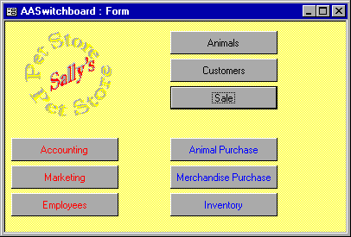
Initial Menu / Switchboard
Starting point for users.
  Identify the user.
    From network if
    possible.
    Separate log in if
    needed.
  Customized for users.
    Hide restricted options.
    Different forms as
    needed.
Avoid cluttered screens.
  Use graphics and color to enhance the presentation.
  Limit the number of options.

Slide 35
Switchboard Uses
Acts as a directory for the application.
Identifies users.
Contains startup and shutdown code.
  Can preload forms in background.
    Make them invisible.
    Speed up later usage.
  Can initiate transaction and security logs.
  Can establish network connections.
Contains copyright and usage notes.

Slide 36
Sally’s Pet Store: Poor Organization
Order
Merchandise
Item
Receive
Merchandise
Item
Sell
Merchandise
Item
What is wrong?
  Focus needs to be at higher level
  (Order, Receipt, Sale); not Item.A
  You cannot go from Order to
  Receipt.
  You cannot go from Receipt to Sale.
  You need to get customer data before recording the sale.
Get
Customer
Data

Slide 37
Sally’s Pet Store: Better Organization
Supplier
Customer
Orders
Receipt
special
orders
Sale
Inventory
Items
More links--usually as buttons.
Separate sales from orders, except for special orders.

Slide 38
Sally’s Pet Store: Initial VTOC*
Sales
Sale Animal
Animals
Sale Merchandise
Customers
Animal Health
Animal Genealogy
Customer Receipts
Suppliers
Supplier Payments
Purchase Animals
Purchase Merchandise
Inventory
Sales Report
Accounting
Cash Flow
Marketing
Accounts Payable
Employees
Accounts Receivable
*Volume Table of Contents

Slide 39
Benefits of Custom Menus
Limit user actions.
Simplify user interface.
Add custom actions.
Menus can be activated by keystrokes.
  Accessibility
  Touch-typists and heads-down data entry.
Sometimes need different menus for each form.
File
Help
Contents
Search
About Rolling Thunder
File Help
Edit
Add Customer
Delete Customer Ctrl+D
Modify Customer Data

Slide 40
Creating Menus
View | Toolbars | Customize
Drag and Drop
  Multilevel menu.
    Sublevels/hierarchy.
    Each level is a separate menu with its own name.
  Menu choices
    Each entry has a name.
    Access key: & (e.g., &File).
    Status Bar Text
  Actions
    Submenu.
    Run any code.

Slide 41
Toolbars
Why toolbars?
  Single click for complex actions.
  Commands available across the application / shortcuts.
  Position and customization by user.
Toolbar components
  Button
    Text
    Icon/graphic (bitmap)
  Tool Tip
  Status Bar description
  Action
Print
Identify report
Ask for single or multiple pages.
Preview or print.
Switchboard
Weekly Sales Analysis
Build graphs
Print reports
Export data to spreadsheet

Slide 42
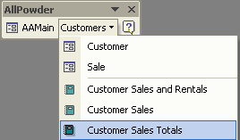
Menus and Toolbars

Slide 43
Creating Toolbars
View | Toolbars | New
Customizing
  Add new button.
    Select from DBMS list.
    Bring up query/form/report.
    Run code.
  Change icon.
    Modify existing icon.
    Replace icon.
    Create your own icon and paste it on the button.
    Place text label on button.
Tool tips are vital.
Status bar for description.

Slide 44
Icons
16 by 16 pixels
16 colors
  Bright and shaded
  Dither to mix colors
Outline in black

Slide 45
Activating Toolbars and Menus
Install a menu
  Form: Attach a bar using the form properties.
  Code
    On Activate
    On Deactivate
Modify from code
  Add or remove options
  Enable/Disable (dim)
Set myBar = CommandBars(”Custom1")
If user = ”Clerk" Then
myBar.Visible = True
Else
CommandBars(”Database").Reset
myBar.Enabled = False
End If
With myBar
.Controls.Add Type:=msoControlButton, Id:=3
.Controls(1).Enabled = False
.Controls.Add Type:=msoControlButton, Id:=3
End With
myBar.Visible = True

Slide 46
Help
On-line help replaces manuals
  Context sensitive:
    Pressing F1 key provides information on topic with current focus
  Hypertext links to related topics
  Sequential topics
    Descriptions
    Examples
  Definitions / Glossary
  Contents / overview
  Index / keywords
  Full-text search
Sally’s Pet Store--Contents
Copyright Notice
The Firm
Introduction
Processes
Entering Data
Sales
Animal Health
Breeds (and other terms)

Slide 47
HTML Help
Microsoft HTML Help Workshop: http://tinyurl.com/6ejdu
Can create each of the following
  Help project files
    Use separate directory
  HTML topic files
    Standard HTML with some additions for keywords
  Topic Header and Text File
  Graphics and multimedia
    Avoid monster sizes
  Contents files
    Can auto-generate from heading tags (<H1>, <H2>, …)
  Index files
    Use Help Workshop to set keywords within each topic

Slide 48
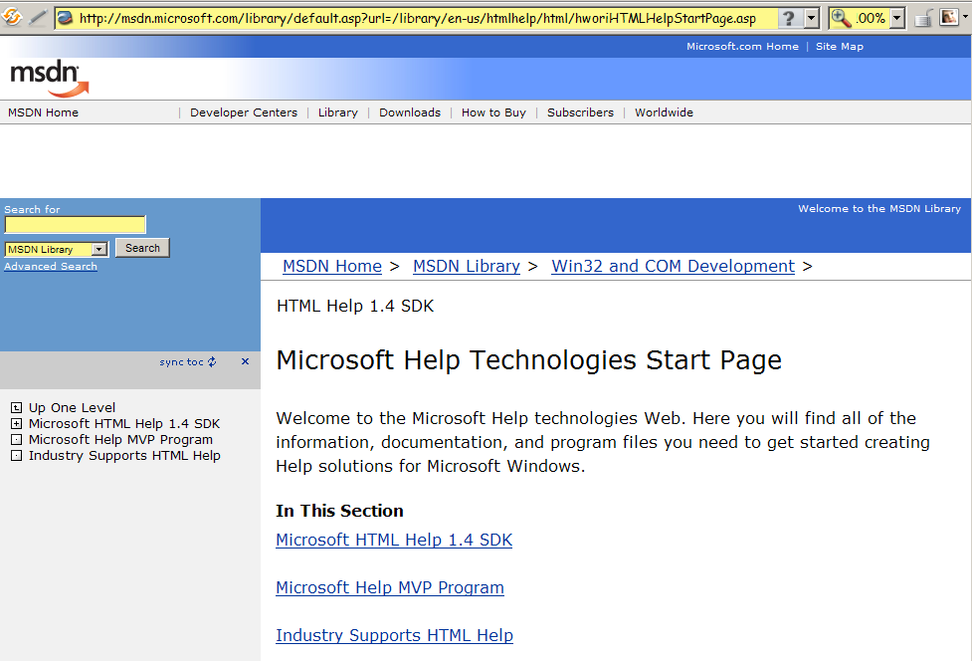
HTML Help Workshop Online

Slide 49
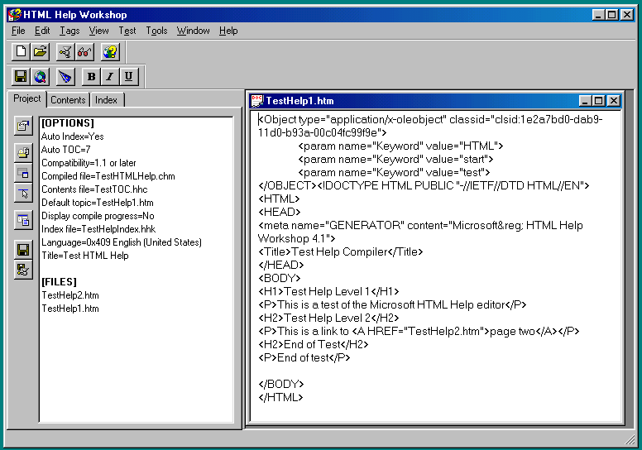
HTML Help Workshop

Slide 50
HOMEWORK & QUIZ
Complete Lab Ch 6: All Powder Board and Ski Shop forms and reports
  Keep your files for review
Continue working on your term project
  Will be the basis of your lab evaluation
Friday 9 April 2010
  Prepare for quiz we missed on 2 Apr 2010 due to Prof Kabay’s horrible wretched equivalent to the bubonic plague:
  Will cover
    Advanced Queries (Lecture 8)
    Forms & Reports (1) (Lecture 9)

Slide 51
DISCUSSION

