Slide 1
Data Warehouses & Data Mining
IS240 – DBMS
Lecture # 14 – 2010-04-26
M. E. Kabay, PhD, CISSP-ISSMP
Assoc. Prof. Information Assurance
Division of Business & Management, Norwich University
mailto:mkabay@norwich.edu V: 802.479.7937
Notes:
Class Notes

Slide 2
Topics
Objectives
Sequential Storage and Indexes
Data Warehouse
OLAP Data Browsing
Data Mining

Slide 3
Objectives
What is the difference between transaction processing and analysis?
How do indexes improve performance for retrievals and joins?
Is there another way to make query processing more efficient?
How is OLAP different from queries?
How are OLAP databases designed?
What tools are used to examine OLAP data?
What tools exist to search for patterns and correlations in the data?

Slide 4
Sequential Storage and Indexes
We picture tables as simple rows and columns, but they cannot be stored this way.
  It takes too many operations to find an item.
  Insertions require reading and rewriting the entire table.
ID | LastName | FirstName | DateHired
1 | Reeves | Keith | 1/29/07
2 | Gibson | Bill | 3/31/07
3 | Reasoner | Katy | 2/17/07
4 | Hopkins | Alan | 2/8/07
5 | James | Leisha | 1/6/07
6 | Eaton | Anissa | 8/23/07
7 | Farris | Dustin | 3/28/07
8 | Carpenter | Carlos | 12/29/07
9 | O'Connor | Jessica | 7/23/07
10 | Shields | Howard | 7/13/07
Notes:
Find an item in a sequential table. Even if you know the primary key value, the system has to start at the first row and continue until it finds the desired match. On average, with N total rows, it takes N/2 row retrievals to find a particular item.

Slide 5
Binary Search
Given a sorted list of names.
How do you find Jones.
Sequential search
  Jones = 10 lookups
  Average = 15/2 = 7.5 lookups
  Min = 1, Max = 14
Binary search
  Find midpoint (14 / 2) = 7
  Jones > Goetz
  Jones < Kalida
  Jones > Inez
  Jones = Jones (4 lookups)
Max = log₂ (N) = 0.30103 log₁₀ (N)
  N = 1000 Max = 10
  N = 1,000,000 Max = 20
Adams
Brown
Cadiz
Dorfmann
Eaton
Farris
1 Goetz
Hanson
3 Inez
4 Jones
2 Kalida
Lomax
Miranda
Norman
14 entries
Notes:
Binary search. To find the entry for Jones, divide the list in half. Jones falls below that value (Goetz), so divide the second part in half again. Jones falls above Kalida. Continue dividing the remaining sections in half until you find the matching row.

Slide 6
Operations on Sequential Tables
Read entire table
  Easy and fast
Sequential retrieval
  Easy and fast for one order.
Random Read/Sequential
  Very weak
  Probability of any row = 1/N
  Sequential retrieval
  1,000,000 rows means 500,000 retrievals per lookup!
Delete
  Easy
Insert/Modify
  Very weak
Row Prob. # Reads
A 1/N 1
B 1/N 2
C 1/N 3
D 1/N 4
E 1/N 5
… 1/N i

Slide 7
Insert into Sequential Table
Insert Inez:
  Find insert location.
  Copy top to new file.
  At insert location, add row.
  Copy rest of file.
ID LastName FirstName DateHired
8 Carpenter Carlos 12/29/98
6 Eaton Anissa 8/23/98
7 Farris Dustin 3/28/98
2 Gibson Bill 3/31/98
4 Hopkins Alan 2/8/98
5 James Leisha 1/6/98
9 O'Connor Jessica 7/23/98
3 Reasoner Katy 2/17/98
1 Reeves Keith 1/29/98
10 Shields Howard 7/13/98
ID LastName FirstName DateHired
8 Carpenter Carlos 12/29/98
6 Eaton Anissa 8/23/98
7 Farris Dustin 3/28/98
2 Gibson Bill 3/31/98
11 Inez Maria 1/15/99
5 James Leisha 1/6/98
9 O'Connor Jessica 7/23/98
3 Reasoner Katy 2/17/98
1 Reeves Keith 1/29/98
10 Shields Howard 7/13/98

Slide 8
Pointers
When data is stored on drive (or RAM).
  Operating System allocates space with a function call.
  Provides location/address.
    Physical address
    Virtual address (VSAM)
      Imaginary drive values mapped to physical locations.
    Relative address
      Distance from start of file.
      Other reference point.
Address
Data
      Volume
      Track
      Cylinder/Sector
      Byte Offset
      Drive Head
Key value
Address /
pointer

Slide 9
Pointers and Indexes
Address
Data
LastName Index
A11
1 Reeves Keith 1/29/07
LastName Pointer
Carpenter A67
Eaton A58
Farris A63
Gibson A22
Hopkins A42
James A47
O'Connor A78
Reasoner A32
Reeves A11
Shields A83
A22
2 Gibson Bill 3/31/07
ID Index
A32
3 Reasoner Katy 2/17/07
ID Pointer
1 A11
2 A22
3 A32
4 A42
5 A47
6 A58
7 A63
8 A67
9 A78
10 A83
A42
4 Hopkins Alan 2/8/07
A47
5 James Leisha 1/6/07
A58
6 Eaton Anissa 8/23/07
A63
7 Farris Dustin 3/28/07
A67
8 Carpenter Carlos 12/29/07
A78
9 O’Connor Jessica 7/23/07
A83
10 Shields Howard 7/13/07
Notes:
Pointers and indexes. Each piece of data is stored in a location with a specific address. An index consists of the column value to be searched along with the pointer to the rest of the row. Multiple indexes can be assigned to a table and quickly searched.

Slide 10
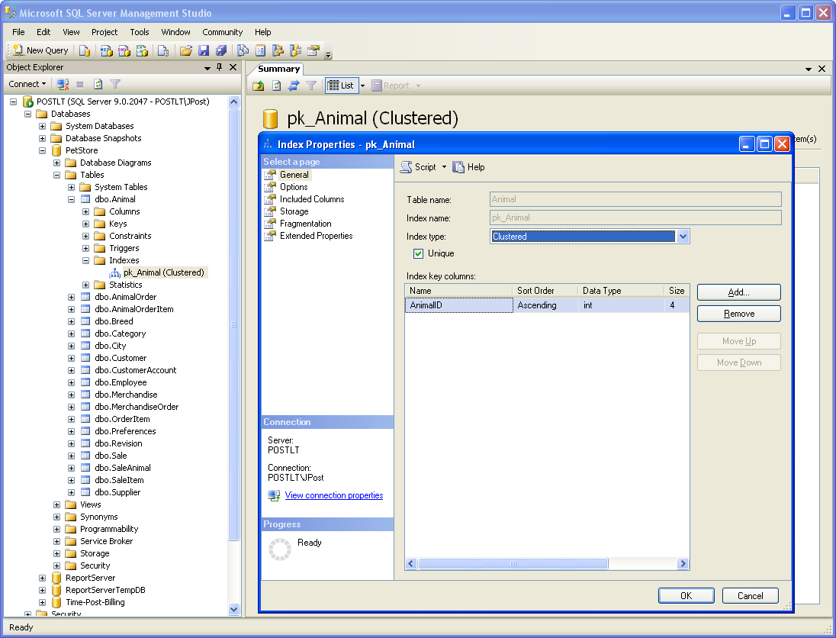
Creating Indexes: SQL Server Primary Key
Notes:
Index for primary key. SQL Server automatically generates and maintains indexes for primary key columns. Higher-end systems, such as SQL Server, provide several options to optimize the storage and use of indexes. These options can be used to improve the performance of your queries and applications.

Slide 11
SQL CREATE INDEX
CREATE INDEX ix_Animal_Category_Breed
ON Animal (Category, Breed)
Notes:
SQL CREATE INDEX command. The basic syntax is straightforward. Give the index a unique name, then specify the table and columns to be used. Most systems support additional options to control the details such as storage and type of index.

Slide 12
Indexed Sequential Storage
Common uses
  Large tables.
  Need many sequential lists.
  Some random search--with one or two key columns.
  Mostly replaced by B+-Tree.
Address
A11
A22
A32
A42
A47
A58
A63
A67
A78
A83
ID LastName FirstName DateHired
1 Reeves Keith 1/29/98
2 Gibson Bill 3/31/98
3 Reasoner Katy 2/17/98
4 Hopkins Alan 2/8/98
5 James Leisha 1/6/98
6 Eaton Anissa 8/23/98
7 Farris Dustin 3/28/98
8 Carpenter Carlos 12/29/98
9 O'Connor Jessica 7/23/98
10 Shields Howard 7/13/98
ID Pointer
1 A11
2 A22
3 A32
4 A42
5 A47
6 A58
7 A63
8 A67
9 A78
10 A83
LastName Pointer
Carpenter A67
Eaton A58
Farris A63
Gibson A22
Hopkins A42
James A47
O'Connor A78
Reasoner A32
Reeves A11
Shields A83
Indexed for ID and LastName

Slide 13
Linked List
Separate each element/key.
Pointers to data.
Pointers to next element.
Starting point.
A67
8 Carpenter Carlos 12/29/98
A22
2 Gibson Bill 3/31/98
A58
6 Eaton Anissa 8/23/98
A63
7 Farris Dustin 3/28/98
B87
Carpenter
B29
A67
B38
Gibson
00
A22
B29
Eaton
B71
A58
B71
Farris
B38
A63
End of List

Slide 14
B-Tree (Detail in Chapter 12)
Store key values
Utilize binary search (or better).
Trees
  Nodes
  Root
  Leaf (node with no children)
  Levels / depth
  Degree (maximum number of children
  per node)
<
Key
Data
>=
Hanson
Dorfmann
Kalida
Brown
Farriis
Inez
Miranda
Adams
Cadiz
Eaton
Goetz
Inez
Jones
Lomax
Norman
A
B
C
D
E
F
G
H
I
J
K
L
M
N

Slide 15
Index Options: Bitmaps and Statistics
Bitmap index
  A compressed index designed for non-primary key columns. Bit-wise operations can be used to quickly match WHERE criteria.
Analyze statistics
  By collecting statistics about the actual data within the index, the DBMS can optimize the search path. For example, if it knows that only a few rows match one of your search conditions in a table, it can apply that condition first, reducing the amount of work needed to join tables.

Slide 16
Problems with Indexes
Each index must be updated when rows are inserted, deleted or modified.
Changing one row of data in a table with many indexes can result in considerable time and resources to update all of the indexes.
Steps to improve performance
  Index primary keys
  Index common join columns (usually primary keys)
  Index columns that are searched regularly
  Use a performance analyzer

Slide 17
Data Warehouse
Predefined
reports
Interactive
data analysis
Operations
data
Daily data
transfer
OLTP Database
3NF tables
Data warehouse
Star configuration
Flat files
Notes:
Data warehouse. Data from the OLTP system and other sources is cleaned and transferred into a data warehouse on a regular basis. The data warehouse is optimized for interactive data analysis.

Slide 18
Data Warehouse Goals
Existing databases optimized for Online Transaction Processing (OLTP)
Online Analytical Processing (OLAP) requires fast retrievals, and only bulk writes.
Different goals require different storage, so build separate dta warehouse to use for queries.
Extraction, Transformation, Loading (ETL)
Data analysis
  Ad hoc queries
  Statistical analysis
  Data mining (specialized automated tools)

Slide 19
Extraction, Transformation, and Loading (ETL)
Customers
Convert Client to Customer
Apply standard product numbers
Convert currencies
Fix region codes
Data warehouse:
All data must be consistent.
Transaction data from diverse systems.
Notes:
Extraction, transformation, and transportation (ETT). Transaction data usually has to be modified to make it completely consistent. This process must be automated so it can run unattended on a regular schedule.

Slide 20
OLTP v. OLAP
Online Transaction Processing (OLTP)
Online Analytical Processing (OLAP)

Slide 21
Multidimensional Cube
Spider
Category
Fish
Dog
Cat
Bird
CA
1420
1258
1184
1098
1578
MI
437
579
683
873
745
Customer Location
NY
1011
1257
985
874
1256
TX
880
750
935
684
993
Jan
Feb
Mar
Apr
May
Time
Sale Month
Notes:
Multidimensional cube. The fact element is sales. The dimensions are location, time, and category. Managers are interested in various combinations of the dimensions, and can use a cube browser to look at various subtotals.

Slide 22
Sales Date: Time Hierarchy
Year
Levels
Roll-up
To get higher-level totals
Quarter
Month
Drill-down
To get lower-level details
Week
Day
Notes:
Drill down and Roll up. In a given dimension, drill down provides more detail. Roll up aggregates the values from subcategories.

Slide 23
OLAP Computation Issues
Quantity | Price | Quantity*Price
3 | 5.00 | 15.00
2 | 4.00 | 8.00
5 | 9.00 | 45.00 or 23.00
Totals:
Compute Quantity*Price in base query, then add to get $23.00
If you use Calculated Measure in the Cube, it will add first and multiply second to get $45.00, which is wrong.
Notes:
Order of computations. Multiplications should be performed in a query that is used for the fact table to get the correct total of $23.00. Computing it in the cube calculation causes sums to be computed first and then multiplied to give the incorrect value of $45.00.

Slide 24
Snowflake Design
City
CityID
ZipCode
City
State
Merchandise
Sale
ItemID
Description
QuantityOnHand
ListPrice
Category
SaleID
SaleDate
EmployeeID
CustomerID
SalesTax
Customer
CustomerID
Phone
FirstName
LastName
Address
ZipCode
CityID
OLAPItems
SaleID
ItemID
Quantity
SalePrice
Amount
Dimension tables can join to other dimension tables.
Notes:
Snowflake design. It is less strict than the star design in that dimension tables can be joined to other dimension tables before being connected to the fact table.

Slide 25
Star Design
Dimension Tables
Products
Sales Date
Fact Table
Sales
Quantity
Amount=SalePrice*Quantity
Customer
Location
Notes:
Star OLAP design. The fact table holds the numeric data managers want to examine. The dimension tables hold the characteristics. In a star design, all dimension tables connect directly to the fact table.

Slide 26
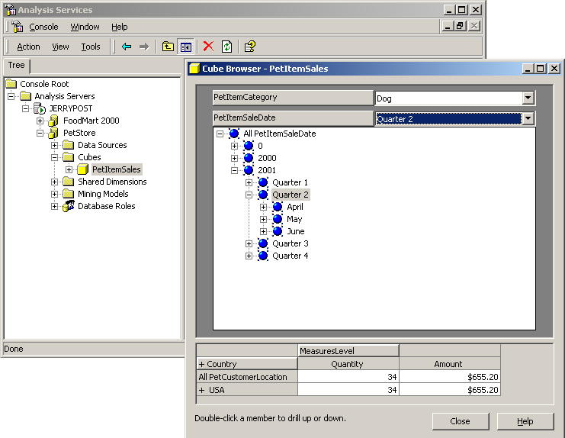
OLAP Data Browsing

Slide 27
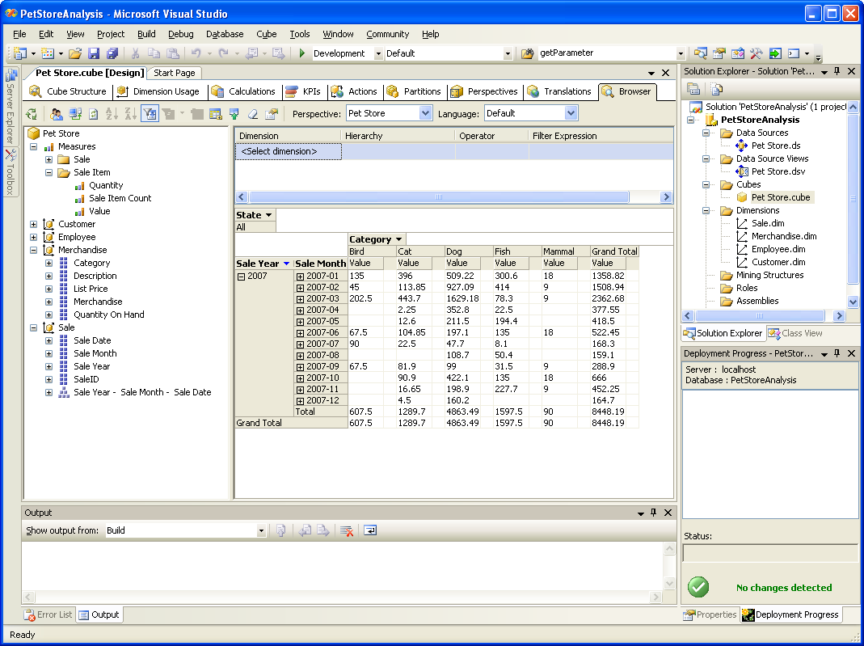
OLAB Cube Browser: SQL Server
Notes:
An OLAP cube browser. The time (SaleDate) dimension is shown in the table of data along with the merchandise Category. Users can change the display simply by dragging the dimensions on or off the grid. They can also add filter fields such as the State dimension. The year-month-date hierarchy enables users to drill down or roll up data.

Slide 28
Microsoft PivotTable

Slide 29
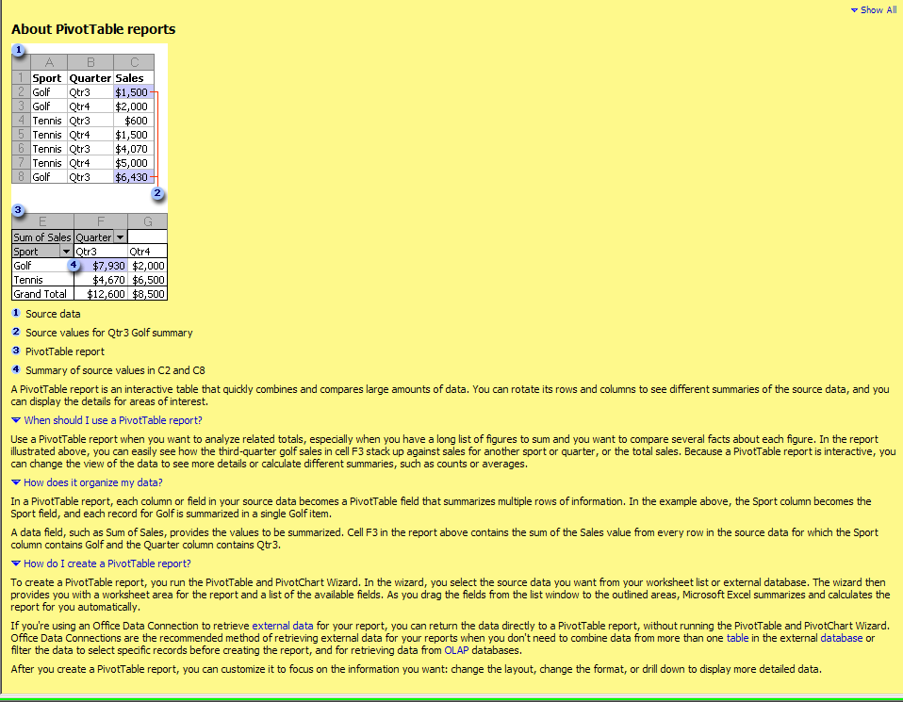
MS-Excel Pivot Table
HELP file entry

Slide 30
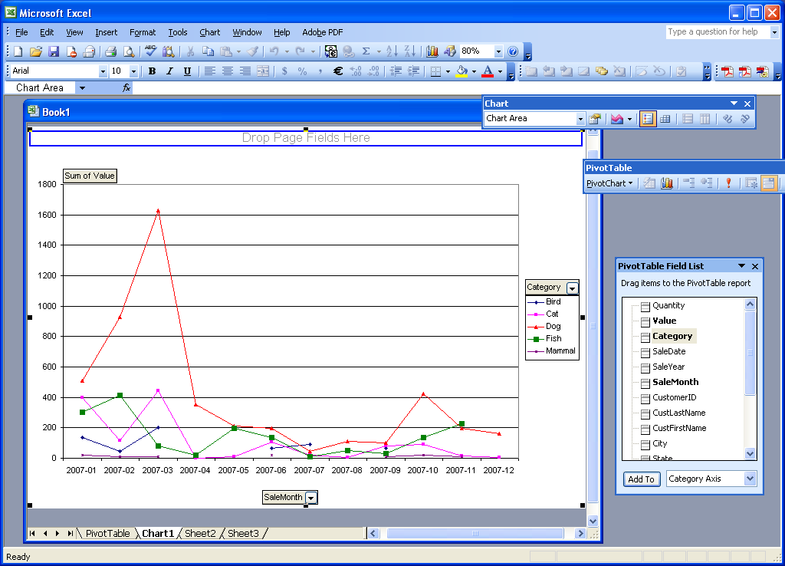
Microsoft PivotChart
Notes:
Microsoft PivotChart. Pivot tools make it easy for managers to examine cube data from any perspective, to select subsets of the data, to perform calculations, and to create charts.

Slide 31
SQL OLAP Analytical Functions
VAR_POP variance
VAR_SAMP
STDDEV_POP standard deviation
STDEV_SAMP
COVAR_POP covariance
COVAR_SAMP
CORR correlation
REGR_R2 regression r-square
REGR_SLOPE regression data (many)
REGR_INTERCEPT

Slide 32
Data Mining
Goal: To discover unknown relationships in the data that can be used to make better decisions.
Transactions and operations
Reports
Specific ad hoc questions
Queries
Aggregate, compare, drill down
OLAP
Databases
Look for unknown relationships
Data Mining
Notes:
Data mining. With a goal of identifying unknown relationships. Data mining is a bottom-up approach. Highly specialized tools scan the data searching for information that might be useful.

Slide 33
Exploratory Analysis
Data Mining usually works autonomously.
  Supervised/directed
  Unsupervised
  Often called a bottom-up approach that scans the data to find relationships
Some statistical routines, but they are not sufficient
  Statistics relies on averages
  Sometimes the important data lies in more detailed pairs

Slide 34
Common Techniques
Classification/Prediction/Regression
Association Rules/Market Basket Analysis
Clustering
  Data points
  Hierarchies
Neural Networks
Deviation Detection
Sequential Analysis
  Time series events
  Websites
Textual Analysis
Spatial/Geographic Analysis
Notes:
Data mining techniques. Classification and market basket analysis are popular technologies in business. New technologies and new methods of estimating relationships are still being developed.

Slide 35
Classification Examples
Examples
  Which borrowers/loans are most likely to be successful?
  Which customers are most likely to want a new item?
  Which companies are likely to file bankruptcy?
  Which workers are likely to quit in the next six months?
  Which startup companies are likely to succeed?
  Which tax returns are fraudulent?
Notes:
Classification examples. Many common business problems can benefit from classification analysis. Each problem has an outcome and the goal is to classify elements into the outcome choices based on a set of attributes.

Slide 36
Classification Process
Clearly identify the outcome/dependent variable.
Identify potential variables that might affect the outcome.
  Supervised (modeler chooses)
  Unsupervised (system scans all/most)
Use sample data to test and validate the model.
System creates weights that link independent variables to outcome.
Income | Married | Credit History | Job Stability | Success
50000 | Yes | Good | Good | Yes
25000 | Yes | Bad | Bad | No
75000 | No | Good | Good | No
Notes:
Bank loan classification. The indicator attributes affect the outcome in some fashion. The data mining software estimates the strength of each attribute on a set of test data. The resulting model can be applied to future data to predict the potential success or failure of new loans.

Slide 37
Classification Techniques
Regression
Bayesian Networks
Decision Trees (hierarchical)
Neural Networks
Genetic Algorithms
Complications
  Some methods require categorical data
  Data size is still a problem

Slide 38
Association/Market Basket
Examples
  What items are customers likely to buy together?
  What Web pages are closely related?
  Others?
Classic (early) example:
  Analysis of convenience store data showed customers often buy diapers and beer together.
  Importance: Consider putting the two together to increase cross-selling.

Slide 39
Association Details (two items)
Rule evaluation (A implies B)
  Support for the rule is measured by the percentage of all transactions containing both items: P(A ∩ B)
  Confidence of the rule is measured by the transactions with A that also contain B: P(B | A) (probability of B given A)
  Lift is the potential gain attributed to the rule—the effect compared to other baskets without the effect. If it is greater than 1, the effect is positive
Notes:
Evaluating a market basket association. Support is the percentage of both items being purchased in one transaction. Confidence is the probability of purchasing beer (B) given that diapers (D) are purchased. Lift is the contribution of the effect to sales and should be greater than 1.

Slide 40
Association Challenges
If an item is rarely purchased, any other item bought with it seems important. So combine items into categories.
Some relationships are obvious.
  Burger and fries.
Some relationships are meaningless.
  Hardware store found that toilet rings sell well only when a new store first opens. But what does it mean?
Item | Freq.
Hardware | 15%
Dim. Lumber | 20%
Plywood | 15%
Finish lumber | 15%
Item | Freq.
1 “ nails | 2%
2” nails | 1%
3” nails | 1%
4” nails | 2%
Lumber | 50%
Notes:
Balanced frequencies. Items that are rarely purchased will lead to false rules. The solution is to define the items so that they balance. In this case, combine nails into a hardware category and split lumber into smaller categories.

Slide 41
Cluster Analysis
Examples
  Are there groups of customers? (If so, we can cross-sell.)
  Do the locations for our stores have elements in common? (So we can search for similar clusters for new locations.)
  Do our employees (by department?) have common characteristics? (So we can hire similar, or dissimilar, people.)
Problem: Many dimensions and large datasets
Large intercluster distance
Small intracluster distance
Notes:
Cluster analysis. The goal is to find data points that are grouped close to each other and farther from other groups. Larger datasets with multiple dimensions are difficult and time-consuming to evaluate.

Slide 42
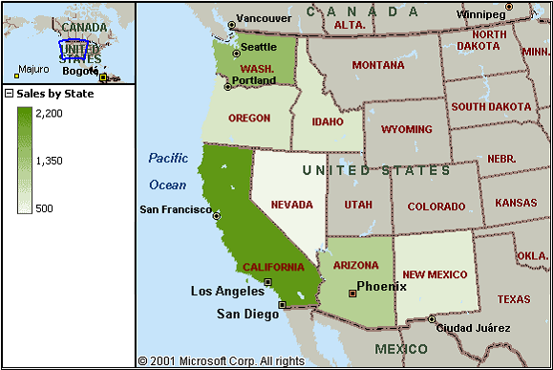
Geographic/Location
Examples
  Customer location and sales comparisons
  Factory sites and cost
  Environmental effects
Challenge: Map data, multiple overlays
Notes:
Geographic analysis. This basic map shows sales by state. As shown by the key, darker colors represent larger sales. Additional data, such as income, could be shown as overlays or compared in charts.

Slide 43
DISCUSSION

