Slide 1
DBA / ERP Work
Richard A. Huebner
Database Administrator
Rhuebner@northernpower.com
Or: Rich.Huebner@yahoo.com

Slide 2
Agenda
DBA Skill Sets
DBA Challenges
Certifications in the Area
Primer on ERP
ERP Systems in Action
Open Issues in ERP

Slide 3
DBA Key Skills
Schema design, development, tuning, refactoring
Normalizing vs. denormalizing
Triggers, stored procedures programming
SQL queries and views
Create/maintain indexes
Diagnosing and resolving performance problems
Coding skills
Not just SQL…
Reporting / Bulk data loads, exports, etc. ETL helpful on migrations to new systems
Notes:
Problem-solving skills
In small IT environments:
willingness and ability to work with ALL user types
Willingness to do things outside the normal scope of DBA work (end-user support backup)
Wear more hats than just your “DBA” hat

Slide 4
DBA Challenges
Indexing tradeoffs
Locking mechanisms
Normalization tradeoffs
Star vs. Snowflake Schemas
Star (relational)
Snowflake (data warehouses, etc)
Notes:
Clustered vs. Unclustered
Performance gains? Or is my index slowing people down?
- There are many places that can slow down transaction / query performance. What are some of them?
Locking:
Do we go with optimistic or pessimistic locking? Depends on the application mostly, but highly transactional
With MANY users, I would probably go with pessimistic, to make sure if someone has a short lock on a record, that someone else cannot update that record. Usually a read lock is sufficient, but maybe you don’t even want other users seeing the record? I haven’t see a situation where we needed to lock an entire row from being visible.
How much do we normalize or not normalize? Do we take every single table every single time all the way to 3NF?

Slide 5
The case for indexing!
Without them:
Searches are performed using table scans
Table scan moves from the physical beginning of the file to the end
Looks through every single row in the table
For very large tables, this is a problem
What the user sees:
My query is painfully and utterly slow
Productivity of end users is reduced due to wait-time
With small tables, the table scan can actually be the faster method of retrieving rows.

Slide 6
Indexing
Provide the DB engine with quick ways to find data, and to take shortcuts to the data’s physical location on disk.
The right indexing scheme can significantly improve query response time; however
Poorly planned indexes can increase query processing time
In larger databases (VLDBs), getting your indexes right is CRITICAL.

Slide 7
SQL Server
Clustered
Is unique for a table – you can only have one per table
Commonly used as 1st index on a table
Leaf nodes are where actual data is
Major performance gains
Each step down the tree brings us closer to the actual data; and to smaller subsets of our data
Data is physically in the order of the index
Non-Clustered
Non clustered on a heap (uses pointers to data at leaf level)
Data retrieval from disk may have to retrieve from all over the disk
Non clustered on a clustered index
Leaf level is not the data, but have pointers to data

Slide 8
Index pages can become fragmented
Occasionally, as index page files become large and fragmented, we have to “defrag” our indexes (or rebuild them).
DBMSs give you the ability to rebuild your indexes; which can help with performance
Can’t rebuild while people are in the DB

Slide 9
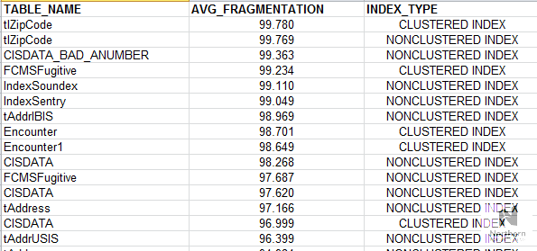
We can determine the amount of fragmentation and the types of indexes on each table. This is where I start to analyze which tables need my attention.

Slide 10
Locking
Locks limit or prevent other users from accessing the entity in the database.
Locks can be DB locks, table locks, page locks, and row locks.
We will look at row locking, which is probably the most common type of locking done.

Slide 11
Optimistic vs. Pessimistic
Optimistic
Assumes transactions can compete without affecting each other
Assumes the collisions occur infrequently
(Meaning users more than likely won’t be using the same record at the same time)
Pessimistic
Record is locked that prevents anyone else from updating that record
Easy to implement;
Changes to DB are consistent and safe
Read lock: others can read but not update
Write lock: disallow anyone from reading or editing the record
Drawback:
If transactions or locks take a lot of time, other users cannot access the data

Slide 12
Normalization tradeoffs
Each table related to another requires a join statement to get fields from multiple tables;
Each join takes query processing time
Too many joins can slow down query performance
Of course, indexing can help
There are cases for NOT normalizing to 3NF or above in certain circumstances
Can you normalize?

Slide 13
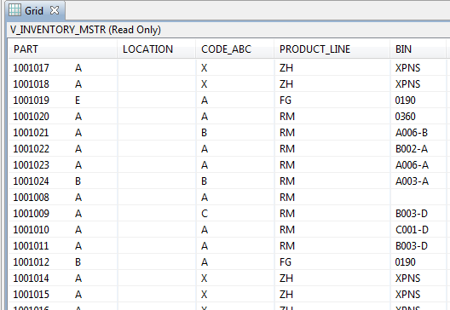

Slide 14
OLAP
Data warehouses usually follow a snowflake schema, and are not necessary normalized
OLAP/Data warehouses designed for advanced queries, multidimensional cubes
Historical data
Requires ETL process; not transactional, but more analysis.

Slide 15
Some Tips
Design:
Know how to construct ERDs
Know your normalization
Use your ERD as a communication tool
Administration
Do your backups work??
Understand DB tradeoffs
How much indexing?
Subselect vs. join? (when same result is given)
Programming:
Know at least another language besides SQL
Notes:
If a subselect does the same thing as a join, which would you use? (not just because one is easier than the other)

Slide 16
Primer on ERP
Enterprise resource planning (ERP) systems are integrated software solutions designed to manage a company’s resources (Xia, Lok, & Yang, 2009).
ERP helps a company manage important aspects of the business, including production, product planning and purchasing, as well as inventory, accounting, and customer service.
ERP systems are tailored to certain markets

Slide 17
ERP or ES (Enterprise Sys)
An enterprise-wide, integrated software solution that brings together various functional areas within the business under one system.
Accounting, purchasing, inventory, shipping and receiving all use the same integrated system.
Supports from order entry through shipping the product and everything in between.
Updating one piece of information in the system updates related records.
Increased business intelligence across departments/divisions.
Helps eliminate information silos
Ex: ERP you update customer data in one place; cascades through the system.

Slide 18
ERP Vendors
(A very short list)
SAP
J.D. Edwards
Oracle / Peoplesoft
Microsoft
Net suite
Global Shop (NPS uses this one)
Sungard HE (Banner system @ NU)

Slide 19
Primer on ERP
1970s … MRP
1980s … MRP II
1990s … ERP
2000s … ERP II
Tomorrow’s ERP: … ERP & EAI?
XML, SOAP, WSDLs, and so forth
Most authors simply refer to “ES”, or Enterprise Systems
Notes:
1970s – Material Requirements Planning --- aids in improving how material flows through manufacturing enterprise
1980s – Manufacturing Requirements Planning – (MRP II)
1990s – Enterprise resource planning
2000s – ERP II

Slide 20
Open Research Issues for ERP
Plenty of studies done on implementation, but NOT on maintenance & support (M&S) issues
Most ERP systems are internally focused; that is, integrate internal business processes well but do not integrate external processes well
E.g.: inter-company processes; transactions between vendors, etc.
Portions of code within ERP systems of today still use business logic developed during the 1970s. (MRP modules haven’t changed much!!)
Logic coded in ERP is based on how the ERP vendor views “business best practices”. (which may not be “best practice” to another vendor)

Slide 21
ERP issues, cont.
More failures than successes – 70% failure rate
Many studies have been done
CSFs have been proposed; but still failure rate remains high
Many risk factors
Need significant resources (time, $$$$$, staff)

Slide 22
Additional issues
Data quality / integrity issues
ERP data has required mass updates/edits by running SQL UPDATE queries
Software bugs / patch management and upgrades
We are about 5 months into our ERP implementation

Slide 23
Critical Success Factors for ERP
Executive support and guidance (#1 factor)
Project management ownership
Organizational culture
Organizational fit between ERP and organization
Step-by-step implementation (modular approach works best)
Clear implementation strategy
Clear project management route
Change management competency
Training
Partnering with supplier and customer sides with ERP software
Contingency planning
More recently, the literature has begun to discuss post-implementation factors of ERP success.

Slide 24
Org Structure for ERP
Global Shop Business Council
Doc Ctl Specialist
Sr. Mfg. Engr.
Dir. Mfg.
VP Client Services
Master Scheduler
Sr. Buyer/Planner
Shop Floor Supv
Quality Mgr.
AR Specialist
AP Supv
Cost Accountant
Project Manager
DBA (me)
Process Specialists
Global Shop Steering Committee
DBA
Project Manager
IT Director
Assistant Controller
Quality Manager
Dir. Mfg.
Sr. Buyer/Planner
(7 people)
Executive Council
CFO, Mfg. VP, President & GM, VP SCM, CHRO, Finance Mgr, VP Service, IT Director, Dir. Mfg., Controller, and Project Manager
(11 staff)
Notes:
Business Council discusses and addresses various ERP problems. Each person on council represents his/her department, and brings feedback back to his/her department.
Unresolved issues are escalated to steering committee, which provides tactical direction to ERP system users. Technical issues are handled by IT, who apply patches or apply configuration changes as necessary.
Communication is also critical to ERP success.

