Slide 1

“Data, data everywhere
but not a thought to think.”
Theodore Roszak
If that’s so, then why is it that “Research is easy; and, getting data is difficult”? Just sayin’…

Slide 2
Upcoming Assessments
Online quiz over material through about pg 155; should be available Wed or so, due start of class 9/30
Discussion Topic & work due Mon 9/30 (next slide)
Wed (10/2) we will examine data modeling
Friday of next week (10/4) the discussion topic will be focused on data modeling

Slide 3
Discussion (DUE Monday 9/30)
Read Case Study 5:
  “Fail Away with Dynamo, Bigtable, and Cassandra”
Briefly, substantively answer the questions (1 – 5) and bring your written or typed answers to class for discussion
Answers will be submitted for partial quiz credit
Be advised there will be an individual data modeling assignment for submission later next week, too.
Imp. Note: you will have to review the “GearUp” scenario that has been used to open each chapter.
Additional info about NoSQL databases:
  http://newtech.about.com/od/databasemanagement/a/Nosql.htm
  http://stackoverflow.com/questions/1145726/what-is-nosql-how-does-it-work-and-what-benefits-does-it-provide

Slide 4
Database Application Systems
Expect an online quiz for the material we cover Mon & Wed,

Slide 5

The Goal – To Get From Here…

Slide 6
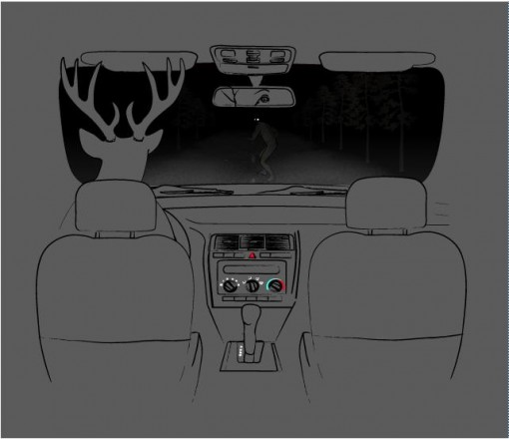
…To Here

Slide 7
Outline
How did we get here?
The map is not the territory
The purpose of a database
Why not use spreadsheets for everything?
Database definition
Database structure & terminology
Database Application System Components
Database Management Systems (DBMS)
Forms, Queries & Reports
Multi-User Processing
Enterprise vs. Individual User Databases

Slide 8
How Did We Get Here?
Individuals…
Have wants, needs, problems requiring info
They find information to satisfy need.
  Determine What’s Needed
  Identify Resources
  Gather Details
  Process Details
  Produce Results
  Deliver Results to End User
Repeat as needed
Collate
Clean
Contextualize
Compare
Calculate

Slide 9
How Did We Get Here?
When the need is frequent, individuals…
Organize records for easier retrieval.
Refine, update, manage stored details
Refine, expand, improve the process
Increase system flexibility and usefulness
Reduce dependence on owner
A diagrammatic representation…
detail → data → info → knowledge

Slide 10
What’s Happening at the Arrows?
A diagrammatic representation…
detail → data → info → knowledge
Even “simple” data are highly structured
Even juxtaposed context adds “Structure”
Added layers of structure are abstraction
Abstraction ignores/adds details
With added structure meaning is gained/lost
Sometimes it’s unfounded or false meaning

Slide 11
The Map is Not The Territory
What we choose to look at, and how we define it, defines that “slice” of the world
After a while, people just assume that the representation is the real thing
Data Problems?
  Same names; Different things
  Different names; Same things
  Critical details missing (for a variety of reasons)
  Details there, but between data sets they don’t match up
  Some data recorded, some left out; which is right?
  Etc.

Slide 12
The Purpose of a Database?
To track details of interest about things of interest
  People (customers, employees, perps, victims, etc.)
  Events (orders, transactions, crimes, etc.)
  Things (inputs, goods, equipment, weapons, etc.)
In combination w/database applications and database management systems (DBMS), they enable analysis of these details for business decision-making & problem-solving
Of interest to whom, specifically? The Map is not only not the Territory – it may not be your map!

Slide 13
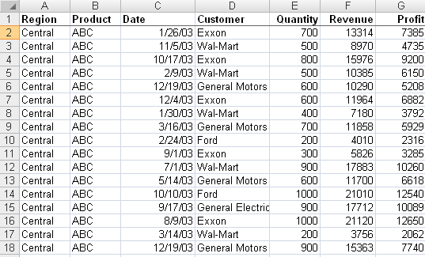
Why Not Spreadsheets?
? ? ?
???
Is this file of Sales? Customers? Products? Regions?
Massive data duplication even in this simple table
What if the Regions or Products are renamed?
Now, multiply the problems a thousand-fold

Slide 14
Why Not Spreadsheets?
Spreadsheet tables are 2-dimensional
Tracking details about even one thing in a table invites duplication of data
Data duplication invites problems
  Wasted space
  Difficulties w/lookups
  More chance of entry/edit errors
  Problems w/edits (data integrity)

Slide 15
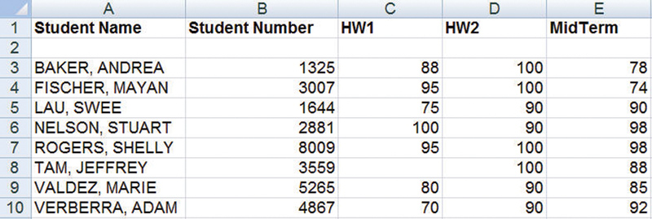
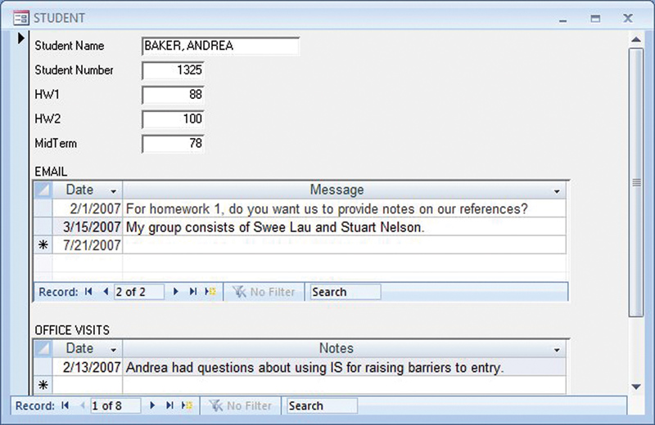
General Rule
Single theme data lists can be stored in a spreadsheet.
Multi-theme data lists require a database.

Slide 16
What is a Database
Note this definition is more specific than that in the book
Database:
  Structured (tables, rows, columns, cells)
  Self-describing (holds data about itself)
  Collection of integrated records (the tables themselves and their connections)
  In other words, it’s actually an “information”-base…
Notes:
Stopped here for Section B

Slide 17
What is a Databae
Tables (Relations or Entities) capture details about types of things of interest, such as Student.
Columns (Fields, Attributes), represent characteristics of the thing, such as Student Number and Student Name
Rows (Records) represent instances of the thing in the table
Attribute Values of each thing of interest contained in cells (row/column intersections)
Bytes (characters) used to construct the values
Bits (binary digits) used to represent the bytes
Relationships exist between fields in the tables

Slide 18
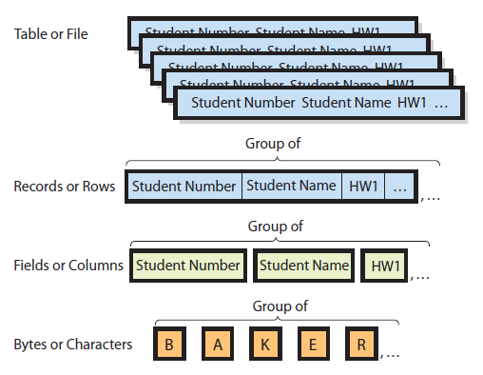
Table, Records, Fields & Values
Student table then is related to another structured table, such as Advisor, Class, etc.
The characters designate or form values, and those populate the fields!

Slide 19
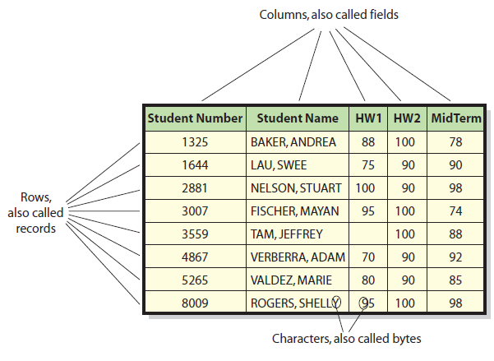
Table, Records, Fields & Values
Values or details about the thing the record represents

Slide 20
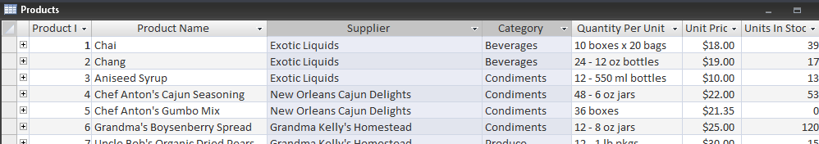
Table, Records, Fields & Values
Products Table from Northwind.mdb
Quantity Per Unit – an attribute of interest for each Product
Products – a table of data (details) of interest to the business about instances of one type of thing
Each row is an instance of a Product
“36 boxes”, the value for the Quantity Per Unit attribute of the fifth instance (record) in the Products table

Slide 21
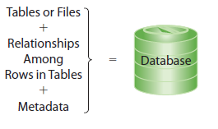
Metadata Describes Structure of Database
meta-data: data about data
“Self-Describing”:
Database contains meta-data – data about it’s data, structure and meaning.

Slide 22
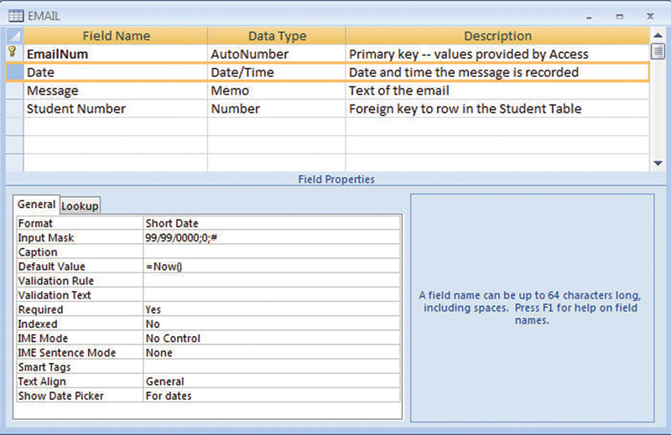
Metadata
Database:
  A database is a self-describing collection of integrated records.
Metadata
  Data that describe data

Slide 23
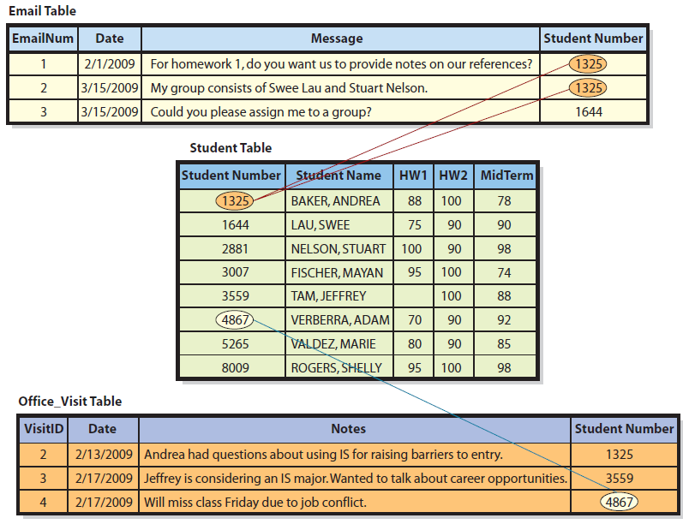
How Are Tables Related?
First row of the Email Table is related to Andrea Baker in Student Table
Last row in Office_Visit Table related to Adam Verberra in Student Table

Slide 24
Relationship Special Terms
Key – A column or group of columns that identify a unique row in a table. (also called a primary key)
  Student Number is the key of the Student table. Given a value of Student Number, you can uniquely identify/determine one and only one row in Student. Only one student has the number 1325.
  Every table must have a key.
  Sometimes more than one column is needed to form a unique identifier. In a table called City, for example, the key might be a combination of columns (City, State).
  Email_Num is the key of Email Table.
  VisitID is the key of Office_Visit Table.

Slide 25
Relationship Special Terms
Foreign keys
  These are keys of a different (foreign) table than the table in which they reside.
Relational databases
  Relationships among tables are created by using keys and their paired foreign keys.
Relation
  Formal name for a table

Slide 26
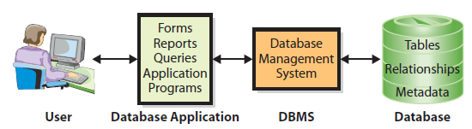
Components of a Database Application System
Applications make database data more accessible and useful.
Users employ an application with forms, formatted reports, queries, and application programs.
Database management system (DBMS) processes database tables for applications.
Notes:
STOPPED HERE W/SECTION A 9/24

Slide 27
What Is a Database Management System (DBMS)?
DBMS
  A program (software) used to create, process, and administer a database
Popular DBMS products are:
  DB2 from IBM
  Access and SQL Server from Microsoft
  Oracle from the Oracle Corporation
  MySQL—an open-source DBMS product that is license-free for most applications

Slide 28
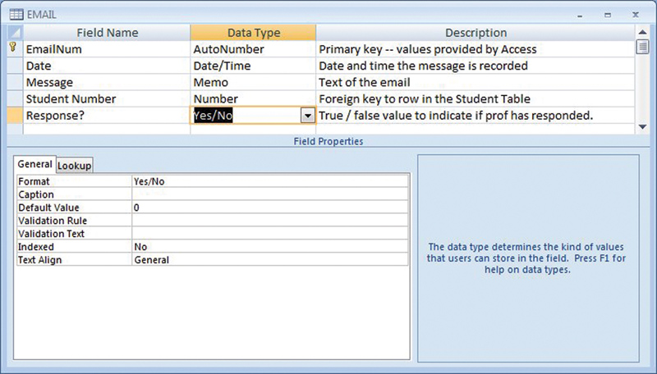
Creating the Database and Its Structures
Database developers use the DBMS to create and modify tables, relationships, and other structures in the database.
Below, the developer has added a new column called Response?. This new column has data type Yes/No.

Slide 29
Processing the Database
DBMS operations
  Read, insert, modify, delete data
  Applications call DBMS in different ways
    From a form, when the user enters new or changed data, a computer program behind the form calls the DBMS to make the necessary database changes.
    From an application program, the program calls the DBMS directly to make the change.

Slide 30
Structured Query Language (SQL)
SQL—“see-quell”
International standard language for creating databases and database structures, and processing databases
All five of the most popular DBMS products accept and process SQL.
Following SQL statement inserts a new row into the Student table:
  INSERT INTO Student
  ([Student Number], [Student Name], HW1, HW2, MidTerm)
  VALUES
  (1000, ’Franklin, Benjamin’, 90, 95, 100);

Slide 31
Administering the Database
DBMS provides tools to assist in administration of the database.
Used to set up a security system involving user accounts, passwords, permissions, and limits for processing the database
Backing up database data, adding structures to improve performance of database applications, removing data no longer wanted or needed, and similar tasks
Most organizations dedicate one or more employees to the role of database administration.

Slide 32
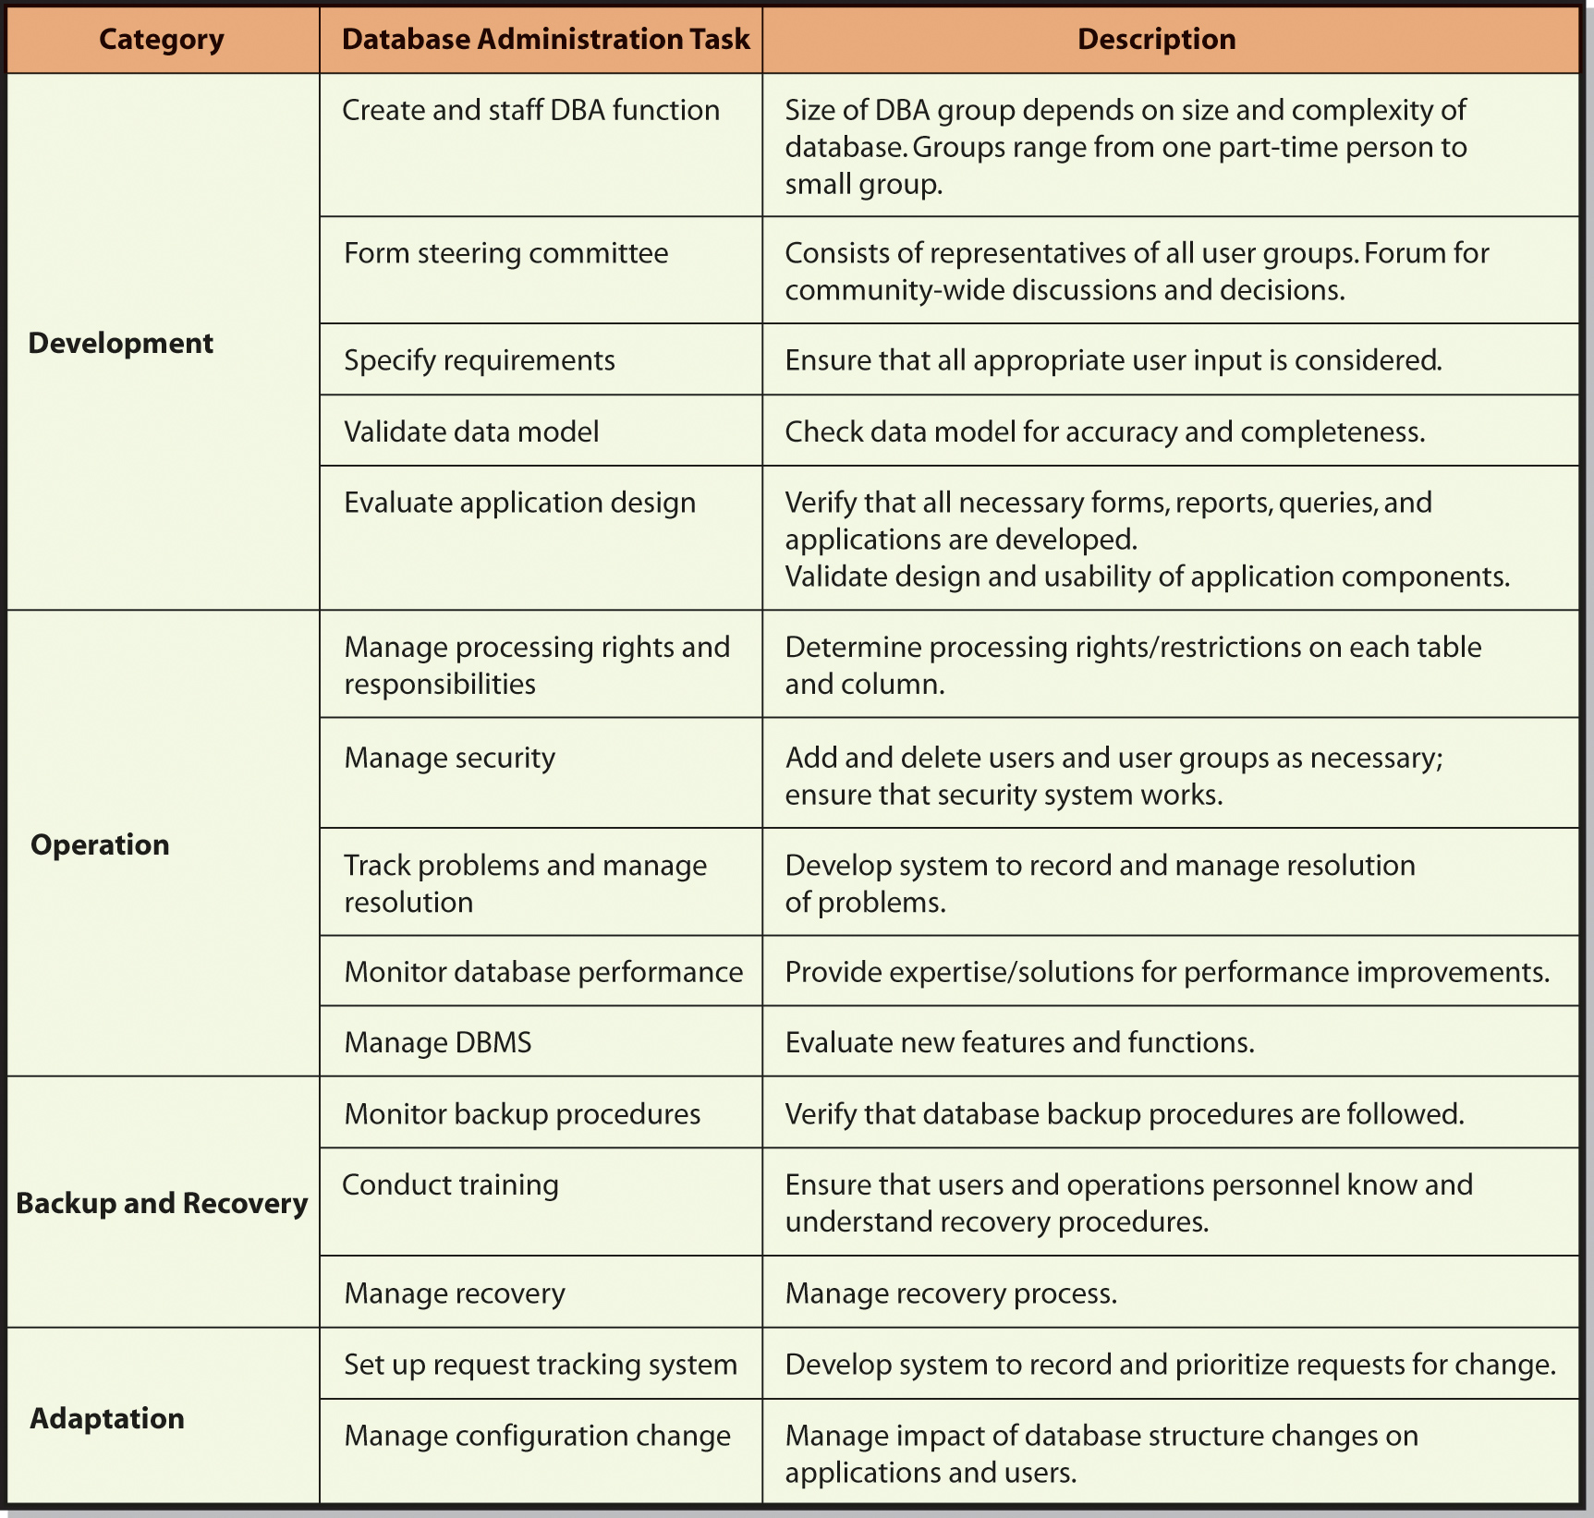
Major Responsibilities of Database Administration

Slide 33
Why Are Database Application Programs Needed?
Forms, reports, and queries work well for standard functions. However, most applications have unique requirements that a simple form, report, or query cannot meet.
Application programs process logic specific to a given business need.
Application programs serve as an intermediary between the Web server and database.
  Responds to events, such as when a user presses a submit button; also reads, inserts, modifies, and deletes database data

Slide 34
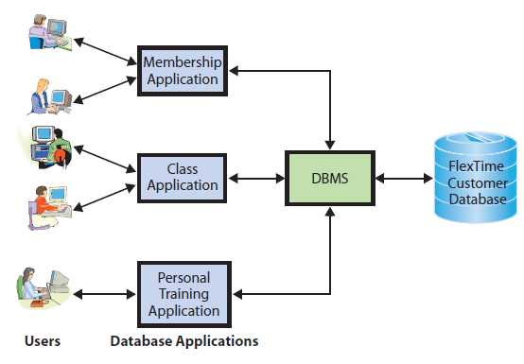
Database Applications at FlexTime

Slide 35
Forms, Queries, Reports
Forms – add structure and context to input/output, helping to control flow, enhance meaning, reduce error, etc.
Queries – save structure of questions; repeatable, modifiable
Reports – add structure and context to output; repeatable, modifiable.

Slide 36
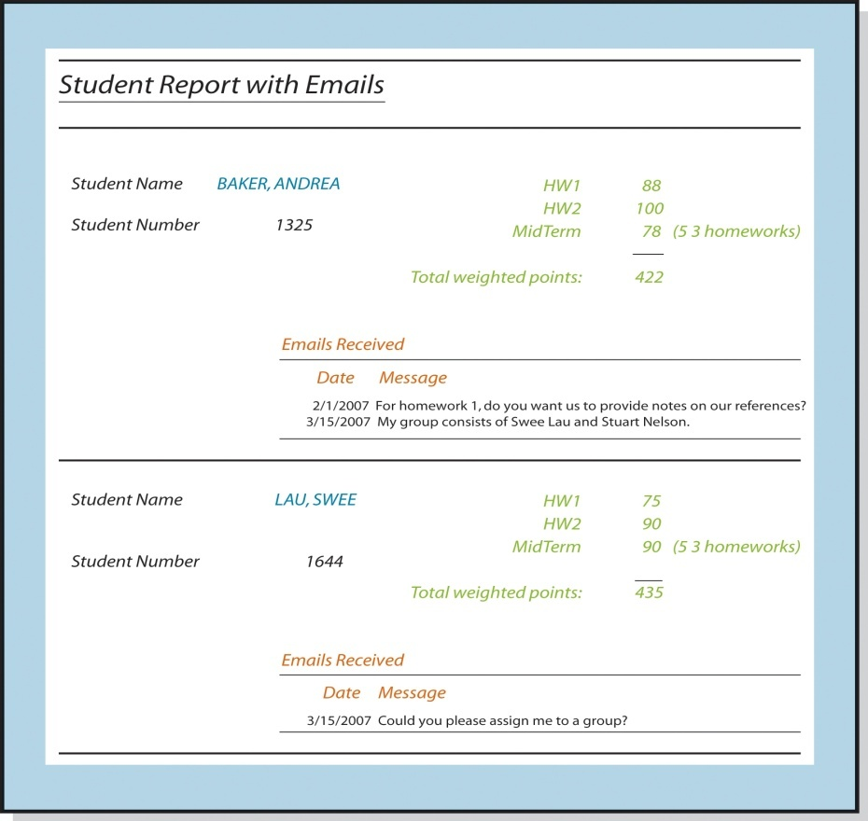
What Are Forms, Reports, and Queries?
Reports show data in a structured context. By adding structure and context they enhance meaning, helping to transform data into information.
Note that here the screen shows both Student and Email data in the same screen for ease of use and understanding. Note too that some identifiers (like email number) may be hidden and managed for the user in the background

Slide 37
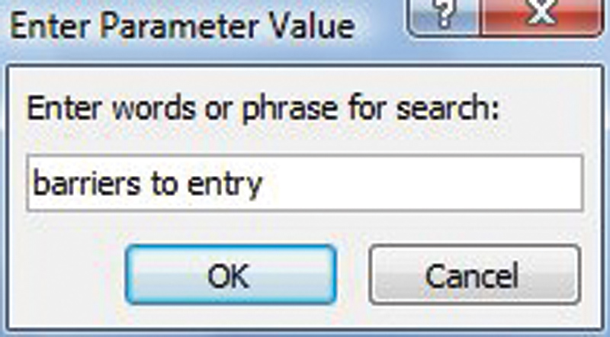
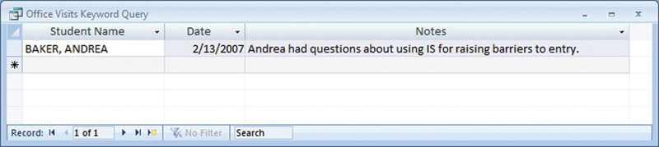
What Are Forms, Reports, and Queries?
Sample query form used
to enter phrase for search
Sample query results of query operation

Slide 38
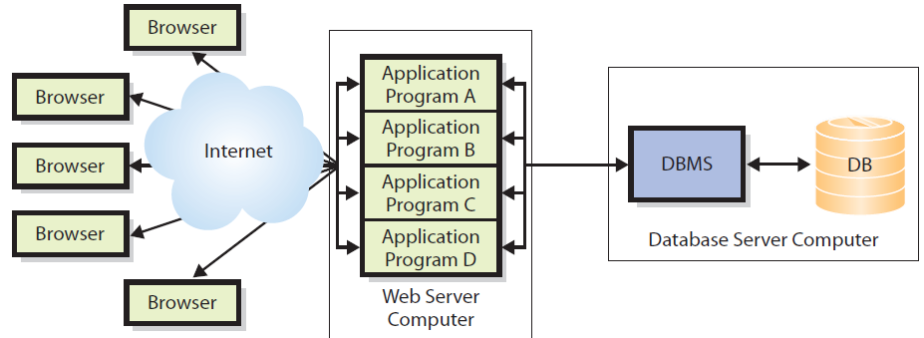
Four Database Application Programs Running on a Web Server Computer

Slide 39
Multi-User Processing Problem
Lost-update problem
  Process A reads a customer record from a file containing account information, including the customer’s account balance and phone number.
  Process B now reads the same record from the same file so it has its own copy.
  Process A changes the account balance in its copy of the customer record and writes the record back to the file.
  Process B—which still has the original stale value for the account balance in its copy of the customer record—updates the customer’s phone number and writes the customer record back to the file.
  Process B has now written its stale account balance value to the file, causing the changes made by process A to be lost.
  (Source: http://en.wikipedia.org/wiki/File_locking)

Slide 40
Enterprise DBMS vs. Personal DBMS
Enterprise DBMS
  Process large organizational and workgroup databases
  Support many, possibly thousands, of users and many different database applications
  Support 24/7 operations and can manage databases that span dozens of different magnetic disks with hundreds of gigabytes or more of data
  IBM’s DB2, Microsoft’s SQL Server, and Oracle’s Oracle are examples of enterprise DBMS products.
Personal DBMS
  Designed for smaller, simpler database applications
  Used for personal or small workgroup applications that involve fewer than 100 users (normally fewer than 15), single user

