Slide 1
Software Evolution
IS301 – Software Engineering
Lecture #28 – 2004-11-05
M. E. Kabay, PhD, CISSP-ISSMP
Professor of Computer Information Systems School of Business & Management, Norwich University
mailto:mkabay@norwich.edu V: 802.479.7937
Notes:
M. E. Kabay, PhD, CISSP

Slide 2
Objectives
To explain why change is inevitable if software systems are to remain useful
To discuss software maintenance and maintenance cost factors
To describe the processes involved in software evolution
To discuss an approach to assessing evolution strategies for legacy systems

Slide 3
Topics
Program evolution dynamics
Software maintenance
Evolution processes
Legacy system evolution

Slide 4
Software Change (1)
Managing processes of software system change

Slide 5
Software Change (2)
Software change inevitable
New requirements emerge when software used
Business environment changes
Errors must be repaired
New equipment must be accommodated
Performance or reliability may have to be improved
Key problem for organizations:
Implementing and managing change to legacy systems

Slide 6
Software Change Strategies
Software maintenance
Response to changed requirements
Fundamental software structure stable
Architectural transformation
Generally from centralized architecture to distributed architecture
Software re-engineering
No new functionality added
Restructured and reorganized
To facilitate future changes
Strategies may be applied separately or together

Slide 7
Spiral Model Of Evolution

Slide 8
Program Evolution Dynamics
Study of processes of system change
Lehman and Belady
Major empirical study
Proposed ‘laws’ applying to all systems as they evolved
Sensible observations rather than laws
Applicable to large systems developed by large organizations
Perhaps less applicable in other cases

Slide 9
Lehman’s Laws
Continuing Change
Increasing Complexity
Large Program Evolution
Organizational Stability
Conservation of Familiarity

Slide 10
Continuing Change
A program used in a real-world environment must necessarily change or it will progressively become less useful in that environment.

Slide 11
Increasing Complexity
As an evolving program changes, its structure tends to become more complex.
Extra resources must be devoted to preserving and simplifying the structure.

Slide 12
Large Program Evolution
Program evolution is a self-regulating process.
System attributes such as size, time between releases and the number of reported errors are approximately invariant for each system release.

Slide 13
Organizational Stability
Over a program’s lifetime, its rate of development is approximately constant and independent of the resources devoted to system development.

Slide 14
Conservation of Familiarity
Over the lifetime of a system, the incremental change in each release is approximately constant.

Slide 15
Applicability of Lehman’s Laws
Not yet been established
Generally applicable to
Large, tailored systems
Developed by large organizations
Not clear how they should be modified for
Shrink-wrapped software products
Systems that incorporate significant number of COTS components
Small organizations
Medium sized systems

Slide 16
Software Maintenance
Modifying program after it has been put into use
Does not normally involve major changes to system’s architecture
Changes are implemented by
Modifying existing components and
Adding new components to system

Slide 17
Maintenance Inevitable
System requirements likely to change while system being developed
Because environment changing
Therefore delivered system won't meet its requirements (!)
Systems tightly coupled with their environment
When system installed in environment it changes that environment
Therefore changes system requirements
Systems MUST be maintained if they are to remain useful in their environment

Slide 18
Tool/Problem Relation
Availability of a tool changes the perception of what is possible

Slide 19
Types of Maintenance
Repair software faults
Adapt software to different operating environment (e.g., new computer, OS)
Add to or modify system’s functionality

Slide 20
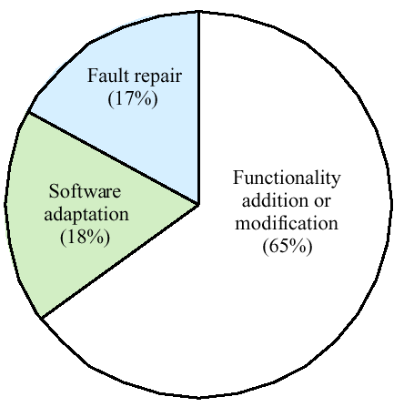
Distribution of Maintenance Effort

Slide 21
Maintenance Costs
Usually greater than development costs (2* to 100* depending on application)
Affected by both technical and non-technical factors
Increases as software maintained
Maintenance corrupts software structure thus making further maintenance more difficult
Ageing software can have high support costs (e.g. old languages, compilers etc.)

Slide 22
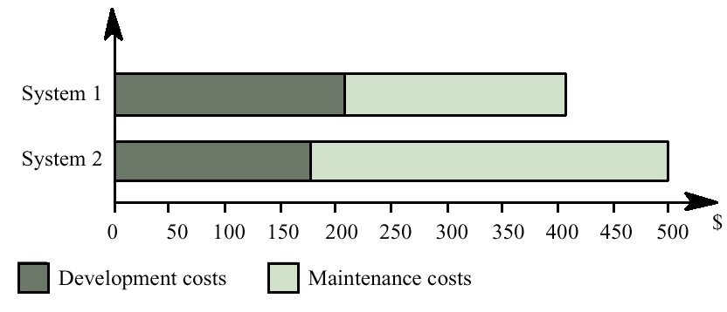
Development/Maintenance Costs

Slide 23
Maintenance Cost Factors
Team stability
$$ reduced if same staff involved with them for some time
Contractual responsibility
Developers of system may have no contractual responsibility for maintenance
So no incentive to design for future change
Staff skills
Maintenance staff often inexperienced and may have limited domain knowledge
Program age and structure
As programs age, their structure degraded and they become harder to understand and change

Slide 24
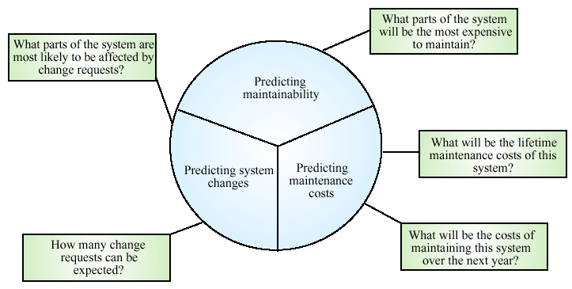
Maintenance Prediction

Slide 25
Complexity Metrics
Predictions of maintainability can be made by assessing complexity of system components
Studies have shown that most maintenance effort spent on relatively small number of system components
Complexity depends on
Complexity of control structures
Complexity of data structures
Procedure and module size

Slide 26
Process Metrics
Process measurements may be used to assess maintainability
Number of requests for corrective maintenance
Average time required for impact analysis
Average time taken to implement change request
Number of outstanding change requests
If any or all of these increasing, this may indicate decline in maintainability

Slide 27
Evolution processes
Evolution processes depend on
The type of software being maintained;
The development processes used;
The skills and experience of the people involved.
Proposals for change are the driver for system evolution. Change identification and evolution continue throughout the system lifetime.

Slide 28
Change Identification and Evolution

Slide 29
The System Evolution Process

Slide 30
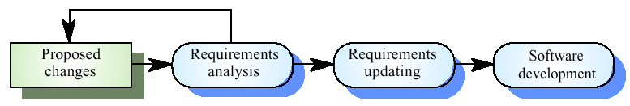
Change Implementation

Slide 31

Emergency Repair

Slide 32
System re-engineering
Re-structuring or re-writing part or all of a legacy system without changing its functionality.
Applicable where some but not all sub-systems of a larger system require frequent maintenance.
Re-engineering involves adding effort to make them easier to maintain. The system may be re-structured and re-documented.

Slide 33
Advantages of Reengineering
Reduced risk
There is a high risk in new software development. There may be development problems, staffing problems and specification problems.
Reduced cost
The cost of re-engineering is often significantly less than the costs of developing new software.

Slide 34
Forward and Re-engineering

Slide 35
The re-engineering process

Slide 36
Reengineering Process Activities
Source code translation
Convert code to a new language.
Reverse engineering
Analyze the program to understand it;
Program structure improvement
Restructure automatically for understandability;
Program modularization
Reorganize the program structure;
Data reengineering
Clean-up and restructure system data.

Slide 37
Re-engineering Approaches
Automated program restructuring
Program and data restructuring
Automated test restructuring with manual changes
Restructuring plus architectural changes
Automated source code conversion
Increased cost

Slide 38
Reengineering Cost Factors
The quality of the software to be reengineered.
The tool support available for reengineering.
The extent of the data conversion which is required.
The availability of expert staff for reengineering.
This can be a problem with old systems based on technology that is no longer widely used.

Slide 39
Legacy System Evolution
Organizations that rely on legacy systems must choose a strategy for evolving these systems
Scrap the system completely and modify business processes so that it is no longer required;
Continue maintaining the system;
Transform the system by re-engineering to improve its maintainability;
Replace the system with a new system.
The strategy chosen should depend on the system quality and its business value.

Slide 40
System Quality and Business Value
Business value

Slide 41
Legacy System Categories
Low quality, low business value
These systems should be scrapped.
Low-quality, high-business value
These make an important business contribution but are expensive to maintain. Should be re-engineered or replaced if a suitable system is available.
High-quality, low-business value
Replace with COTS, scrap completely or maintain.
High-quality, high business value
Continue in operation using normal system maintenance.

Slide 42
Business Value Assessment
Assessment should take different viewpoints into account
System end-users;
Business customers;
Line managers;
IT managers;
Senior managers.
Interview different stakeholders and collate results.

Slide 43
System Quality Assessment
Business process assessment
How well does the business process support the current goals of the business?
Environment assessment
How effective is the system’s environment and how expensive is it to maintain?
Application assessment
What is the quality of the application software system?

Slide 44
Business Process Assessment
Use a viewpoint-oriented approach and seek answers from system stakeholders
Is there a defined process model and is it followed?
Do different parts of the organization use different processes for the same function?
How has the process been adapted?
What are the relationships with other business processes and are these necessary?
Is the process effectively supported by the legacy application software?
Example - a travel-office system may now have a low business value because of the widespread use of Web-based ordering.

Slide 45
Environment Assessment (1)
Supplier stability
Is the supplier is still in existence?
Is the supplier financially stable and likely to continue in existence?
If the supplier is no longer in business, does someone else maintain the systems?
Failure rate
Does the hardware have a high rate of reported failures?
Does the support software crash and force system restarts?

Slide 46
Environment Assessment (2)
Age
How old is the hardware and software?
The older the hardware and support software, the more obsolete it will be.
It may still function correctly but there could be significant economic and business benefits to moving to more modern systems.
Performance
Is the performance of the system adequate?
Do performance problems have a significant effect on system users?

Slide 47
Environment Assessment (3)
Support requirements
What local support is required by the hardware and software?
If there are high costs associated with this support, it may be worth considering system replacement.
Maintenance costs
What are the costs of hardware maintenance and support software licences?
Older hardware may have higher maintenance costs than modern systems.
Support software may have high annual licensing costs.

Slide 48
Environment Assessment (4)
Interoperability
Are there problems interfacing the system to other systems?
Can compilers etc. be used with current versions of the operating system?
Is hardware emulation required?

Slide 49
Application Assessment (1)
Support requirements
What local support is required by the hardware and software?
If there are high costs associated with this support, it may be worth considering system replacement.
Maintenance costs
What are the costs of hardware maintenance and support software licences?
Older hardware may have higher maintenance costs than modern systems.
Support software may have high annual licensing costs.

Slide 50
Application Assessment (2)
Interoperability
Are there problems interfacing the system to other systems?
Can compilers etc. be used with current versions of the operating system?
Is hardware emulation required?
Programming language
Are modern compilers available for the programming language used to develop the system?
Is the programming language still used for new system development?

Slide 51
Application Assessment (3)
Configuration management
Are all versions of all parts of the system managed by a configuration management system?
Is there an explicit description of the versions of components that are used in the current system?
Test data
Do test data for the system exist?
Is there a record of regression tests carried out when new features have been added to the system?
Personnel skills
Are there people available who have the skills to maintain the application?
Are there only a limited number of people who understand the system?

Slide 52
System Measurement
You may collect quantitative data to make an assessment of the quality of the application system
The number of system change requests;
The number of different user interfaces used by the system;
The volume of data used by the system.

Slide 53
Key points
Software development and evolution should be a single iterative process.
Lehman’s Laws describe a number of insights into system evolution.
Three types of maintenance are bug fixing, modifying software for a new environment and implementing new requirements.
For custom systems, maintenance costs usually exceed development costs.

Slide 54
Key points
The process of evolution is driven by requests for changes from system stakeholders.
Software re-engineering is concerned with re-structuring and re-documenting software to make it easier to change.
The business value of a legacy system and its quality should determine the evolution strategy that is used.

Slide 55
Now go and study

