Slide 1
Politics of Cyberspace @ JCOGS Social Media
M. E. Kabay, PhD, CISSP-ISSMP
Professor of Computer Information Systems
School of Business & Management
College of Professional Schools
Norwich University
Notes:
M. E. Kabay, PhD, CISSP

Slide 2
Topics
Social-Media History
The Profit Mechanism: Advertising & Profiling
Cambridge Analytica Case
DISINFO via Social Media
Trolling & Cyberbullying
Privacy Issues
Political Implications
Censorship
Return of Intermediation
Surveillance
Identity Theft using Social Media
Facebook Settings

Slide 3
Social-Media History
Cave art (40,000 BCE)
Graffiti (13,000 BCE)
Cork Bulletin boards (1801)
Electronic systems (1970s ff)
CompuServe (1969)
PLATO (1970s)
USENET (1980)
IRC (1980s)
Blogs (1990s)
AIM (1997)
LinkedIn (2002)
MySpace (2003)
Facebook (2004)
Twitter (2006)
Weibo (2007)

Slide 4
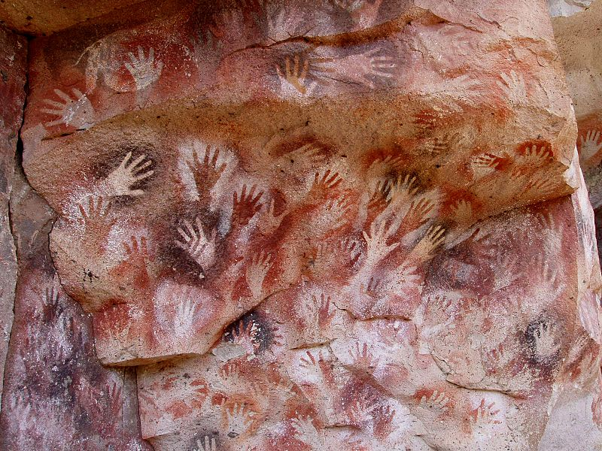
Cave Art
Cave of Hands
(13,000 BCE)

Slide 5
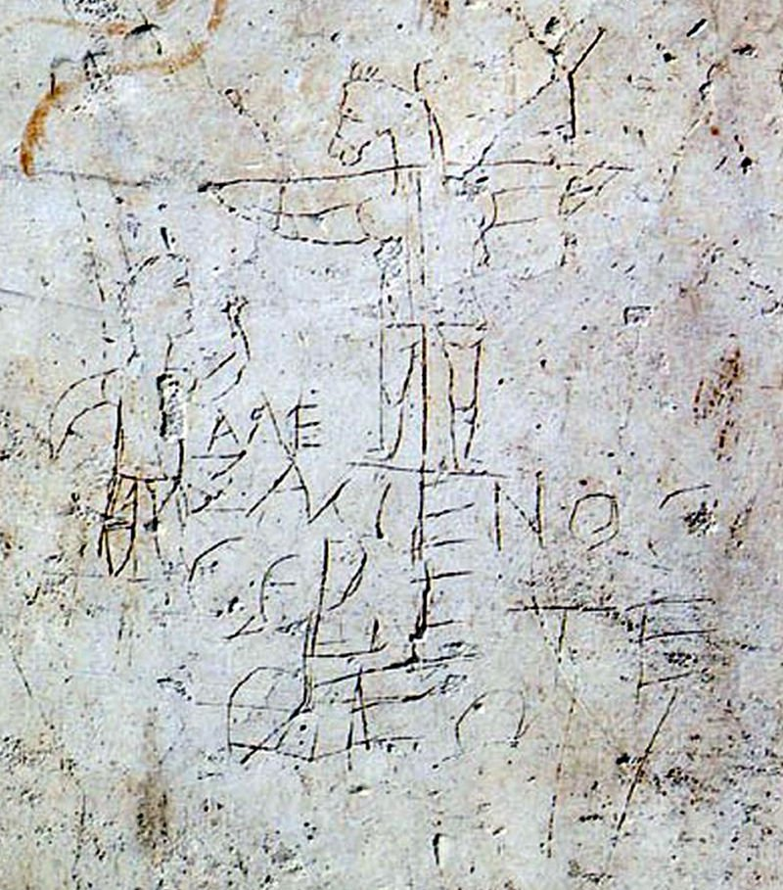
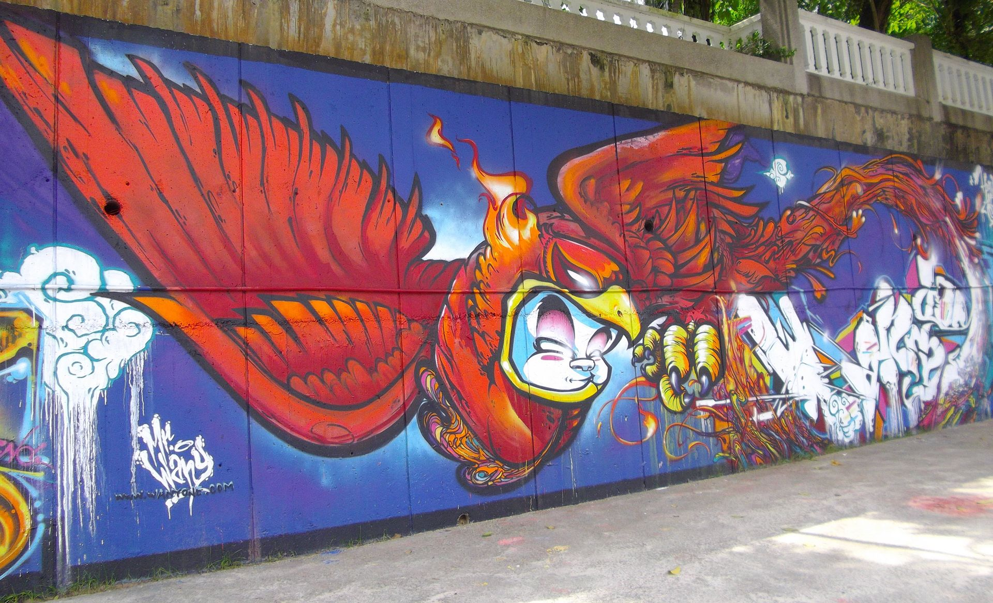
Graffiti
Alexamenos Graffito
(200 CE)
Graffiti art in Kuala Lumpur, Malaysia

Slide 6
Cork Bulletin Boards

Slide 7
Social Media Today
Computer-mediated technologies
Facilitate creation & sharing of information, ideas, career interests and other forms of expression via virtual communities and networks
User-generated content
Text posts, comments
Digital photos & videos
https://en.wikipedia.org/wiki/Social_media

Slide 8
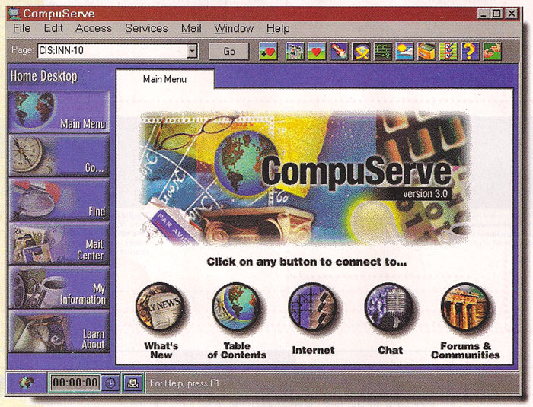
CompuServe (closed 2009)

Slide 9
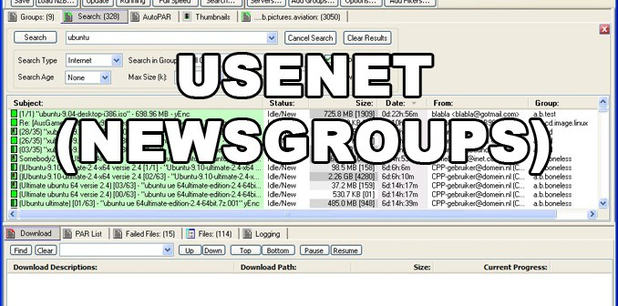
USENET (74M posts in Jan 2018)
USENET Satire: alt.sex.bestiality.hamster.duct-tape

Slide 10
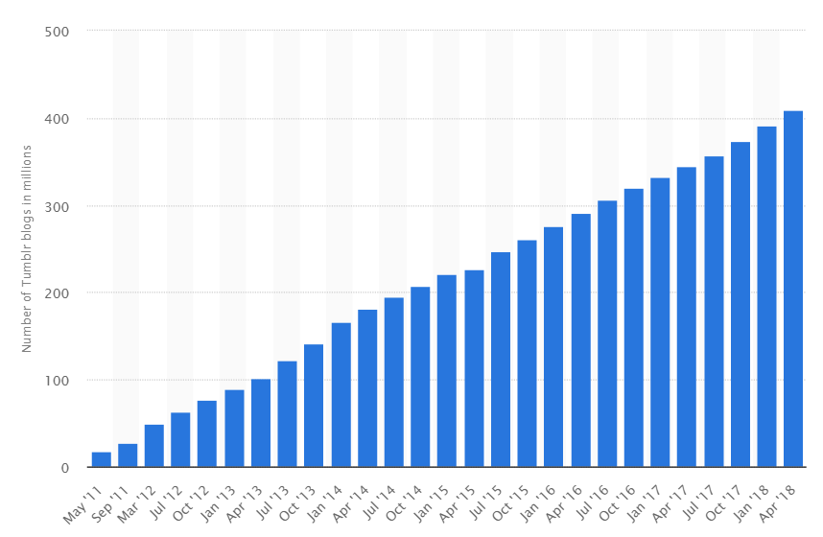
Blogs
Originally “weblogs”
Diary-like “posts” w/ most recent first
~440M bloggers worldwide by 2017
Tumblr most used
Cumulative total of Tumblr blogs from May 2011 to April 2018
From < https://www.statista.com/statistics/256235/total-cumulative-number-of-tumblr-blogs/ >

Slide 11
AIM (~1M users in 2017)
2017-12-15 R.I.P. AOL Instant Messenger

Slide 12
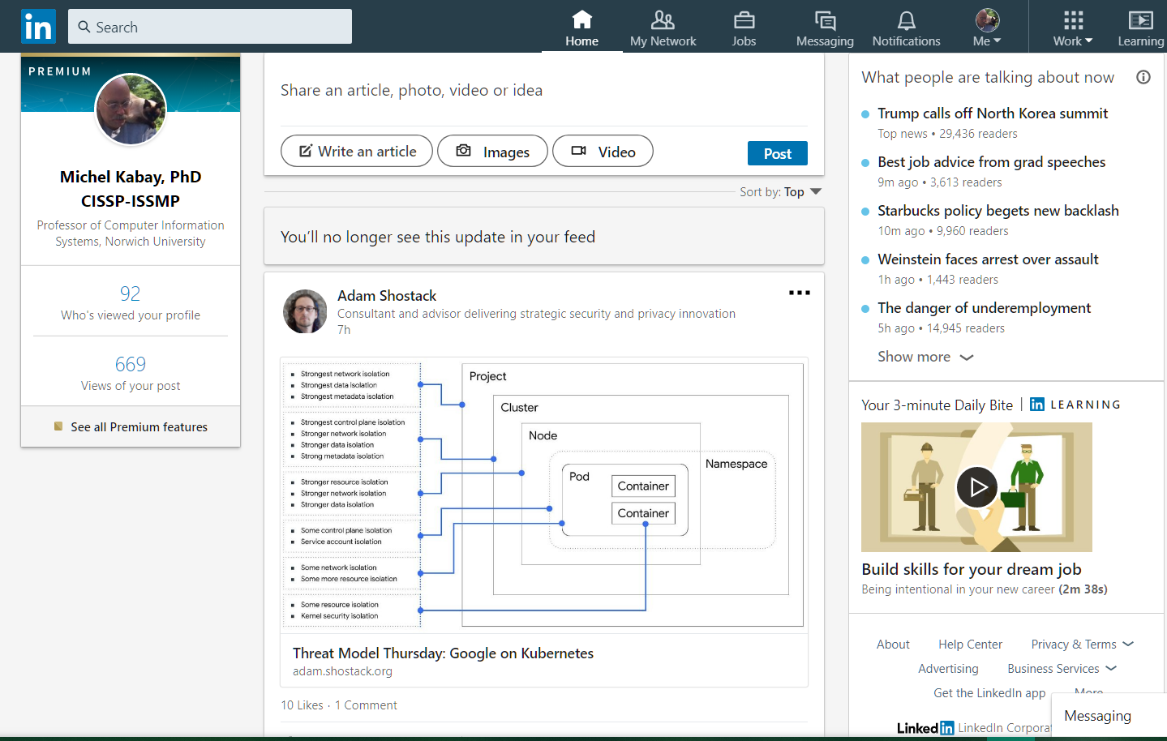
LinkedIn (500M users 2018)

Slide 13
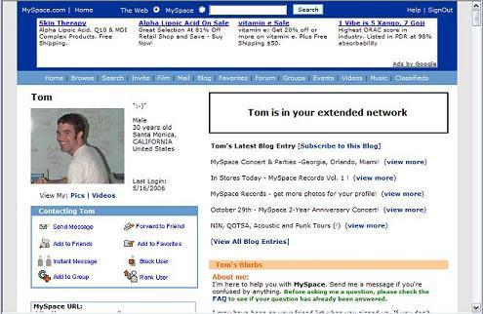
MySpace (50M users 2015)

Slide 14
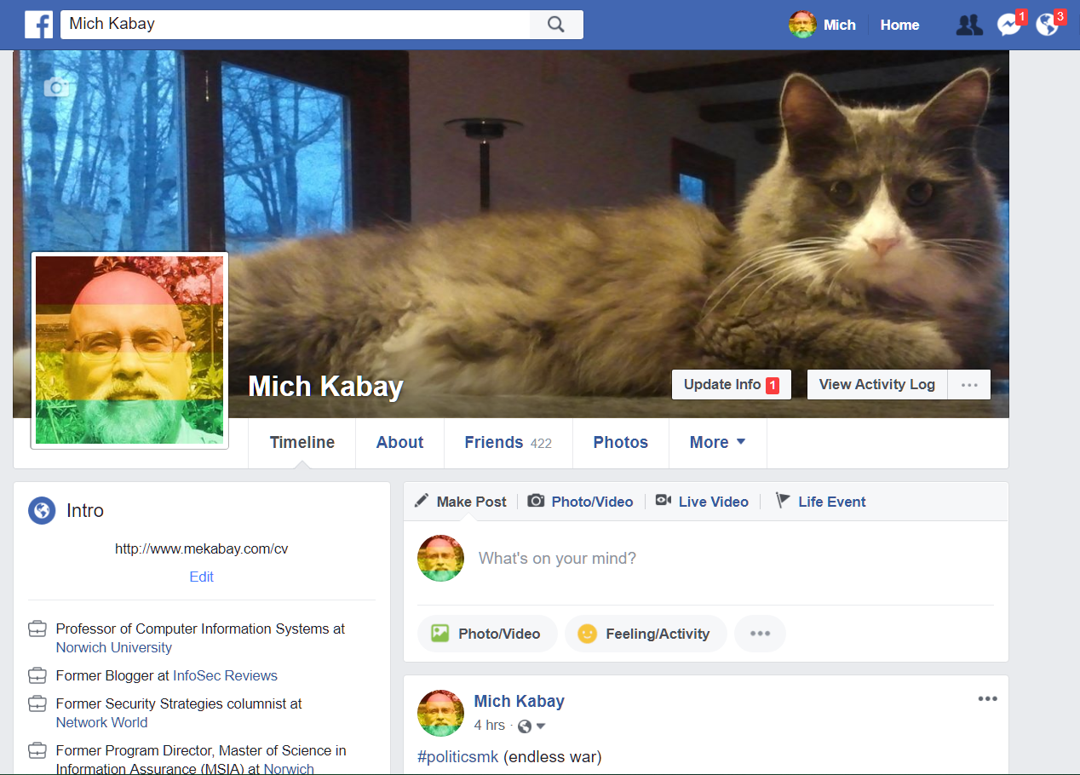
Facebook (2.19B users 2018)

Slide 15
Twitter (327M users 2018)
Originally 140 characters – 280 in 2017
Anyone can read “tweets”
Must register to post tweets
Widely used mechanism for broadcasting information and opinions
Donald Trump sent out
2,568 tweets
From 20 Jan 2017 through
20 Jan 2018.

Slide 16
Weibo (600M users 2017)
Generic term 微博 means “microblog.”
Most popular: Weibo.com for Sina Weibo
Others: Alibaba, Baidu, Ctrip, JD.com, QQ, YY, WeChat, Tmall, Taobao
140 Chinese characters > info than 280 letters via Twitter
Sina Weibo – most used
Strictly monitored by Chinese government (see later under “Censorship”)

Slide 17
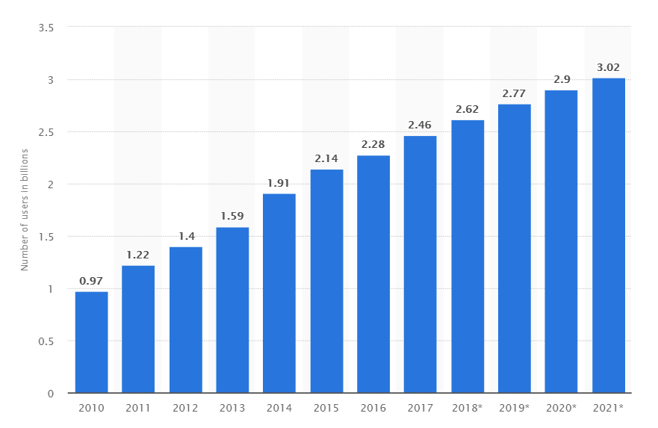
Social Media Growth & Projections
Number of social network users worldwide from 2010 to 2021 (in billions).
From < https://www.statista.com/statistics/278414/number-of-worldwide-social-network-users/ >.

Slide 18
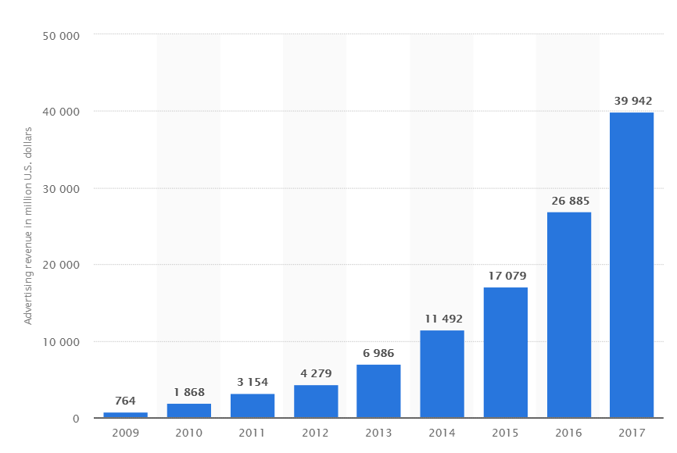
The Profit Mechanism: Advertising & Profiling
~$40B
Facebook's advertising revenue worldwide from 2009 to 2017
From < https://www.statista.com/statistics/271258/facebooks-advertising-revenue-worldwide/ >.

Slide 19
Profiling
Online quizzes used to store preferences
Analysis generates profiles
Profiles influence
What gets posted to user’s page
What advertising appears to user
Critics
Profiling generates political bubbles
Only similar materials shown
“Echo chambers” worsen isolation of different opinion/preference groups

Slide 20
The Cambridge Analytica Case
UK political consulting firm (“CA”)
Researcher sold CA personality profiles of 87M Facebook users
Violated contract
Only 270K users gave permission
But CA linked to their “friends” w/out notification
Owners/executives boasted about dirty-tricks campaigns in contracts to discredit politicians
May 1, 2018 CA filed for bankruptcy

Slide 21
DISINFO via Social Media
DISINFO = disinformation = deliberately incorrect information or false rumors
Methods for spreading DISINFO
Selective censorship (e.g., China)
Hacking/leaking (e.g., DNC email hack)
Tricking search algorithms (e.g., padding sites with thousands of invisible links to target to raise its profile in GOOGLE search)
Bots (from “robots”): automated fake users to spread false information
Trolls: humans who deliberately post lies and accusations to generate controversy
https://medium.com/center-for-data-science/the-state-of-disinformation-on-social-media-397d3c30f56a

Slide 22
Effectiveness of DISINFO
Aug-Oct 2016: Users read more from top 20 false news stories than from authentic information
Oct 2016: 400K bots posted 3.8M tweets
Credibility of false news
Factual topics:
30-40% non-experts are tricked
15-20% experts tricked
Opinions:
60% non-experts tricked
30% experts tricked

Slide 23
Trolling & Cyberbullying
Trolls
Deliberately foment discord
Post off-topic comments
Insults, abuse
Cyberbullies
Target specific individuals or groups
Post sneers, insults, & lies
Can include threats of harm
May post doctored photographs
Often directed at women

Slide 24
Privacy Issues
Confidentiality
Limits on who sees what about whom
Control
Degree to which confidentiality can be maintained
Classic failure of privacy
Young people send nude or otherwise embarrassing pictures to a few supposed friends
This is attempting to define confidentiality
But recipients have complete control over whether they share info with others w/out permission

Slide 25
Privacy in Cyberspace
ANYONE SHARING CONFIDENTIAL INFORMATION VIA ELECTRONIC MEANS HAS
NO CONTROL
OVER HOW THAT INFORMATION WILL BE USED BY RECIPIENTS.

Slide 26
Political Implications
Sharing information can challenge dictatorships
“Arab Spring” demonstrated power of uncontrolled communications via smart phones
Possible to
Distribute recordings challenging gov lies
Plan & announce meetings, rallies
Terrifies dictators – shut down networks
See for example Banks, R. (2015). “Smartphones and social media: driving political revolution.” Mobile Industry Review < http://www.mobileindustryreview.com/2015/01/smartphones-and-social-media-revolution.html >

Slide 27
Censorship (1)
1st Amendment of US Constitution
Controls government suppression of information
No restriction on suppression by private individuals or organizations
Most other nations do not have severe restrictions on government control of information
E.g., hate speech illegal in Canada & EU
Anything that threatens power of dictatorships
Chinese suppression of challenges prime example
See for example Heins, M. (1993). Sex, Sin and Blasphemy: A Guide to America’s Censorship Wars. New Press 1993. Extract:
“What is Censorship?” < http://ncac.org/resource/what-is-censorship >

Slide 28
Censorship (2)
Wolfson, S. (23 May 2018) “Donald Trump cannot block anyone on Twitter, court rules.” The Guardian < http://tinyurl.com/y8v98zts >
Reuters (29 Apr 2018) “Turkey blocks Wikipedia under law designed to protect national security.” The Guardian < http://tinyurl.com/lx884sq >
Phillips, T. (14 Mar 2018) “Chinese reporter's spectacular eye-roll sparks viral memes and censorship.” The Guardian < http://tinyurl.com/ycfrzvnp >
Sharkov, D. (31 May 2017) “Pornhub Posts Putin Critic Alexey Navalny's Anti-Government Film Online After Russian Court Bans It.” Newsweek < http://tinyurl.com/ya24y8mg >

Slide 29
Return of Intermediation
Disintermediation: reduction in power of conventional news sources to control information
Social media increasing control over content: intermediation returns
Waterson, J. & P. Duncan (24 May 2018) “Irish anti-abortion campaigners dodge Google’s ad ban.” The Guardian < http://tinyurl.com/yab6hx4j >
Ingram, D. & J. Menn (16 Aug 2017) “Internet firms shift stance, move to exile white supremacists.” < http://tinyurl.com/yak4v4cz >
Lecture @ JCOGS July 15

Slide 30
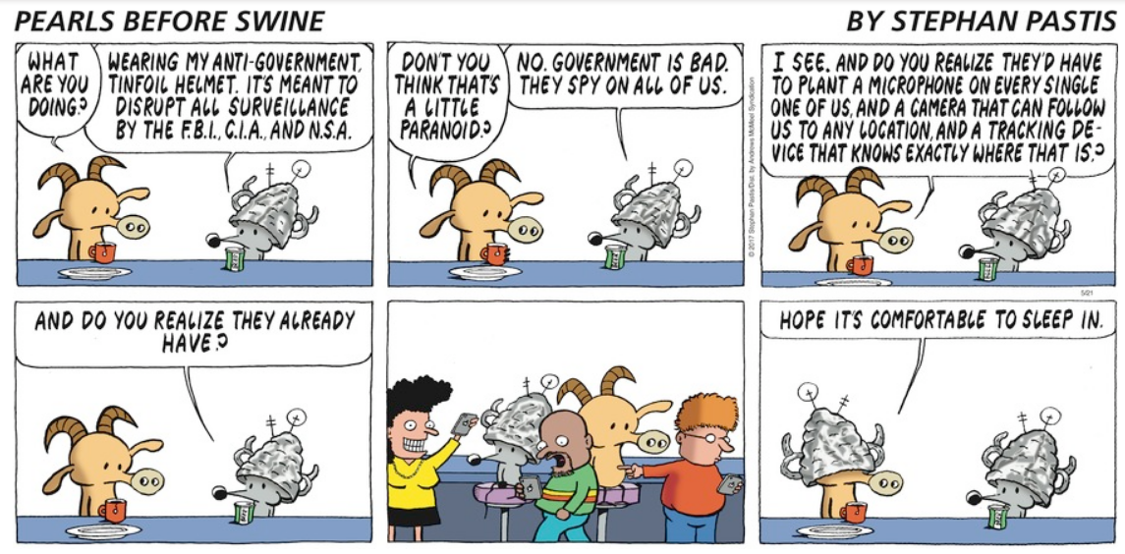
Surveillance (1)
https://www.gocomics.com/pearlsbeforeswine/2017/05/21

Slide 31
Surveillance (2)
US govt under Trump secretly increasing surveillance of social-media posts
DHS: “Shared Social Media Screening Service”
ICE: $100M contract to monitor social media of visitors
State Dept: 14.7M applicants for work/tourist visas will submit social-media identifiers
FBI: task force to monitor social media posts
Surveillance will chill expressions of criticism of government / society
Discriminatory monitoring well documented (e.g., Black Lives Matter members monitored)
Handeyside, H. (24 May 2018). “We’re Demanding the Government Come Clean on Surveillance of Social Media.” < http://tinyurl.com/yacln64n >

Slide 32
Identity Theft using Social Media (1)
Authentication is tying an identifier (e.g., user name) to a specific person (i.e., YOU).
If someone forgets a password, systems may ask for additional authentication using secret questions chosen by the user.
Some authentication routines allow users to choose whose answers are supposedly unknown by others
What was the name of your school in grade 3?
Who was your prom date in high school?
What was the name of your first pet?

Slide 33
Identity Theft using Social Media (2)
However, anyone can see public information from social media
Including answers to all the secret questions!
Identity thieves can use the information to impersonate victim
ID theft can result in
Theft of $$ via credit cards, banks, loans
Spoofing identity to tarnish/destroy reputation using fake accounts
Use social-media settings to restrict access to such information

Slide 34
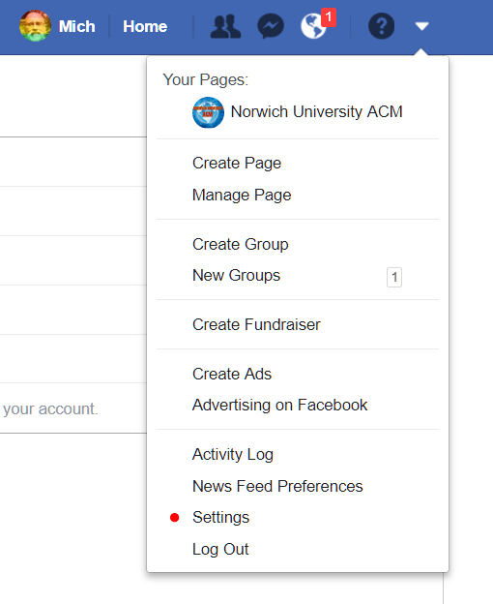
Facebook Settings (1)

Slide 35
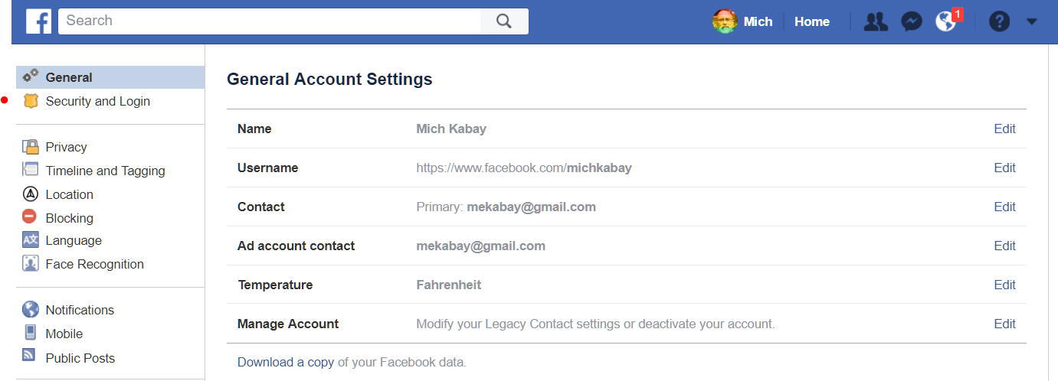
Facebook Settings (2)

Slide 36
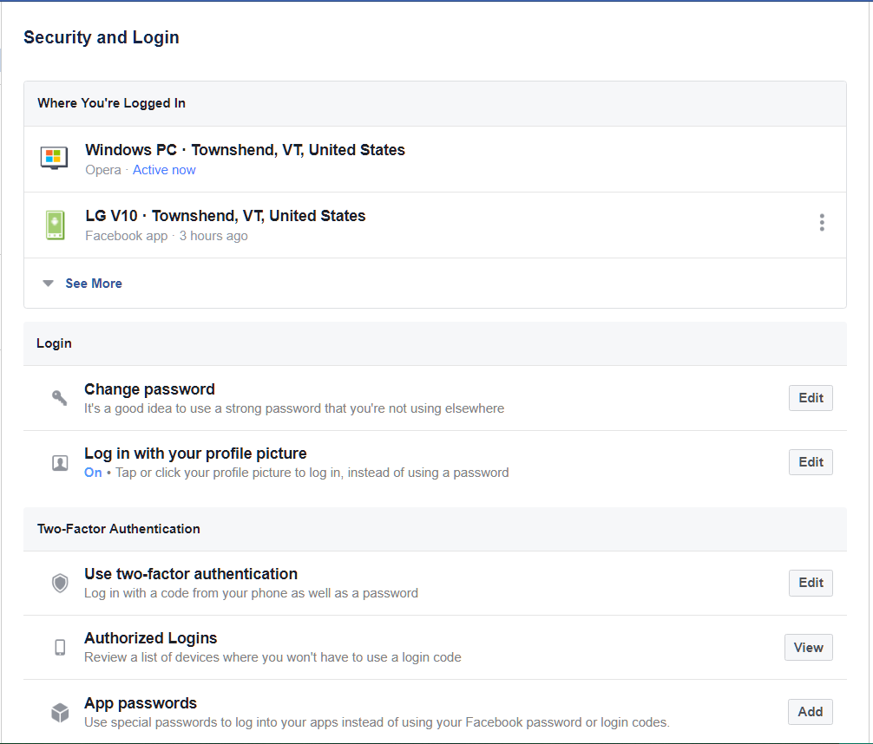
Facebook Settings (3)

Slide 37
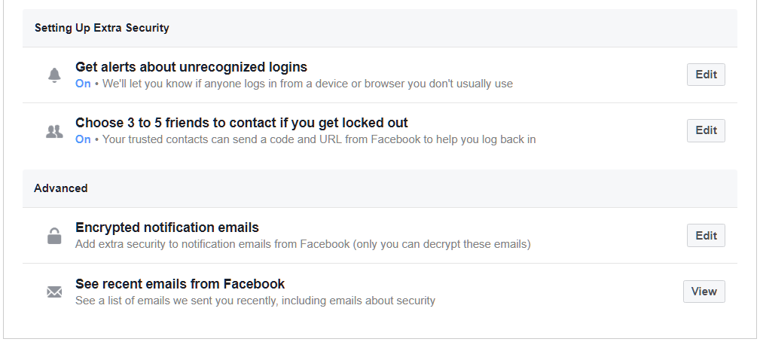
Facebook Settings (4)

Slide 38
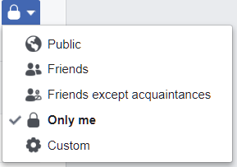
Facebook Settings (5)
Can control who can see EVERY ELEMENT of your Facebook profile

Slide 39
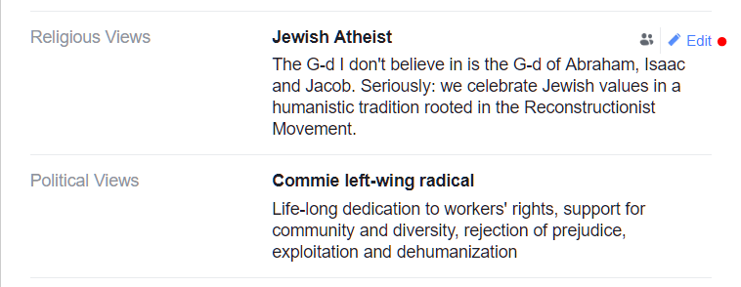
Facebook Settings (6)

Slide 40
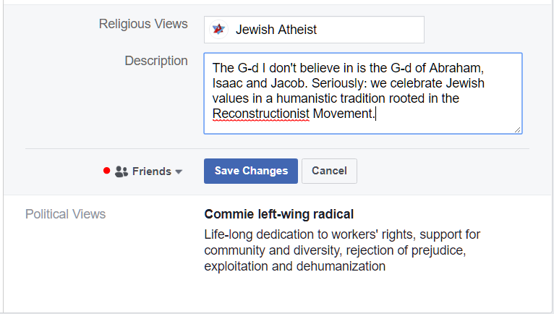
Facebook Settings (7)

Slide 41
Now go and study
These notes are available as PPTX and PDF files online at
< http://www.mekabay.com/courses/academic/norwich/cs407/cs407_lectures/index.htm > or use the abbreviation: < http://tinyurl.com/ybx2yykx >.

