Slide 1
Politics of Cyberspace @ JCOGS Privacy
M. E. Kabay, PhD, CISSP-ISSMP
Professor of Computer Information Systems
School of Business & Management
College of Professional Schools
Norwich University
Notes:
M. E. Kabay, PhD, CISSP

Slide 2
Topics
Privacy in US Jurisprudence
Effects of Information Technology on Privacy
Fourth Amendment Issues
Key US Laws Protecting Privacy
Defending Privacy in Cyberspace
Privacy Resources for Everyone

Slide 3
Privacy in US Jurisprudence
Privacy:
Power to control truths about you that other people know
Power to hide parts of the truth
Myth: “If you have done nothing wrong, you have nothing to fear from breaches of privacy.”
Many private acts and statements are not illegal or immoral, but societal norms allow them to remain private: known only to participants or those selected to know
Obvious example is sexual interactions
But key issue is that those in power may use breaches of privacy to punish those who threaten the political power-structures

Slide 4
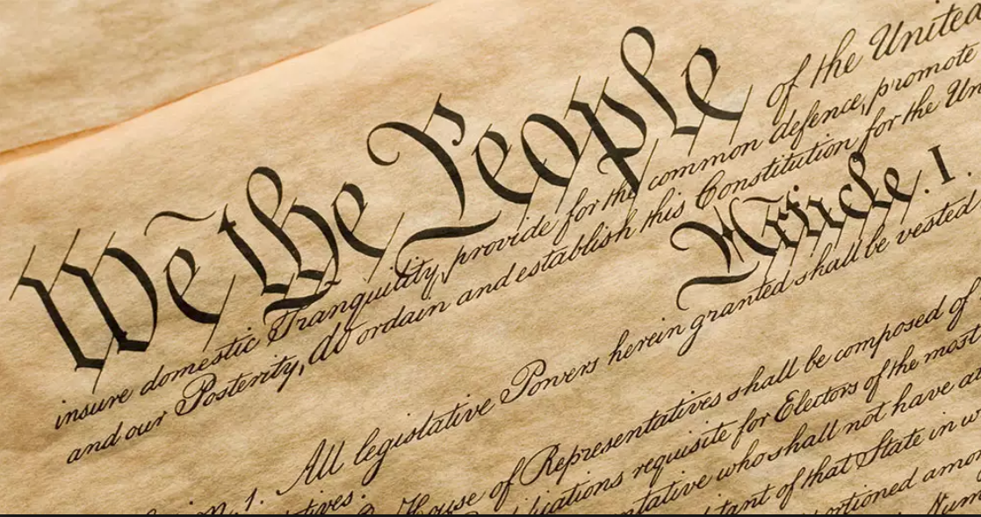
Common Law Privacy (1)
The makers of our Constitution. . . Sought to protect Americans in their beliefs, their thoughts, their emotions and their sensations. They conferred as against the Government, the right to be let alone – the most comprehensive of the rights of man and the right most valued by civilized men.”
Justice Louis D. Brandeis
Dissenting in the Olmstead decision

Slide 5
Common Law Privacy (2)
Invasion of privacy under common law:
Intrusion upon seclusion
Appropriation of name or likeness
Publicity given to private life
Publicity placing person in false light
US Constitution does not specifically mention privacy
But 4th amendment usually applied when discussing government intrusion

Slide 6
Types of Privacy
Informational privacy: Truths you have revealed to others but still want to control
Public records
Medical records
But public behavior is not protected
Truths you have kept private
Books you read
What you say in private letters or e-mail
Used to protected by laws of trespass

Slide 7
Effects of Information Technology on Privacy
Controlling Electronic Information is Difficult
Easier Data Acquisition
Informational Privacy
Privacy & the Internet
Privacy & Social Media
Data Collection on the Web
IoT
Drones
Spyware

Slide 8
Controlling Electronic Information is Difficult
E-mail messages often circulated without permission
Theoretical violation of copyright
In practice, impossible to stop once it starts
Private message group discussions are often made public
Can be embarrassing
Has led to lawsuits

Slide 9
Easier Data Acquisition
Radical change in ease of acquiring data about individuals
Electronic purchase records
Telephone and e-mail records
Surveillance technology redefines public space
Identification technology reduces the anonymity of the crowd
Public records online
Radical change in ease of acquiring aggregate data about groups

Slide 10
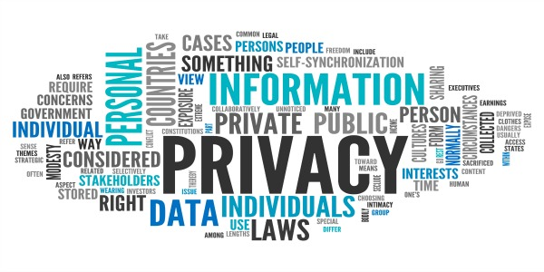
Informational Privacy
US law traditionally did not limit uses of observations about consumers
What you buy / read / view / eat
Data shared among credit agencies
Names, addresses, preferences sold to advertisers
Even medical data were not much protected
European Privacy Directive much more stringent
Caused problems for US firms – barred from doing business because of lax laws

Slide 11
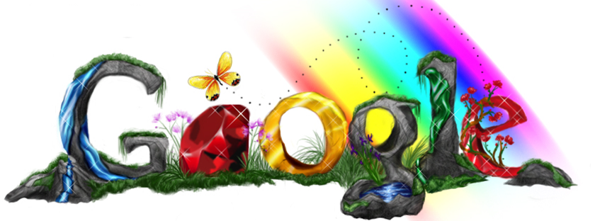
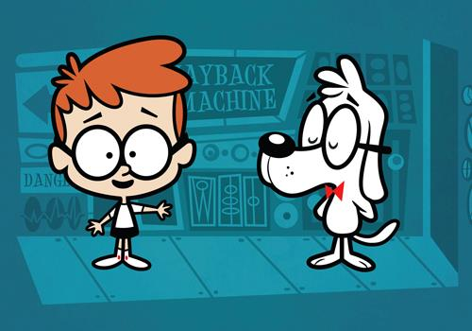
Privacy and the Internet
Google bought DejaNews
Archive of all USENET discussions
Spans ~15 years
Can provide interesting information about previous levels of professionalism
Google caches Web pages
Owner can remove an embarrassing page from Web site
But cached copy persists for months
Wayback Machine
>332 billion web pages saved

Slide 12
Privacy & Social Media
Facebook case
Illustrates how user behavior is monetized
What we click on, what we post, what we like – information sold to advertisers
Authoritarian governments redefine privacy
PRC govt routinely monitors postings, email
Those insufficiently “loyal” to the dictatorship are punished and even killed

Slide 13
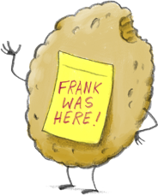
Data Collection on the Web
Cookies store information about where you have been on a specific Web site
E.g., AMAZON uses cookies to track your identity and your book preferences
Unless badly formed, cookies are not supposed to be shared among Web sites
Web bugs
1-pixel images (invisible) that return information to specific advertisers
Allow tracking of how many people visit a Web page vs how many click on ads

Slide 14
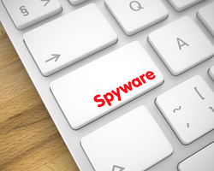
Data Collection – cont’d
Spyware
Software that covertly communicates with a Web address (phones home)
Caught by firewalls
E.g., was present in Comet Cursor – cartoon cursors favored by children
Sent information about exactly what Web pages kids were looking at
Covert market research
Some spyware transmits all details of everything done on infected computer
Some spyware does not remove itself via its uninstall function

Slide 15
Internet of Things (IoT)
Many electronic objects now connecting to remote computers via Internet
Fridges automatically send email about time to buy new supplies
Electronic speakers respond to voice commands
Concern about equipment with microphones and cameras
Some have primitive artificial intelligence
But still not smart enough to protect privacy
E.g., Alexa smart speaker recently transmitted conversation to someone’s voicemail by mistake

Slide 16
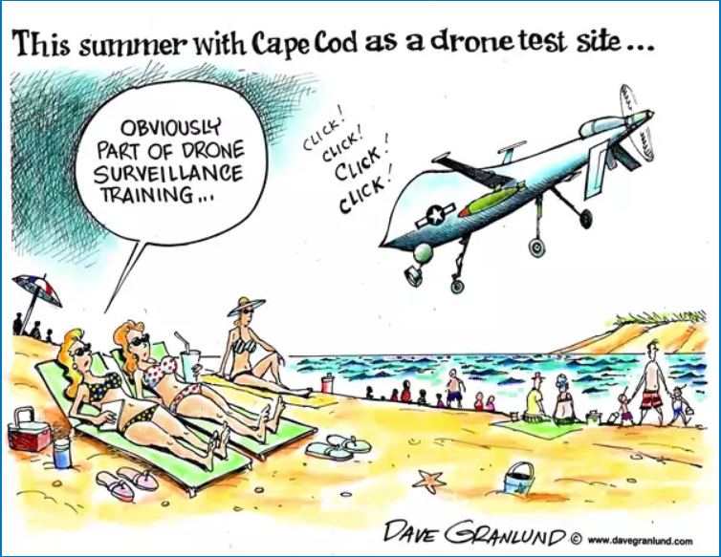
Drones
Little helicopter-like units
Often equipped with cameras
Already known to have been used to spy on victims in back yards and through upper windows
Being used by law-enforcement
Serious questions about invasions of privacy

Slide 17
What Is Spyware?
Spyware: any technology that covertly gathers information
About person
About organization
About system
Without knowledge of victim
Any software which
Employs user's Internet connection
In background ("backchannel")
Without their knowledge or explicit permission
Notes:
http://whatis.techtarget.com/definition/0,289893,sid9_gci214518,00.html
http://grc.com/optout.htm
http://www.logophilia.com/WordSpy/spyware.asp
http://www.acecmt.com/spyware.html
http://home.t-online.de/home/TschiTschi/spyware.htm

Slide 18
How does Spyware Enter a System?
Install freeware, shareware
Often those that are ad-supported
Some browser plugins
Offer new functions
New file format compatibility
Viruses & worms
E-mail attachments
Notes:
http://www.lavasoftusa.com/faq.html

Slide 19
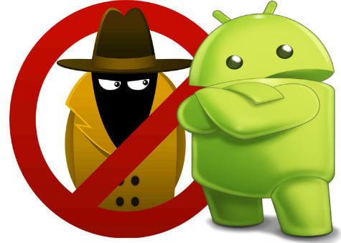
Removing Spyware
Problems with uninstalling spyware
Some products do not (or did not) include uninstall function
Uninstall function failed in several cases
Some products reinstall themselves
Tools available for removal; e.g.,
AdAware
Aureate/Radiate DLL remover
CA Anti-Spyware
Notes:
http://www.spychecker.com/download.html

Slide 20
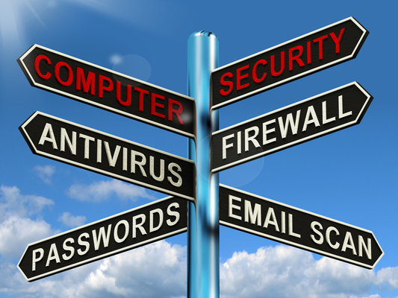
Blocking & Removing Spyware
Can prevent messages from reaching “mother ship”
Modern antivirus/security programs; e.g.,
AVG
Bitdefender
BullGuard
Malwarebytes
McAfee
Norton
PCProtect
Scanguard
TotalAV
TrendMicro
Notes:
http://www.firewallguide.com/

Slide 21
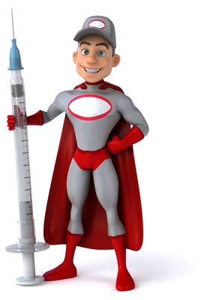
Preventing Spyware Infestations
Read the fine print before installing software
Especially adware = freeware supported by advertising
Run appropriate scanners (removal tools) periodically
Firewalls help identify infestations as well as blocking transmissions
Choose firewall capable of trapping unexpected outbound connections
Set parameters to alert user to unauthorized connections

Slide 22
Arguments Defending Data Collection
Doesn’t hurt anyone
No names collected
Helps to improve effectiveness of advertising
Improves market mechanisms by providing statistical information about consumer preferences
NO WAY

Slide 23
Attacks on Data Collection
Issue is control
Covert data collection is unacceptable
Data subject must be informed
Who is collecting what info
For what purpose
How to stop collection
Who has used information

Slide 24
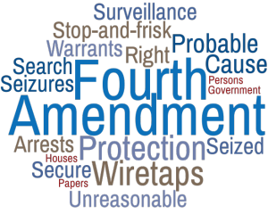
Fourth Amendment Issues
Fourth Amendment to the US Constitution passed in 1791
Forbids unreasonable search and seizure by government and law enforcement agents
Did not apply to new technological means of information gathering
1928 SCOTUS decision excluded telephone wiretaps from 4th Amendment protection
Brandeis dissented, arguing that interpretation must be updated to include new technologies

Slide 25
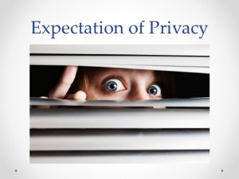
New Interpretations of 4th Amendment
1968 Katz vs US
Constitution protects “people, not places”
Invasion of property not the issue
Key is whether person has “reasonable expectation of privacy”

Slide 26
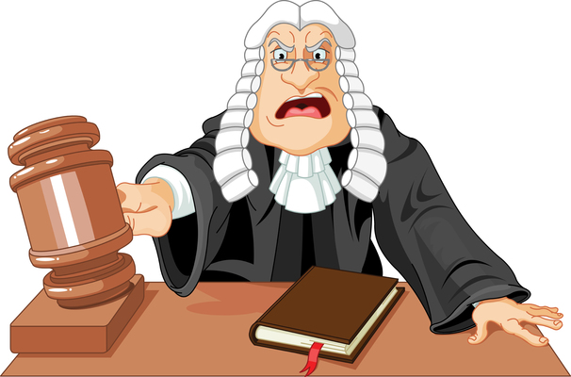
Later Judgements
Would you expect privacy in
Bank records (no: US vs Miller)
Car travel tracked by LoJack (no: US vs Knotts)
Material stored in open field (no: Oliver vs US)
Garbage on curbside (no: CA vs Greenwood)
Material visible from plane (no: Dow Chemical v US)
Marijuana farming Gro-Lights seen via infrared cameras (yes: US vs Robinson)

Slide 27
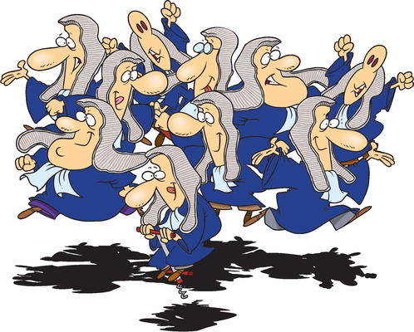
Key US Laws Protecting Privacy
Fair Credit Reporting Act of 1970
Privacy Act of 1974
Right to Financial Privacy Act of 1978
Privacy Protection Act (PPA), 1980
Electronic Communications Privacy Act (ECPA), 1986
Computer Fraud & Abuse Act (1986)
Telephone Consumer Protection Act, 1991
Health Insurance Portability and Accountability Act (HIPAA), 1996
Gramm-Leach-Bliley Act (GLB), 1999

Slide 28
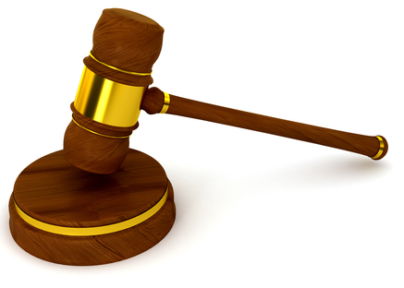
Fair Credit Reporting Act of 1970
Credit reports limited to
Credit application
Insurance
Employment
Government benefits
Business transactions justifying such reports
Credit bureaus are data sinks
Share information via clients (banks etc.)
Refusals can be mislabeled, sent on
Wrong data can circulate endlessly
FCRA requires due care to remove / correct bad info
See http://www.ftc.gov/os/statutes/fcra.htm

Slide 29
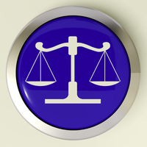
Privacy Act of 1974 5 USC §552a
Government agencies may not conceal data gathering about individuals and data repositories
Also restrictions on distribution
Publish notice giving details including
Name, location
Types of people covered
Purposes of routine uses of the data
Responsible persons
Means for data subjects to check correctness of record about themselves
http://www4.law.cornell.edu/uscode/5/552a.html
http://www.usdoj.gov/04foia/privstat.htm

Slide 30
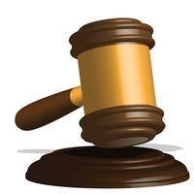
Right to Financial Privacy Act of 1978 (amended 1987)
Limits government access to financial records
Allows reports to government agencies for
Establishing collateral or security for loan
Bankruptcy proceedings
Application for government loans
Banks (etc.) may notify government agencies of suspected wrongdoing
Customers may authorize any disclosure
Permission extends max. 3 months
Permission can be revoked any time
http://www.dol.gov/dol/allcfr/SOL/Title_29/Part_19/toc.htm

Slide 31
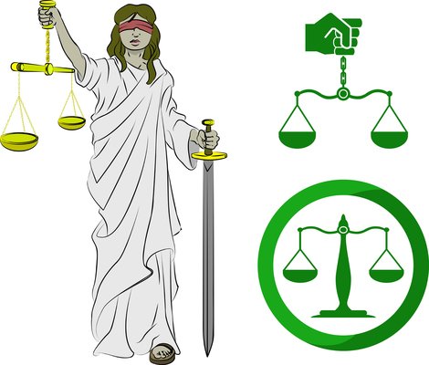
Privacy Protection Act (PPA) of 1980 42 USC §2000aa
Protects journalists’ and writers’ materials and sources
Require probable cause for search or seizure
Except if crime is in process or has already occurred
To prevent immediate injury to a victim
Steve Jackson Games case
Secret Service raided game company
Seized computers, refused to return them
See http://www.eff.org/Legal/Cases/SJG/ http://www4.law.cornell.edu/uscode/42/2000aa.html

Slide 32
Electronic Communications Privacy Act (ECPA), 1986
17 USC §1367 et al.
Governs interception and disclosure of electronic communications
Telephone
E-mail
Fax
Pager
Employers are not subject to ECPA restrictions on their own employees’ communications
Except if they have allowed a reasonable expectation of privacy to develop
http://www.cpsr.org/cpsr/privacy/wiretap/ecpa86.html

Slide 33
Computer Fraud & Abuse Act, 1986
18 USC §1030 (a)
Bars unauthorized access to electronic sources
Primary law for punishing hackers
Defines intrusion as felony
Penalties severe
1st offense
Up to $250,000 fine
Up to 5 years in federal penitentiary
2nd offense
Up to $500,000 fine
Up to 10 years imprisonment

Slide 34
Telephone Consumer Protection Act, 1991
47 USC §227
Bars automated calling systems that charge consumers
Makes unsolicited commercial fax illegal
Need pre-existing business relation or
Agreement of recipient
Some attempts to extend this law to junk e-mail
UCE = unsolicited commercial e-mail
aka SPAM
http://www.fcc.gov/ccb/consumer_news/tcpa.html

Slide 35
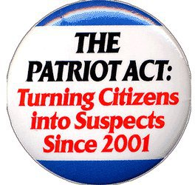
U.S.A.P.A.T.R.I.O.T. Act (1)
Uniting and Strengthening America by Providing Appropriate Tools Required to Intercept and Obstruct Terrorism Act
Called the “US Patriot Act” to sway public opinion in its favor
Passed by a Congress whose members did not read the text of the Act before approving it
Based on premise that civil liberties prevented discovery of 9/11 plot

Slide 36
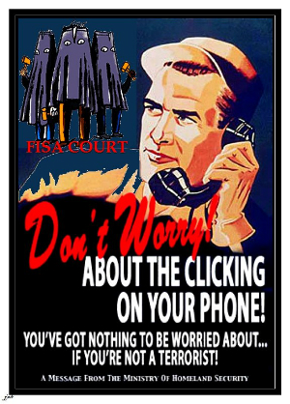
U.S.A.P.A.T.R.I.O.T. Act (2)
Extension of Foreign Intelligence Surveillance Act (FISA)
Allows surveillance of US citizens and residents by CIA & NSA
Information sharing between intelligence agencies and law enforcement
Had been separated after abuses in 1950s & 1960s
Increased authority to Attorney General to circumvent restrictions on domestic surveillance limitations

Slide 37
U.S.A.P.A.T.R.I.O.T. Act (3)
Warrant can be obtained without providing evidence to justify request
Inform FISA Court judge that surveillance is “relevant” to an investigation
Target need not be subject of investigation
No requirement to report findings to judge or to subject
Judge has only 2 choices
Grant permission
Accuse law enforcement of lying
Easier surveillance in cases of suspected computer crime – some without court order

Slide 38
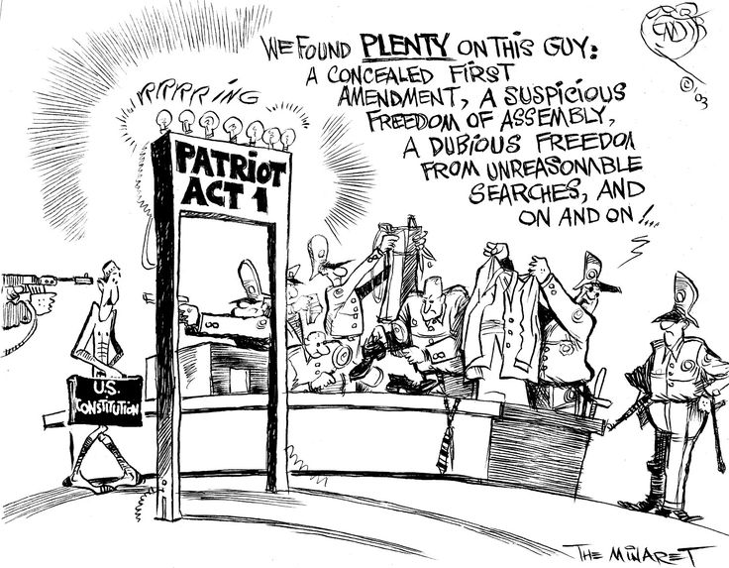
U.S.A.P.A.T.R.I.O.T. Act (4)

Slide 39
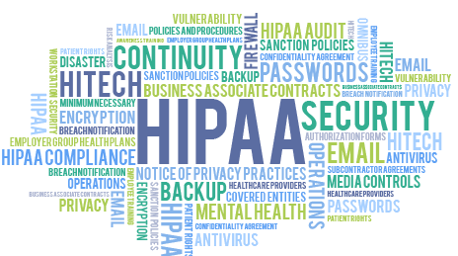
Health Insurance Portability and Accountability Act (HIPAA), 1996
42 USC 1297ii
Protects employees who change jobs but want to keep their health insurance
Mandates administrative simplification
Privacy provisions affect everyone who collects, keeps and transmits medical information
Patients must have full access to their medical files
Standards for protecting individually identifiable health information
http://www.hcfa.gov/hipaa/hipaahm.htm

Slide 40
Gramm-Leach-Bliley Act (GLB), 1999
Financial Services Modernization Act
Many sections dealing with structure of banks, securities firm
Title V – Privacy
Clear disclosure of privacy policies
Notice to consumers
Opt-out of sharing consumer info
Enforced by FTC, federal banking agencies, SEC, National Credit Union Administration
http://www.senate.gov/~banking/conf/grmleach.htm

Slide 41
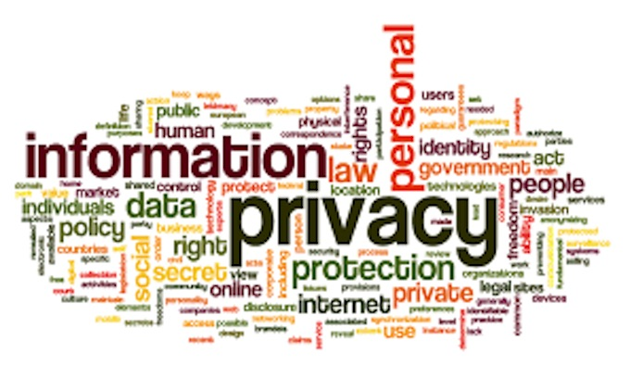
Defending Privacy in Cyberspace: Technology
Encryption
Steganography
Anonymizers

Slide 42
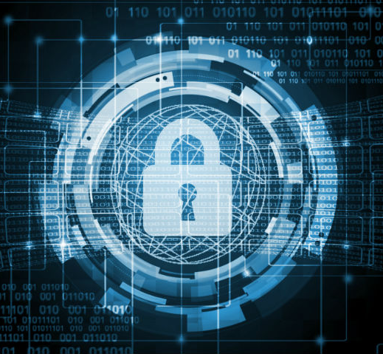
Encryption
Methods for converting (encrypting) original text (plaintext) into gibberish (ciphertext)
Reversible (decipherable) only if recipient is given a key to unscramble
Secret-key cryptography
Ancient origins
But difficult to manage if many readers must decipher the ciphertext
Public-key cryptography
Create a pair of keys
Each can decipher what the other encrypts
Keep one private and make the other public

Slide 43
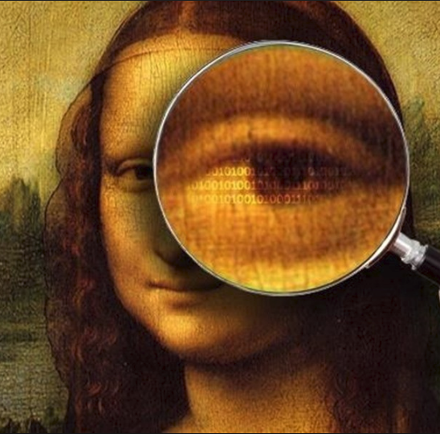
Steganography
Information in images based on series of bits (1s and 0s) defining pixels
Can alter lower-order bits without making obvious changes to colors of the pixels
Thus can store other info in pixels using special steganography (“hidden writing”) program
Needs the same special program to decode the hidden message
Must know that the message is hidden in the image

Slide 44
Anonymizers
All Internet usage generates info about which computers were used
Internet protocol (IP) addresses can be recorded for access to Web pages or for email
Typically specific IP addresses can be tied to specific areas on the globe
E.g., IP addresses for Stowe VT are recognizable down to specific homes
Anonymizers
Strip the original IP address from the packets of information
Allow anonymous access to Web
The Onion Network (TOR) is example

Slide 45
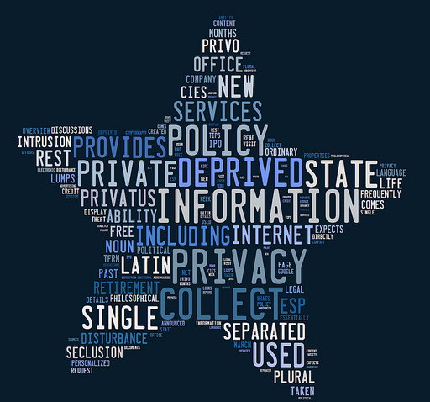
Defending Privacy in Cyberspace: Organizations
Center for Democracy and Technology
Electronic Frontier Foundation
Electronic Privacy Information Center (EPIC)
Privacy International

Slide 46
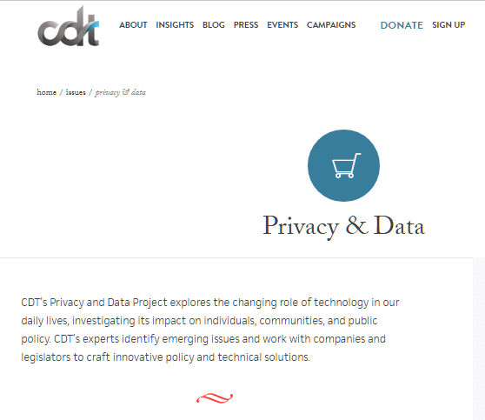
Center for Democracy and Technology (CDT)
State Privacy Resource Center
Digital Decisions
Student Privacy
Drones
Broadband Privacy
Internet of Things
Health Privacy

Slide 47
Electronic Frontier Foundation (EFF)
Free speech
Creativity & innovation
International issues
Privacy
Security
Transparency

Slide 48
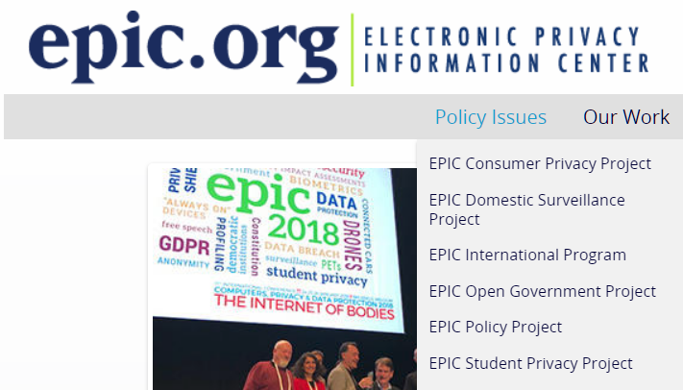
Electronic Privacy Information Center (EPIC)

Slide 49
Privacy International (PI)
AI
Biometrics
Data Retention
Communications Surveillance
Cross-Border Data Access
Cyber Security
Data Protection
Financial Privacy
GDPR
Govt Hacking
Identity & Privacy
IoT
Mass Surveillance
Migration & Borders
Policing & Tech
Profiling
Security-Assistance Agreements between Governments
Smart Cities
Social-Media Surveillance

Slide 50
Privacy Resources for Everyone
Privacy Checklist
AARP Fraud Watch
Privacy-Monitoring Services

Slide 51
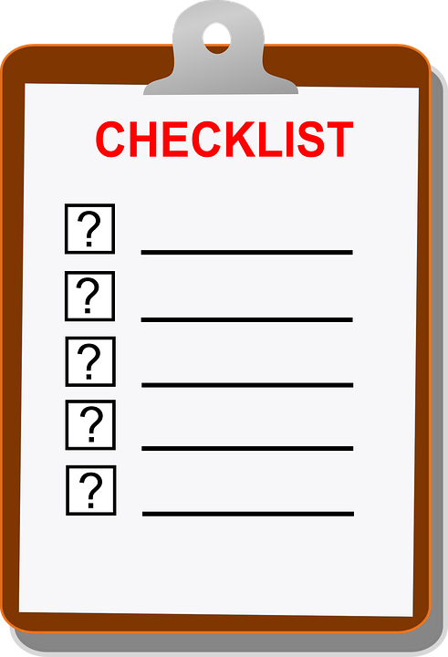
Privacy Checklist (1) http://tinyurl.com/ogf7ntg
DesMarais, C. (2013). “11 Simple Ways to Protect Your Privacy.” TIME
Don’t fill out your social-media profile
Be choosy about sharing your social security number – even the last 4 digits
Lock down your hardware (i.e., use password to access)
Turn on private browsing
Use a password vault that generates & remembers strong, unique passwords
Use two-factor authentication

Slide 52
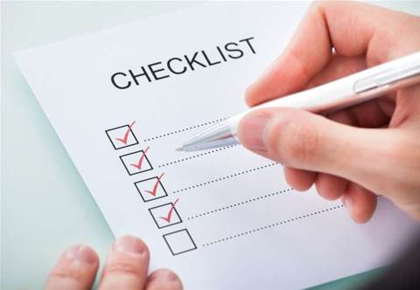
Privacy Checklist (2) http://tinyurl.com/ogf7ntg
Set up a Google alert for your name.
Pay for things with cash.
Keep your social-network activity private.
Don’t give out your zip code when making credit card purchases.
Lie when setting up password-security questions.

Slide 53
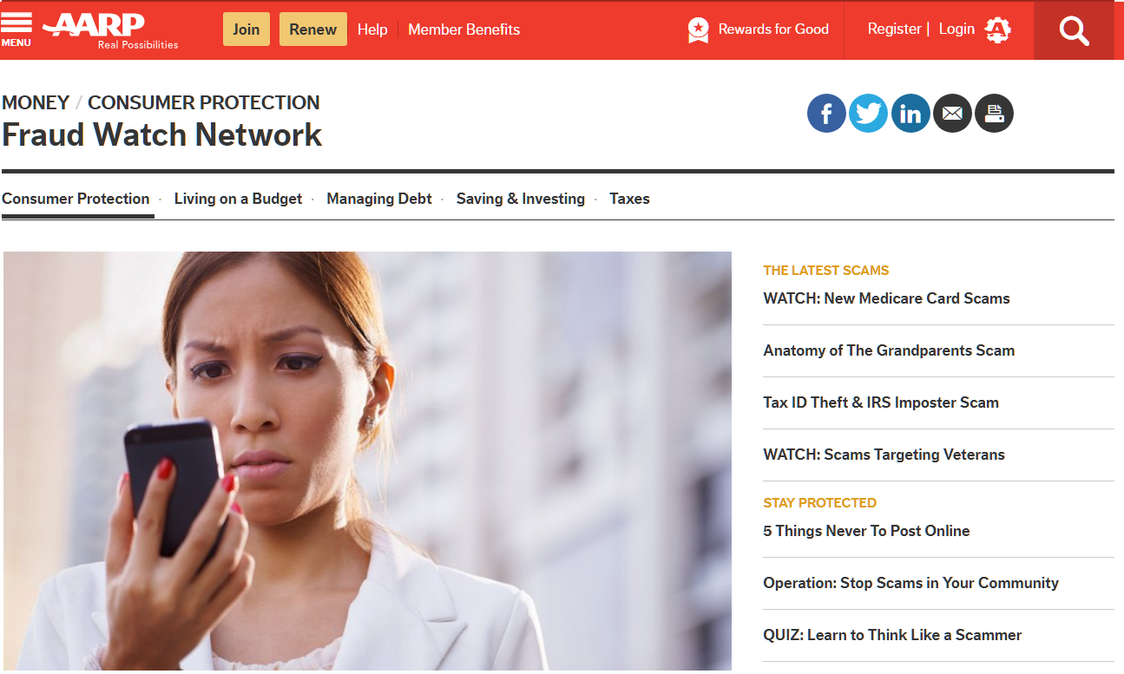
AARP Fraud Watch http://tinyurl.com/y77czozd

Slide 54
Privacy-Monitoring Services
Lifelock < https://www.lifelock.com/products/ >
Various plans/prices
All include
Support in case of fraud
Alerts for threats (e.g., requests to change address)
IDShield < https://www.idshield.com/ >
Monitor wide range of activities
Support restoration of identity

Slide 55
Now go and study
These notes are available as PPTX and PDF files online at
< http://www.mekabay.com/courses/academic/norwich/cs407/cs407_lectures/index.htm > or use the abbreviation: < http://tinyurl.com/ybx2yykx >.

