Slide 1
Politics of Cyberspace @ JCOGS Net Neutrality
M. E. Kabay, PhD, CISSP-ISSMP
Professor of Computer Information Systems
School of Business & Management
College of Professional Schools
Norwich University
Notes:
M. E. Kabay, PhD, CISSP

Slide 2
Topics
Common Carrier
Telecommunications Status
Defining Net Neutrality
Arguments In Favor of Repeal
Counter-Arguments
ISP Interference w/ Bandwidth
Legal Liability from Non-Neutrality
FCC: The Mandate
Verizon Executive at FCC
Consolidation – Net Neutrality = Trouble
Resistance

Slide 3
Common Carrier Status – 1934
Shipping companies & telecommunications providers
Telegraph
Telephone
Forbidden under US law from discriminating among clients
Cannot apply different rules/charges to different clients for same service
Only attributes of service count
E.g., Weight, size of package, delivery time
Source/destination of communications
Cannot charge two customers different prices for exactly same service
Cannot speed up service for different senders to same client who has paid for delivery

Slide 4
47 USC §153 (11)
The term “common carrier” or “carrier” means any person engaged as a common carrier for hire, in interstate or foreign communication by wire or radio or interstate or foreign radio transmission of energy, except where reference is made to common carriers not subject to this chapter; but a person engaged in radio broadcasting shall not, insofar as such person is so engaged, be deemed a common carrier.

Slide 5
47 USC § 202 (a)
It shall be unlawful for any common carrier to make any unjust or unreasonable discrimination in charges, practices, classifications, regulations, facilities, or services for or in connection with like communication service, directly or indirectly, by any means or device, or to make or give any undue or unreasonable preference or advantage to any particular person, class of persons, or locality, or to subject any particular person, class of persons, or locality to any undue or unreasonable prejudice or disadvantage.

Slide 6
Telecommunications Status
Common-carrier status applied to
Telegraph
Telephone
Internet Service Provider (ISP)
E.g., AT&T or Verizon could not discriminate among content providers
Netflix could not pay more for higher bandwidth than YouTube
Could not slow down access to small Websites (e.g., mekabay.com) while speeding up access to big sites (e.g., AMAZON.COM)

Slide 7
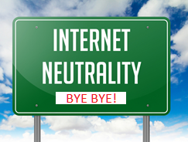
Defining Net Neutrality
Net neutrality is the absence of restrictions placed on the transmission of content by the major ISPs that provide service to millions of homes and offices. It means all packets are delivered on a first-come, first-served basis regardless from where they originate.
From Computer Desktop Encyclopedia http://www.computerlanguage.com/

Slide 8
Arguments In Favor of Repeal
Contribute to lively competitive marketplace
New offerings for consumers
Ability for suppliers of content to benefit from higher bandwidth by paying fees
Users could pay less for Internet access
ISP profits could increase
High-bandwidth content suppliers could benefit

Slide 9
Counter-Arguments
Not all supposedly competitive industries benefit consumers
Consider PHARMA in US
Since ISPs are no longer common carriers, what will prevent political discrimination among information sources?
How about 30-second wait times for New York Times articles v
0.3 second wait for Breitbart News Network?
(Substitute your own preferences)
$$$

Slide 10
ISP Interference w/ Bandwidth
Madison River v Vonage (2004)
Telus v TWU (2005)
Verizon v NARAL (2007)
Comcast v BitTorrent (2007)
Verizon Blocks Tethering (2008)
Comcast & Microsoft (2010)
AT&T Blocks Apple Facetime (2012)

Slide 11
Vonage v Madison River (2004)
Vonage provided landline phone & Internet service to customers in North Carolina
Madison River: ISP in same area
VoIP
Voice over IP = telephone via Internet
Suddenly Madision River blocked everyone using VoIP
Vonage felt VoIP via Madison River competed w/ Vonage telephone service
FCC imposed $15K fine on Madison River

Slide 12
Telus v TWU (2005)
Telus – leading telecom in western Canada
July 21
Telecommunications Workers Union
Declares strike v Telus
www.voices-for-change.com posts info about strike
July 22
Telus blocks own customers’ access to Website
No notification to anyone
July 28
Telus stops blocking Website
http://www.cbc.ca/news/canada/telus-cuts-subscriber-access-to-pro-union-website-1.531166

Slide 13
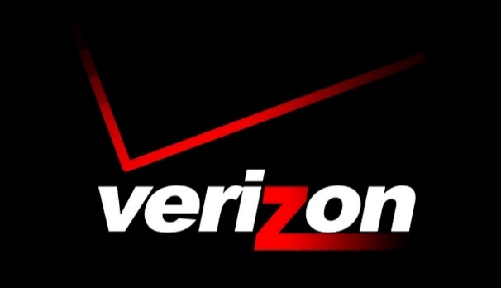
Verizon v NARAL (2007)
National Abortion Rights Action League
Began receiving donations via text message
Verizon refused request
Barred issue-oriented programs
Abortion
War…
Only basic politician-centered fund-raising permitted
Coalition of non-profit groups challenged Verizon
Verizon backed down
But common-carrier restrictions on censorship less stringent for cellular providers

Slide 14
Comcast v BitTorrent (2007)
BitTorrent
Peer-to-peer file-sharing
Often used for pirated content (violating copyright)
Also used for legitimate file transfers
Comcast blocked all BitTorrent connections
Initially denied it was doing so
Eventually stopped (2008)
US Court of Appeals ruled against FCC
But Comcast had changed policies about capping data transfers

Slide 15
Verizon Blocks Tethering (2008)
Tethering = using phone as hotspot
Other devices can use ISP for ‘Net access
Verizon
Permitted tethering only for customers paying for Mobile Broadband Connect Service
Pressured Google to remove tethering apps from Play Store
FCC
Charged Verizon w/ violation of licensing agreements
Fined Verizon $1.25M

Slide 16
Comcast & Microsoft (2010)
Comcast imposed 250 GB/month limit (a data cap) on all its users starting 2008
But in 2010, signed agreement w/ Microsoft
Provided streaming service (movies, games) via MS-Xbox game system
Would not count bandwidth usage against data cap
X-box owners strongly moved to favor Comcast streaming v Amazon or Netflix
Comcast
Rescinded policy after major protests
But reserved right to impose new caps any time

Slide 17
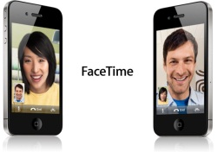
AT&T Blocks Apple Facetime (2012)
AT&T
Phone service
ISP
Apple’s Facetime = video-chat app
Could substitute for phone calls via ‘Net
AT&T blocked Facetime
Even for customers with unlimited bandwidth plans
Unless customers paid for Mobile Shared Data Plan (extra $$)
Coalition of open-Internet advocacy groups threatened formal complaint to FCC
AT&T backed down in 2013

Slide 18
Legal Liability from Non-Neutrality
Cubby v CompuServe (1991)
Stratton Oakmont v Prodigy (1995)
Blumenthal v Drudge & AOL (1998)

Slide 19
Cubby v CompuServe (1991) [1]
CompuServe
Provided thousands of discussion groups
Disclaimed all responsibility for content posted by users
System operators (SYSOPS) governed their own discussion groups (forums)
Journalism Forum
Established by Cameron Communications
Rumorville = newsletter in Journalism Forum
Created by Don Fitzpatrick Associates
Published nasty comments about Skuttlebut newsletter (from Cubby Inc. & Robert Blanchard)

Slide 20
Cubby v CompuServe (1991) [2]
Cubby & Blanchard sued for libel
Included Cameron, Fitzpatrick & CompuServe
US District Court, Southern District of NY ruling
Neither Cameron nor Fitzpatrick agents of CompuServe
CompuServe simply provided communications service
Key finding summarized:
Because CompuServe did not interfere with content in any forums, the provider had no legal liability for that content.

Slide 21
Stratton Oakmont v Prodigy (1995)
Prodigy provided bulletin boards
MoneyTalk board run by Charles Epstein
Posted anonymous claims
Stratton Oakmont & president Daniel Porus involved in criminal fraud
Stratton Oakmont sued Prodigy & poster for libel
Supreme Court, Nassau County, NY ruling (May 1995)
Prodigy advertised its editorial control over content
Therefore this provider was responsible for libel

Slide 22
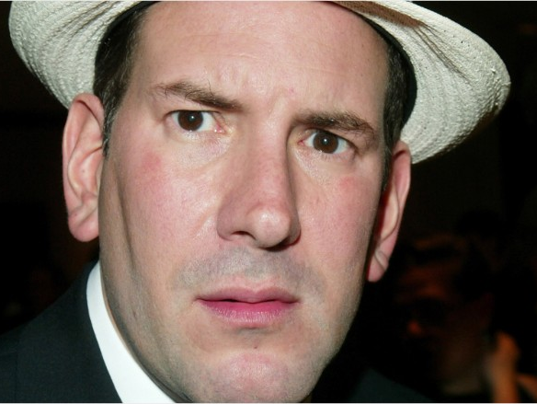
Blumenthal v Drudge (1998)
AOL Drudge Report on AOL
Aug 1997 – Matt Drudge posted rumors
Claimed Sidney Blumenthal abused his wife
Bluementhal sued Drudge & AOL for libel
District Court for District of Columbia
AOL not responsible for Drudge libel
Cited Communications Decency Act of 1996 )47 USC 230 §230)
Indemnified ISPs against liability for user content
Thus effectively granted common-carrier status to ISPs

Slide 23
FCC: The Mandate
Regulates interstate & international communications
Radio
Television
Wire
Satellite
Cable
Enforces US communications law & regulations
https://www.fcc.gov/about/overview

Slide 24
FCC Goals
Promoting Economic Growth and National Leadership
Protecting Public Interest Goals
Making Networks Work for Everyone
Promoting Operational Excellence

Slide 25
Promoting Economic Growth and National Leadership
Promote the expansion of competitive telecommunications networks, which are a vital component of technological innovation and economic growth and help to ensure that the U.S. remains a leader in providing its citizens opportunities for economic and educational development.

Slide 26
Protecting Public Interest Goals
The rights of network users and the responsibilities of network providers form a bond that includes consumer protection, competition, universal service, public safety and national security. The FCC must protect and promote this Network Compact.

Slide 27
Making Networks Work for Everyone
In addition to promoting the development of competitive networks, the FCC must also ensure that all Americans can take advantage of the services they provide without artificial impediments.

Slide 28
Promoting Operational Excellence
Make the FCC a model for excellence in government by effectively managing the FCC’s resources and maintaining a commitment to transparent and responsive processes that encourage public involvement and best serve the public interest.

Slide 29
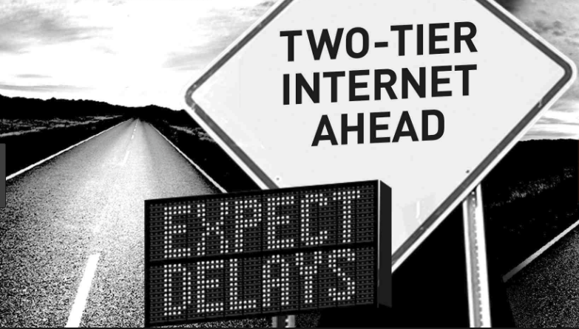
Verizon Lawyer at FCC
Ajit Pai appointed Chairman by Trump Jan 2017
Several years serving as attorney for Verizon
Consistently argues against Net Neutrality
Explicitly dismissed value of public comments supporting Net Neutrality
https://www.fcc.gov/about/leadership/ajit-pai
https://ajitvpai.com/

Slide 30
Consolidation – Net Neutrality = Trouble
AT&T permitted to merge w/ Time Warner
Major broadband / wireless provider
Major media company
Comcast now bidding to buy 21st Century Fox film/TV studios
Experts predict
Higher prices
Fewer choices
Fewer views
AT&T will be able to
Speed access to Time Warner materials
Slow down access to competing media providers

Slide 31
Resistance
ACLU
Center for Digital Democracy
Common Cause
Consumers Union
EFF
Global Net Neutrality Coalition
Net Neutrality Activists’ Campaign
Teletruth
http://www.pbs.org/moyers/moyersonamerica/net/sites.html

Slide 32
For Further Reading
Kabay, M. E. (2010). “Who’s responsible in the battle for Internet freedom.” Network World Security Strategies. https://www.networkworld.com/article/2205395/security/ who-s-responsible-in-the-battle-for-internet-freedom.html
Sankin, A. (2014). “The 6 worst net neutrality violations in history.” The Daily Dot. https://www.dailydot.com/layer8/net-neutrality-violations-history/
Brodkin, J. (2017). “FCC explains why public support for net neutrality won’t stop repeal.” Ars Technica. https://arstechnica.com/tech-policy/2017/11/why-the-fcc-ignored-public-opinion-in-its-push-to-kill-net-neutrality/
Reardon, M. (2018). “Why net neutrality supporters are cringing at the AT&T-Time Warner merger.” c|net. https://www.cnet.com/news/why-net-neutrality-supporters-are-cringing-at-the-at-t-time-warner-merger/

Slide 33
Now go and study
These notes are available as PPTX and PDF files online at
< http://www.mekabay.com/courses/academic/norwich/cs407/cs407_lectures/index.htm > or use the abbreviation: < http://tinyurl.com/ybx2yykx >.

