Slide 1
Politics of Cyberspace @ JCOGS Disintermediation & Intermediation
M. E. Kabay, PhD, CISSP-ISSMP
Professor of Computer Information Systems
School of Business & Management
College of Professional Schools
Norwich University

Slide 2
Topics
Definitions
Examples of Intermediated Communications
Disintermediated Communications
Re-Intermediation
Discussion
For Further Reading
Note on Sources:
Much of the historical information used in these notes is based on encyclopedia entries using Encarta & Wikipedia.

Slide 3
Definitions (1)
Intermediation = insertion of control between creator & recipient
Business
Wholesalers
Retailers
Information gate-keepers
Book/newspaper/magazine owners, publishers, editors
Broadcasting owners, producers
Commercial Websites, social-media providers, Internet service providers w/out Net Neutrality protections

Slide 4
Definitions (2)
Disintermediation = Removal of intermediaries
Business:
“Elimination of intermediaries such as wholesalers or retailers in business transactions between producers and consumer”
Information:
“Reducing gate-keepers in the flow of information from provider to user”
E.g., flyers v newspapers
Internet social media v broadcasters

Slide 5
Definitions (3)
Cardinality
Numerical relationship among factors
Can be denoted as factor1:factor2::m:n
M elements to N relations
E.g.,
Monogamy → 1:1 cardinality of partners:relationship
Polygamy → n:n cardinality of partners:relationship
String quartet → 4:1::musicians:group
Recipes → m:n::components:recipes
Communications can be 1:1, 1:n, & m:n

Slide 6
Definitions (4)
Nymity
Linking identifiers in communication to real entity
Anonymity: no connection, no stability
E.g., anonymous posters without attribution
Pseudonymity: no connection, stability
E.g., “Publius” (Federalist Papers) actually James Madison, Alexander Hamilton, and John Jay
Identity: connection, stability
E.g., how we identify ourselves in normal life
“M. E. Kabay” only way author labels his publications

Slide 7
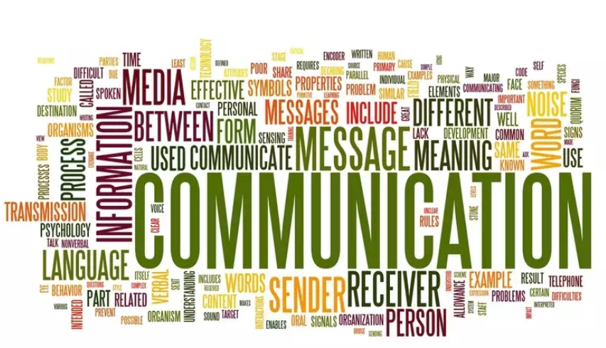
Examples of Intermediated Communications
Torah
Tanakh
Bible(s)
Catholic Church
Anglican Church
Gutenberg
Libraries
Flyers
Newspapers
Broadcasting
Subscription-Only Media

Slide 8
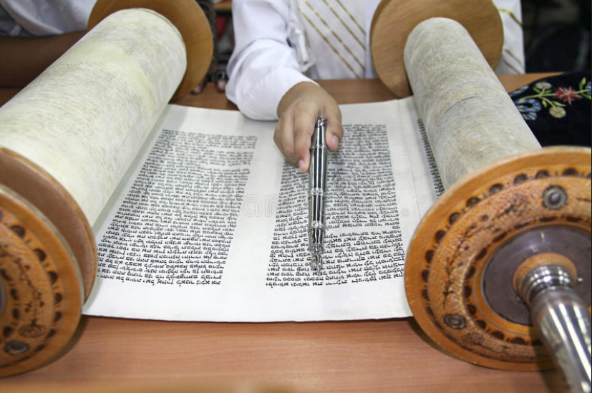
Torah as Intermediated Communication
Orthodox Judaism:
Torah entirely written by Moses
Transmitted only by oral recitation
Writing Torah forbidden
Writing the Torah
~200 CE
Rabbi Judah haNasi compiled Mishnah
Other traditions written as Baraitot (external teaching), Tosefta (laws) & Midrashim (commentaries)
New scrolls (Sefer Torah) copied painstakingly – not one deviation permitted

Slide 9
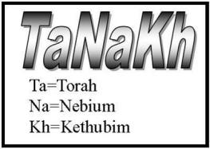
Tanakh as Canon
Debate about when 24 books of the Tanakh (Masoretic Text) were fixed
May have been 140-40 BCE
Or possibly as late as 200 CE
Dead Sea Scrolls
Discovered 1946-7 & later (even 2017)
Dates estimated between ~170 BCE to 230 CE
Noticeable differences from accepted version

Slide 10
Christian Bible(s)
Refer to Tanakh as “Old Testament”
“New Testament”
Started largely in Aramaic
Mostly completed by 120 CE
Official versions defined over centuries
Council of Rome (382)
Councils of Hippo & Carthage (393-419)
Second Council of Trullan (692)
Canons of Florence (1442)
Council of Trent (1545)
Protestants defined own canonical versions
Thirty-Nine Articles (1563) [C. of England]
Westminster Confession of Faith (1647) [Calvinism]

Slide 11
Catholic Church
Nihil obstat = “No impediment”
Censor librorum issues approval
Imprimatur = “Let it be printed”
Bishop and other clerics have authority to approve publication or deny it
Applies to religious topics relevant to Catholicism
Book is free of doctrinal or moral error
Does not imply agreement w/ ideas

Slide 12
Anglican Church
English laws 1586, 1637
Official license required for printing books
1662
Imprimatur required from any of following:
Lord Chancellor
Earl Marshall
Principal Secretary of State
Archbishop of Canterbury
Bishop of London
Expired 1695

Slide 13
Gutenberg
Before printing presses, copies only by hand
Non-moveable printing required carving each page (usually wood)
Gutenberg (~1400-1468)
Invented moveable type
Allowed mass production of printed materials
Effects of wide available of print
Trans-border communications
Ideas challenging status quo
Increase in literacy
Breaking control of power structure

Slide 14
Libraries
Collections of information media
Reference
Borrowing
Physical or digital
History (1)
Sumerian clay tablets with cuneiform (c 2600 BCE)
Papyrus collections of Egypt (c 1900 BCE et seq)
Mesopotamia clay tablets at Nineveh (700 BCE)
Alexandria (Egypt) – Ptolomy dynasty (300 BCE)
Destroyed by fire (48 BCE) & war (270 CE)
Rome: public libraries – (40 BCE et seq) – 28 total

Slide 15
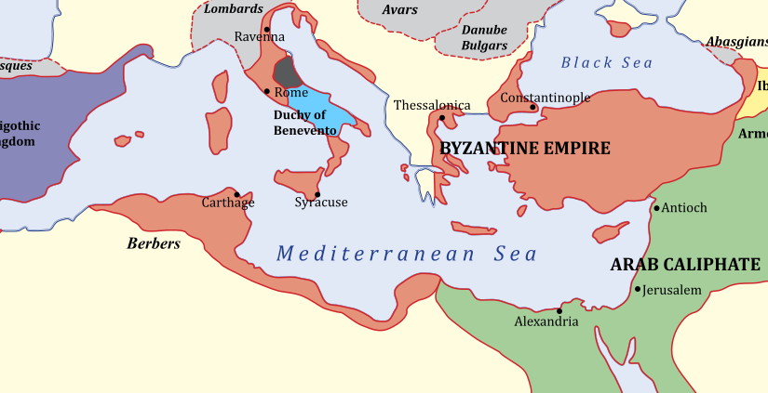
Libraries – History (2)
Byzantium (667 BCE et seq)
Later = Constantinople (~330 CE) / Istanbul
Monastic scriptoria
Monks only
Preserved Christian & also classical Greek texts
Islamic cultures
Baghdad (Iraq) – Houses of Knowledge (900 CE)
Organized books by subject
First catalogs of collections
Southeast Asia
Burma – Pitakataik Library (11th century CE)
Buddhist texts

Slide 16
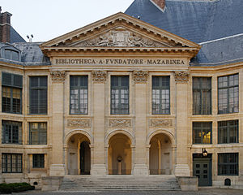
Libraries – History (3)
Europe
15th & 16th centuries CE: Italy built many libraries
17th & 18th centuries CE: “Golden Age of Libraries”
Bibliothèque Mazarine
Founded 1368
Expanded greatly 1692
Grew to 300,000 in French Revolution (took books from aristocrats’ collections)
British Museum (1753) – 1st national library
19th century CE
Limited public libraries
Commercial lending libraries flourished

Slide 17
Libraries – History (4)
England & Scotland
Public Libraries Act (1850)
Establish free local public libraries
Salford Museum & Art Gallery (1850)
Education Act (1870)
Increased literacy
300 libraries in UK by 1900
United States
American School [Traveling] Library (1839)
American Library Assoc (1876)
Dewey Decimal System (1876)
Carnegie Library Endowment (1883-1929): >2,000 public libraries

Slide 18
Flyers
=“Leaflets,” “circulars,” “handbills”, “pamphlets”….
Various sizes but usually single page
Invented after printing press
Enormously popular in 15th – 16th centuries CE
Especially for politics
Occasionally banned by rulers
Also fiction, criticism….
Used during time of English Civil Wars (1642-1651 CE)
Important during & after American Revolutionary War
Thomas Paine, Federalist Papers….
French Revolution (1787-1799)
Voltaire, Rousseau, Montesquieu, Diderot….

Slide 19
Newspapers (1)
Regularly published w/ news, views, etc
Early 17th century
Germany, Italy, Netherlands, England
England
1st daily: Daily Courant (1702-1735)
The Times (1785)
The Observer (1791)
France
1st daily: Journal de Paris (1771)
Journal des Débats (1789)

Slide 20
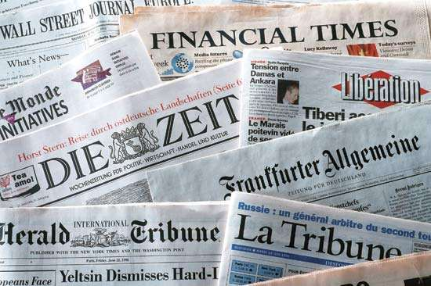
Newspapers (2)
United States
Publick Occurrences Both Forreign and Domestick (Boston 1690) – suppressed by governor
Boston News-letter (1704) -- weekly
Boston Gazette (1719)
New-England Courant (1721)
New York City Sun (1833)
New York Herald (1835)
New York Tribune (1841)
New York Times (1851)
Associated Press (1848)
Alternative press (e.g., Village Voice) mid-20th century

Slide 21
Broadcasting (1)
Radio in USA
1st: 1906-12-24 –
Reginal Aubrey Fessenden
Brant Rock, MA
2 pieces of music, 1 poem, & short talk
Expanded after WWI
KDKA Pittsburgh, PA – 1920-11-02
Broadcast results of Harding/Cox presidential election
564 new stations licensed by 1922-11-01
Radio Act (1927) → FCC to regulate airwaves

Slide 22
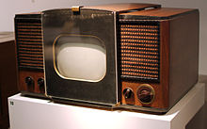
Broadcasting (2)
Television in USA
New York World’s Fair (1939-04-30)
NBC demonstrated TV (2 hrs/wk)
CBS started 1939
23 TV stations established by mid-1940s
Rapid growth in distribution of TV sets
1949: 1,000,000 receivers
1951: 10,000,000
1959: 50,000,000

Slide 23
Broadcasting (3)
US Federal Communications Commission (FCC)
Regulates technical aspects
Frequencies
Equipment
Limited restrictions on content in broadcast media
Defamation
Obscenity
“Seven Words You Can Never Say on Television”
George Carlin, 1972 < http://tinyurl.com/clhmuvc >

Slide 24
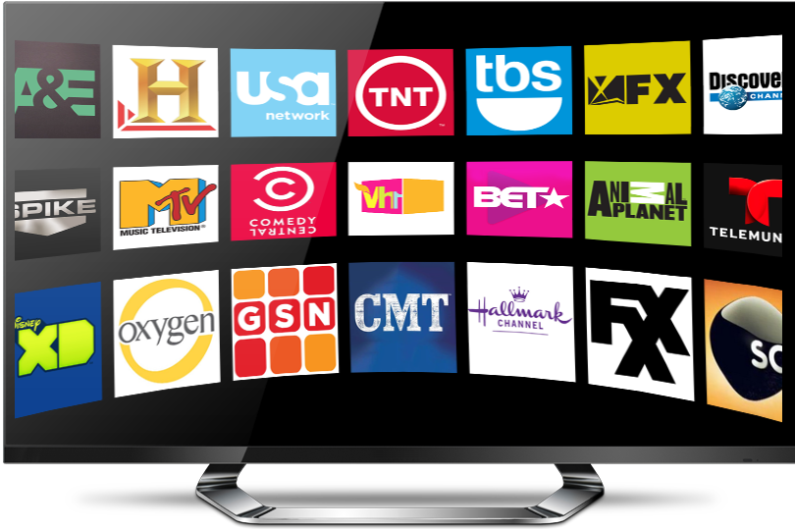
Subscription-Only Media
Cable TV
NOT broadcasting
Coaxial or fiber-optic cables
Many specialized services
Much less government regulation than broadcasting
Satellite Radio
E.g., XM Satellite Radio (2001) & Sirius Satellite Radio (2002) became Sirius XM Radio (2008)
100s of specialized channels
FCC rules

Slide 25
Disintermediated Communications
Internet
Web
Email
Mobile Phones
Text Messaging
Social Media
Abuses of Disintermediation

Slide 26
Internet (1)
ARPANET (Advanced Research Projects Agency Network)
DARPA (US Defense Advanced Research Projects Agency)
Started 1966, operational 1975
Restricted to US Government agencies & projects
Opened to more general use 1981
Foundation of today’s Internet
Switched to TCP/IP (Transmission Control Protocol / Internet Protocol) in 1982
IPv4 allows 2³² (4x10⁹) unique computers
Already approaching maximum
IPv6 allows 2¹²⁸ (3x10³⁸) addresses

Slide 27
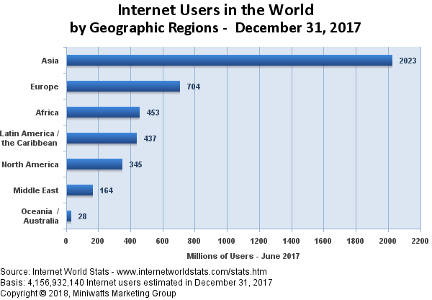
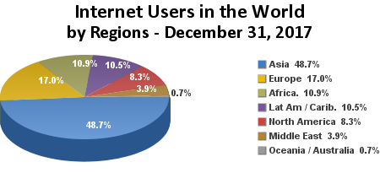
Internet (2)
TOTAL USERS:
4,154 MILLION

Slide 28
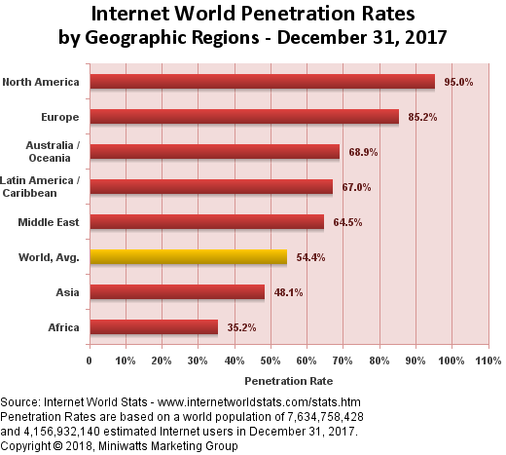
Internet (3)

Slide 29
Web (1)
Particular way of accessing information via Internet
NOT the entire Internet – many other applications of the ‘Net
HyperText: document with integrated links to other parts or other documents
HTML (HyperText Markup Language)
Standard way of formatting information on Web pages
Invented by Tim Berners-Lee (physicist) in 1990
Works with browsers that interpret codes in documents to produce specific appearance of page
HTTP (HyperText Transmission Protocol) -- 1989
Defines the World Wide Web

Slide 30
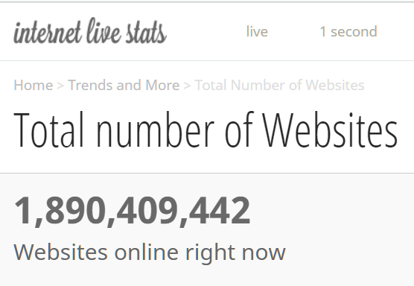
Web (2)
http://tinyurl.com/mc3t7kd

Slide 31
Email (1)
Sending messages through computer networks
Started 1960s
Standards began 1973 (RFC 561)
RFC = Request for Comment
Managed by IETF
Internet Engineering Task Force
Voluntary contributions
Statistics (estimates)
~269 billion messages/day (Feb 2017)
~3.8 billion email users (2018)

Slide 32
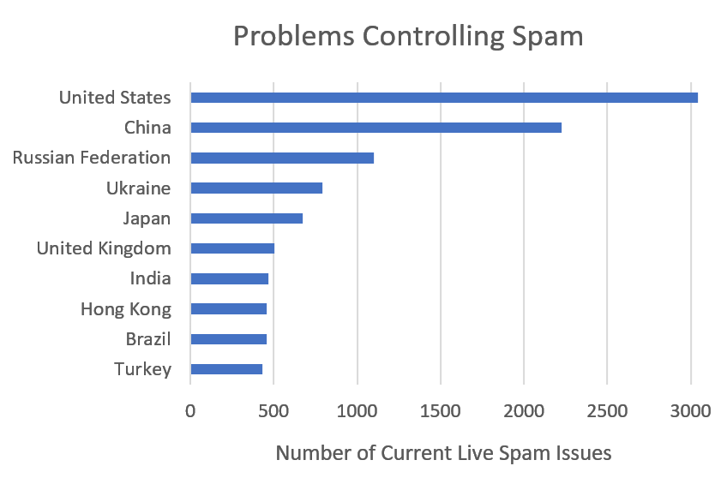
Email (2)
Spam = unsolicited commercial email
Name thought to be based on SPAM skit from Monty Python < https://www.youtube.com/watch?v=anwy2MPT5RE >
In March 2018, ~48% all email was spam < https://www.statista.com/statistics/420391/spam-email-traffic-share/ >
Many governments are not enforcing anti-spam laws
https://www.spamhaus.org/statistics/countries/

Slide 33
Email (4)
Email does not guarantee authenticity of sender
Users can have unlimited number of email accounts
Spammers often generate new numbered accounts for one-time use
E.g., suzy1234@hotmail.com, suzy1235@hotmail.com....
Also used by stalkers
Possible to track origin of email using forensic analysis techniques to locate computer
May be difficult to prove who sent message if computer used by several people

Slide 34
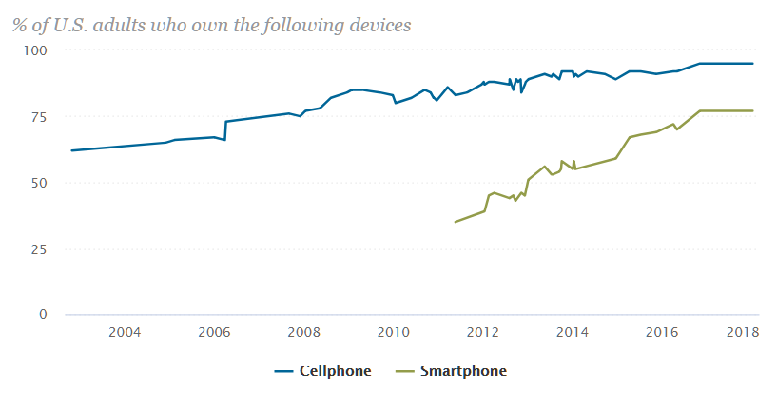
Mobile Phones (1)
Rapid growth in mobile-phone ownership
Regular mobiles offer tracking of owner
But discardable pay-phones difficult to trace

Slide 35
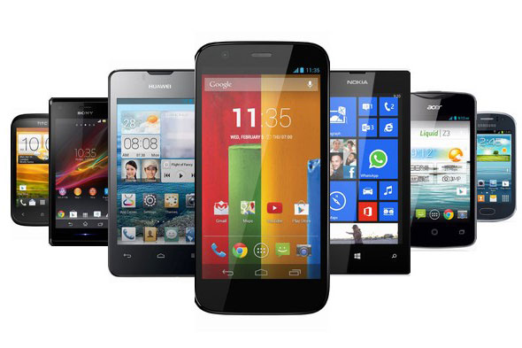
Mobile Phones (2)
Smart phones have Internet access
Include cameras
Still
Movie
Sound recorders
Apps available free
Allow rapid personal communications
Call
Text
Social media
Difficult for authoritarian regimes to control
E.g., Arab Spring (2010) – Tunisia, Libya, Egypt, Yemen, Syria, Bahrain

Slide 36
Text Messaging
SMS (Short Message Service)
Initiated 1985 in Global System for Mobile Communications (GSM) standards
Mostly mobile-to-mobile
Immensely popular
16 million/minute
23 billion/day
8 trillion/year
Can define groups
Organize protests
Flash crowds
Sexting significant problem for teenagers
https://teckst.com/19-text-messaging-stats-that-will-blow-your-mind/

Slide 37
Social Media (1)
Computer-mediated communications
Share information (cardinality m:n)
1 individual’s post may be seen by many
Postings may be reposted, extending availability
Virtual communities
Nymity
Anonymity tolerated in some (not all)
Pseudonymity difficult to detect/stop
Authentic identification common in most
Intermediation varies
Some completely disintermediated
Others controlled to varying degrees

Slide 38
Social Media (2)
CompuServe (1969)
USENET (1980s)
America Online = AOL (1985)
LinkedIn (2002)
MySpace (2003)
Baidu Tieba (2003) – China
Facebook (2004)
Wikia (2004)
Twitter (2006)
VK (2006) – Russia
Tumblr (2007)
Sina Weibo (2009) – China
WhatsApp (2009)
Instagram (2010)
Pinterest (2010)
Viber (2010) – Japan
Snapchat (2011)
Google+ (2011)
WeChat (2011) – China

Slide 39
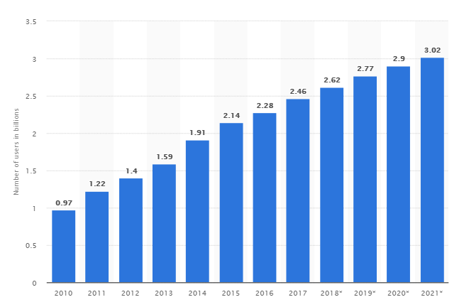
Social Media (3)
Number of social media users worldwide from 2010 to 2021 (billions)
https://www.statista.com/statistics/278414/number-of-worldwide-social-network-users/

Slide 40
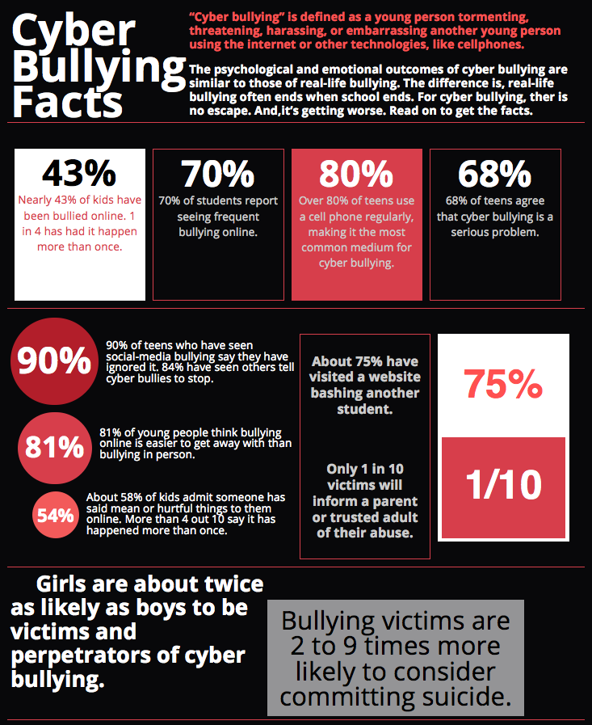
Abuses of Disintermediation
Harassment
Pornography
Hate Speech
Disinformation

Slide 41
Harassment
Cyberbullying: general term for online intimidation
Cyberstalking – follow victim, threaten
Trolling – provoke reactions online
Doxing – publishing private information online
Swatting – calling police w/ false warning of violence in progress
Revenge Porn – posting embarrassing pictures (usually nude or nearly so) of victim

Slide 42
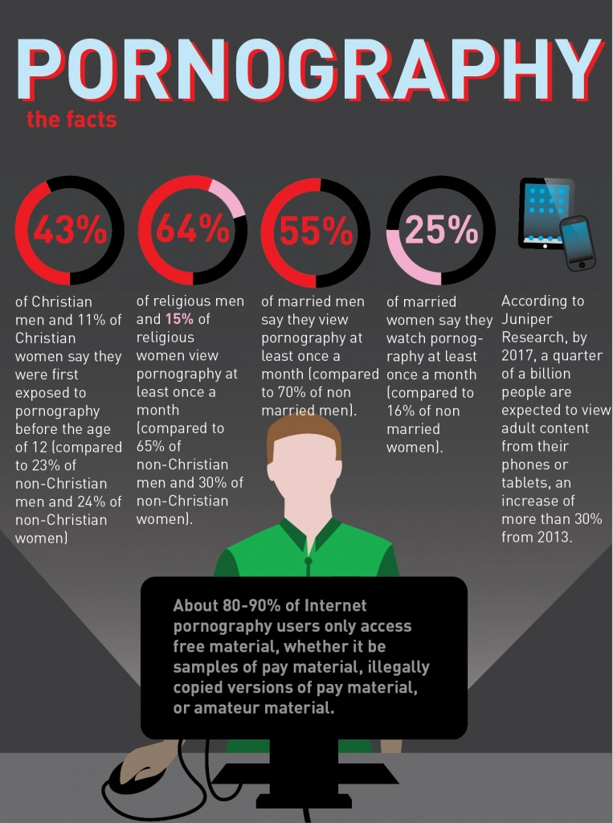
Pornography
Posting sexual imagery or text
Specifically aimed at sexual arousal
Wide range of social norms worldwide
Some cultures extremely restrictive
Others permissive
US law distinguishes between pornography & obscenity (“highly offensive”)
1st Amendment does not protect obscenity
Pornography not consistently under law
Child pornography illegal worldwide (almost all countries)

Slide 43
Hate Speech
Attacking person or group based on disability, ethnic origin, gender, gender identity, national origin, race, religion, sexual orientation
Generally illegal for specific issues worldwide
E.g., Holocaust denial illegal in EU, Australia, Israel, Russia
But protected by US 1st Amendment
Rampant online
Some groups use correct identification of authors
Others allow pseudonymity & anonymity

Slide 44
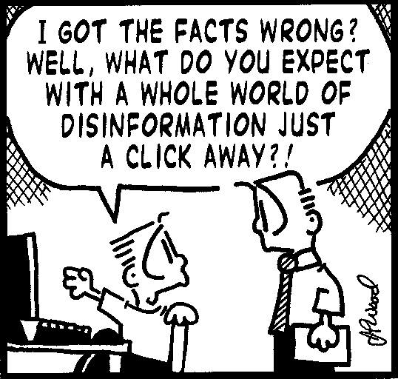
Disinformation (1)
Spreading false information deliberately to alter public opinion = DISINFO
Widely used by totalitarian regimes
Russia formally defined office 1923
Major sources of DISINFO
Crackpots (e.g., Flat Earth Society)
Exploiters for gain (e.g., INFOWARS)
Political parties
Online resources exacerbate problem
Gullible victims may share/spread DISINFO
Easy to create false sources (e.g., bots) to spread lies

Slide 45
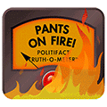
Disinformation (2)
SNOPES.COM
Major resource
Analyze misinformation (wrong by mistake)
Explode DISINFO
POLITIFACT.COM
Awarded Pulitzer Prize (2009)
Focused on political speech
Truth-O-Meter (Pants On Fire)

Slide 46
Re-Intermediation
Social Media Changing Rules
Legal Liability for Intermediation
Censorship
Denial of Service

Slide 47
Social Media Changing Rules
August 2017
Internet firms begin banning white supremacists
April 2018
Facebook removes >100 accounts linked to Russian troll factory
Facebook releases content moderation guidelines
May 2018
German government increases Facebook restrictions on hate speech
June 2018
Activists in Myanmar demand Facebook do more to quell hate speech
Twitter accidentally bans mosquito death threat
Facebook begins labeling news as politics

Slide 48
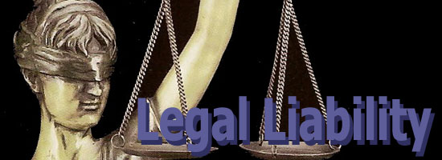
Legal Liability for Intermediation
Cubby v CompuServe (1991)
Stratton Oakmont v Prodigy (1995)
Blumenthal v Drudge & AOL (1998)

Slide 49
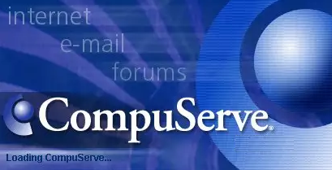
Cubby v CompuServe (1991) [1]
CompuServe
Provided thousands of discussion groups
Disclaimed all responsibility for content posted by users
System operators (SYSOPS) governed their own discussion groups (forums)
Journalism Forum
Established by Cameron Communications
Rumorville = newsletter in Journalism Forum
Created by Don Fitzpatrick Associates
Published nasty comments about Skuttlebut newsletter (from Cubby Inc. & Robert Blanchard)

Slide 50
Cubby v CompuServe (1991) [2]
Cubby & Blanchard sued for libel
Included Cameron, Fitzpatrick & CompuServe
US District Court, Southern District of NY ruling
Neither Cameron nor Fitzpatrick agents of CompuServe
CompuServe simply provided communications service
Key finding summarized:
Because CompuServe did not interfere with content in any forums, the provider had no legal liability for that content.

Slide 51
Stratton Oakmont v Prodigy (1995)
Prodigy provided bulletin boards
MoneyTalk board run by Charles Epstein
Posted anonymous claims
Stratton Oakmont & president Daniel Porus involved in criminal fraud
Stratton Oakmont sued Prodigy & poster for libel
Supreme Court, Nassau County, NY ruling (May 1995)
Prodigy advertised its editorial control over content
Therefore this provider was responsible for libel

Slide 52
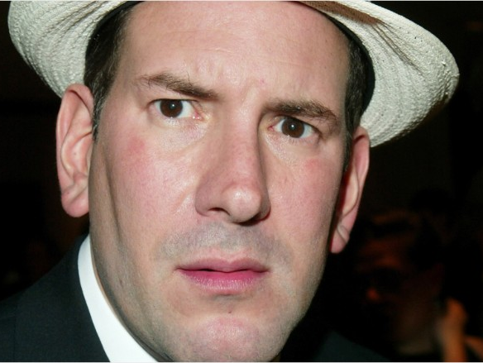
Blumenthal v Drudge (1998)
AOL Drudge Report on AOL
Aug 1997 – Matt Drudge posted rumors
Claimed Sidney Blumenthal abused his wife
Bluementhal sued Drudge & AOL for libel
District Court for District of Columbia
AOL not responsible for Drudge libel
Cited Communications Decency Act of 1996 )47 USC 230 §230)
Indemnified ISPs against liability for user content
Thus effectively granted common-carrier status to ISPs

Slide 53
Censorship
Government controls over information
July 2017
Apple accused of removing apps used to evade Chinese censorship
August 2017
“Stop Enabling Sex Traffickers Act (SESTA)” would have penalized anyone or service for content
May 2018
Papua New Guinea bans Facebook for a month
Peppa Pig censored by Chinese government
June 2018
China censors the Net using too much information
China blocks HBO after John Oliver mocks Xi Jinping
July 2018
ACLU files suit against Trump for blocking Twitter users on POTUS Twitter feed

Slide 54
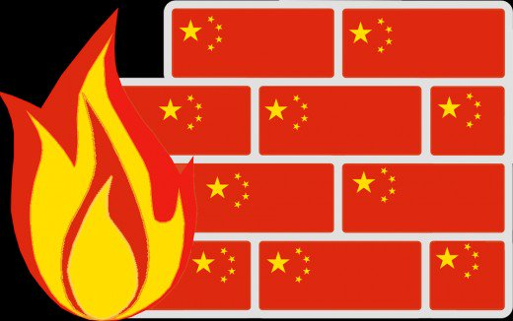
Denial of Service
1997 – Great Firewall of China
Aims (from Wikipedia article):
30,000-50,000 police involved in monitoring
Block inbound/outbound communications & access to international Web
June 2018 – Algeria blocks Internet to prevent students cheating during exams
See “Internet Society Perspectives on Internet Content Blocking: An Overview”
https://www.internetsociety.org/resources/doc/2017/internet-content-blocking/

Slide 55
Discussion (YOUR turn!)

Slide 56
For Further Reading
Kabay, M. E. (2007). “Critical Thinking and Disintermediation.” https://tinyurl.com/yamduxkk
Kabay, M. E. (2009). “Iran, Disintermediation, and Cyberwar.” https://tinyurl.com/y8zqq44t
Hedges, C. (2010). “The Information Super-Sewer.” http://tinyurl.com/y99ex9wa
Kabay, M. E. (2011). “Disintermediation Affects Reputation.” https://tinyurl.com/ya5xnhhb
Kabay, M. E. (2018). “Disintermediation” reading list. http://tinyurl.com/ycre8cll

Slide 57
Now go and study
These notes are available as PPTX and PDF files online at
< http://www.mekabay.com/courses/academic/norwich/cs407/cs407_lectures/index.htm > or use the abbreviation: < http://tinyurl.com/ybx2yykx >.

