Slide 1
Politics of Cyberspace @ JCOGS Robotics
M. E. Kabay, PhD, CISSP-ISSMP
Professor of Computer Information Systems
School of Business & Management
College of Professional Schools
Norwich University

Slide 2
Topics
Definitions
Robots in Literature
Robots in Movies
Robots in Industry
Robots & War
Robots & Eldercare
Robots & Sex
For Further Reading

Slide 3
Definitions
A robot is defined as
“a device that automatically performs complicated often repetitive tasks”
Origin: Czech robota: compulsory labor
An android is
“a machine that looks like a human being and performs various complex acts (as walking or talking) of a human being”

Slide 4
Robots in Literature (1)
First published in Karel Čapek’s play, “R.U.R.: Rossum's Universal Robots” (1921)
Robots start off as smart labor
Eventually dominate humanity

Slide 5
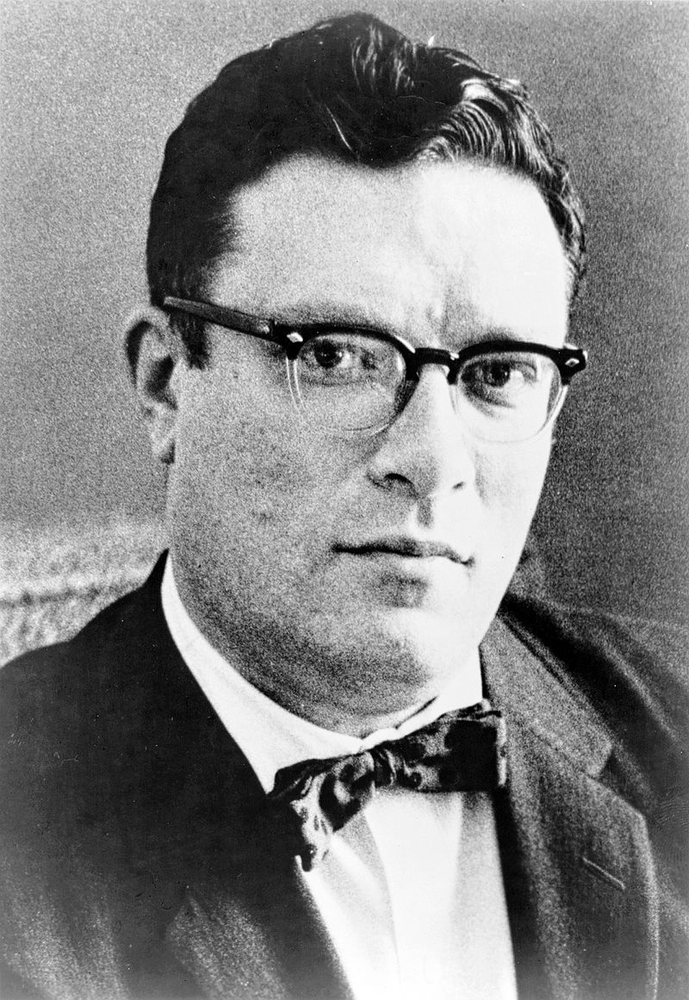
Robots in Literature (2)
Isaac Asimov (1920-1982)
I, Robot (1950)
The Rest of the Robots (1964)
The Complete Robot (1982)
Robot Dreams (1986*)
Robot Visions (1990*)
_____________
*Posthumous

Slide 6
Asimov’s Three Laws of Robotics
A robot may not injure a human being or, through inaction, allow a human being to come to harm.
A robot must obey the orders given it by human beings except where such orders would conflict with the First Law.
A robot must protect its own existence as long as such protection does not conflict with the First or Second Laws.

Slide 7
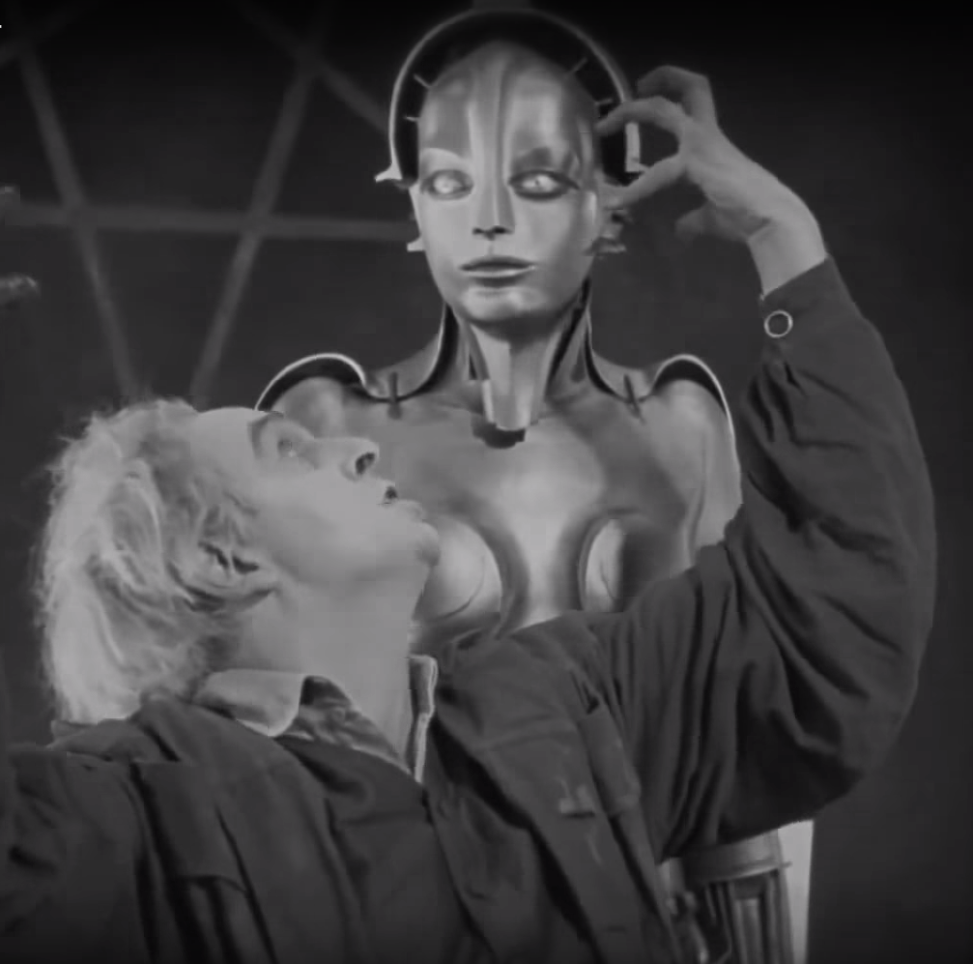
Robots in Movies (1)
Metropolis (1927)
http://tinyurl.com/ycsvdybn

Slide 8
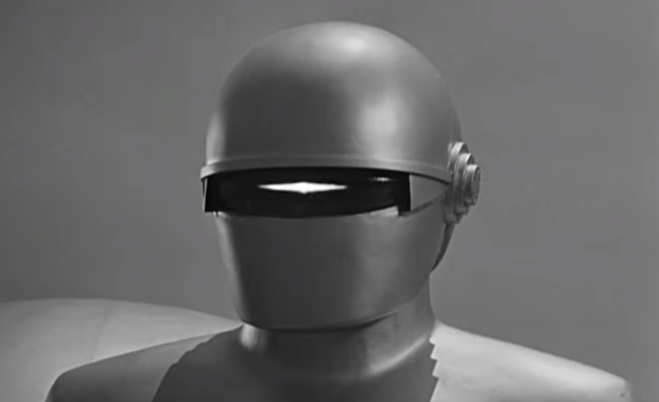
Robots in Movies (2)
The Day the Earth Stood Still (1951)
http://tinyurl.com/y7no4rb7

Slide 9
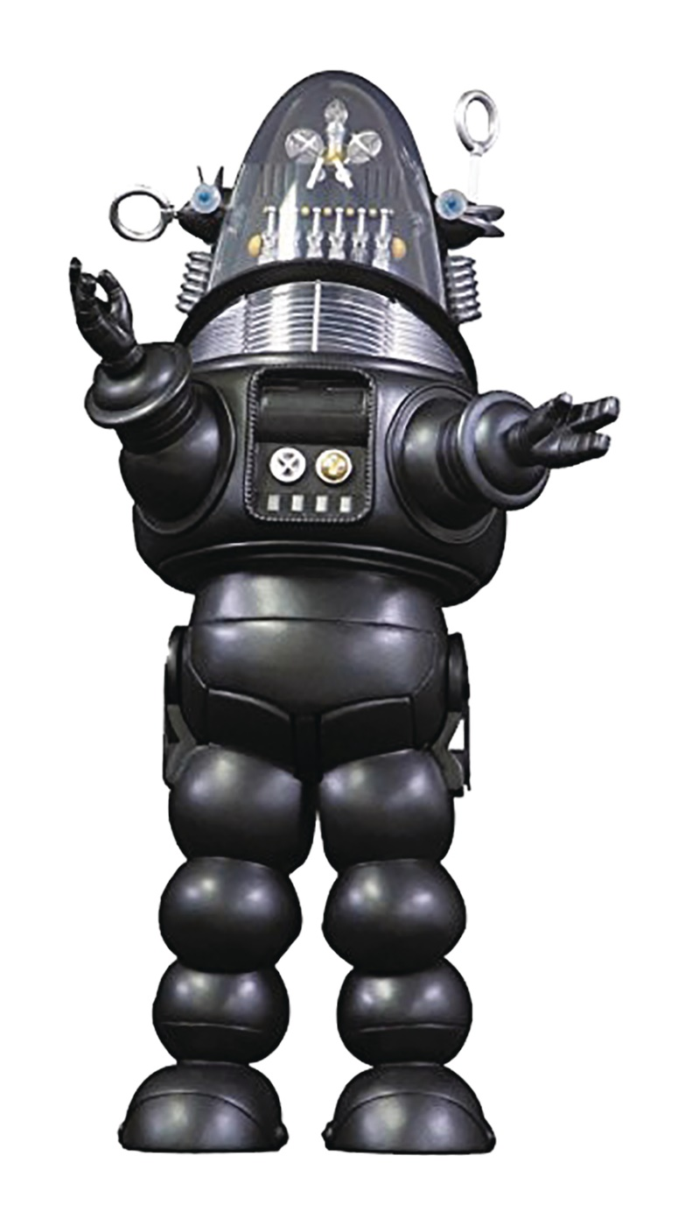
Robots in Movies (3)
Forbidden Planet (1956)
Trailer (1:33) http://tinyurl.com/mqpcrla

Slide 10
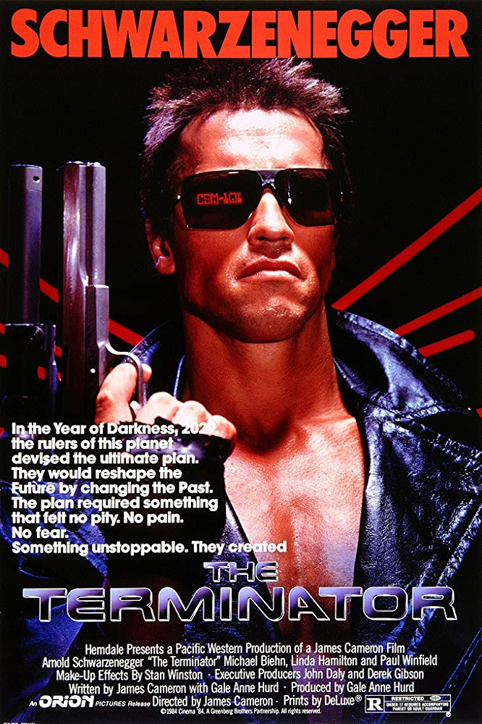
Robots in Movies (4)
Terminator series (1984 ff)
Robots have taken over the world by 2029
Skynet sends back assassin androids
Trailer from 2015 film
http://tinyurl.com/n92gu6o

Slide 11
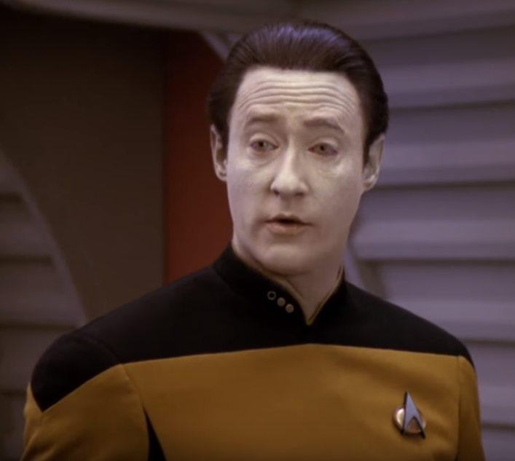
Robots in Movies (5)
Commander Data from Star Trek Next Generation (1987)
http://tinyurl.com/y7q2ldpt

Slide 12
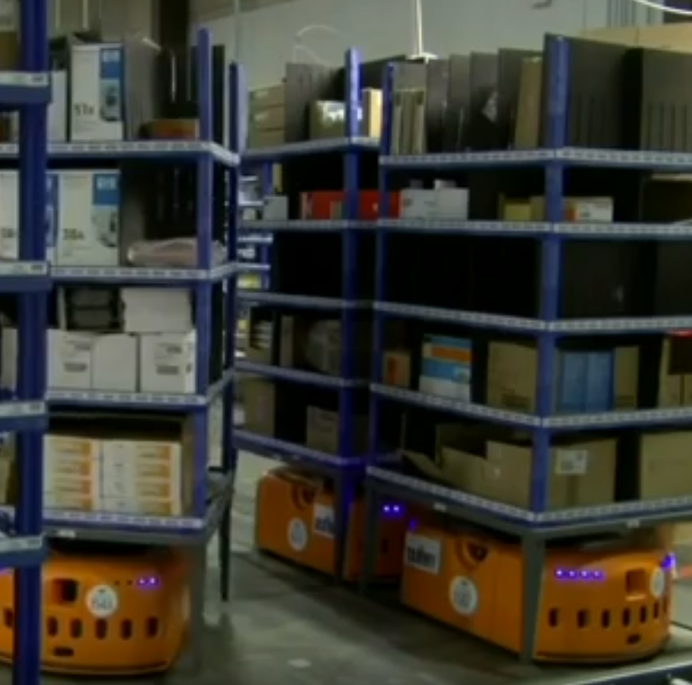
Robots in Industry (1)
What happens inside those massive warehouses? TEDxBoston 2011
Abstract: We make millions of online purchases daily, but who (or what) actually puts our items into packages? In this talk, Mick Mountz weaves a fascinating, surprisingly robot-filled tale of what happens inside a warehouse.
http://tinyurl.com/y97x42x5

Slide 13
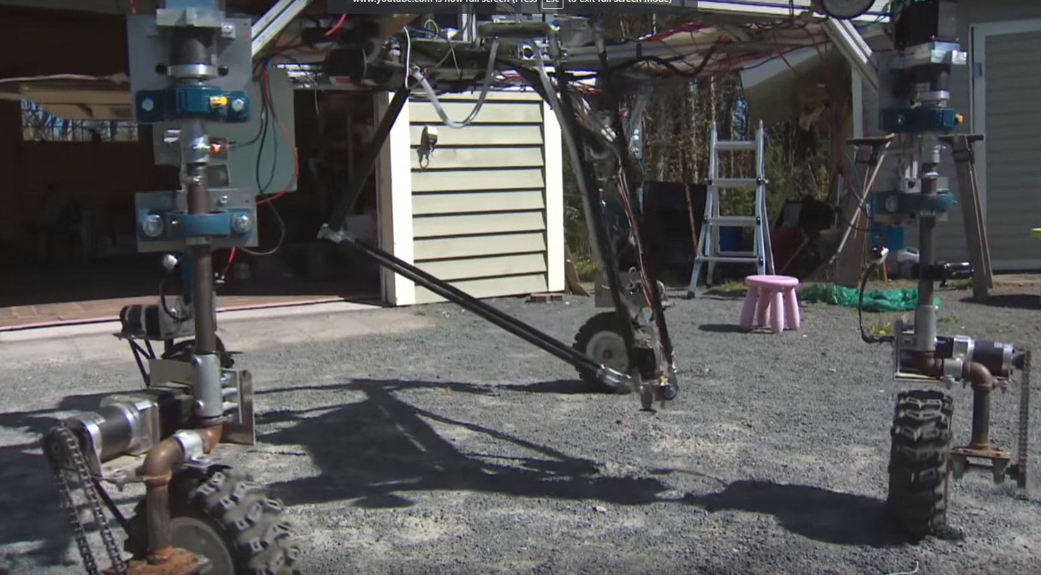
Robots in Industry (2)
Weed-picking robot takes top prize at robotic farming competition
CBC (2018)
http://tinyurl.com/y8xn5ozl

Slide 14
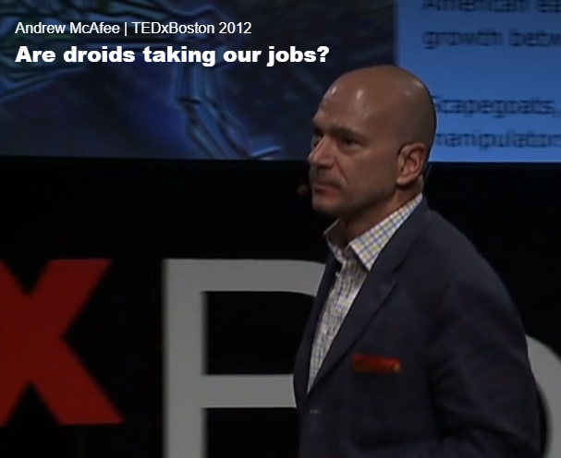
Robots in Industry (3)
Are droids taking our jobs?
TedXBoston (2012)
Abstract: Robots and algorithms are getting good at jobs like building cars, writing articles, translating – jobs that once required a human. So what will we humans do for work? Andrew McAfee walks through recent labor data to say: We ain't seen nothing yet. But then he steps back to look at big history, and comes up with a surprising view of what comes next.
http://tinyurl.com/kpl2ctt

Slide 15
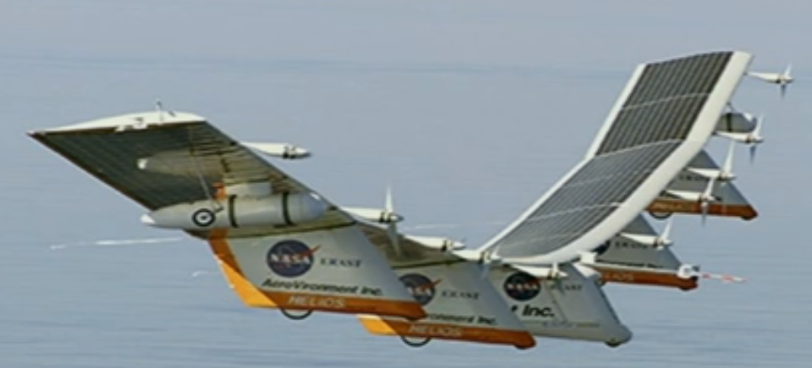
Robots & War (1)
Military robots and the future of war
TED2009
Abstract: In this powerful talk, P.W. Singer shows how the widespread use of robots in war is changing the realities of combat. He shows us scenarios straight out of science fiction -- that now may not be so fictitious.
http://tinyurl.com/ydgtb2g4

Slide 16
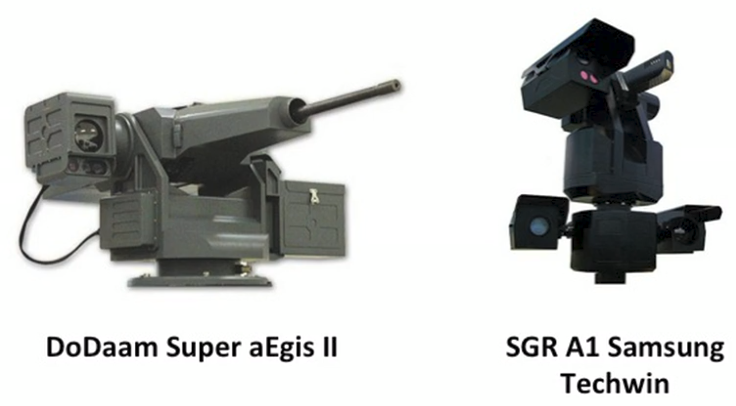
Robots & War (2)
The kill decision shouldn’t belong to a robot
TEDGlobal 2013
http://tinyurl.com/yczlcqex

Slide 17
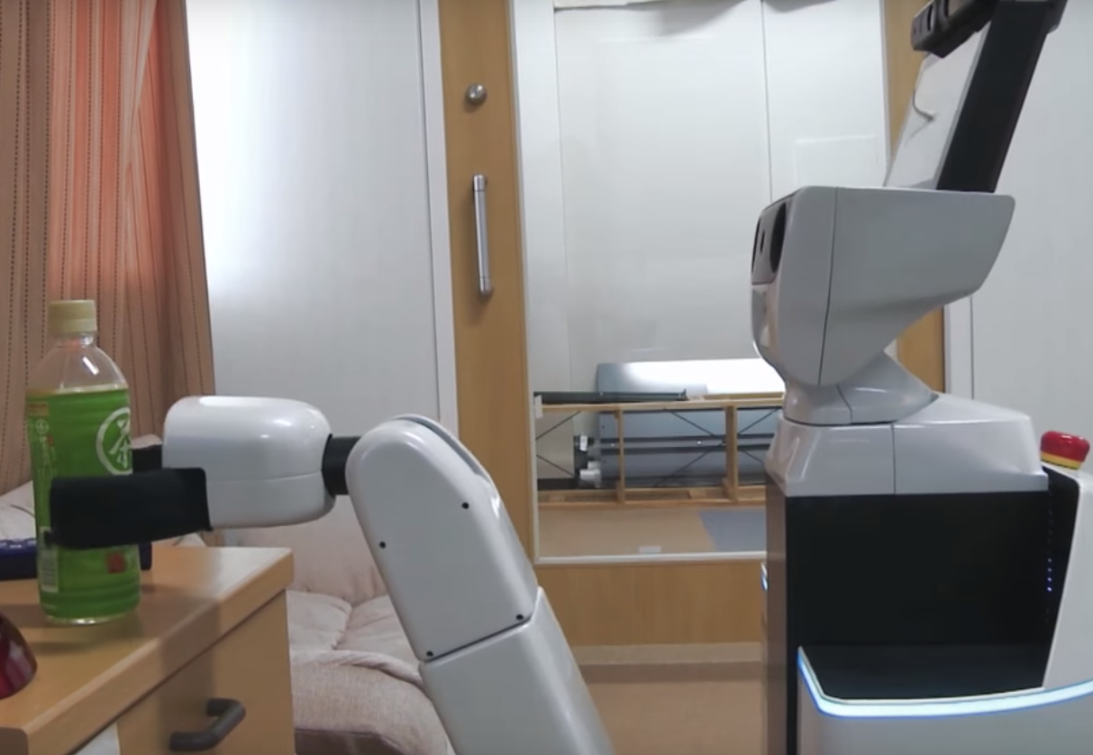
Robots & Eldercare (1)
The soft side of robots: elderly care
Financial Times (2016)
http://tinyurl.com/ya7z7pow

Slide 18
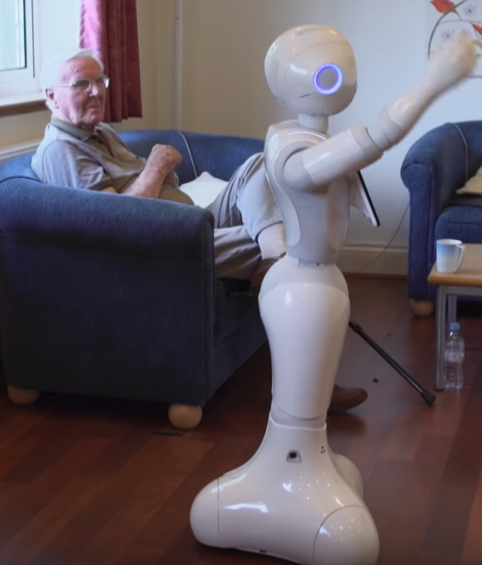
Robots & Eldercare (2)
Can robots take care of the elderly?
BBC (2017)
http://tinyurl.com/y6umcvht

Slide 19
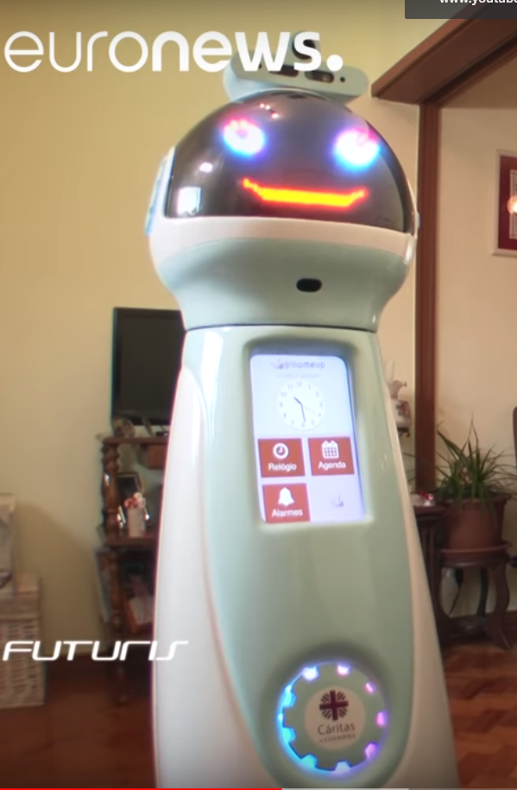
Robots & Eldercare (3)
How robots can enhance the lives of Europe's elderly citizens
Euronews Knowledge (2017)
http://tinyurl.com/y9975tvy

Slide 20
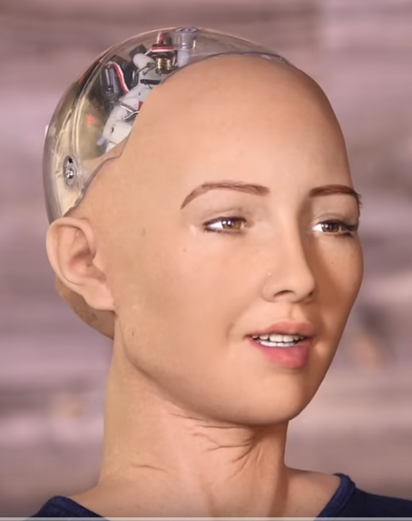
Robots & Sex (1)
Hot Robot At SXSW Says She Wants To Destroy Humans
CNBC (2016)
Abstract: Robotics is finally reaching the mainstream and androids – humanlike robots – are everywhere at SXSW Experts believe humanlike robots are the key to smoothing communication between humans and computers, and realizing a dream of compassionate robots that help invent the future of life.
http://tinyurl.com/zrueeu8

Slide 21
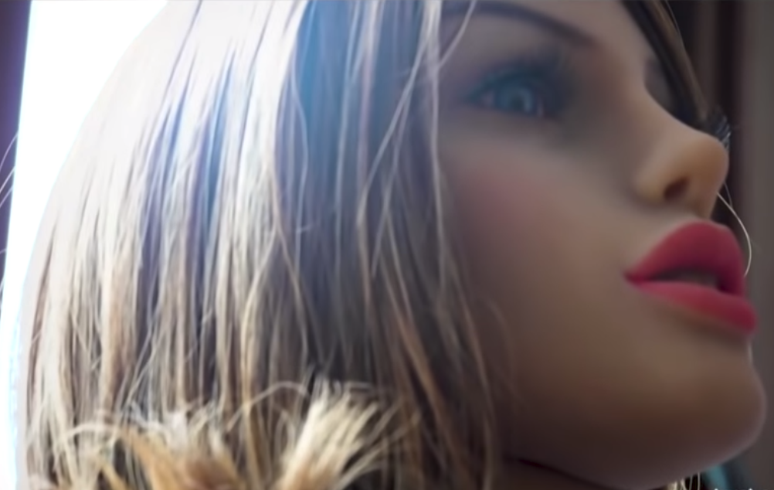
Robots & Sex (2)
Stephen Colbert's Cyborgasm: Intelligent Sex Robots Edition (2018)
http://tinyurl.com/y87hxa8p

Slide 22
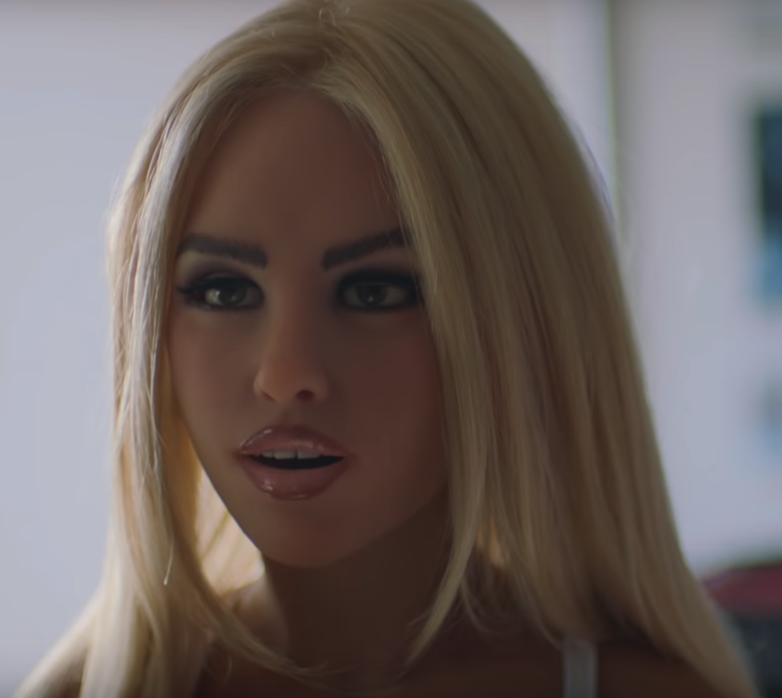
Robots & Sex (3)
Meet Harmony the Sex Robot
VICELAND (2018)
http://tinyurl.com/yarv3efv

Slide 23
Robots & Sex (4)
Sex robot brothel planned for Houston and some people aren't happy
ABC13 Houston
http://tinyurl.com/yb4phut7

Slide 24
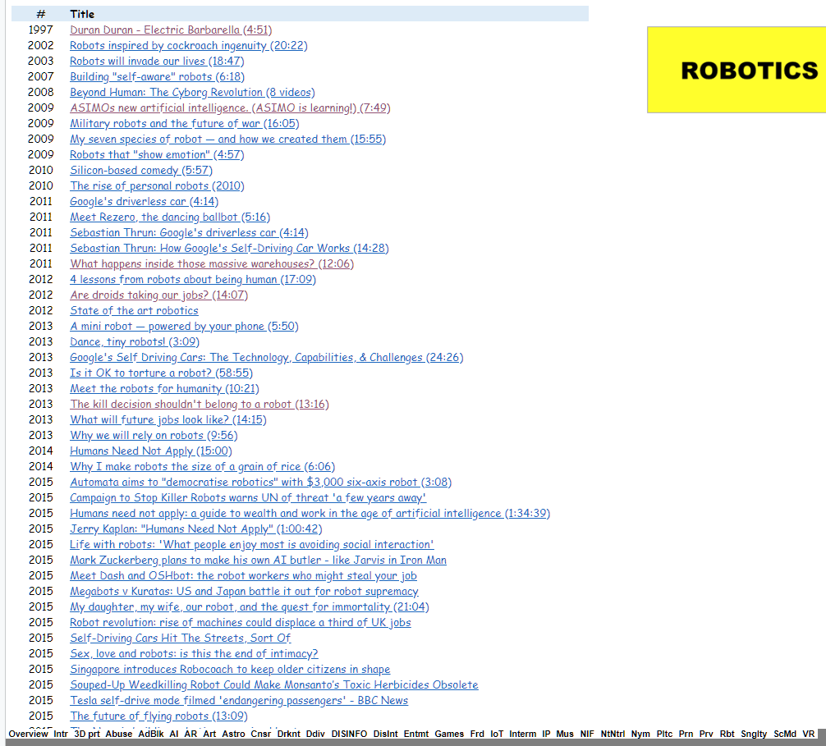
For Further Reading
CS407 Weekly Resources – click RBT page
http://tinyurl.com/yc5fckud

Slide 25
Now go and study.

