Slide 1
Introduction
IS 342 – Management of Information Assurance
Introduction to the Course
M. E. Kabay, PhD, CISSP-ISSMP
Assoc Prof Information Assurance
School of Business & Management
Norwich University
mkabay@norwich.edu
Notes:
M. E. Kabay, PhD, CISSP

Slide 2
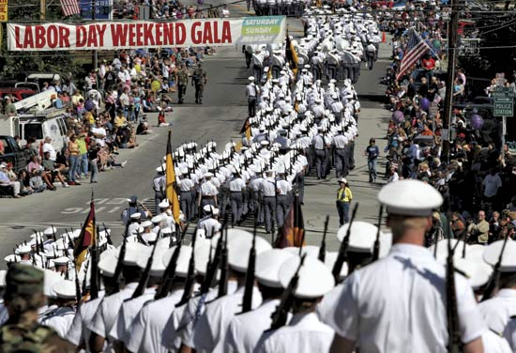
Topics
Goals
Classes
Textbook
Web Site
Grading
Term paper
Research
Citations
Presentation
Exams
Online Discussions
Extra Work
Honesty & Attendance
SQ3R
Readings for next class

Slide 3
Goals
Lay foundations for working effectively in information assurance (IA) in military, government, business & academia
Contribute to public discussion of laws governing behavior when using computers and networks
Stimulate interest in IA
Lead to successful careers
Help protect employers and nation against computer crime
Have fun in class with challenging ideas & discussions!

Slide 4
Classes
Don't be late for class
  Prof won't be late
  Prof won't make you late
Don't miss class
  Attendance taken at start of class
  >2 unexcused absences = OUT
Read before you arrive
  Questions in class
  Free discussion encouraged

Slide 5
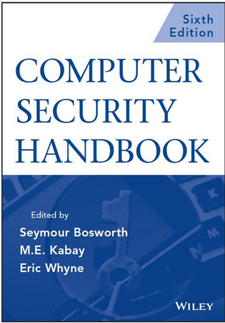
Textbook
Bosworth, Kabay & Whyne (2009)
  CSH5 – Computer Security Handbook,
  5th ed.
  Also useful to build up biceps & triceps
  Can be helpful in propping doors open or to raise monitor to eye level
Eric Whyne
  Graduated from NU in 2004
    Major in Computer Science
    Minors in Mathematics, IA, Engineering
  Served in Iraq as Captain in US Marine Corps
  Currently working in high-tech research

Slide 6
Web Site
http://www.mekabay.com/courses/academic/norwich/is342
All information, documents about course
Lecture materials
Schedule in syllabus
Extra readings
Guidelines for papers
List of topics to be presented by students

Slide 7
Grading
Term project 25%
Presentation 5%
Pre-class Quizzes 5%
Weekly Quizzes 15%
Mid-term Multiple-Choice Exam 10%
Mid-term Memo Exam 10%
Final M/C Exam 20%
Final Memo Exam 10%
Extra points available

Slide 8
Term papers
Features
4,000 ± 500 words
Longer essays not necessary but accepted
Academic standards for writing & sources
See Term-Paper Guidelines
Complete stages BEFORE deadlines for extra points
Topic, outline, draft, final
See syllabus for details of deadlines

Slide 9
Research
Kreitzberg Library Databases
Wikipedia only as source for
primary references
Search-engine articles OK but secondary to academic research articles
May include hands-on projects using virtual laboratory (see instructor for arrangements)
Use CATA™ to organize information
  Computer-Aided Thematic Analysis™
  http://www.mekabay.com/methodology/CATA.pdf
  http://www.mekabay.com/methodology/cata.pps

Slide 10
Citations
MUST cite all information that is not your own creation
Use automatic (NOT MANUAL) footnotes (not endnotes)
WORD has bibliography features
  Will generate Works Cited list for you
MLS, APA or CMS styles acceptable
  Be consistent

Slide 11
Presentation
Time determined by #students
Tell us what you found most interesting
Relax – everyone wants you to succeed
With or without slides
  Min 2 minutes/slide unless you obtain
  special permission by demonstrating
  talk to instructor before class
  Dark letters on light background OR
  light letters on dark background
    Purple letters on blood-red
    background will make instructor
    violently ill ☺
  Slides are point form, not full text
  Don’t read the text on the slides!
  Don’t look at the screen – use the laptop

Slide 12
Exams
No tricks: no attempt to fool you
All exams open-book
Memo exams are realistic situations requiring professional-level responses
Upload responses via NUoodle
Multiple-choice exams delivered through NUoodle

Slide 13
Online Discussions
NUoodle
Accessible through my.norwich.edu
Weekly postings of questions
OPTIONAL
Extra points
  Intelligent, helpful = pts
  Pts for providing
  references
  Added to quiz score
Fun!

Slide 14
Extra Work
Ask prof for approval
Special projects
Anything that helps you
learn
Should be fun!
Can compensate for mistakes in some other area
Can lead a class (max 10% of FINAL GRADE)
  Take charge of one of the class discussions
Can write review articles
  500 words of good writing = 1 pt on quiz score

Slide 15
Honesty & Attendance
All dishonesty will be reported to Academic Integrity Committee
  Cheating in exams
  Interfering with other
  students’ work
  Plagiarism
Permitted no more than 2
unexcused absences
  Arriving after sign-in sheet
  removed = absent
  Notification that 3rd unexcused absence will result in expulsion from course with F grade

Slide 16
The SQ3R Method
Survey
Question
Read
Recite
Review

Slide 17
Background to SQ3R
Effective studying does not consist merely of reading and rereading
Oberlin College studies in 1960s → SQ3R
Retention
Time

Slide 18
SQ3R: Survey
1st pass: entire document
2nd pass: section
3rd pass: chapter
4th pass: 1st sentences
of paragraphs

Slide 19
SQ3R: Question
Jot down ideas
Pictures
Diagrams
Legends

Slide 20
SQ3R: Read
One paragraph at a time
Boldface
Italics

Slide 21
SQ3R: Recite
After every paragraph
Stop, look away
Summarize main ideas
Own words
If not clear, reread

Slide 22
SQ3R: Review
At end of each study period
Daily
Weekly
Monthly

Slide 23
Now go and study

