Slide 1
Disinformation (DISINFO)
IA455 – Contemporary Topics in IA
Lecture # 4 – 2020-09-14
D. M. Zeedick, Ed.D., CISM, CBCP
Professor of Information Security School of Cybersecurity, Data Science & Computing Norwich University
mailto:dzeedick@norwich.edu
Notes:
Class Notes

Slide 2
Topics
Definitions
Case: QAnon
Social Media Spread
Qanon Symbols
Influence
Questions for Consideration
Resource for further review

Slide 3
Definitions
Misinformation
Incorrect information
Thoughts informed by a misinterpretation of the facts
DISINFORMATION
Data intended to deceive
Information intended to guide popular thought away from facts
Purpose is to lead into a state of belief in the seemingly ‘accurate’ reports
A form of misinformation
A form of propaganda

Slide 4
Case: QANON
Far-right wing fringe culture
Initial conspiracy theory is that Donald Trump is conducting a secret war with Satan-worshipping pedophiles and human trafficking
Endgame will punish participants including the guilty Democrats like Hillary Clinton
Established(?) in 2016
Movement gaining more notoriety as 2020 presidential election nears
Why Q? Hints to a “Q” security clearance issued by the US Department of Energy for access to restricted, usually nuclear, classified information.
Prominent Qanon poster’s handle included “Q Clearance”
Qanon members are most likely NOT cleared at all

Slide 5
Social Media Spread
Social media influence and reaction
Facebook has deleted/banned some Qanon content, but not all
Perhaps too many to delete all or find all(?)
News about “the Storm” and “the Awakening” that is coming including the “Deep State” arrests of prominent people not supporting Donald Trump (Comey, Clinton, Obama, military leaders)
Unfounded in truth or facts but believed by members

Slide 6
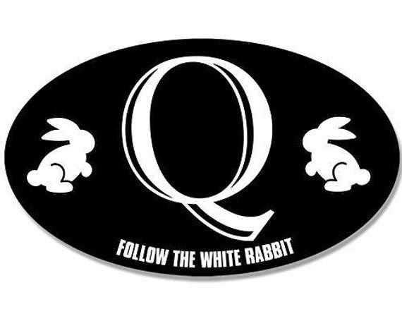
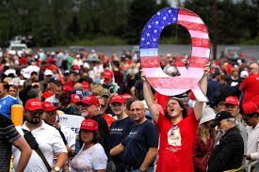
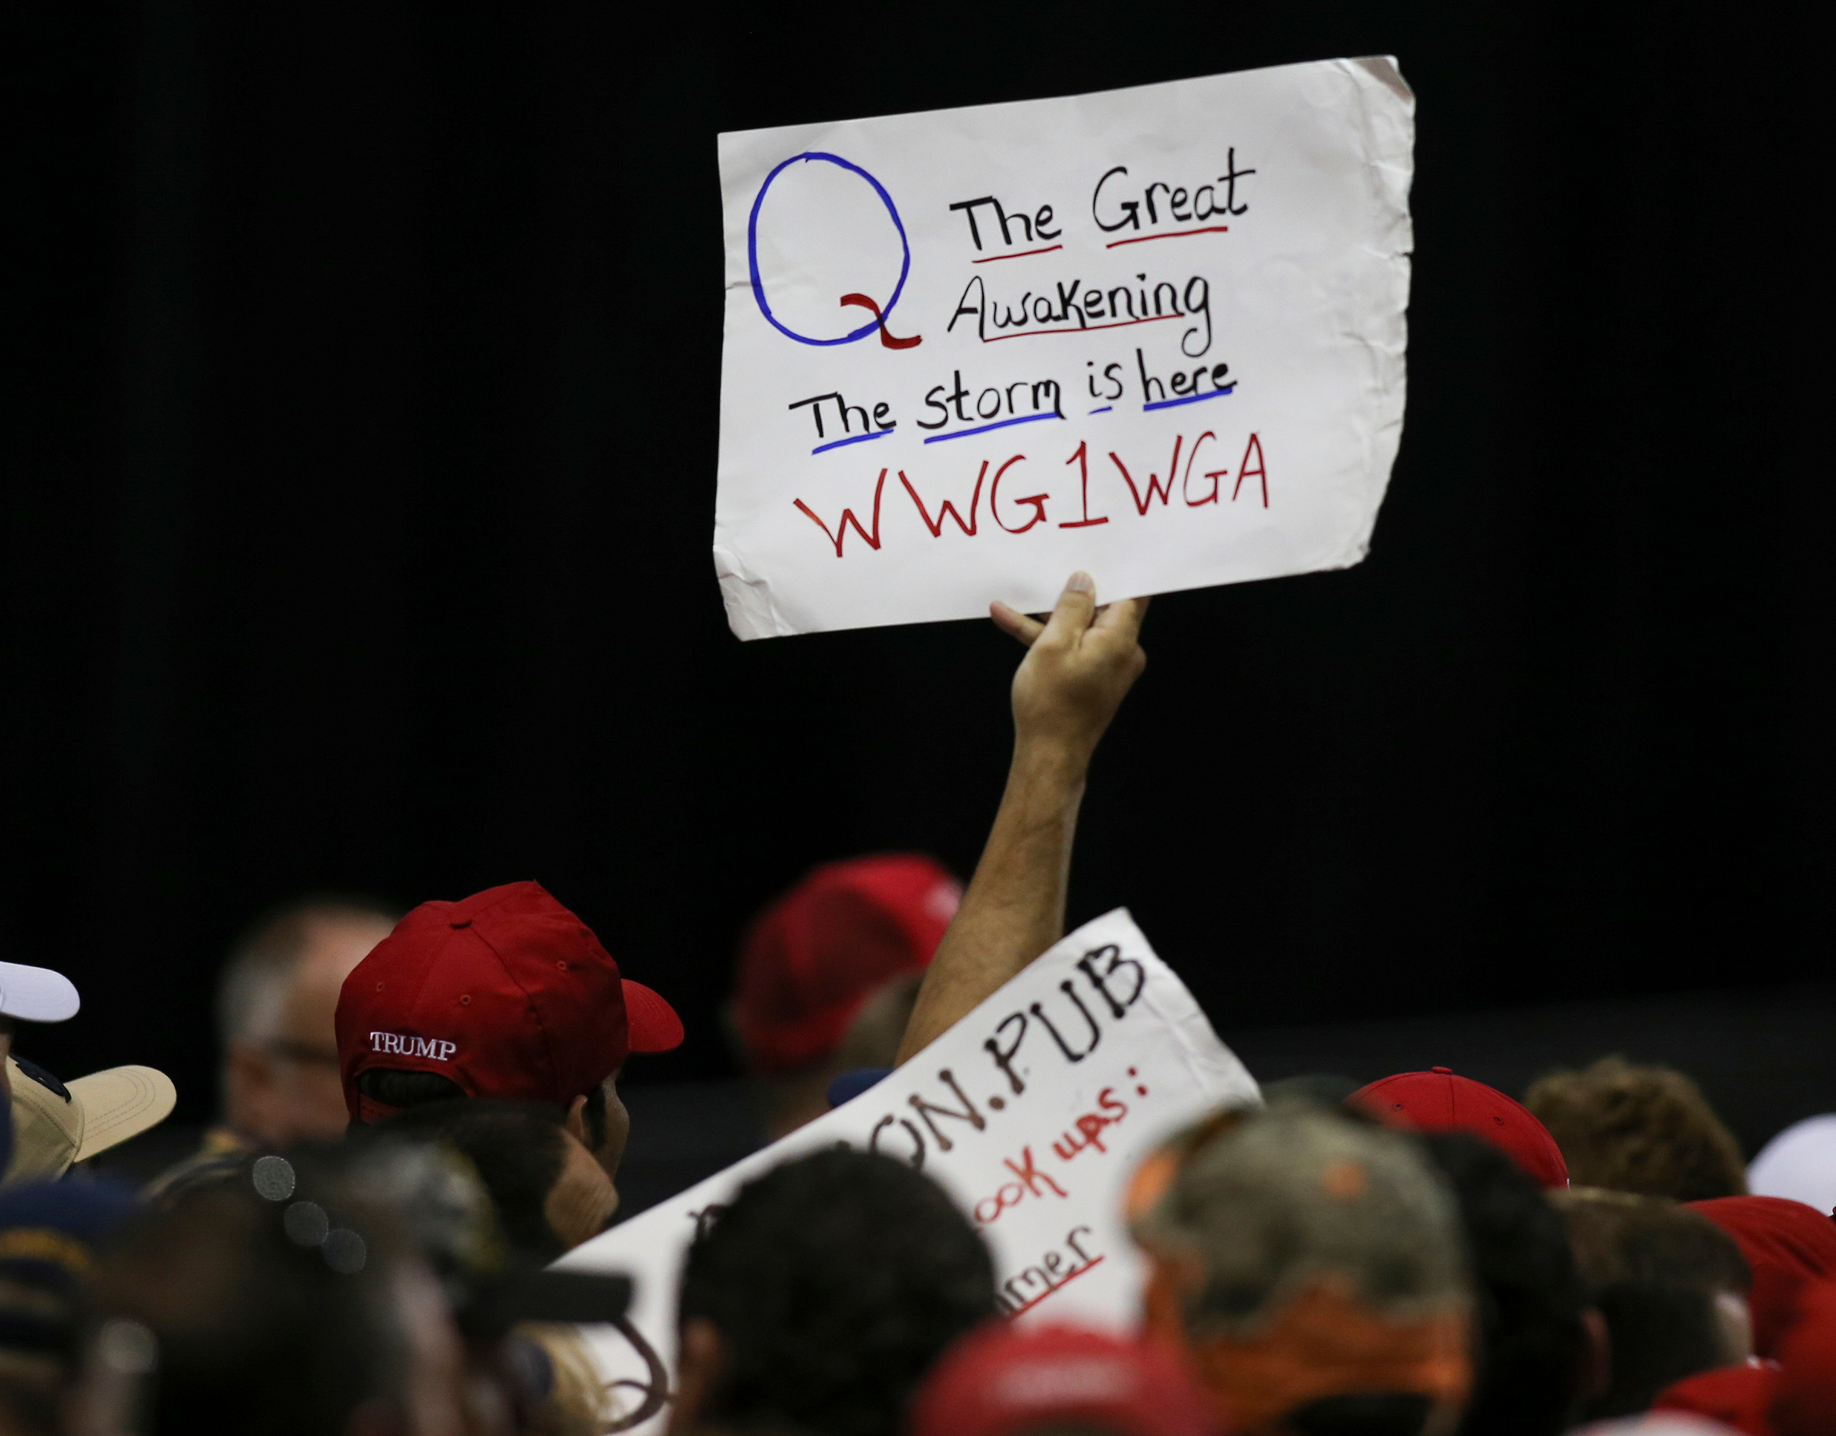
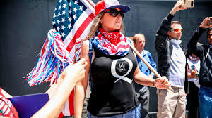
QAnon Symbols

Slide 7
Influence
QAnon’s action effect on the current political climate
Media gives them press
Pres. Trump states “they like him” (showing tacit credence to their cause)
While reported as conspiracy theorists, fringe, out-of-touch, QAnon receives coverage
Potential damage by QAnon
Election influence (negative)
Fear mongering
Untruths becoming accepted facts
Division

Slide 8
Questions for Consideration
Does the media coverage of QAnon give them positive credibility? Why or why not?
Does QAnon need to be shut down by authorities?
Does their cause fall under the First Amendment?
What kind of speech does QAnon engage in?
Is this type of speech protected speech? Explain.
Does QAnon pose a threat to the 2020 presidential election? Explain.
What value does QAnon add to the current political climate? Why?
How does QAnon gain traction in society?
How can we, as security professionals, stop or limit the amount of disinformation touted on the internet?
USE THESE QUESTIONS TO FORM YOUR ANSWERS IN OUR DISCUSSION FORUM

Slide 9
Resource for Further Review
QAnon and the Emergence of the Unreal
Downloads PDF file
https://tinyurl.com/y4c385tb

Slide 10
Now go and study

