Slide 1
Legal Aspects of Investigating & Prosecuting Computer Crimes
6th Annual
MSIA Graduate Security Conference
Norwich University
Workshop: June 10, 2009
M. E. Kabay, PhD, CISSP-ISSMP
mailto:mekabay@gmail.com
V: 802.479.7937
Assoc Prof Information Assurance, School of Business & Management
Norwich University, Vermont
http://www.mekabay.com
SLIDES AVAILABLE ONLINE AT http://tinyurl.com/l5vusf

Slide 2
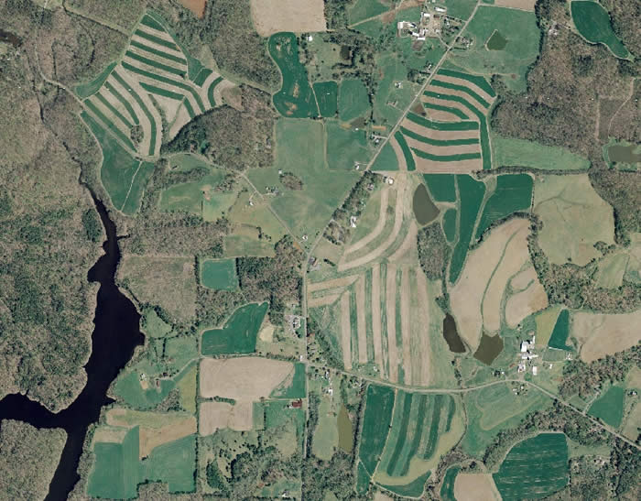
Topics: Fire Hose Time
Introduction (slides 1:24)
Search Warrants (25:49=25)
Warrantless Seizure of Evidence
(50:73=24)
Electronic Crime Scene Investigation
(74:102=29)
Analysis of Digital Evidence
(103:143=41)
Using Seized Materials & Results
in Evidence (144:160=17)
Hour 1
49 slides
Hour 2
53
Hour 3
58

Slide 3
Disclaimers
Instructor is not a
lawyer.
This is not legal advice.
For legal advice, consult an
attorney specializing in this practice area.
This overview is NOT an in-depth discussion of the entire field of IP law: it is an overview to remind students of key issues. We won’t be discussing all the slides in detail.
You may download the PPT file from
http://www.mekabay.com/courses/academic/norwich/msia/ipcc.ppt or
http://tinyurl.com/l5vusf

Slide 4
Introduction
Goals
Recommended Texts
Recent Internet Usage Statistics
Tracing a Suspect on the Internet
Proactive vs Reactive strategies
Online Stings: Entrapment?

Slide 5
Goals
Review (or introduce) basic concepts
Manage evidence
  Gather
  Preserve
  Present
Law and procedures useful to
  Law enforcement officials
  Information security professionals
Interest participants in further / deeper study

Slide 6
Recommended Texts
Burgunder, L. (2007). Legal Aspects of Managing Technology, Fourth Edition. Thomson West Legal Studies in Business (ISBN 0-324-39973-1). xv + 683. Index.
Moore, R. (2005). Cybercrime: Investigating High-Technology Computer Crime. Matthew Bender & Co. (ISBN 1-59345-303-5). xii + 258. Index.
Clifford, R. D. (2006). Cybercrime: Investigation, Prosecution and Defense of a Computer-Related Crime, Second Edition. Carolina Academic Press (ISBN 1-59460-150-X). xii + 282. Index.
These texts are used in the CJ341 Cyberlaw
& Cybercrime course at Norwich University.

Slide 7
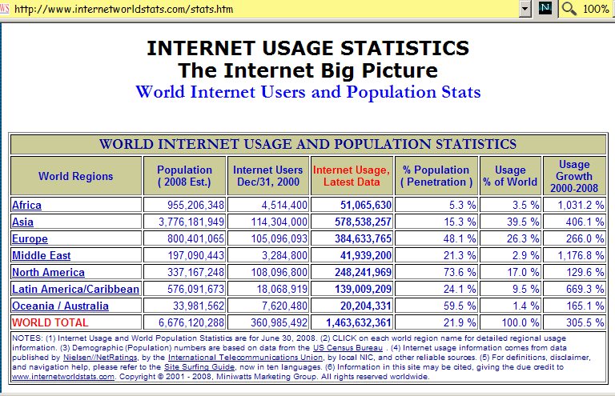
Recent Internet Usage Stats

Slide 8
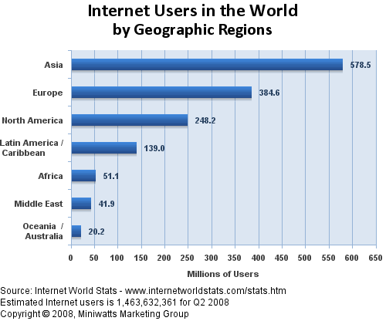
Internet Users by Region (1)

Slide 9
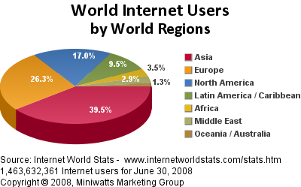
Internet Users by Region (2)

Slide 10
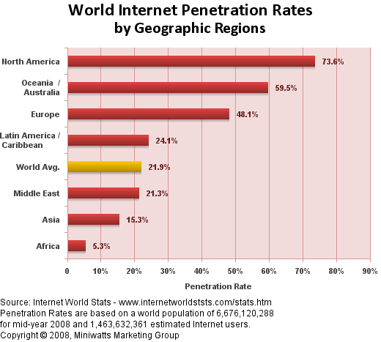
Internet Penetration Rates by Region

Slide 11
Tracing a Suspect on the Internet
The Dynamic IP Address
Locating the Host
DNS Lookup
whois.net
SamSpade Program
Locating Information from E-Mails
E-Mail Headers

Slide 12

The Dynamic IP Address
Suspect may have own connection to ‘Net
  Has permanent IP address
  E.g., gmail.com has IP address 64.233.171.83
  Norwich.edu is 192.149.109.197
Or suspect connects to Internet via ISP
  DHCP (Dynamic Host Configuration Protocol)
  User is assigned temporary “dynamic” address
  Re-used and not unique
  Logged by ISP for some time (days to forever)
  Must absolutely get cooperation of ISP and obtain records (if they still exist) under subpoena
  The records will show match of dynamic address to user’s modem’s MAC (media access control) address and from there to the assigned modem location, authorized user, address and so on
What would
an unsecured
WAP do to
this linkage?

Slide 13
Locating the Host
ICANN (Internet Corporation for Assigned Names and Numbers) http://www.icann.org/
  Global coordination of IP address assignments
  Defines rules for domain names
InterNIC < http://www.icann.org/ > points to registrars around world
  See lists e.g., http://www.internic.net/origin.html
  Australia has 13 registrars
  Canada has 152
  US has 562

Slide 14
DNS Lookup
WHOIS functions available online from each registrar
  But http://www.whois.net/ works with all registrars (see next page)
Many other tools available online for DNS lookup
SamSpade tool and service from http://www.samspade.org can find many records as well as providing additional functions (see page after next)
Info in registry may be false or out of date
  Often see dummy phone numbers in DNS

Slide 15
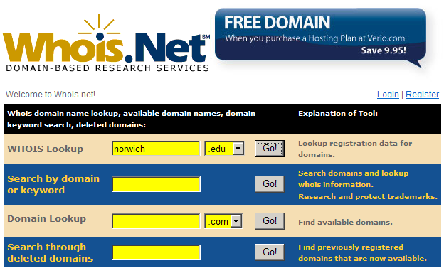
Looking Up DNS Information (1)

Slide 16

Looking Up DNS Information (2)
Domain Name: NORWICH.EDU
Registrant:
Norwich University
158 Harmon Drive
Juckett Hall / Computer Service
Northfield, VT 05663
UNITED STATES
Administrative Contact:
NORWICH DNS ADMINISTRATOR …
Technical Contact: …
Name Servers:
NS.NORWICH.EDU 192.149.109.19
A.DNS.TDS.NET …

Slide 17
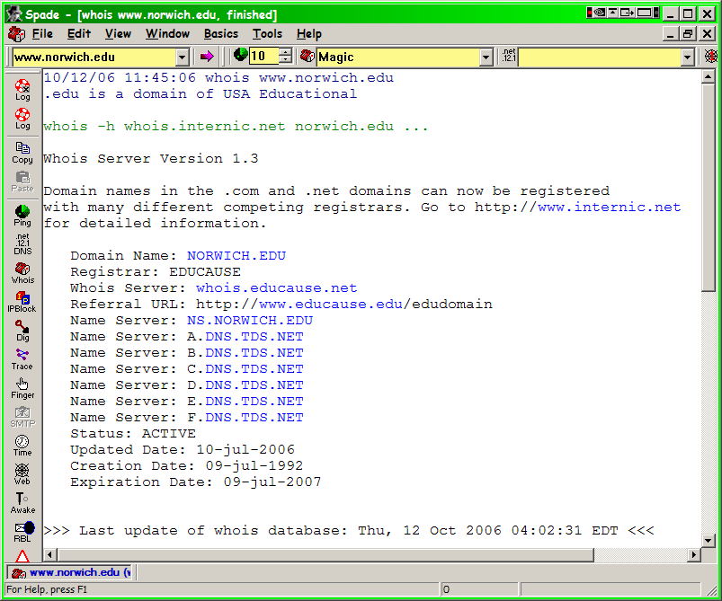
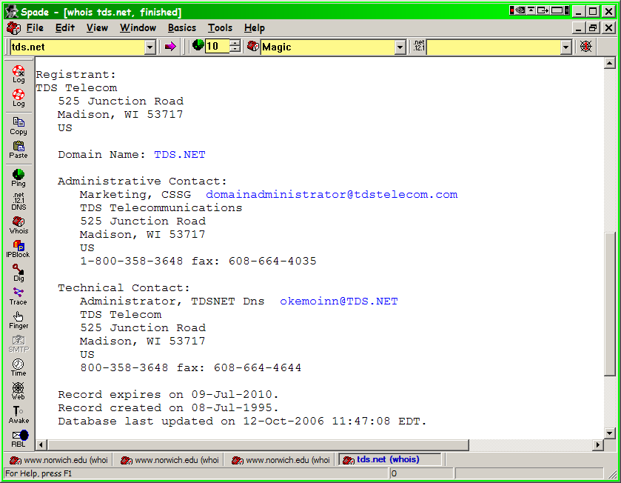
SamSpade Program

Slide 18
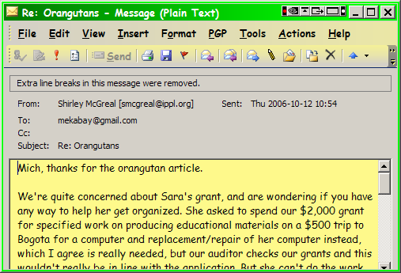
Locating Information from E-Mails
Headers are crucially important
  Often stripped from display

Slide 19
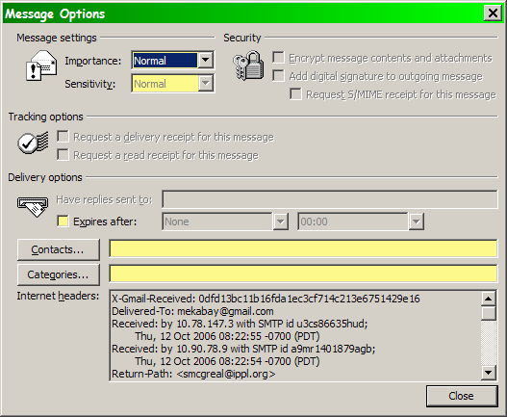
E-Mail Headers
Can be displayed through e-mail options
This example
is from
MS-Outlook

Slide 20
E-Mail Headers
Show details of who sent e-mail and how it was routed
X-Gmail-Received: 0dfd13bc11b16fda1ec3cf714c213e6751429e16
Delivered-To: mekabay@gmail.com
Received: by 10.78.147.3 with SMTP id u3cs86635hud;
Thu, 12 Oct 2006 08:22:55 -0700 (PDT)
Return-Path: <smcgreal@ippl.org>
Received: from mail42.opentransfer.com (mail42.opentransfer.com [71.18.111.198])
by mx.google.com with SMTP id 29si861796wrl.2006.10.12.08.22.53;
Thu, 12 Oct 2006 08:22:54 -0700 (PDT)
Received-SPF: neutral (google.com: 71.18.111.198 is neither permitted nor denied by best guess record for domain of smcgreal@ippl.org)
Received: (qmail 11919 invoked by uid 399); 12 Oct 2006 14:54:05 -0000
Received: from unknown (HELO System5.ippl.org) (70.60.217.92)
by mail42.opentransfer.com with SMTP; 12 Oct 2006 14:54:05 -0000
Message-Id: <7.0.1.0.2.20061012104204.03a1daf8@ippl.org>
X-Mailer: QUALCOMM Windows Eudora Version 7.0.1.0
Date: Thu, 12 Oct 2006 10:54:04 -0400
To: <mekabay@gmail.com>
From: Shirley McGreal <smcgreal@ippl.org>
Subject: Re: Orangutans
In-Reply-To: <200610121353.k9CDrlN3004352@cronus.email.starband.net>
NEVER simply forward an e-mail of interest to an investigator;
always copy and paste the headers into your message to avoid
corrupting the header.

Slide 21
Proactive vs Reactive Strategies
Some crimes are difficult to locate before they happen – need victim complaint to find out
  Identity theft
  Cyberstalking
Others benefit from dragnets
  Child pornography
  Child abuse
Officers need familiarity with
argot (slang), culture

Slide 22
Online Stings: Entrapment?
Must not give any basis for claim that officer initiated, suggested, prompted, or encouraged
  Illegal activity or
  Investigative actions that violate privacy or
  Convert a civilian into an agent of law enforcement to violate legal restrictions
ENTRAPMENT can destroy case
  Why? 4th Amendment safeguards
Sorrells v. United States (1932)
  SCOTUS ruled that entrapment defense must show proof that LEO encouraged crime
  Defendant would not have been predisposed to commit crime

Slide 23
United States v. Poehlman (2000)
Poehlman alleged to have met undercover LEO to have sex with minor
But defendant said he started online discussions with LEO to form adult relationship
LEO wrote she was looking for
someone “to train her daughters
in the ways of the world”
Poehlman explicitly said he wasn’t
interested and LEO responded that
she would terminate relationship
Poehlman offered to “train” daughters as way of continuing relation but claimed he had no intention of having sex with them – was ploy
SCOTUS ruled in favor of defendant: evidence that pedophilia was not his original intent & LEO was significantly responsible for his actions

Slide 24
BREAK
5’12”

Slide 25
Search Warrants & Seizure of Electronic Evidence
Identifying Physical Location of Electronic Evidence
  ECPA Effects on Data Acquisition
  Collaboration from Third-Party Record-Holders
Which Computers?
Legal Limits on Searches
  Federal Constitutional Limits
  State Constitutional Limits
  Statutes
References:
Clifford pp 111-137
Moore pp 141-153;
148-155

Slide 26
Identifying Physical Location of Electronic Evidence
General Principles
ECPA Effects on Data Acquisition
  Coverage
  Disclosure to Government Agents
  Contents of Electronic Communications
  Violations of the ECPA
Collaboration from Third-Party Record-Holders
  Finding the Records
  Evaluating Utility of Records
  Authenticating Records
  Obtaining Records
  Contacting ISP & Serving Papers

Slide 27
General Principles
Katz v US (1967): SCOTUS held that publicly disclosed information is not constitutionally protected
  Includes voluntarily transferred
  info in hands of third parties
  Thus third-party repositories
  limited by statute, not 4th
  amendment
Restrictions include laws
protecting
  Bank records
  Cable TV & video rentals
  E-mail & other electronic communications

Slide 28
ECPA Coverage
2000: Updated Wiretap law (18 USC §2510-22)
2004: Added Stored Electronic Communications Privacy Act (SECA, 18 USC §2701-11)
Protects contents of e-communications in storage by service
Prohibits provision of communications to government agencies without strict controls

Slide 29
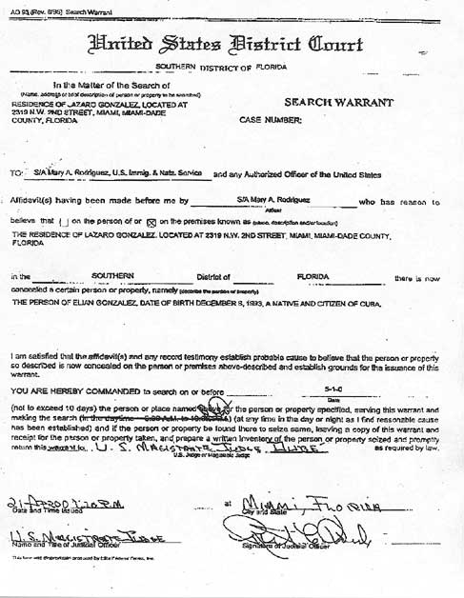
Disclosure to Government Agents
All records may be obtained through warrant
Subscriber/customer records (identity, services) may also be obtained by subpoena
Transaction history available through subpoena since U.S.A.P.A.T.R.I.O.T. Act passed
E-mail may be retrieved by subpoena provided user given notice (up to 90-180 days delay)
May use “§2703(d) court order” to access everything except unopened e-mail stored < 180 days

Slide 30
Contents of Electronic Communications
Agreement of one party in electronic communication suffices for legal disclosure
Take that fact into account when you are writing e-mail
  In general, when writing with
  employee userID, all e-mail
  must be considered equivalent
  to using company letterhead
  All official e-mail may become
  evidence in a court of law
When writing informally using your own address, remember that everything on Internet is POTENTIALLY PERMANENT and may affect your future employment prospects

Slide 31
Violations of the ECPA
Criminal liability
  Up to 2 years in federal prison
Civil liability
  Damages & attorneys’ fees
  Government agent may be
  personally liable
Suppression: NOT a remedy
Good faith defense:
  Government agent may
  Rely on good faith application of warrant or subpoena
  As absolute defense against civil or criminal charges stemming from actions

Slide 32
Evaluating Utility of Records
But look for
video camera
tapes
Records may not be available
  Typically 30-60 day retention of log
  records
  Dynamic IP addresses may make identification difficult for older evidence
Some records may originate in public computers that are effectively anonymous
  Business services (e.g., Kinko’s)
  Libraries, Internet cafés
  Wireless services
  Hijacked services
  Anonymizers

Slide 33
Authenticating Records
Spoofing may disguise origin
  Naïve users alter originating
  address
  But headers show real IP
  addresses
More sophisticated criminals
add faked header lines
  Must always analyze entire header
  SamSpade does this (discussed in lecture 16)
Open spam relay a danger
  Logon to unprotected SMTP server
  Send mail from someone else’s system

Slide 34
Obtaining Records
Typically obtain search warrant
  Better than subpoena
  Can obtain any records at all
  Avoids problem of more restrictive state laws that require warrant
So why not use a warrant?
  Might not have probable
  cause
  Difficulty getting
  warrant across state
  lines

Slide 35
Contacting ISP & Serving Papers
Call ISP to be sure they have records you need
  Discuss IP addresses with
  technical staff
  Identify possible errors of
  analysis
  Find out if there have been
  mergers or acquisitions
  Identify possible IP sub-blocks
  owned/used by other entities
Ask if ISP will accept warrant by fax
Explain exactly what you need

Slide 36
Search Warrants
Which Computers?
Legal Limits on Searches
  Federal Constitutional Limits
  State Constitutional Limits
  Statutes

Slide 37
Which Computers?
Goal of tracing electronic communications:
  Locate computer at origin of evidence of crime
  Link to specific person
Computers that may be involved
  Victims’ computers may be searched without warrant with permission
  Publishers’ computers not restricted if publisher is the victim
  ECPA does not apply to suspects’ computers

Slide 38

Federal Constitutional Limits
Fourth Amendment
  Reasonable expectation of privacy
  Government action
Legal Warrant
  Probable cause
  Neutral/detached magistrate
  Reasonably precise
Rules for Executing Warrant
http://tinyurl.com/4jmcaz

Slide 39
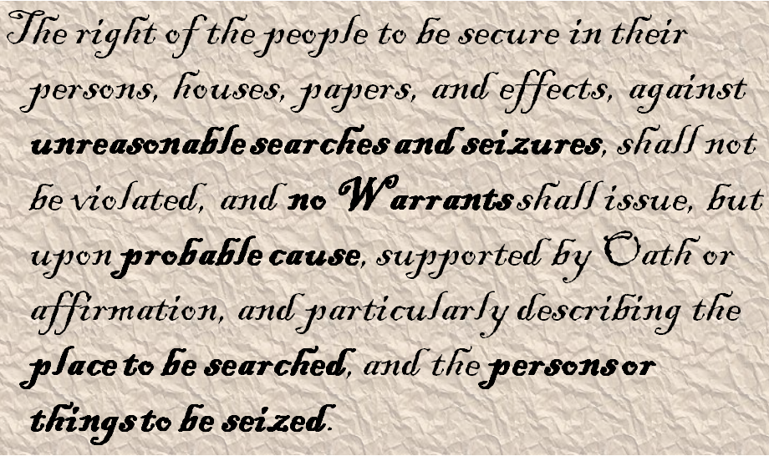
The Fourth Amendment Text
Bold emphasis added

Slide 40
4th Amendment Issues (1)
Reasonable expectation of privacy (EOP)
Subjective expectation
  Computer in home has higher EOP
  Shared computer has lower EOP
  Employer’s computer: depends –
    Policy?
    Awareness?
    Enforcement?
Social acceptance or
expectation of search

Slide 41
4th Amendment Issues (2)
Government action
  Searches by state
  law enforcement
  may transfer results
  to federal agencies
    But federal authorities must not have been involved in a way that would require suppression of evidence
Private citizens
  Constitution does not affect search by private citizen not acting as an agent of law enforcement
  Thus evidence usually admissible in court

Slide 42
Legal Warrant
Probable cause
  Evidence of a crime
  Likelihood that evidence will
  be found in location to be
  searched
    How do you know suspect
    used computer in home?
    Could have been elsewhere
    May need circumstantial evidence such as time stamps, stakeout
Neutral/detached magistrate
  Who has authority for warrant location
  Watch out for cross-state jurisdiction
Reasonably precise
  General description may lead to suppression
  Best to mention computers & media explicitly

Slide 43
Rules for Executing Warrant (1)
Knock and announce: identify as LEOs & explain purpose in entering premises
Take items in plain view
  But contraband and tools for
  crime may also be seized if they
  are visible and obviously
  incriminating

Slide 44
Rules for Executing Warrant (2)
Good faith
  Evidence seized under faulty warrant may be suppressed
  But generally LEOs not prosecuted if acting under good faith in legality of (later overturned) warrant
Remove computers for analysis off-site
Prompt execution
  Don’t let evidence evaporate
  Cannot hold warrant in abeyance indefinitely

Slide 45
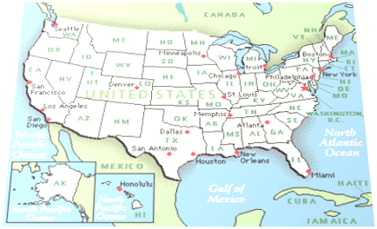
State Constitutional Limits
Some states more restrictive than federal rules
Some do not allow good-faith exception to requirement for valid warrant
Some may protect vehicles (and by implication portable computers) more than federal courts

Slide 46
Statutes
ECPA (as discussed above)
Zurcher v. Stanford Daily
  LEOs had warrant to search student newspaper’s computer for pictures of political demonstration
  SCOTUS ruled that 1st Amendment issues did not further limit warranted searches
This is not a statute.

Slide 47
Statutes: PPA
PPA passed to further restrict warrants
  Privacy Protection Act (42 USC §2000aa)
  Passed in 2000
  Any material intended for publication or broadcasting requires a subpoena
  Exceptions
    Contraband, fruits or tools for crime
    Preventing imminent death or injury
    Material held by target of investigation
    Child pornography
And neither is this.

Slide 48

PPA & Steve Jackson Games
March 1990: Secret Service raided Steve Jackson Games
  Looking for info about BellSouth’s emergency service
  Had been posted on BBS
  Seized entire computer for BBS
  Held for months
  Severely damaged company
SJG sued under PPA & ECPA
  Won trial
  Awarded damages $51K
  Attorneys’ fees $250K
Irony: BellSouth info was actually public & available for sale from company

Slide 49
BREAK
10’27”

Slide 50
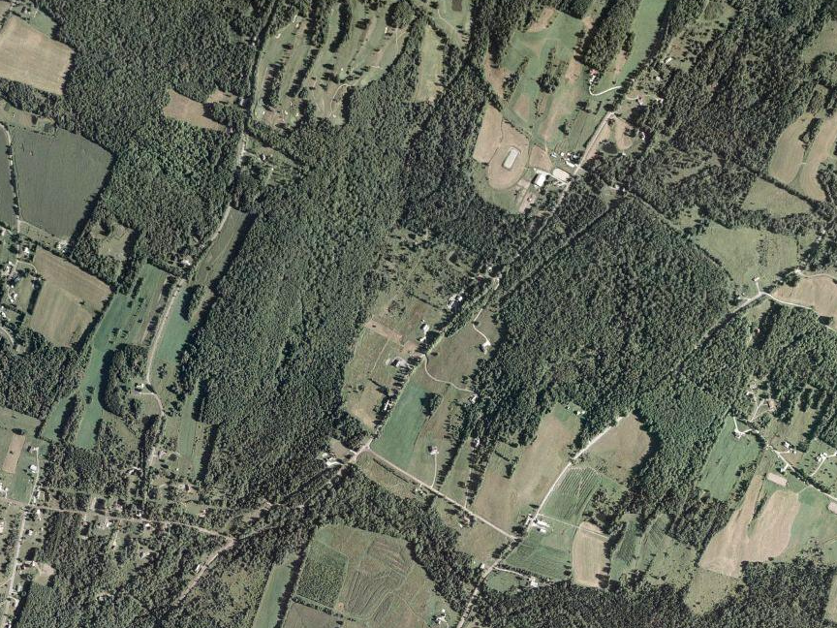
Warrantless Seizure of Evidence
Exceptions to the Requirement for Warrant
Consent
Search Incident to Arrest
Exigent Circumstances
Inventory
Stop and Frisk
Mobility
Plain View
Clifford pp 137-155
Moore pp 153-165

Slide 51

Exceptions to Requirement for Warrant
Long-standing view in jurisprudence:
  Warrant not necessary IF
  Owner of property agrees to search
Issues
  Does consenter have legitimate right to consent to search?
  Expectation of privacy
  Degree of ownership of property

Slide 52

Consent
Who May Consent?
  Employer
  Parent
  Spouse
  Co-User
  Third-Party Holder
Notification of Right to Withhold Consent
Limitations and Withdrawal of Consent

Slide 53

Who May Consent?
Matlock 1974: Common authority or sufficient relationship to the premises or effects
Rith 1999: Mutual use
  Joint access
  Control of property for most purposes
Crucial test: expectation of privacy
  Reduced in shared accommodations
  But evidence of rent & of security strengthens expectation of privacy (see later slides)

Slide 54

Private Employers
Employer not
acting as agent of
LEO is free to
search own
property without
suppression of
evidence
General acceptance of right of search
  For area not exclusively reserved for a particular employee
  Expect same rule for computers
Explicit policy reducing expectation of privacy strengthens admissibility of evidence

Slide 55
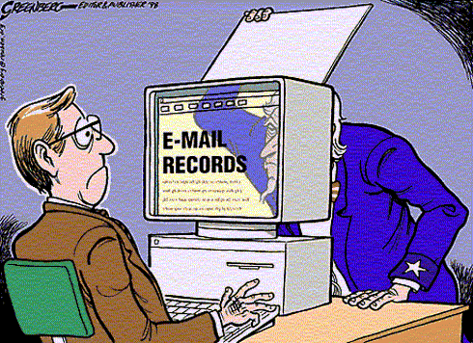
Public Employers
SCOTUS: O’Connor v. Ortega (1987) established expectation of privacy for government employees
  But open office could
  reduce expectation
  Also affected by
  specific policy
Policy effectiveness
depends on
  Clear enunciation of
  limits to privacy
  (e.g., logon banner)
  Evidence that
  employees are aware
  of policy
Problems
  Allowing private use of government computers
  Allowing unauthorized encryption
Used with permission of artist. http://tinyurl.com/6pszy7
Copyright © 1998 Steve Greenberg. All rights reserved.

Slide 56
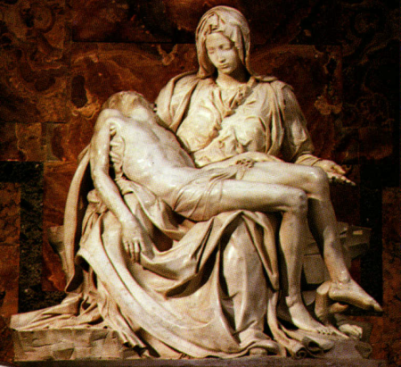
Parent
Closer relationship supports consent
Parents’ consent generally accepted by court
  But child must be “essentially dependent” on parent
  Payment of rent reduces authority to grant consent
US v. Durham (1998): Mother could
not grant consent for search of
son’s computer
  Even though she owned some
  of equipment
  Because son applied security
  to system
  And he paid small amount of
  rent
Pietà, marble sculpture by Michelangelo, 1499; in St. Peter's Basilica, Rome

Slide 57
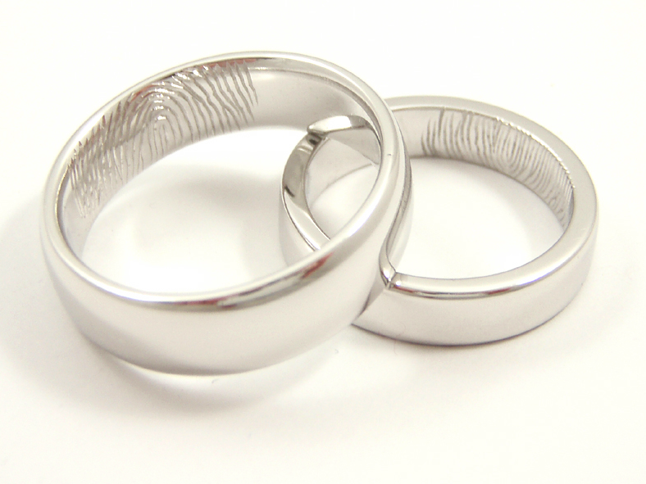
Spouse
Generally viewed as having “joint control and equal right to occupancy of premises and access to computers on the premises” [Orton p 141]
BUT consent is invalid if
  Computer is used exclusively by non-consenting partner
  Kept in separate room (esp. if locked)

Slide 58
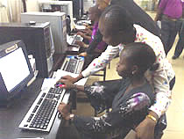
Co-User
Shared use reduces expectation of privacy
But still case law to develop on effects of
  Access controls
  Encryption
For time being, assume co-user cannot grant consent to prima
facie private areas of
computer

Slide 59

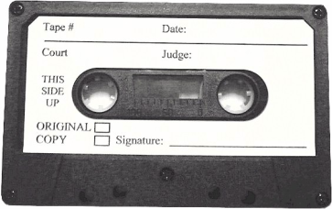
Third-Party Holder
If equipment or media left in possession of someone else, does that person have right to consent to search without warrant?
Problematic case law: contradictions
US v. James (2003):
  Court ruled search of data CDs invalid because
  Owner did not intend to give 3rd party authority to grant consent for search
  But note that CDs were in sealed envelope
US v. Falcon (1985):
  Cassette tape labeled “confidential/do
  not play”
  Court ruled tape admissible without
  warrant
  Argued holder could have played tape any time
CONCLUSION: best to proceed with warrant to avoid risk of suppression

Slide 60

Notification of Right to Withhold Consent
Is the consent to the search voluntary?
Federal system imposes burden of proof on government using preponderance of evidence
Other jurisdictions may be more exigent
  E.g., requiring “clear and convincing evidence”

Slide 61
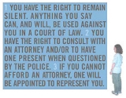
Factors affecting judgement of voluntary consent:
Age/intelligence of suspect
Being advised of
constitutional rights
(Miranda warning)
Custody or detention
(and length)
Physical punishment
or deprivation (sleep,
food)
Generally, advising
person that warrant
will be sought if consent not granted is acceptable

Slide 62
Limitations and Withdrawal of Consent
Consent for search may be withdrawn at any time
Area of search may be limited
Continuing to search after withdrawal or in unauthorized areas leads to suppression of evidence
Does breaking access protection or encryption violate restrictions on unwarranted search?
  In physical world, breaking locks or sealed containers has led to suppression
  But no damage when breaking security so evidence may be accepted by court

Slide 63
Search Incident to Arrest
General principle allows
search and seizure of
evidence at time of arrest
  Purpose: prevent
  destruction of evidence
  Therefore expect same rule for digital evidence
Particularly useful for seizing cell phones and PDAs
  May contain useful data
  E.g., phone lists, calendars, call logs

Slide 64
Exigent Circumstances (1)
Probable cause
Exigent circumstances defined essentially by
  Imminent destruction of evidence
BUT
  Allows for seizure of computer
  But NOT for search
    Need separate warrant for search

Slide 65
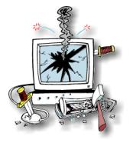
Exigent Circumstances (2)
US v. Reed (1991) established requirements for admitting evidence obtained under warrantless search with claim of exigency
  Must demonstrate degree of urgency
  Amount of time required for getting warrant would seriously interfere with process of ensuring justice
  Evidence in danger of
  destruction or removal
  Danger to officers or
  evidence at crime scene
  Suspect’s awareness of
  anticipated seizure of
  evidence
  Ease of destruction of
  evidence by suspect

Slide 66
Exigent Circumstances (3)
US v. David (1991)
  LEO observed suspect deleting data from PDA
  Seized device and scanned names
  Court admitted evidence
  But exigency ended as soon as PDA was
  seized
US v. Ortiz (1996): court ruled that search of pager
was warranted because of risk of data loss as
batteries failed
US v. Romero-Garcia (1997): search of laptop computer was not warranted by fear of battery failure (would not normally destroy data)
Best practice: if device seized under exigent circumstances, obtain a warrant using probable cause to justify search that will ensure evidence is accepted in court unless data are evanescent

Slide 67
Inventory
Normally associated with
searching vehicles to list
all evidence present
Booking search catalogs
possessions of suspect at
time of arrest
Might permit LEO to search computer or electronic device to determine identity of suspect
But should not use as basis for extensive forensic analysis: get a warrant

Slide 68
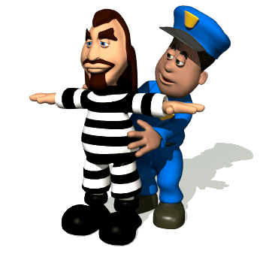
Stop and Frisk
LEO may search suspect for weapons
May seize computing device during search
BUT should not search computer without warrant

Slide 69
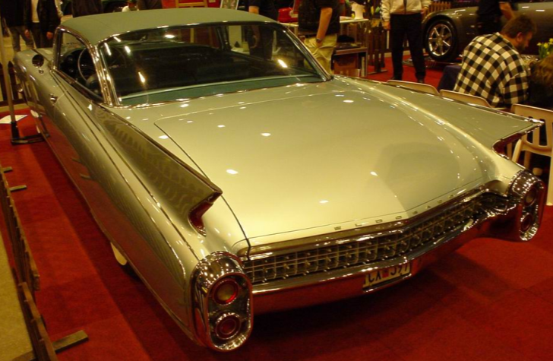
Mobility
Vehicle’s mobility serves as exigent circumstance justifying immediate search without warrant
Could therefore
reasonably seize a
computer found in
such a search
But Orton argues that
this view could not
justify search of
computing devices
And there is no current case law supporting such a procedure

Slide 70
Plain View (1)
Doctrine: If contraband is
  Left in plain view of LEO
  Who is in lawful place
  Then there is no expectation of privacy
Limits
  Incriminating nature must be obvious
  LEO must be legally allowed to be in position where item is in view
  LEO must not alter search process as result of plain-view discovery

Slide 71
Plain View (2)
So cannot exceed limits of warrant when searching computer even if plain-view item such as file-name suggests crime
If protocol in warrant specifies searching all files, may log child porn as long as search continues through all files
If protocol in warrant specifies searching all files but only for business fraud data, may NOT open file suspected to contain child porn
So if new evidence of a different crime is discovered in plain view, get a warrant to change search protocol.

Slide 72
Plain View (3)
US v. Carey (1999)
  Narcotics investigation of computer disk
  Officer’s discovery of 1st child porn image accepted in court
  But subsequent discoveries suppressed – unlawful search beyond terms of warrant
US v. Gray (1999)
  LEO conducting file-by-file search
  Discovered child porn
  Immediately applied for warrant to search of child porn
  Court ruled that not only was officer correct but also that had other child porn been discovered in systematic examination of all files, those images would have been admissible also

Slide 73
BREAK
4’58”

Slide 74

Electronic Crime Scene Investigation
Introduction
Nature of Electronic Evidence
Handling Electronic Evidence at the Crime Scene
Electronic Devices
Securing and Evaluating the Scene
Documenting the Scene
Moore Ch 9
Clifford Ch 3 pp 155-160
ECSIGFR = Electronic Crime
Scene Investigation: A Guide for
First Responders (NIJ)
Another useful reference: Volonino, L., R. Anzaldua, J. Godwin (2007).
Computer Forensics: Principles and Practices. Pearson Prentice Hall
(ISBN 0-13-154727-5). xviii + 534. Index.

Slide 75
Introduction
Law Enforcement Response to Electronic Evidence
Latent Nature of Electronic Evidence
RULE 1 OF DIGITAL FORENSICS
Forensic Process

Slide 76
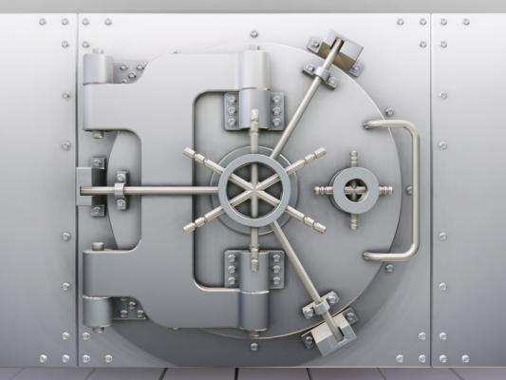
Law Enforcement Response to Electronic Evidence
Computers involved in crime may be
  Tools
  Repositories of
  evidence
  Targets
Personnel of many types may
be involved in responding to
crime involving computers
  LEOs
  Investigators (private, corporate)
  Forensic examiners
  Managers (case, corporate, political)
First responder can be anyone in LE
  Must safeguard EE against loss or tampering

Slide 77
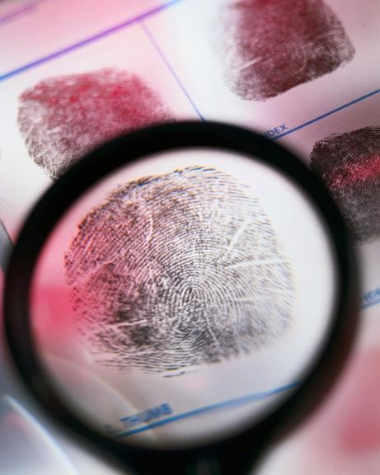
Latent Nature of Electronic Evidence [EE]
“Electronic evidence is information and data of investigative value that is stored on or transmitted by an electronic device.” [ECSIGFR p. 17]
EE thus latent (like fingerprints, DNA evidence) because not immediately visible
  Requires technical equipment
  & expertise
  May need expert testimony in
  court to explain analysis
EE fragile
  Easily destroyed or altered
  Chain of custody & technical
  safeguards essential for
  successful prosecution

Slide 78

RULE 1 OF DIGITAL FORENSICS
HARM NOTHING!
(E.G., DON’T LET AMATEURS
COLLECT DIGITAL
EVIDENCE)

Slide 79
Forensic Process
Key phases:
Collection: search / recognition / collection /
documentation of evidence
Examination (technical perspective)
  Document content / state
  of evidence
  Reveal hidden data
  Identify relevant data
Analysis (legal perspective)
Reporting
  Process notes for expert
  testimony
  Results
  Reliability

Slide 80
Nature of Electronic Evidence
Quoting directly from
ECSIGFR p. 20
Is often latent in the same sense as fingerprints or DNA evidence.
Can transcend borders with ease and speed.
Is fragile and can be easily altered, damaged, or destroyed.
Is sometimes time-sensitive
Therefore only those with expertise should handle digital evidence
  E.g., rebooting alters or destroys data that could be useful in investigation
  Forensic data-capture tools
  often require training

Slide 81
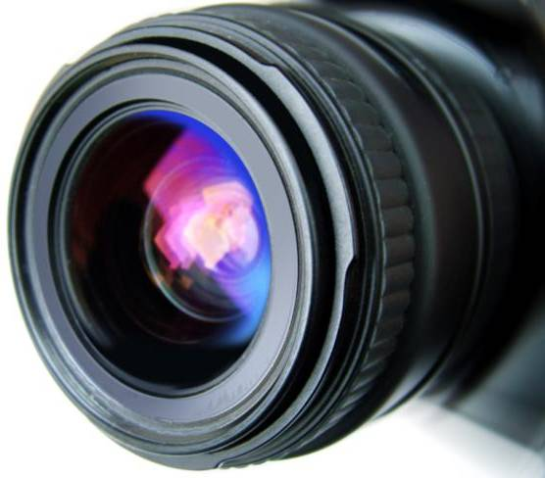
Handling Electronic Evidence at the Crime Scene
Preparations
  Secure and document crime scene (photographs, sketches, notes)
  Use protective equipment to avoid contaminating crime scene (e.g., gloves)
Recognize and identify
evidence
Document electronic
equipment at crime scene
Collect and preserve EE
Package and transport EE
Maintain chain of custody

Slide 82
The Digital Forensics Tool Kit (1)
Volonino et al. p 126 ff
ECSIGFR p 23 ff
Cellular phone
Basic hardware toolkit: screwdrivers, pliers, duct tape etc.
Watertight & static-resistant plastic evidence bags
Labels and indelible markers
Bootable media: DOS startup, bootable CDs, bootable USB drives w/ forensic software
Cables: USB, FireWire, CAT5 crossover & straight-through, power cables
Laptop computer for tools and notes
PDA with integrated camera & link to PC

Slide 83
The Digital Forensics Tool Kit (2)
High-resolution camera(s) w/ date-time stamps
Hardware-write blocker (e.g., FastBloc, DriveLock) to prevent damage to removed drive
Luggage cart
Flashlight
Power strip
Log book
Gloves
External USB hard drive
Forensic examiner platform (e.g., specialized tools) for data acquisition

Slide 84
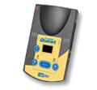
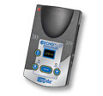
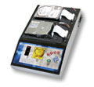
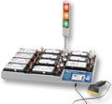
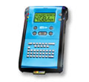
Specialized Forensics Tools
E.g., Logicube® < http://www.logicube.com/ >
Popular hard-drive cloning systems
Used by
  Law enforcement
  Military
  Internal IT departments
Products support various drive interfaces and connectors
  IDE
  SATA
  SAS
  SCSI
  USB

Slide 85
Establish Your Search Parameters
Volonino et al. p 129
What types of evidence are you looking for?
  Photographs? Document? DBs? E-mail?
What is the user’s/suspect’s skill level?
What kind of hardware is involved?
  Computers (Mac? Windows? Linux?)
  PDAs? Cell phones? Watches?
What kind of software is involved?
Do I need to preserve other types of
evidence?
  Fingerprints? DNA?
What is the computer environment?
  Network? (Protocols, topology…) ISP?
  Security? UserIDs? Passwords? Encryption?
  Real bombs inside the cases [thanks to Chris Tanguay]

Slide 86
Managing the Onsite Investigation
Volonino et al. p 130 ff
Maintain integrity of data collection process
Estimate time required for onsite examination
Limit costs to target organization
  Legal liability for interruptions
  of business
  May outweigh importance of
  crime
  May stop investigation
Evaluate necessary equipment for
onsite work
Evaluate personnel costs
  Who should be onsite?
  Would their involvement impede other critical investigations?

Slide 87
Remove Suspect from Computer
Moore Ch 9
Potential for instant data deletion by suspect
  Can prepare programs to delete key evidence
  Activate at touch of keyboard
  (macros, “hot keys”)
  Or through voice-command interface
    E.g., Dragon Dictation, Windows
    voice-recognition
No-knock search warrants still problematic
Therefore instantly move suspect away from computer
  Shake hands with LEO & prevent return
  Physical force only if necessary
  Allow no return to computer
BOOM

Slide 88
Secure the Scene
Photograph scene
  Agencies are currently using digital cameras
  But recall discussion of falsifiability of digital images
  Use video camera to document process
  May see cases hinging on credibility of such evidence
    Defense sometimes challenges timestamps
    But claims of fraud / error must include likelihood (proffer of proof)
Photograph computer screen(s)
  Especially evidence of system time
Photograph everything that may be evidence
  Cost is not a factor w/ digital cameras

Slide 89
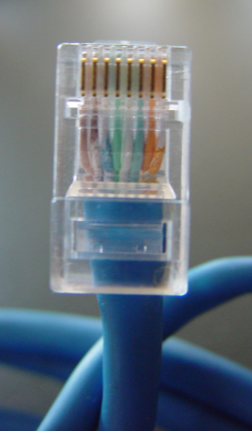
Disconnect Outside Control
Remove network connectivity
  Phone line / DSL
  Cable / satellite modem
  Suspect may be storing
  evidence on remote systems
Wireless connectivity may be
more difficult to handle*
  Wireless I/F may be integrated within computer case – not obvious outside
  Especially true in laptop computers
Look for evidence of home network
  May have data storage in other locations
  *For more details see “The Need for a Technical Approach to Digital Forensic Evidence Collection for Wireless Technologies” by B. Turnbull & J. Slay (2006)
  < http://www.itoc.usma.edu/Workshop/2006/ Program/Presentations/IAW2006-07-1.pdf >

Slide 90

Handling Downloads
What if system shows signs that user was downloading file(s)?
  Could be evidence
Photograph download window
  Reduces chance that suspect can successfully deny involvement in download
  May allow download to complete
Videotape entire process

Slide 91
Powering Down Computer
Moore p 172 ff
ECSIGFR p 30 ff
Want to avoid damaging data
Determine Operating System
Save Data from Running Programs?
Save Data in RAM?
Handling Specific OSs
Laptop Computers

Slide 92
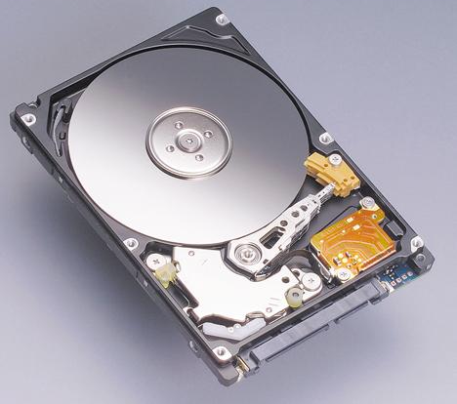
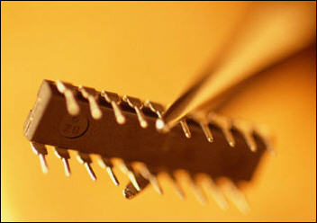
Determine Operating System
GOAL: make bit-images of RAM and of DISK before going any further
OS does not influence which tools
to use for bit-image capture onsite
  Mac versions
  Windows versions
  Unix flavors
  Hardware-specific OSs (cell phones, PDAs)
Must have right tools and procedures
  Avoid imprecise copy
Subject of more advanced courses

Slide 93
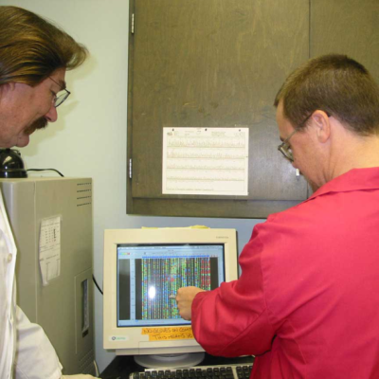
Save Data from Running Programs?
May be able to see that programs
are running (e.g., on program bar)
Disagreement among experts
  Pull the plug: data in temporary
  regions on disk anyway; or
  Save the temporary data explicitly in case they have not yet been written to disk
Technical knowledge essential
  E.g., many OS use extensive write-behind buffering
  Encrypted volumes may be corrupted by instant power-down

Slide 94
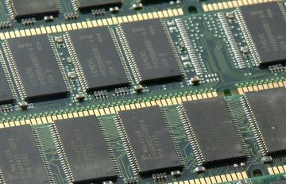
Save Data in RAM?
Most OSs use Virtual Memory (VM)
  Reserve space on hard disk for extension of main memory (RAM)
  Swap data back and forth
  between VM and RAM
  Thus VM swap file a
  treasure-trove of
  potentially valuable data
  about what was in RAM
  However, some users disable VM because of large RAM (e.g., 2 GB)
Specialized utilities for saving data directly from RAM depending on OS & hardware
Particularly important for cell phones and PDAs which may depend on battery power for maintenance of volatile memory

Slide 95




Handling Specific OSs at the Scene
Not suitable topic for this course
For brief overview of
instructions involved, see Moore
p 175 ff
  Microsoft OSs
    Windows 3.11 through XP
  Macintosh
  Unix/Linux
Special tools
for PDAs (e.g.,
Palm, Windows
CE)

Slide 96
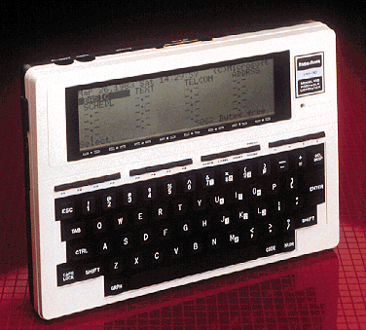
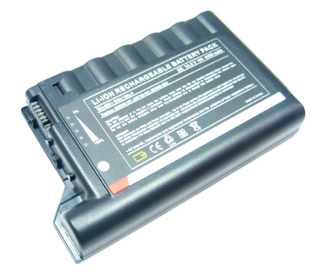
Laptop Computers
Problem: unplugging laptop
instantly switches to battery
power
Need to remove battery from
laptop
  Usually easy
  Simple latch or an easy screw or two
Keep battery with laptop for bagging & shipment
*
* TRS Model 100 from 1983
Computer Desktop Encyclopedia
Used with permission.
Prof Kabay’s very first portable!

Slide 97

Disassembling Computer
Critically important that each computer can be reassembled exactly as it was
Identify each computer with unique identifier
Label absolutely every component with its computer’s identifier
  Particularly the ports
  Mask and mark ports not in
  use
  Masking tape or colored
  labels are fine
  Colors can be assigned to
  specific computers
Show directions of connectors
(which end to which computer
and port)
Moore p 179 ff

Slide 98

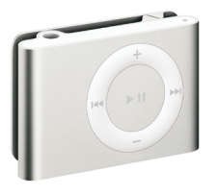
Securing Additional Evidence (1)
How much peripheral equipment should you seize?
  Terms of warrant
  Peculiarities of system (e.g., old)
Peripherals may have evidence
  Cameras, games (XBox, PSPs)
  Scanners (check the scanner bed)
  Sound recorders, iPods (can even carry computer data or operating environments)*
  Calculators (large memory)
Other evidence
  Paper notes and documents
  Digital storage media (magnetic & optical disks – but remember old tape systems)
  Label evidence bags in detail (where, who…)
*Thanks to Ryan Davis
& Stanley François

Slide 99
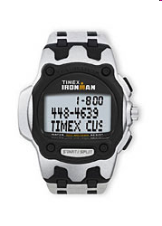
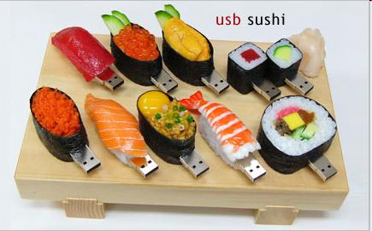

Securing Additional Evidence (2)
USB Port
Already mentioned obvious devices
  PDAs, cell phones, data-watches
USB flash drives may not be obvious
  Small
  May look like pens
  May look like
  … wait for it …
  sushi!

Slide 100
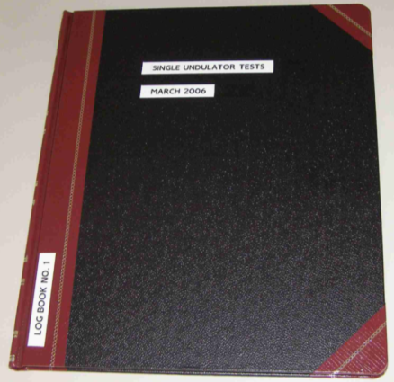

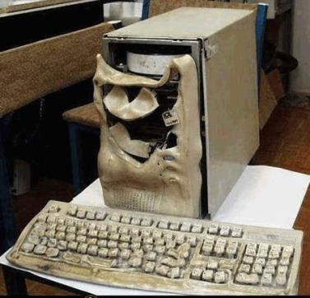
Preparing for Transport
Complete asset-seizure log
  Provide copy to suspect
  Get suspect to sign log sheet
  Note refusal & have OIC
  sign sheet
Bags or boxes depending on
agency
  Do not use Styrofoam – static electricity
  Disk drives that take mobile media (floppies, CDs) should have blanks inserted to
  prevent damage in transit
DO NOT PUT IN TRUNK OF CAR
  Heat & electronic gear can harm
  evidence
  Place on floor or on storage surface

Slide 101
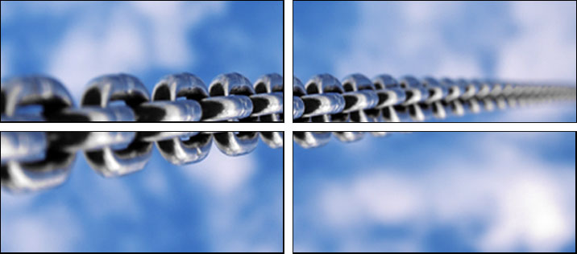
Chain of Custody
Standard concerns about maintaining credible protection of evidence in custody
NEVER allow evidence to be unsecured at any time
Digital evidence can be altered at any time
Unique identification to ensure credibility in court
Detailed records of who accessed the evidence at what time and for how long
Provide detailed records of why individuals needed access to evidence
Ideally, original data must never be released – keep for comparison with digital bitwise copies if anyone challenges authenticity

Slide 102
BREAK
11’3”

Slide 103

Analysis of Evidence
Introduction to Computer Forensics
  How Computers Store Data
  Internet Activity Stored on Disk
Computer Forensics Process
  Verifying Files and File Signatures
  Forensic Analysis
  Forensics Report
Concealing Evidence
Computer Forensics Software Packages
  EnCase
  Forensic Tool Kit
  Non GUI Software Utilities
Moore Ch 10
Clifford pp 160-174
ECSIGFR pp 37-46

Slide 104
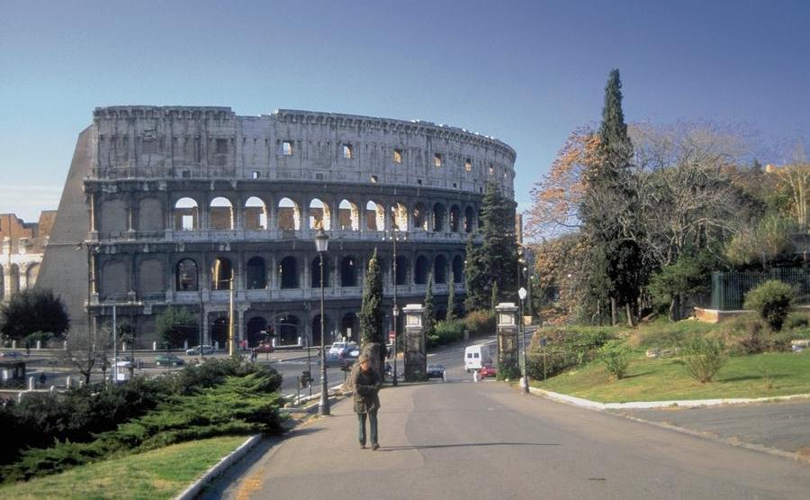
Introduction to Computer Forensics
Forensic science
  Latin forensis = “of legal proceedings from forum where discussions take place”
  Application of scientific techniques to criminal investigation
  Presentation of evidence at trial
Growing value to computer forensics
  Increasing role of computers throughout human activity, including crime
  Persistence of digital trail useful as evidence
  Opportunities for employment in LE and in private industry
Moore Ch 19
Clifford Ch 3 pp 160-174
NIJ Guide for First Responders pp 27-46

Slide 105
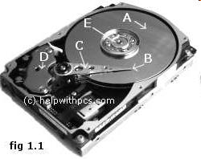
How Computers Store Data
A - Platter/s
B - Read/Write Head/s (and slider)
C - Actuator Arm/s
D - Actuator
E - Spindle
http://www.helpwithpcs.com/courses/hard-drive-mechanics.htm

Slide 106
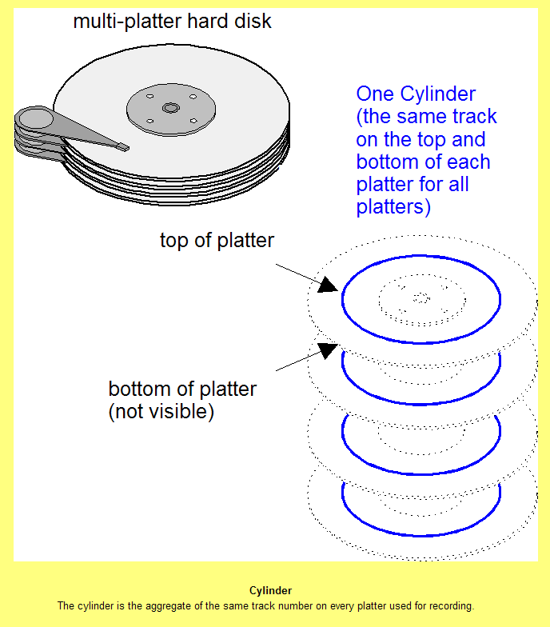
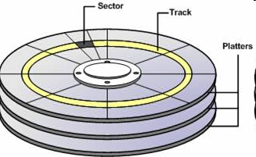
Cylinders
Tracks
Sectors
http://www.msexchange.org/img/upl/image0021118243018869.jpg
Computer Desktop Encyclopedia
V19.3

Slide 107
“Deleted” Files
File Allocation Table
FAT
File Label
Data
File label. . . . . . . . . . . . . . . . . . .
Filename. . . . . . . .

Slide 108
Slack Space
File
Unused space between EOF and end of cluster is slack space
May contain uninitialized data from previous (different) file use
Slack
space
EOF
End of
cluster

Slide 109
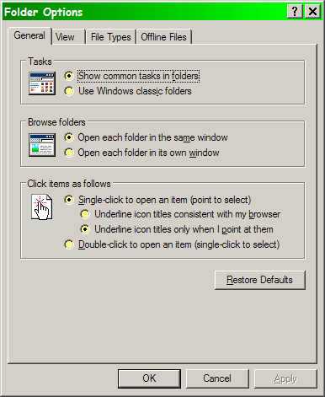
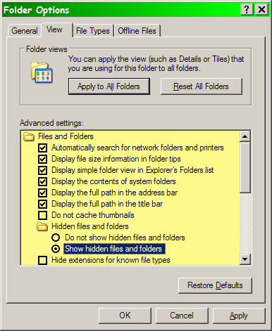
Internet Activity Stored on Disk

Slide 110

Internet Activity Stored on Disk

Slide 111


Internet Activity Stored on Disk

Slide 112

Internet
Activity
Stored on Disk

Slide 113


Computer Forensics Process
Copy entire hard disk(s)
  Disks typically now 100 GB and up
  CD-ROM now too small (700 MB)
  Even DVDs too small (4 or 8 GB)
  Separate medium – new hard disk best
    250 GB Western Digital USB for $100
    1 TB Maxtor external drive for $200
Make bit-for-bit copy (bit-image)
  Ordinary copy reads file, creates
  new file
    Lose all data in deleted files
    Lose all data in slack space
  Bit-image copies everything

Slide 114

Digitally Securing Evidence
How can one mark digital data so that any change, even to just one bit, flags the copy as bad?
Three approaches
  Hash
  Encryption
  Digital signatures

Slide 115

Hashing
HASH FUNCTION: An algorithm that turns
a variable-sized amount of text into a fixed-
sized output (hash value). Hash functions
are used in creating digital signatures,
hash tables and short condensations of
text for analysis purposes (see hash buster).
Hash functions are also known as
"cryptographic hash functions."*
E.g., MD5 (Message Digest 5)**
Results look something like this:
  Input: “The quick brown fox jumps over the lazy dog.”
  (Made-up) Output: 8u3J50pW
SHA-512 another popular algorithm***
***Thanks to
Chris Tanguay
* Computer Desktop Encyclopedia, v 21.3. Copyright © 2008
Computer Language Company, Inc. All rights reserved.
** http://www.ietf.org/rfc/rfc1321.txt?number=1321
*** http://csrc.nist.gov/publications/fips/fips180-2/fips180-2.pdf

Slide 116
Hashing (cont’d)
Hashing functions are designed so that any change to the input produces a different output
E.g. (made-up, not real):
  “The quick brown fox jumped over the lazy dog.” could hash to “8u3J50pW”
  “The quick brown fox jumped over the lazy dog!” could hash to “Y35_e)t7k”
Thus by keeping a copy of all data with hash function output, one can identify changed data.

Slide 117

Using Hash Function for File Inventory
FileList utility
  Every single file on disk
  Directory tree format
Most important: MD5 hash
  Applied to copy of original disk
  Every file marked with hash
  Nearly impossible to alter file without altering hash
  Unchanged MD5 hash value is very strong evidence that files have not been altered since the hash was originally calculated

Slide 118

Digital Signatures
Digital signatures encrypt a hash
Quicker than encrypting entire source
Many different tools available for such signature
Legally recognized as evidence of data integrity
Can also indicate exactly who signed document
Contributes to chain of evidence by tying specific analyst to digital copy

Slide 119

Digital Signatures Before and After Single-Character Change
Hi there.
wj8DBQFJBek/UbF73uXqlJ8RAiWVAKDnsmqVn64zcKseFCqecCcHD6xytQCgn+8kT8jUtvEhucbjQXpkqYs66pw==rI4S
Ho there.
wj8DBQFJBelkUbF73uXqlJ8RAsHPAKCNrCfv6+N8WDi4V7PbHwz62SGwwwCdHAesXOwawwKTzuSvsOqh0DvfovA==0w8t
Signatures created using
Prof Kabay’s PGP private key.
Prof Kabay’s PGP public key.

Slide 120

Verifying Files and File Signatures
Create digital signature for disk
contents
  Typically use MD5 hash
  Effectively impossible to
  modify contents of original
  disk without changing hash
Analyze files to detect altered file types
  Can crudely hide data by pretending that images are documents (etc)
  Forensic packages can detect such subterfuges
Error on p. 196 of Moore (Chapter 10): author meant “algorithm” where “logarithm” is written in paragraph beginning “The MD5 logarithm….”

Slide 121
Concealing Evidence
Stop people from finding or capturing information
  Prevent penetration of system perimeters
Stop people from using information
  Encryption
Stop people from knowing there’s any information
  Misleading directory and file names
  Misleading file types
  Information hiding: steganography

Slide 122

Hard to Find
Secret compartments (furniture, clothing, luggage)
Messages placed inside books, in book covers. . .
Palimpsests: ➔ overwriting or overpainting
The Archimedes Palimpsest discovered 1899 in Istanbul.
Original Greek (3rd century BCE) was overwritten at 90° in 12th century CE by Greek Orthodox monks in Constantinople.
Image from < http://www.artlex.com/ArtLex/P.html >

Slide 123


Hard to See
Invisible ink
  Substances change from colorless to colored upon treatment (heat, UV light…)
  Milk, lemon juice, cobalt chloride solution
Microdots
  Invented by Germans during WWII
  Images at high resolution
  Shrunken to tiny size – usually that of period (.), dots on i, j or umlauts (ö) in text
  Read with microscope if you knew where to look
*
* Mark IV microdot camera < http://en.wikipedia.org/wiki/Microdot >

Slide 124

Hard to Notice
Coded language
  Writing, speech, symbols in
  pictorial art
  Shared code-book + start-point
  permits decoding (not decryption)
  of meaning
  E.g., “The ship sails at midnight”
  = “Meet Bob on Thursday”
Chaffing and winnowing
  Ron Rivest (1998)
  Output large volume of info, hide small amounts of significant data
  See < http://theory.lcs.mit.edu/~rivest/chaffing.txt >
Steganography
  Embedded information in music, pictures, numbers and data communications
  Extract by knowing rules
Cipher for Telegraphic Correspondence
— a code book used by Union General
Joseph Hooker’s code clerk
(From Answers.com
http://tinyurl.com/6gguav )

Slide 125




Searching for Hidden Information
Intelligent filters
  Filter_I used only on copy of original data
    http://www.forensics-intl.com/filter_i.html
    Removes binary data from output
    Eliminates useless ASCII strings
    Use in multiple passes, step by step
Slack space & free space
  Getslack (http://www.forensics-intl.com/getslack.html ) & Getfree (http://www.forensics-intl.com/getfree.html )
  Convert these types of disk data into files
  Can also create files from swap and cache
Steganography and steganalysis
  Hiding data in low-order bits of a file
  E.g., putting text inside a picture file
  See following slides

Slide 126

Steganography
Steganography = information hiding
  Greek: secret writing
  Hiding existence of
  message or other data
  Different from cryptography,
  which hides the meaning but
  not message itself
Sometimes referred to as using
covert channels
  E.g., could conceal text in
  low-order bits of cells of a
  spreadsheet
  Currently most popular using images and music as channels for message
Press reports claim terrorists are using steganography – but see later slides
Illustration from article by Rachel Thomas (2002),
“Safety in numbers” in +plus magazine (21),
Sept 2002. < http://tinyurl.com/6yalbs >
Used with permission.

Slide 127
Example: Covert Channel Using Low-order Numbers

Slide 128


Example: Steganography Using a JPG Image
“The top image of Voyager contains no stego and is not featured in the search engine's output. However, the second image contains a 10K text file encoded with JSteg….”
Copyright © 2008 F. C. Gonzalez. All rights reserved. Used with permission.
http://mscmese.tripod.com/steg/

Slide 129

Steganography using JPG (cont’d)
Niels Provos & Peter Honeyman
  University of Michigan Center for Information Technology Integration
  Scanning Web for steganography
Located sovereigntime.jpg
  Shown on ABC TV program
  Retrieved concealed image embedded in JPG – B52s
ONLY case found in 2,000,000 images checked
http://www.citi.umich.edu/projects/steganography/faq.html

Slide 130

Why Use Steganography?
To avoid notice
  Some governments ban
  unauthorized use of encryption
  Obvious encryption may draw
  unwanted attention to its users
  Encrypted traffic may be
  susceptible to data-flow
  analysis (e.g., identifying areas of greater operational importance)
To embed secret information in documents or other files to help protect copyright
  Allow copies to be identified or traced
  Called Digital Watermarking

Slide 131

Steganography Tools
Medium + message + stegokey = stego-medium
Freeware, shareware, commercial programs available
  List of over 80 programs at
http://www.stegoarchive.com/
Many use JPG picture files as carrier
Scramdisk creates virtual encrypted drives by using a WAV audio file as output
MP3Stego program hides data in MPE audio files
Sam’s Big Play Maker hides data in a post-modern play (mostly gibberish)
  http://www.scramdisk.clara.net/play/playmaker.html

Slide 132






Sam’s Big Play Maker

Slide 133


Steganalysis
Tools available to identify and reconstitute hidden messages
Carrier-information degradation problem
  Any modification of data in original file degrades quality
    Image
    Sound
Notes:
Images from
Johnson, N. F. & S. Jajodia (1998). Lecture Notes in Computer Science, v1525. In Procededings of the Second Information Hiding Workshop (Portland, OR 1998-04-15/17). Online at http://www.jjtc.com/ihws98/jjgmu.html

Slide 134


Steganalysis (cont’d)
Some stego tools generate signatures
  Statistical techniques use many modified images to identify signatures
  Can identify repetitive patterns
  Spot abnormal palette colors in images
Notes:
Images from Johnson & Jajodia http://www.jjtc.com/ihws98/jjgmu.html

Slide 135

Forensic Analysis
Examine only bit-image copies of original disks
Can analyze every file
Locate files of specified
types
List all file and real types
Search contents of files
for strings
Search deleted files
Search unallocated space
Can take days of work

Slide 136

Forensics Report
Written report
  Can be partly software-generated
  Explain exactly how searches were performed
  Detail exact locations of
  evidence
Useful in many ways
  Help prosecutor decide
  whether to charge suspect
  Help persuade perpetrator to plea-bargain
  Support testimony in trial

Slide 137

Computer Forensics Software Packages
GUI-based packages
  Helpful for LEOs with less experience
    EnCase from Guidance Software
    Forensic Tool Kit from AccessData
Command-line interfaces
  Require expert to know command language

Slide 138

EnCase
Preview allows selection of which disks to image (can save time)
Extensive training available
Ability to image disk without removal from case
Extensive automated search capabilities
http://www.guidancesoftware.com/

Slide 139

EnCase

Slide 140

Forensic Tool Kit (FTK)
Similar to EnCase + improvements
E-mail search
Import image files in wide variety of formats
Password-cracker (Password Recovery Tool Kit, PRTK)
Distributed Network Attack (DNA) for parallel processing of decryption tasks
http://www.accessdata.com/

Slide 141

FTK

Slide 142

Non GUI Software Utilities
Less expensive than GUI-based tools
E.g., Maresware Utility Suite
  Available through Norcross Group as of July 2005
  Product description at http://www.maresware.com/maresware/suite.htm
Features
  Very fast
  Provides scripting
  for automated
  analysis
  Complete control of
  analytical sequence
  Audit trail

Slide 143
BREAK
5’19”

Slide 144
Use of Seized Materials & Results in Evidence
Admissibility of Digital Evidence
The Courts & Digital Evidence
Admission of Digital Evidence at Trial
Moore Chapter 11
Clifford Chapter 3 pp 174-186
SSCOEECI §V (PDF pp 119-128).

Slide 145
Admissibility of Digital Evidence
US v. Liebert (1975)
  Could computer records for alleged federal tax-evader be admitted as evidence?
  Yes, provided
    Prosecution could prove digital data were accurate and authentic
    Defense was given opportunity to check
Resistance to admitting digital evidence continued
  Based on Federal Rules of Evidence
  http://www.law.cornell.edu/rules/fre/
  Includes hearsay, authentication, nature of writings & copies

Slide 146
Hearsay
Rule 801: “…statement, other than one made by the declarant….”
Rule 801(d)(1) permits digital evidence such as e-mail or Web postings if
  Statement contradicts sworn testimony
  Statement rebuts accusation of lying
  Statement helps identify person

Slide 147
Authentication (1)
Authentication validates
evidence
Rule 901(a) requires
authentication
  One method uses self-
  authentication mostly
  involving public records and certification (rarely works for digital evidence)
  Other approach involves authentication by a qualified professional
Prof Moore argues that only 2 of the Rule 901 subclauses apply to digital evidence: both involve testimony of expert witnesses

Slide 148
Nature of Writings
Rule 1002: specifies that original “writing, recording or photograph” must be available to authenticate copies presented in evidence
Rule 1001(1) stipulates that writings and recordings include “letters, words, or numbers, or their equivalent, set down by…magnetic impulse, mechanical or electronic recording, or other form of data compilation.”
Rule 1004: allows for admission of bit-images of forensic data

Slide 149
Copies
Rule 1004 allows submission of copies when
Originals are lost or destroyed
  But verifiable copies make it easy to present in court given hash functions,
  proper bit-image
Original is not obtainable
  Usually have to return equipment
  to suspect
  But data may be destroyed by
  suspect
Original is in possession of opponent
  Suspect may refuse to grant access to original data

Slide 150
The Courts & Digital Evidence
Frye v. US (1923)
Daubert v. Merrell Dow Pharmaceuticals (1993)
State v. Hayden (1998)
People v. Lugashi (1988)
US v. Scott-Emuakpor (2000)
Williford v. State (2004)

Slide 151
Frye v. US (1923)
Could scientific evidence about blood pressure and effects on polygraph evidence be introduced at trial?
Court ruled that evidentiary collection had to cross line from experimental to demonstrative
Set standard that evidence must be “generally accepted in scientific community”

Slide 152
Daubert v. Merrell Dow Pharmaceuticals (1993)
Woman claimed drug
company caused birth
defects
Offered scientific studies
showing relationship
Court required method to
conform to general
acceptance in scientific
community using Frye
SCOTUS overturned
verdict
  Scientific evidence need only be reliable and scientifically valid
  Now known as the Daubert Test (see next slide)

Slide 153
The Daubert Test
Has the scientific theory or technique been empirically tested? According to K. Popper (1989) in The Growth of Scientific Knowledge, "the criterion on the scientific status of a theory is its falsifiability, refutability, and testability."
Has the scientific theory or technique been subjected to peer review and publication? This ensures that flaws in the methodology would have been detected and that the technique is finding its way into use via the literature.
What is the known or potential error rate? Every scientific idea has Type I and Type II error rates, and these can be estimated with a fair amount of precision. There are known threats to validity and reliability in any tests (experimental and quasi-experimental) of a theory.
What is the expert's qualifications and stature in the scientific community? And does the technique rely upon the special skills and equipment of one expert, or can it be replicated by other experts elsewhere?
Can the technique and its results be explained with sufficient clarity and simplicity so that the court and the jury can understand its plain meaning? This is just the Marx standard, which is assumed to be incorporated in Daubert as it was with Frye.
Quoted from http://faculty.ncwc.edu/toconnor/425/425lect02.htm

Slide 154
State v. Hayden (1998)
Hayden charged with rape and murder
Difficulty obtaining fingerprints from bloody sheet
Forensic specialist used digital
photography and computer
enhancement to develop fingerprint
Challenged in court – not approved
technique
Prosecutors argued that all steps were scientifically sound
Court rejected argument, suppressed evidence

Slide 155


People v. Lugashi (1988)
Case involved theft of credit-
card data from backup tapes
Forensic investigator could
not explain details of how
forensic software worked
Defense argued for suppression of evidence
Court ruled that expert had sufficient experience with software to warrant confidence
  Relying solely on experts
  who understood all details
  of all hardware & software
  would limit testimony &
  impede justice

Slide 156


US v. Scott-Emuakpor (2000)
Nigerian advance-fee fraud
Secret Service investigators searched defendant’s computer
  Found evidence of crime
Defense argued that SS officials were not computer experts and evidence should be suppressed
Court ruled that SS agents were sufficiently expert in use of forensic tools to qualify as witnesses

Slide 157
Williford v. State (2004)
Computer repair tech found child porn on
computer
Police investigator made bit-image of
suspect’s HD using EnCase
Investigator challenged at trial over lack
of computer-science education
Prosecution argued that extensive
training in use of EnCase + reliability of
software itself warranted admission of evidence
Court ruled in favor of prosecution (2003)
  Officer did qualify as expert for purposes of presenting digital forensic evidence
  EnCase satisfied requirements for admission as scientific evidence
Appeals Court of Texas supported decision (2004)

Slide 158

Admission of Digital Evidence at Trial
Additional criteria for
admissibility
  Authentication
  Chain of custody
Authentication based
largely on digital signatures or hashes
Chain of custody requires minute attention to detail
  Every person in contact w/ evidence is opportunity for challenge
  Must have valid reason for access
  Detailed records of involvement

Slide 159

Supporting the Chain of Custody
Chain-of-custody log should include critical elements
Evidence inventory number
Date and Time
Who Removed the Evidence
Location Removed and Taken To
Reason Evidence
Being Removed
Date of return
Moore p 213
Also “Chain of Custody”
By R. L. Trench of the
Intl Assoc Property & Evidence
http://tinyurl.com/6febwf

Slide 160
Now go and study*
____________________________
*A Roman prankster once sneeringly asked the famous Jewish sage Hillel the Elder (110 BCE-10 CE),
“Can you teach me the whole of the Torah while I stand on one foot?”
Hillel answered, “The whole of the Torah is this: what is hateful to you, do not do to others.
All the rest is commentary. Now go and study.”

