Slide 1
Intellectual- Property Law Review 2010
MSIA Graduate Conference Workshop
M. E. Kabay, PhD, CISSP-ISSMP
Assoc Prof Information Assurance
School of Business & Management
Senior Academic Advisor, MSIA
School of Graduate Studies & Continuing Education
Norwich University

Slide 2
Topics for Discussion Today
General IP Overview
Patents
Trade Secrets
Copyright
Discussion
The Future of IP

Slide 3
Why Protect Intellectual Property?*
Allow creators to benefit
Promote creativity
Everyone encouraged to be productive, creative
  Society progresses
  Nation progresses
  Humanity progresses
*With thanks to Karthik Raman, NU 2006
Notes:
For artist,
Creator needs a profit monetarily from his/her work-get credit, recognition
Example:
If an artist creates a painting after months of labor, then he/ she deserves the credit for making it and the income from selling or exhibiting it. In the music world, this can’t be applied simply, as we will see
If a business comes up with an attractive marketing logo, then no other businesses should be allowed to use that logo legally to promote their own products without permission.
For everyone else
If no one is allowed to copy another person’s work and get away with it then creativity is thrust upon everybody.
Increased creativity contributes enormously to the economic development of a nation.
Since it is clear that protecting the rights of IP is essential to the progress of a nation, nations have laws to achieve that end. They also sign international agreements relating to the rights of intellectual property.

Slide 4
Intellectual Property Law
Several issues of interest
  Copyright
  Patents
  Trademarks
  Trade Secrets
  Reverse Engineering*
  EULAs*
  Trademarks and the DNS*
This lecture looks at some interesting cases drawn from IYIR database
*Not discussed in
today’s brief workshop

Slide 5
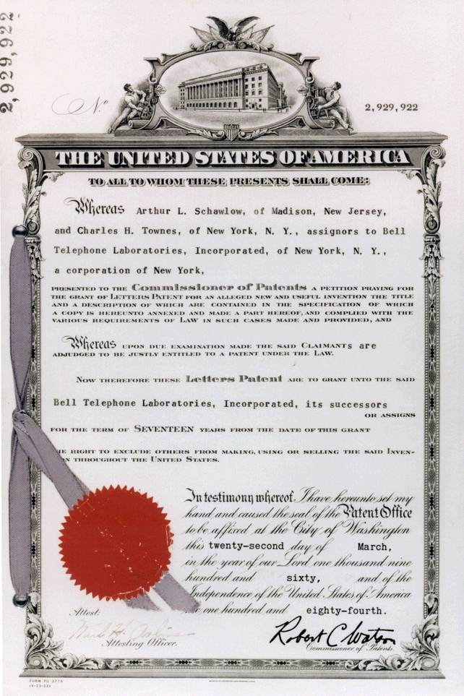
Patents in the USA
Patents Defined
US Constitution and Laws
Utility
Design
Plants
Infringement
Exemption
Remedies
Reform
International Agreements
Recent Case Law Involving Patents

Slide 6
Patents Defined
Word means “open” (14th century Latin)
Defined: “a property right granted by the Government of the United States of America to an inventor ‘to exclude others from making, using, offering for sale, or selling the invention throughout the United States or importing the invention into the United States’ for a limited time in exchange for public disclosure of the invention when the patent is granted.” (Source: http://www.uspto.gov)
Patent Protection = reward for disclosing invention

Slide 7
US Constitution and Laws
US Constitution Article 1, §8, clause 8:
  Progress of science and useful arts
  Limited time of exclusive right to use
    Writings
    Discoveries
1st Patent Act: 1790
Patent Act of 1793
35 USC: Patent Act of 1952, amended 1995
  Utility patents
  Design patents
  Plant patents
Patent Reform Act of 2005
  Proposes significant changes to patent laws
  Not yet passed, in bill format
  See Burgunder p. 79-80, Exhibit 3.1
Most patents
last 20 years

Slide 8
Utility
US Patent Act - §101
  Entitled to a patent for an invention if it is novel, nonobvious, and a proper subject
§103 - New, useful and nonobvious
    Process
    Machine
    Manufacture
    Composition of matter
    Improvement

Slide 9
Novel
US Patent Act §102 excludes patents if
  Previously known or used in US
  Patented or described in printed publication before filing
  In public use or for sale in US >1 year before filing
  Abandoned
  Someone else previously filed for patent on it
  Not invented by applicant
  Also invented by someone else
§102 encourages rapid filing by inventors
  1 year to file

Slide 10
Useful
Reject patent filing if
  Doesn’t work
  Has no defined purpose
Exceptions
  Cannot patent natural process or material
  Abstract mathematical equations or algorithms care not patentable
    However, expressing ideas mathematically or as computer algorithms does NOT preclude patent

Slide 11
Nonobvious
Exclude patent filing if
  Obvious to person with
    Ordinary skill
    In art (meaning science, technique, technology)
What defines “ordinary skill?”
  Awareness of all pertinent prior art
  Types of problems encountered
  Prior art solutions
  Speed of technology change
  Educational level

Slide 12
Design
US Patent Act §171 defines patents for design
  new, original and ornamental design
  Any article of manufacture
  14 year protection
Seiko Epson Corp v Nu-Kote Intl (1999)
  Patent infringement on shape of ink cartridges
  Trial court ruled against plaintiff because cartridges not visible to user, thus not patentable as “design”
  US Court of Appeals reversed lower court
    Patent was valid even if design not visible or obvious to user

Slide 13
Patent Duration
Utility Patents: at least 20 years
  Changed in 1995 to comply with international agreement obligations
Legal protection starts when the PTO (Patent Trademark Office) issues the patent and lasts until expiration
  Note: term begins when filed
    Invention can be used while PTO processes a patent application, even though patent term has not begun
    But once patent granted, patent holder can require royalties for previous use
  Exceptions apply for new pharmaceutical products

Slide 14
Infringement
}
Without permission of patent holder, to
  Make
  Use
  Offer for sale
  Sell
  Import
the patented invention

Slide 15
Exemptions
US Patent Act §273
Good faith
Used subject of patent at least 1 year before filing date of patent
Holder of patent abandoned it for ~6 years or more

Slide 16
Enforcement Issues & Challenges
Patent issued by PTO assumed valid
  Challenger of patent must overcome presumption of validity
  Must show patent invalidly granted by PTO
    Erred in determination that product or process was novel or nonobvious

Slide 17
Remedies
Injunction to stop infringing
  Likely most powerful weapon of patent holder
Damages equivalent to royalty + interest + costs
  Limited to 6 year period before filing of complaint
  Examples:
    Profits from lost sales
Treble damages at discretion of court
  Awarded if willful infringement
Attorney fees in exceptional cases
  E.g., where willful infringement found

Slide 18
Reform
Patent Reform Act of 2005 in works
Currently, US stands alone in first-to-invent approach
  Focuses on novelty inquiry on date of invention rather than date of application
  Likely to join international consensus with Reform Act passage
Drawback to current approach
  Increases litigation expenses
    Determining priority by invention is tough;
    Simple to determine who is the first to file
Challenges to change
  Fairness concerns
  Produce a race to the patent office
    Less thoughtful patent applications?

Slide 19
International Agreements on Patents
Paris Convention for Protection of Industrial Property (1883)
TRIPS (1994)
  Agreement on Trade-Related Aspects of Intellectual Property Rights
  See http://www.wto.org/english/tratop_e/trips_e/tripfq_e.htm
NAFTA (1992)
  North American Free Trade Agreement
  See http://www.ladas.com/BULLETINS/1994/NAFTAGATT.html
  See also http://www.customs.ustreas.gov/nafta/docs/us/chap-17.html

Slide 20

Recent Case Law Involving Patents
In re Bilski
Microsoft v Salesforce.com
i4i v Microsoft
Kodak v Apple & RIM
Elan v Apple
Nokia v Apple v Nokia v…
Apple v HTC
New Troll v Expired Patents
Aussie CSIRO WLAN Patents
Patents & Open Source Software
First We Kill All the Patent Lawyers
Keep Higher Patent Fees?

Slide 21
In re Bilski (1)
1997: Bernard J. Bilski & Rand Warsaw
  Filed patent application for commodities trading methods
  USPTO examiner rejected all claims for patent
  Appealed decision to Board of Patent Appeals and Interferences; rejected
2006: Appealed to Court of Appeals for Federal Circuit (CAFC)
2008: Decision rendered Oct 30
  Upheld rejection of Board in 1998
  9-3 majority argued that machine-or-transformation test was essential for patent
  (cont’d)
Notes:
IN RE BILSKI: US COURT OF APPEALS DISAVOWS STATE STREET BANK RULING
Jennifer Forsyth of the Wall Street Journal wrote, "In a 9-3 decision, the court upheld a ruling made by the Board of Patent Appeals and Interferences that denied a patent for a method of hedging in commodities trading developed by Bernard Bilski and Rand Warsaw…. The ruling in the case, called In re Bilski, largely disavowed the controversial State Street Bank case of 1998. There, the Federal Circuit opened the door to business method patents, which had until then been excluded from patent protection, by granting protection to a system for managing mutual fund accounts. The decision, according to its detractors — which included several members of the Supreme Court — had led to the issuance of weak patents and exposed financial services companies to high-dollar litigation over business method patents."

Slide 22
In re Bilski (2)
Implications of CAFC decision
  Explicitly rejected precedent set in State Street Bank decision of 1998
    That case involved patent on managing mutual fund accounts
  Bilski setting stage for landmark showdown
    Can so-called “business methods” be patented?
      Processes and procedures
      Not widgets
    Affects software, biotech
SCOTUS agreed in June 2009 to hear appeal
  Hearing November 2009
Notes:
SCOTUS TO HEAR ARGUMENTS
In June 2009, the Supreme Court of the United States (SCOTUS) agreed to review the decision and heard the arguments in November 2009. Tony Mauro commented in the Blog of LegalTimes < http://tinyurl.com/n7hmng > that the case is setting the stage for a landmark showdown over whether so-called "business methods" -- processes and procedures, not widgets -- are patentable. The case is a challenge to an en banc ruling last October by the U.S. Court of Appeals for the Federal Circuit that a process for predicting and hedging risk in commodities markets did not deserve a patent, because it was not tied to a machine, and did not result in a physical transformation. The ruling sent ripples through the IP world, with critics saying the decision would slow innovation in the areas of information technology and financial services, where patents are sought -- and had been granted -- for new processes that are less tangible than a physical invention. In an interview when the petition was filed in January, J. Michael Jakes, partner at Finnegan, Henderson, Farabow, Garrett & Dunner, said, 'This is the fundamental question of patent law. It doesn't just affect business methods, but software and the biotech industry as well.' Jakes represents the plaintiff who sought the patent."

Slide 23
Microsoft v Salesforce.com
2010-05: MS accuses CRM vendor of stealing 9 patents
  Seattle Federal Court
  Web-based CRM software
Broad patents; e.g.,
  Displaying Web page using embedded menu
  Stacking toolbars in computer display
Only 4th time MS has sued anyone for patent infringement
Notes:
MICROSOFT SUES SALEFORCE.COM OVER 'CROWN JEWEL' PATENTS
Gregg Keizer, writing for Computerworld, reported that "Microsoft sued Salesforce.com in federal court on Tuesday, alleging that the customer-relationship management (CRM) vendor has violated nine of Microsoft's patents…. According to Microsoft's complaint, which was filed on Tuesday in a Seattle federal court, Salesforce.com is using Microsoft-patented technologies in its Web-based CRM software and service service, and in supporting hardware and software…. Among the patents are several that at a glance appear to be quite broad. One of the nine patents that Microsoft alleged Salesforce.com infringed is entitled 'System and method for providing and displaying a web page having an embedded menu,' while another is labeled 'Method and system for stacking toolbars in a computer display.'"
Although Microsoft has rarely sued anyone for patent infringement (only three times before this case), Microsoft's Deputy Counsel of Intellectual Property and Licensing stated that "Microsoft has been a leader and innovator in the software industry for decades and continues to invest billions of dollars each year in bringing great software products and services to market…. We have a responsibility to our customers, partners, and shareholders to safeguard that investment, and therefore cannot stand idly by when others infringe our IP rights."

Slide 24
i4i v Microsoft (D v G?)
2007: i4i sues MS for patent infringement – use of XML editing tools in OFFICE 2007
2009-05: MS loses trial in Texas
  Fined $300M damages
  Ordered to revise software within 60 days
    Or stop selling Office 2007
2009-09: MS appeals injunction in Court of Appeals for Federal Circuit
  Wins extension to 11 Jan 2010
  But fine stands
MS complied
Notes:
i4i WINS MICROSOFT APPEAL: COURT BANS OFFICE 2007 SALES PENDING REVISIONS
Gregg Keizer of Computerworld summarized an interesting case of patent infringement as follows (paraphrasing from his article):
* In 2007, the Canadian software company i4i sued Microsoft (MS) for patent infringement, alleging that had used XML editing tools in its Office 2007 products.
* In May 2009, MS lost the case before a Texas court and was fined $300M in damages.
* The judge in the trial then issued an injunction in August ordering MS to revise within 60 days to comply with the ruling or stop selling Office 2007.
* In its appeal against the injunction in September 2009 before the Court of Appeals for the Federal Circuit, MS claimed that 60 days was an impossible deadline.
* Several computer manufacturers including HP and DELL filed amicus curiae briefs supporting the extension of the deadline, concurring that otherwise "sales chaos would result."
* The appeals court rules in December 2009 that a five-month delay was reasonable, meaning that all news copies of Office 2007 (and its components) sold after 11 Jan 2010 must comply with the ruling of the lower court.
* The three judges of the appeals court also reaffirmed the jury award of $300M in damages to be paid to i4i.
[Gregg Keizer, Computerworld, 22 Dec 2009 < http://tinyurl.com/yal4h8d >]

Slide 25
Kodak v Apple & RIM
2010-01: Kodak sues Apple & RIM
After years of negotiation
Issue: “method for previewing camera phone images that has been patented by Kodak.“ [Brad Reed, Network World]
Other companies had licensed technology under patent
  Motorola
  Nokia
  Samsung
Notes:
KODAK SUES APPLE AND RIM FOR PATENT INFRINGEMENT OF IMAGE PREVIEWS
After years of discussion among Kodak, Apple and RIM (makers of the Blackberry phone), negotiations broke down in January 2010 and Kodak finally sued the two phone manufacturers for their use of what Brad Reed of Network World summarized as "a method for previewing camera phone images that has been patented by Kodak." That technology has been licensed "to several major tech companies, including Motorola, Nokia and Samsung," wrote Reed.

Slide 26
Elan v Apple
2010-04: Elan Microelectronics of Taiwan
  Charges Apple with patent infringement
  Technology for touch-sensitive devices
  Used in iPad, iPhone, iPod Touch, MacBook, Magic Mouse
Filed complaint with US International Trade Commission
  Demanded ban on import of affected goods into US
  Until licensing issues resolved
Case scheduled for June 21, 2010 in San Francisco
Notes:
ELAN MICROELECTRONICS FILES COMPLAINT WITH INTL TRADE COMMISSION AGAINST APPLE FOR PATENT INFRINGEMENT IN IPHONE AND IPAD
Elan Microelectronics of Taiwan charged Apple with illegally using its patents on technology that detects fat-fingering touch-sensitive devices. Agam Shah of the IDG News Service explained that the technology confers "the ability to detect the simultaneous presence of multiple fingers on touch devices. The technology involved is used in the iPad, iPhone, iPod Touch, MacBook and Magic Mouse products." The complaint filed with the US International Trade Commission in April 2010 demanded that Apple be forbidden to import any of the affected products into the US until the licensing issues are resolved. The case was scheduled to continue on June 21 in San Francisco.

Slide 27
Nokia v Apple v Nokia v….
2009-10: Nokia sues Apple
  Infringing 10 of its patents in iPhone concerning wireless networks
2009-10: Apple files countersuit
  Patent infringement by Nokia of 13 Apple patents
2009-12: Nokia files complaint with US Intl Trade Commission
  7 more patents relating to interface, camera, antenna, power management
2010-05: Nokia adds 5 more patents to its charges
  Signal-to-noise modulation, geo-location, antenna technologies
Notes:
NOKIA CLAIMS IPAD, IPHONE INFRINGE FIVE NOKIA PATENTS
In October 2009, Nokia, the Finnish mobile-phone manufacturer, sued "Apple in the U.S. District Court for the District of Delaware. Nokia, the world's largest mobile handset maker, alleged in that lawsuit that Apple infringed 10 of its patents related to wireless technologies used in the iPhone. Apple countersued earlier this month, charging that Nokia has infringed on 13 Apple patents." [Nancy Weil, Computerworld, 29 Dec 2009 < http://tinyurl.com/35f3je9 >]. Apple promptly countersued on the basis of 13 alleged violations of its patents by Nokia.
Then in December 2009, Nokia complained to the US International Trade Commission that Apple had infringed seven critical patents "related to the user interface and camera, antenna and power management technologies." [Ibid.] Nokia then filed almost identical claims with a Federal court in Delaware, asking for an injunction barring Apple from importing its products into the US. [Gregg Keizer, Computerworld, 5 Jan 2010 < http://tinyurl.com/yclee3p >]
In May 2010, Nokia added five more specific alleged infringements of its patents by Apple in the iPad and iPhone covering "signal-to-noise modulation, geo-location and antenna technologies."[Gregg Keizer, Computerworld, 7 May 2010 < http://tinyurl.com/32s65rt >]

Slide 28
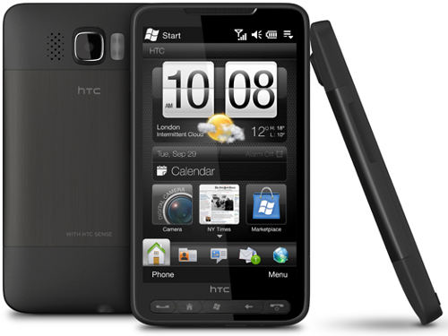
Apple v HTC
2010-03: Apple files for patent infringement v HTC
  Taiwan-based mfr
  Android, Touch Pro, Imagio, Tilt mobile phones
US District Court in
Delaware
US International
Trade Commission
Notes:
APPLE CLAIMS HTC INFRINGES ON 20 OF ITS PATENTS
Apple filed a patent infringement lawsuit in the US Disctrict Court in Delaware in March 2010 against the Taiwan-based manufacturer of the Android, Touch Pro, Pure, Imagio and Tilt mobile phones for allegedly trampling on 20 of Apple's patents. The US company also filed a complaint with the US International Trade Commission.

Slide 29
New Troll v Expired Patents
2010-03: Attorney Thomas Simonian
10 cases filed against dozens of corporations
All filed between 25 Feb & 4 Mar
  Northern IL Fed Circuit Court
All alleging companies are using expired patents as if valid
Could be bonanza:
  $500 per infraction (sale of device)
  Half profit to attorney, half to govt
  Plus court costs
Notes:
ATTORNEY SUES SEVEN FIRMS FOR CLAIMING EXPIRED PATENTS AS VALID
Michael Thompson reported on an interesting tactic in March 2010: Attorney Thomas Simonian had ten current cases pending before the Northern Illinois Federal Circuit Court filed between 25 Feb and 4 Mar 2010 against dozens of corporations. In all cases, the attorney alleges that the companies have been using expired patents as if they were valid. Thompson explains, "If he's right, he'll collect millions, at $500 per infraction, half to himself and the other half to 'the government'. (Oh, and his court costs to be paid by the defendant, naturally.)"

Slide 30
Aussie CSIRO WLAN Patents
2010-05: Australian CSIRO* sues 3 US mobile phone operators
  AT&T
  Verizon
  T-Mobile
Infringing on patents for using Wi-Fi in phones
  IEEE 802.11 a, b, g, & n
  Warned companies in 2009 that they were infringing
*Commonwealth Scientific and Industrial Research Organization
Notes:
AUSTRALIA'S CSIRO HITS U.S. CARRIERS ON WLAN PATENTS
Stephen Lawson of IDG News Service writes, "The Australian Commonwealth Scientific and Industrial Research Organization (CSIRO) is suing three of the largest U.S. mobile operators, charging they infringed a patent by selling wireless LAN products. CSIRO last year settled with 14 wireless LAN vendors, including Microsoft, Hewlett-Packard and Dell, after suing them in 2005 over the same patent. The current lawsuits, filed in late February in the U.S. District Court for the Eastern Division of Texas, target AT&T, Verizon Wireless and T-Mobile USA."
Lawson explains that CSIRO is charging that AT&T, Verizon and T-Mobile are infringing its patents by including Wi-Fi functions in their smartphones using "U.S. Patent No. 5,487,069, issued in 1996, entitled 'Wireless LAN,' which it claims covers fundamental aspects of the IEEE 802.11a,b,g and n standards." CSIRO further charges that it informed the companies of their infringement in 2009.

Slide 31
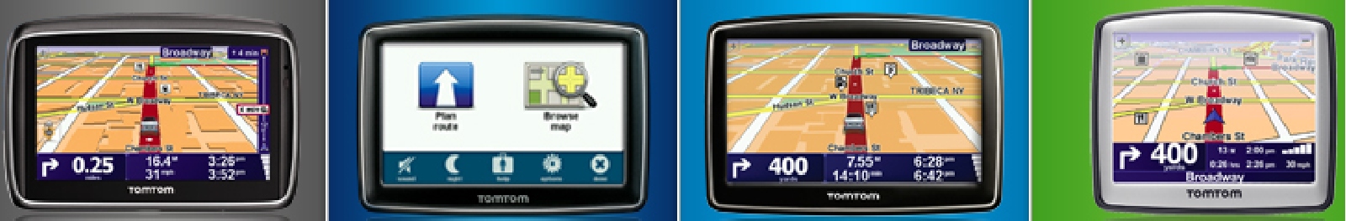
Patents and Open Source Software
2009-02: Microsoft & TomTom enter negotiations
  TomTom makes GPS navigation devices
  Use elements of LINUX kernel
  MS threatened to sue over use of patented MS FAT OS components
2009-03: agreeement
  2 years to remove offending components
  No lawsuits during that time
Notes:
MICROSOFT AND TOMTOM SETTLE PATENT DISPUTE OVER LINUX KERNEL
After extensive discussions in March 2009 between the GPS navigation device manufacturer TomTom and Microsoft, the two companies agreed that TomTom, which uses the Linux kernal, would pay Microsoft license fees for the sections of its code using elements of the FAT operating system. TomTom would also remove that functionality by 2011 and Microsoft would refrain from suing them. Ryan Paul, writing in Ars Technica, wrote, "Although the settlement has ended the conflict between Microsoft and TomTom, questions still remain about the implications for FAT in the broader Linux ecosystem. Microsoft has previously stated that this lawsuit represents an isolated issue and that the company does not intend to broadly sue Linux users. Upstream kernel developers could potentially adopt TomTom's code changes in order to avoid future patent disputes with Microsoft over FAT."[Ryan Paul, Ars Technica, 30 Mar 2009 < http://tinyurl.com/3emf95 >]

Slide 32
Defensive Patent License (DPL)
2010-05: Jason Schultz and Jennifer Urban
  Law professors
  Directors, UC Berkeley's Samuelson Law, Technology & Public Policy Clinic
DPL similar to GPL (GNU General Public License)
  Open source software protection
Pool resources to fight patent trolls
Avoid exploitation by commercial companies who seize open-source materials
Notes:
DEFENSIVE PATENT LICENSE MAKES PATENTS LESS EVIL FOR OPEN SOURCE
"Open Source Subnet" reported in May 2010 on a new development that could help open-source developers:
>Two law professors from UC Berkeley have come up with a novel idea to protect open source developers from patent bullies. They call it the Defensive Patent License. They hope the DPL can address the objections FOSS developers have with patents the way the GPL addressed them for copyright.
Open source developers notoriously shy away from pursuing software patents. The concept is ugly to them…. But without patents of their own, FOSS developers have limited their defense against patent bullies, those seeking to stop innovation by filing patent infringement suits. And to some extent, having no patents makes them vulnerable to patent trolls, those who make no product and buy patents to collect royalties. So says the DPLs creators, Jason Schultz and Jennifer Urban, law professors and directors of UC Berkeley's Samuelson Law, Technology & Public Policy Clinic.<

Slide 33
“First We Kill All the Patent Lawyers” – S. J. Vaughan-nichols
2010-05: Computerworld
  Assured readers he did not mean literally
US patent system is dysfunctional
  Supposed to encourage innovation
  In re Bilski threatens software industry
  Searching for possible infringement opens inventor to increased liability
  Increasing # companies paying settlements even when infringement claims wrong: cheaper
  Patent trolls & anti-competitive large companies exploiting system
Notes:
US PATENT SYSTEM IS DYSFUNCTIONAL
Steven J. Vaughan-nichols of Computerworld wrote a blistering attack on the state of US patent law and administration in May 2010. Entitled, "First, we kill all the patent lawyers," the article makes the following key points:
* "In the beginning, the U.S. patent system was meant to encourage inventors and innovation."
* The Bilski case (US Court of Appeals for the Federal Circuit "In re Bilski") of 2008 reversed the 1998 ruling by the Federal Circuit (the State Street Bank case) in which general business methods had been permitted as a basis for granting patents, but the SCOTUS still has not ruled on the appeal.
* Many software patents are similar to business process patents in that "there is no specific language, no hard code, but only descriptions of general processes that can be implemented in multiple ways."
* Patent applicants who do search for possible infringement before filing their application may be liable for even more severe penalties on the grounds that "you might have been aware that what you were doing was in violation of a patent."
* Companies are pay settlements in the $M even if the patent-infringement claims are unfounded simply to avoid litigation and the possibility of penalties in the $100M range.
* The US patent system is broken: "As it is now, any software program can be attacked either by patent trolls -- companies that do nothing but collect patents and then look for companies that might be implementing the ideas within them -- or by big companies wanting to stomp out competition."

Slide 34
Keep Higher Patent Fees?
2010-05: House Judiciary Ctee
  John Conyers (D-MI) & Lamar Smith (R-TX)
  Patent and Trademark Office Funding Stabilization Act
Support USPTO
  Reduce 2-year backlog of unprocessed applications
  750,000 patents uncleared
  500,000 new applications per year
Prevent Congress from diverting patent fees into general US govt revenues
Increase fees for processing
Hire new staff
Notes:
LEGISLATION IN HOUSE WOULD ALLOW USPTO TO INCREASE FEES
A proposal by John Conyers (D-MI) and Lamar Smith (R-TX) from the House Judiciacy Committee introduced the Patent and Trademark Office Funding Stabilization Act in the US House of Representatives in mid-May 2010. The proposed bill would support the USPTO in reducing its current two-year backlog (including 750,000 patents) in processing patents by hiring new experts and by stopping the long-standing practice through which Congress steals, er, diverts patent fees from the Agency.

Slide 35
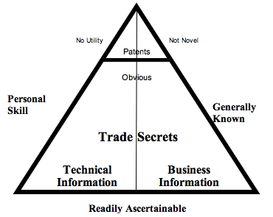
TRADE SECRETS
Definition of Trade Secrets
Protection
Polices & Law
Damages
International Issues
Industrial Espionage
Image Copyright © 2007 Karl Jorda. All rights reserved.
Used by kind permission of Webmaster.
http://blogs.piercelaw.edu/tradesecrets/tradesecretdiagram.gif
FROM: http://www.jordasecrets.com/2007/10/jorda_on_what_is_and_what_is_n.html

Slide 36
Definition
“In most states, a formula, pattern, physical device, idea, process, compilation of information or other information that
  provides a business with a competitive advantage, and
  is treated in a way that can reasonably be expected to prevent the public or competitors from learning about it, absent improper acquisition or theft.”*
Sometimes referred to as confidential information or proprietary knowledge
See also Burgunder p. 212
_____
* http://www.nolo.com/dictionary/trade-secret-term.html

Slide 37
Purpose of Trade Secret Laws
Protect valuable creative ideas at various stages of development
Patents cover completed inventions & processes
  Require inventions be
    novel and
    Nonobvious
Trade secrets require only information be valuable

Slide 38
Trade Secret Policies & Law
Formula
Pattern
Compilation
Program
Device
Method
Technique
Process
Uniform Trade Secrets Act (UTSA)
  Information
  Derives independent economic value
  from secrecy
  Subject of reasonable efforts
  to maintain secrecy
Contrast with patent (“patent” means “open”)
Unauthorized use of trade secret can lead to civil tort for misappropriation

Slide 39
Misappropriation Defined
Trade secret holder entitled to remedies when misappropriation occurs:
Acquiring trade secret by improper means
Disclosing or using trade secret reasonably knowing that such conduct violates duty to maintain confidence
While reasonably knowing of the impropriety, using or disclosing secret received from another who improperly obtained it
While reasonably knowing about fiduciary breach, using or disclosing secret that was disclosed by another under such a duty to maintain confidence
(See Burgunder p. 213)

Slide 40
State Laws on Trade Secrets
State Level: Most states have separate statutes criminalizing trade secret theft
American Law Institute (ALI)
  1995: Restatement (Third) of Unfair Competition
National Conference of Commissioners on Uniform State Laws
  1979: formulated UTSA
  Uniform Trade Secrets Act
  Model for state legislatures to follow to pass statutes that codify policies
  By 2005, 44 states & District of Columbia had statutes based on UTSA

Slide 41
Federal Level
Trade Secrets Act (18 USC §1905)
Economic Espionage Act (18 USC §1831 et seq.)

Slide 42
Trade Secrets Act
18 USC §1905
Covers
  Unauthorized disclosure
  Of secrets relevant to government work
    Contracts
    Investigations
    Reports
  By government employee or agent only
Text on next slide

Slide 43
Trade Secrets Act (Text)
Whoever, being an officer or employee of the United States or of any department or agency thereof, any person acting on behalf of the Office of Federal Housing Enterprise Oversight, or agent of the Department of Justice as defined in the Antitrust Civil Process Act (15 U.S.C. 1311–1314), or being an employee of a private sector organization who is or was assigned to an agency under chapter 37 of title 5, publishes, divulges, discloses, or makes known in any manner or to any extent not authorized by law any information coming to him in the course of his employment or official duties or by reason of any examination or investigation made by, or return, report or record made to or filed with, such department or agency or officer or employee thereof, which information concerns or relates to the trade secrets, processes, operations, style of work, or apparatus, or to the identity, confidential statistical data, amount or source of any income, profits, losses, or expenditures of any person, firm, partnership, corporation, or association; or permits any income return or copy thereof or any book containing any abstract or particulars thereof to be seen or examined by any person except as provided by law; shall be fined under this title, or imprisoned not more than one year, or both; and shall be removed from office or employment.
http://www4.law.cornell.edu/uscode/html/uscode18/usc_sec_18_00001905----000-.html

Slide 44
Economic Espionage Act of 1996 (EEA)
18 USC §1831 et seq.
Criminalizes unauthorized disclosure of government OR commercial secrets by anyone
Includes penalties for those receiving such information
See text on next slide

Slide 45
EEA Text
§ 1831. Economic espionage
(a) In General.— Whoever, intending or knowing that the offense will benefit any foreign government, foreign instrumentality, or foreign agent, knowingly—
  (1) steals, or without authorization appropriates, takes, carries away, or conceals, or by fraud, artifice, or deception obtains a trade secret;
  (2) without authorization copies, duplicates, sketches, draws, photographs, downloads, uploads, alters, destroys, photocopies, replicates, transmits, delivers, sends, mails, communicates, or conveys a trade secret;
  (3) receives, buys, or possesses a trade secret, knowing the same to have been stolen or appropriated, obtained, or converted without authorization;
  (4) attempts to commit any offense described in any of paragraphs (1) through (3); or
  (5) conspires with one or more other persons to commit any offense described in any of paragraphs (1) through (3), and one or more of such persons do any act to effect the object of the conspiracy, shall, except as provided in subsection (b), be fined not more than $500,000 or imprisoned not more than 15 years, or both.
(b) Organizations.— Any organization that commits any offense described in subsection (a) shall be fined not more than $10,000,000.
http://www4.law.cornell.edu/uscode/html/uscode18/usc_sec_18_00001831----000-.html

Slide 46
EEA Penalties include
Up to 15 years in jail
MAX($500,000 fine or 2x value)
Forfeiture
Import-export restrictions

Slide 47
UTSA Remedies for Misappropriation
Damages ($)
  Amount needed to compensate the trade secret holder for losses
  Amount of unjust enrichment earned by unlawful use or disclosure
Injunctions
  Preventing use
    Including “threatened misappropriation”
  To obtain preliminary injunction, must prove:
    Irreparable harm
    Strong likelihood of success of winning if case goes to trial

Slide 48
First Amendment Issues
Opponents of corporate actions have revealed trade secrets to press
  Concerned or disgruntled employees
  Journalists or activists using social engineering (e.g., Ciarelli)
Can corporations impose prior restraint to prevent publication?
  Generally, no: 1st Amendment protects such publication absent compelling reasons to interfere
  May still prosecute for industrial espionage after the fact

Slide 49
Reverse Engineering
Defined in Computer Desktop Encyclopedia:
  To isolate the components of a completed system. When a chip is reverse engineered, all the individual circuits that make up the chip are identified. Source code can be reverse engineered into design models or specifications. Machine language can be reversed into assembly language (see disassembler).
Applicability to discussion of trade secrets
Ethical considerations
  State trade secret law (misappropriation prohibitions) v. acquisition of info through reverse engineering

Slide 50
International Trade Secret Protection
TRIPS agreement
  Agreement on Trade-Related Aspects of Intellectual Property Rights
  Members of the World Trade Organization (WTO) must protect “undisclosed information”
  Does not use trade secret term
  WTO members required to enforce their own trade secret laws with remedies
Issues
  Enforcing contractual obligations / confidentiality agreements
  Determining damages
  Durational periods – variation in time limits for maintaining secrecy of info
  Need to exercise caution with trade secrets overseas

Slide 51
Ipreo v Goldman Sachs
2010-05: Illegal access to database
Ipreo Holdings of NY
  Provides banks & corporations w/ business intelligence & software
  Bigdough DB (!)
Sued GS in Southern District of New York
  Accused GS employees of illegal access
  GS allegedly downplayed seriousness
  $2M punitive damages
  ≥$1M compensatory damages
Notes:
IPREO SUES GOLDMAN SACHS FOR ILLEGALLY ACCESSING IPREO DATABASE
Ipreo Holdings LLC of New York provides banks and corporations with market intelligence and special software. Claiming that Goldman Sachs employees accessed their Bidgough database without permission at least 264 times in 2008 and 2009, the company sued Goldman Sachs in the U.S. District Court for the Southern District of New York on May 6, 2010 for $2M in punitive damages and a minimum of $1M in compensatory damages. The lawsuit also claims that Goldman Sachs downplayed the situation when informed of the security breaches, claiming that only one rogue employee must have been involved in the massive downloads of information from the database.

Slide 52
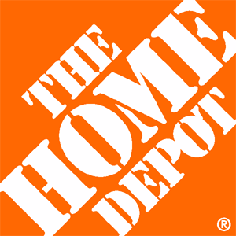
Home Depot Steals Invention
Michael Powell, inventor
  20-yr relation with HD
  2004: shows HD finger guard prototype
HD steals design
  Makes 2,000 copies
  Executive says, “Fuck Michael Powell. Let him sue us.”
So he did. Decision 2010-05:
  $3M punitive damages
  $15M restitution
  $2.8M legal fees
  $1M/year interest starting 2006
  (year patent granted)
Notes:
HOME DEPOT CONVICTED OF STEALING INVENTOR'S IDEA
Inventor Michael Powell had a 20-year relationship with Home Depot. In 2004, he brought the prototype of his then-unpatented finger-guard for protecting workers from radial saws to the company to help reduce injuries when cutting wood for customers. He was shocked when Home Depot simply stole his design and manufactured thousands of the devices for their own use without payment. A Home Depot executive, informed that Powell would sue for theft of trade secrets, said, "Fuck Michael Powell. Let him sue us."
In May 2010, U. S. District Judge Daniel Hurley angrily ordered the company to pay the inventor $3M in punitive damages. In March, a jury had ordered a fine of $15M in restitution. The judge also ordered payment of $2.8M in legal fees and $1M a year in interest starting in 2006, the year Powell obtained his patent on the "Safe Hands" device.
The judge's blistering ruling also included severe criticism of Home Depot's attorneys. According to Jane Musgrave of the Palm Beach Post, "He also criticized Home Depot attorneys for their handling of the case, which he described as 'nasty, mean litigation.' For instance, when Powell's attorney asked for records of injuries caused by the saws, Home Depot attorneys handed over 6,000 documents. In a spot check of 2,300 pages, Powell's attorneys found one document that dealt with a saw injury. 'This is the kind of activity that people look at that engenders outright disgust for the legal profession,' Hurley said. 'It is shameful.'"
Total settlement: about $25M. Original bill if Home Depot had paid the inventor his asking price in 2004: $4M.
Fuck you indeed.

Slide 53
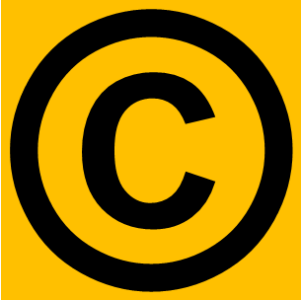
Copyright
Copyright purpose & history
Legal formalities
Felony Violations
Misdemeanor Violations
1st Amendment Issues
Defenses to Infringement
Fair Use
Recent Developments in Copyright Law

Slide 54
Purpose
Stimulate creativity
Protect creative investments of authors & artists
Mechanisms:
Protect intellectual property
  Prevent loss of control or possession
Gainful return on investment

Slide 55
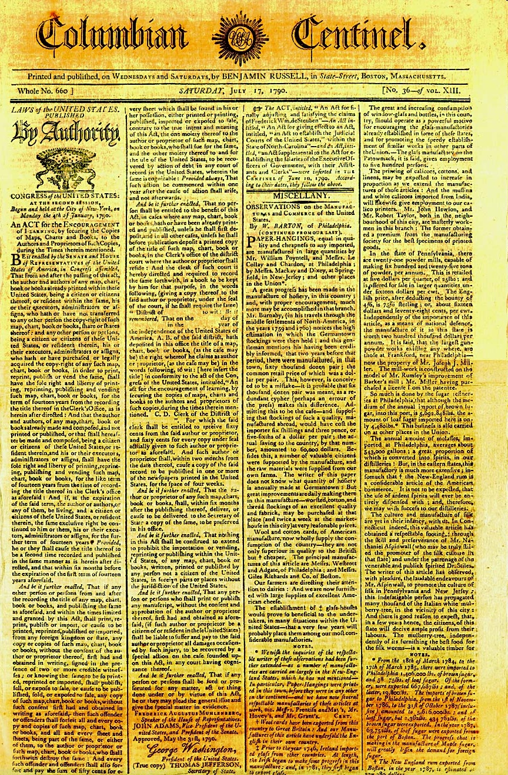
History (1)
Copyright Act of 1790 -- based on Statute of Anne (1710) in England
http://tinyurl.com/kb295
Thanks to Prof Robert Guess of Tidewater Community College!

Slide 56
History (2)
Early 1900s: Federal copyright laws improved
  Despite technological advances, fundamental objective remains constant
  Multiple amendments of federal copyright statute to accommodate advances
    Question: Can the law evolve fast enough to accommodate change?
1995: Digital Performance Right in Sound Recordings Act (DPRA)
  Passed before pervasiveness of webcasting
1998: Digital Millennium Copyright Act (DMCA)
  among other requirements, created new statutory license fee requirement for webcasting services
Prof Guess also contributed this link: Copyright Office maintains
a useful timeline of United States Copyright Laws:
http://www.copyright.gov/circs/circ1a.html

Slide 57
What is Protected by Copyright?
Reproduction
Preparation of derivative works
Distribution
Performance
Display in public

Slide 58
Formalities
Original work is automatically copyrighted in the name of the author / creator
  Theoretically not necessary to indicate “Copyright © 2009 name-of-author. All rights reserved.”
  But highly advisable to do so to strengthen legal position in case of claimed doubt.
  Written assertion of copyright eliminates defense of innocent infringement of copyright
May register US works with US Copyright Office
  Offers increased protection
  $500-$20,000 statutory damages
  Register within 3 months of publication

Slide 59
Works Made for Hire
Full-time employees generally forfeit claim to work created expressly for purpose of their job
  Copyright belongs to the employer
Employers' rights do not apply to creative work outside employment
    Not created with employer facilities, tools
    Not interfering with regular work
    Created outside normal working hours
Problems can occur when creative outside work is directly related to job function

Slide 60
Contractual Sale
Copyright ownership may be traded or sold
Employers often include clause claiming copyright over all creations by employee
  Sometimes specify work created for any purpose and at any time
    E.g., children's story book
  No obligation to agree to such clause
  But no obligation to hire employee without such agreement
Publishers almost always try to get all rights
  Recent case distinguishes between paper publication and electronic publication

Slide 61
Infringement
Any use without express permission of copyright holder
  Printing
  Posting on Web
  Using in derivative work
Direct infringement
  Monetary profit is not an issue
  Distributing someone else's work for free is not a mitigating factor
Contributory infringement: ISPs?
  Requires substantial or pervasive involvement

Slide 62
Facts?
Factual information cannot be copyrighted in itself; e.g.,
  2+2 = 4
  Distance between Norwich and Montpelier
The representation of factual information can be copyrighted; e.g.,
  A times-table designed for children with pictures of friendly animals romping around edge of the table
  A map of Vermont with particular fonts, colors, and symbols

Slide 63
Burden of Proof for Felony
Copyright existed
Defendant infringed the copyright by reproduction or distribution of the work
Defendant acted willfully (intent – mens rea)
Defendant reproduced or distributed
  ≥10 copies of
  ≥1 copyrighted works with
  a total value of ≥$2,500
  within a 180-day period
Punishment: ≤5 years and/or fine;
  If no reproduction or distribution, fine & imprisonment ≤1 year;
  Harsher penalties for subsequent offenses

Slide 64
Burden of Proof For Misdemeanor
Copyright existed
Defendant infringed copyright by reproduction and/or distribution
Defendant acted willfully
Defendant either reproduced or distributed the copyrighted material for the purposes of commercial advantage or private financial gain or distributed or copies ≥ 1 copyrighted works with a total retail value of more than $1,000 within a 180-day period
Showing of commercial advantage or private financial gain = penalty enhancer

Slide 65
1st Amendment?
Does the 1st Amendment protect unauthorized copying of copyrighted works?
  Some defendants have claimed 1st Amendment protections when publishing work of public officials
But SCOTUS* ruled that even a public official's own copyrighted materials cannot be infringed
No ban on publishing the substance of such documents; only on publishing exact form
*SCOTUS: Supreme Court of the United States

Slide 66
Defenses to Copyright Infringement: First Sale
Allows someone who buys a copyrighted work to freely distribute copy bought
But only copy actually bought,
NOT copies of the item bought
Typically doesn’t apply when someone is charged with software piracy (Clifford)
Warning: upgrades to software
  Upgrades typically purchased with reduced cost when earlier version available
  Earlier version cannot legally be sold or given away if upgrade is in use
  E.g., if Windows XP bought as upgrade from Windows ME, must keep Windows ME disk to justify use of XP upgrade

Slide 67
Defenses to Copyright Infringement: Lack of Intent
Did not act willfully
  “No Electronic Theft Act” – amended 17 USC § 506(a) states that “evidence of reproduction or distribution of a copyright work, by itself, shall not be sufficient to show willful intent
  Courts disagree whether willful refers to intent to copy the material or intention to infringe the owner’s copyright
    Most interpret willfulness as specific intent to violate copyright laws
Other defenses:
  Statute of limitations (government has 5 years to bring charges)
  Fair use (see following slides)

Slide 68
Fair Use Exception
Copyright Act (Sections 107-122) lists a number of exceptions to set of protected rights, including fair use
Fuzzy exceptions, although some specifics
  E.g., Section 109: provides that one who owns a copy of a protected work may distribute the copy without getting permission from the copyright owner (First-sale doctrine)
“The notion of fair use acknowledges that copyrights provide substantially broad rights, and that there may be occasions when strict application of those privileges interferes with the public interest.” (Burgunder p. 278)

Slide 69
Fair Use Doctrine:
17 USC § 107
Equitable defense to copyright infringement
Excepts otherwise infringing use of a work for certain purposes
  Criticism
  Comment
  News reporting
  Teaching (including copies for classroom use – with some limitations)
  Scholarship
  Research
Fair Use issues are usually litigated as civil infringement cases

Slide 70
Fair Use
Codified in part in 17 USC §107-118 (Copyright Act)
Fuzzy doctrine: no specific # words, lines
See http://www.copyright.gov/fls/fl102.html
Key issues (quoting from above ref):
the purpose and character of the use, including whether such use is of commercial nature or is for nonprofit educational purposes;
the nature of the copyrighted work;
amount and substantiality of the portion used in relation to the copyrighted work as a whole; and
the effect of the use upon the potential market for or value of the copyrighted work.

Slide 71
Fair Use Guidelines
Guidelines for determining if your use of copyrighted materials qualifies as fair use*:
1. Is your use noncommercial?
2. Is your use for purposes of criticism, comment, parody, news reporting, teaching, scholarship, or research?
3. Is the original work mostly fact (as opposed to mostly fiction or opinion)?
4. Has the original work been published (as opposed to sent out only to one or a few people)?
5. Are you copying only a small part of the original work?
____________
* Larry Lessig, David Post and Eugene Volokh in Cyberspace Law for Non-Lawyers (1996): http://w2.eff.org/legal/CyberLaw_Course/index.html

Slide 72
Fair Use – cont'd
6. Are you copying only a relatively insignificant part of the original work (as opposed to the most important part)?
7. Are you adding a lot new to the work (as opposed to just quoting parts of the original)?
8. Does your conduct leave unaffected any profits that the copyright owner can make (as opposed to displacing some potential sales OR potential licenses of reprint rights)?
The more YES answers there are to the above questions, the more likely it is that your use is legal.
The more NO answers there are, the more likely it is that your use is illegal.
So is this use of the Fair Use text a fair use?

Slide 73
Recent Legal Developments In Copyright
Capitol v Thomas-Rasset
RIAA v Tenenbaum
RIAA wants ISPs to be © Cops
IFPI v Google v Bloggers
UK’s Ofcom Publishes Draft Antipiracy Regs
Irish ISP Attacks File Sharers
Italian ISPs Still Common Carriers
Novell & Unix Code

Slide 74
Capitol v Thomas-Rasset (1)
2007-04: Jammie Thomas (now Thomas-Rasset)
  Sued by RIAA for using Kazaa to steal 24 tracks
  Actually stole 1,702
  1st individual in US to be sued
  Convicted & fined
    $9,250 per song
    Total $222,000 penalties
2009-06: retrial for procedural errors in 1st trial
  Convicted again
  Jury awarded $80,000 per song
  Total penalty now $1.92M
Notes:
CAPITOL V. THOMAS-RASSET LEGAL SAGA CONTINUES
Jammie Thomas (now Jammie Thomas-Rasset), then 30 years old, was sued in April 2007 (the original case was Virgin v. Thomas) by the RIAA for copyright infringement using Kazaa -- the first individual to be tried in this way in the US. Although the plaintiffs claimed that she shared 1,702 tracks, they charged her for only 24; the jury ignored her defense that she didn't do it and ruled against her, assessing damages of $222,000 ($9,250 for each of 24 songs). However, the judge in the original trial ordered a retrial because the jury had been instructed to consider "making the music available" for illegal download equivalent to participating in illegal file sharing. In the retrial, in June 2009, the jury ruled that the defendant was guilty of wilful copyright infringement; this time, they assessed statutory damages of $1.92M ($80K for each of the 24 songs).

Slide 75
Capitol v Thomas Rasset (2)
2010-01: Damages reduced
  U.S. District Court of the District of Minnesota
  Judge Michael Davis
  Ruled damages abusive
RIAA offered settlement: $25,000
  Thomas-Rasset & attorneys refused
  Preparing for 3rd trial
Questioning constitutionality of damages
  Intended for commercial copyright infringers
  Not individuals
Notes:
(cont’d)
Shortly thereafter, Thomas-Rasset and her attorneys filed for a retrial, reduction of damages or removal of statutory damages. In January 2010, U.S. District Court Judge Michael Davis of the District of Minnesota reduced damages to $54,000 ($2,250) per song and the plaintiffs then offered Thomas-Rasset a settlement for "only" $25,000. She refused. The RIAA and Thomas-Rasset's attorneys were preparing for a third trial. Jaikumar Vijayan, writing in Computerworld, reported that "Several lawyers, rights groups and even the judges in the two music piracy cases that have gone to court have questioned the constitutionality of the damages. They have said that the laws were meant to be applied against commercial copyright infringers and not individuals such as Thomas-Rasset."

Slide 76
RIAA v Tenenbaum
2009-07: Joel Tenenbaum convicted
  Boston University grad student
  Admitted to downloading songs illegally
    800 on computer
    24 specified in trial
  Convicted and fined
    $22,500/song
    $675,000 total penalties
2010-01: Hoping for reduction on appeal
  Citing Thomas-Rasset case (qv)
Notes:
RIAA v. TENENBAUM
In July 2009, Joel Tenenbaum, a Boston University graduate student, was convicted of illegally downloading 24 songs owned by members of the Recording Industry Association of America (RIAA), which sued in federal court in Boston in a jury trial -- the second (after Capitol v. Thomas-Rasset) such trial in the US. Tenenbaum admitted under oath that he did in fact download and distribute songs (there were 800 illegal downloads on his computer), but he and his attorney, Charles Nesson of the Harvard Law School, argued that there was in fact little damage to anyone. The RIAA argued that the damages should be assessed on the basis of lost revenues due to the illegal distribution of the copyrighted materials. Tenenbaum and Nesson tried to assert fair use, but before the trial began, Judge Nancy Gertner ruled that Tenenbaum would not be permitted to submit a fair-use defense and explicitly ruled during the trial that there was no basis for such an argument. The jury awarded damages of $22,500 per song, for a total of $675,000 in penalties. In January 2010, Tenenbaum expressed optimism that his appeal could result in a lower fine because of the decision in the Thomas-Rasset case in which a $1.92M fine was reduced to $54K. However, said Tenenbaum, even a tenfold reduction of his own fine -- to a mere $67K -- would bankrupt him.

Slide 77
RIAA wants ISPs to be © Cops
2010-01: Recording Industry Association of America
  Brief to FCC
  Net neutrality enquiry
ISPs should police subscribers’ behavior
  Unique position to spot infringement of copyright
  Should terminate access when users ignore warnings 3 times
Notes:
RIAA TELLS FCC: ISPS NEED TO BE COPYRIGHT COPS
The Recording Industry Association of America (RIAA) submitted a brief to the Federal Communications Commission's (FCC's) request for comments about net neutrality in early January 2010 arguing that ISPs should be able to control their subscribers' access to illegal file-sharing sites and other forms of copyright infringement. "ISPs are in a unique position to limit online theft. They control the facilities over which infringement takes place and are singularly positioned to address it at the source. Without ISP participation, it is extremely difficult to develop an effective prevention approach." Other arguments submitted by supporters of ISP involvement in antipiracy efforts were that illegal file sharing contributes to network congestion.
The RIAA proposed that ISPs terminate access to users who are shown to have violated copyright laws more than three times; ISPs vigorously objected to any such rules. Opponents argued that ISPs were "poorly placed to determine whether or not transfers of content are infringing or otherwise unlawful, a task generally reserved to attorneys, courts, and law enforcement" and warned that infringing net neutrality would also hurt access to the Internet by minority and underprivileged demographic groups.

Slide 78
IFPI v Google v Bloggers
2010: International Federation of the Phonographic Industry (IFPI)
  Sends take-down orders to Google
  Remove hundreds of songs from music blogs
  Google shuts down 6 popular music blogs
Errors
  Many songs were legitimately posted with written permission
  Google failed to abide by DMCA requirements for 2 week notice
  Bloggers deprived of legal right to file counternotifications (explanations)
Notes:
MUSICBLOGOCIDE 2010: GOOGLE DELETES YEARS OF ARCHIVES FROM SIX BLOGS
In early February 2010, Google shut down six popular music blogs on its Blogger service in response to take-down notices from the International Federation of the Phonographic Industry (IFPI). As analyzed by Robert X. Cringely of InfoWorld in February 2010, a series of errors by all concerned resulted in deletion of legitimately-posted music, some of which had actually been posted by request of public relations officials of the copyright owners. In particular, Google responded to the IFPI demands without informing the bloggers as stipulated by terms of the Digital Millennium Copyright Act (DMCA), which is supposed to allow the accused to beneefit from two weeks in which to file counternotifications (explanations) with the ISP and the copyright holders.

Slide 79
UK’s Ofcom Publishes Draft Antipiracy Regs
2010-06: Office of Communications (Ofcom)
  Draft Code of Practice
  Largest ISP's response to complaints
    Illegal file sharing
Copyright owners complain about alleged illegal file sharers
ISPs send 3 warning letters to users
Anonymized details
  Can be requested by copyright holders
  Used to start legal action
Notes:
OFCOM PUBLISHES DRAFT CODE TO TACKLE NET PIRACY
The British Office of Communications (Ofcom) issued a draft Code of Practice governing the largest ISP's response to complaints about illegal file sharing. Computerworld UK reported, "Under the code, copyright owners will have to complain about alleged illegal file sharers. ISPs will then have to send three warning letters to web users suspected of illegal activity. The anonymised details of those that have received three or more notifications in a year can be request by copyright holders in a bid to start legal action."

Slide 80
Irish ISP Attacks File Sharers
2010-05: Pilot program by Eircom
  3-month test
Repeat offenders of copyright
  Cut Internet service
Eircom sued by Irish Recorded Music Association (IRMA)
  Out-of-court settlement 2009-01
  3-strike plan
  Provide IRMA w/ IP addresses of suspected file sharers
Notes:
IRISH ISP LAUNCHES PILOT PROGRAM AIMED AT FILE SHARERS
Jeremy Kirk of IDG News Service wrote, "Irish ISP Eircom launched a three-month pilot program on Monday that will see those who repeatedly share files under copyright cut off from their Internet service.... Eircom was sued by the Irish Recorded Music Association (IRMA) -- a trade association composed of such record labels as EMI, Sony, Universal Music Group and Warner Music Group -- which sought to force the ISP to install traffic-monitoring equipment that would have examined the content of its subscribers in an attempt to clamp down on illegal file sharing.
Eircom, which has about 750,000 subscribers, resisted but reached an out-of-court settlement in January 2009 with IRMA. Eircom agreed to put in place a so-called three-strikes plan, where those illegal sharing files under copyright are warned and eventually have their access suspended or cut off…. Under the new scheme, Eircom will receive lists of the IP addresses of suspected file sharers from Dtecnet, a company that specializes in tracking files illegally distributed online, according to an Eircom spokesman."

Slide 81
Italian ISPs Still Common Carriers
2010-04: Audiovisual Antipiracy Federation (FAPAV)
  Telecom Italia should identify customers responsible for copyright violations
  Report them to justice authorities
  Block access to P2P Web sites
  Inform them breaking law
Judge Antonella Izzo rejected request
  Also rejected €10,000 (US $13,000) fine / day without compliance
Notes:
ITALIAN JUDGE RULES IN FAVOR OF ISP COMMON CARRIER STATUS
Philip Willan of IDG News Service reports, that in Rome on April 19, 2010 , "Judge Antonella Izzo rejected a request from the Audiovisual Antipiracy Federation (FAPAV) that Telecom Italia identify customers responsible for copyright violations and report them to the justice authorities, block their access to peer-to-peer Web sites where they were illegally downloading copyright material, and inform them that they had been breaking the law.
Judge Izzo, whose ruling was made public Friday, also turned down FAPAV's request that Telecom Italia be fined €10,000 (US $13,000) for every day that passed without it acceding to the antipiracy body's demands."

Slide 82
Novell & Unix Code
2009-08: 10th Circuit Court of Appeals
  Reversed 2007 decision by US District Court for Utah
  Had found that Novell owned Unix and UnixWare copyrights
  Remanded case for retrial
Novell bought UNIX System Laboratories
  1993 – $300M
  Sold to SCO 1995
  Novell claimed Unix ownership
2003: SCO sued over its own alleged ownership of Unix copyright
  Claimed Linux was illegal derivative
Notes:
JUDGE OVERTURNS 2007 UNIX COPYRIGHT DECISION
John Fontana, writing in Network World, reported, "A federal appeals court Monday overturned a 2007 decision that Novell owns the Unix code and remanded the case for trial.
In a 54-page decision, the 10th Circuit Court of Appeals said it was tossing out the 2007 summary judgment decision by Judge Dale Kimball of the U.S. District Court for the District of Utah, which found that Novell was the owner of Unix and UnixWare copyrights."
The case involves the battle between Novell, which paid $300M in 1993 to buy UNIX System Laboratories and then sold the company to SCO in 1995. In 2003, SCO sued to enforce what it claimed was its ownership of the UNIX copyright.
Fontana writes, "In 2003, SCO claimed that Linux was an illegal derivative of the Unix, which SCO said it had purchased from Novell. SCO then went head-hunting, picking IBM as its first target in a $1 billion copyright infringement suit, claiming Big Blue had violated SCO's rights by contributing Unix code to Linux.
Microsoft joined the fray shortly thereafter, agreeing to license Unix code from SCO and then using the association to fuel confusion over open source licenses and the liability they could carry for corporate users.
SCO eventually sent letters to some 1,500 large companies warning them that their use of Linux could infringe on SCO's intellectual property. SCO then turned on Novell when it claimed Unix ownership."

Slide 83
DISCUSSION
The Future of IP
???

