Slide 1
MSIA Program
School of Graduate Studies
Norwich University
MSIA REVIEW COURSE
M. E. Kabay, CISSSSSSSPPPPP – ISSSSSMMMMPPPPP
Help! My keyboard has sticky keys!!

Slide 2
MSIA Program
In this course we will review important principles you have learned in your studies in the MSIA.

Slide 3
MSIA Program
Always know what to expect:

Slide 5
MSIA Program
How to use a computer:

Slide 8
MSIA Program
How to use
a CD:

Slide 10
MSIA Program
How to use
the keyboard:

Slide 13
MSIA Program
How to use
the mouse:

Slide 15
MSIA Program
What key to press
when you don't know
what to do:

Slide 17
MSIA Program
How to take
notes on a
computer:

Slide 19
MSIA Program
How to configure
your ideal workstation:

Slide 21
MSIA Program
How to take
your work
home:

Slide 23
MSIA Program
How to install
a program:

Slide 25
MSIA Program
How to maintain
your computer:

Slide 27
MSIA Program
Tools you need
to fix your
computer:

Slide 28
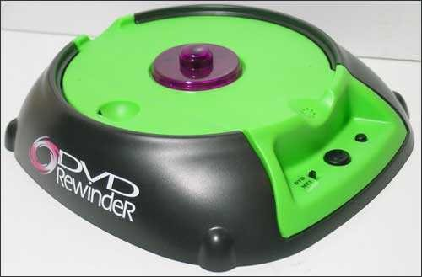

Slide 29
MSIA Program
Use the right tools:

Slide 31
MSIA Program
How to install
a CPU fan:

Slide 33
MSIA Program
How to keep
your desktop
tidy:

Slide 35
MSIA Program
How to get
rid of a
virus:

Slide 37
MSIA Program
How to clean
your computer of
adware and spyware:

Slide 39
MSIA Program
Try not to be
a slave to your
computer

Slide 41
MSIA Program
Take the right certification tests:

Slide 42
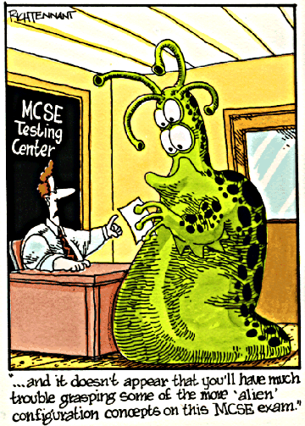

Slide 43
MSIA Program
Be precise
in your research:

Slide 44
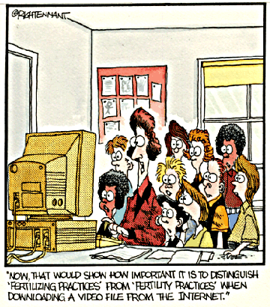

Slide 45
MSIA Program
Learn about the history of computer crime:

Slide 46
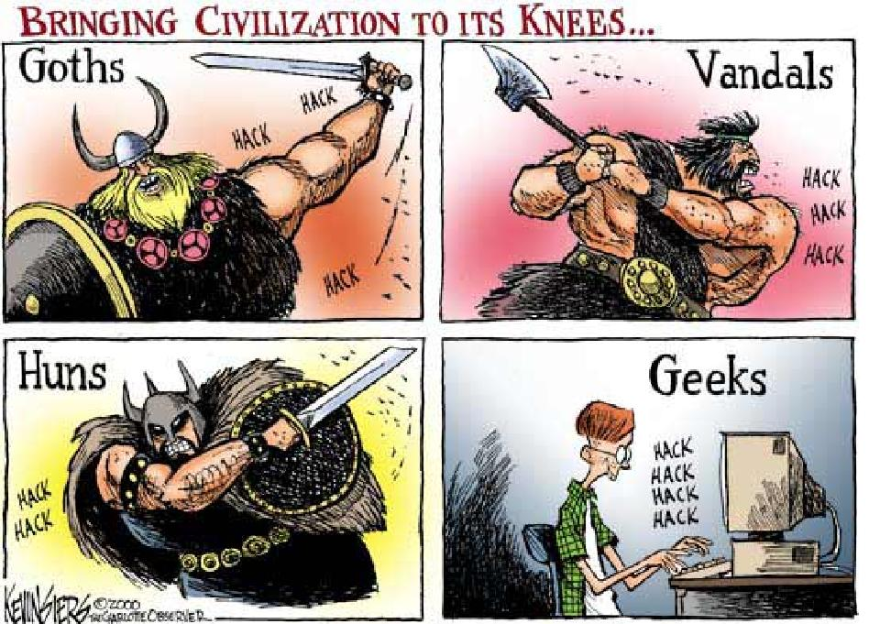

Slide 47
MSIA Program
Use good sources
when studying:

Slide 48
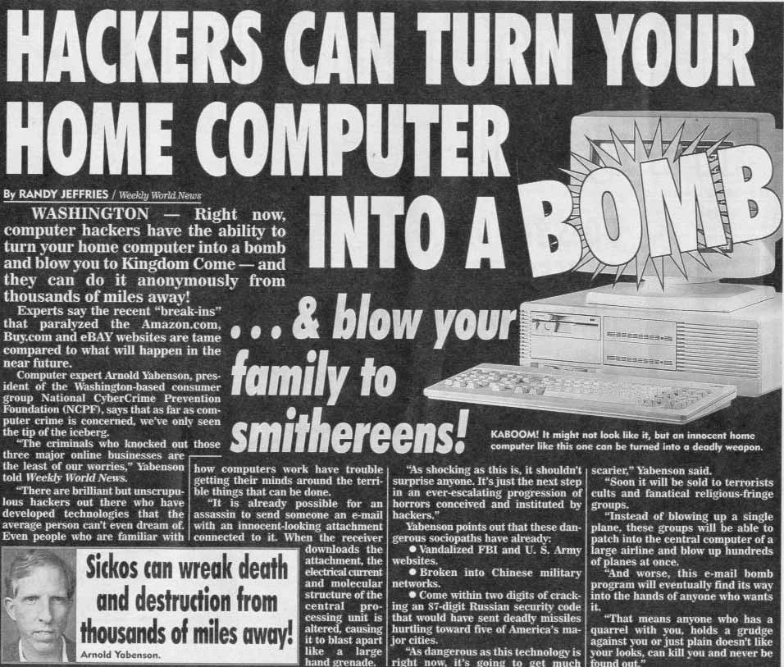

Slide 49
MSIA Program
Establish backup policies:

Slide 50
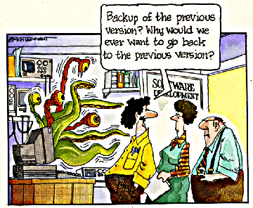

Slide 51
MSIA Program
Set clear rules:

Slide 53
MSIA Program
Be precise in your instructions:

Slide 55
MSIA Program
Provide adequate training:

Slide 56
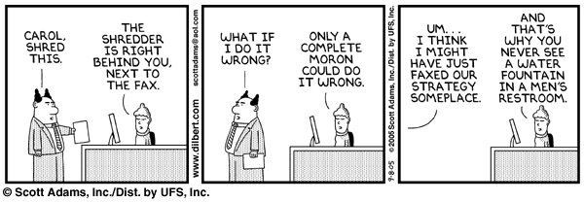

Slide 57
MSIA Program
Always take a break when studying:

Slide 59
MSIA Program
Cultivate patience:

Slide 60
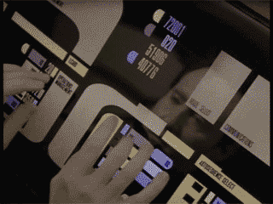

Slide 61
MSIA Program
Develop interpersonal skills:

Slide 62
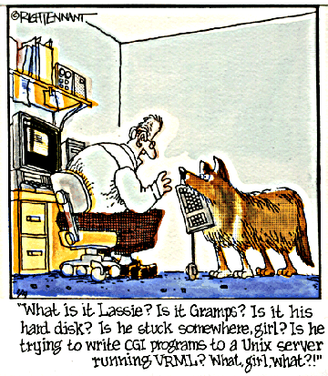

Slide 63
MSIA Program
Motivate employees:

Slide 64
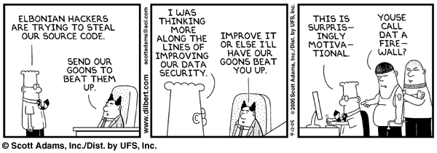

Slide 65
MSIA Program
Don’t form preconceptions:

Slide 66
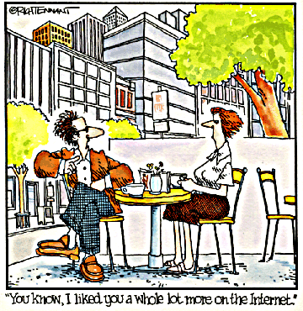

Slide 67
MSIA Program
Determine the source of errors:

Slide 68
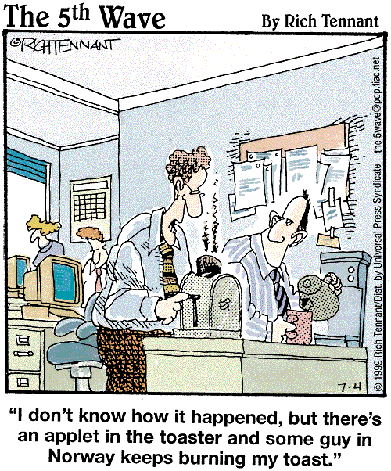

Slide 69
MSIA Program
Be brief in your diagnosis of problems:

Slide 70
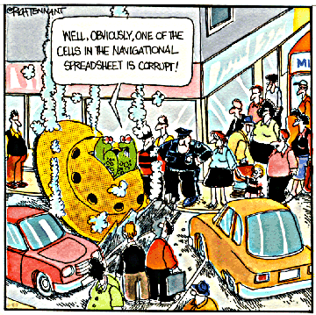

Slide 71
MSIA Program
Distinguish between hypothesis and observation:

Slide 72
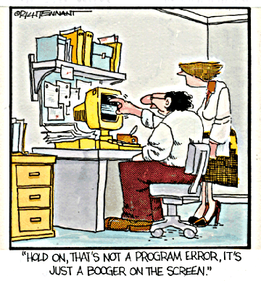

Slide 73
MSIA Program
Consider context when hypothesizing:

Slide 74
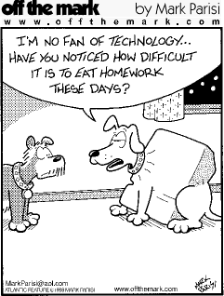

Slide 75
MSIA Program
Be careful at borders:

Slide 76
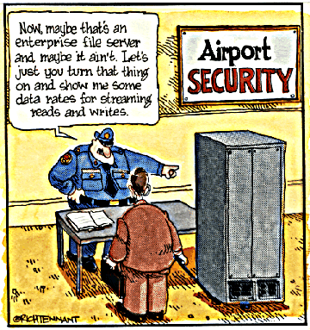

Slide 77
MSIA Program
Always consider interconnectivity:

Slide 78
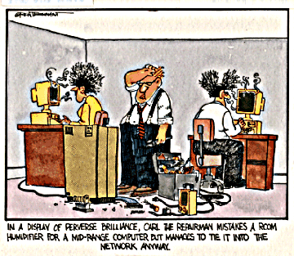

Slide 79
MSIA Program
Use products that conform to industry standards:

Slide 80
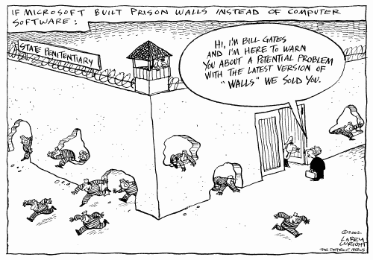

Slide 81
MSIA Program
Always test your
BCP & DRP:

Slide 82
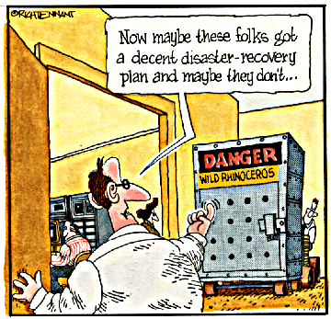

Slide 83
MSIA Program
Run acceptance tests before going live in production:

Slide 84
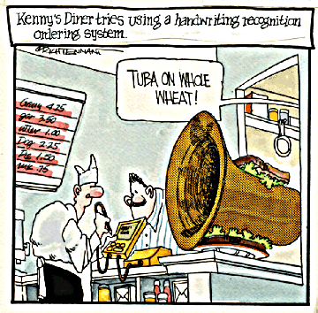

Slide 85
MSIA Program
Use the right experts for each job:

Slide 86
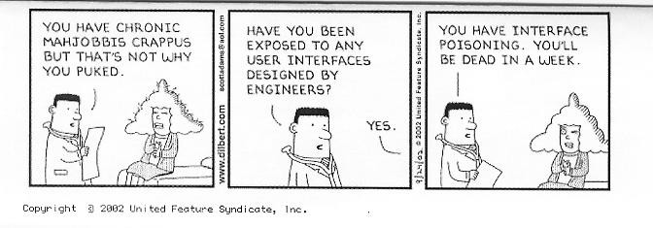

Slide 87
MSIA Program
Choose appropriate authentication methods:

Slide 88
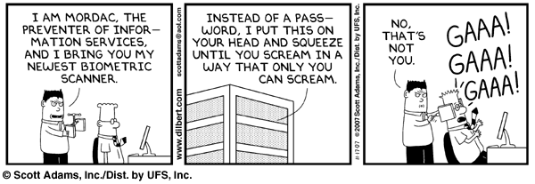

Slide 89
MSIA Program
Use incident postmortems:

Slide 90
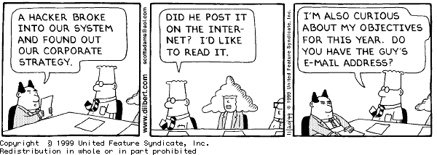

Slide 91
MSIA Program
Set effective password
policies:

Slide 92
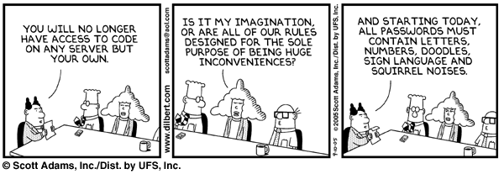

Slide 93
MSIA Program
Define Internet-use policies:

Slide 94
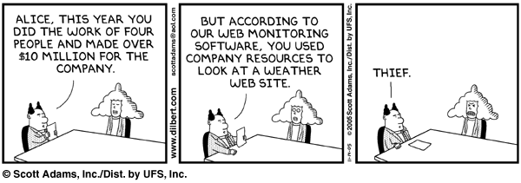

Slide 95
MSIA Program
Configure firewalls properly:

Slide 96
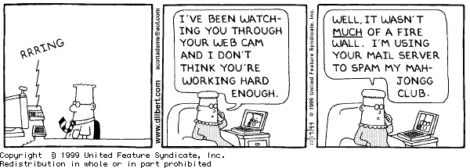

Slide 97
MSIA Program
Don’t get too used to online sex:

Slide 98
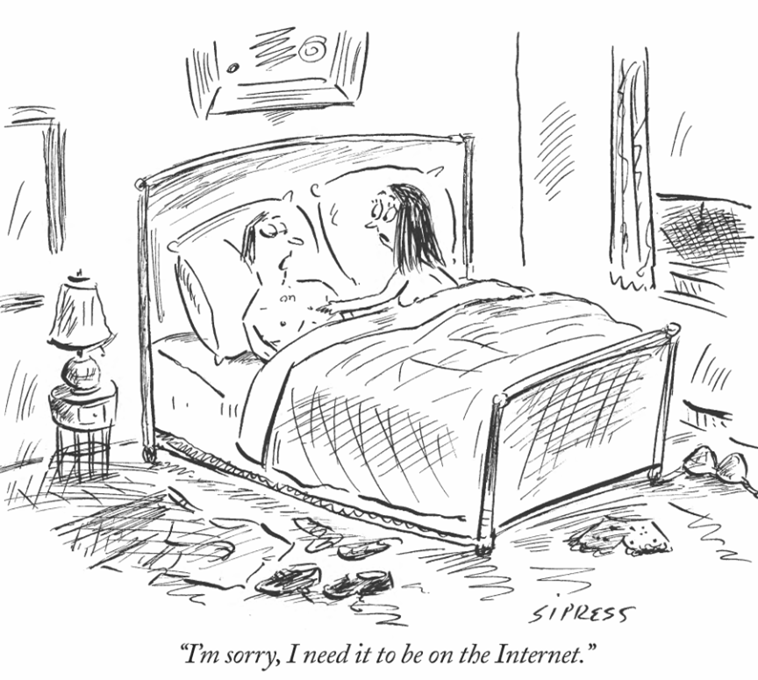

Slide 99
MSIA Program
Protect the privacy of your clients:

Slide 100
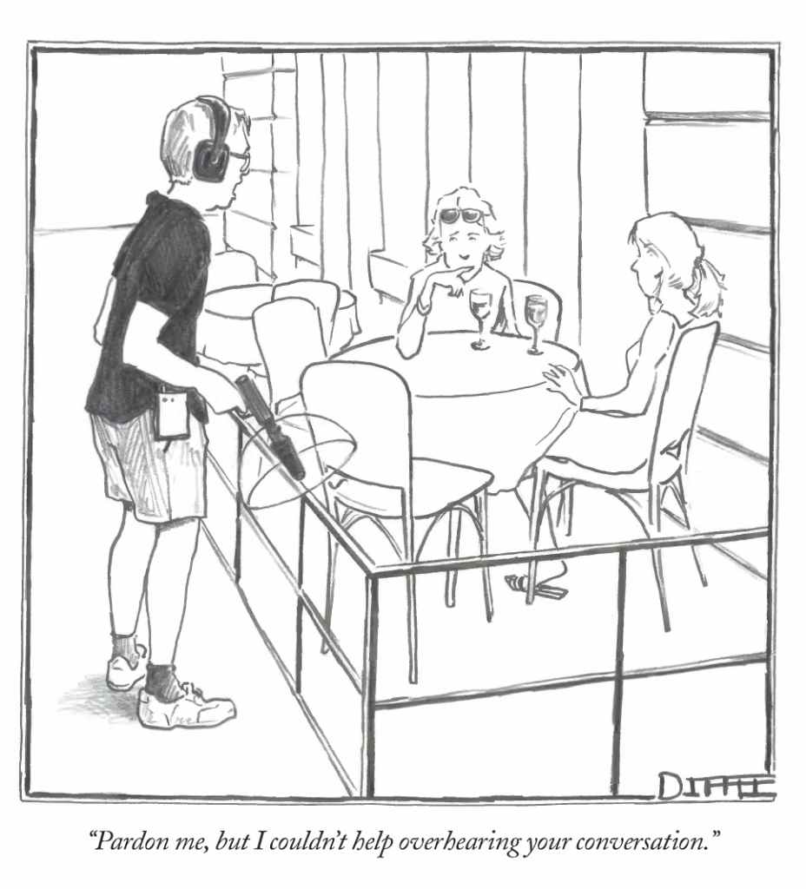

Slide 101
MSIA Program
Control public relations in a crisis:

Slide 102
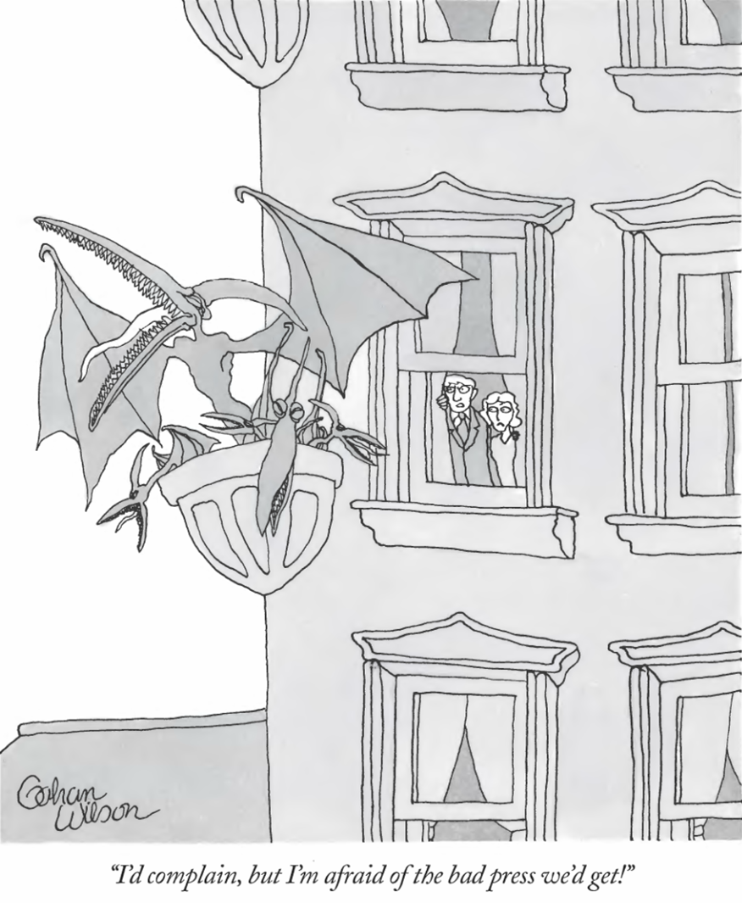

Slide 103
MSIA Program
Use cost-effective risk management :

Slide 104
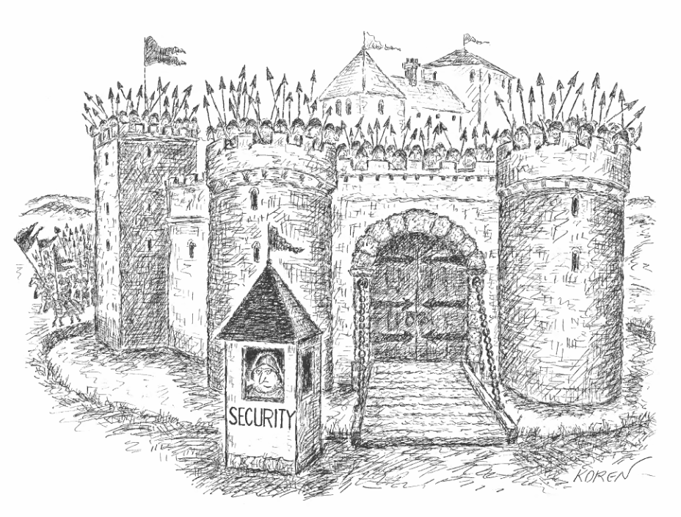

Slide 105
MSIA Program
Enforce anti-porn
policies:

Slide 107
MSIA Program
Remain anchored to reality:

Slide 108
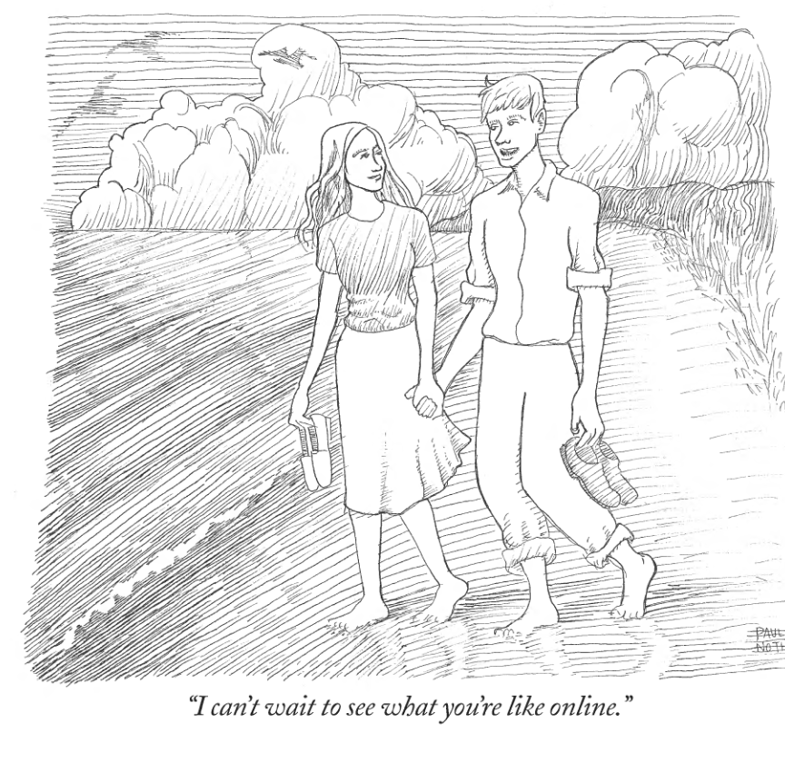

Slide 109
MSIA Program
Outsource wisely:

Slide 111
MSIA Program
Be on guard against industrial espionage:

Slide 113
MSIA Program
Don’t let the Internet
waste corporate
resources:

Slide 114
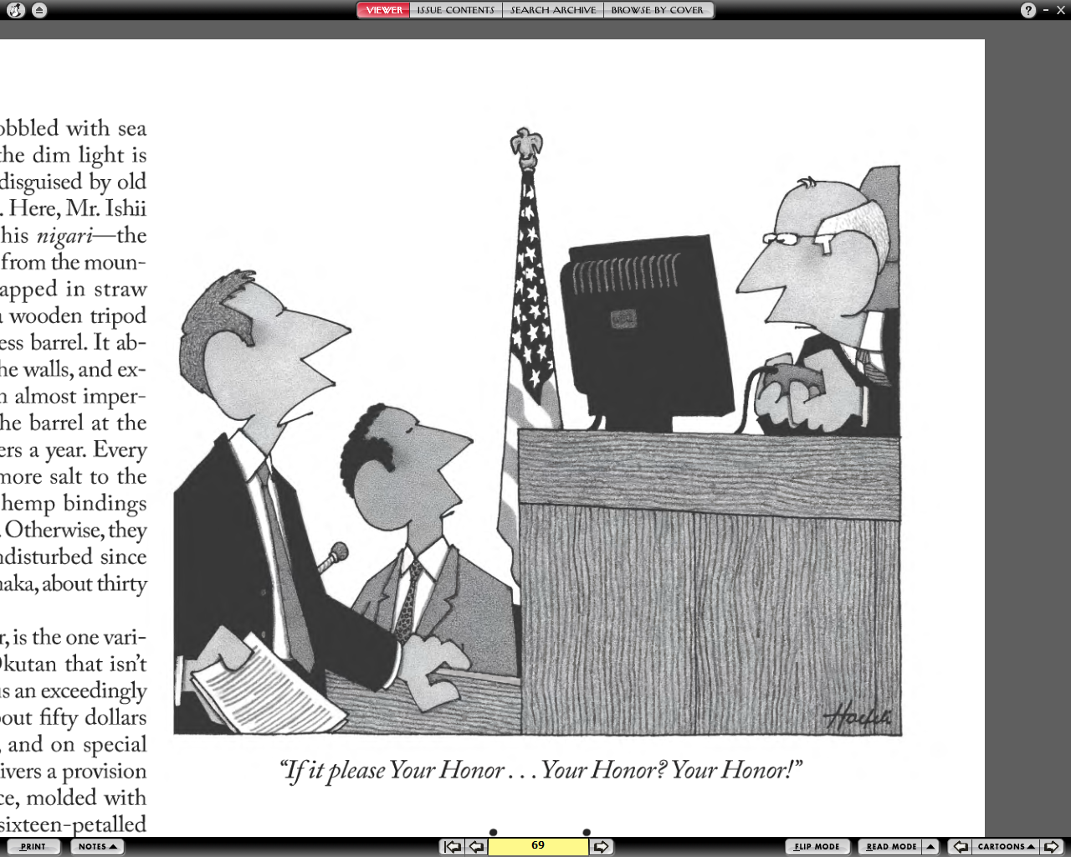

Slide 115
MSIA Program
Control theft of resources:

Slide 116
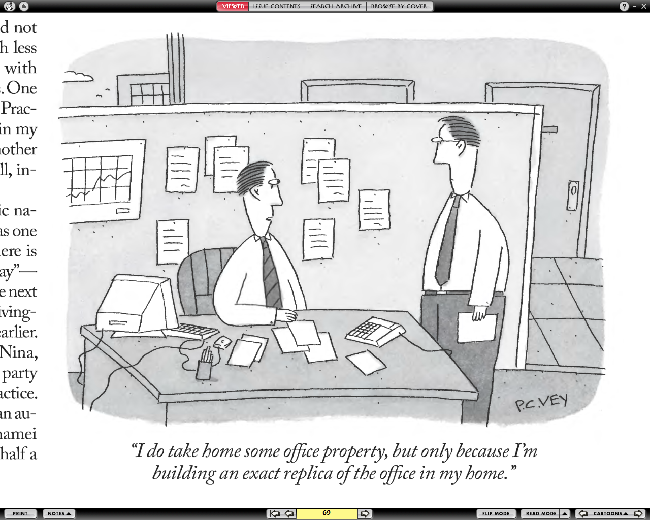

Slide 117
MSIA Program
Do background checks on prospective employees:

Slide 118
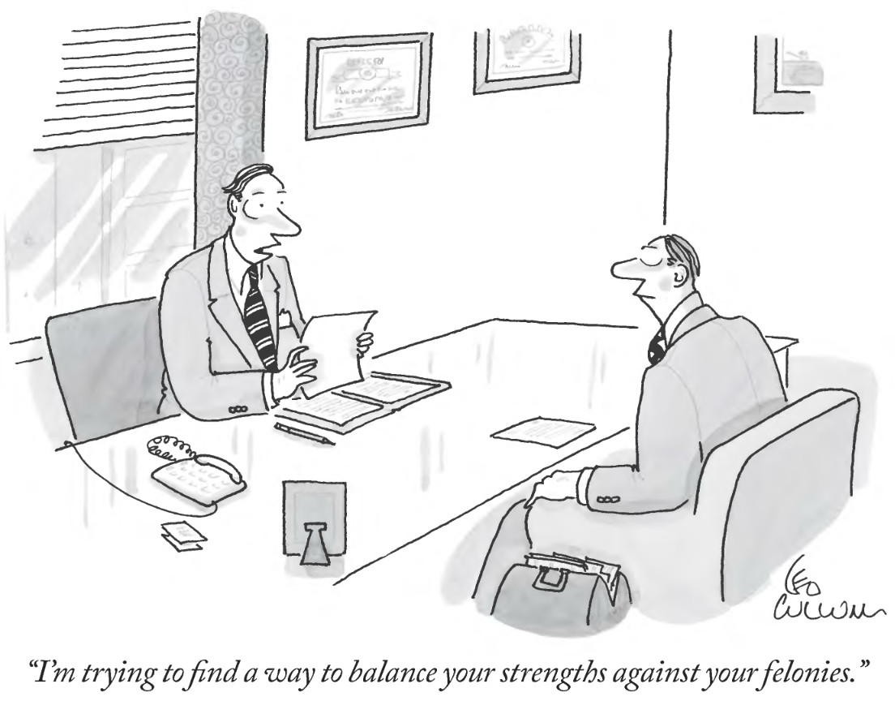

Slide 119
MSIA Program
Be ethical at all times:

Slide 120
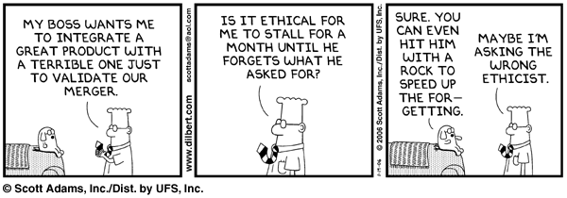

Slide 121
MSIA Program
STAY IN TOUCH:

Slide 122
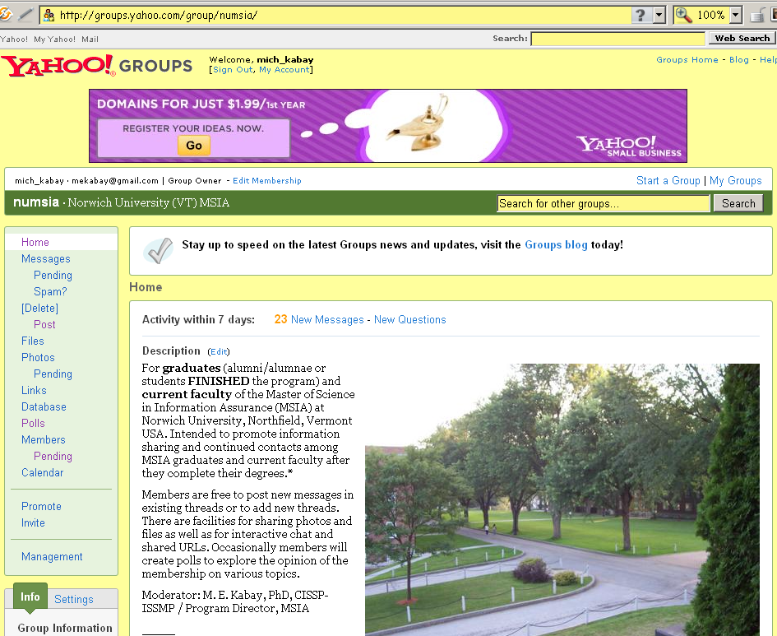

Slide 123
NOW GO AND STUDY OR SOMETHING

