Slide 1
Cryptography Fundamentals
MSIA GI512 Seminar 1 Week 8
Prof M. E. Kabay, PhD, CISSP-ISSMP
Assoc Prof Information Assurance School of Business & Management Norwich University
mekabay@gmail.com

Slide 2
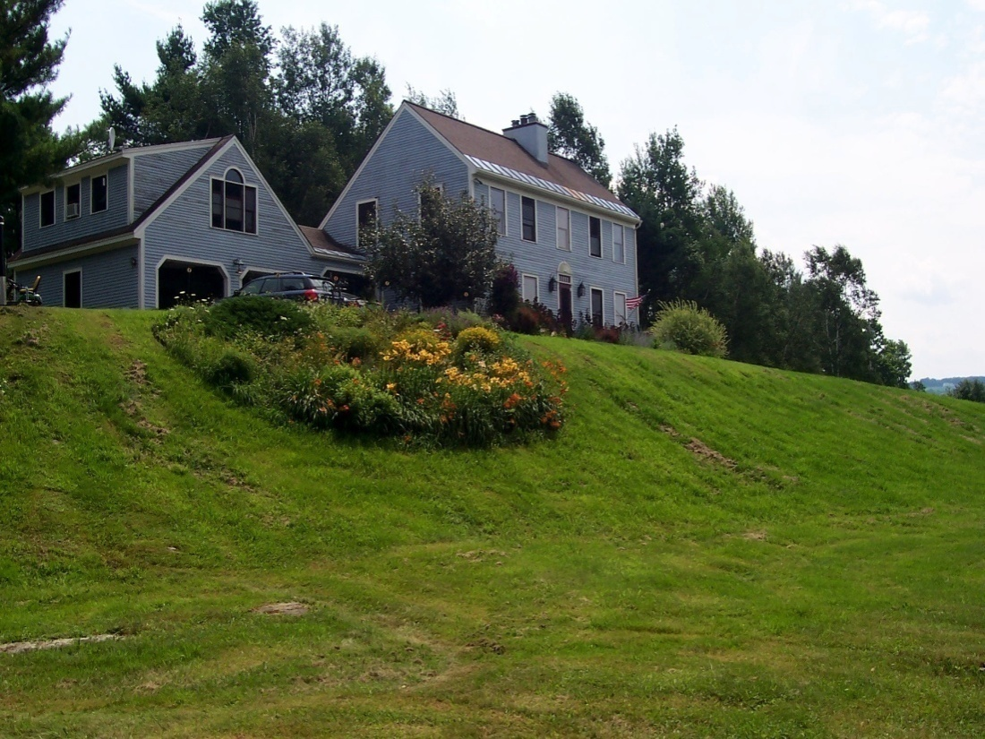
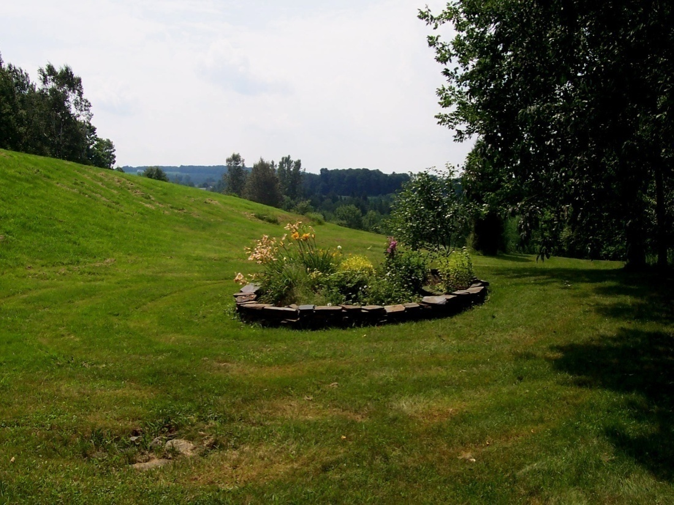
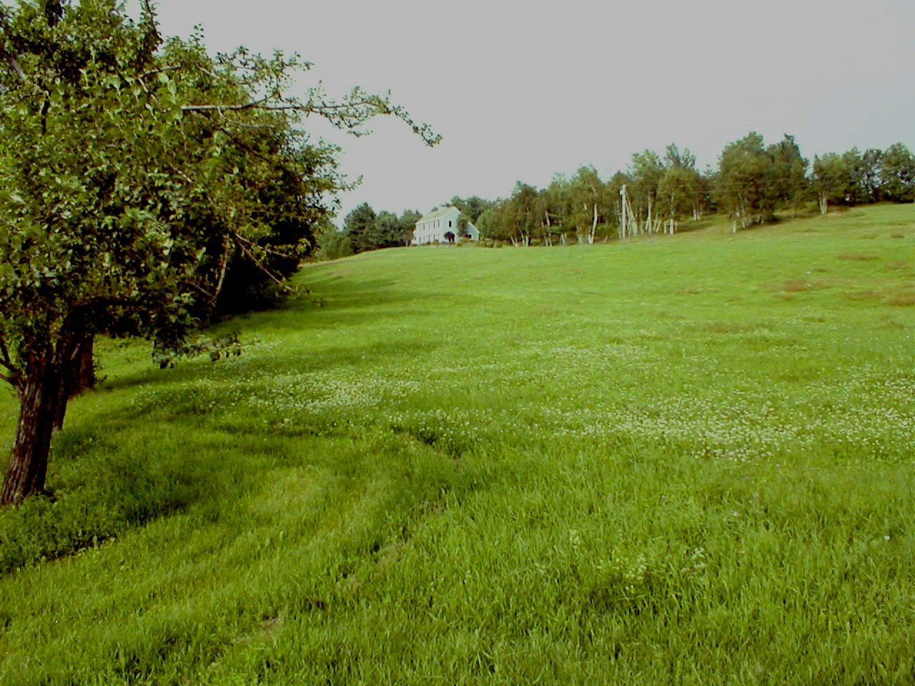
Welcome

Slide 3
Topics
Basic Concepts & Terminology
Types of Algorithm
Cryptanalysis Methods
Stronger Encryption
Asymmetric Encryption & the Public-Key Cryptosystem
Using PGP

Slide 4
Encryption in INFOSEC
Foundation technology
Underlies almost everything in INFOSEC
Ensures or supports
Confidentiality
Control and possession
Integrity
Authenticity
Non-repudiation

Slide 5
Basic Concepts & Terminology
Plaintext (aka cleartext): original, readable data
Ciphertext: scrambled form of plaintext
Encryption: reversible conversion of plaintext into ciphertext
Decryption: conversion of ciphertext back into plaintext
Crack (aka break) code: decrypt ciphertext without knowing key

Slide 6
Basic Concepts & Terminology (cont’d)
Key: secret allowing encryption and decryption to be restricted to possessors of key
Symmetric encryption: encryption requiring a shared key for both encryption and decryption
Asymmetric encryption: algorithm using a different key for decryption than for encryption

Slide 7
Basic Concepts & Terminology (cont’d)
Keylength: number of bits in key
Keyspace: number of possible keys
Keyspace = 2^{keylength}
2^{n} ≈ 10 ^{n(log}₁₀²⁾
≈ 10 ^{0.30103n}

Slide 8
Topics
Basic Concepts & Terminology
Types of Algorithm
Cryptanalysis Methods
Stronger Encryption
Asymmetric Encryption & the Public-Key Cryptosystem
Using PGP

Slide 9
Monoalphabetic Substitution Ciphers
“Secret decoder ring” or Caesar cipher
Algorithm uses key = offset and algorithm = transposition;
e.g., if offset = 3, then A becomes D, B = E etc.
Subject to cryptanalysis using known letter frequencies in specific languages
English: etaionshrdlu. . . .
For English alphabet, only 25 possible offsets; therefore maximum 25 tries to find the “key”

Slide 10
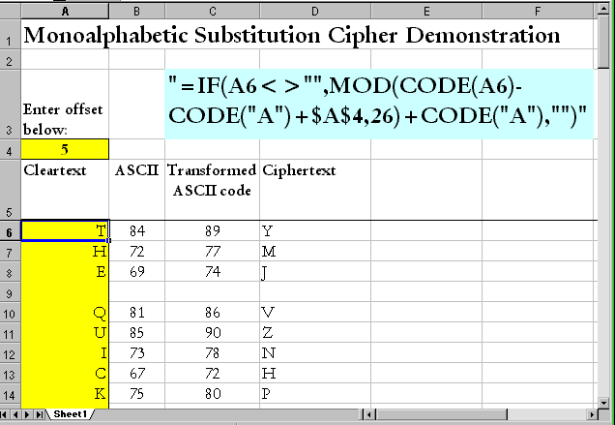
Monoalphabetic Substitution Cipher: Example

Slide 11
Polyalphabetic Substitution Ciphers
Can use different offsets for each position in plaintext
E.g., Vigenère cipher is like 26 Caesar ciphers
Use key indicating which offset to use for which position in sequence of 26 letters
Wrap around when reach end of alphabet
Maximum offset = 1 less than number of letters in alphabet (differs by language)
Example:
Key 1,8,24,2,17,…
Cleartext: brown
Ciphertext: czmyd

Slide 12
One-Time Pad
Use a fixed and shared secret to determine offsets
In theory, is only cipher impossible to break IFF
Pad kept secret
Key data truly random
Key data never re-used
In practice, people use natural language (e.g., novels) and reduce strength of algorithm
Major problem: how to distribute the pad securely?

Slide 13
Linear Congruential Pseudo-Random Number Generators
One-time pad must be truly random
Amateurs assume that RAND() function can be used as basis of one-time pad
Use starting seed value as key
But in fact such functions are NOT truly random
Therefore ciphers with natural-language plaintext are subject to frequency analysis

Slide 14
Topics
Basic Concepts & Terminology
Types of Algorithm
Cryptanalysis Methods
Stronger Encryption
Asymmetric Encryption & the Public-Key Cryptosystem
Using PGP

Slide 15
Cryptanalysis
Cryptanalysis Methods
Proprietary Algorithms
Cryptanalytical Attacks

Slide 16
Cryptanalysis Methods
Possible to use frequency of single letters and digraphs (pairs of letters) to analyze ciphertext
But this technique works only for plaintext based on natural language
Must know (or guess) which language is used
Need large amounts of data
Does not help with cryptanalysis of purely numerical data unless there are regularities in the plaintext

Slide 17
Cryptanalysis (cont’d)
Brute-force cryptanalysis tries every possible key
Facilitated by massively parallel computing
Must be able to identify plaintext for this to work
Attacking weakness of algorithm
Find methods of deducing key due to bad algorithms
But may be able to find key for only one message at a time
Fundamental principle: strength of encryption measured by time and cost of cryptanalysis for specific application

Slide 18
Proprietary Algorithms
Principles of cryptography
The strength of an encryption algorithm does not reside in the secrecy of the algorithm*
The strength of an encryption algorithm is not measurable unless the algorithm is known
* Kerckhoffs’ Principle/Maxim paraphrased: All security resides in the key
*Kerckhoffs’ Principle: “The design of a system should not require secrecy ….”
-- Auguste Kerckhoffs (1835-1903), Dutch linguist and cryptographer.

Slide 19
Proprietary Algorithms (cont’d)
Therefore beware of secret, proprietary algorithms
Many amateurs have failed utterly to defeat cryptanalysis
Must demonstrate that even with knowledge of the algorithm and even knowledge of the plaintext, still too expensive to decrypt ciphertext to make cryptanalysis worthwhile

Slide 20
Cryptanalytical Attacks
Ciphertext only:
No idea of plaintext at all
Known plaintext:
See plaintext + ciphertext
Chosen plaintext:
Choose plaintext and see ciphertext
Adaptive chosen plaintext (aka differential cryptanalysis):
Repeatedly choose plaintext and see results of encryption

Slide 21
Topics
Basic Concepts & Terminology
Types of Algorithm
Cryptanalysis Methods
Stronger Encryption
Asymmetric Encryption & the Public-Key Cryptosystem
Using PGP

Slide 22
Stronger Encryption
Transposition Ciphers
Block Ciphers & Chaining
Product Ciphers
DES: Data Encryption Standard
DES: Modes
Triple DES (3DES)
AES: Advanced Encryption Standard

Slide 23
Stronger Encryption
Substitution ciphers are generally weak (i.e., cheap or quick to crack)
Stronger ciphers include
Transposition ciphers
Block ciphers & chaining
Product ciphers

Slide 24
Transposition Ciphers
Change order of plaintext
Use specific algorithm (rule)
Example: matrix rotation
Matrix dimensions can serve as key; e.g., 6 x 8 then read as 8 x 6
Read text in opposite direction of matrix
See next slide for illustration

Slide 25
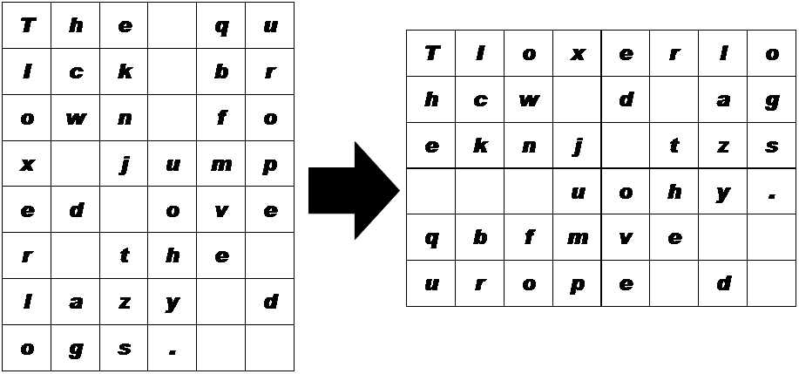
Transposition Ciphers: example
The quick brown fox jumped over the lazy dogs.
Tioxerlohcw d ageeknj tzs uohy.qbfmve urope d

Slide 26
Block Ciphers & Chaining
Introduce additional complexity:
Break plaintext into blocks
Apply transposition and substitution ciphers to each block
Chaining
Introduce an element from previous block into next block
Thus specific ciphertext becomes context dependent
Risk: transmission error may render ciphertext unrecoverable

Slide 27
Product Ciphers
Use all methods at once
Blocks
Chaining
Transpositions
Problem: no mathematical way of proving that a product cipher is actually strong
Therefore try to look at degree of randomness
Measure frequencies of symbols
Also 1st, 2nd, 3rd. . . n^{th}-order correlations

Slide 28
DES: Data Encryption Standard
1971: IBM created “Lucifer”
Used in financial transactions
Single-key symmetric algorithm using 56-bit keys
NIST selected Lucifer to be the DES
1977: Federal Information Processing Standard (FIPS) 46
US government standard for unclassified use
Widely adopted in commercial banking
Originally defined in hardware
Increased general computer speed led to approval for software implementations

Slide 29
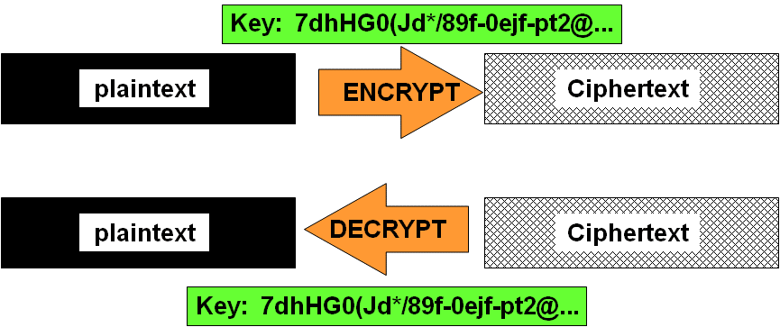
Encryption: DES
Data Encryption Standard
example of symmetric encryption algorithm

Slide 30
DES: Modes
ECB: electronic code book
Same encryption key applied to each block of 64 bits
Identical plaintext blocks have identical ciphertext blocks
Repeats make cryptanalysis easy
Not secure for long messages
Often used for secure transmission of a single value (e.g., an encryption key)

Slide 31
DES: Modes (cont’d)
CBC: cipher block chaining
XOR previous 64-bit block of ciphertext with current 64-bit block of plaintext
Encrypt this XOR’d text using a single key
Chains together all the blocks
Because previous block changes next block, no two identical plaintext blocks produce same ciphertext blocks
Often used for file encryption
However, a single transmission error corrupts all subsequent decryption of blocks

Slide 32
DES: Modes (cont’d)
CFB: cipher feedback
Like CBC but with arbitrarily chosen block length
Typically choose 8 bits, thus creating a stream cipher that encrypts each character
Use ciphertext of previous block as input to encryption algorithm
XOR ciphertext with next block of plaintext
Often used for authentication

Slide 33
DES: Modes (cont’d)
OFB: output feedback
Similar to CFB and usually applied to bytes
Uses the ciphertext of the previous block as the input for encrypting the next block
However, each ciphertext byte is encrypted individually; thus a single error does not propagate to all subsequent ciphertext bytes
Often used for transmissions over noisy channels

Slide 34
Triple DES (3DES)
C = E_{k1}[D_{k2}[E_{k1}(P)]]
Where
E_{k1}(P) means “encrypt plaintext using key 1”
C means “ciphertext”
Keylength 110 bits
Keyspace 2¹¹⁰ ≈ 10³⁶
Much used for key management (see next lecture)

Slide 35
AES: Advanced Encryption Standard
1997: NIST requested new encryption algorithm
Protect sensitive unclassified US government information
Competition among candidate algorithms
Winner: Rijndael (“Rhine doll”)
Drs Joan Daeman & Vincent Rijmen from Belgium
Block cipher w/ variable block length & variable key length (easily extendible)
Easy to implement in hardware (e.g., smart cards) as well as software

Slide 36
Topics
Basic Concepts & Terminology
Types of Algorithm
Cryptanalysis Methods
Stronger Encryption
Asymmetric Encryption & the Public-Key Cryptosystem
Using PGP

Slide 37
The Public Key Cryptosystem (PKC)
History
Protecting confidentiality
Assuring integrity
Demonstrating authenticity
Using PGP

Slide 38
PKC: Public Key Cryptosystem
Radical new concept
Create 2 complementary keys
Make one of them public and keep the other private
Dispense with problems of secure key distribution for decryption
Discoverers / Inventors – 1974-1975
Stanford University
Whitfield Diffie
Martin Hellman
UC Berkeley
Ralph Merkle
Notes:
See, for example,
Diffie, W. & M. E. Hellman (1976). Multiuser cryptographic techniques. In AFIPS Conference Proceedings, vol 45: National Computer Conference, New York, June 7-10, 1976. AFIPS Press (Montvale, NJ), pp. 109-112
Merkle, R. C. (1978). Secure communications over insecure channels. Communications of the ACM 21(4):294-299 (April 1978).

Slide 39
PKC History – cont’d
Idea developed into the Public Key Cryptosystem (PKC) by three scientists
Ron Rivest
Adi Shamir
Len Adleman
Founded RSA Data Security Inc. (RSADSI)
Now one of best-known security firms
Sponsor highly-regarded annual conference
Web site has much useful information
http://www.rsa.com

Slide 40
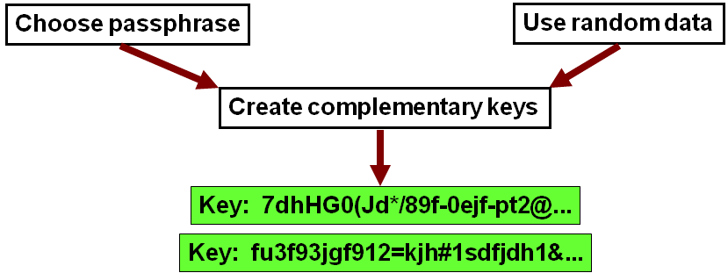
Encryption Using PKC
Key generation produces 2 keys
Each can decrypt the ciphertext produced by the other
One is defined as public
Other is kept as private

Slide 41
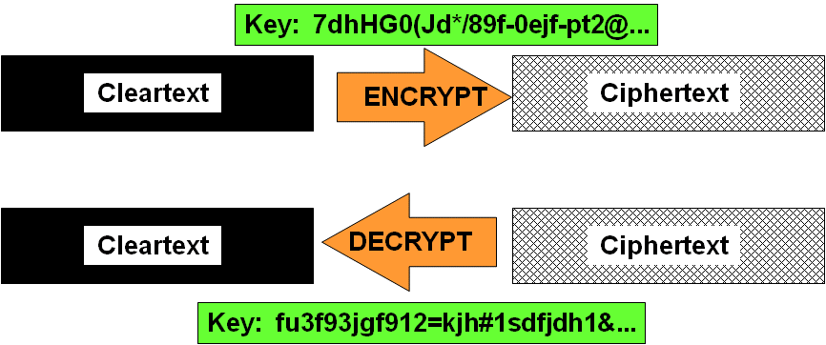
Encryption Using PKC (cont’d)
Key generation produces 2 keys
Each can decrypt the ciphertext produced by the other
One is defined as public
Other is kept as private

Slide 42
Using the PKC for Encryption
How can we send a message so only the desired recipient can read it? Select the correct answers in the following description.

Slide 43
Using the PKC for Encryption (cont’d)

Slide 44
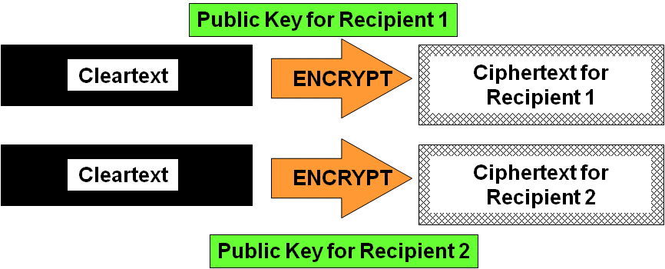
Sending a Ciphertext to Multiple Recipients
What if you have to send a message securely to many people?
Obvious way is to encrypt the message separately for each recipient
Thus generate as many ciphertexts as recipients

Slide 45
Multiple Recipients (cont’d)
However, e-mail normally makes it easy to send one message to multiple recipients
Don’t want to send a different ciphertext to each recipient
PKC algorithms are computationally demanding
Can take significant time to encrypt large messages
Encrypting same message n times could take a long time if n is large

Slide 46
Multiple Recipients – cont’d
Use a one-time symmetric key to create ciphertext: this is called the session key
Prepare as many copies of this session key as necessary to reach all the recipients
Encrypt each copy of the symmetric key with the public key of a different specific recipient
Do this step for each recipient

Slide 47
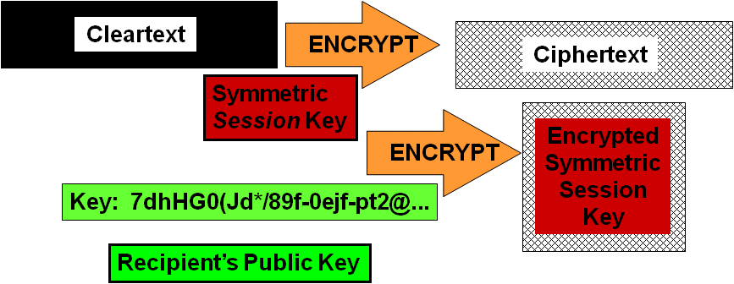
Multiple Recipients (cont’d)
Send both the ciphertext and the encrypted decryption keys to all the recipients

Slide 48
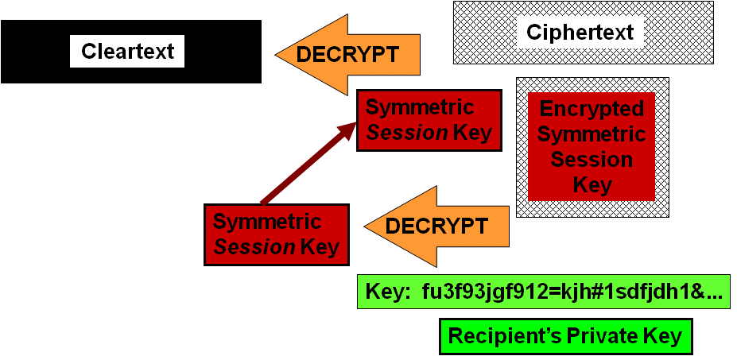
Multiple Recipients (cont’d)
Each recipient decrypts the asymmetric key using their own private key

Slide 49
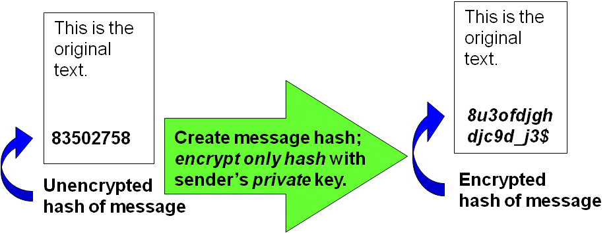
Digital Signature using the PKC
Signing a document using PKC

Slide 50
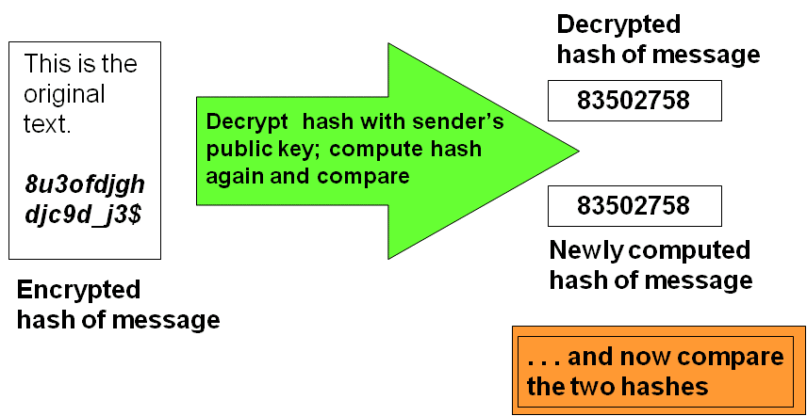
Digital Signature Using the PKC (cont’d)
Verifying the signature using PKC

Slide 51
Digital Signature Using the PKC (cont’d)
IF (decrypted hash = newly computer hash)
THEN
The message has not been modified in transit
The message was signed by the owner of the private key corresponding to the public key*
* Or by someone who has compromised that key!

Slide 52
Using PGP
Basic Concepts & Terminology
Types of Algorithm
Cryptanalysis Methods
Stronger Encryption
Asymmetric Encryption & the PKS
Using PGP
History of the Software
Creating a New Key
Signing a Document
Validating a Signature
Encrypting a Document
Decrypting a Document

Slide 53
PGP: Pretty Good Privacy
Phil Zimmermann
Computer programmer
Civil libertarian
Released Pretty Good Privacy*
June 1991 – worldwide distribution
Became most widely-used encryption program in world
* Reference to Garrison Keillor’s Prairie Home Companion radio show, where a mythical sponsor was “Ralph’s Pretty Good Grocery.”

Slide 54
PGP (cont’d)
Zimmermann investigated by grand jury for violating ITAR (Intl Traffic in Arms Regulations)
Prosecution abandoned after several years
PGP bought by Network Associates Inc (NAI) in mid-1990s
NAI sold PGP to PGP Corp. in Aug 2002
Getting PGP
For professional use see
http://www.pgp.com/products/desktop/index.html
Freeware for personal use
http://www.pgp.com/products/freeware.html

Slide 55
PGP Personal Privacy 9.8.3

Slide 56
Encryption: PGP Demo
The following screenshots demonstrate the actions of PGP in an old commercial version, 6.5.8 (but current versions are similar):
Creating a private key / public key pair
Signing a document with a private key
Validating a signature with a public key
Effect of a single-byte change on validity of a digital signature
Encrypting a document using a public key
Decrypting a document using a private key
Effect of a single-byte change on decryption

Slide 57
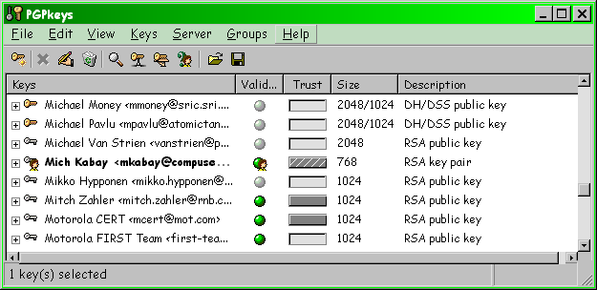
PGP: Creating a Private Key / Public Key Pair

Slide 58
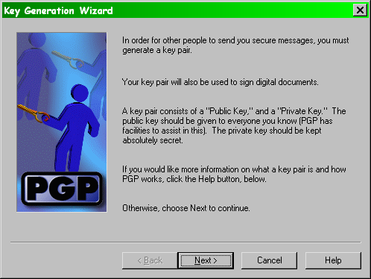
New Key (cont’d)

Slide 59
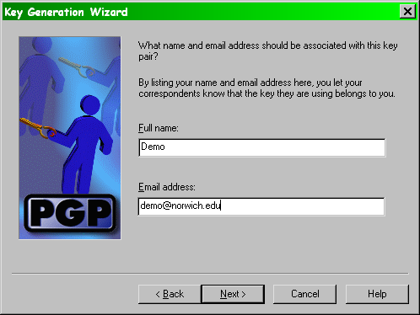
New Key (cont’d)

Slide 60
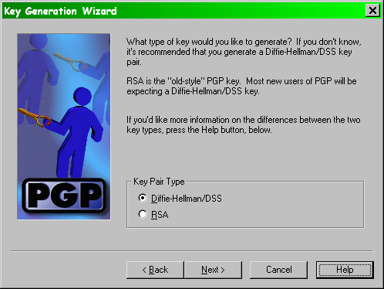
New Key (cont’d)

Slide 61
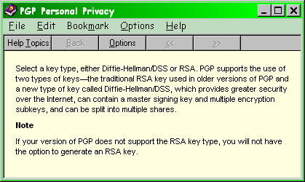
New Key (cont’d)

Slide 62
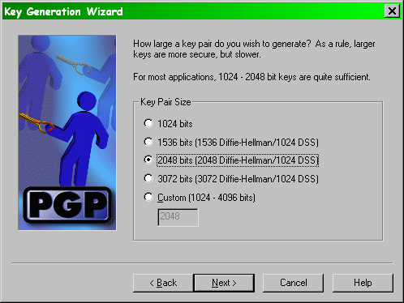
New Key (cont’d)

Slide 63
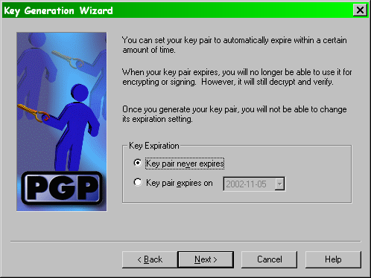
New Key (cont’d)

Slide 64
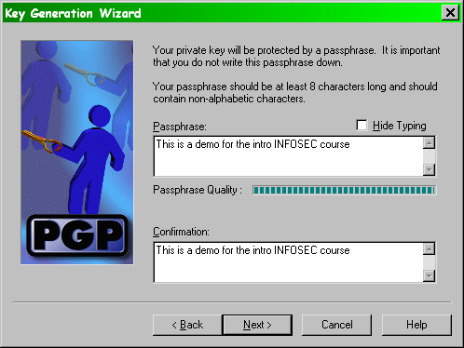
New Key (cont’d)

Slide 65
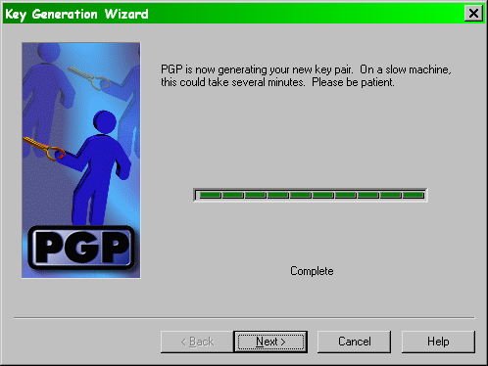
New Key (cont’d)

Slide 66
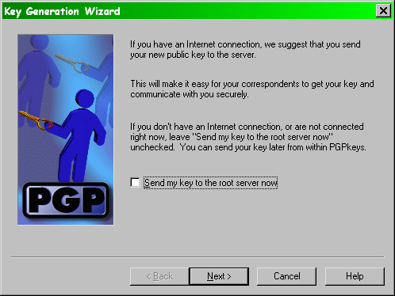
New Key (cont’d)

Slide 67
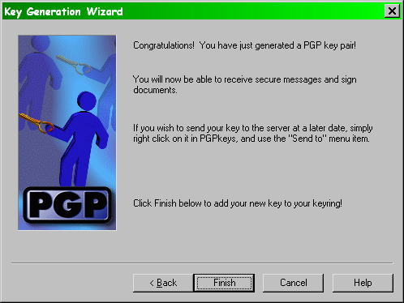
New Key (cont’d)

Slide 68
PGP: Signing a Document With a Private Key
-----BEGIN PGP SIGNED MESSAGE-----
This is the original text.
-----BEGIN PGP SIGNATURE-----
Version: PGP Desktop 9.8.3
Comment: Digital signatures increase security for everyone.
iQB1AwUBO+dfOzPd6/an40lzAQF7rQL+MPLG+V/J8H0QhDLE3JUDo4tYqPOJ682r
zv457NmbycGz05hlq6TtNuLCWRbashcQZ7eWiwHybgLwhgbYY8G4HnAYFHh6vKyb
3csmoTm29uHD+/4av98awA23Bf1aEW+t
=WhgQ
-----END PGP SIGNATURE-----

Slide 69
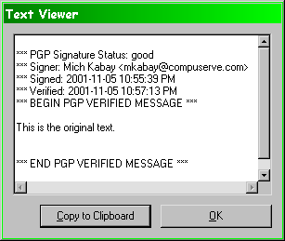
PGP: Validating a Signature With a Public Key

Slide 70
PGP: Single-byte Change Alters Digital Signature
-----BEGIN PGP SIGNED MESSAGE-----
This is the original text!
-----BEGIN PGP SIGNATURE-----
Version: PGP Personal Privacy 6.5.8
Comment: Digital signatures increase security for everyone.
iQB1AwUBO+dfOzPd6/an40lzAQF7rQL+MPLG+V/J8H0QhDLE3JUDo4tYqPOJ682r
zv457NmbycGz05hlq6TtNuLCWRbashcQZ7eWiwHybgLwhgbYY8G4HnAYFHh6vKyb
3csmoTm29uHD+/4av98awA23Bf1aEW+t
=WhgQ
-----END PGP SIGNATURE-----

Slide 71
Single-byte Change Alters Digital Signature (cont’d)
iQB1AwUBO+dfOzPd6/an40lzAQF7rQL+MPLG+V/J8H0QhDLE3JUDo4tYqPOJ682r
zv457NmbycGz05hlq6TtNuLCWRbashcQZ7eWiwHybgLwhgbYY8G4HnAYFHh6vKyb
3csmoTm29uHD+/4av98awA23Bf1aEW+t
=WhgQ
iQB1AwUBO+fETTPd6/an40lzAQFagQL/Thfw3DAJA/KRgoH+kSFcoRL39eJp4s5h
v3zeHUesOkgQk2zSUF+evbRhw5cxZJkUA1Qid6cg58tEaP9jI+7J3wILmJrFPF/K
L42qO9yjxalNssnflUaSf7ry7xXV3blK
=svYa
This is the original text.
This is the original text!

Slide 72
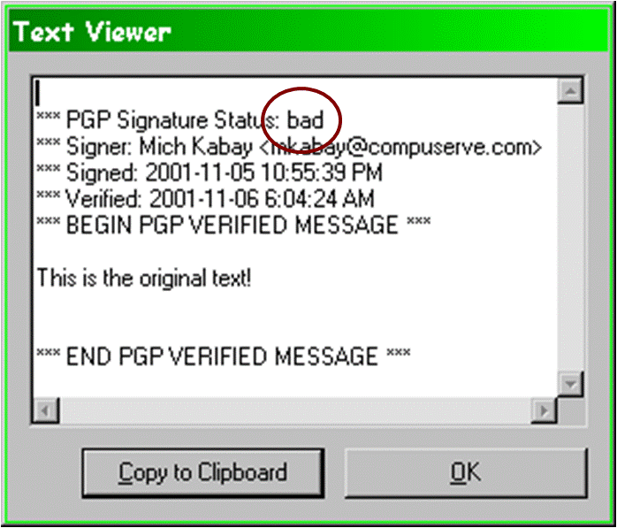
Single-byte Change (cont’d)

Slide 73
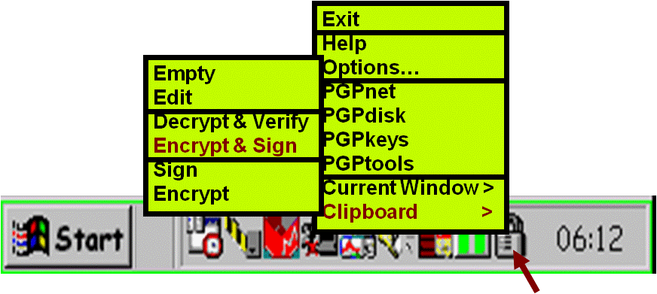
PGP: Encrypting a Document Using a Public Key

Slide 74
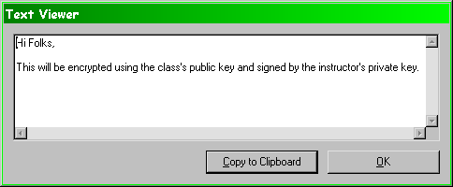
Encryption (cont’d)
Note that the sender should ALWAYS encrypt using the sender’s private key to allow decryption by the sender.

Slide 75
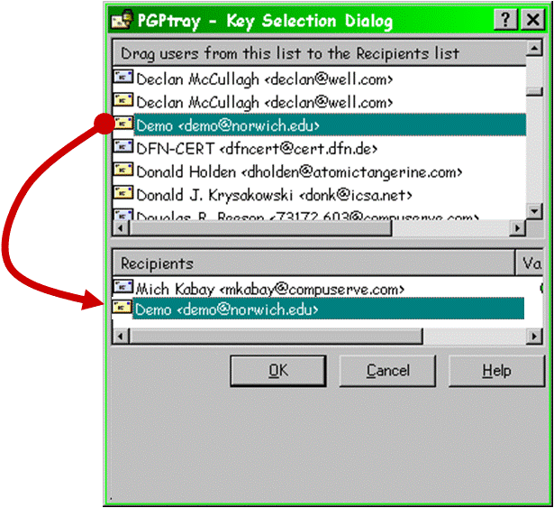
Encryption (cont’d)

Slide 76
Encryption (cont’d)
-----BEGIN PGP MESSAGE-----
Version: PGP Desktop 9.8.3
hQIOA8BxvYx90+tvEAf/eXW8I9vY45PwN27gd4kzg0DyoCJiucXXA4eDtzHqBUJm
nWadsATpcspqQNaZwgp8d5FwxRhafOtG2WqSXI2SgsFUIjraYgXdlRBm2qeU/dKh
8+NfNZv2ol5bPaDAg9oiYDRV7KcFAMm3RfIiSTRv6f72mE+Y6VPAvQmL6zjLAe0D
i/9n7Sh0UyM+71YuNeY0V+EZ88rTBa7JP4xr/GfAVKwwSHIWEhOfiwe82LMxOnSg
t8vj6amULTYp4daULqDt+qewULR4XWLhQ73zVT9578BSaUmgSnlRXveIsHj4fj9n
2+Ry7QZZL7k2XDybIjAw8QfLcShDgC3n5Wlt+mWLwwgA8zJSyzTdKYtVh0kuo3CP
9kkGpkgqyqitVFhua+J4bvQrrhLCLBzCWXBl6RSdFvChJ7JNhtgzajV16L5SepDS
tHMcahPvGoE1e+uG5P80xqngbc5Sl7BY0jfsUjGBlyfVRpt+oC37l4W2ZKZ6mgRU
4yY+H2NTi28gC0SfXjzwRwS4qARSicjIuUkYVUuRqSDfeK4slaV8FVs/xg+Ra7U3
HuyD8VmBi0/uO3RSsyPldbh2FqA1+raqeL2yuoUXLe8DI1CToLQ595/4s0wiNIzT
Ys2W5ZbOT+P2gjoVfNaRQlWFzntkRXBcs/Kx9R8pu+NMTdpjJsip0oqiGfH2jtqk
2IUAbAMz3ev2p+NJcwEC/i8eoq7FornXxjxzB5/hQ3Ie0Ww+Vxk2LZVHdT07eqiz
8eN9e2XSxt4cr216MFCPOf1Wj8j3suYvX7mnJa7hu0mvJvxalHawEq3U+r4ZczcC
e+q9YAukL9iXyRHYCrWZWqT6dj1Bynmi6hzgLfApq+270u8QwaGud1d/aOHGlhD7
+9JcSC1AkXoVZsA3ltaOMPP7frIOOZfdyFzr874mhG+Lru9sBFUy1S7h3gNQfUwx
ZEe9uGnDfNUth33VrrtMqjIvUjh9gZN8BOXdkKOk0WGkVvJDy6D8bSphSaQR+vvP
V83K4BaD24kiAJ70NLbeQXPx2H5j0HYT+4bD0RTt4RQgbeRLhqgwZfKpVdldXC13
P06+MTFlIiqcs+p4OJo/Mj67H6x877KWU3G7SKG4pBpgmy6KwKeUW8j9EpcKTgh+
+8/tgDZNAzcm8vnCQ9HEAAsN6KM9V0qoCiyDDA==
=IIr+
-----END PGP MESSAGE-----

Slide 77
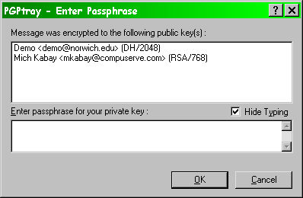
PGP: Decrypting a Document Using a Private Key
As;dfkljasd;flkajsd;

Slide 78
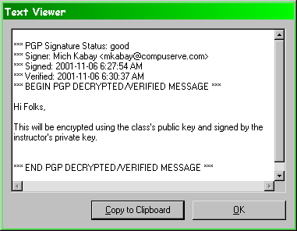
Decryption (cont’d)

Slide 79
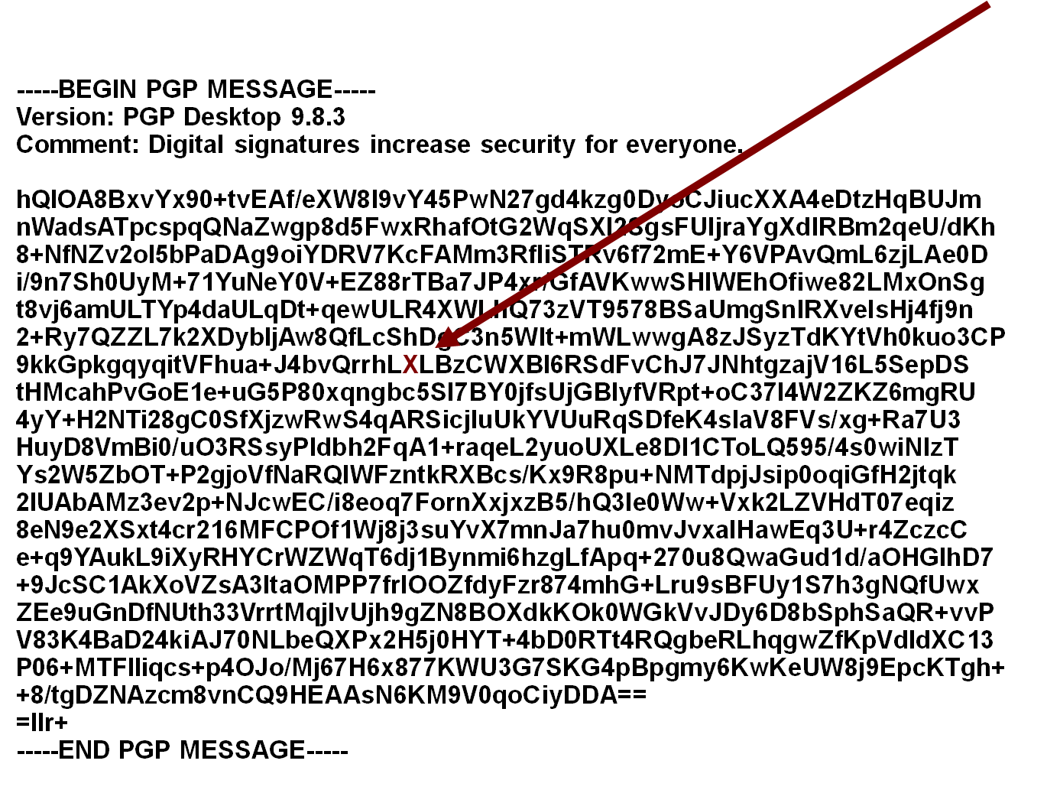
PGP: Effect of a Single-byte Change on Decryption

Slide 80
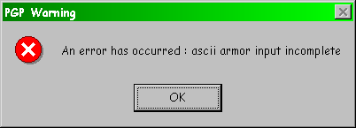
Single-byte Change & Decryption

Slide 81
Now go and study

