Slide 1

I&A
MSIA
Seminar 2 Week 3
M. E. Kabay, PhD, CISSP-ISSMP
Program Director, MSIA
School of Graduate Studies
Norwich University
mekabay@gmail.com
Notes:
M. E. Kabay, PhD, CISSP

Slide 2
Topics
Identification and authentication basics
Forms of authentication
Passwords
Tokens
Biometrics
Artificial intelligence

Slide 3
Basics
Identification – specific code for user
Authentication – binding specific human being (or computer) to specific ID
Authorization – granting specific permissions for particular actions on particular data; e.g.,
  Read, Write, Append, Lock, Execute
  Create new file, save old file, rename file
  Define check amount, payee, OK payment

Slide 4
Forms of Authentication
What you know
  Passwords
  Pass phrases
What you have
  Keys
  Tokens
Biometrics
  What you are (passive biometrics)
    Face, iris, retina, fingerprint, hand geometry
  What you do (active or dynamic biometrics)
    Voice, signature dynamics, keystroke dynamics

Slide 5
Passwords
Threats to authentication
Sharing passwords
Writing passwords & posting them in obvious places
Password guessing
  Dictionary-based
  Brute force
Strength of password depends on keyspace
Keyspace is a function of positions (P) and choices at each position (C_{i})

Slide 6
Keyspace (1)
Keyspace is number of possible codes
All uppercase or case-insensitive → 26 possibilities / position
Uppercase and lowercase (case-sensitive) → 52 possibilities / position
Numbers: add 10 choices
Special characters |!”/$%?&*()_+#\@-=:;~{}[] increase depends on which are permitted
PINs (personal identification numbers) typically all digits → 10 values per position
Number of possibilities of sequence is PRODUCT of choices; e.g., imagine 2 in 1st and 3 in 2nd –
{A,B} and {1,2,3} → A1, A2, A3, B1, B2, B3 :
i.e., 2 x 3 = 6 permutations.

Slide 7
Keyspace (2)
If repetitions are allowed, C is constant:
P positions with C choices per position → C^{P} possible passwords;
  e.g., 4-digit PIN → 10⁴
If repetitions are not allowed, there is one fewer choice for each successive position, or
C(C-1)(C-2). . . (C-P+1) or C!/P! possibilities
  E.g., 6-position passwords with case-insensitive letters & numbers only and no repetitions → 36 * 35 * 34 * 33 * 32 * 31
  If first character a letter only, then
  → 26 * 35 * 34 * 33 * 32 * 31
P! is “P factorial”
P! = P*(P-1)*(P-2)…3*2*1

Slide 8
Exercises
Consider keys using only the 10 numerical digits.
What is the keyspace with repetition for keys of
  2 positions?
  8 positions?
What is the keyspace without repetition for keys of
  2 positions?
  8 positions?
102=100
108=100,000,000
10 x 9 = 90
10x9x8x7x6x5x4x3 = 1,814,400

Slide 9
Cryptographic Strength of a Password
A password is called strong when
  the time it takes to guess the password
  is longer than the useful lifetime
  of the password-protected resource.
Thus the strength of any specific password declines over time because. . .
  . . . the time available to test the keyspace increases.
The strength of all passwords of a given complexity declines over time because. . .
  . . . the speed of cryptanalysis increases as computational speed increases.

Slide 10
Lifecycle of the Password
Source
  User, system or user choice from list
  If from tech support, one-time only (why?)
Composition: jumble hard to recall; syllables OK
Ownership: single individual only (why?)
Entry: protected against viewing/capture
Storage: one-way encrypted (why?)
Authentication period: timeout on inactivity (why?)
Retirement: force password change periodically
  Not all users on same day (why not?)
  Keep history to preclude re-use (why?)

Slide 11
Forgotten Passwords
Problem: user forgets important password (e.g., encryption key) for production system
Avoid the problem
  Choose software with admin password
  Record password in opaque envelope
  Sign seals and tape over with sticky tape
  Store in company safe
  Require two signatures to remove
Emergencies
  Password cracking software available
  Some software vendors have back doors

Slide 12
Tokens
One-time password generators
  Create password every 1-3 minutes
  Includes cryptogram using token # & time
  Software on server decrypts cryptogram, checks token ID, assigned user
Smart cards, dongles
  Microprocessor interacts with reader
  Encrypted traffic establishes identity and authenticity of device
  Tables relate token to human user

Slide 13
Password Tokens
14:27
Enter ID:
A32H7296Q*3

Slide 14
Password Tokens
14:27
Enter ID: G674$2
A32H7296Q*3

Slide 15
Password Tokens
14:27
Enter ID: G674$2
Enter PW:
A32H7296Q*3

Slide 16
Password Tokens
14:27
Enter ID: G674$2
Enter PW: A32H7296Q*3
A32H7296Q*3

Slide 17
Password Tokens
14:27
Enter ID: G674$2
Enter PW: A32H7296Q*3
* Valid *
A32H7296Q*3

Slide 18
Password Tokens
14:27
Enter ID: G674$2
Enter PW: A32H7296Q*3
* Valid *
14:28
A32H7296Q*3
8N27^#11929
Notes:
The preceding 5 pages are not shown in your workbook because they are used in building up this animated PowerPoint slide sequence.
Similarly, the next 4 pages are not printed here.

Slide 19
Password Tokens
14:27
Enter ID: G674$2
Enter PW: A32H7296Q*3
* Valid *
14:28
Enter ID:
8N27^#11929

Slide 20
Password Tokens
14:27
Enter ID: G674$2
Enter PW: A32H7296Q*3
* Valid *
14:28
Enter ID: G674$2
Enter PW:
8N27^#11929

Slide 21
Password Tokens
14:27
Enter ID: G674$2
Enter PW: A32H7296Q*3
* Valid *
14:28
Enter ID: G674$2
Enter PW: A32H7296Q*3
8N27^#11929

Slide 22
Password Tokens
14:27
Enter ID: G674$2
Enter PW: A32H7296Q*3
* Valid *
14:28
Enter ID: G674$2
Enter PW: A32H7296Q*3
* Invalid *
8N27^#11929

Slide 23
Biometrics
Fingerprints*
Hand geometry
Face
Iris
Retina
Voice*
Signature*
Keystrokes*
* Especially useful for access to computer systems and networks.
Remember that we saw these in our discussion of physical security.

Slide 24
Measuring Error Rates
Two distinct types of error when applying I&A
  Type I: reject valid identification (false negative)
  Type II: accept false identification (false positive)
These error rates are generally inversely related
TYPE II ERROR
TYPE I ERROR

Slide 25
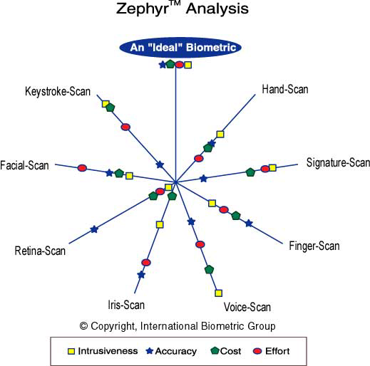
Comparison of Biometrics
http://www.biometricgroup.com/

Slide 26
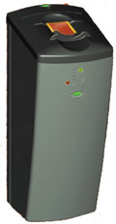
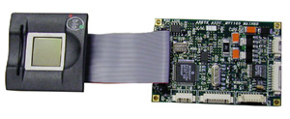
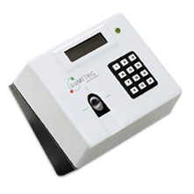
Fingerprints
http://www.biometricid.com/Products/

Slide 27
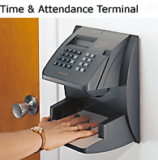
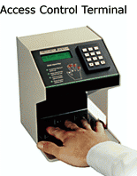
Hand geometry
http://www.hand-scan.com/

Slide 28
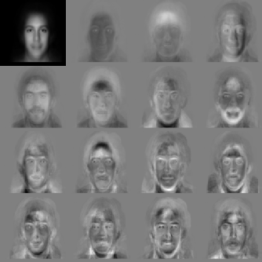
Face
http://www.sans.org/infosecFAQ/authentic/face_rec.htm
Eigenfaces

Slide 29
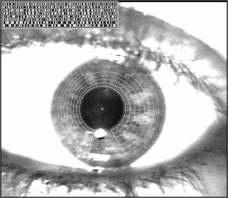
Iris
http://www.iris-scan.com/iris_technology.htm

Slide 30
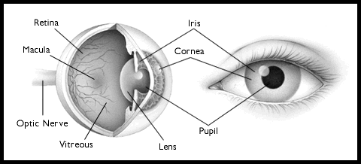
Retina
http://www.retina-scan.com/

Slide 31
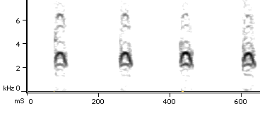
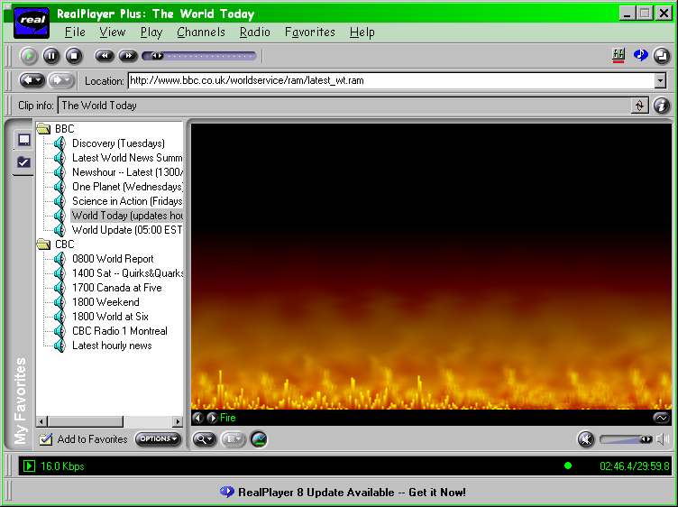
Voice (1)
http://research.amnh.org/ornithology/crossbills/sonograms.html

Slide 32
Voice (2)
Voice ranks #1 in accuracy, convenience, and cost for biometric authentication (Morgan Keegan Research and the International Data Group, 2001)
Biometrics provide higher security than PINs, passwords
Voice cannot be shared, stolen, or forgotten
Voice especially useful for hands-free user verification in mobile environments
Voice rated as least intrusive biometric technology (The International Biometric Group, Morgan Keegan Research, the International Data Group, Federal Computer Week, and others)

Slide 33
Signature Dynamics
Record measurements of handwritten signature: stroke order, pen up/down, acceleration, deceleration
Cannot be replicated by tracing signature
Can measure degree of similarity, reject false

Slide 34
Keystrokes
Each person types a phrase differently from everyone else
  Intervals between keystrokes can be measured and recorded
  Patterns are unique and therefore usable for authentication
Problems when people are novices learning to type
  Errors in entering passphrase
  Change their typing pattern as they improve – may require re-registration

Slide 35
Keystrokes
The quick brown fox jumps over the lazy dog.
70 ms
152 ms
398 ms
207 ms
193 ms
193 ms
84 ms
The quick
etc.

Slide 36
Artificial Intelligence
Pattern-recognition systems learn normal system behavior
  Who logs on where at what time for how long
  Identify anomalies, report to human being
Neural networks particularly good
But all systems can be tricked by insider
  Distorts behavior as function of future needs
  Systems learns abnormal patterns

Slide 37
Review Questions (1)
Name the methods used in authentication.
Name the most frequently-used method of authentication used in controlling access to electronic systems.
How can an organization best discourage sharing of passwords?
How should a system respond to repeated entry of incorrect passwords?
Explain how a brute-force cracking attack works.
Explain how an offline dictionary attack works.

Slide 38
Review Questions (2)
What is the function of salt in password protection?
What are zero-knowledge password proofs?
Explain how one-time password generators work.
Explain the difference between false positive and false negative errors in I&A.
Calculate the keyspace of passwords given the character set, the maximum length and the repetition rules.

Slide 39
Now go and study

