Slide 1

Employment Practices & Policies
MSIA Seminar 3, Week 4
M. E. Kabay, PhD, CISSP-ISSMP
Program Director, MSIA, & CTO, School of Graduate Studies
Norwich University
mailto:mekabay@gmail.com V: 802.479.7937

Slide 2

Topics in CSH4 Ch 31*
What’s the Problem?
Cases
Hiring
Management
Termination
___________
* & CSH5 Ch 45

Slide 3

What’s the Problem?
Notes:
People are fundamental to security. If we hire crooks, even the best technical security in the world can be subverted.

Slide 4
What’s the Problem?
Human beings are at the core of information assurance
Employees who are trusted can bypass normal security controls
Dishonest people are good at fooling others into trusting them
Anyone with physical access to computer systems has virtually complete control

Slide 5
Threats Before 1993
Rough Guesses About Threats to
Computer Systems & Data before the Internet Explosion
Fire
Dishonest
Outsider
E&O
Water
Disgruntled
Virus
Fuzzy borders
  bad information about computer crime
Problems of ascertainment
  noticing violations
  reporting
  consolidating information
Notes:
This is the famous “fuzzy graph” that took me a long time to create in PowerPoint!
It is intended to communicate not only the rough guesses about where threats came from, but the fact that the guesses really are rough.
Remember, security statistics suffer from
Lack of ascertainment (people don’t notice computer security breaches)
Lack of reporting (they don’t have any central organization to report breaches to – and often wouldn’t want to do so anyway).
The best estimates are that before Internet connectivity exploded around 1993, most systems were limited to users hard-wired to the mainframes or to the LANs + a few modem connections. By far the most important source of harm came from errors and omissions (E&O) perpetrated by insiders. There were also some problems from dishonest or angry employees.

Slide 6
Threats After 1993
Rough Guesses About Threats to
Computer Systems & Data linked to the Internet
Fire
Dishonest
Outsider
E&O
Water
Disgruntled
Virus
Fire
Dishonest
Outsider
DoS
E&O
Water
Disgruntled
Virus/
worms/
Trojans
Notes:
After the Internet opened up to commercial use around 1993, the number of people who were able to access YOUR systems exploded.
Although external access did increase the number of outsider attacks, the errors and omissions and crimes by dishonest and disgruntled employees don’t seem to have changed all that much.
What has changed a lot is the occurrence of automated attacks, including malicious software and denial of service.

Slide 7

Some Notorious (Old) Cases of Employee Malfeasance
Diddling: New York City tax records
Sabotage: CA Dept Info Tech
Sabotage: Gateway2000
Diddling: Thick Salami at Taco Bell
Diddling: Embezzlement
InfoWar: Industrial Espionage
Data Loss: Stanford
Data Diddling: SSA
Embezzlement: 1998-12
Logic Bomb: 2000-02
QA: Easter Eggs in Programs
QA: Naughty Words
QA: UK National Insurance Registry Database Destroyed
$2.1B for QA Failure
1999-10

Slide 8

Diddling: New York City tax records
Nov 96 – AP
3 NYC tax department employees
Bribed by property owners
from 1992 onward
Removed records of taxes owing
Fraudulently entered legitimate payments from innocent victims to wrong tax accounts
Used bugs in software
to cover tracks
Stole $13M in taxes owing
+ $7M in interest
Over 200 arrests
Notes:
Hacker Scheme: By KAREN MATTHEWS, Associated Press Writer
NEW YORK (AP) – City workers, in exchange for bribes from property owners, falsified computer records to eliminate nearly $13 million in unpaid taxes in a scheme called the largest tax fraud case in New York City history.
Some of the tax bills were simply erased, but others were cleared when workers moved money paid by legitimate taxpayers – including Donald Trump – to the accounts of bribe givers.
Authorities charged 29 people in federal indictments – three former city employees, 22 property owners and four others who acted as go-betweens, officials said Thursday. Authorities expect to charge as many as 200 more people.
"Landlords who engaged in this improper activity would be well advised to come forward voluntarily now, rather than waiting for us to knock on their door," said Frank Maas, acting commissioner of the city Department of Investigation. . . .
The scheme involved 1,500 mainly residential buildings in Manhattan and Brooklyn and hundreds of landlords. . . .Three employees of the city collector's offices exploited computer "glitches" to make it appear that unpaid taxes had been paid, officials said. In exchange, landlords handed over cash and gifts – ranging from a bottle of lotion to a Jeep Cherokee. The landlords paid bribes generally amounting to about 10 percent – but sometimes higher – of the taxes erased. . . .

Slide 9

Sabotage: CA Dept Info Tech
Jan 97 — San Francisco Chronicle, RISKS
Fired subcontractor arrested
  Accused of trying to cause damage to the California Department of Information Technology
  Spent six hours online before
  being detected
  Crashed system
  Data restored from backups
System management did not
know the accused had been fired
Did not alter security after his
dismissal
Notes:
Date: Thu, 16 Jan 1997 11:05:00 PST
From: Cathy Horiuchi <cathy.horiuchi@smud.org>
Subject: More on fired contractor arrested in computer sabotage (RISKS-18.75)
This was reported locally in the *Sacramento Bee*, 8 Jan 1997, and is being discussed extensively if informally hereabouts. Unfortunately, the twenty-column-inch long article is not stored at www.sacbee.com's archive page online.
The accused saboteur was a subcontractor of a subcontractor of a contractor of a state agency. He spent at least six hours online before being detected, and then crashed the system, which had to be restored from backup. The newspaper article states damages as limited to $10,000, but that number may be invalid. Here in Sacramento the cost of a first-rate security incident audit by an outside firm runs $20 to $30K, plus the cost of system changes based on security weaknesses.
The nature of professional services procurement in government lends itself to multiple levels of subcontracting. Most computer technical experts do not work independently, since that would require large insurance bonds and skills writing responses to governmental requests for proposal. Often contracting and outsourcing firms bid for contracts, and only hire contractors once the bid is rewarded, so there is constant staffing churn.
The RISK here is starkly stated in the article, in the last few paragraphs, where the opinions of the management team are given: "Department officials claim they did not know Salas was fired because he was a subcontractor and they had no direct dealings with him. John Thomas Flynn, who heads the department, said his staff did everything 'by the book'.... Flynn said, 'We didn't drop our guard.' Since the intrusion, computer security has been improved. But even without the extra precautions, it is unlikely that such an intrusion will ever occur again, department officials said."
[Cont’d on next page]

Slide 10

Sabotage: Gateway2000
Jan 97 — EDUPAGE
20,000 copies of promotional video
30 seconds of pornography in mid-video
Investigators thinking focusing on likelihood of disgruntled employee of Gateway2000 or at video production company
Notes:
[Cont’d from preceding page]
Isn't it the job of management to know and manage the chain of control? Even if a department employee were tasked with managing all the contractors, there is a big difference between knowing a contractor is working between 8 & 5 and knowing exactly what that person is doing and creating. Traditional management practice does not require or expect technical knowledge. That means security, reliability, auditability are dependent on the integrity of the technical workforce, not on the management and quality control processes.
The idea that it cannot happen again is naive; the statement itself is an attractive nuisance. No system is static in this day and age. The next DNS server or Internet firewall that is installed will create a situation wherein this may happen again, since it appears, from what has been stated in public, management has learned little from the event.
Cathy Horiuchi, Principal IT Analyst, Sacramento Municipal Utility District choriuc@smud.org

Slide 11

Diddling: Thick Salami at Taco Bell
1997.01 — RISKS
Willis Robinson (22 years
old) reprogrammed Taco Bell
cash register
  Registered each $2.99 item as costing $0.01
  Pocketed $2.98 cash per transaction
  Stole $3,600
Management assumed error was hardware or software
Idiot was caught because he bragged about his theft to co-workers*
Sentenced to 10 years in prison
____
* Criminals often caught because of THEIR errors and not because of management cleverness

Slide 12
Diddling: Embezzlement
London & Manchester Assurance (1997.01)
Jamie Griffin
  21 years old
  Clerk
  Altered records to steal £44,000
  Gambled it all away
  Claimed extortion by IRA
Sentenced to 7 months
imprisonment
Notes:
ACCOUNTS CLERK STOLE #44,000 BY COMPUTER
PA News January 17, 1997 14:17:00
Copyright 1997 PA News.
By Chris Court, PA News
Computer crook Jamie Griffin diverted more than £44,000 of his firm's cash into bank accounts — then blew the lot on fruit machines in gambling arcades, a court heard today.
The 21-year-old was earning 6,000 a year in the customer accounts department of London and Manchester Assurance when he embarked on his seven-month fiddle. He covered his tracks by correcting computer records, but was discovered when irregularities in the section were he worked led to an investigation, said prosecutor Brian Letts at Exeter Crown Court.
Griffin had access to the company computer to raise cheques for payment to policy holders, but diverted money into his own and a friend's bank account. Then he tinkered with the computer records again so that policy holders still got their cash, said Mr Letts.
Mr Letts dismissed as "totally incredible" Griffin's claim to police that he was acting under threats from "an IRA figure". He said the prosecution believed he had stolen to support his gambling addiction. After the thefts, Griffin fled his home in Greenhall Avenue, Exmouth, and went into hiding a few miles away on Woodbury Common, where he was eventually arrested.
Defence counsel Sarah Munro said all the money had gone, and there was no evidence of extravagant living except gambling. Griffin admitted five charges of theft, and one of receiving a driving certificate and was jailed for seven months. Judge Sean Overend said it was "barefaced theft" by an employee who had manipulated the company computer, then tried to cover up what he had done.

Slide 13
InfoWar:
Industrial
Espionage
Two Taiwanese arrested for espionage (June 97)
Wanted production details for Taxol
  Ovarian cancer drug
  Worth $B
Attempted to bribe Bristol-Myers Squibb scientist
Employee reported to employer
FBI arranged sting
Both agents arrested
Faced 35 years and 10 years in jail, respectively
Notes:
Trade Secrets
AP US & World June 17, 1997 06:26:00
Copyright 1997 The Associated Press. All rights reserved.
By KAREN L. SHAW Associated Press Writer
PHILADELPHIA (AP) – Two Taiwanese men were prepared to pay millions of dollars to a U.S. drug company worker for the secret to a lucrative ovarian cancer drug, authorities said.
"This is a billion-dollar product around the world," said John Skule, a spokesman for New York-based Bristol-Myers. "The cost to us would have been significant."
Kai-Lo Hsu, an employee of Taipei-based Yuen Foong Paper Co., and Chester Ho, a university professor, were arrested by FBI agents Saturday on charges they tried to cut a deal for Bristol-Myers Squibb Co.'s technological secrets. Investigators said the men wanted to know how to produce Taxol, a drug made from the Pacific Yew tree, an endangered plant that can no longer be harvested. The men were arrested after meeting with an undercover FBI agent and a Bristol-Myers employee posing as a corrupt scientist.
Hsu, 47, technical director of Yuen Foong, said his company was getting into the area of biotechnology and working on a government project on Taxol technology, investigators said. Another Yuen Foong Paper executive, Jessica H. Chou, allegedly arranged payment for the technology in 1995 but has not been charged. It was not known if the attempted deal was sanctioned by high-level executives at Yuen Foong, the FBI said.
"The only people that were arrested were the people at the meeting," said Linda Vizi, a spokeswoman for the FBI. "But the investigation is continuing."
Ho, 47, teaches at the National Chiao Tung University and the Institute of Biological Science and Technology in Taiwan. He is also co-owner of Asiapharm Inc., a biotechnology company incorporated in Delaware, and is believed to live in Wayland, Mass. Hsu is charged with attempted theft of trade secrets, wire fraud, conspiracy, and interstate and foreign travel to commit commercial bribery. Ho is accused of aiding and abetting the scheme. Hsu faces a maximum of 35 years in prison; Ho faces up to 10 years.

Slide 14
Data Loss: Stanford
Stanford University Graduate School of Business — 1998.03
Sys admins added disks
Reloaded files from corrupt backup tape
Faculty & student files destroyed
IMPLICATIONS
  It ain’t a backup if it’s the only copy
  Verify readability of backups before storing
  Make 2 backups before planned reload
Notes:
RISKS 19.66:
Date: Thu, 9 Apr 98 14:56:47 PDT
From: "Peter G. Neumann" <neumann@csl.sri.com>
Subject: Stanford business school hit by [Windows] computer 'disaster'
The Stanford University Graduate School of Business underwent a serious computer system breakdown on 7‑8 Mar 1998 (during the weekend that GSB was hosting an entrepreneurship conference on ``The Technology of Success''), and some folks are still trying to recover. Under the guise of ``routine maintenance'' to add storage capacity to two network file servers, disaster struck. The files were unreadable. The Admin server was able to be restored from backup tapes, but the other server with faculty and student files was clobbered when backup tapes were loaded, overwriting the original contents without being able to restore the backups. At least 10 faculty members and Ph.D. candidates have still not been able to recover their files ‑‑ in some cases representing work over the past three years. The article notes that ``many of the faculty members and students were shielded from the disaster because they used Apple computers or Unix mainframes [sic] ‑‑ rather than the Windows‑based PCs served by the business school network.'' [PGN Abstracting from an article by Scott Herhold, *San Jose Mercury News*, 8 Apr 1998 (http://www.sjmercury.com/business/center/stanford09.htm)]
[Noted by several readers.]

Slide 15
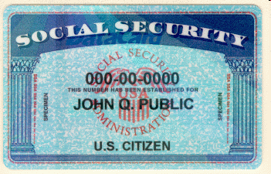
Data Diddling: SSA
Social Security Administration
— 1998.10
Employee become angry with
woman he had met online
  Argued in an Internet chatroom
Used fellow-employee's terminal
Filled in death date for woman in SSA records
Victim applied for loan at bank
  She was "cyberdead”
Jorge Yong admitted culpability
  Resigned
  Paid $800 in fines and damages
Notes:
RISKS 20.01:
Date: Fri, 25 Sep 1998 15:24:25 ‑0700
From: Scott Peterson <scottp4@ibm.net>
Subject: "Cyberdeath' raises privacy issue
An article yesterday in my local paper crediting Cox News service relates the story of a woman who applied for a loan at her bank. However, the credit check indicated that Social Security said she was dead.
An investigation uncovered that a claims agent at the SSA's Belle Glade FLA office named Jorge Yong had had a fight with the woman in an internet chat room and was banned from it. In retaliation, he used a co‑workers terminal to put a date of death on the woman's record.
Yong resigned and was ordered to pay $700 to the victim and pay a $100 fine after pleading guilty to one count of falsifying personal data
This story came out in testimony by acting inspector general James Huse before the Senate Governmental Affairs Committee as part of an ongoing investigation of whether private information is safe on government computers.
Scott Peterson <ScottP4@IBM.NET>

Slide 16

Embezzlement: 1998-12
China continued crackdown on computer crime
Zhenjiang
Two criminal hackers
  Twin bothers
Stole 720,000 Yuan (~U$87K) from bank
  Transferred to their own accounts
Sentenced to death (!)
Notes:
Date: Thu, 31 Dec 1998 12:38:59 -0500 (EST)
From: John Knight <jck@cs.virginia.edu>
Subject: Chinese sentence hackers to death
Twin-brother computer hackers sentenced to death in China (Deutsche Presse-Agentur, 28 Dec 1998).
Two Chinese computer hackers who illegally transferred 720,000 yuan (about 87,000 dollars) to their own bank accounts have been sentenced to death, the Beijing Chenbao newspaper said in its Monday edition. The hackers, twin brothers, had used inside information to rob a bank in the city of Zhenjiang, the report said. One of the brothers, Hao Jingwen, opened 16 accounts under false names in September, the report said. Then he entered a branch of the Trade and Industry Bank in Zhenjiang, in Jiangsu province, and installed a piece of equipment in the bank's computer system.
http://web.lexis-nexis.com/more/cahners-chicago/11407/4120740/4
[Extracted from NMIA ZGram, zhi@zgram.net (Zhi Hamby)]

Slide 17
Logic Bomb: 2000-02
Deutsche Morgan Grenfell Inc.
Tony Xiaotong Yu, 36, Stamford, CT
Indicted 2000-02-10
  NY State Supreme Court,
  Manhattan
Charge: Unauthorized modifications to computer system & grand larceny
1996: hired as a programmer
  End of 1996, became securities trader
Accused of inserting programmatic time bomb into a risk model
  Trigger date July 2000
Months repairing the program
Notes:
February 10, 2000
Man Indicted in Computer Case
By THE ASSOCIATED PRESS
A former investment bank employee was indicted yesterday on charges of programming a glitch into the bank's computer system in an attempt to cause it to lose millions of dollars.
Tony Xiaotong Yu, 36, of Stamford, Conn., pleaded not guilty at his arraignment in State Supreme Court in Manhattan on charges of computer tampering and grand larceny. Acting Justice Brenda Soloff let him remain free until today to raise bail of $50,000.
Mr. Yu was hired by Deutsche Morgan Grenfell Inc., a division of Deutsche Bank, in February 1996 as a computer specialist to help create a program for bond traders.
In late 1996, Mr. Yu changed jobs within the bank and became a securities trader. He supposedly ended his involvement in computer programming.
But Manhattan District Attorney Robert Morgenthau said Mr. Yu secretly wrote a "time bomb" into the program he helped create, which was called a risk model. The bomb was supposed to "explode" in July, Mr. Morgenthau said.
The destructive code was found in February 1998 by other specialists who were working on the risk model program, Mr. Morgenthau said. He said programmers worked for months to undo problems created by Mr. Yu, who was dismissed after the code was found.
Mr. Morgenthau said Mr. Yu's involvement was confirmed by taped phone conversations with acquaintances.

Slide 18
QA: Easter Eggs in Programs
1998.01: Unauthorized code in commercial programs
Major manufacturers; e.g., Microsoft
Get through QA testing — questions about thoroughness
Startling example: MS-Excel 97 flight simulator
  Sequence of keystrokes
  Huge color graphic images
  Real-time recalculations
  Names of development team

Slide 19
QA: Naughty Words
1998.06: Matsushita Panasonic Interactive Media
“Secret Writer’s Society” software
  Helps kids by reading their writing
Included extensive set of forbidden words (curses, etc.) intended to protect children
Bug caused random emission of foul language from list of forbidden text
Company denied it was a significant problem
*$*!*/|**!%!
Notes:
EDUPAGE:
KIDS' SOFTWARE IS CURSED BY A BUG
An educational software program has exhibited an unusual glitch – under certain circumstances it can spew forth language that would make a sailor blush. "Secret Writer's Society," a product of Matsushita's Panasonic Interactive Media, is a writing program for children that, among other things, recites their compositions back to them in a computer-generated voice. The problem is, there's a bug in the filter that's supposed to prevent the text-to-speech function from reciting foul language, and instead of suppressing those words, it delves into the archives of prohibited words to string together streams of obscenities that go "way beyond George Carlin's seven banned words," as one parent who tested the program says. A Matsushita marketing manager says she has heard of only two instances of the problem, both using a Macintosh and both times, when a lot of memory was in use. But the editor-in-chief of SuperKids, which reviews educational software on the Web, says that he was able to activate the glitch simply by writing a passage longer than just a few sentences and double-clicking the mouse instead of single-clicking. "It's got a very expressive vocabulary," he notes. (Wall Street Journal 17 Jun 98)

Slide 20

QA: UK National Insurance Registry Database Destroyed
1998.10: U.K. Department of Social Security
Andersen Consulting installed new software
Destroyed National Insurance Registry
Payments had to be made by hand
Normal checks on eligibility foregone
Outage lasted a month
Untold hardship for government staff and victims of delays
Unknown losses due to fraud

Slide 21

$2.1B for QA Failure
1999-10
Bug in some Toshiba laptop computers
  Allowed data corruption on diskettes
  When writing to last byte on any sector
Toshiba settled class-action lawsuit
  Paid $2.1B in damages to plaintiffs*
Serious pressure to improve QA before release in future
____
*Consider putting THAT on your CV! “I caused my employer $2.1 B in losses….”
Notes:
At $2.1 billion per bug, reliability tests are urgent
OTC 11-25-99 7:38 AM
By: RAMIN HOJATI
Nov. 24, 1999 (Electronic Engineering Times - CMP via COMTEX) – On Oct. 28, Toshiba Corp. announced the settlement of a class action lawsuit in which it was alleged that Toshiba's notebook computers could, under certain circumstances, cause data loss or data corruption to information stored on a floppy disk. Toshiba valued the settlement at $2.1 billion. Reports said the problem stemmed from a potential data loss when writing to the last byte on a sector. Supposedly, the floppy-disk controller would fail to raise an overrun flag, if there were a delay between a data request and a transfer. Without the flag being asserted, the system believed the data was written correctly.
The alleged disk controller bug raises an important question. How many flaws escape detection in complex chip designs, and what are the potential consequences? Are chip makers practicing sufficient verification, and are they paying enough attention to quality and reliability?
In the legal arena, liability may hinge on the question of a vendor's knowledge of a bug's existence or the feasibility of discovering it at system test. Some believe a bug that surfaces only under the most unlikely set of conditions would be all but impossible to find. Though the Toshiba problem originated with a design done in the late 1980s, would today's verification methods have caught it?
A technique called static functional verification (SFV) uses no vectors, but analyzes the properties or expected behaviors of a design. Verifying a behavior, equivalent to an astronomical number of vectors, can be accomplished in just seconds, and exposes many hard-to-reach corner cases.
(Cont’d on next page)

Slide 22
Some More Recent Employee Errors & Crimes
NY City Police Inspector Hacks DB (2006-05)
Wrong Number Costs Gateway $3.6M (2002-07)
Ericsson Employees Charged (2003-05)
Revenge Motivates Sabotage (2005-05)

Slide 23
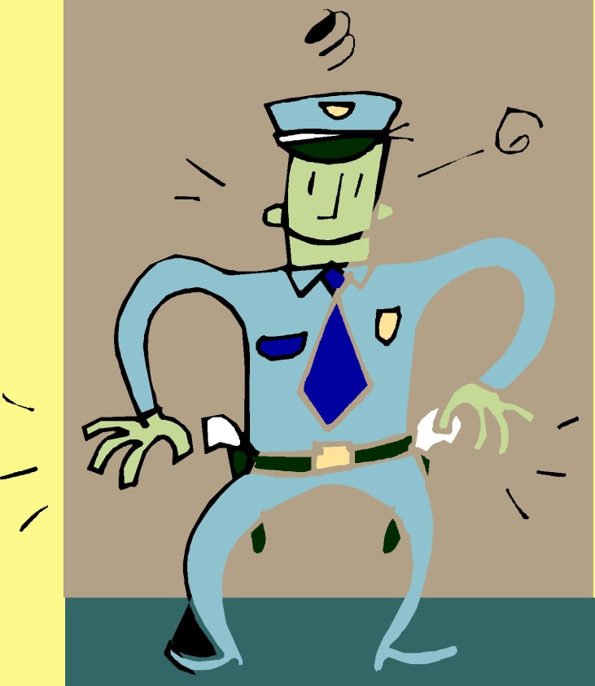
NY City Police Inspector Hacks DB (2006-05)
RISKS 24.28:
Deputy inspector altered CompStat data
  Inflated old crime statistics
  Deflated current statistics
Intended to make himself look better than predecessor in job

Slide 24

Wrong Number Costs Gateway $3.6M (2002-07)
In 1999, Gateway employee mistakenly used 800-nnn-nnnn instead of 888-nnn-nnnn for Gateway’s complaint line
Distributed to all stores; listed on Web site; added to bills; sent to 100,000 customers
Number was actually used by Mo’ Money distributor
  Warned Gateway within 6 days of flood of calls
  Gateway took 2 years to fix
  problem
Mo’ Money awarded $3.6M in
compensatory and punitive damages

Slide 25

Ericsson Employees Charged (2003-05)
3 Swedish employees of Ericsson wireless-equipment manufacturer arrested
Charged with industrial espionage
Accused of selling trade secrets to Russian intelligence agent
Involved commercial, not military, products

Slide 26
Revenge Motivates Sabotage (2005-05)
DHS –funded study reports common factor in sabotage: revenge
Study conducted by US Secret
Service & CERT-CC
  Dozens of computer-sabotage
  cases from 1996-2002
  Data destruction, posting
  porn on Websites,
  denial of service. . .
Most attackers disgruntled,
angry employees or former employees
  Resented disciplinary actions, missed promotions or layoffs

Slide 27

Hiring, Management and Firing
Hiring
Management
Termination of
Employment

Slide 28

Hiring
Check background carefully
  Legal limitations on how far one can go
  Beware negligent hiring
Have candidates interviewed by future colleagues
  Best placed to identify fakes and liars
Enforce employment agreements
  Legally-binding contractual terms
  Require conformance with policies
  Grounds for termination of employment
  Protect intellectual property with NDA

Slide 29
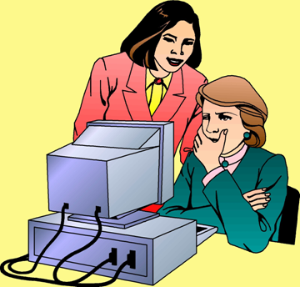
Management
Identify Opportunities for Abuse
Access Is Not A Privilege
or a Right
Beware the Indispensable Employee
Enforce Vacations
Respond to Changes in Behavior
Enforce Separation of Duties
Ban Unauthorized Security Probes

Slide 30

Identify Opportunities for Abuse
Think like a criminal
  Look for ways to get around controls
Work through scenarios for possible crimes
  Develop countermeasures
  Institute monitoring procedures / audits
  Beware sole control of critical resources (see later)
  Teach employees how to respond to attempted collusion

Slide 31
Access Is Not A Privilege or a Right
Do NOT allow access to become a badge of high rank
Managers do NOT need uncontrolled access to physical computer equipment
No one needs master keys without a reason
No one needs access to other people’s passwords or tokens
Access can be assigned temporarily
  Specific reason (documented)
  Limited time
  With log records

Slide 32

Beware the Indispensable Employee
Kabay’s Law:
NO ONE SHALL BE THE SOLE REPOSITORY OF CRITICAL INFORMATION OR SKILLS
Having to depend on a single person for critical functions is prescription for disaster
Extremely difficult to terminate employment of such a person
  If you tell them they are fired,
  they have enormous power
  to do harm
  If you don’t have their knowledge
  transferred before they leave, can
  cause chaos

Slide 33
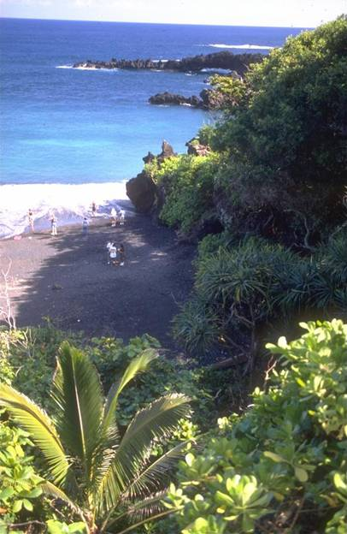
Enforce Vacations
Vacations not only help employees, they offer an opportunity for operational testing
Operations must continue in the absence of any one person
Case:
  One client went on holiday on south-sea island without communications facilities
  Operations ground to a halt for a week

Slide 34

Respond to Changes in Behavior
Any unusual change in mood / behavior warrants management attention
  Happy → sad
  Grumpy → friendly
  Relaxed → nervous
Cases:
  Employee appears with new expensive car
  Nasty sysadmin suddenly all smiles

Slide 35

Enforce Separation of Duties
No one should be able to authorize and also carry out a critical function
Examples
  Accounting: make out
  check vs sign check
  Operations: add a new
  batch job vs launch it
  Programming: make a
  change vs put it into production
  Security: add a new user vs authorize addition
Separation of duties forces collusion – more difficult for the criminal

Slide 36
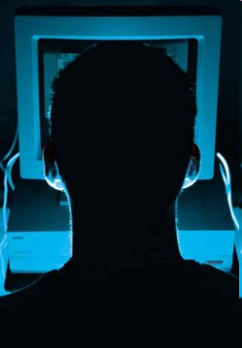
Ban Unauthorized Security Probes
Explicitly forbid scans / probes of security posture
No one to install unauthorized security (or other) software
Require written authorization* from appropriate authority before attempting security evaluations
Warn all employees not to cooperate with “new security procedures” or “security checks” without verification of authority
______________________
* Known as the get-out-of-jail card

Slide 37

Termination of Employment (1)
Resignations vs. firings
  Which do you think is more challenging for security staff?
Shut down access immediately
  During exit interview
  Have procedures in place for complete removal of privileges for departing employee throughout
  entire organization
Retrieve corporate property
  Equipment, tokens,
  badges, documents,
  forms, policies….

Slide 38

Termination of Employment (2)
Principle of consistency
  Critically important to treat all employees the same way
  Cannot give a farewell party to some and frog-march others to the door
    Why not?

Slide 39
Review Questions
Why should the security group work with the HR department to establish procedures for safeguarding information and information systems?
How can dishonest employees compromise information security? (many ways)
What are the key safeguards during the hiring process that can reduce risk of information security breaches?
Be ready to explain all of the key principles of effective employee management that improve information security as discussed in the chapter and the slides.
Discuss the relative difficulties of resignations and firings for security enforcement.

Slide 40
Now go and study

