Slide 1
Working with Vendors
MSIA
Seminar 6
M. E. Kabay, PhD, CISSP-ISSMP
Program Director, MSIA School of Graduate Studies
Norwich University
mekabay@gmail.com
Notes:
M. E. Kabay, PhD, CISSP

Slide 2
Vendor Relations
Establishing Constructive Relationships
Hardware Support
Vendor
3rd-party
Self
Software Support
Vendor responsibilities
Client responsibilities
Cooperative Problem Resolution
Records are Important
Problem-Database Design
Problem Escalation
Multi-Vendor Problems

Slide 3
Establishing Constructive Relationships
Value
Avoid the bleeding edge
Don't buy on price alone
Evaluate / select your sales contact from vendor
Determine corporate liaison to vendor
Specify all commitments in the contract
Do not tolerate illegal or unofficial deals
Never buy under pressure
Include time limits and penalties in contract
Write down details of meetings and distribute minutes to all participants
$

Slide 4
Hardware Support: Vendor
Vendor:
High expertise
Up-to-date training
Higher cost (10-15% of purchase cost / yr)

Slide 5
Hardware Support: 3rd Party
3rd-party:
Lower cost (e.g., ~33% cheaper than vendor)
Suitable for established / obsolete equipment
Get references from customers
Require 3rd party support to pay vendor charges as part of contract
Contact your vendor to be sure you will receive first-class service if you need it

Slide 6
Hardware Support: Self
Self:
Suitable for large installations
Permits high availability, short response time
Must train your own technician
Or hire a technician from your vendor – but only with permission
For obsolete equipment,
Buy spares on used market
Stockpile old parts

Slide 7
Software Support: Vendors
Vendor Responsibilities
Define levels of support unequivocally
Source code in escrow
Provide user-group contacts
Offer alternative sources of info
FAQs, knowledge-base
Phone-in consulting service
E-mail support
Web-based support
Fax-back service
Priority service ($)

Slide 8
Software Support: Clients
Client Responsibilities
Identify a specific problem-manager
Characterize each problem
Isolate bug and reproduce if possible
Research in documentation before calling
Provide full information to vendor support team
Document problem resolution in detail

Slide 9
Cooperative Problem Resolution
Records are important
Problem database design
Problem database usage
Escalation
Multi-vendor problems

Slide 10
Records are Important
Share information among responsible staff
Prevent thrashing
Speed resolution
Micro or network-based
Enhance credibility with vendor staff
Keeping consistent records may play role in legal battles

Slide 11
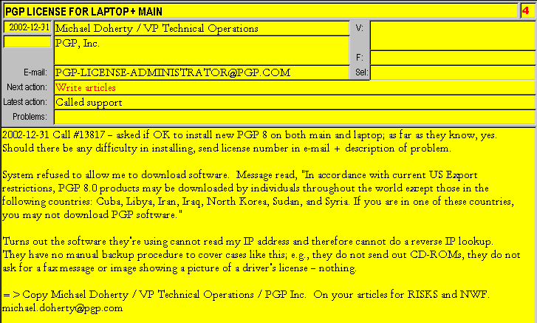
Problem-Database Design
Priority
Keywords
Contacts
Telephone #s
Address info
Free-format selection field
Notes

Slide 12
Cooperative Problem Resolution
Problem database usage
Don't use abbreviations in WHO and WHAT fields
Keep it short
Integrate correspondence if messages are short
Refer to longer documents by name and path
Track dates and times
Mark action items clearly
e.g., use -> and CAPITALS for action items

Slide 13
Problem Escalation
Keep support-line calls open until problem solved
Obtain vendor escalation schedule
Insist on proper escalation
Keep your own upper management informed at every step
Contact user networks for extra help and insight
Meetings: high positions and equal levels
Openly contact the vendor's competition
Involve legal staff as last resort

Slide 14
Multi-Vendor Problems
Finger-pointing degenerates into deadlock
Arrange meeting of vendor representatives
Use external consultant if necessary
Provide transcript of meeting notes to all participants
Define tasks and deadlines cooperatively
May be able to assign responsibility to one vendor for a fee

Slide 15
END

