Slide 1

Leadership Skills
MSIA
Seminar 6
M. E. Kabay, PhD, CISSP-ISSMP
Program Director, MSIA
School of Graduate Studies
Norwich University
mekabay@gmail.com
Notes:
M. E. Kabay, PhD, CISSP

Slide 2
Goals
Improve Capabilities of IA Specialists and Managers
  Organize meetings efficiently
  Communicate well to groups
  Organize knowledge effectively
  Report findings comprehensibly

Slide 3
Overview
Leading Meetings – the Infrastructure
Ground Rules for Meetings
Presenting Information Effectively
Analytical Techniques

Slide 4
Infrastructure for Effective Meetings
Participant roles
  Facilitator
  Business leader
  IT leader
  Subject-matter experts
  Scribe
Ground rules
  Do’s
  Don'ts

Slide 5
Facilitator
Schedule and keep to schedule
Choose attendees
Encourage participation
Stop personal conflicts
Test for consensus
Cover agenda and finish items
Respond to innovation
Summarize actions and responsibilities

Slide 6
Business Leader
Keep group focused on real-world issues
General business experience
Bring practical information to bear on discussions
  Client-related issues
  Regulatory considerations
  Organizational structure
  Budgetary constraints
    Who will support proposals
    Who will oppose — and how to enlist

Slide 7
IT Leader
Technical perspectives
Up-to-date in appropriate areas of discussion
Background research
  Relevant to particular issues
  Bring documentation, URLs of value
Real-time research
  Fast access to Web
  Appropriate CD-ROM resources
Find ways to implement ideas
Identify technically unsound ideas
  Offer corrections or alternatives

Slide 8
Subject-Matter Experts
Knowledgeable, experienced in specific issues
Example: designing new course on identification and authentication methods
  Biometrics expert
  Tokens expert
  Instructional designer
  Graphics designer
Class exercise: Identify some subject-matter experts who could help you in a particular problem you are working on at work

Slide 9
Scribe
Responsible for recording significant information
  Issues, discussions, solutions
  Decisions — drop, shelve, study, act
  Action items: who does what by when?
Skills
  Type fast and accurately
  Take structured notes (see next slide)
  Analyze and summarize in real time
  Show real-time notes* on wall through LCD projector (*see part 3)
Distribute notes fast to participants for review

Slide 10
Structured Notes
I. Main topic*
  A. Second-level topic
  1. Third-level topic
  a. Fourth-level topic
  i. Fifth-level topic
  (A) Sixth
  (1) Seventh
  (a)
  (i)
* Some people / groups prefer legal numbering:
1, 1.1, 1.1.1, 1.1.1.1, etc.

Slide 11
Overview
Leading Meetings – the Infrastructure
Ground Rules for Meetings
Presenting Information Effectively
Analytical Techniques

Slide 12
Ground Rules: What Fails
Cell phones, beepers, PDA alarms
Interruptions by managers
Leaving to handle operational emergencies
Answering e-mail
Private dialogs
Random walk (jumping around topics)
Hostility
Unhealthy group behavior
  Social loafing
  Group polarization
  Groupthink

Slide 13
Ground Rules: What Works
Operational focus
Mutual support
Preparation
Agenda
Punctuality
Participation
Order
Active listening

Slide 14
Operational Focus
What will we be able to DO after this meeting that we cannot do now?
Frame objectives in behavioral terms
  Will be able to analyze, explain, decide, effect, act on, create, remove. . . .
  Avoid vague words like “understand, become familiar with. . . .”
Theoretical frameworks applied to practical decisions — “So what does this mean for us?”
Include planning for process of change
  Milestones
  Deadlines

Slide 15
Mutual Support
Adversarial meetings don’t work well
  Not a zero-sum game (you win, I lose)
  Neurotic to demonstrate superiority
    Intellectual
    Power
  Destructive to appropriate ideas (MY idea)
Supportive meetings get results
  Everyone wins through group success
  Strive for mutual encouragement, support
  Egoless ideation: OUR idea, not MINE
    Open to improvement
    Encourages joint involvement

Slide 16
Preparation
Be clear on purpose of meeting
Define specific agenda
Ask for additional issues from members
  By specific date & time
Avoid presenting new proposals at a meeting
  Prepare the ground
  Speak with members of group before meeting
  Summarize proposals, explain context
  Send written explanation or background before meeting

Slide 17
Preparation (cont’d)
Using presentation software effectively
Plan ~2-3 minutes per slide
  Unless you know that you need more or less for specific application
Present no more than ~6-8 main points per slide
Visibility
  ~24 point bold text
  ~36 point headings
  Readable colors: dark letters on light background best

Slide 18
Agenda
Devise appropriate sequence of topics
Review of previous action items
Status reports from sub-groups
Introduction of new issues
Open discussion
Review of new and continuing action items
  Who?
  Specifically what?
  By when?

Slide 19
Punctuality
Avoid announcing meeting for “broadcast time”
  09:00, 09:30. . . .
Use humor to get the point across:
  “The meeting will begin at 08:59:43”
Define quorum
No allowance for habitually late people
  Habitual latecomers will always arrive after a meeting has begun
  Starting 10 minutes later will make them 20 minutes later next time
Finish on time

Slide 20
Participation
Keep track of all members
  Watch participants’ body language
    Arms crossed, sitting back vs
    Leaning forward, nodding
Who’s talking and who’s silent?
  Is this the usual behavior?
  Call on silent partners to voice comments on specific issues
  Cue big talkers to stick to topic, be concise
Encourage shy members using social cues
  Thanks for idea, contribution
  Smile, nod, lean forward, focus on face

Slide 21
Order
One speaker at a time
  Get people used to asking for floor
  Keep track of who’s next
Civility
  Maintain professional courtesy
  Prevent interruptions by members
Stick to the agenda
  Avoid side-issues
Stop side-discussions
Prevent distractions
  People using cell-phones
  Interruptions from outside

Slide 22
Active Listening
Focus entirely on person speaking
Reflect key points presented
Use diagrams to represent relations
Use visual aids
Ask questions on specific points
Don’t be afraid of looking foolish
Invite elaboration on complex issues
Go beyond what’s presented
  Extend ideas beyond boundaries
  Apply to new spheres of activity
  Look for parallels, analogies

Slide 23
Using Diagrams to Focus While Listening
Speaker/presenter can supplement presentations or discussion with drawings, slides, pictures
Listeners can use diagrams effectively
  Represent relations
  Remind one of key points
Any method that works for an individual is OK
  Trees
  Pies
  Stick figures
  Flow charts

Slide 24
Diagram Examples

Slide 25
Aside: Beware the Non-Zero Ordinate
MY HERO!
He started the ordinate at zero! Wow!
10,000
This guy, on the other hand, is trying to fool us with a non-zero ordinate.
0
11,000
10,000

Slide 26
Overview: Presenting Information Effectively
Leading groups and teaching have much in common
Effective communication affected by variables in
  Listeners
  Channels
  Presenters
  Messages
Evaluating effectiveness of communication
Part 3 (this one)
Part 4

Slide 27
Leading Groups & Teaching Have Much in Common
Operational focus: attempt to change something
  Students’ abilities in a particular subject
  Meeting participants’
    Range of options in a particular problem area
    Beliefs, attitudes, motivation, actions
  Organization’s / society’s options / direction
Two-way communication
  All participants can learn / improve / contribute

Slide 28
Overview
Leading Meetings – the Infrastructure
Ground Rules for Meetings
Presenting Information Effectively
Analytical Techniques

Slide 29
Effective Communication:
Listener Variables
Knowledge base
Objectives
Intelligence
Alertness
Motivation

Slide 30
Knowledge Base
Define prerequisite knowledge, skills
Ask each participant for brief biography
Explore related areas of knowledge
Identify strengths and weaknesses
Incorporate interests into examples, discussions

Slide 31
Intelligence
Less important than frequently assumed
Encourage questions, discussion
Praise interventions, ideas, contributions
For courses
  Effective study methods can compensate
  Offer assistance outside class

Slide 32
Alertness
Sleep deprivation harmful to learning
Use channel variables to enhance alertness
Provide frequent breaks
Respond immediately to inattention
Use humor and the unexpected
Discourage heavy lunches
Forbid alcohol during task-force meetings, workshops and training

Slide 33
Motivation
“What would you like to be able to do after this course that you can’t do now?”
Beware forced participation: work to convince of meeting or courses utility
For courses: address benefits of mastery
  Share experiences in real world
  Bring in enthusiastic “graduate”
    If possible, one who was negative at start
    Have brief description of positive results, value

Slide 34
Channel Variables
Time available
Working conditions
Visibility, audibility, clarity
High interactivity

Slide 35
Time Available
Allow for at least ~2-3 minutes/slide on average
  Check your timings if you use more slides
  Be sure that you can in fact present all the slides
At most ~1 hr between breaks
  Use longer breaks (e.g., 20-30 minutes)
  to foster creativity
  Informal discussions often useful
At most ~7 hr/day
If necessary, plan 2 or more days or sessions for better assimilation and application of complex issues

Slide 36
Working Conditions
Keep room relatively cool
Lights bright if possible
Comfortable chairs
Desks or tables with enough room for computers and papers
Printed materials with room for notes
Multimedia: reference articles, videos
If possible and appropriate, network with hub & LAN connectors
  High-speed access to Net
  NetMeeting software

Slide 37
Visibility, Audibility, Clarity
Stand, move, sit
Speak clearly at all times
  Keep microphone away from direct line of breath (avoids noise)
Vary speed
  Slower than conversation
  Pauses effective for emphasis
Over-inflect for emphasis
  Different from conversational mode
  Increase frequency range and dynamic range
Face the audience, not the slide / poster

Slide 38
High Interactivity
Ask questions frequently
Challenge individuals
Turn discussion to relevant personal experiences
Use digressions constructively to reinforce message
Use examples from participants’ experiences
When teaching, remember individual students’ interests and point out relevance of specific material to them

Slide 39
Effective Communication:
Presenter Variables
Psychology and motivation
Empathy and imagination
Patience
Subject knowledge
Background knowledge
Ethical standards
Externals

Slide 40
Psychology and Motivation
Commitment to group / participant / student achievement
Beware feelings of power and superiority
Encourage questions, challenges
  Thank people for raising questions; smile
  Set example: “I don’t know that; can anyone help on that question?. . . . I’ll do some research for the next meeting / class.”
  Deal with extensive discussions at break to avoid disrupting flow of meeting

Slide 41
Psychology and Motivation (cont’d)
Admit mistakes immediately and clearly
  “On that third point, I was wrong. Thank you to Scott for pointing out that. . . .”
Unforgivable to humiliate people
  Grounds for dismissal
Every session is a chance for leader / teacher to learn
  Write down ideas for improvement

Slide 42
Empathy and Imagination
Remember what it was like being a beginner
  Define jargon terms
  Define acronyms on first use
Identify basic knowledge and skills needed for assimilation of later concepts, material
In courses, ensure that basics are thoroughly mastered
  If necessary, take disproportionately longer at start of meeting / course
Encourage meetings after meeting / class
  Make schedule of availability known
  Stick to schedule, especially for students

Slide 43
Patience
Find alternative ways of explaining ideas / skills
  Analogies
  Examples
  War stories
When question out of place, defer answer
  Later in lecture if suitable
  At break or after class
Respect students for wanting to understand

Slide 44
Subject Knowledge
Difficult or impossible to provide technical leadership or to teach without mastering subject
Create your own presentation materials
  Or adapt existing materials
Use all available resources to supplement your knowledge and understanding
  Textbooks
  Articles
  Colleagues
  Online databases
“I don’t know; let’s try to find out!”

Slide 45
Background Knowledge
Read widely in related areas
Bring in analogies from other areas of experience
Use personal life-experiences when suitable
Talk about feelings as well as ideas
Express values openly
Use divergence of judgment or opinion as opportunity for expanding everyone’s knowledge

Slide 46
Ethical Standards
Work for the participants’ and the organization’s benefit
Review and revise course materials as appropriate before reusing them
Provide value for time invested
Take participants’ other commitments into account — stay on schedule
  Start when you say you’ll start
  Stop when you say you’ll stop
If teaching a course, make it possible to achieve maximum grades
Teachers: beware of emotional / sexual entanglements with students — violation of professional ethical standards

Slide 47
Effective Communication:
Message Variables
Context
Behavioral objectives
Organization
Content
Review questions

Slide 48
Context
Provide overview of coming materials
  If appropriate, specify preliminary readings
  Provide notes for participants / students
  Use overview slides throughout presentation
Explain why information matters to participants or students
Focus on practical skills and examples
Courses: consider open-book exams, cooperative learning

Slide 49
Behavioral Objectives
Avoid internally defined objectives such as “knowing”, “becoming familiar with” etc.
What will the team or the class be able to DO after the session / course that they can’t do yet?
  Analyze, apply, attack, choose, compare, contrast, decide, defend, define, discuss, design, demonstrate, establish, explain, improve, optimize, prepare, repair, solve, teach, . . . .
  Within certain time limits, with certain tools available, accomplish specific actions. . . .

Slide 50
Organization
Design presentation / course top-down
  Sketch out areas of concern, skills
  Fill in details
Fundamental questions
  What’s this all about? (context)
  So why should I care about it? (motivation)
  So what’s the scoop? (content)
Provide signposts explaining upcoming sections
Start each section with restatement of why it matters
Emphasize mastery of basic knowledge
Point to more advanced topics

Slide 51
Organization (cont’d)
Memory works through association
  Engrams — patterns of neuronal firings in chains that activate experience, concepts
  Want to provide lots of hooks for assimilation / memory
Present practical examples before stating theory
  Need concrete example to establish framework for associations
Invite comment, experiences from participants before presenting theory
  Opportunity to strengthen integration of new information into web of associations

Slide 52
Evaluating Effectiveness of Communication
Declining accuracy
When leading a meeting or an informal course or workshop, gauge effectiveness through
  Watching body language throughout session
  Informal discussion
  1:1 conversation
Interviews, focus groups, surveys
For formal courses, can use essays, quizzes, examinations, projects
  Include active knowledge as well as passive
  If open-book, preferable to restrict time; e.g., 2 minutes per question

Slide 53
Overview
Leading Meetings – the Infrastructure
Ground Rules for Meetings
Presenting Information Effectively
Analytical Techniques

Slide 54
Goals
Review and introduce useful methods for making sense of complex situations
Help groups of people communicate more quickly
Introduce non-linear, non-sequential perceptions to a discussion
  Listening is serial: one idea at a time
  Take advantage of 2-dimensional representation – see more at once
  Methods below allow grasp of relations

Slide 55
Techniques for Analysis
Using real-time notes in meetings
Using brainstorming to identify issues
Using Computer-Aided Consensus to stimulate discussion and to order options
Using Post-It cluster analysis to organize ideas
Using Functional-Matrix Analysis to resolve confusion over roles
Using Computer-Aided Thematic Analysis to make sense of non-quantitative data

Slide 56
Real-Time Notes
Scribe must be capable of typing quickly and accurately
  Know how to take structured notes
  Sufficient self-confidence not to mind showing inevitable typos
Project notes as they are being written
  Large screen or wall
  Big print
Useful tools
  Word or WordPerfect outline
  PowerPoint outline
Outline goes here
more here
and more
and more
And more

Slide 57
Real-Time Notes (cont’d)
Guidelines
Not full sentences
  Don’t try to transcribe every word
    Leave out articles, adjectives. . . .
  Put down only essential information
Don’t try to correct typos right away
Clean up notes before distributing
  Distribute by e-mail or printout at end of meeting or ASAP
  Request corrections; changes to go to scribe before distribution of final version

Slide 58

Brainstorming
Goal: generate ideas to solve problem
Separate ideation from analysis
  2 phases: find/create ideas then organize
Ideation
  Set numerical goal (e.g., “100 ideas on how to. . .”
  No critical (negative or positive) responses
  Write every idea down on large paper
    Including silly ones
    Post sheets on walls
100, now let`s find 10 more!”

Slide 59
Brainstorming (cont’d)
Facilitator encourages ideation
Scribe writes everything down
Participants
  Should have means for
  making notes – avoid losing new ideas
  Should not go into any detail
  Cryptic suggestions are good
Hitchhiking
  When an idea sparks a new one, use
  hand signal to indicate priority (to
  avoid forgetting)

Slide 60
Delphi Technique
RAND Corporation, 2nd World War
Develop quantitative estimates using expert opinion
Ask top and bottom
quartiles to explain
reasons
Share reasons
Estimate again
Iterate to stability
Top Quartile
Estimates
Days

Slide 61
Computer-Aided Consensus
Real-time Delphi Technique
Need a spreadsheet & printer or network
1st, determine operational scale of importance
  How much time?
  How much money?
  When to start?
Agree on simple scale; e.g.,
  1 = start this week OR spend $0
  2 = this month $1,000
  3 = this quarter $10,000
  4 = this year $100,000
  5 = never $1,000,000

Slide 62
Computer-Aided Consensus (cont’d)
Lay out results of brainstorming or other list
  Use spreadsheet
  1 idea/proposal per row
Define 1 column per
participant
Enter each participant’s
estimate of importance /
priority / value in column
beside ideas / proposals
Can collect scores using printouts or using networked computers to fill in spreadsheets

Slide 63
Computer-Aided Consensus (cont’d)
Calculate average and variance
Sort descending by priority / importance

Slide 64
Computer-Aided Consensus (cont’d)
Group roughly by class of priority / importance
Sort downward by variance within subgroup
Discuss reasons for greatest variation in estimated priority / importance among
most important proposals / ideas
Why so much disagreement?
Arbitrarily defined
top (most important)
group

Slide 65
Computer-Aided Consensus (cont’d)
Spend most time on important issues where people disagree
Discussing differences reveals new information about why people diverge:
  different assumptions
  divergent priorities
  unshared or contradictory information
  different reasoning
  errors
Sharing info and resolving differences on important issues speeds consensus

Slide 66
Computer-Aided Consensus (cont’d)
Extremely important not to generate hostility
Best if spreadsheet visible for everyone
  Projector
  Network with net-meeting software
Keep track of explanations for divergences
  Use brainstorming techniques
Make process as dynamic as you can
  Change priorities in spreadsheet as often as needed
  Recalculate and sort again

Slide 67
Post-It™ Cluster Analysis
Devise categories
Write down all ideas one per sticky note
Silently put related ideas (sticky notes) in categories
Everyone may move a sticky from one place to another
No limit on how often note (idea) may be moved back and forth
Keep going until no one wants to move anything else OR only a couple of people disagree
Then discuss consensus and objections

Slide 68
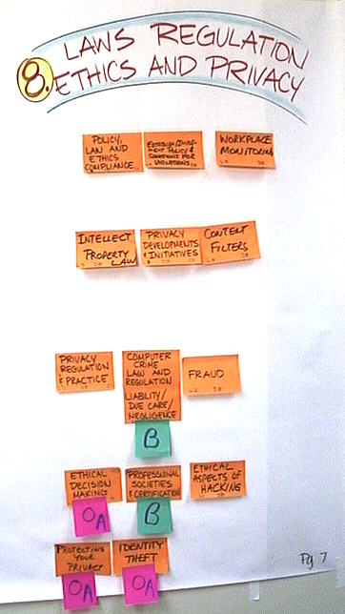
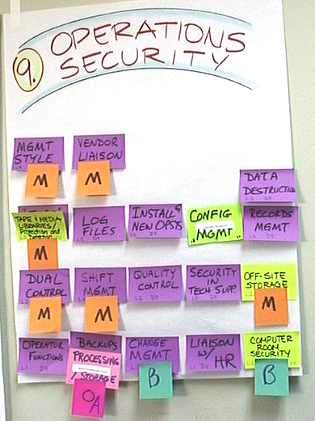
Post-It Cluster Analysis (cont’d)

Slide 69
Last Two!
Functional-Matrix Analysis
Computer-Aided Thematic Analysis (CATA)
Notes:
Both of these techniques were developed in the 1980s by
M. E. Kabay, PhD, CISSP
CATA is similar to a technique used by ethnographers (originally with index cards)

Slide 70
Functional-Matrix Analysis
Identifying who has (or should have) responsibility for a specific function / task
List all tasks one per row in spreadsheet
Label one column for each participant
Print spreadsheet or distribute copy via network
Have each person indicate privately who is
  (1) responsible for function / task
  (2) backup to the primary person
1
2

Slide 71
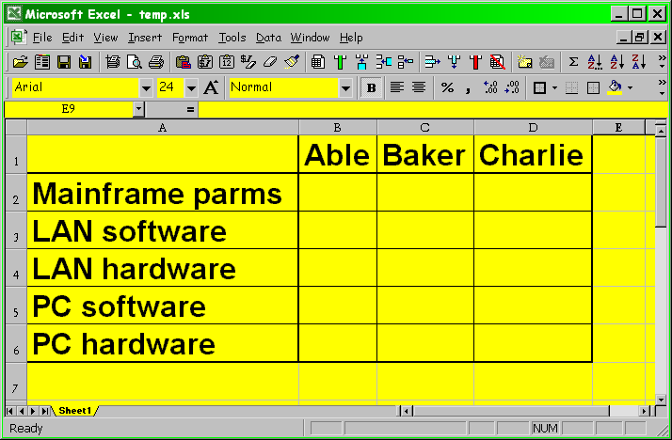
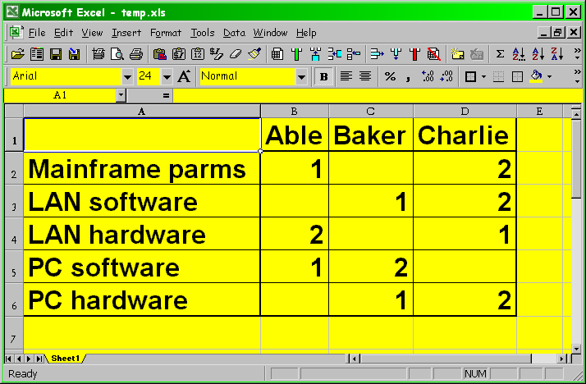
Functional-Matrix Analysis (cont’d)

Slide 72
Functional-Matrix Analysis (cont’d)
Collate results and evaluate collectively
Empty rows
No primary at all
No one admits to being primary
Multiple primaries/secondaries
Conflicting primaries/secondaries
Full columns vs empty columns
1
2

Slide 73
Computer-Aided Thematic Analysis (CATA)
How can we organize non-quantitative knowledge without imposing extrinsic framework
Intrinsic frameworks
  Develop by examination of data themselves
  Work with existing frameworks but go beyond conventional ideas
Extrinsic frameworks (preconceived notions)
  Can interfere with development of novel insight
  May mask data that don’t fit preconceptions

Slide 74
Overview of CATA
Define themes
Write one theme per line in spreadsheet
Keep track of origin
Develop intrinsic framework for classification
Apply preliminary classification
Sort
Classify again using finer granularity
Repeat sort/classify until stable
Report using synthetic paragraphs

Slide 75
Define Themes
“Theme”
  Any expression of fact, opinion or feeling
  “This project started 18 months ago.”
  “This project has been running too long.”
  “I hate this project.”
Break down all sentences
  at punctuation marks (. , ; : ! ? )
  at some conjunctions (and, but)
Insert hard-return (line-break) to demarcate themes
  Use global find-replace function

Slide 76
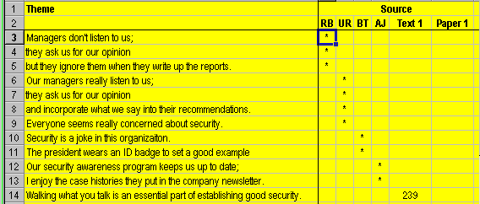
Enter Themes into Spreadsheet
Paste (copy) text into spreadsheet
  One theme per line in spreadsheet
Keep track of origin
  1 column per source / person

Slide 77
Develop Intrinsic Framework for Classification
Read through the (huge) list of themes
Jot down any word that
  Occurs spontaneously to you
  Could help you organize themes
Look through categories or metathemes
  Organize, order, number metathemes
  Stick to 6-10 metathemes if possible
  E.g.,

Slide 78
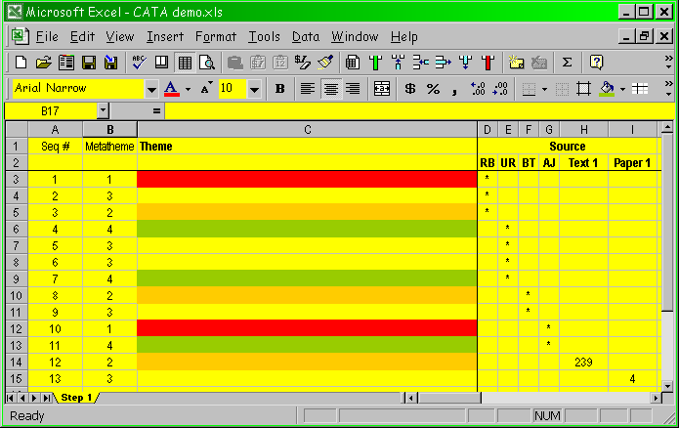
Apply Preliminary Classification & Sort
Insert 2 columns to left of themes
Generate sequence number for
each line
  To keep connected themes
  together
Classify each theme by noting number (or letter) of the appropriate metatheme
Sort entire list (including origin columns) by
  Metatheme; and
  By sequence number within metatheme
See next slides for illustrations

Slide 79
Preliminary Classification

Slide 80
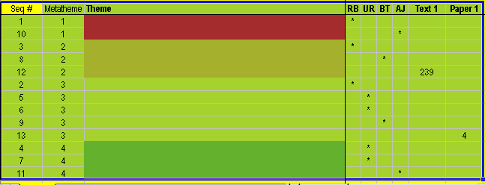
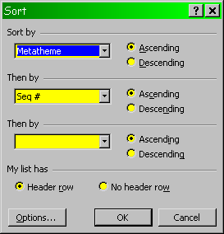
Sort
By metatheme
And by sequence number

Slide 81
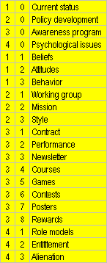
Classify Again Using Finer Granularity & Sort
Examine each group of items under one metatheme
As required, subdivide metathemes
  Grouping helps identify subdivisions
  Original metathemes become “n – 0”
Introduce another column into listing
Rate each theme according to two-part metathemes
Duplicate lines for more than 1 metatheme
Reorganize metathemes as needed
  Can use find-replace function and sort to move whole blocks

Slide 82
Report Using Synthetic Paragraphs
When satisfied at organization of data, can start writing report
“-0” items serve as headings and sub-headings
Summarize findings and combine quotations that are in the same direction as one synthetic paragraph; e.g.,
“Most employees felt that management were listening to their feelings:
  Managers really listen to us. They pay attention to our suggestions.”

Slide 83
Now go and apply these methods

