Slide 1
Solving Problems
MSIA
Seminar 6
M. E. Kabay, PhD
Former Program Director, MSIA College of Graduate & Continuing Studies
Norwich University
mekabay@gmail.com

Slide 2
Topics
Set Your Goals
Get the Global Picture
Distinguish Observation from Assumption
Distinguish Observation from Hearsay
Distinguish Observation from Hypothesis
Challenge Your Hypothesis
Track the Details
RTFM
Use Bug/Patch Reports

Slide 3
Set Your Goals
Short-term objective of problem solving:
Fix It
Long-term objectives of problem solving:
Figure out why it happened
Make sure it doesn't happen again (if possible)

Slide 4
Get the Global Picture: Perspective
What is the person is trying to do?
Prog: How do I write octal data directly in the directory?
Tech: Why would you want to do that?
Because I have to alter the first 8 bytes of the file block, some parts of the file index block, and data in the group and account index blocks.
No, I mean, what are you trying to do? How would you describe the problem to someone who didn't know about the directory?
I have to change the name of the file.
How about :RENAME?
Oh yeah... I forgot.

Slide 5
Get the Global Picture: Backtrack
Client may be far off-track
Notes:
It is not always obvious which of several possibilities to pursue in solving
problems. Sometimes people go off on the wrong branch of the decision
tree. By asking to understand what they are trying to do, one can often
help them solve their underlying problem more quickly.

Slide 6
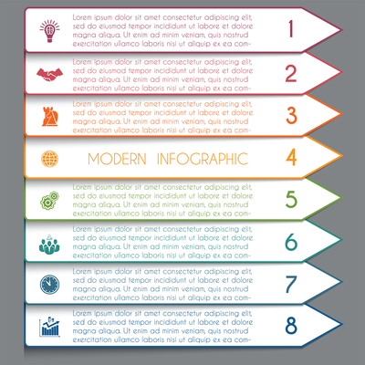
Get the Global Picture: Find Alternatives
Even for non-technical issues:
Can I have system ALPHA for a production that lasts 3 hours and takes 2,000,000 sectors of space this weekend?
Bad answer: Sorry, ALPHA's booked solid this weekend.
Better answer: Sorry, ALPHA's booked solid this weekend. But what's the problem--what do you need? Maybe we can solve it some other way--like system BETA.
Oh, sure, I guess BETA would be OK too

Slide 7
Assumptions

Slide 8
Distinguish Observation From Assumption
The #$@*&^%! FORTRAN compiler doesn't work!
Oh? That's interesting. What's the problem?
Program working fine; now it doesn't.
So when did you last run it?
Was another person at another firm.
Same model as ours--a HORTENSE 5400?
No, uh, actually, it's a URFORB series 876.
Say, how did you get this program, then? Tape? Diskette?
No, I typed it in from the listing. Why?
Notes:
Assumptions:
Perfect transcription (unlikely);
Identical versions of FORTRAN (unlikely);
Identical implementation on different computers (unlikely).

Slide 9
Distinguish Observation From Hearsay
One of our terminals has double softkeys showing up.
What were you doing when it happened?
Running program ABC.DEF; got second set of softkeys.
What do these softkeys show? The same as the original set?
I don't remember.
Well, can you go see it again?
Uh, actually, I didn't see it myself; C told me.
Get C. [...C arrives...] C, tell me again what happened.
Well, I was running program ABC.DEG when...
Wait a minute, not program ABC.DEF?
No, that one runs fine. Why?

Slide 10
Distinguish Observation From Hypothesis
There's some sort of problem with port 26 on system ALPHA; all we can get is an endless series of the letter `k' in lower case all over the screen. It’s hardwired, so it must be the computer.
No, actually, the problem is the `k' all over the screen; we don't know yet whether it's the screen or the keyboard or the cable between the screen and the keyboard or the cable between the screen and the port or the port or the AIB micro-board or the AIB itself or the SIB or the IMB or the ATP driver or the main memory boards or the CPU boards or the backplane connectors.

Slide 11
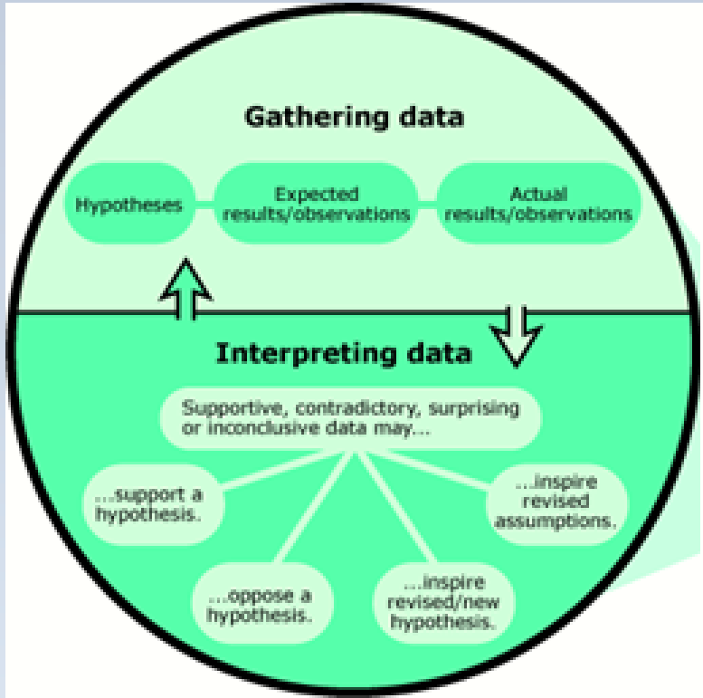
Challenge Your Hypothesis
So let's see this terminal.
IDEA: If it's the port,
TEST: then detaching the RS-232 connector will stop the `k.' AHA, it doesn't. The garbage has nothing to do with the link to the computer. So we look at something else.
IDEA: Suppose it's the keyboard? Then
TEST: removing the keyboard connection will stop it. Yes indeed, it does. I see the connector's a little bent ... oh, I see: there's a pin out of place because perhaps someone forced the connector into place.
IDEA: If the pin is responsible, then
TEST: perhaps bending it back will fix the problem.
Yes ... it works now.

Slide 12
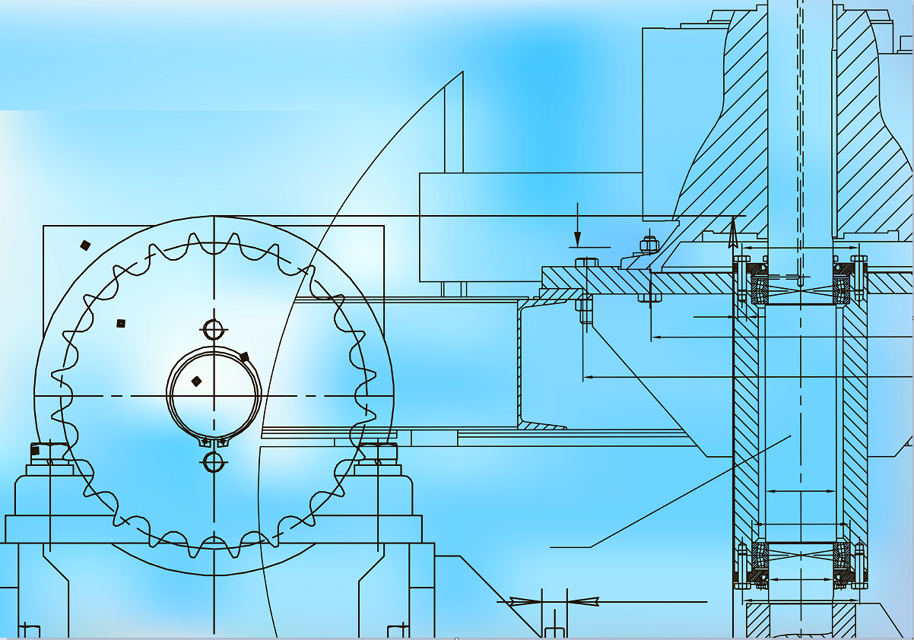
Track The Details
When a major problem occurs,
Sit down and reconstruct the events before trying out various solutions and workarounds
Write down everything you remember
What you did
In what sequence and
Whether there were unusual events before the problem occurred.

Slide 13
Track The Details (cont’d)
Write down everything you remember and use TIMESTAMPS
What were we trying to do?
How were we trying to do it?
Exactly what did we observe?
Then what did we do in what order?
And then what happened?

Slide 14
Don't Prejudge What's Important
CUST: We had a system failure AB3 a few minutes ago.
SUPPORT: Exactly what did you do?
The operator was working with spool files. He changed the outfence on ldev 6, then tried to alter the priority of a spoolfile on a remote spooled printer. Oh--he made a typing mistake on the class name: used MAX even though we had removed that class name a week ago. Then he....
WAIT! That's it! The bad class name. There's a known bug that causes this system failure when you refer to a nonexistent class name. We'll send you a patch.

Slide 15
RTFM: Read the ... Fine ... Manual
Your vendor reference manuals
should be
Up to date
Online if possible
Accessible to programming and operations staff
In numbered, labeled volumes
Cross indexed by key word in a separate list
Signed out to show where the volume is now
Returned within a few hours at most
Purchased separately for frequent users

Slide 16
Use Bug/Patch Reports or Databases
BugTraq
http://www.securityfocus.com/popups/forums/bugtraq/intro.shtml
Also published/updated regularly by most vendors
Online using WWW
KnowledgeBase
Known-Problem Reports
Usually have a keyword index
New versions may fix several problems at once
(Or cause new ones)
Patches – WWW or FTP
Program-code changes
Usually self-installing
“BugTraq is a full disclosure moderated mailing list for the *detailed* discussion and announcement of computer security vulnerabilities: what they are, how to exploit them, and how to fix them.”

Slide 17
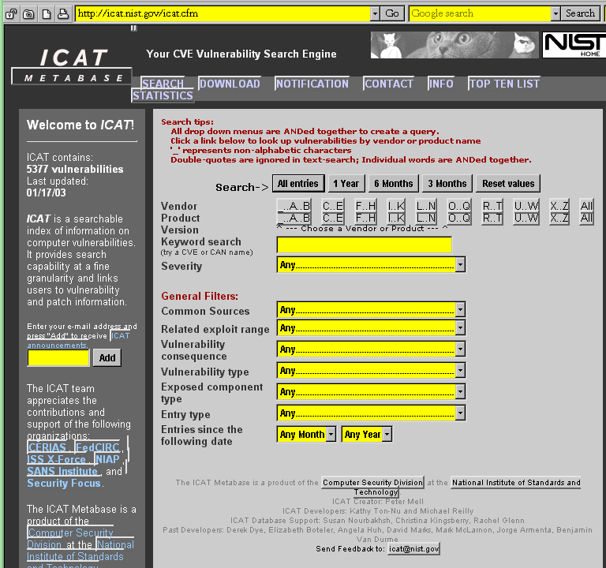
ICAT Metabase for CVE

Slide 18
Now go and study

