Slide 1
Staying Safe Online
Montpelier Senior Center
Week 6
Protecting Your Data
M. E. Kabay, PhD
Emeritus Professor – BSc & MSc Cybersecurity Programs
Norwich University
https://tinyurl.com/3b6p3h8s

Slide 2
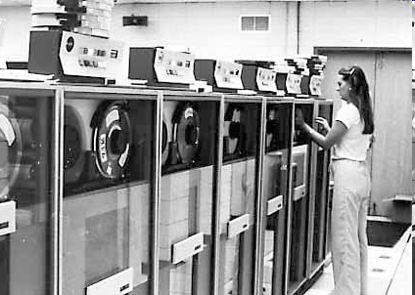
Topics
Definitions and Needs
Backup Bloopers
Strategies
Archives, Maintenance
and Retention
Storage
Disposal
Costs
Optimizing Frequency

Slide 3
Definitions
Backups – copies of data files or records
  Should be on different device
    Tape, hard disk, CD, DVD, cloud…
  May be on same disk (*.wbk, *.bak etc.)
  Better to be separate as well
Units & abbreviations
  Kb v KB – kilobits v kilobytes (1 byte is 8 bits)
  KB = kilobyte = 1024 bytes (characters)
  MB = megabyte = 1024 KB = 1,048,576 bytes
  GB = gigabyte = 1024 MB = 1,073,741,824 bytes
  TB = terabyte = 1024 GB = 1,099,511,627,776 bytes
  PB = petabyte = 1024 TB = 1.126 E15 bytes
  EB = exabyte = 1.153 E18 bytes
Notes:
According to a 1998 proposal from the International Electrotechnical Commission (IEC), the prefixes above should be KiB for kibibytes, MiB for mebibytes, GiB for gibibytes, and TiB for tebibytes to distinguish them from the powers-of-ten notations using kilo (10³), mega (10⁶), giga (10⁹) and tera (10¹²), but this suggestion has been widely met with ridicule by the technical community, many of whom argue that the prefixes sound like names from the TeleTubbies TV show.

Slide 4
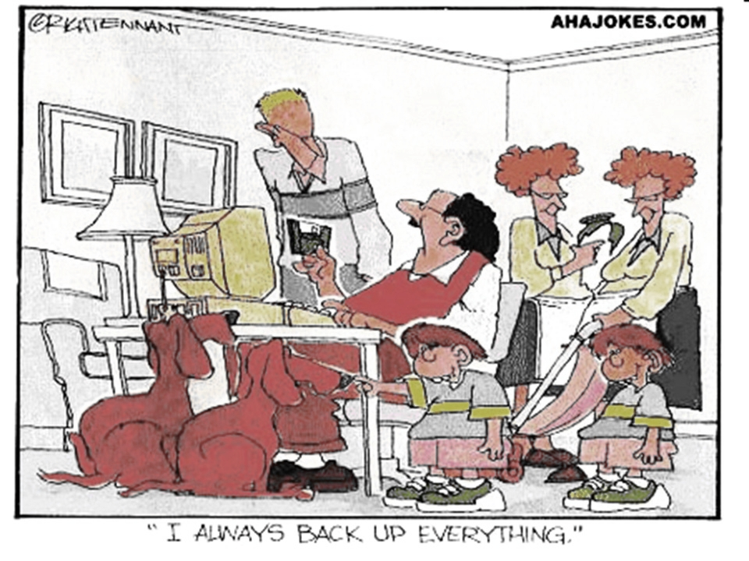
Backups

Slide 5
Backup Bloopers (Just a Few)
BerkshireNet
Margot Kidder
MIT
Macomb County
Electronic Voting Machines
These examples are not important in themselves: they’re just to illustrate
the importance of backups for
avoiding serious trouble.

Slide 6
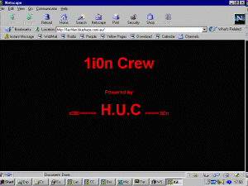
BerkshireNet Backup Blooper
Feb 96 -- RISKS 17.83
BerkshireNet, Pittsfield, MA
  Swastikas and racist messages
  Masqueraded as provider's administrator
  Erased data on two computers
  Shut down system
Down 12 hours
  no current backup
  older deleted files restored
  but several days of data lost

Slide 7

Margot Kidder Backup Blooper
Sept 96 -- People Online via RISKS 18.46
Computer virus was last straw
Led to nervous breakdown
Unidentified virus apparently destroyed only copy of her book
No backup
Notes:
MK has long predicted that one day a dead computer user will be found with a scary virus message on his/her screen. The shock of the payload will have caused a heart attack.

Slide 8

MIT “Cheating Scandal”
2000-03
Boston Globe reported “cheating scandal”
  22 students in cell bio class had wrong grades
Turned out a grad student had sorted the names but not included the grades. . . .
No backups, so no records of correct grades
No logs, no tracking, no nothing

Slide 9




Macomb County (Michigan) Sheriff’s Dept
2002-05: RISKS 22.08
Lost 50,000 photos of criminals
  Hard drive crashed
Had some pictures printed out as backups
But had made no electronic backups at all on any medium
D. L. Smith
MELISSA
J. L. Parson
W32.Blaster.B
R. E. Rutkowski
Ur-spammer
T. C. Cowles
Ur-spammer

Slide 10
Electronic Voting Machines
2004 election period saw growing concern about electronic voting machines
  Entirely proprietary (secret) code
Most had no audit trail of any kind
  Trust the electronic counts without means of verification??
  Documented cases of votes being switched to opposite party
Demands growing for paper-trail BU
  Print ticket to allow user to see vote supposedly registered by machine
  Place tickets in ballot box as backup measure in case of recount
Kabay testified 2002 before Vermont Govt Ctee about importance of paper trail
2025 – paper trails are normal now for almost all

Slide 11
Backup Media
Floppy disks (obsolete now)
Optical Disks
  CDs
  DVD Types
  Blu-ray Disks
Hard drives
Solid-state drives (SSDs)

Slide 12
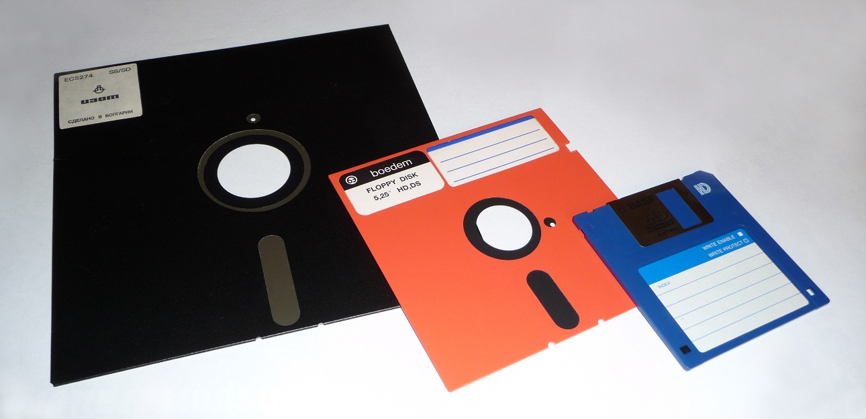
Floppy Disks (Obsolete Now)
1971 – IBM 8” floppy
@ 80 KB – 1.2 MB
1976 – 5.25”
@ 110 KB – 1.2 MB
1982 – 3.5”
@ 720 KB – 1.44 MB
1998 – Apple drops
all floppy drives
2000s – rapid decline due to CDs & USB drives
2010 – Sony ends production of floppy drives
Floppy-drive transfer rates were ~500 kbps or 0.5 MB/sec
Notes:
A student commented that a physical floppy disk his teacher brought to class was “a model of the SAVE icon.”

Slide 13
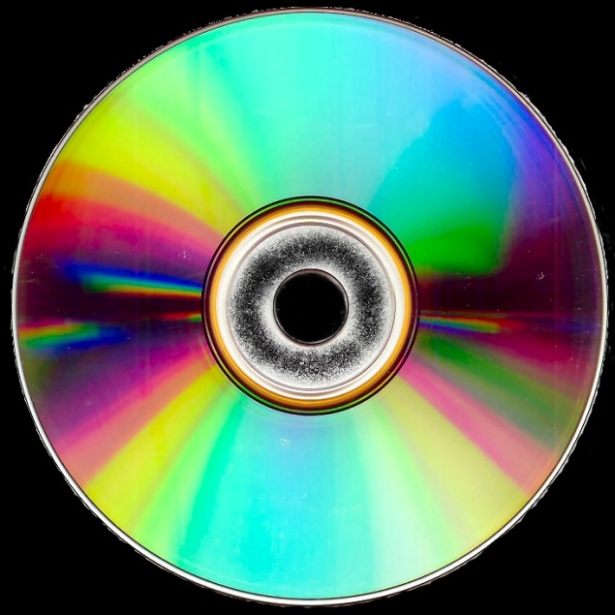
Optical Disks
CD (compact disk)
  650 MB capacity
  ~3 Mbps transfer rate
DVD “digital videodisk” → “digital versatile disk” → “DVD”
  4.7 GB single-side single-layer
  8.5 GB single-side double-layer
  9.4 GB double-sided single-layer
  17 GB double-sided double-layer
  Transfer rates ~200 Mbps

Slide 14
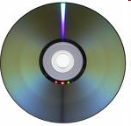
DVD Types
Standards from the DVD Forum
DVD-R: DVD-Recordable
  Write-once, read-many
  “DVD-dash-R” or “DVD-minus-R”
  4.7 GB standard
DVD-RW: DVD-Read-Write
  Write many, read many
  “DVD-dash-RW” or “DVD-minus-RW”
  4.7 GB standard
  Rewrite 1,000 times

Slide 15
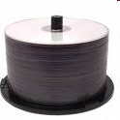
DVD Types (cont’d)
Standards from the DVD+RW Alliance
DVD+R: DVD+Recordable
  Write-once, read many
  4.7 GB
DVD+RW: RVD+ReadWrite
  Write many, read many
  4.7 GB
  DVD+RW drives typically read DVD-R media as well

Slide 16
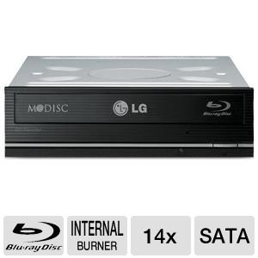
Blu-ray Disks for Backups
Developed in 2002 by Sony, Hitachi, Philips…
  Same size as CDs and DVDs
  Single-layer: 25 GB
  Dual-layer: 50 GB
Blu-ray Burners
  Internal
  External
  In 2013, about $60
Blu-ray software
  E.g., WinDVD, PowerDVD,
  Handy Backup
  25 - 128 GB/disk depending on layers (1, 2, 3, 4)
  Speeds up to ~288 Mbps (may increase in future)

Slide 17
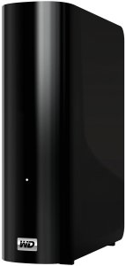
Hard Drives for Backups
For consumers: small external drives
Types of USB drives
  Solid-state drives (SSDs)
    Fastest transfer rates
  Hard-disk drives
USB 2.0/3.0, Firewire
  Maxtor, Seagate, Western Digital, ….
In Dec 2025
  500 GB to 1 TB ~$60
  10 TB ~$225
Transfer rates ~3Gbps
Synology DS412+
$1159 for 16 TB

Slide 18
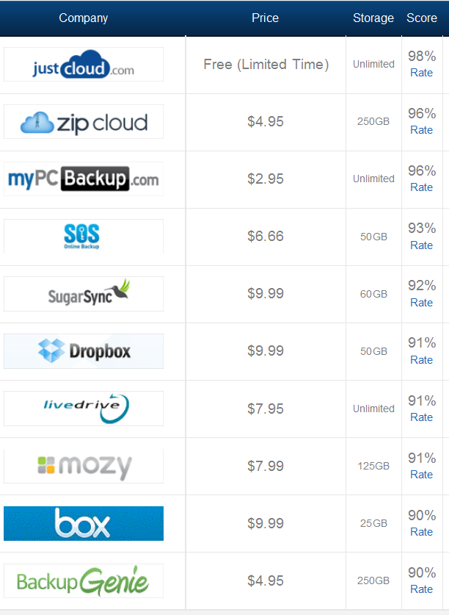
Cloud Backup (1)
Once connected to ‘Net
  Backup from anywhere
  Retrieve from anywhere
Warnings:
  Confidentiality
  Shared folders may result in accidental deletion or sabotage
  Xfr rate depen`ds on ‘Net bandwidth
http://www.thetop10bestonlinebackup.com/cloud-backup

Slide 19
Cloud Backup (2)
Consider for organizations too
See “Why Cloud Backup: Top 10 Reasons”*
  Achieve disaster recovery with secure offsite cloud backup
  Freedom from manual and complex tape backup tasks
  Predictable costs for simpler budgeting
  Reliable and guaranteed data recovery
  Minimized risks and costs of downtime
  Fast data restores
  Take advantage of service provider’s expertise and resources
  Offload regulatory compliance requirements to service provider
  Well-managed cloud more secure than your own
  Ease of setup and use, set-and-forget, no training required
* http://www.ironmountain.com/arma/docs/top_ten_reasons.pdf

Slide 20
Strategies
Everything
Everything changed since the last full BU
Exclusive access
Types by coverage
  Full
  Differential
  Incremental
  Delta
Types by target
  System
  Application
Testing
Everything changed since the last BU of any type
All the records that have changed since the last BU
WARNING:
Always ask for a definition of
“Daily “or “Partial” BU

Slide 21

Archives, Maintenance and Retention
What to keep?
How long?
Retention policies
Rotation of media
Media longevity and technology changes
  Media degradation
  (e.g., fungus*)
  Software and hardware
  changes
    Application programs
    Operating systems
* See Mendham, S. (2005). A little care goes a long way. PC World.
http://www.pcworld.idg.com.au/index.php/secid;3;id;461315701

Slide 22
Storage for Backups
Online storage secure (see slides 18 & 19)
Safes for the home
  Size depends on what you want to protect
  Fireproof helpful (e.g., 3 hours insulation in fire)
  Water resistant helpful (e.g., protect against fire hoses)
  Physical security: combination lock, thick walls, secure hinges
KEEP A RECORD OF YOUR COMBINATION!
  Can be in secure entry in OUTLOOK or other email software
  External to home: bank safety-deposit works

Slide 23

Disposal
Scavenging
  Dumpster® Diving
  Scratch tapes
  Diskettes, cartridges
Data and media destruction
  Erase ≠ destroy
  Reformatting inadequate
  Degaussers inadequate
  Random overwrites
    Military-grade = 7 passes
  Smashing with hammer works too!
http://tinyurl.com/6dhnu2y

Slide 24
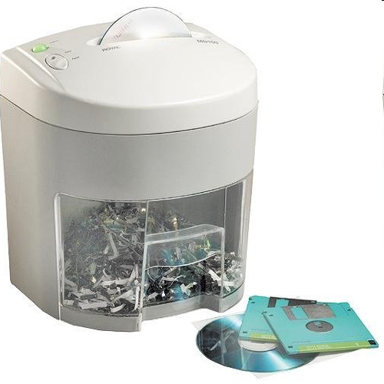
Disposal (cont’d)
Physical destruction works
  Recommended: specialized shredders
  Incineration (special types)
Secure collection points
  Lockbox magnetic garbage
Mobile data destruction services
  Paper shredders
  Special facilities for tapes
Royal Media Shredder
http://tinyurl.com/24mwtb

Slide 25
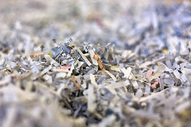

Secure Data Destruction
Equipment for destroying documents:
  Paper shredders (crosscut ONLY – see oval)
  See “Cross Cut Shredders – 5 Reasons Why They Are Better” < http://tinyurl.com/65cuw52 >
Considerations when evaluating
services
  Costs
  Types of media processed
  Onsite vs offsite
  Chain of custody
  assurance
  Regulatory compliance
  Environmental
  protection

Slide 26
Personal Notes on Kabay BUs
Two ~identical computers: MAIN & SPARE
5 1-TB portable USB drives for alternate-day use
ViceVersa synchronization software
PM at end of workday:
  Daily incremental BU
  Synch MAIN → USB (including Backups)
Synch BU to SPARE every week
Monthly FULL BU MAIN → TB drive
Archives on 9 multiTB drives in fire safe
EXCEL file for tracking BU dates & drives

Slide 27
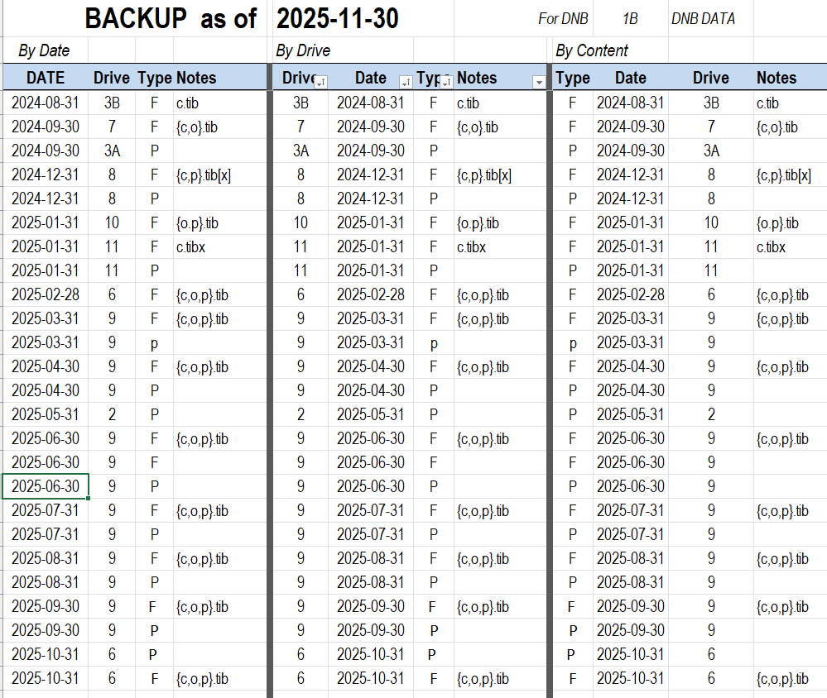
Keeping Track of BUs (1)

Slide 28
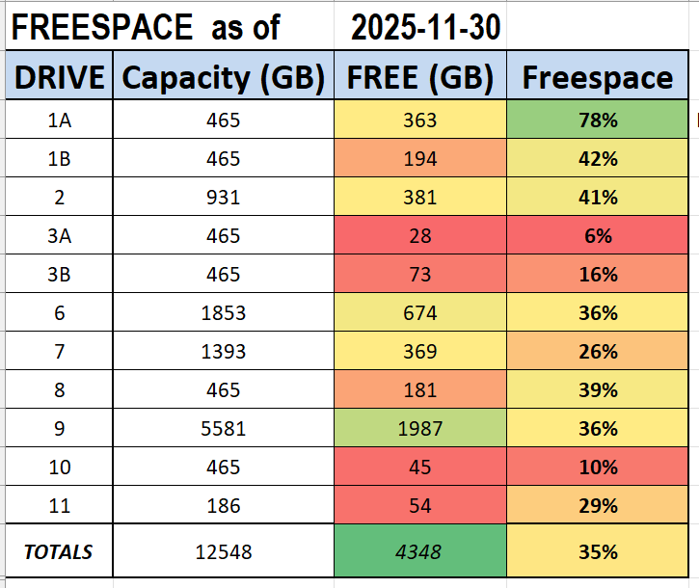
Keeping Track of BUs (2)

Slide 29

OK, STAY SAFE!

