Slide 1
Using Email Effectively, Safely and Well
NU Staff In-Service Retreat 2019-01-09
M. E. Kabay, PhD, CISSP-ISSMP
Professor of Computer Information Systems
School of Business & Management
College of Professional Schools
Norwich University
Notes:
M. E. Kabay, PhD, CISSP

Slide 2
Topics
DELIVERY NOT GUARANTEED
FIRST E-IMPRESSIONS
DISCRETION IN EMAIL CRITICISM
HTML-FORMATTED EMAIL DOESN’T WORK RELIABLY
TO/CC + REPLY ALL = TROUBLE
MAILSTORMS
BCC PREVENTS EMAIL NUISANCES
BURYING YOUR EMAIL MESSAGE
MISLEADING SUBJECT FIELDS
FORWARDING CORPORATE EMAIL
EMAIL CARRYING MALWARE
THE KEEPER OF THE LISTS

Slide 3
DELIVERY NOT GUARANTEED (1)
IETF* definition of email** does not include guaranteed delivery
DEFINITELY does not guarantee reading!
Do NOT assume delivery or reading
Use Request a Delivery/Read Receipt when necessary
CALL YOUR CORRESPONDENT for urgent messages
_____
* Internet Engineering Task Force < https://tools.ietf.org/ >
** White, J. (1973). “A Proposed Mail Protocol.” IETF RFC 524. < https://tools.ietf.org/html/rfc524 >

Slide 4
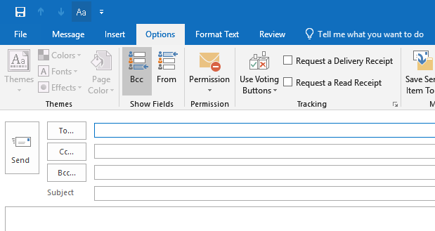
DELIVERY NOT GUARANTEED (2)

Slide 5
FIRST E-IMPRESSIONS
Context matters
Friends do not communicate the same way as colleagues
Research indicates email 1st impressions matter more than in phone calls*
Spelling/grammar mistakes
Offensive language
Off-color humor
________
*Winerman, L. (2006). “E-mails and egos.” Monitor on Psychology 37(2):16. American Psychological Association. < https://www.apa.org/monitor/feb06/egos.aspx >
(may also violate Title IX)

Slide 6
DISCRETION IN EMAIL CRITICISM
Sources of disagreement
Fundamental assumptions
Vocabulary
Unspoken goals & values
Implicit reasoning
Missing information
Mistakes
Avoid verbal hostility
Ad hominem remarks
Aggressive content
TALK to the person if email gets rude!

Slide 7
HTML-FORMATTED EMAIL DOESN’T WORK RELIABLY
HTML email not guaranteed to look like what sender sent
Recipient’s system may have radically different font assignments
Sizes may differ from original
Some characters altered (e.g., ‘ becomes ?)
Worst case: sending posters as HTML!
If appearance must match, use
Acrobat PDF (include fonts)
Image (JPG, PNG….)

Slide 8
TO/CC + REPLY ALL = TROUBLE
TO: people who should reply
CC: people who should be able to reply
BCC: everyone else
Trouble from REPLY ALL w/ visible distribution lists
Violate privacy
Cause mailstorms (see next slide)
REPLY ALL restrictions
Don’t REPLY ALL unless appropriate
THINK before using REPLY ALL

Slide 9
MAILSTORMS
Dec 2018: Utah state worker sends invitation to 25,000 recipients in TO: field for pot-luck dinner*
Some REPLY ALL with dietary preferences & “OK GREAT!” messages
Many send REPLY ALL asking to be removed from list
Others REPLY ALL to tell everyone to stop using REPLY ALL
Potentially crash mail servers
DO NOT PUT LARGE DISTRIBUTION LISTS IN TO: OR CC: – USE THE BCC FIELD
_____
* Dumais, E. (2018). “Office Potluck Email Mistakenly Sent to 25,000 Employees, Reply-All Chaos Ensues.” Thrilllist < https://www.thrillist.com/news/nation/utah-state-office-potluck-email-reply-all >

Slide 10
BCC PREVENTS EMAIL NUISANCES
Listing extensive contacts in TO: or CC: may betray confidential information
People may copy list to spam recipients
May betray operationally sensitive info
Worse if email goes to outside addresses
May reveal organizational addresses that are supposed to be internal-only
E.g., specific participants on confidential projects

Slide 11
BURYING YOUR EMAIL MESSAGE
Errors that can delay having your message read
Using a non-corporate email address
Using a non-descriptive subject line
Mixing critical information with non-critical info (especially if non-critical comes first)
Never use non-corporate email for internal email (& may violate FERPA)
Always have clear, informative subject
Put one critical topic per email – use additional messages for additional topics

Slide 12
MISLEADING SUBJECT FIELDS
REPLY automatically copies subject line & puts RE: in front
But some users think REPLY is shortcut instead of NEW EMAIL
Fail to correct subject line
Results
Confusion
Message ignored or reading delayed
Irritation for all concerned
Use NEW EMAIL, not REPLY when composing email on a new topic

Slide 13
FORWARDING CORPORATE EMAIL
Some information must be protected against public release
FERPA: student information
HIPAA: medical information
GLB/SoX: information that can influence stock prices
Military applications
Do NOT include external email addresses in distribution unless
Justified
Necessary

Slide 14
EMAIL CARRYING MALWARE (1)
Malware can generate email using fake origination addresses
Some phishing email carries infected attachments (HTML, PDF, DOC[X]…)
Many phishing emails have links that don’t match appearance
Link has 2 components
Appearance – can look like good link
Actual hyperlink – can be for criminals’ Website
ALWAYS look at lower left corner of email window or in popup to see real link

Slide 15
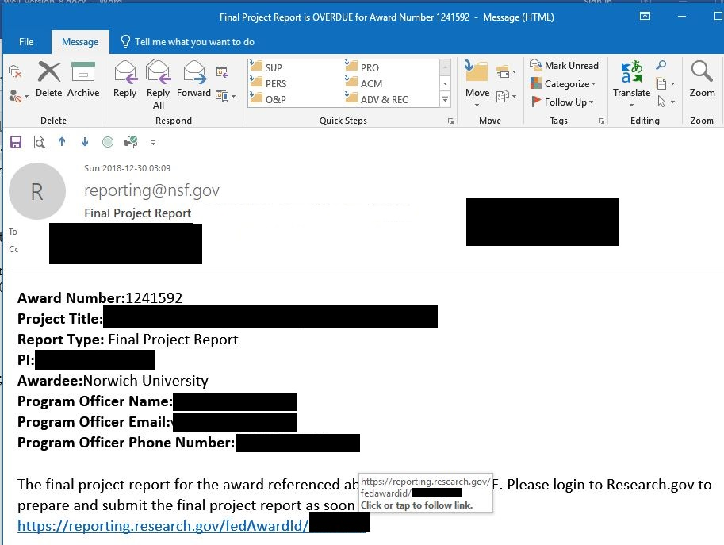
EMAIL CARRYING MALWARE (2)
The URLs match!

Slide 16
THE KEEPER OF THE LISTS
Anyone can copy a visible (TO:, CC:) list
But copies can become outdated
Best to use an official Keeper of the Distribution Lists
Typically administrative assistant / secretary
Messages for everyone in a group (department, school; students, staff, faculty, committee….)
Send to Keeper of the Lists
Guarantees up-to-date distribution

Slide 17
For Further Reading
Kabay, M. E. (2016)"Using E-mail Safely and Well"
< http://www.mekabay.com/infosecmgmt/emailsec.pdf >
Bauer, J. & D. G. Jerz (2000). “Email Tips: Top 10 Strategies for Writing Effective Email.” Jer4z;s Literacy Weblog. < https://jerz.setonhill.edu/writing/e-text/email/ >
Doyle, A. (2018). “How to Write and Send Professional Email Messages.” The Balance Careers. < https://www.thebalancecareers.com/how-to-write-and-send-professional-email-messages-2061892 > or < http://tinyurl.com/y9r4s3yp >

Slide 18
Now go and study

